Slide 1
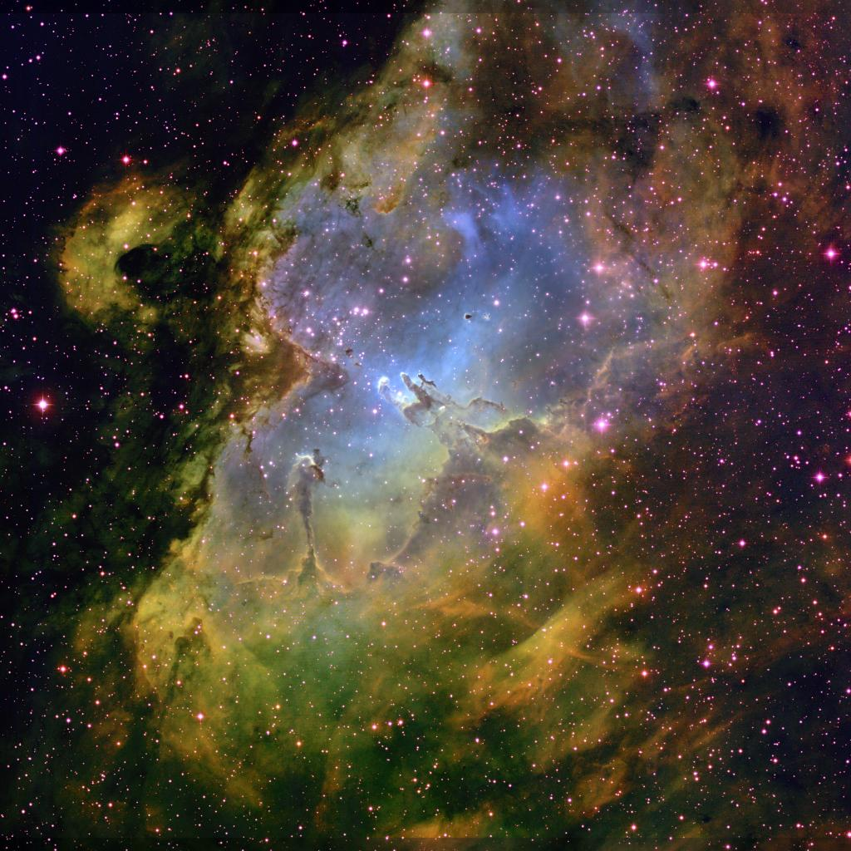
The Condensation of Gas-Phase Elements onto Interstellar Dust Grains
Edward B. Jenkins
Princeton University Observatory
A Consolidation of Findings from 45 Years of Investigation of Ultraviolet Absorption Lines

Slide 2
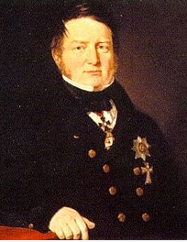
F. G. W. von Struve
In an 1847 work, Etudes d'Astronomie Stellaire: Sur la voie lactee et sur la distance des etoiles fixes, Struve was one of the first astronomers to identify the effects of interstellar extinction (though he provided no mechanism to explain the effect). His estimate of the average rate of visual extinction, 1 mag per kpc, is remarkably close to modern estimates (0.7–1.0 mag per kpc).
(copied from Wikipedia)

Slide 3
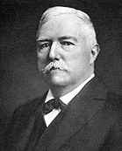
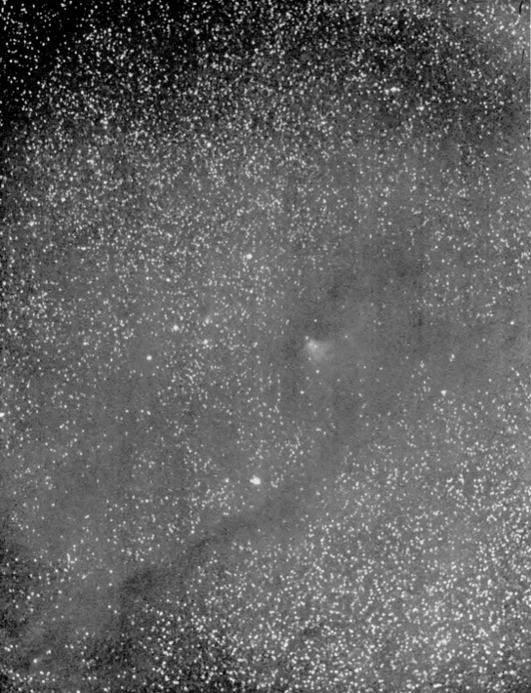
E. E. Barnard (1907)
(60 years later)
“This idea of the absorption of the light of the stars by a dead nebula or other absorbing matter has been used by some astronomers as an explanation of the dark or starless regions of the sky. Though this has not in general appealed to me as a true explanation – an apparently simpler one being that there are perhaps no stars at these places – there is yet considerable to commend it in some of the photographs.”

Slide 4
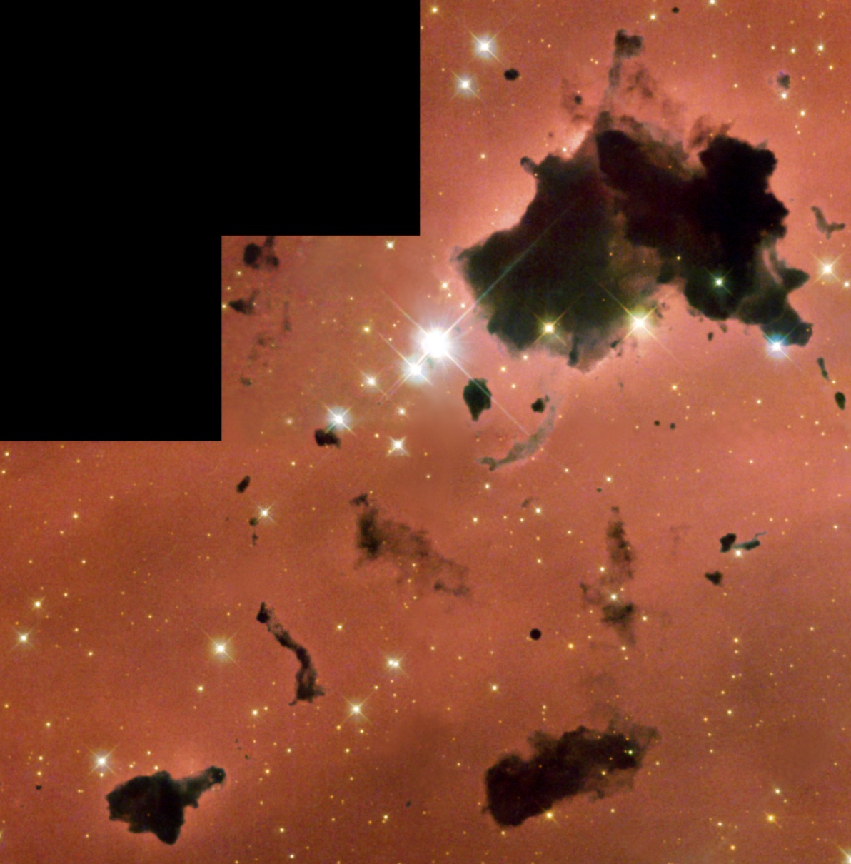
Dust Clouds in the Nearby Interstellar Medium
Notes:
----- Meeting Notes (7/20/13 15:42) -----
Thomas Kuhn's influential book writtin in 1962 "The Structure of Scientific Revolutions" introduced the term Paradigm Shift

Slide 5
… and in Galaxies

Slide 6
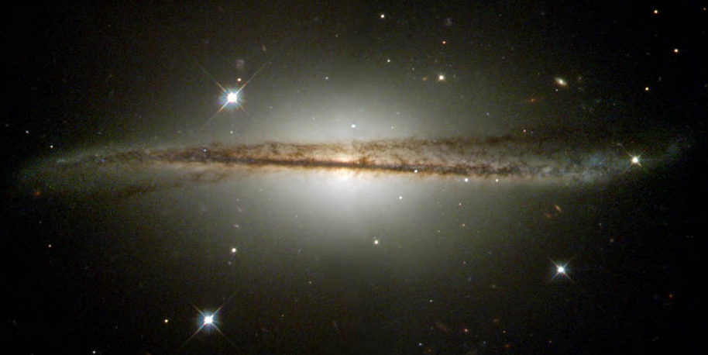
… and in Galaxies

Slide 7
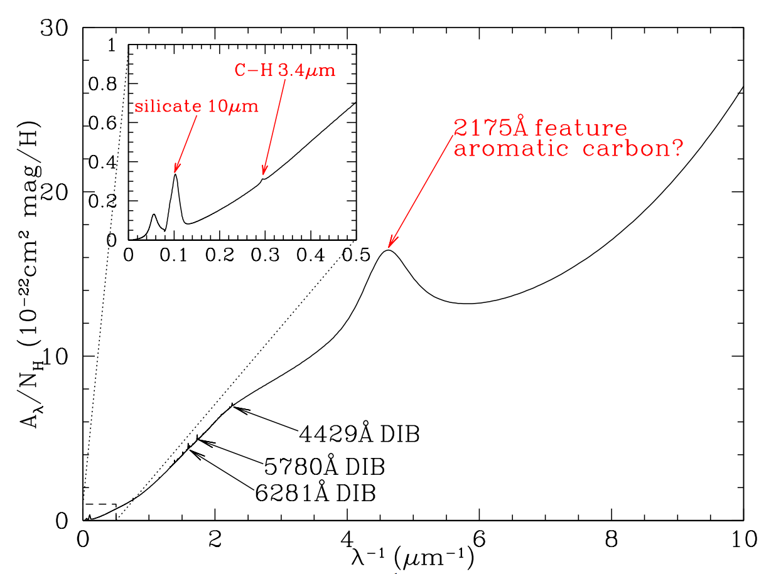
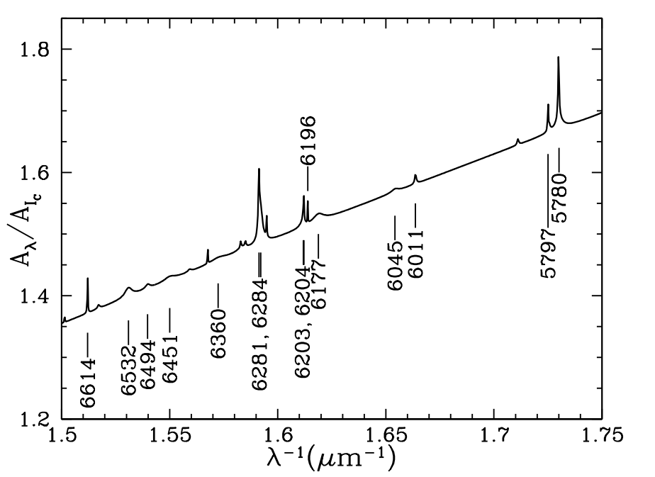
Absorption of Starlight

Slide 8
Average Density of Dispersed Solids
Refractive index at low freq.
Number of grains per unit area in a column of length d
Radius of each grain
Q_{e}
Optical depth over a distance d
Internal density
Grain volume
Extinction efficiency factor
An application of the Kramers-Kronig dispersion relation by Purcell (1969, ApJ, 158, 433)

Slide 9
Average Density of Dispersed Solids
Compare with Z/X in the Sun
Combine A_{V} = 1.8 mag kpc⁻¹ with relative extinctions from 1000 Å to 20 μm
≈ 2 for most substances
≈ 3
0.018

Slide 10
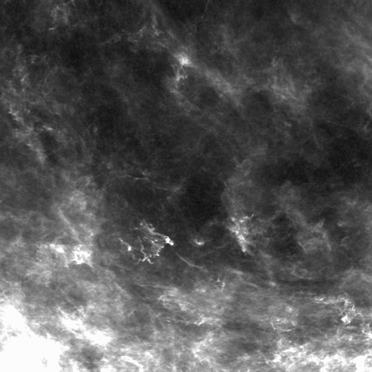
Inventory of Matter: Gas vs. Dust
Assume a total reference abundance relative to hydrogen, based on stellar abundances, and then determine what proportions of the heavy atoms are in the gas and solid (dust) phases -- (according to number densities, not mass).
We characterize the loss of some element X from the gas phase by the logarithmic depletion [X/H], defined by the relationship
Logarithmic Depletion Factor
Reference Abundance

Slide 11
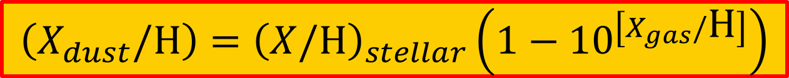
Inventory of Matter: Gas vs. Dust
After the logarithmic depletion factor has been measured, one can determine the proportion of element X that has been removed from the gas phase and is now locked up in dust grains.
$$\left(X_{dust}/\text{H}\right)={\left(X/\text{H}\right)}_{stellar}\left(1−{10}^{\left[X_{gas}/\text{H}\right]}\right)$$
Proportion of X in Dust
Logarithmic Depletion Factor
What do we adopt here?

Slide 12
Inventory of Matter: Gas vs. Dust
Why is it that the heavy element abundances in the Sun (4.5 Gyr old) are generally higher than those in young B stars?
Reference standard for total element abundance ratios:
Solar & Meteoritic?
B stars?
Nieva & Przybilla, 2012, A&A,539, A143
( needed to infer dust composition once the abundances of free atoms are determined)
Abund Rel. to H × 10⁶
Compilation by Asplund, Grevesse, Sauval & Scott, 2009, ARAA, 47, 481

Slide 13
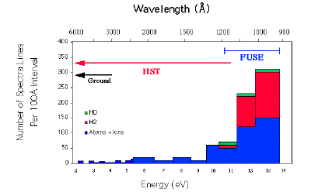
Absorption Lines vs. Energy
Wavelength (Å)
6000 3000 2000 1500 1200 1000 900
400
350
FUSE
300
HST
HD
H₂
Number of Spectral Lines per 100 Å Interval
Ground
250
200
150
Atoms & Ions
100
50
0
2 3 4 5 6 7 8 9 10 11 12 13 14
Energy (eV)

Slide 14
What has been Known for some Time
Depletions vary from one location to the next
Sightlines with low average density N(H)/d have less depletion
Gas at high velocity displacements have less depletion: grains have been disrupted
Depletions vary from one element to the next
Depletion strengths are greatest for elements that can form refractory compounds and are small for those that can only form volatile compounds

Slide 15
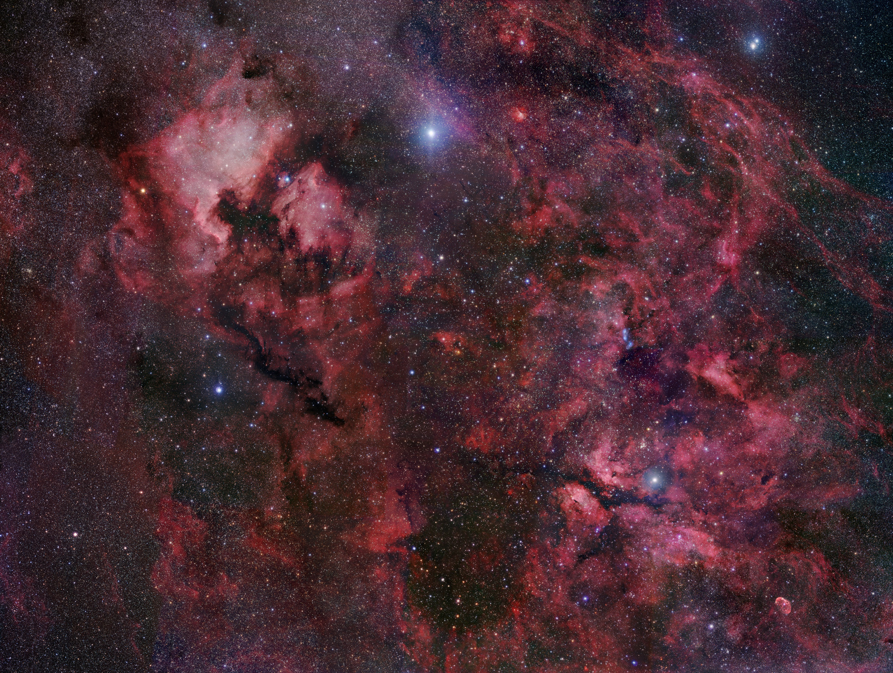
A Study of ISM Gas-Phase Abundance Results in the Literature
Objective: Organize the information so that we can learn more about
Grain composition
How to correct for dust depletions in distant absorption line systems
Survey scope:
17 different elements
243 sight lines
More than 100 articles in the literature
All results have been renormalized to a single compilation of f-values (Morton 2003).
This represents a massive bookkeeping and quality control effort.
Published by Jenkins (2009: ApJ, 700, 1299)

Slide 16
A Study of ISM Gas-Phase Abundance Results in the Literature
Conventional Approach in Past Investigations:
Measure the depletion of a specific element and then characterize it in terms of some property of the sight line
Average density: N(H)/d
Fraction of hydrogen in molecular form

Slide 17
A Study of ISM Gas-Phase Abundance Results in the Literature
New Tactic:
Ignore the sightline properties and characterize depletions of elements with respect to each other, recognizing that the severity of depletions differ from one element to the next and from one region of space to the next.

Slide 18
Underlying Strategy
Basic premise:
All elements deplete together in some systematic fashion, but by differing degrees that change from one region to another and from one element to the next.
Propose a single parameter, F*, that expresses a general level of depletion along a sight line.
F*
(F* is much like <n(H)> that has been used in the past.)
F*

Slide 19
Underlying Strategy
Scale for F* is arbitrary; I chose a calibration as follows:
F* = 0 corresponds to lowest depletions seen (but subject to the restriction that N(H I) > 10^{19.5} cm⁻²).
F* = 1 corresponds to the depletion pattern observed toward ζ Oph
F*
F*

Slide 20
Underlying Strategy
Another basic premise:
Differences in how the elements respond to changes in F* are represented by other parameters specific to each element.
F*
F*

Slide 21
Basic Equation
For element X:
Logarithmic Depletion factor
B_{X}
Slope: A_{X}
z_{x}

Slide 22

The Buildup of Dust Grains
Differential Element Contributions:
Conventional Formula:

Slide 24
Summary of Element Consumption Rates
O
Si
Cl
Cr
Fe
Cu
Ge
-11 -9 -7 -5 -3
Log consumption per H atom per ΔF*
(Mass of elements in dust)/(total element mass) = 0.20 (F* = 0)
0.54 (F* = 1)
(compare with earlier estimate from extinctions: 0.33)

Slide 25
Sightlines

Slide 26
Trends of Overall Depletion Strengths
F*
Log <n(H)>

Slide 27
Trends of Overall Depletion Strengths
F*
Log F(H₂) = 2N(H₂)/[2N(H₂) + N(H I)]

Slide 28
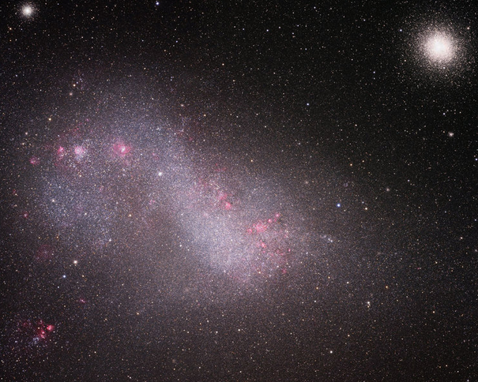
SMC Sight Lines
How do their depletions compare to those of our Galaxy?

Slide 29
Depletion trends with F*
Milky Way trend
SMC trend
Ti
Mn
Fe
Jenkins & Wallerstein (2017, ApJ 838, 85)

Slide 30
The Buildup of Dust Grains
Milky Way trend
SMC trend
(Differential depletions)
Ti
Mn
Fe
Jenkins & Wallerstein (2017, ApJ 838, 85)

Slide 31
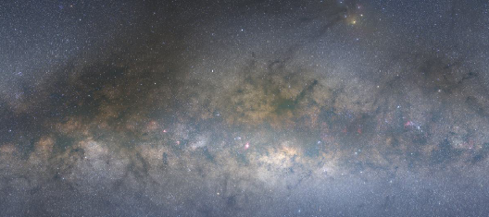
Why do some of the SMC Depletions Differ from those of the Milky Way?

Slide 32
Why do some of the SMC Depletions Differ from those of the Milky Way?
The stellar reference abundances of both 𝛼- and Fe-peak elements in the SMC are uniformly lower than those of the Milky Way by −0.65 dex.
So why does a gas with a dilute mixture of heavy elements exhibit a slightly different depletion behavior for Ti and Mn compared to that of Fe?
A possible answer: an exception to point 1 is the abundance of C, which is low by an additional −0.36 dex. This anomalously low C abundance is supported by a deficiency in PAHs, compared to the Milky Way PAH abundance.
Perhaps the affinity of elements that participate in further growth of grains is altered for a carbon-deficient grain population.
Many distant DLAs with low metallicity also are deficient in C, so the SMC behavior should be modeled when one attempts to correct for depletion.

Slide 33
Elements
Some Noteworthy Behaviors

Slide 34
Depletion Trends against Condensation Temperatures
Jenkins 2009
Ritchey et al. 2018
Cd
Sn
Ga
As
Pb
B

Slide 35
Some Notes about Specific Elements

Slide 36
The Consumption of Oxygen Compared to other Elements
Conventional view: oxygen is mostly incorporated into refractory compounds such as silicates and oxides.
Let’s examine whether or not this is consistent with our determinations of d(X_{dust}/H)/dF*

Slide 37

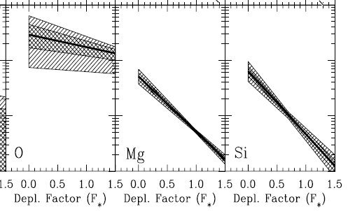
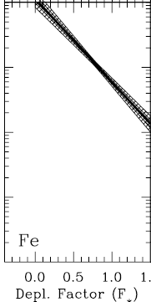

The Consumption of Oxygen Compared to other Elements
At F* = 0.0
O
The most oxygen-rich silicate, MgSiO₃, has a 3:2 ratio of O to other atoms
Mg + Si + Fe
= 2.3

Slide 38
The Consumption of Oxygen Compared to other Elements
At F* = 1.0
O
The most oxygen-rich silicate, MgSiO₃, has a 3:2 ratio of O to other atoms
Mg + Si + Fe
= 16

Slide 39
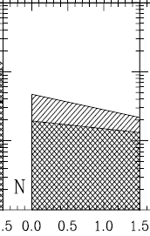
The Consumption of Oxygen Compared to other Elements
Conclusion: In addition to forming silicates, O must deplete by forming some other compound using another abundant element.
Various oxides of N? Unlikely, since N does not seem to deplete (at least not appreciably more than about 10⁻⁵ per H atom per unit change in F*).
H₂O? Perhaps, but 3.05 μm ice feature only seen toward regions with extinctions much larger than those of the lines of sight in the UV absorption studies.
CO, CO₂ and O₂ are present in the ISM, but in amounts that are not sufficient to explain the depletion of O.
Perhaps very large grains (d >> 1μm) containing appreciable amounts of H₂O are present but not visible?

Slide 40

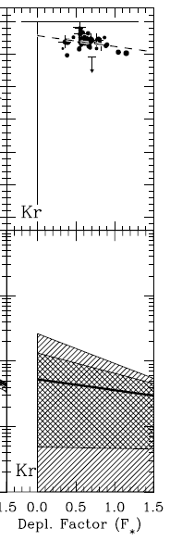
Krypton
Chemically inert
But, in principle, physisorption or trapping in an ice clathrate may be possible.

Slide 41
How Trustworthy are the Transition f-values?
The most useful lines for abundant elements are the semi-forbidden transitions, since they produce absorption features that are not saturated and are easy to analyze.
Determinations of f-values for these transitions often have poor accuracy.

Slide 42
An Example
Stellar model continuum
Most determinations of N(C II) arise from the weak intersystem line at 2325 Å
By measuring the strength of the damping wings for the allowed transition at 1334 Å, Sofia et al. (2011) concluded that the previously accepted f-value for the weak line was too low by a factor 0.43.
This indicates that the gas-phase carbon is lower than previously supposed and thus more carbon is tied up in grains, by a factor 1/0.43.
1334 Å transition

Slide 43
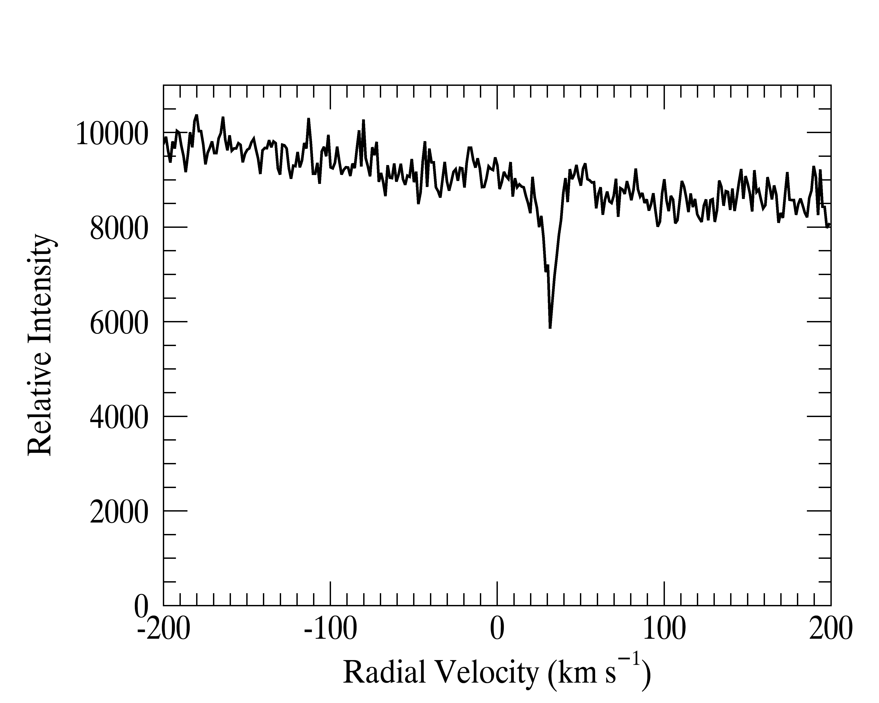
Most N(O I) Determinations Were Made Using the Weak Intersystem Absorption Line at 1355.598Å
This line rarely is strong enough to have saturation take place

Slide 44
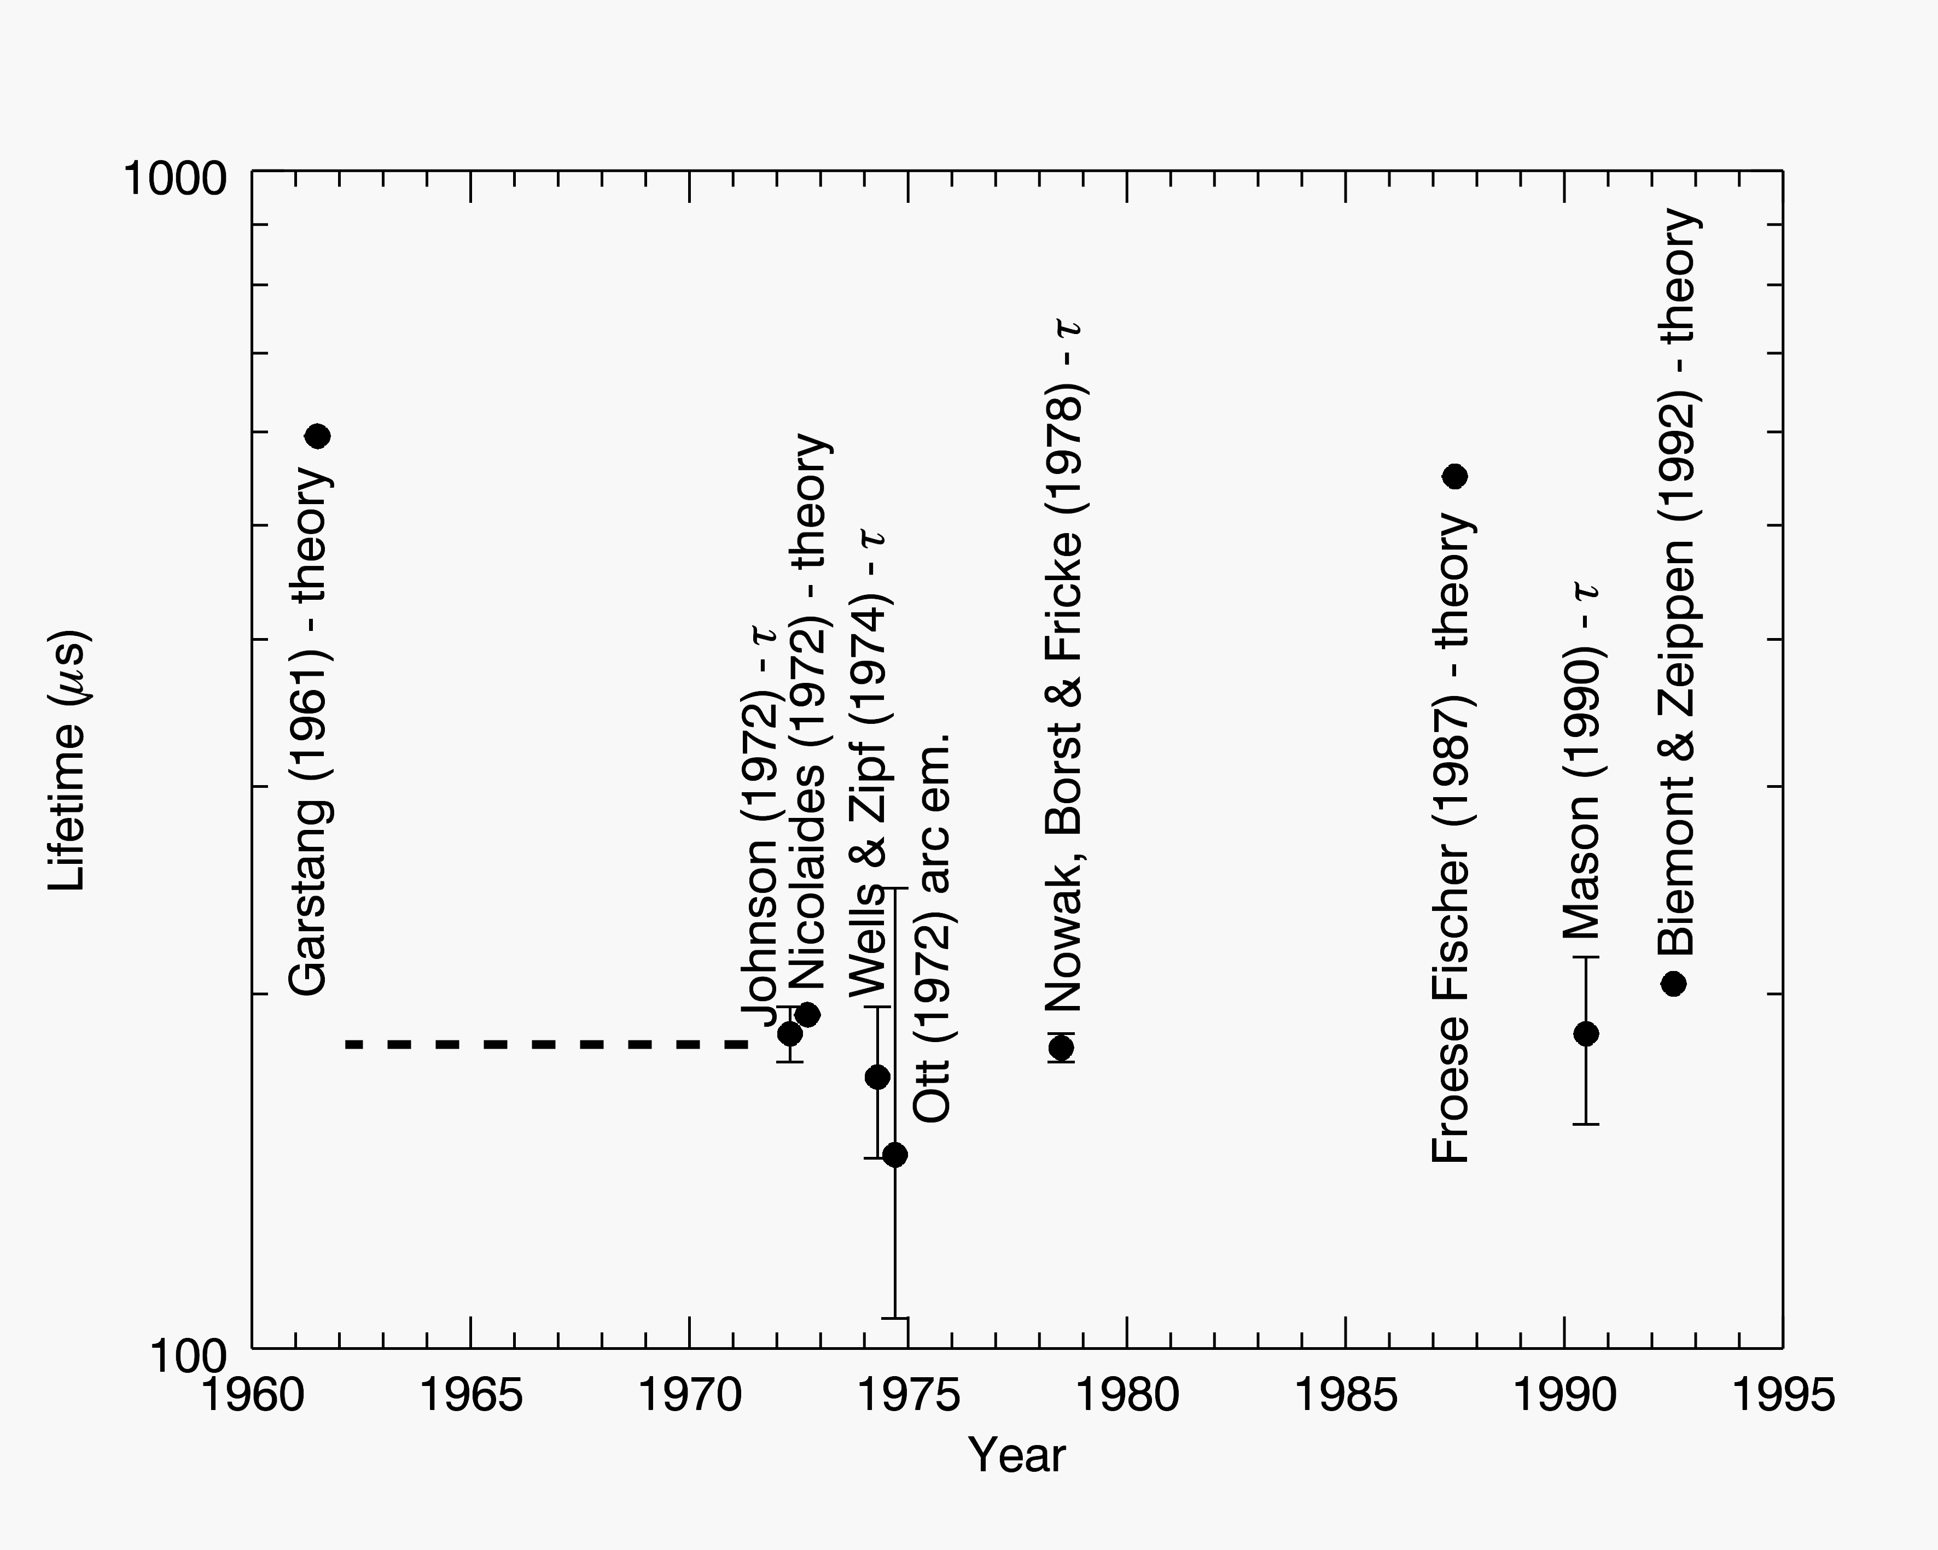

Measurements (or Calculations) of the Lifetime of the Upper State for the Intersystem Transition at 1355.598Å
Value adopted by Morton (2003)

Slide 45
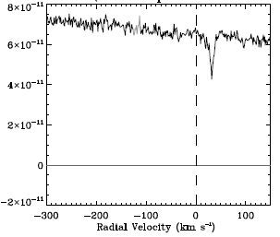
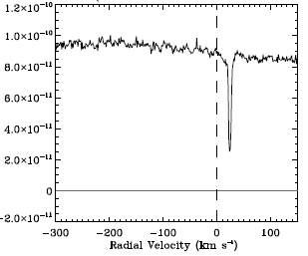
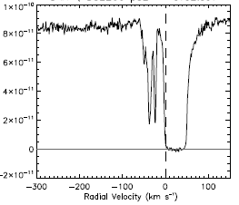
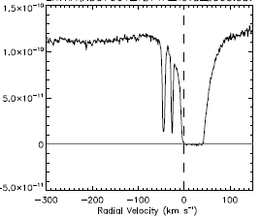
STIS Spectra of Two Stars
HD 52266
HD 37061
Intersystem transition at 1355.598 Å
Allowed transition at 1302.169 Å

Slide 46
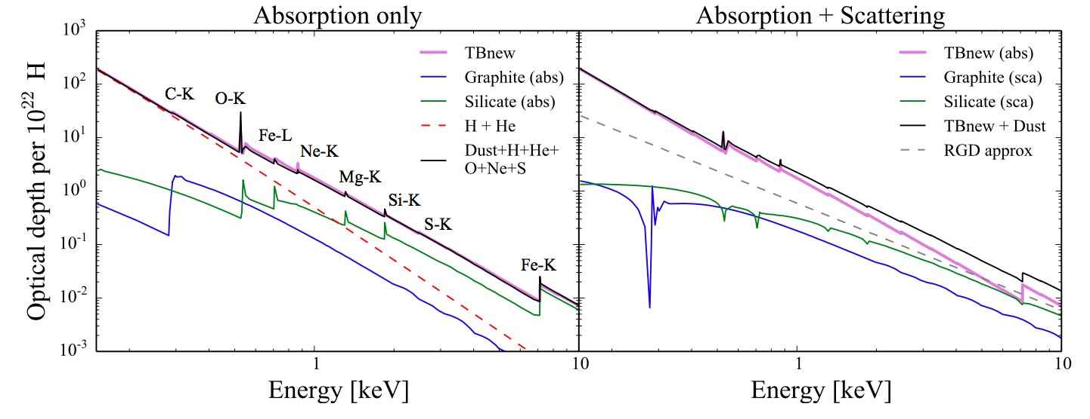
Scattering and Absorption of X-rays from Low-mass Binaries
Detailed shapes of K-shell absorption edges from high resolution X-ray spectra may help to identify atoms bound into different solids.
It is important to understand the effects of both scattering and absorption. This has been recognized only recently.
Corrales et al. (2016, MNRAS, 458, 1345); see also Hoffman & Draine (2016: ApJ, 817, 139)

Slide 47
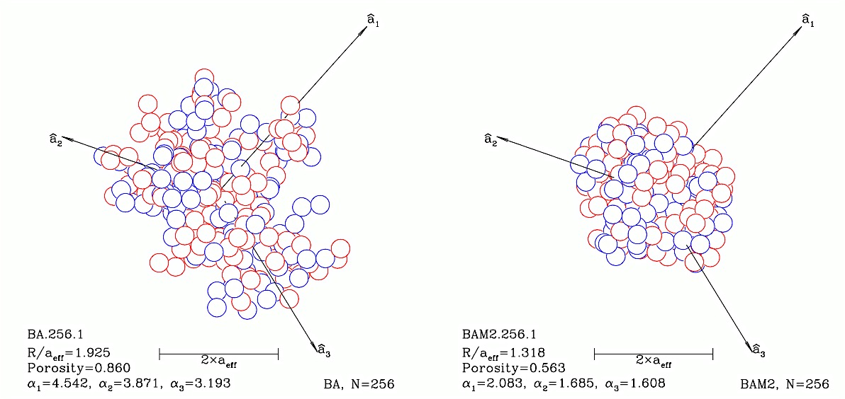
Scattering and Absorption of X-rays from Low-mass Binaries
Detailed shapes of K-shell absorption edges from high resolution X-ray spectra may help to identify atoms bound into different solids.
However outcomes can be influenced by grain porosity.
Hoffman & Draine (2016: ApJ, 817, 139)

Slide 48
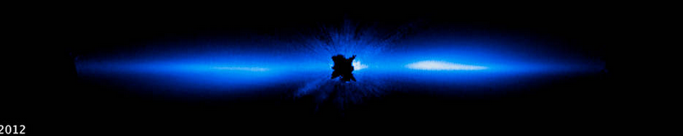
Circumstellar Gas
β Pic

Slide 49
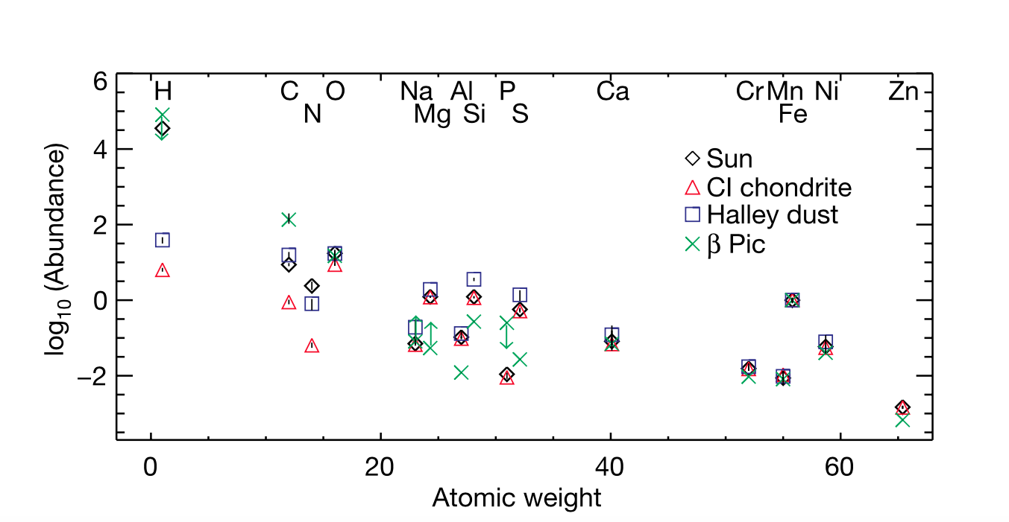
Circumstellar Gas
β Pic
Roberge et al. (2006 Nature 441, 724)

Slide 50
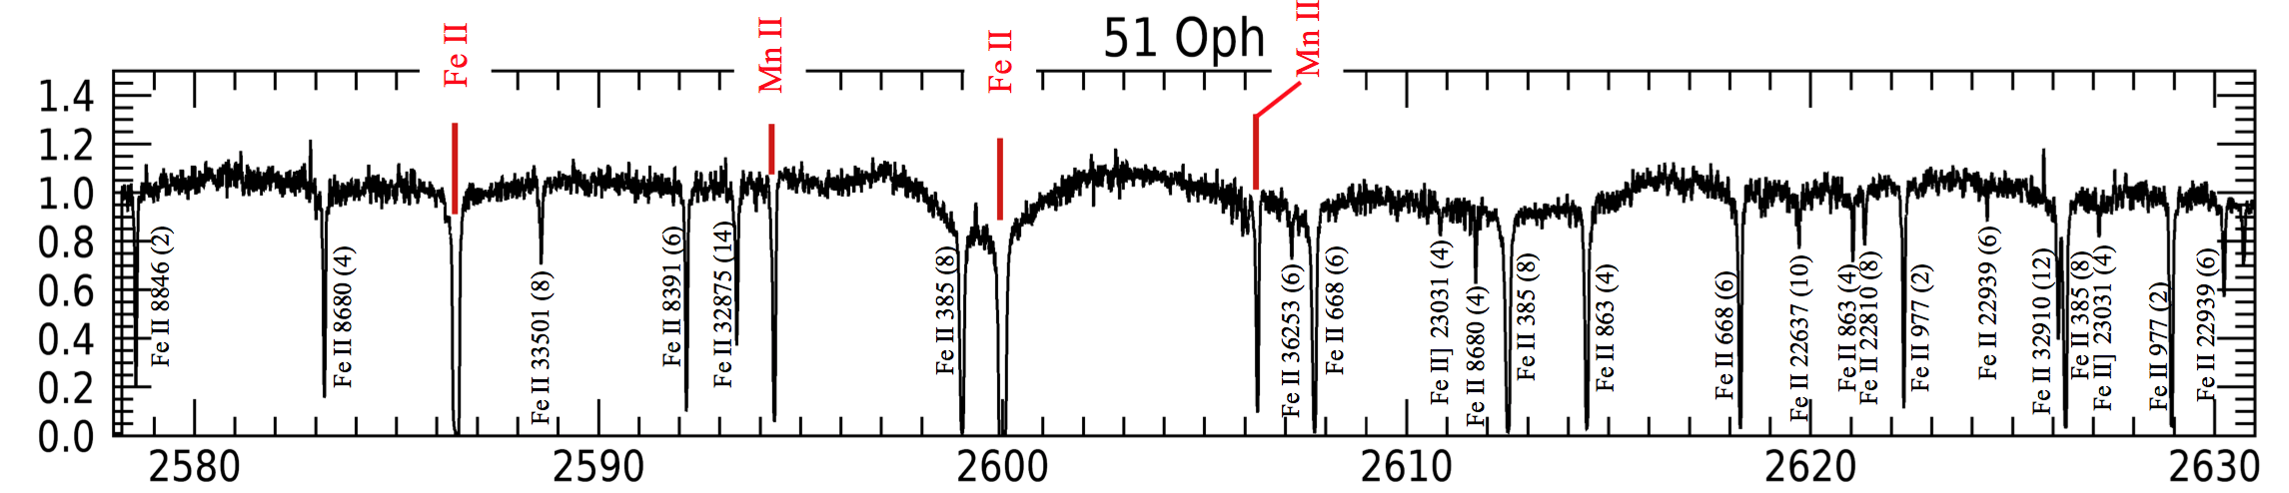
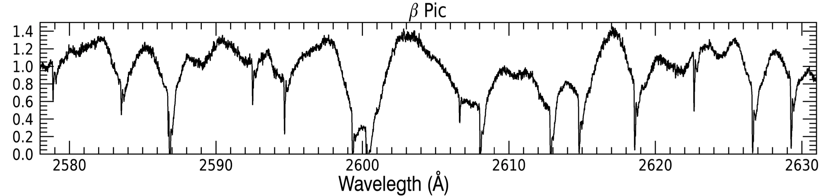
Spectra of Circumstellar Gas
Transition levels: red identification marks from the ground state, black identification marks from metastable levels

Slide 51
Summary
UV Spectroscopy offers insights on the systematics gas-phase abundances, which in turn informs us about the element constituents in solids
Corrections for depletions are needed to derive element abundances in distant galaxies
Depletion patterns in the ISM can guide us in the interpretation of circumstellar gas processes.

