Slide 1
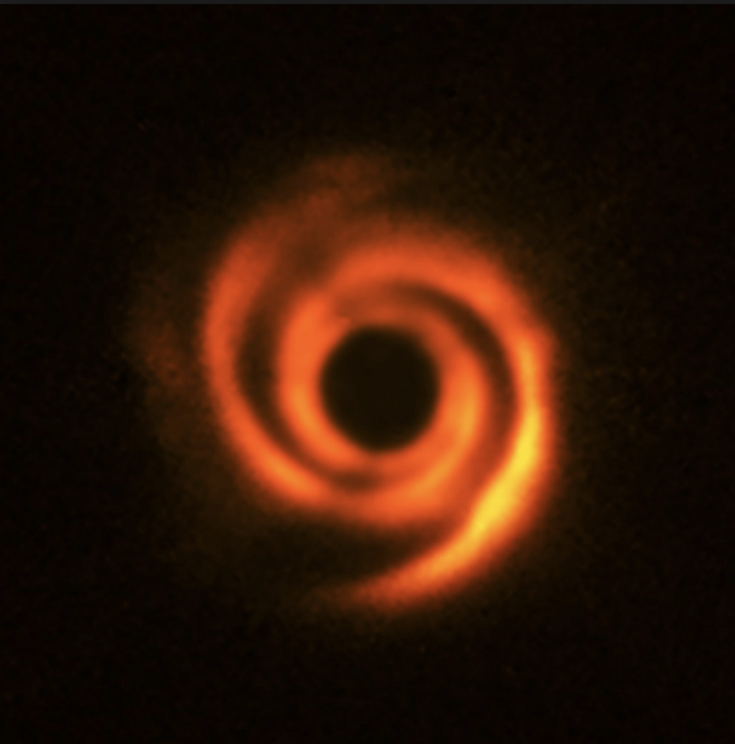
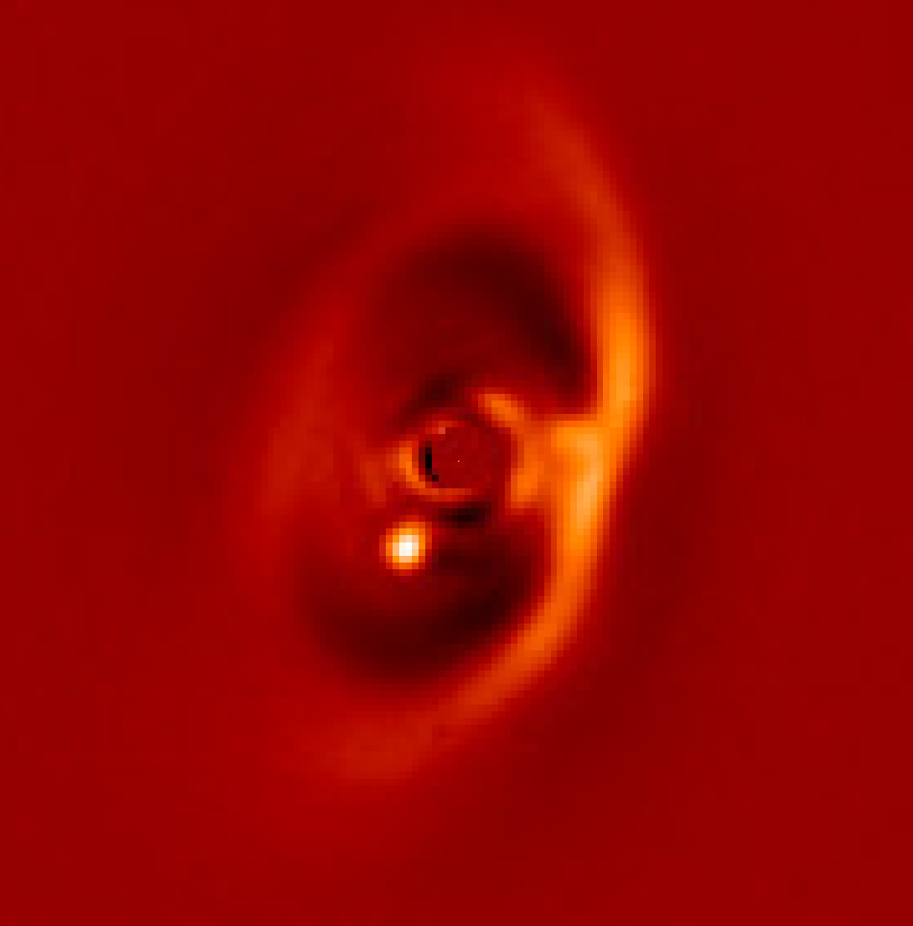
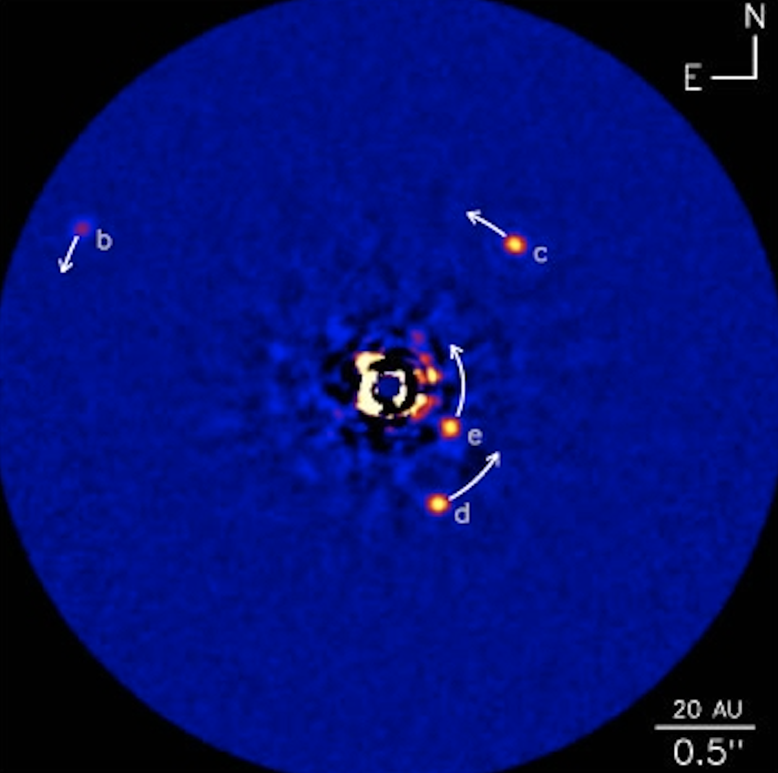
Planet Formation by the Pictures
Zahed Wahhaj, ESO Chile, VLT
Cosmic Dust 2018, Copenhagen
Notes:
My name is Zahed, I work at ESO, Chile as Faculty Astronomer and Instrument scientist for SPHERE.
I would like to thank the organizers for inviting me to this wonderful conference and this beautiful city.
The talks have been so interesting and stimulating that I feel that the weight has been lifted off my shoulders for this talk.
Lets start, my talk is titled ” “ because it is too early to understand anything so let’s just sit around and look at the pictures together.
I am highlighting 3 stages of planet formation through real images from observations
- a protoplantery stage with a massive spiral disk of dust and gas.
- a transitional phase where a planet opens a gap in the disk
- a debris disk phase, where planets have already formed
This striking image in the middle, of a planet in a disk is a new discovery from the SPHERE consortium,
Where for the first time we have captured a planet in a transition disk.
I will talk more about these systems later.

Slide 2
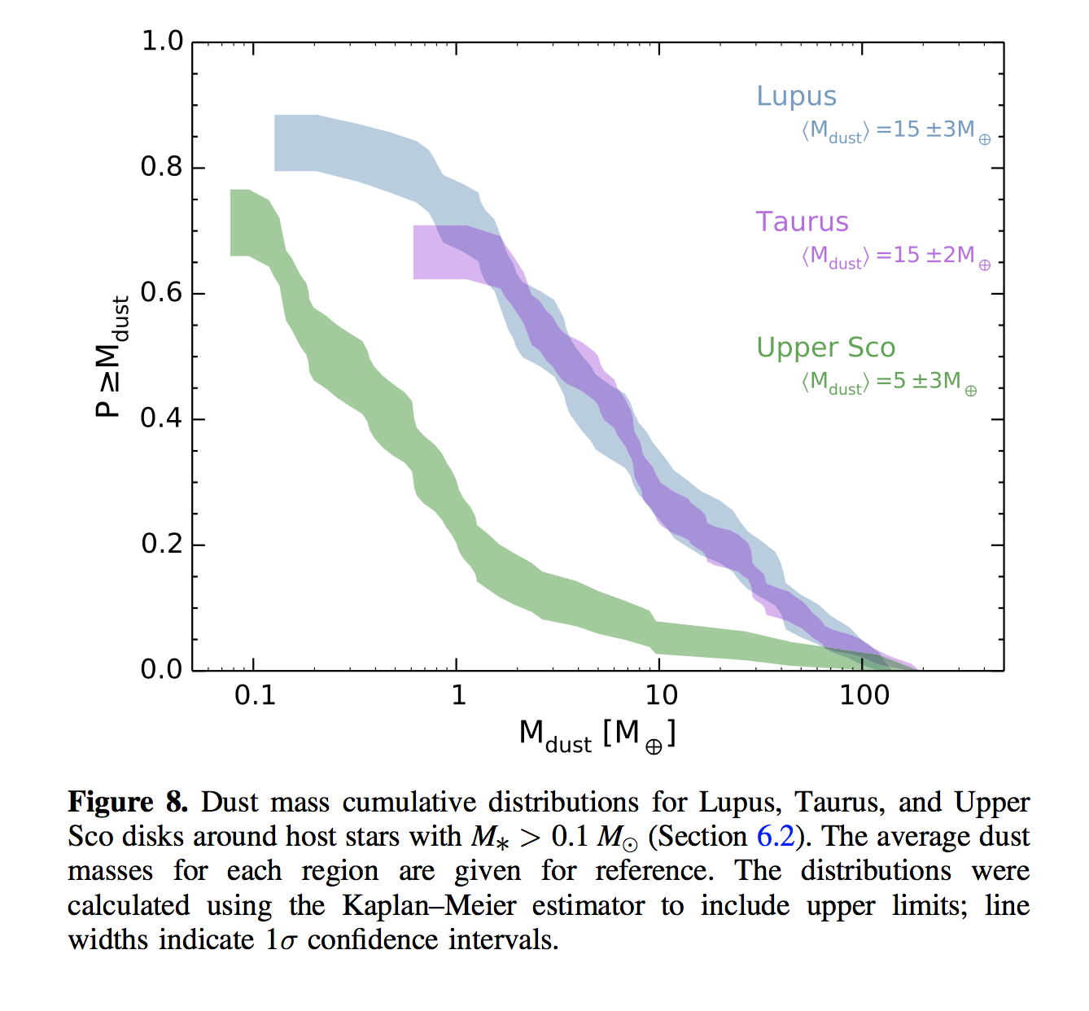
SFRs show < 20% of systems have > MMSN solids
In Tau and Lupus, only >20% of systems have detectable solid mass > 25 earths, only 10% have > 55 earths.
Upper Sco (~ 10 Myr) has less disk mass > Tau and Lupus (~ 2Myr) by x3.
So 10 Me of solids going into planetesimals between 2 and 10 Myr?
Ansdell+ 2016
Notes:
Let’s start off with the question, how much dust mass there is in the 2-3 Myr SFRs, we have ALMA surveys of dust cont, Lupus and Taurus from Ansdell 2016
Looking at the cum. Dist. Of dust mass for Lupus and Taurus, we see that less than 10% of systems have mass greater than modified MMSN ( 55 Me)
Required by the Nice Model one of the most successful models on the SS formation.
Comparing this to the Usco dist at 10 Myr, we see that the median dust mass falls by a factor of 3, from 15 Mearths to 5 earths.
-------------------------------
*”We find a positive correlation between Mdust and M*,”
*The disk mass distribution in Lupus and Taurus (2 Myr) is very different from that of Upper Sco (10 Myrs).
For example, the average dust disk mass in Lup and Tau is 15 earths, while that in Upper Sco is only 5 earths.
Which means 10 earth mass is either assimilated into large bodies or dissipated in 8 Myr years.
*Also the average Gas to Dust ratio is Lup and Tau has already fallen to 10
(meaning average total mass is 150 eaths = 0.5 Mjup).
*Was the gas accreted onto the star or captured by gas giants?
*” the inferred gas depletion indicates that planet formation is well underway by a few Myr
** and may explain the unexpected prevalence of super-Earths in the exoplanet population. “
*Currently, we think Oph/Tau age is 2 Myr
Lup is 3-4 Myr (Tazzri +2017)
Usco 10-15 Myr

Slide 3
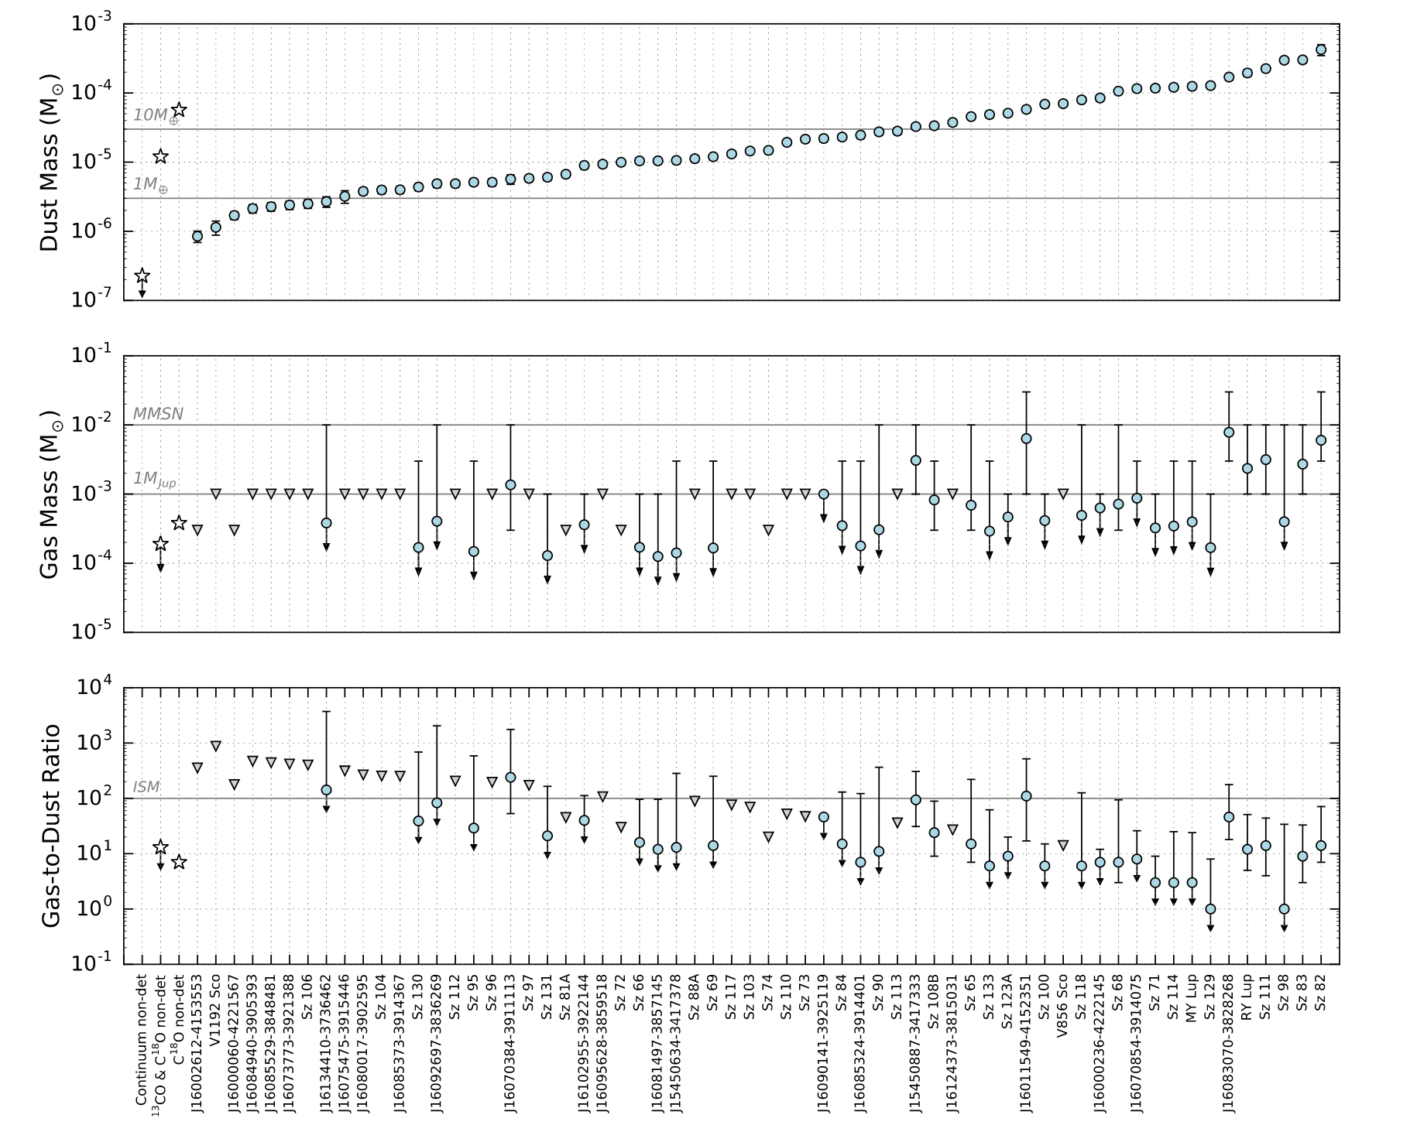
Most systems have < MMSN in gas.
Ansdell +2016: Gas/Dust = 100 to 1. Avg ratio = 10, which is quite depleted from 100 (ISM ratio).
Reason why more Neptunes/SE than Gas Giants.
Ansdell+ 2016
Notes:
Also most systems in Lupus have less than 1 Mj of gas left.
The CO-estimated gas to dust ratio is only 10, instead of 100 as in the ISM.
Reason why more Neptunes/SE than Gas Giants.
------------------------
Theory: Disk to Star mass ratio typically grows to 0.1-1 by 10K yrs and then declines. Bate 2018
Obs: The dust mass in Lupus (1-3 Myrs) ranges from 1e-6 to 5e-4 Msol (1e-3 to 0.5 MJup). This is very close to Oph and Taurus which are only studied for high mass disks. Figure 8. Ansdell+2016.

Slide 4
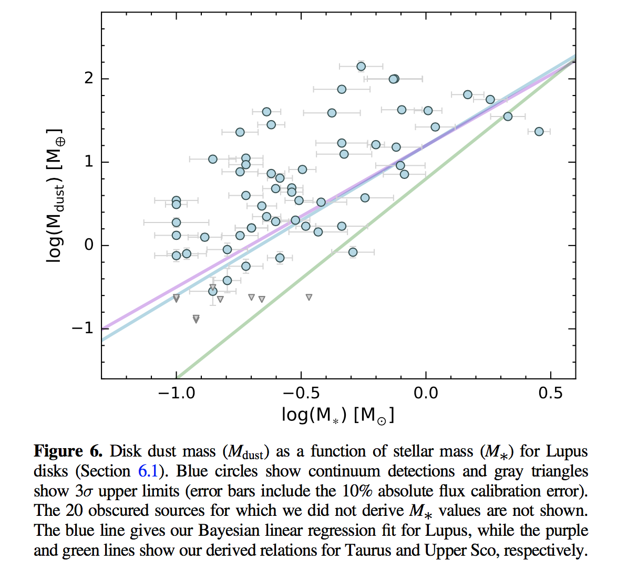
Large variation of disk mass at any Stellar mass.
Large dispersion in dust mass at any stellar mass (e.g. Lupus III)
Thus intrinsic variation of initial conditions wrt. Planet building.
Ansdell+ 2016
Notes:
This is a plot of dust mass vs stellar mass.
And we also see that there is a large variation of the dust mass at any stellar mass
Pointing to different initial conditions as to how much mass is availiable planet formation.
However generally we do see that massive stars are mode likely to have more massive disks.
----------------------------------------------------------
Theory: Disk to Star mass ratio typically grows to 0.1-1 by 10K yrs and then declines. Bate 2018
Obs: The dust mass in Lupus (1-3 Myrs) ranges from 1e-6 to 5e-4 Msol (1e-3 to 0.5 MJup). This is very close to Oph and Taurus which are only studied for high mass disks. Figure 8. Ansdell+2016.

Slide 5
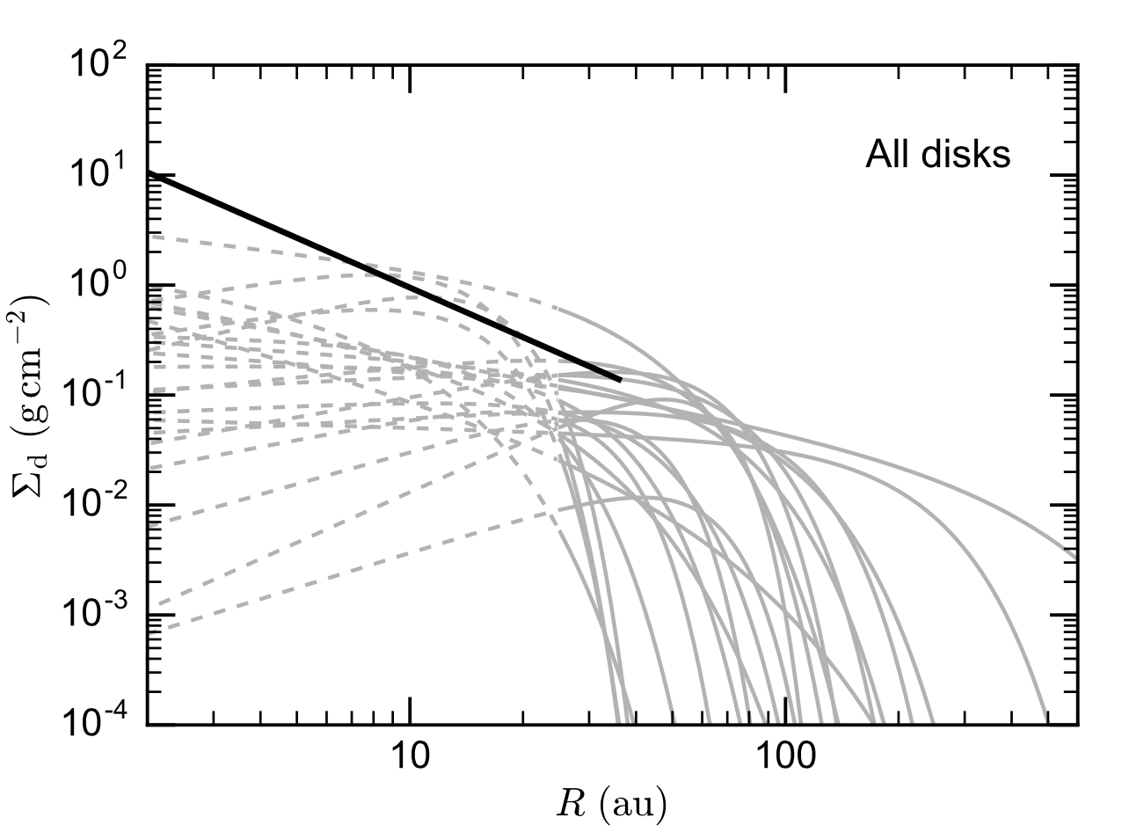
Disks quickly spread out between 2 and 3 Myr.
Lupus (~3Myr) has larger and fainter disks than Tau, Oph (~2Myr).
Could be explained by viscous stirring. Tazzari+2017
Tazzari+2017
Notes:
How do the disk evolve in shape and size after 2 Myrs?
Well, it seems that in roughly 1 Myr (between Lupus and Taurus age) the disks get larger and fainter,
Perhaps due too viscous spreading.
------------------------
Larger and fainter disks (than Oph and Tau) in older Lupus (by 1-2 Myrs) could be explained by viscous stirring. Tazzri+2017

Slide 6
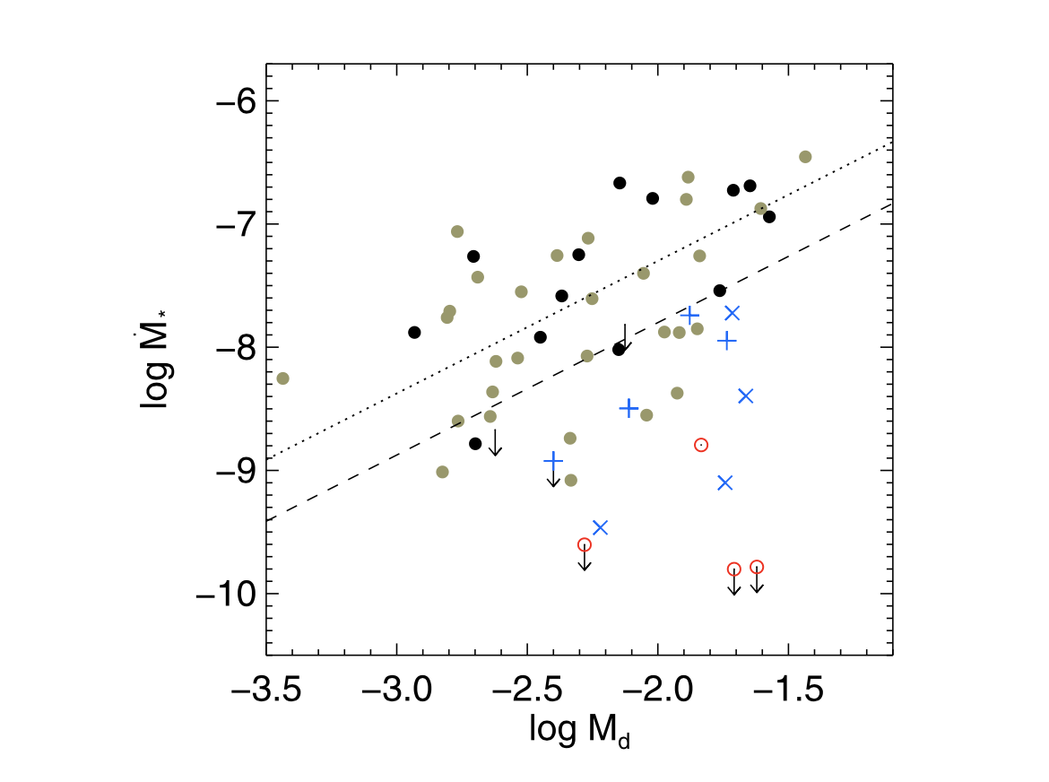
Transition disks have planets slowing accretion?
Transition disks (X and + symbbols) have larger disk masses, but lower accretion rates.
This hints at planets in the disk cavities, sweeping up material.
Najita +2015
Notes:
There is also evidence that the transition disks which have cleared or optically thin inner holes,
Though more massive, actually have lower accretion rates on to the star.
This have been thought to imply planet which the material instead.

Slide 7
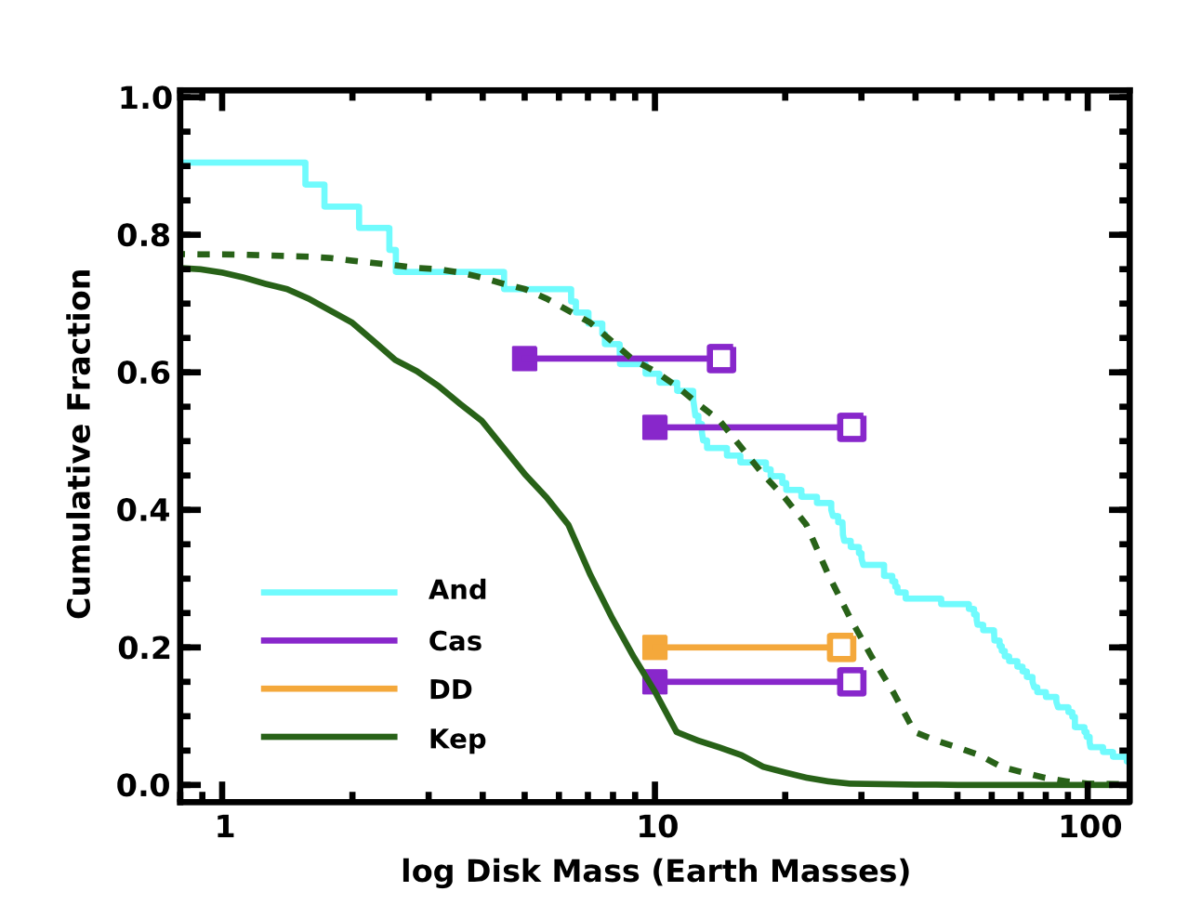
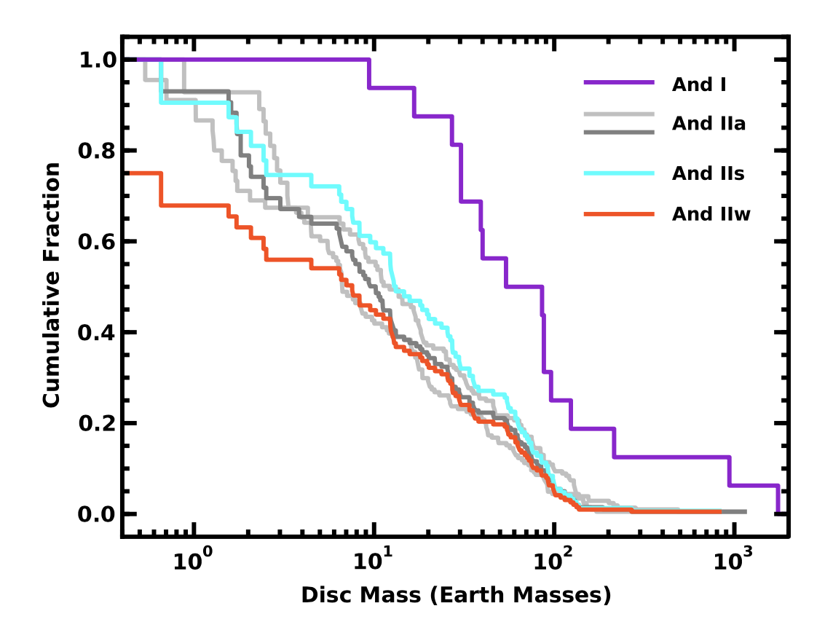
Class II disk solids too little for GG and Neptunes
GG and Neptunes need >28 Me disk incidence at 70%.
Class II >28 Me disk only 30%
Debris disk solids, Kepler planets w/ P< 400d. can all be made by Class II disks.
Najita +2014, Andrews+ 2013, Cassan+ 2012, Gould+ 2010, Eiroa+ 2013, Cumming+ 2008.
Notes:
If we compare the masses in the class II disk stage (2 Myr) to detected planets and debris disks,
we see that there is not enough mass, and solid formation must have happened earlier in the class I stage.
In this plot, we see the cumulative solid distribution in earth masses, for class II disks in the blue line.
It seems there is enough mass to produce there kepler planets within 1 au (green line),
And the detected debris disks beyond 20au orange line.
However microlensing detected Neptunes and GG between 1 and 10au, need 70% of systems (solid purple bar)
To have mass above 28 Me, but only 30% of class II disks have this.
So large pebbles must have already formed in the class I stage, which are invisible in submm.
If we look at thel class I mass distribution, 70% of class I disks have mass > 28 Me!
-----------------------------------------------------
3 regions in the disk, account for different solids in the plantary systems:
<4au for kepler and RV planets (GG and Neptunes with P < 400d).
4-20au for Microlensing planets (GG, Neptune and SE between 0.5-10au).
>20au for debris disks (which require 20% rate of >10 Me disks).

Slide 8
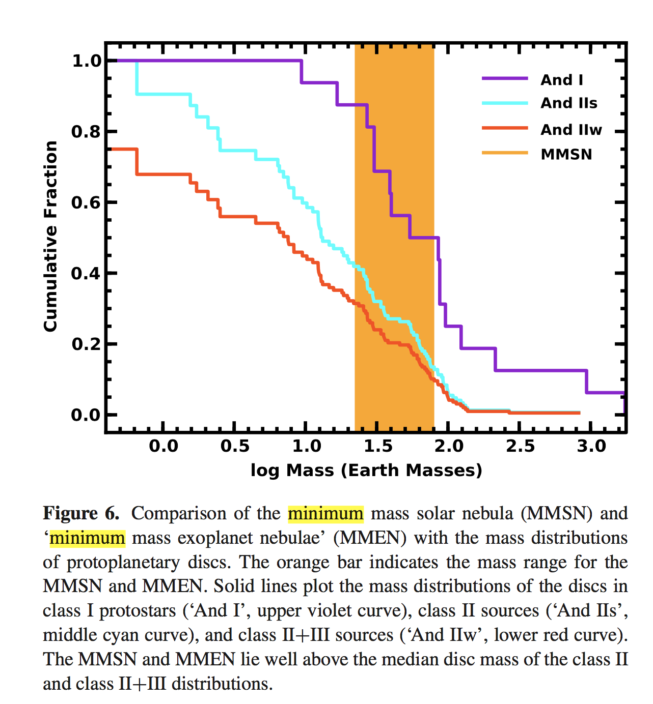
70% of Class I disk have solids > GG + Neptune solids
15%--30% of Class II disk masses surpass MMSN.
50%--85% of Class I disk masses surpass MMSN.
Najita +2014
Notes:
Comparing the class I disk mass dist to the MMSN and the large MMSN demanded by the Nice model (again the most succ SS model).
We see only 15-30% of class II disks surpass MMSN.
While 50-85% of class I disks surpass MMSN.
----------------------
Najita+2014: More than 40percent of the class II discs (30percent of class II+III discs) have masses larger than the most minimal MMSN (25 M⊕).
This minimal MMSN is therefore fairly typical.
However, allowing for the maximum core masses of the gas giants and the inefficiency of the Nice model,
fewer than 15 per cent of the class II discs have sufficient mass (75 M⊕) to produce the planets in the Solar system.

Slide 9
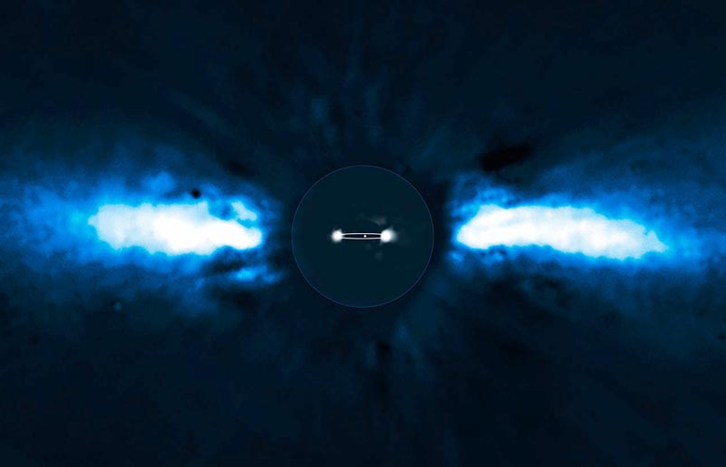
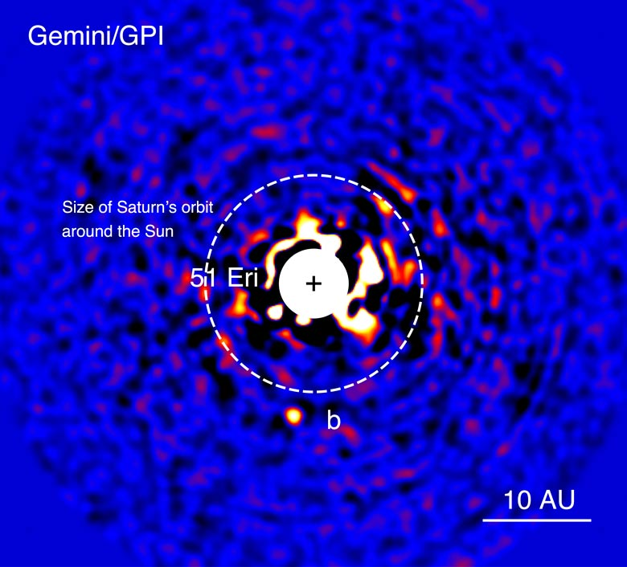
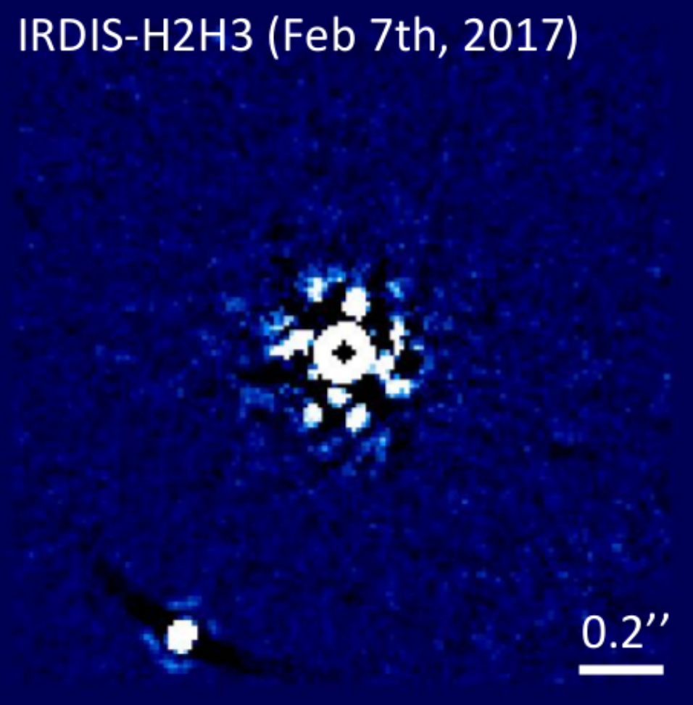
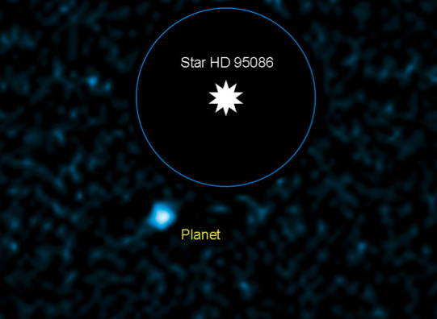
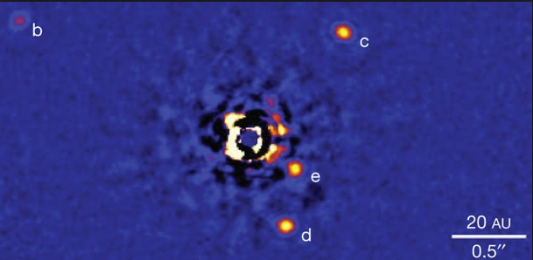
Directly Imaged Planets constrain 10-100 au pop.
Beta Pic b: 8.5 AU, 10 M_{J}
Lagrange+ 2008, 2010
51 Eri b: 13 AU, 2 M_{J}
Macintosh et al. 2015
HIP 65426: 92 AU, 6-12 Mj Chauvin+ 2017
PDS 70b: 22 AU, 5-9 Mj
Keppler+ 2018 (acc.), Mueller+2018(sub.)
HR 8799 bcde:
14, 27, 43, 68 AU
7, 10, 10, 9 MJ
Marois+ 2008, 2010
HD 95086 b: 56 AU, 4.5 M_{J}
Rameau+ 2013
Notes:
So what about the planets imaged directly between 10 and 100au? What can they tell us?
In recent years we have quite a few of these new systems discovered by SPHERE and GPI.
For example, just this year, the SPHERE consortium discovered for the 1st time a clearly imaged planet
Inside the transition disk, PDS 70.
However, it seems these systems do not follow any power-law found for the inner planets.
-------------------------------------------
Many systems have been directly imaged with a planet and debris disk, showing that they frequently occur together.
So the systems we are studying are perfectly capable of making planets.

Slide 10
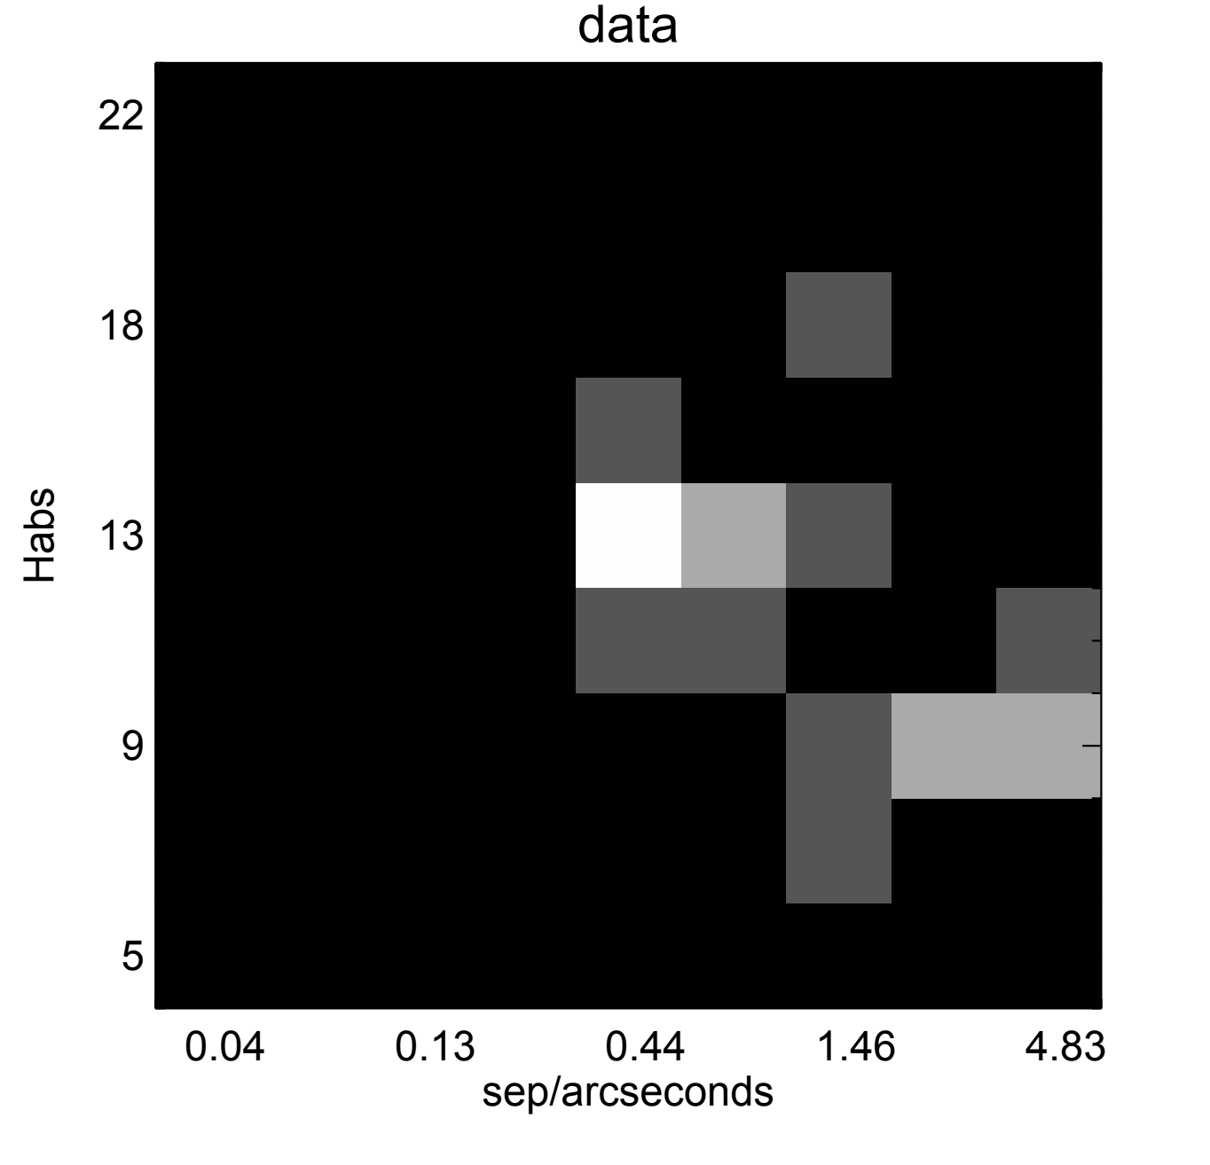
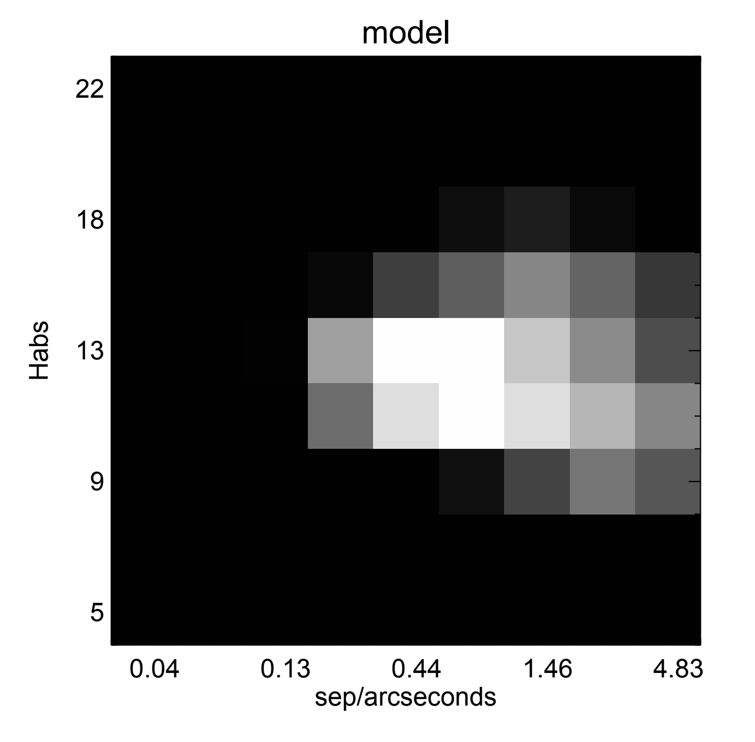
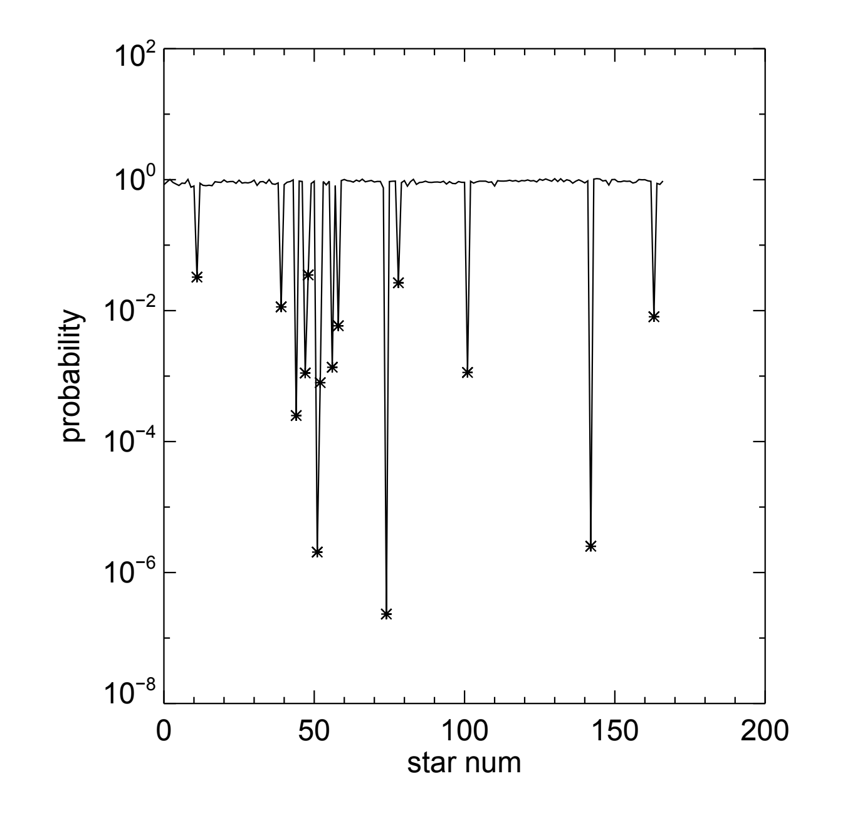
Planet rate between 10-100 au < few %
Vigan,…, Wahhaj in prep
Notes:
For example, this is preliminaty work I am doing with the SPHERE consortium.
Where I set Bayesian constraints on the planet population,
Trying to fit the brightness vs sepration distribution of the directly imaged planets.
As you see the best model, is able to follow the shape of the observed histogram.
The probability of some detected systems given our best model is only a few percent,
Which means they should have a few percent incidence rate.
However, some systems have extremely low probability meaning, given the model, meaning that the typical power-law
Models in mass and separation dist are not good enough.

Slide 11
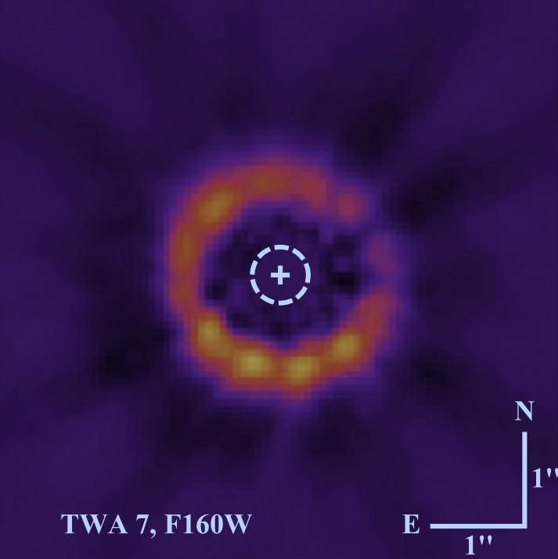
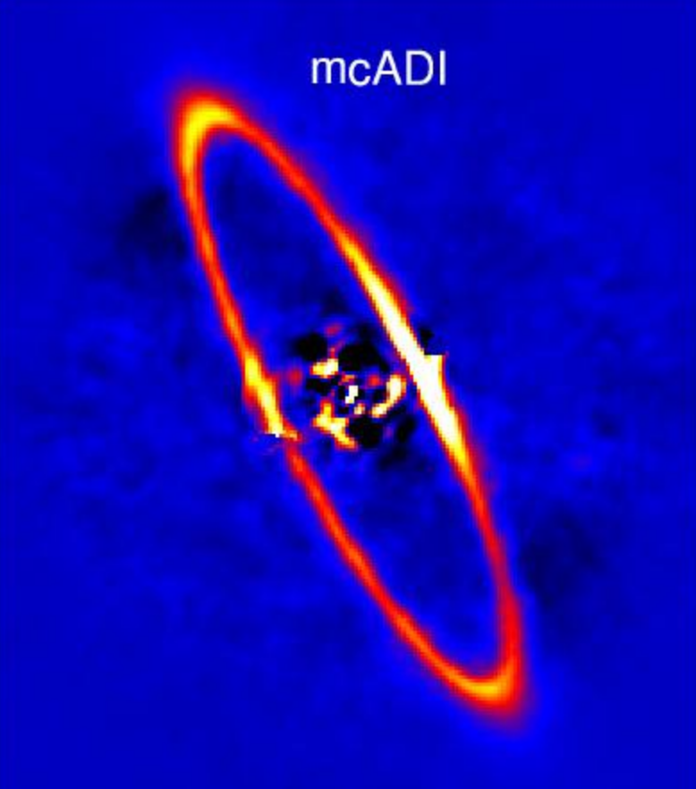
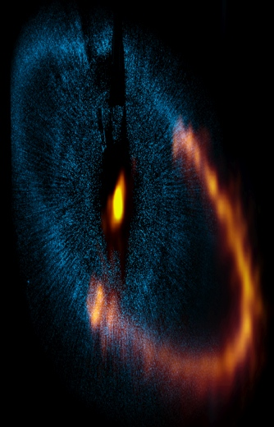
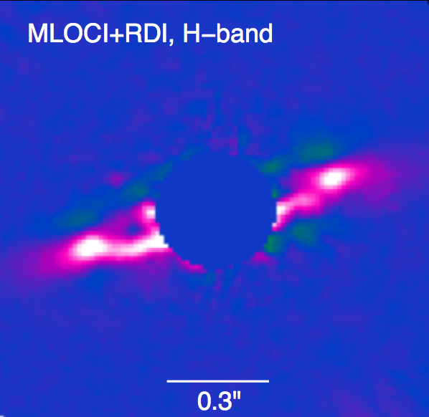
Planet at >10au in debris disks?
TWA 7,
Choquet+2017
dr/r = 0.25, ~4-10 Myr
HR 4796A
Milli+ 2017
dr/r= 0.14, ~10 Myr
HD 114082,
Wahhaj +2016
dr/r=0.1, ~16 Myr
Fomalhaut, Boley+ 2012
dr/r = 0.17, ~400 Myr
Notes:
After our discovery of yet another narrow debris disk ring system (HD 114082) in 2016 by SPHERE
We decided to re-investigate how to make these very narrow rings, and whether you needed planets at 10s of Aus.
These are some of the ring systems with width/radius less than 20%.

Slide 12
Narrow Rings connected to GG or Neptunes
1. Large ring radius at young age -> giant planet excitation (Mustill & Wyatt 2009, 5 AU planet -> 30-100 AU disk).
2. Narrow ring -> exclude large planet close to ring (Rodigas+ 2013)
3. Sharp outer edge -> unstirred, low eccentricity planetesimals (Thebault 2008)
Notes:
Going through the theorectical works,
It seems that large ring radius at young ages, for example HR 4796a, points to inner giant planets.
For older stars, a Neptune mass planet to create just enough stirring of the debris disk would suffice,
And it would also make a sharp inner edge by clearing out the regions with dense mean-motion resonances.
However, the key to a sharp outer edge is low-eccentricity and mainly unstirred disks.

Slide 13
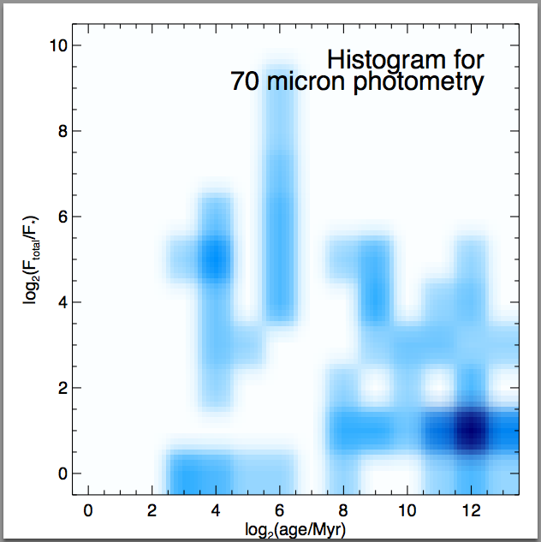
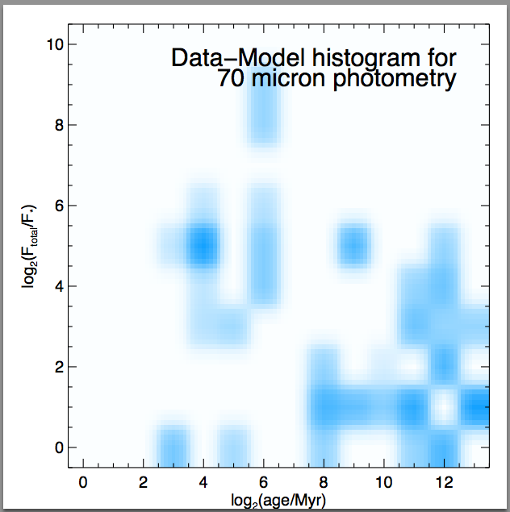
Debris disk pop explained by exo-plutos, no giants?
Wahhaj & Kobayashi (2018) in prep
Model Parameters: R_{in}, ΔR, Σ, N(Σ) ~ Σ^{-Q}
Notes:
We also wanted to see if the whole pop of debris disks could be explained by models without GG formation.
postulating a steady growth of planetesimals growing only to pluto-sizes, gradually from inside out.
Here you see a histogram of spitzer IR excess fluxes from these the debris disk population, 100s of stars.
And we are looking at residuals of the histogram after model subtraction on the right.
We try to create distributions of inner radius, disk width, surface density, etc to explain the observed pop’s photometry.

Slide 14
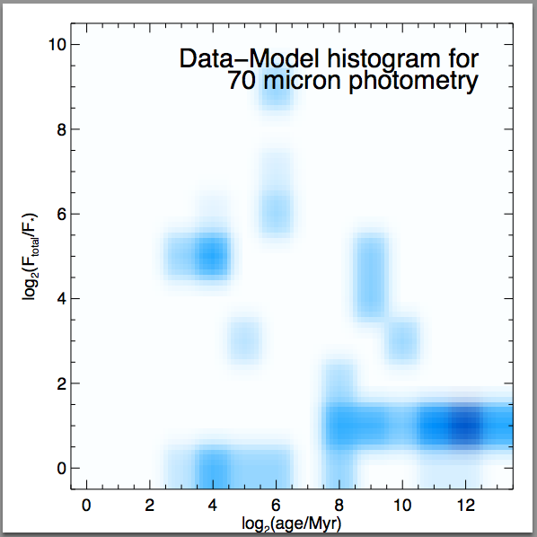
Model spread in disk width is best
70 micron
Data Spread in Σ Spread in ΔR
Model Parameters: R_{in}, ΔR_{min}, Σ, N(ΔR) ~ ΔR^{-Q}
Notes:
And we saw that good models are not easy to find.
The best models required a spread in disk widths, but needed extremely narrow rings (1-2) au.
Then we realized that this was simply b/c all rings simply get wider with age in these steady pluto making systems,
As the inner edge fades slower than the outer edges as new plutos stir the disk.
In summary, the steady-state pluto making models are not a good fit to the population,
Giant planets or some other phenomenon is making the picture more complicated.

Slide 15
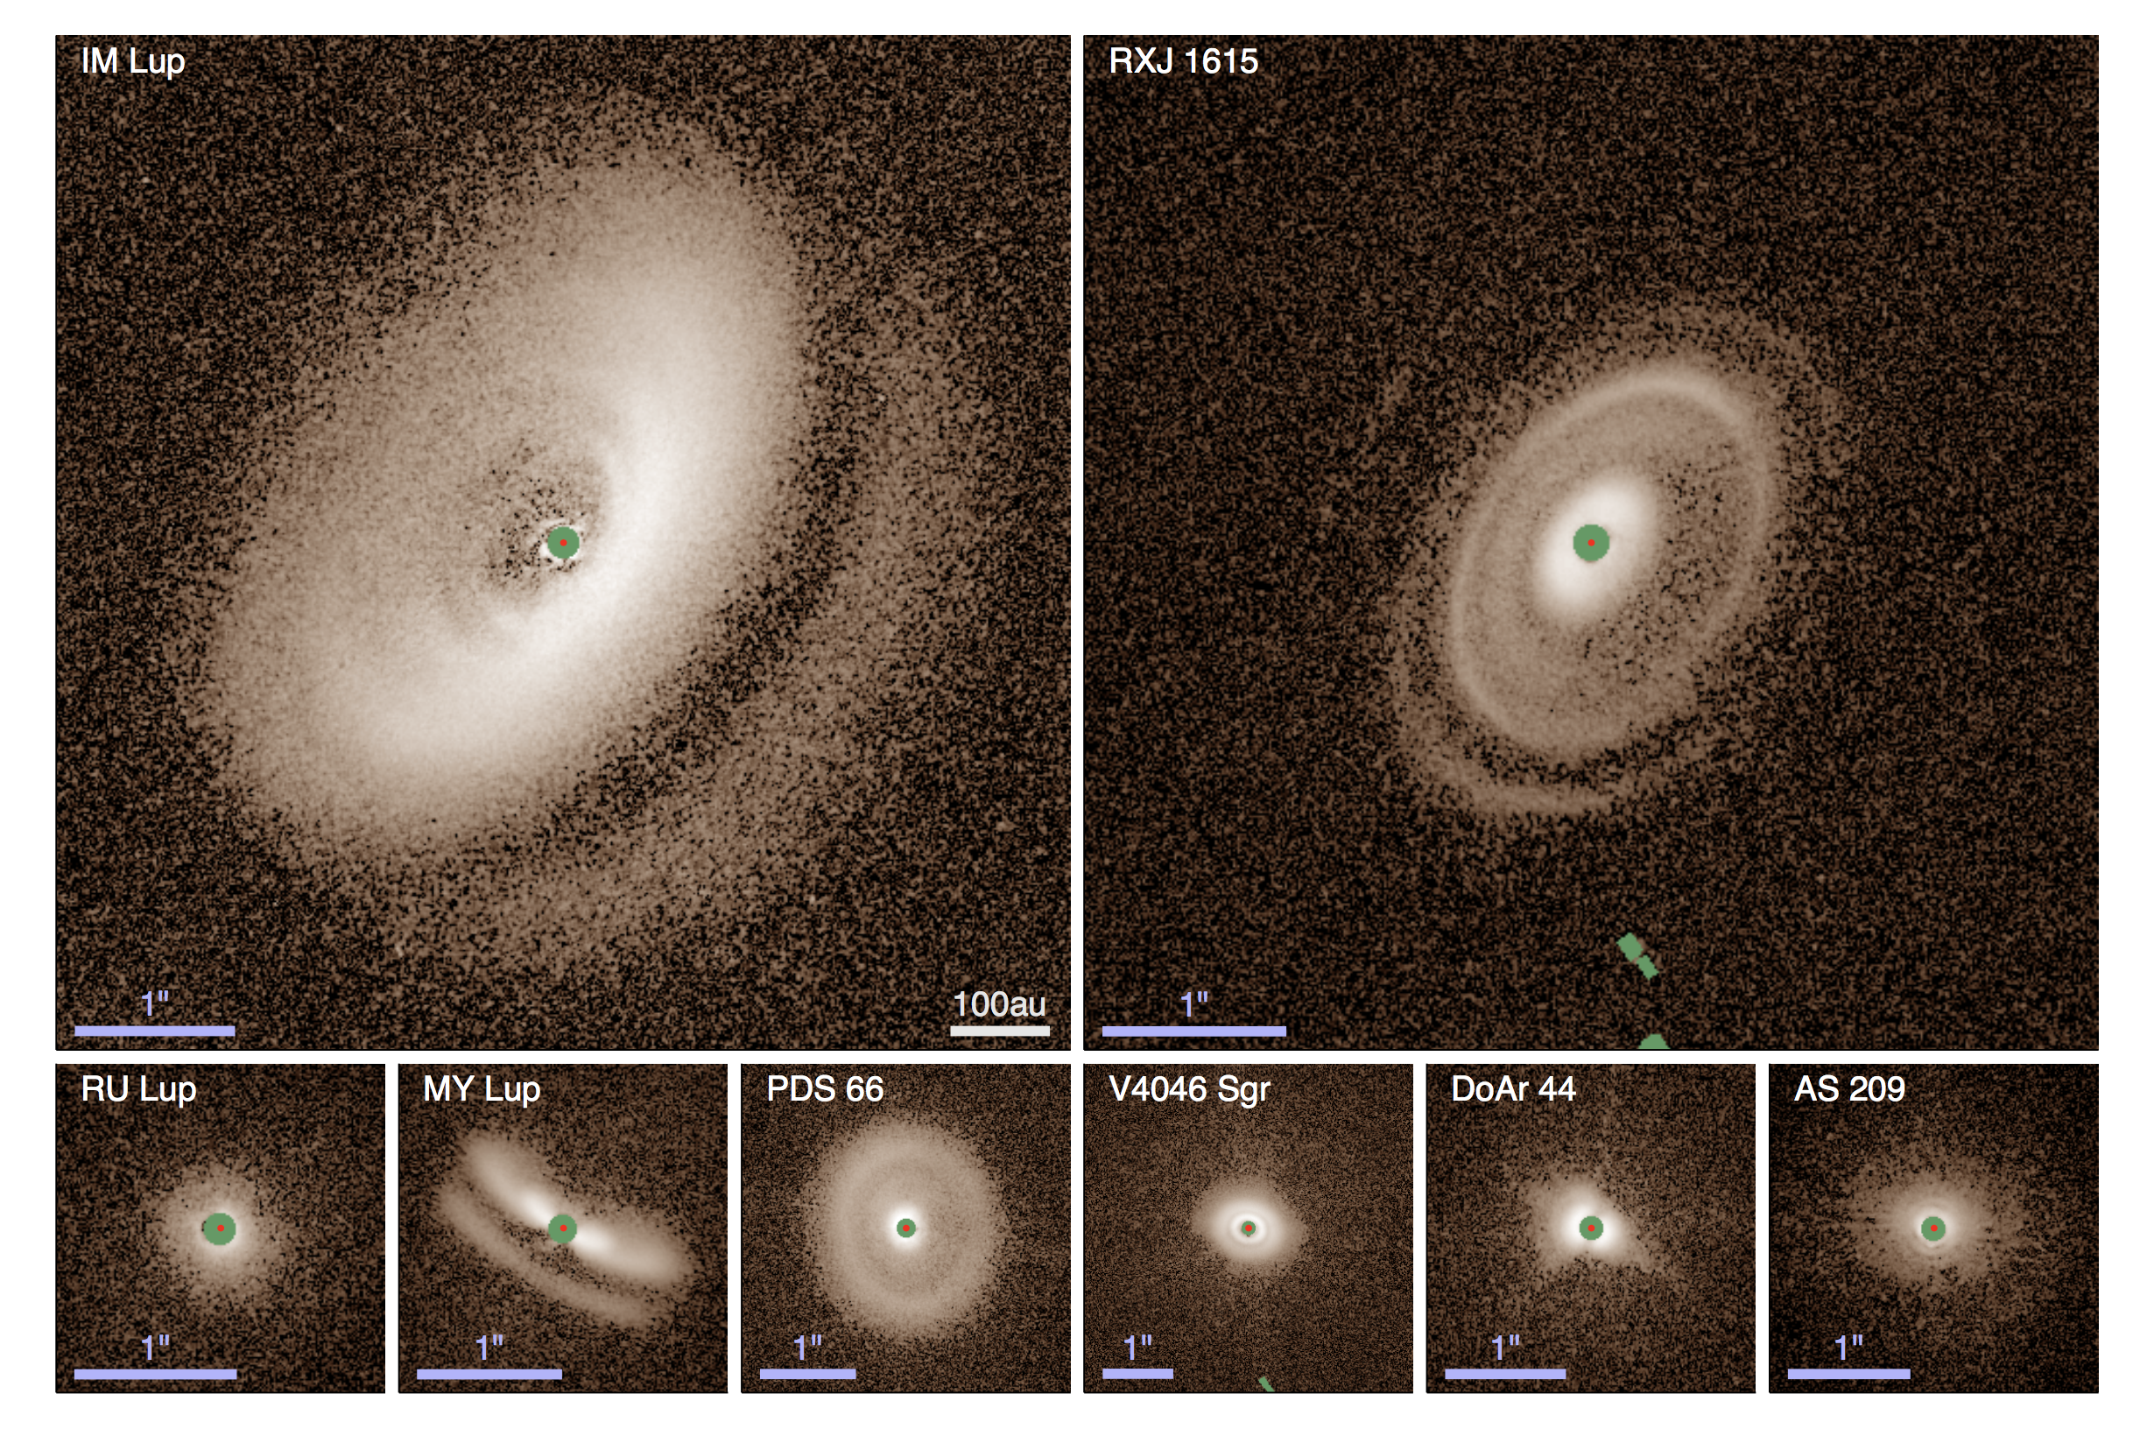
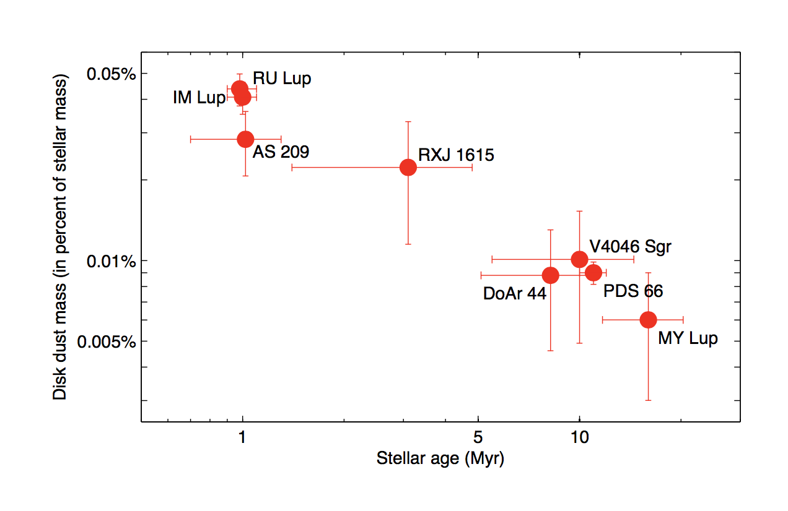
Rings in T Tauri Disks vs Spirals in Herbig Ae? Avenhaus+2018
These T Tauri stars show rings,
While more massive stars show spirals
Masses fall with age.
Notes:
Disks selected based on their strong submm detection.
80 au in scattered light to >400 au.
Pol fluxes 0.06% - 0.89%
Masses of the disks fall with age.
7/8 show rings, none show spirals.
Accretion rates: (AS 209) 1e-7 to (IM Lup) 1e-11 Msol/yr
Most flared disks have lowest accretion rates? –Zwa.

Slide 16
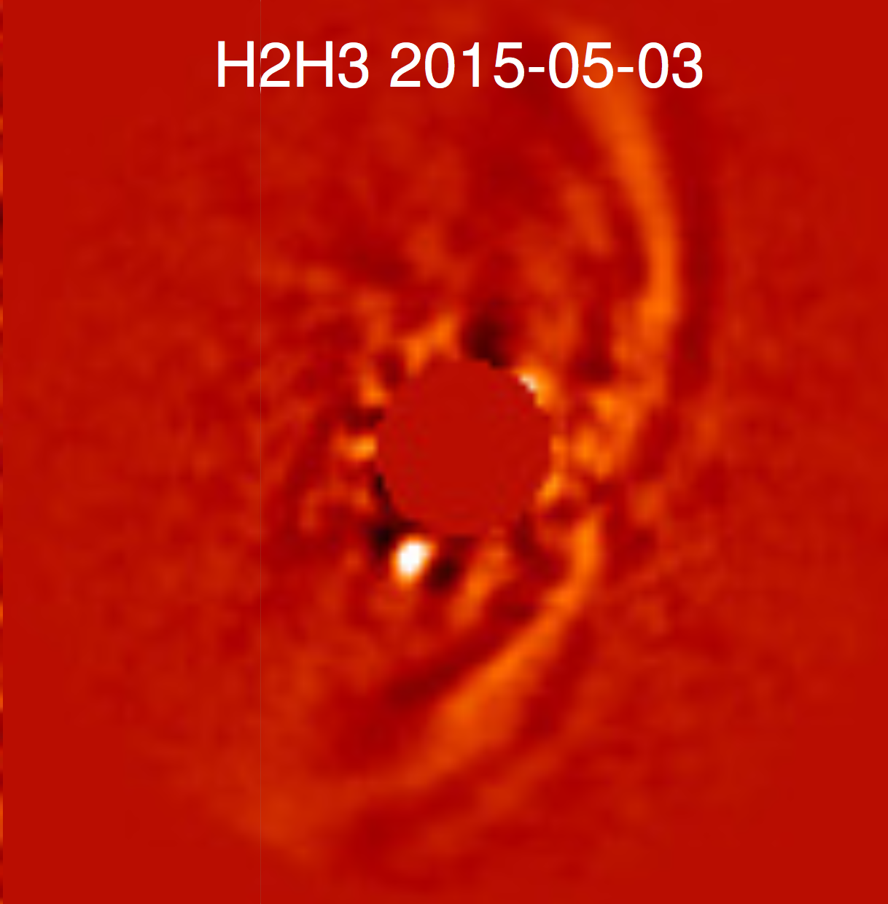
PDS 70 (0.8 Msol): Inner planet but no spirals.
210 au
SPHERE/ K-band
110 au
60 au
22au
Keppler+ 2018
Mueller+ 2018
Notes:
Here is a clearest detection ever of a planet inside a transition disk.
Mass = 0.82 (TTauri).
There is gas detected in the throughout the disk
However there is no obvious spiral in the disk.
Total disk mass = 4.5 Mj
22 au planet det separation.
54 au whole
17 au inner disk
Age = 5.4 +/-1 Myr
Sco-Cen assoc. (113 pc).
Halpha det onto planet (Wagner+ in prep).
A total dust mass of 3e-5 Msol = 3e-2 Mj = 90 Me.
Gas:
0-210au (gas_co)
33-160au (gas_hco),
60-100au (dust) ALMA.
54au (sharp dust ring)
22au (planet)
Dist nee to be updated from 140 -> 113pc (gaia).

Slide 17
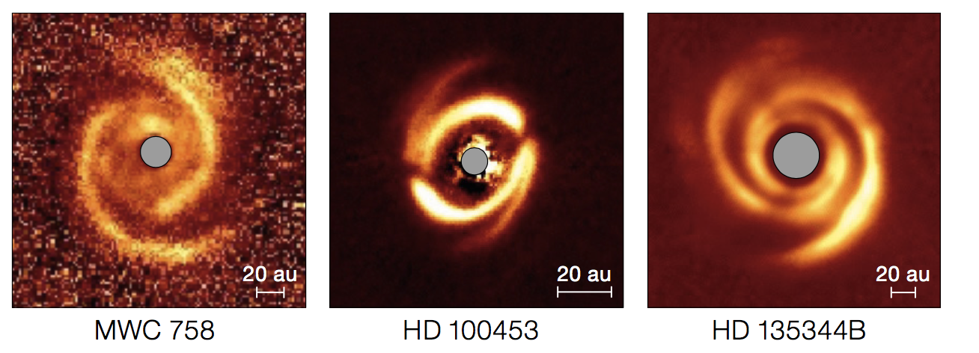
Spirals in Herbig Ae/Be Disks
SPHERE
SPHERE
Benisty +2015
Age =3.5 [2] Myr
Gas = 1-10 Mj (from CO)
Dust = 240 Me
Benisty +2018
Age = 10 [2] Myr
Gas < 8e-2 Mj
Dust = 30 Me
Stolker+2016
Age = 8 [4-16] Myr
Gas = 24 Mj
Dust = 54 Me
ALMA
Notes:
Apart from being Herbig Ae stars, these disks have little in common.
Apart from having spirals some of these have also have shadows (WMC and HD 135xxx).
Shadows cause a periodic temperature perturbation in the outer disk and can launch spirals (Montesinos +2016).
GI is ruled out for all these disks due to insufficient mass.
-----------------
MWC 758:
SHADOWS:
There is no detection of conspicuous shadows similar to the case of HD 142527
SPIRAL:
the observed spiral pattern involves either
the candidate companion itself if it is on an inclined and ec- centric orbit, possibly co-planar with the inner disk
the pres- ence of an undetected ⇠ 6MJup planet at the outer tip of S1, made by overlapping density waves.
the presence of an undetected ⇠ 2MJup planet at or outside the outer tip of S2
----------------------
HD 100453
SPIRALS:
- The two symmetric spiral arms seen in HD 100453 can be induced by the tidal interaction with the low-mass companion located at a projected distance of ⇠119 au (Dong et al. 2016).
Another open question is how a 72 deg misalignment between the inner and outer disk can be generated,
and whether this points towards the presence of an addi- tional, yet undetected, massive companion inside the cavity.
SHADOWS:
The clear connection of the spirals with the shadows is puzzling, and if not coincidental,
means that the shadows may also play a role in triggering the spirals (Montesinos et al. 2016).
------------------
HD 135xxx:
SPIRAL:
The spiral arms are best explained by two proto-planets orbiting exterior to the spiral arms.
Protoplanet solutions inside the scattered light cavity seem unlikely because the spiral arm pitch angles would require unphysical disk temperatures.
The surface brightness contrast and symmetry of the spiral arms indicate that a single massive protoplanet might have excited both the primary and secondary spiral arm.
WARP: .
An inner disk component that is 22◦ inclined with respect to the outer disk can explain shadow features A and B.
A warp in the disk, that connects the mis- aligned inner and outer disk, can explain shadow feature D

Slide 18
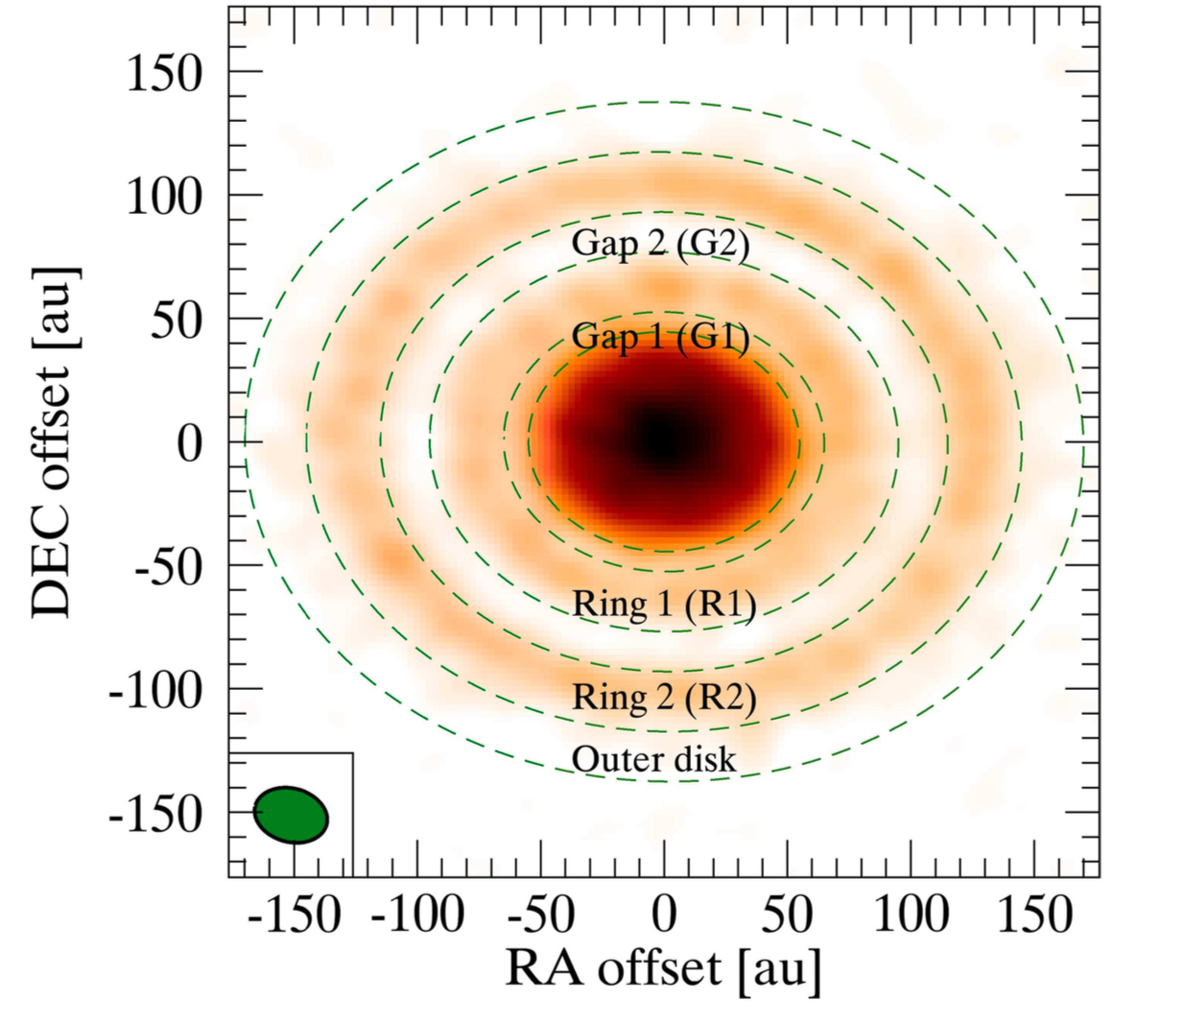
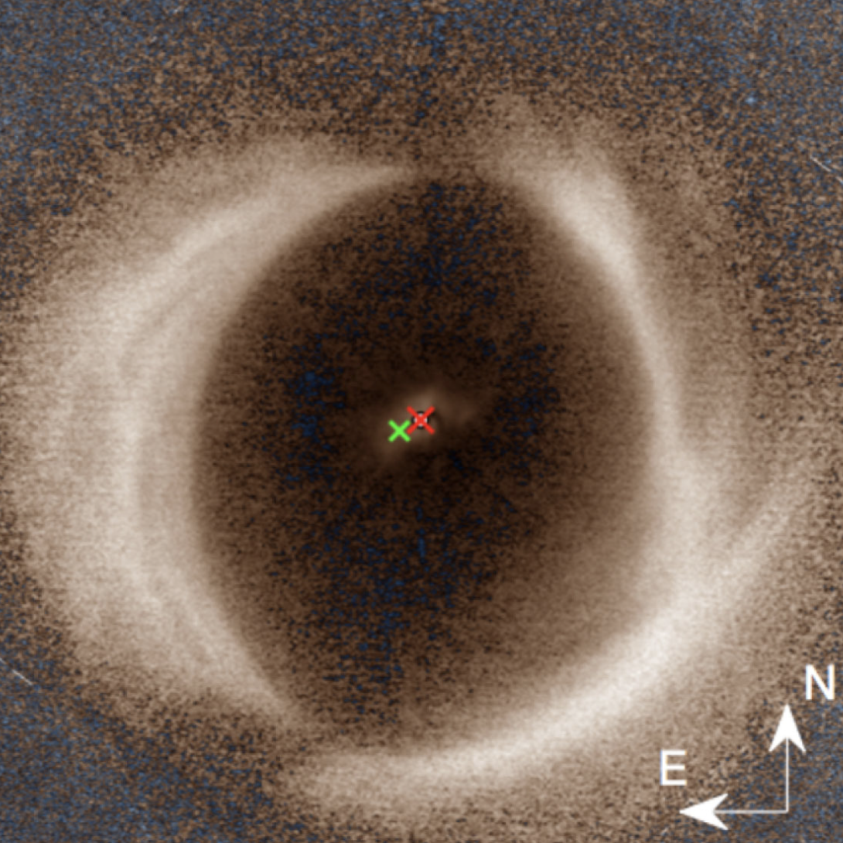
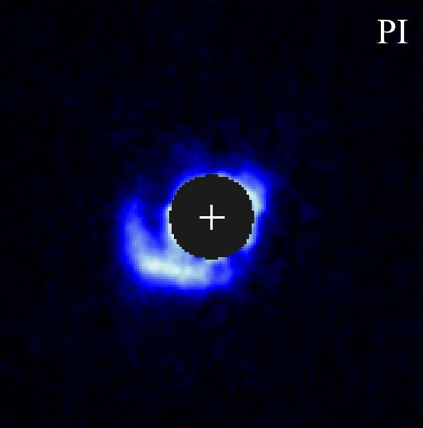
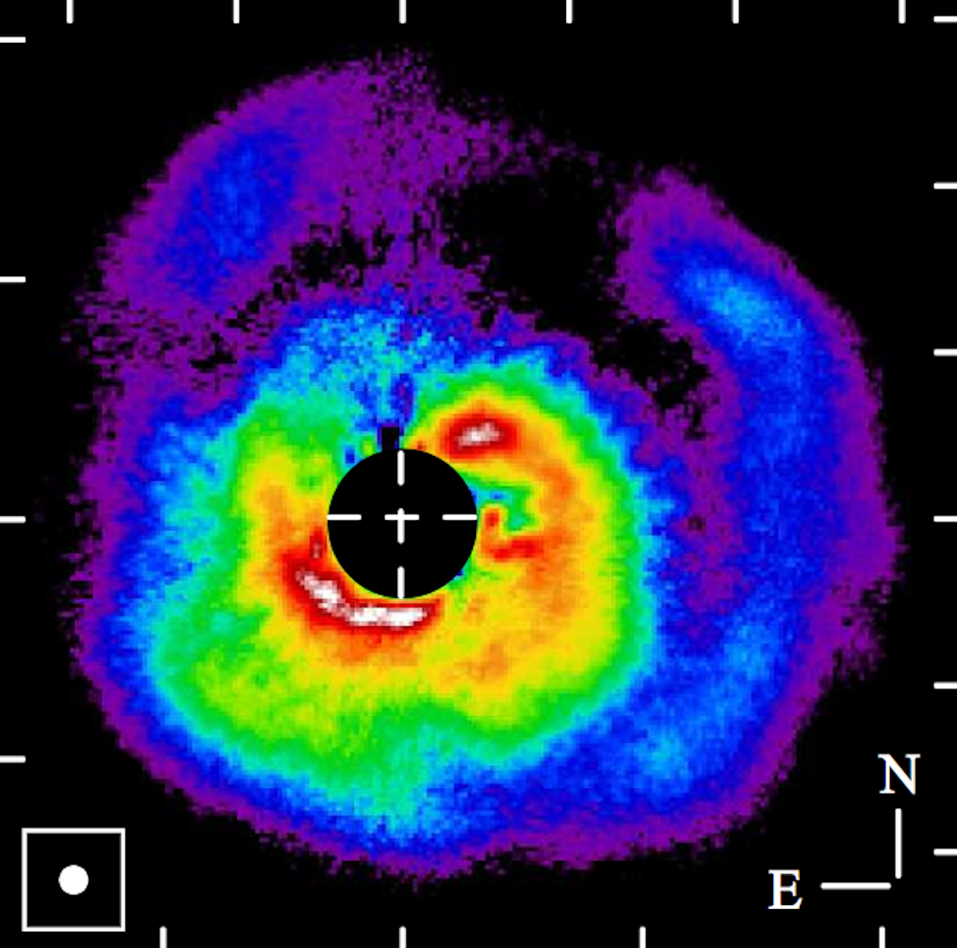
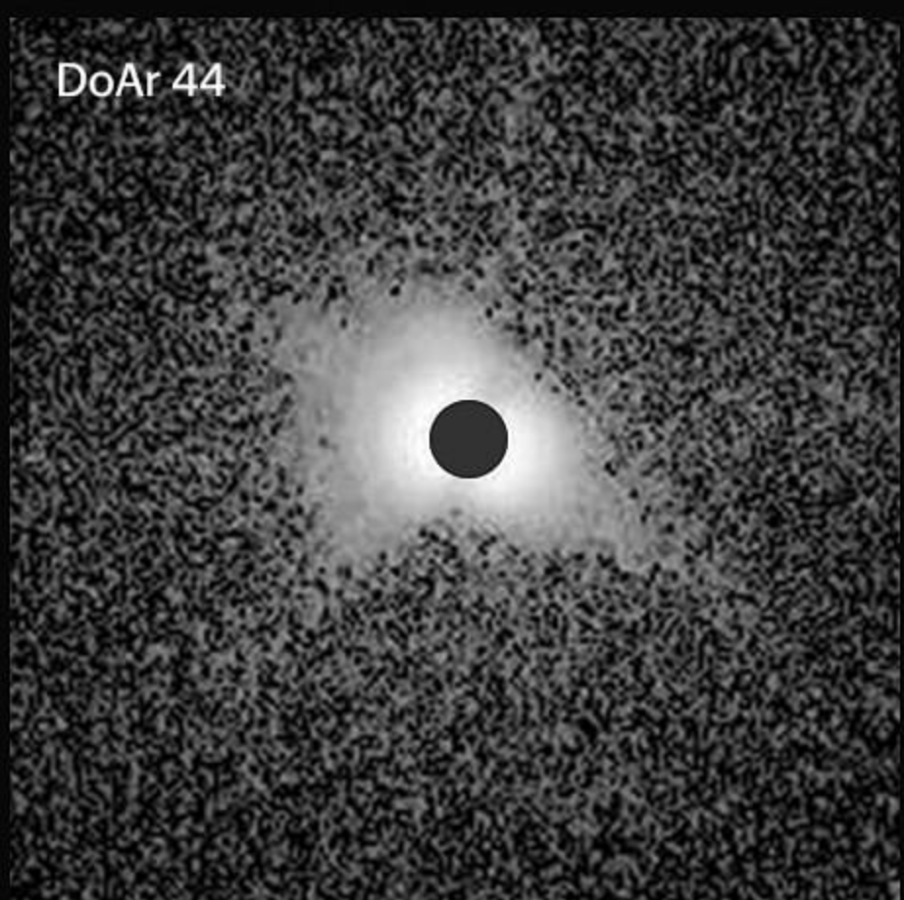
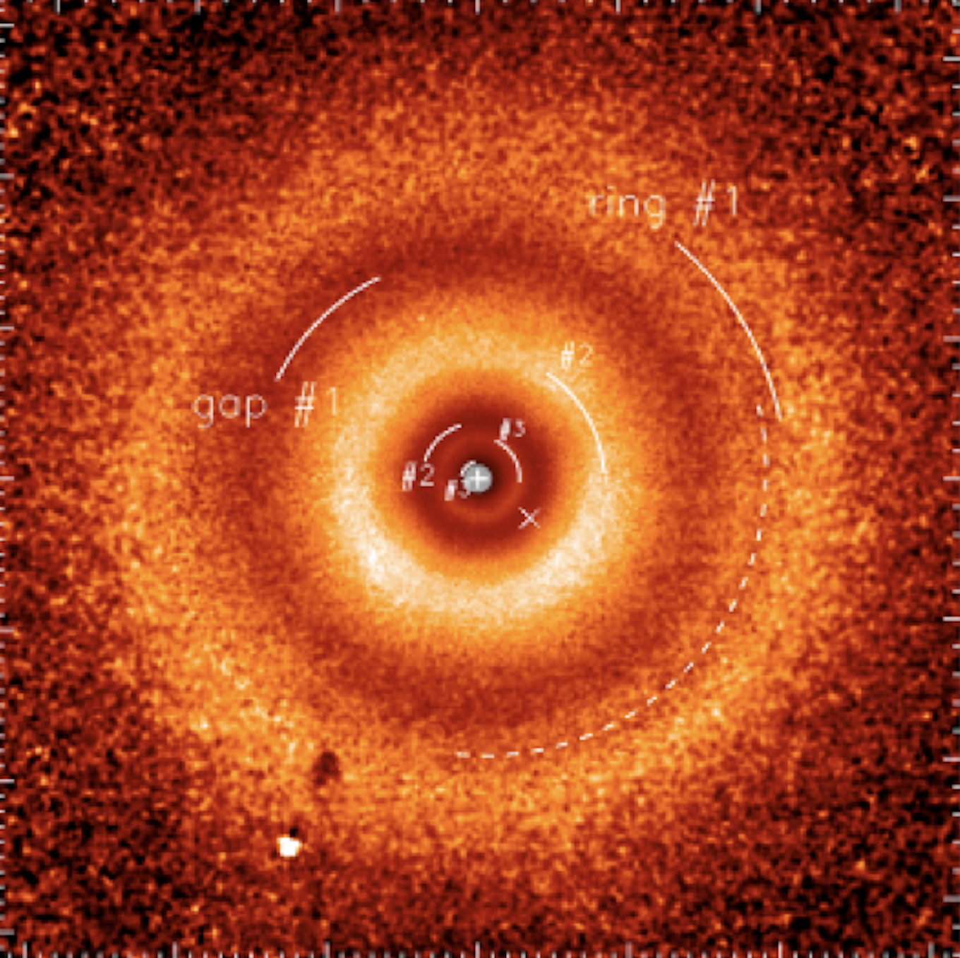
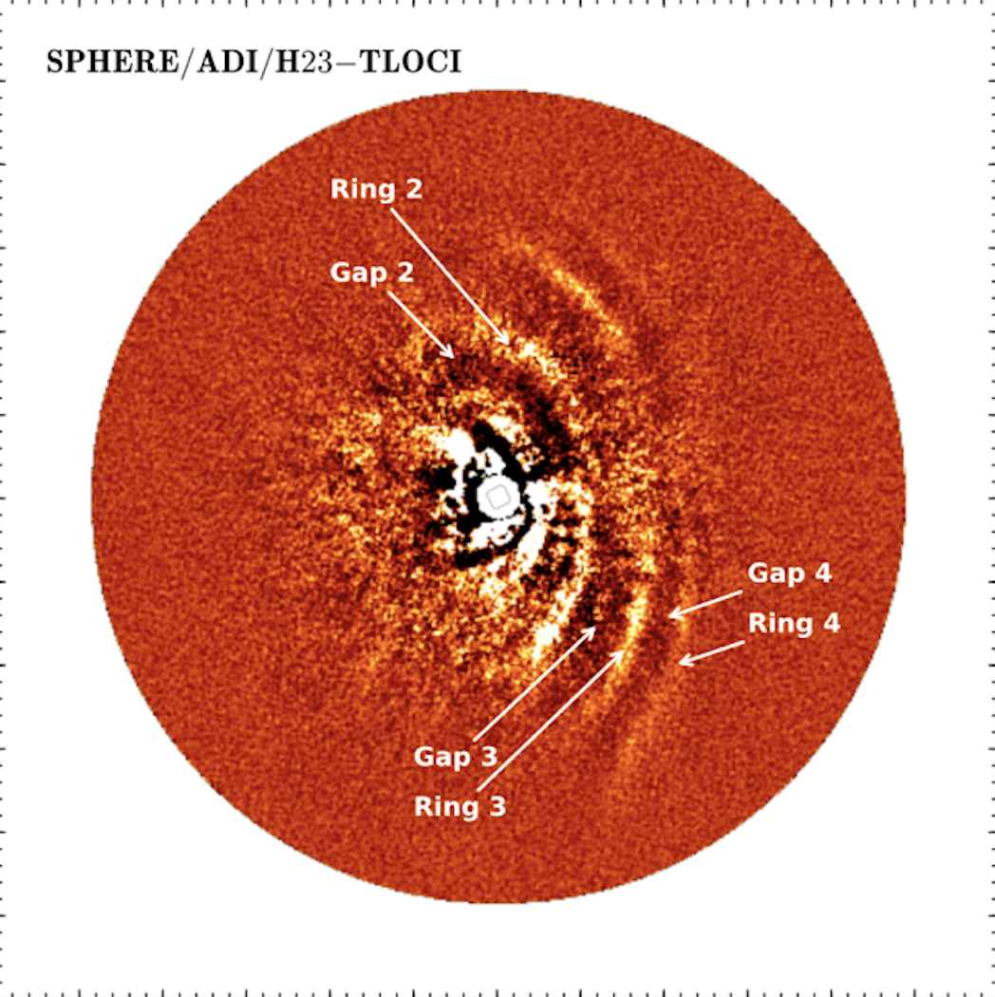
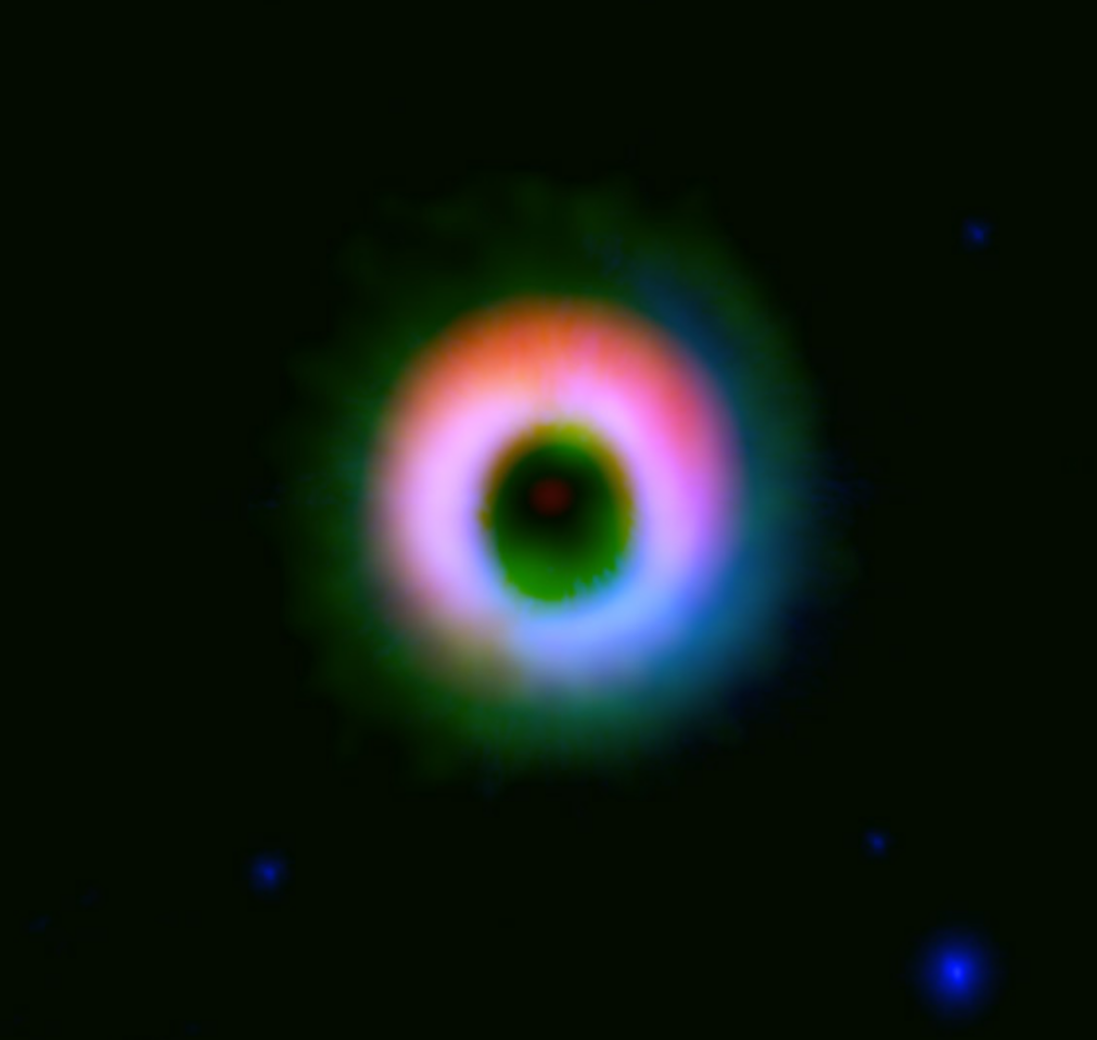
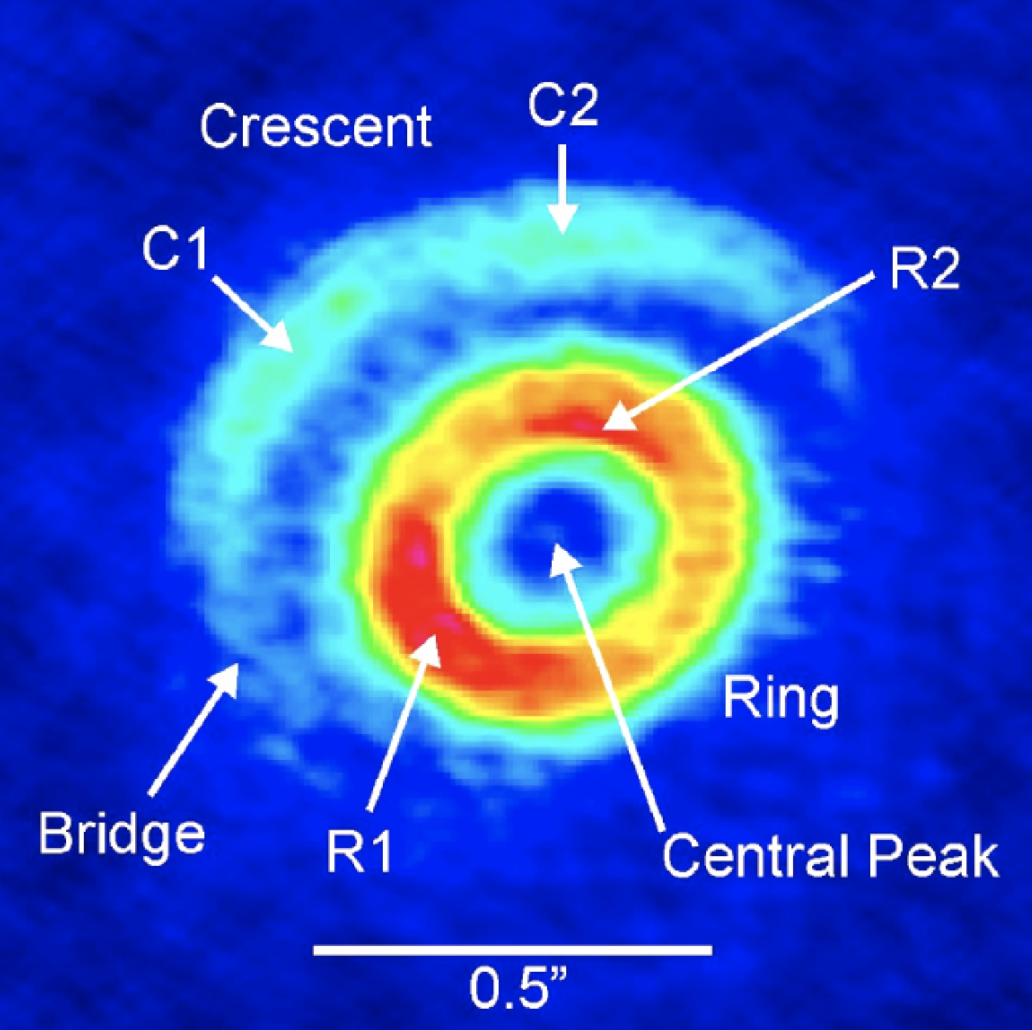
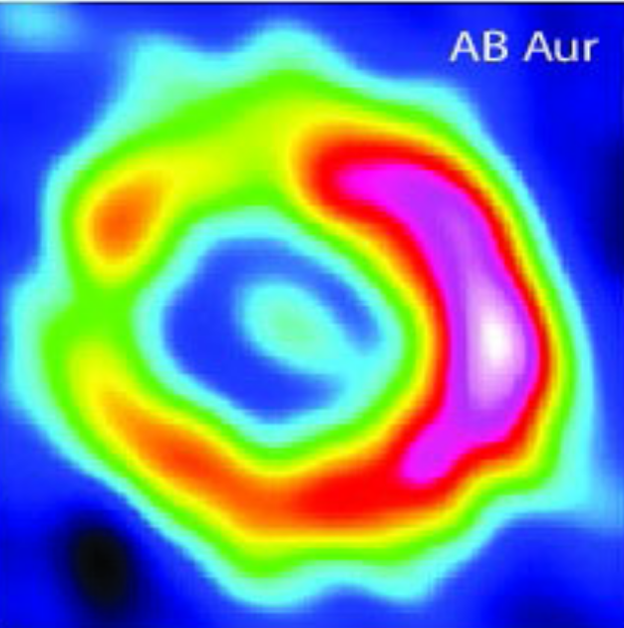
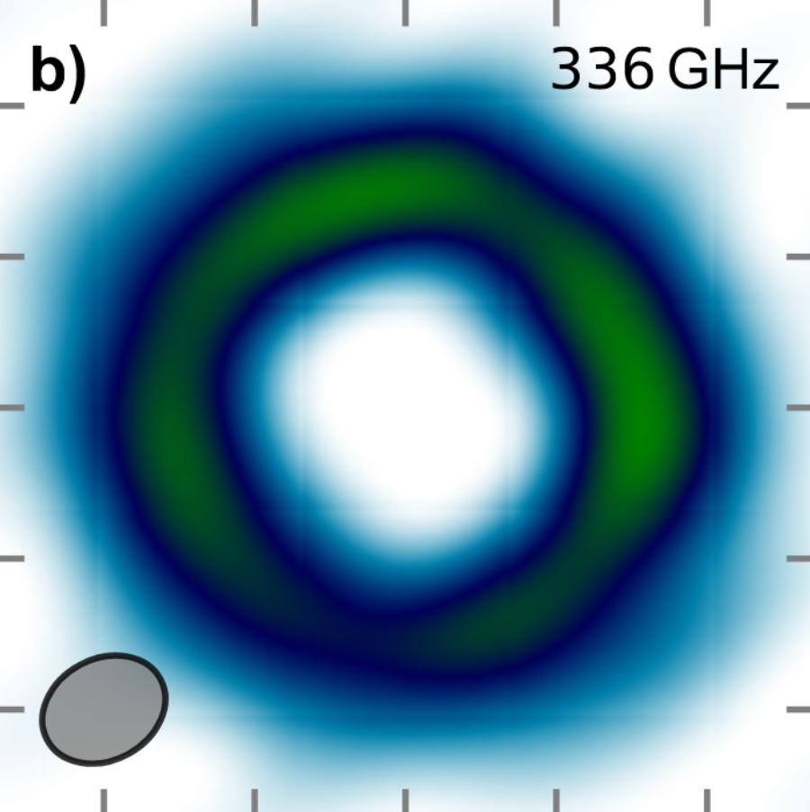
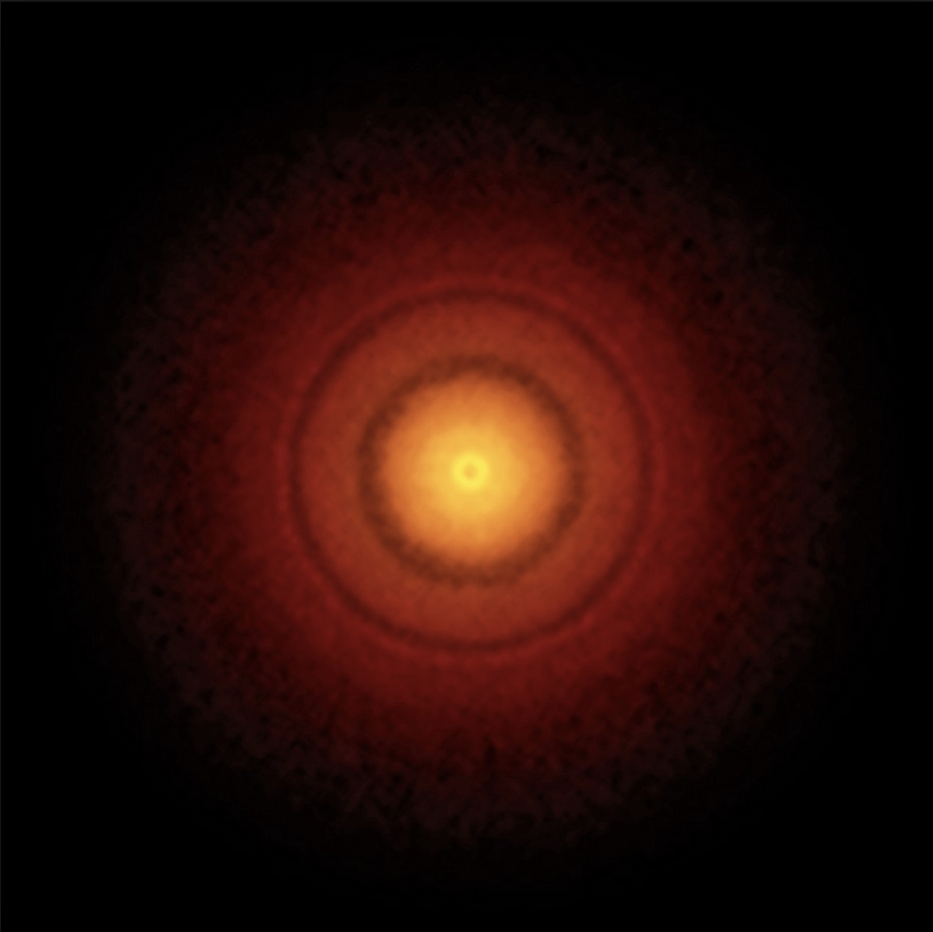
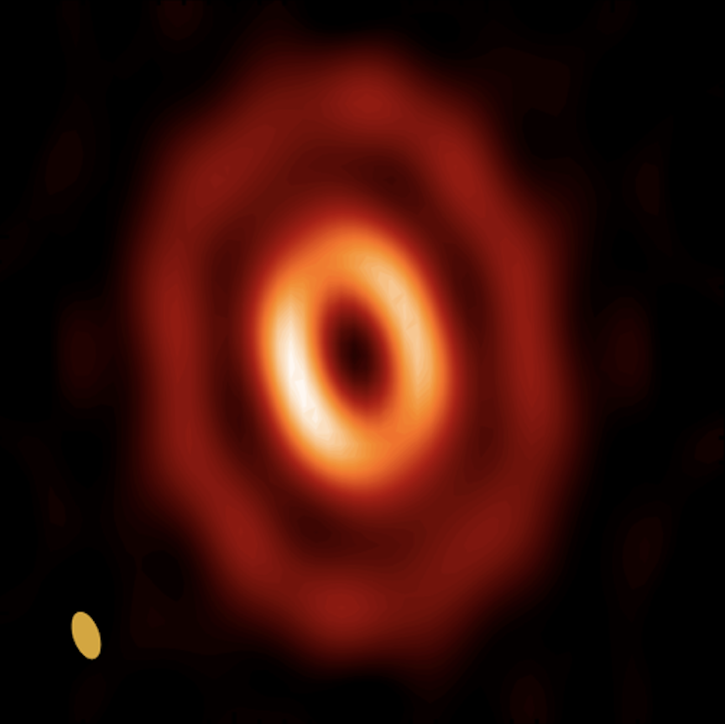
Other structures in young disks
HD 142527
V1247 Ori
AB Aurigae
DoAr 44
TWA Hya
HD 97048
Scattered
light/
NIR
Ohta+ 2016
SPHERE
Avenhaus+ 2017
SPHERE
Hashimoto+ 2011
Avenhaus+ 2018
van Boekel+ 2017
Ginski+ 2016
Thermal/
submm
ALMA
Casassus+ 2012
Kraus+ 2017
Rodriquez+ 2014
Casassus+ 2018
Andrews+ 2017
van der Plas+ 2017
Notes:
Spirals and rings show up in scattered light images.
These presumably show small grains.
Horseshoe-like dust traps show up in thermal/submm images.
These show the large grain behavior
The gas structures do not seem to follow either the small or large grain structures.

Slide 19
Mechanisms for making rings, spirals, gaps
Rings: Snow-lines of different molecules (Okuzumi+ 2015)
Rings: Dust sintering (Okuzumi+ 2016, e.g. HL Tau)
Gaps + Horseshoes: Dead zones, MRI and RWI (Flock +2015)
Gaps + high accretion: Photo-evaporation (Ercolano+ 2018)
Gaps: Multiple super-earths/neptunes (Dipierro+ 2015; Dong+ 2015; Pinte+ 2016)
Gaps + spiral: Inner GG planet + inclined orbit/warped disk (Price+ 2018, e.g. HD 142527)
Spirals: By GG planets/BD outside spirals (Dong+ 2015)
Spirals + shadows: Inner companion + warped disk (Montesino+ 2016)
Notes:
Sintering is the sticking of grain due to heating, and the dumbell
shape of these prevent further growth as they prevent energy loss
in collisions. Thus inside these sintering/sublimation boundaries
grain growth efficiently is very discontinuous, giving rise to bright
edges. HL Tau is simulated well by this model. (okuzumi + 2016)
Spirals by external planets:
The outer arms cannot explain observations as they are too tightly wound given typical disk scale height.
-Dong+2016.
Disk-planet interactions can produce a variety of structures, depending on
the planet mass Mp,
the disk scale height h, and
the disk viscosity as parameterized by α,
the ratio of the viscous stress to thermal pressure
-Dong+2017

Slide 20
Conclusions
Large pebbles invisible in submm solids likely form in Class I phase.
Gas masses in Class II only 10x dust mass, mostly < MMSN?
Planets inside 1au and debris disks > 20 au ok by solids in Class II.
Neptunes + GG between 1 to 10 au too much for Class II solids.
Directly imaged planets > 20au unlikely to follow a power-law from inside.
Debris disks rings are likely to be associated with Neptunes and GGs.
Transitions disks morphologies are successfully described both with and without planet interactions.
Massive stars predominantly have disks with spirals
Low mass stars predominantly have ring structures.
Notes:
Sintering is the sticking of grain due to heating, and the dumbell
shape of these prevent further growth as they prevent energy loss
in collisions. Thus inside these sintering/sublimation boundaries
grain growth efficiently is very discontinuous, giving rise to bright
edges. HL Tau is simulated well by this model. (okuzumi + 2016)
Spirals by external planets:
The outer arms cannot explain observations as they are too tightly wound given typical disk scale height.
-Dong+2016.
Disk-planet interactions can produce a variety of structures, depending on
the planet mass Mp,
the disk scale height h, and
the disk viscosity as parameterized by α,
the ratio of the viscous stress to thermal pressure
-Dong+2017

Slide 21
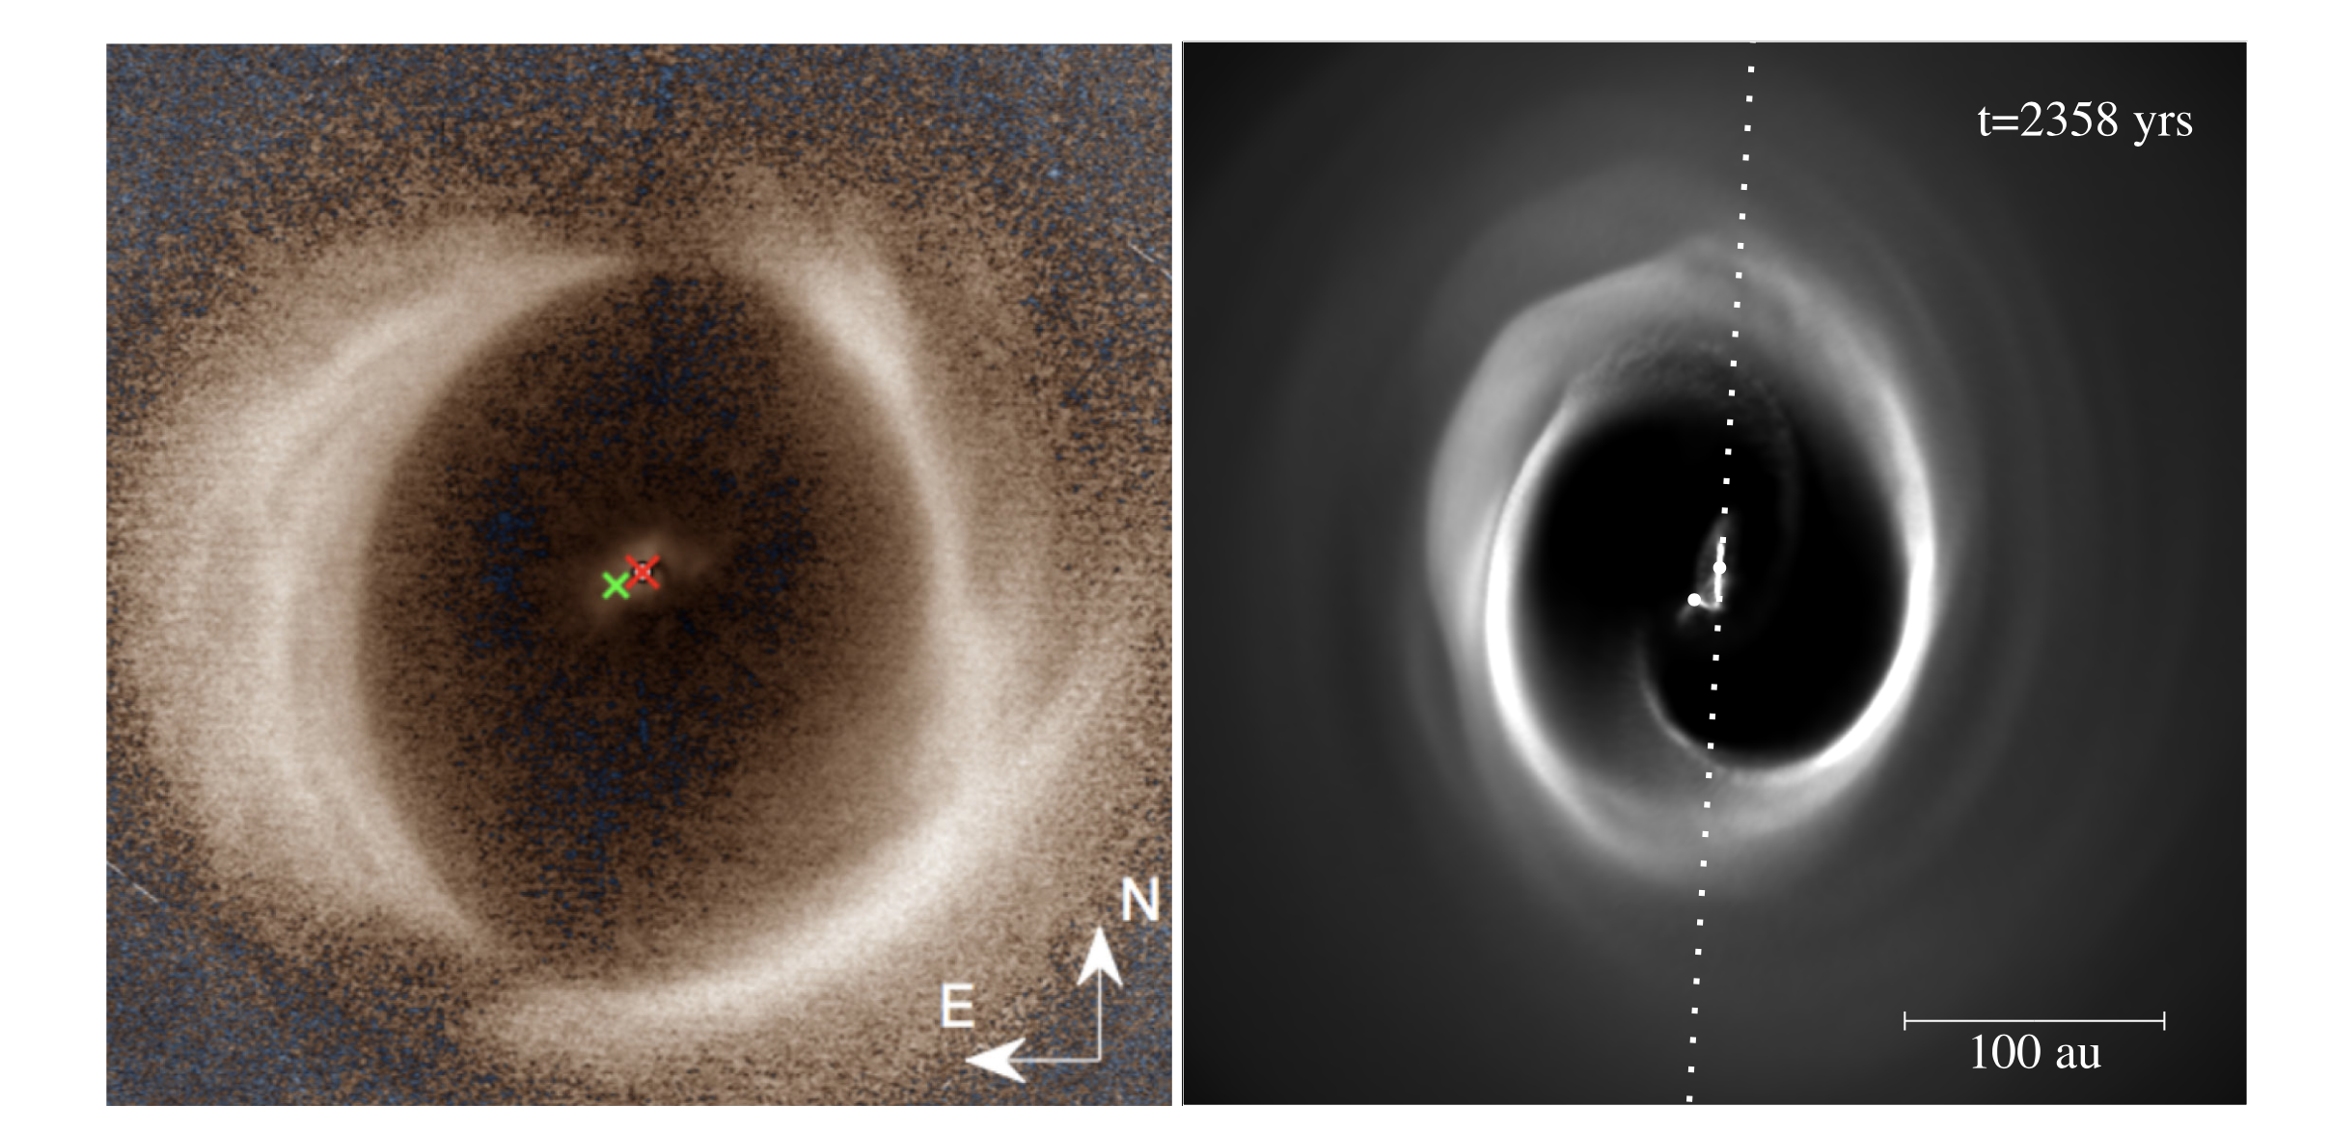
Large gap + weak spiral by companion inclined orbit: Price+2018.
SPHERE
SPHERE
DoAr 44, Casassus+2017
ALMA
Notes:
*Following the proposition of Owen & Lai (2017), it is possible that some of the large transition disk cavities could be evacuated by misaligned companions.
*Indeed, Price et al. (2018) show, using state-of-the-art 3D hy- drodynamics, that the misaligned companion HD 142527B explains all key properties of that system,
including the in- ner disk tilt.

Slide 22
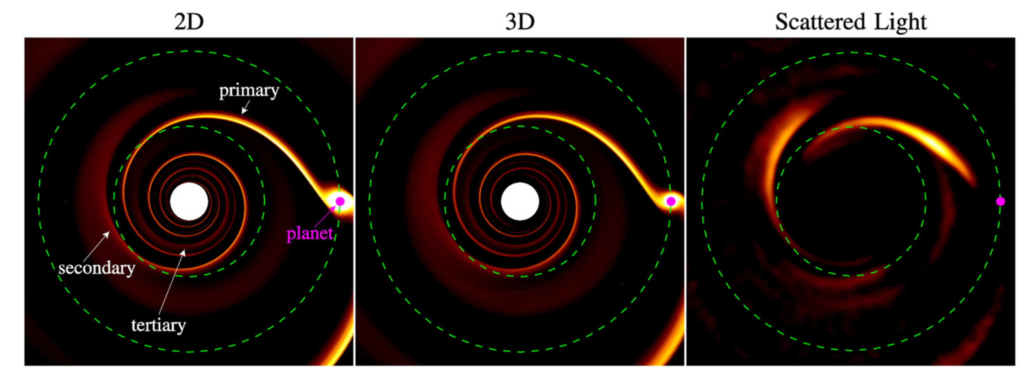
Planets Making Spirals Arms: Fung and Dong 2015

Slide 23
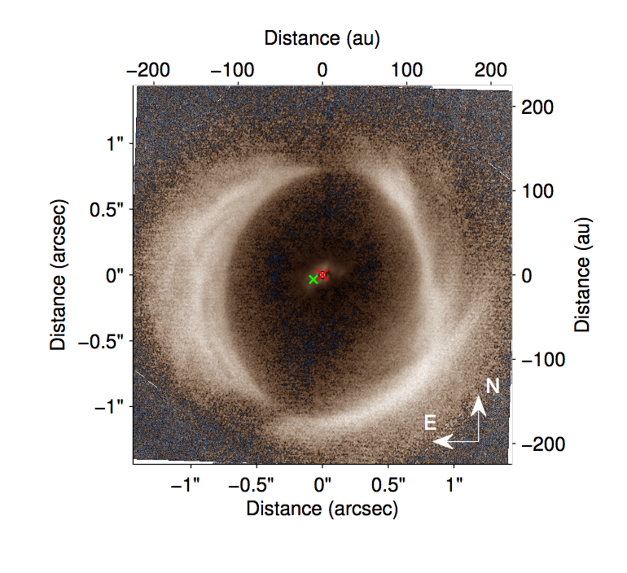
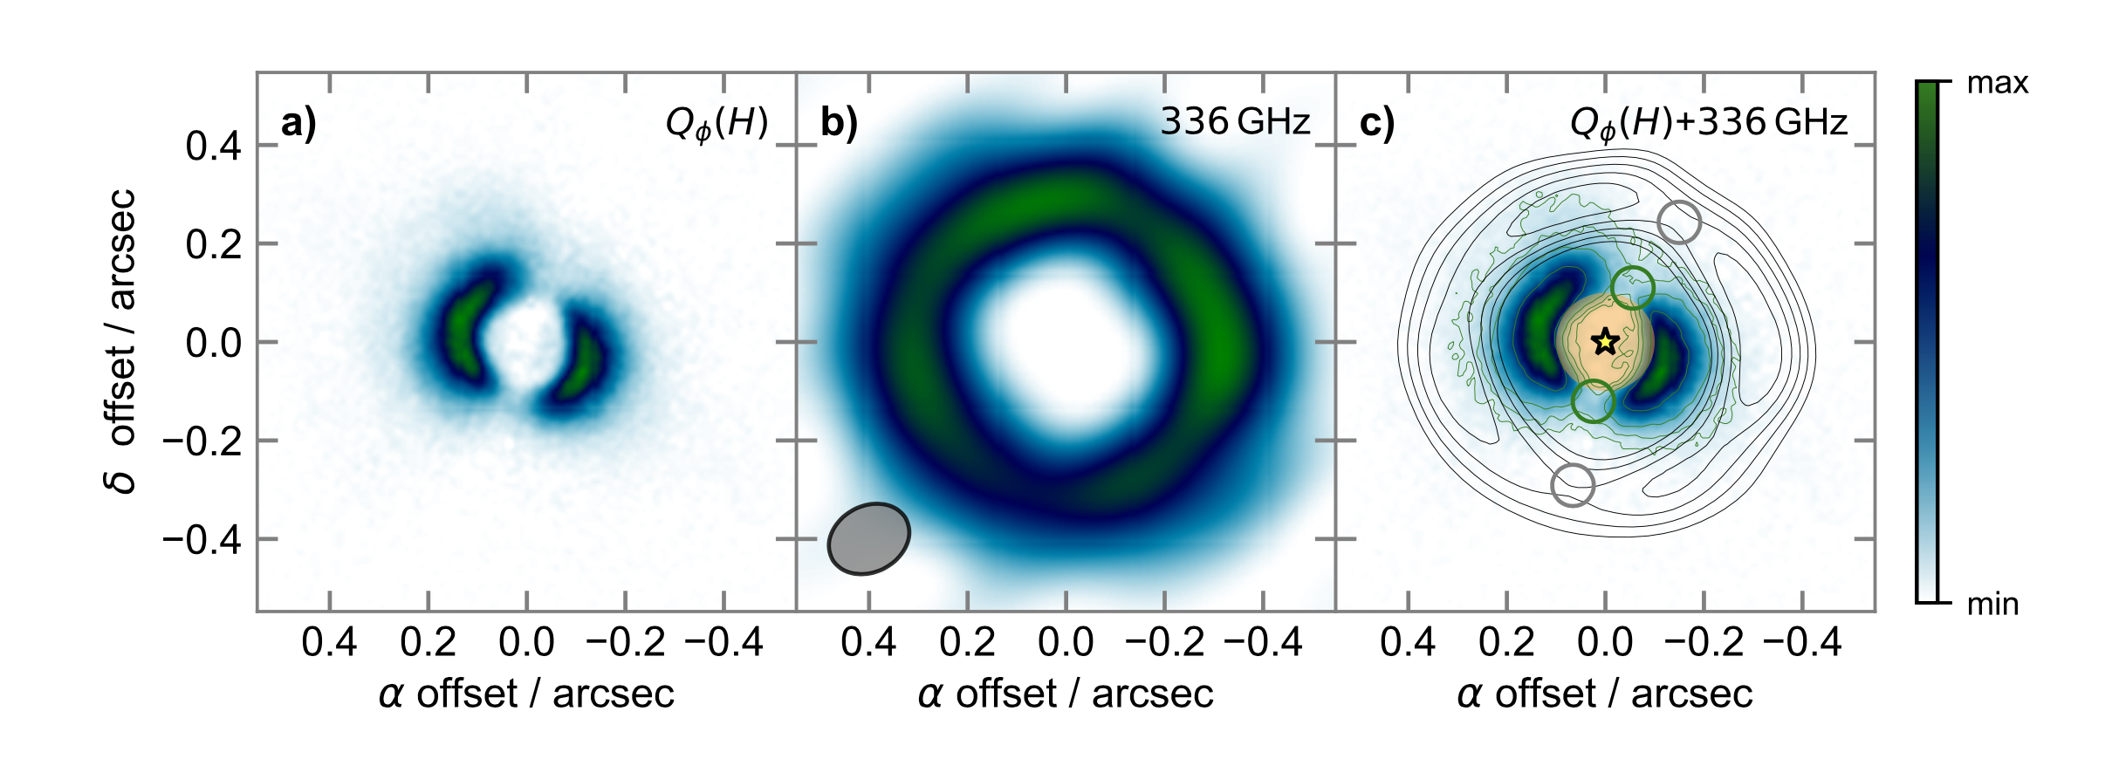
Large Gap Disks
SPHERE
SPHERE
DoAr 44, Casassus+2017
ALMA
HD 142527

Slide 24
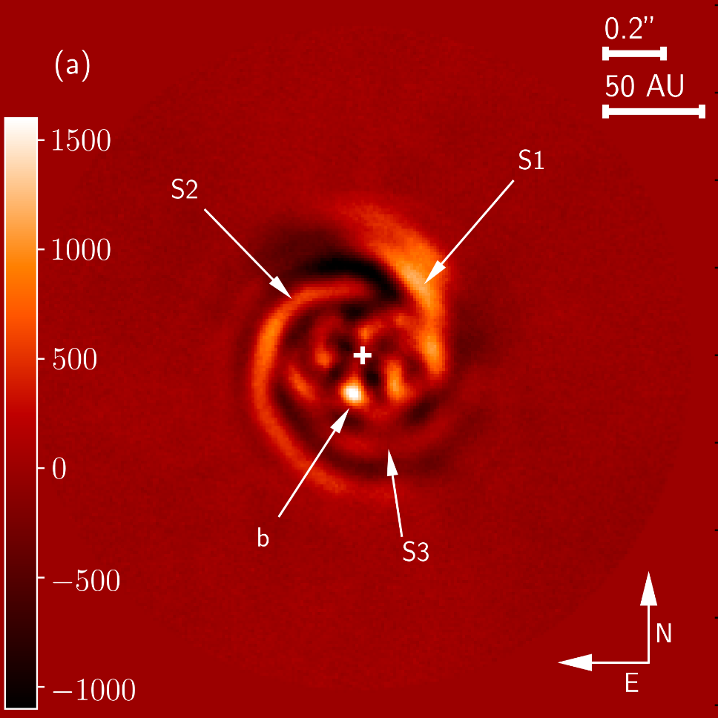
Resolved Young Disks
AS 209: 0.5-1 Myr, Gaps at 62 and 103 au.
Need ⍺ ~ 1e-4, Mp ~ 0.2 Mj for deep Gaps.
Fedele +2018
MWC 758: Reggiani+2018, point source discovered within spirals
Notes:
MWC 758: Considering a stellar mass of 1.5 M⊙, the disk is about 50 times less massive than required to form spiral arms by self-gravity (Dong et al. 2015a).
MWC 758: Based on mm-dust continuum observations and assuming a fiducial gas-to-dust ratio of 100, the disk mass was estimated to 0.008 M⊙ (Andrews et al. 2011).

Slide 25
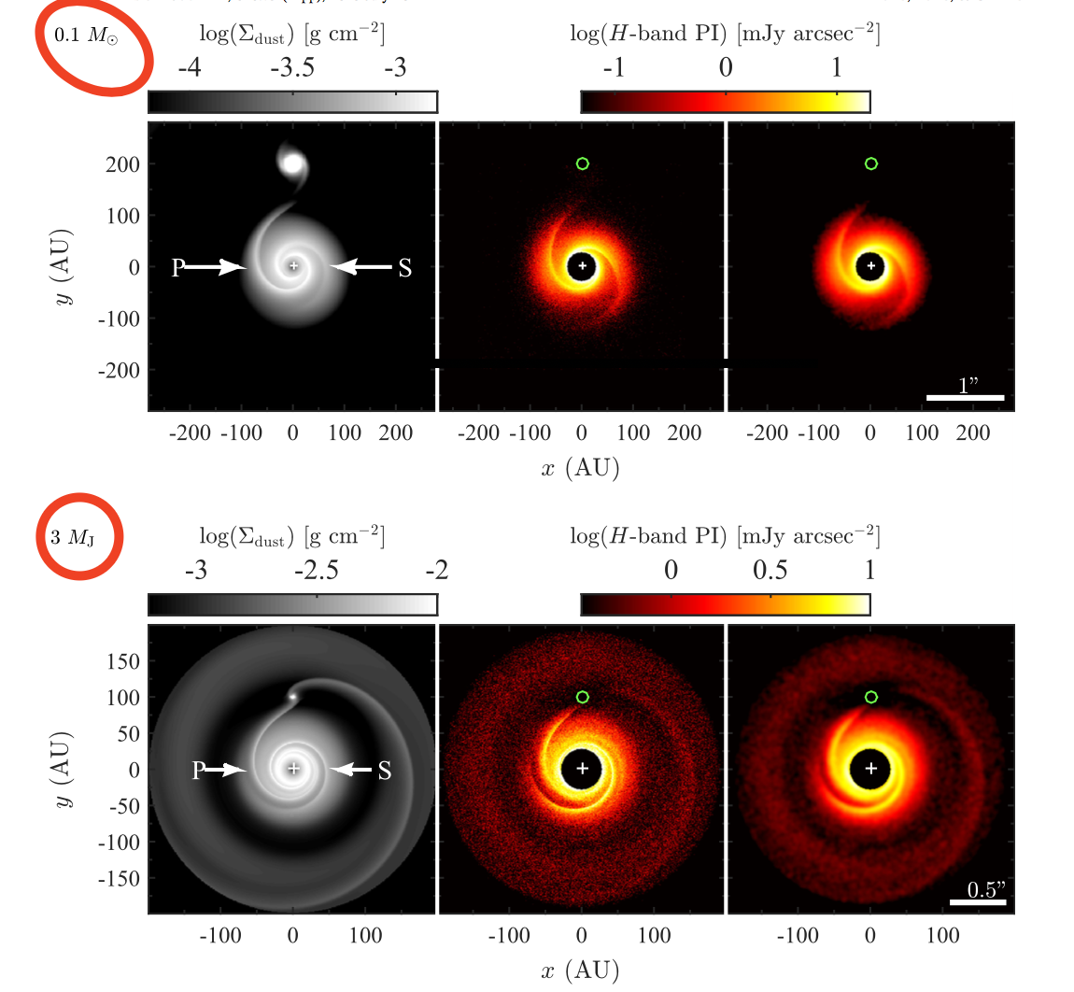
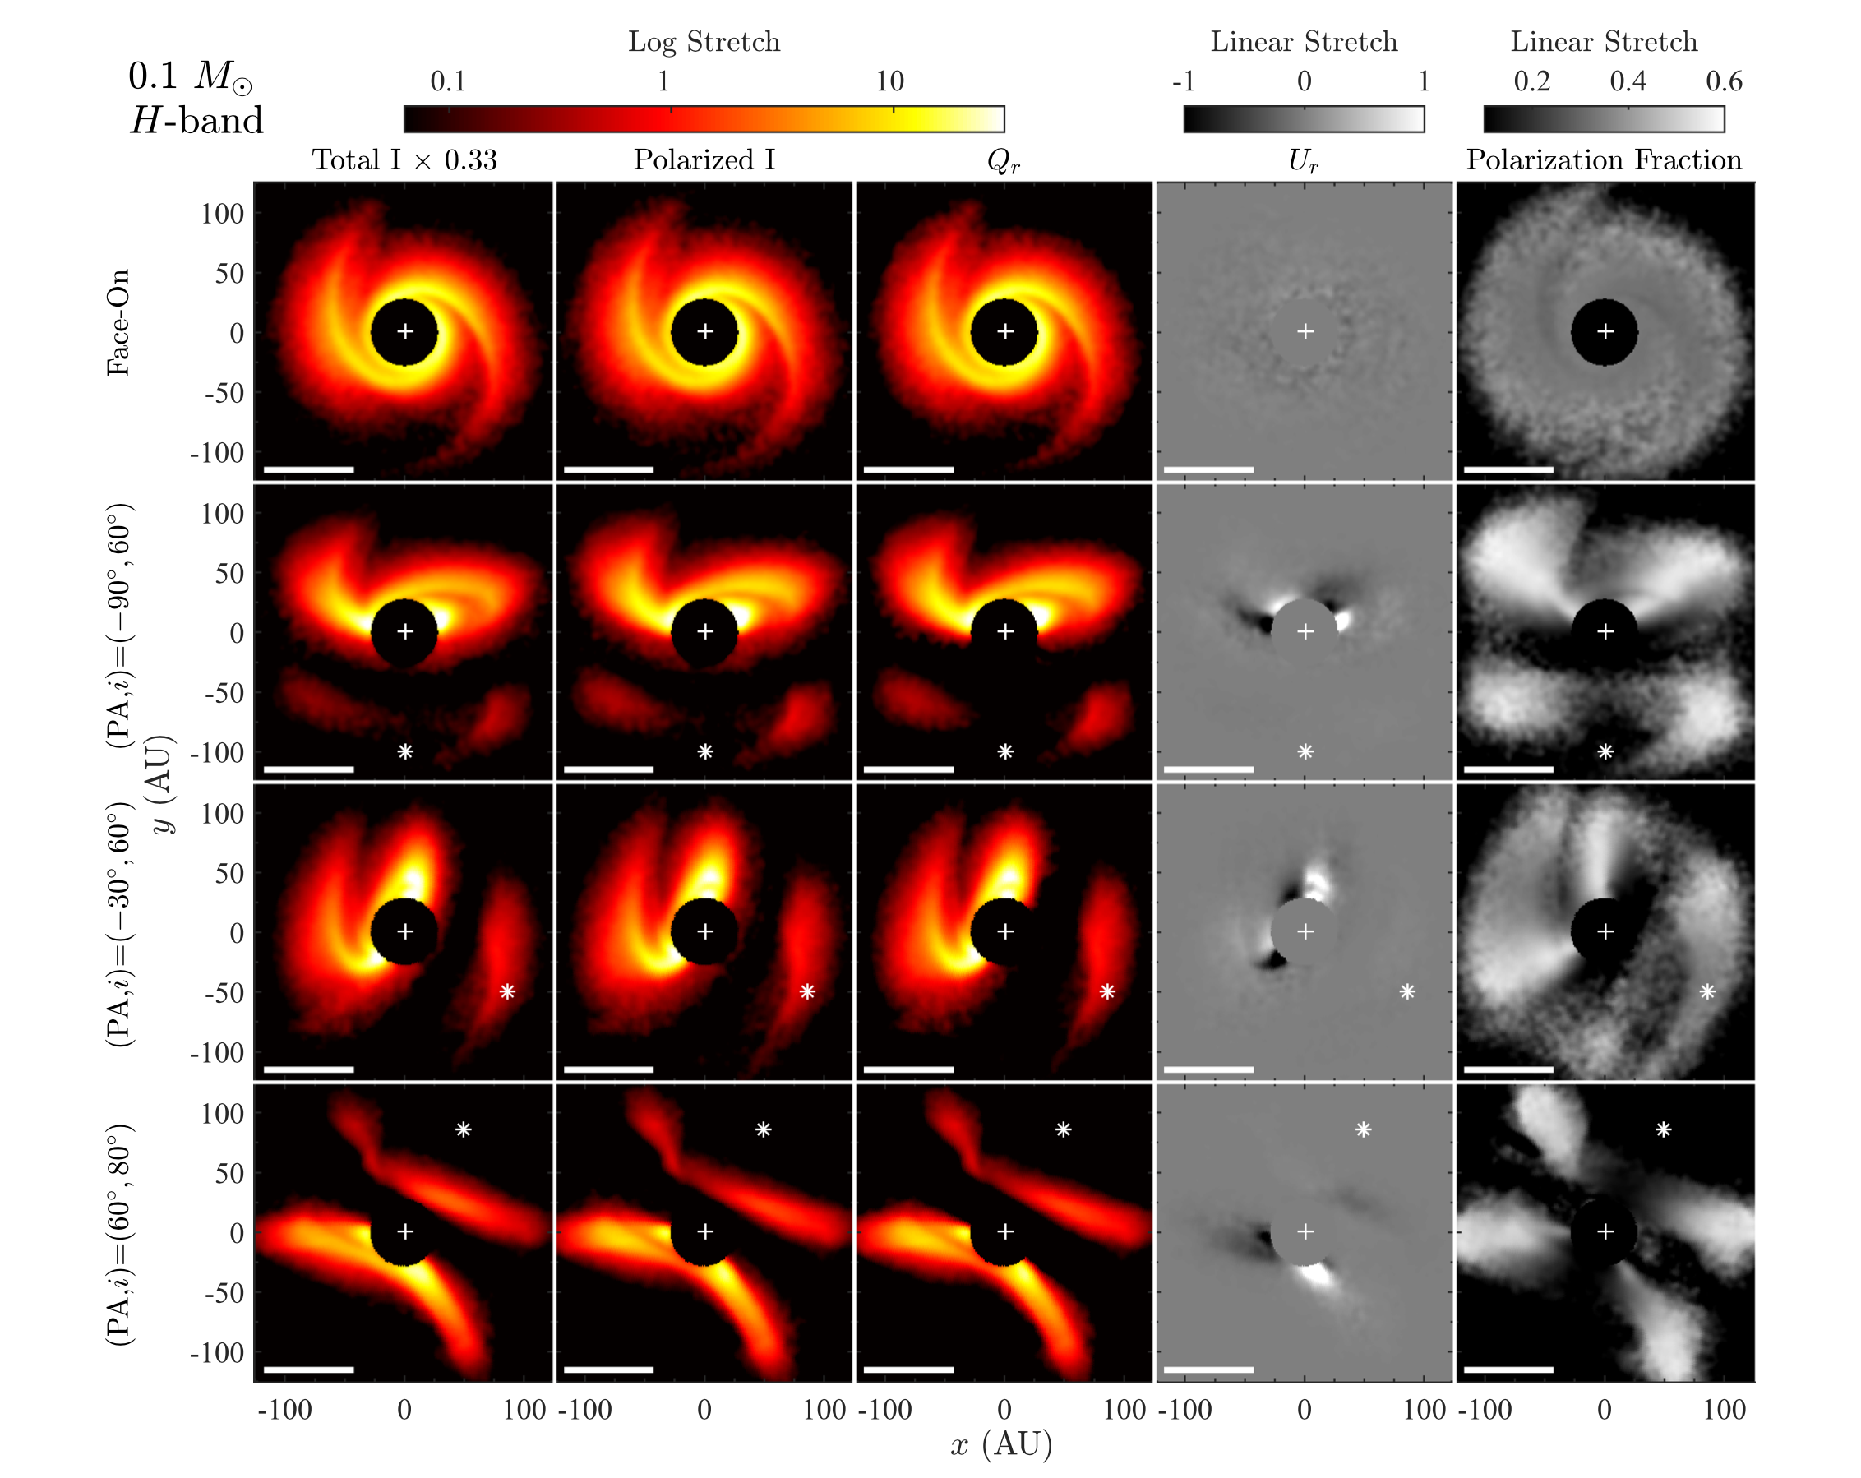
Planets Making Spirals Arms: Fung+ 2016

Slide 26
Planets Making Spirals Arms: Dong+ 2016

Slide 27
Gaps by Super earths and Neptune in low viscosity disks Dong+ 2015

Slide 28
Modeling emission in TW Hya, HL Tau, HD 163296, and DM Tau. Zhang+ 2016
For TW Hya, has a turning point in the slope around 25 AU, followed by a plateau and then a gradual decay out to ∼70 AU.
For HL Tau, its known major gaps at 13, 32, and 63 AU are well recovered.
HD 163296 has two depressed zones centered near 55 and 100 AU
DM Tau has a shallowly depressed emission zone around 70AU.

Slide 29
CO location coincides with Disk Gaps TW Hya, HL Tau, HD 163296, and DM Tau. Zhang+ 2016

Slide 30
EXTRA

Slide 31
CAI and Chrondule formation. Connelly+2012

Slide 32
Disk temperature profiles
Nayakshin+2017

Slide 33
GI by Tidal downsizing by Nayakshin+2017

Slide 34
Inner disk warp model – Stolker 2016

