Slide 1
Probing dust properties in the LMC from the UV to the FIR
Julia Roman-duval
Space telescope science institute, Baltimore, MD, USA
Cosmic Dust 2018: origin, applications, and implications
In collaboration with the METAL team: Lea Hagen (postdoc), Karl Gordon, Ed Jenkins, Kirill Tchernyshyov, Ben Williams, Josh Peek, Margaret Meixner, Jessica Werk, Karin Sandstrom, Petia Yanchulova Merica-Jones
Notes:
Gas and stars from Milii to Mpc. Should I submit an abstract on dust? Yes, because dust affects the RT, chemistry, thermodynamics, dyanmics of the ISM. Sub-grid modeling, dust-based gas masses

Slide 2
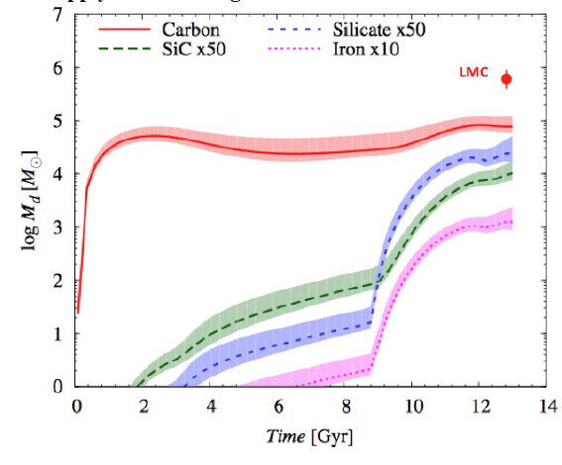
Dust Growth in the ISM
AGB Dust Production in the LMC
Zhukovska & Henning (2013)
LMC dust mass
Carbon
Dust growth in the ISM is required to explain dust masses across cosmic times (Draine 2009, Boyer+2012, Rowlands+2014, Zhukovska+2016)
Si x 50
Log Dust Mass [M_{o}]
SiC x 50
Iron x 10

Slide 3
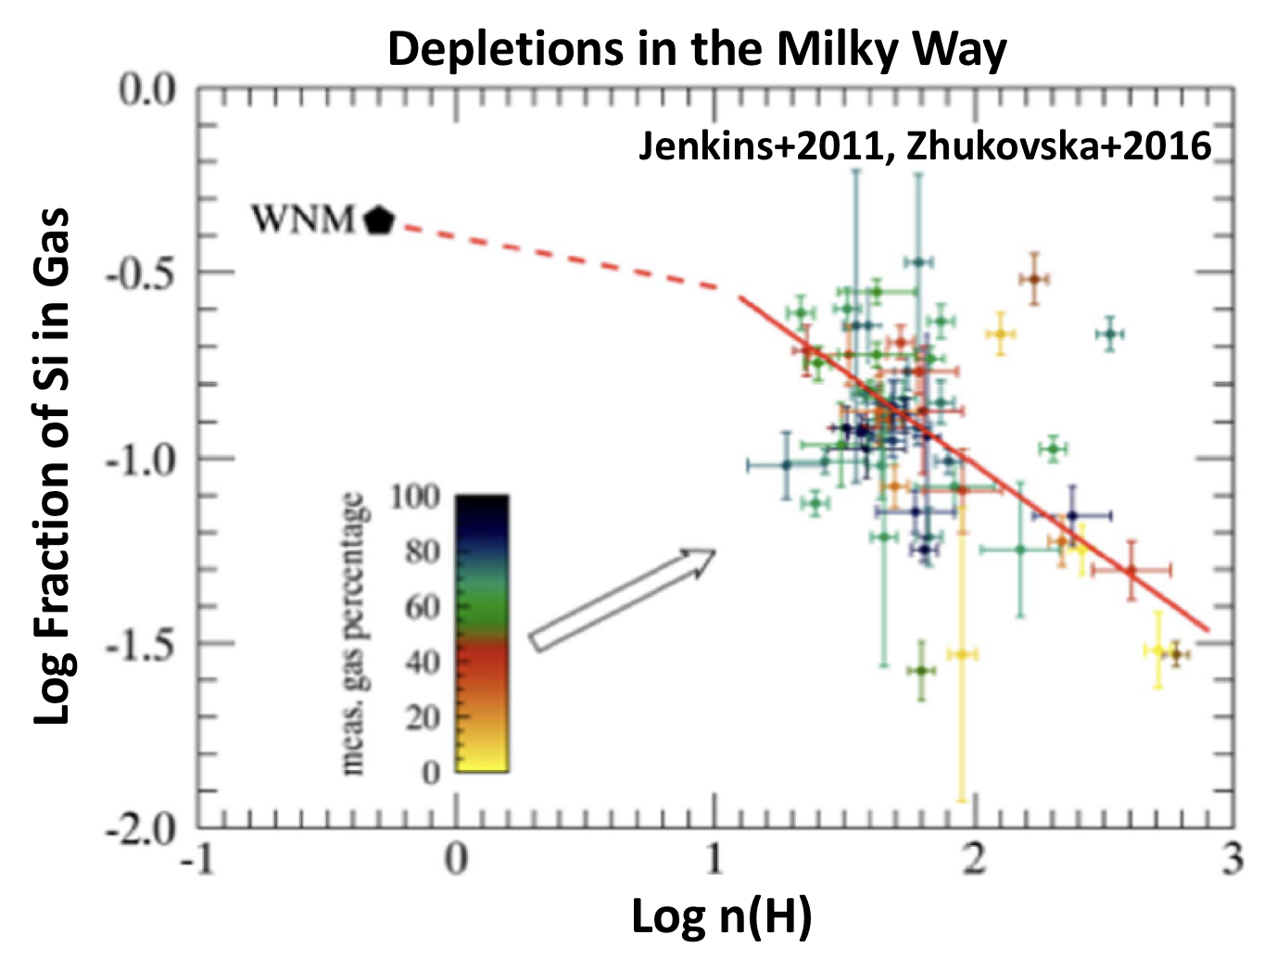
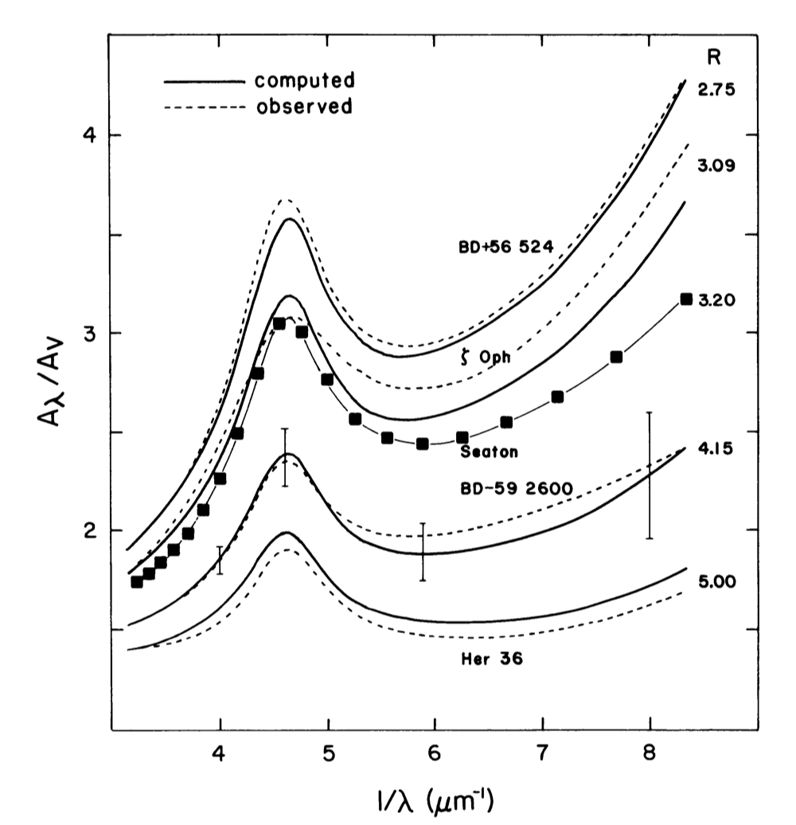
Coagulation and gas-phase accretion
Dust grows in the ISM via:
  Accretion of gas-phase metals onto grains (changes the dust abundance, composition, and size)
  Coagulation (changes the size of grains)
Dust properties/abundance change with mainly with density and metallicity
Cardelli, Clayton, and Mathis (1988)
Notes:
Possibly other envionrment parameters such as presence of shocks

Slide 4
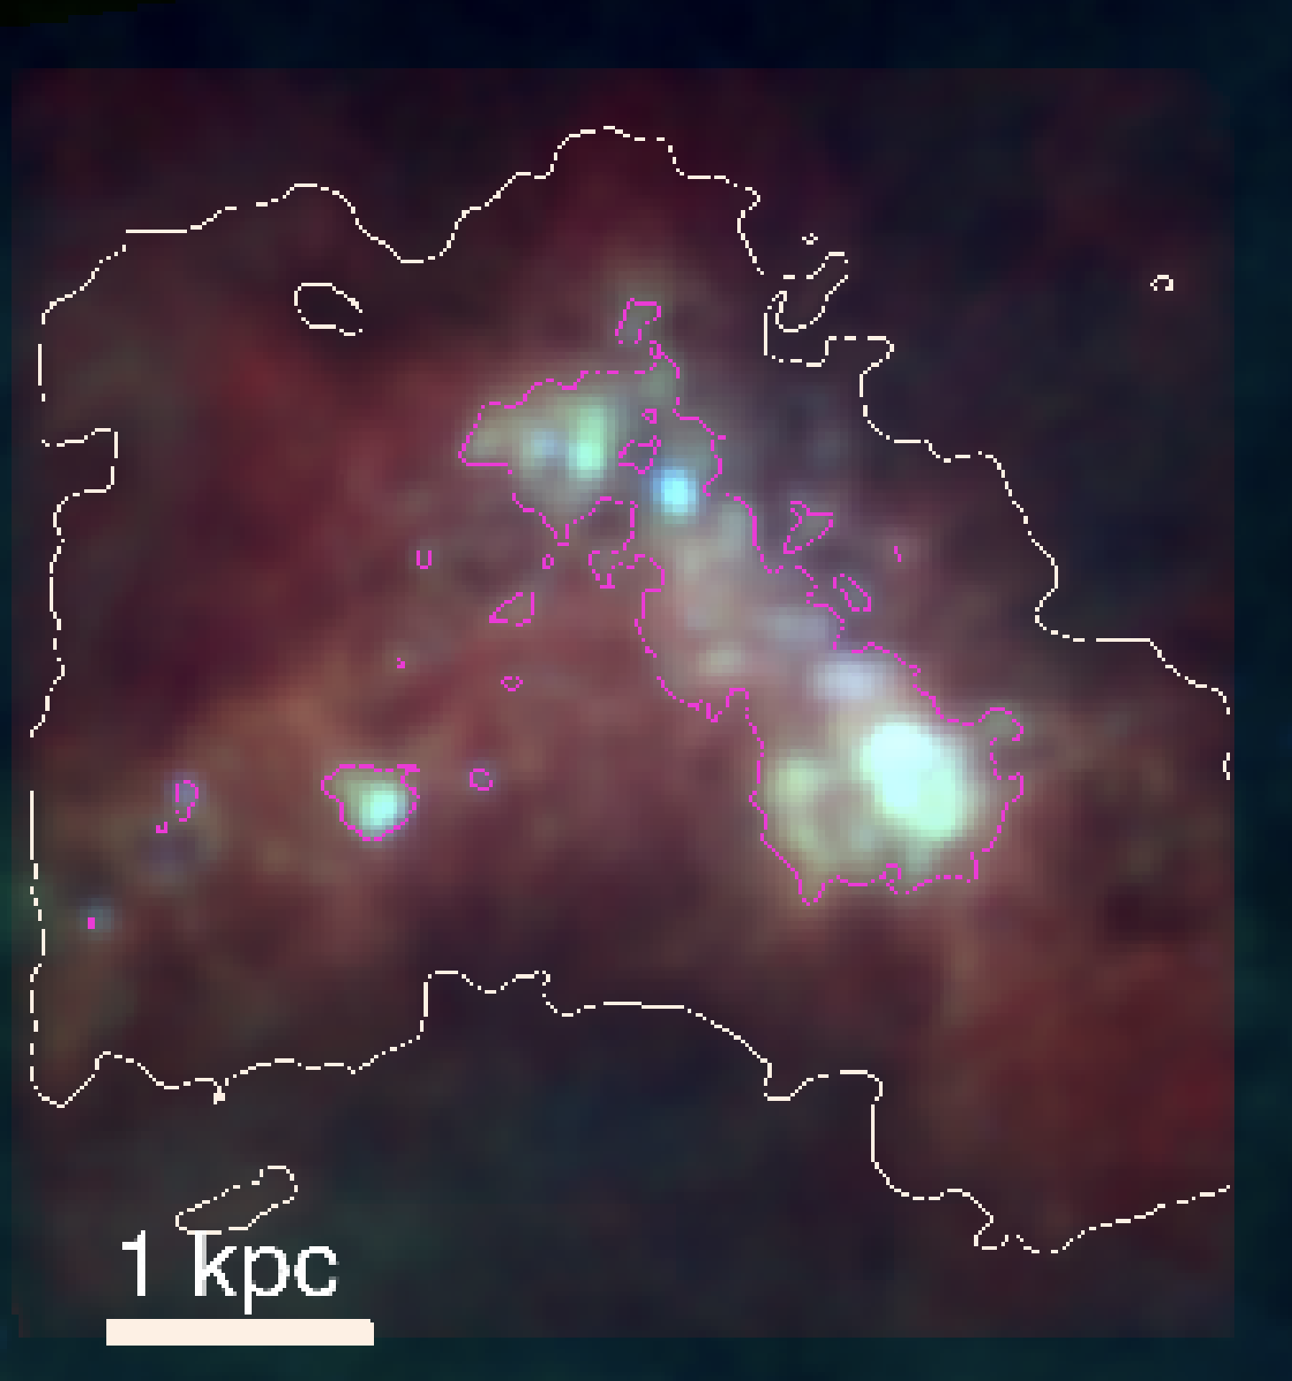
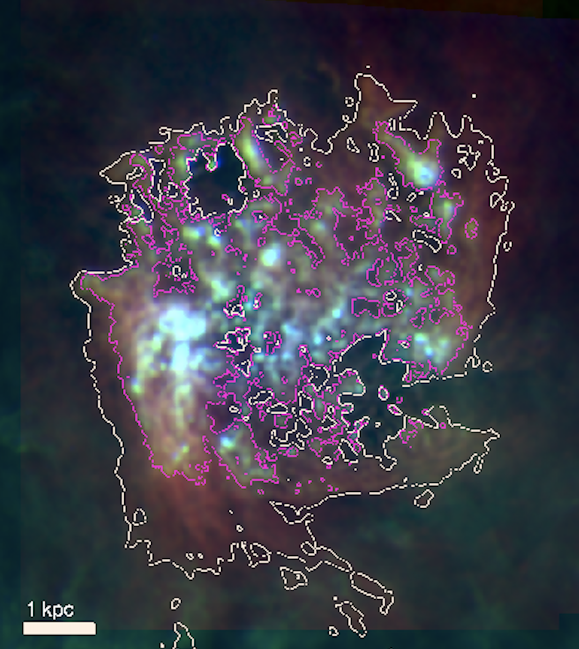
Probing dust in the LMC and SMC in the FIR
--- Herschel high-resolution study of dust and gas (Gordon+2014, Roman-Duval+2014)
--- Use all-sky surveys (IRAS 100 μm ; Planck 350 μm, 550 μm, 850 μm) to probe large-scale variations of dust abundance in the LMC and SMC out to edge of HI disk (Roman-Duval+2017)
HI
Planck 350 μm
IRAS 100 μm
Notes:
We don’t know much about the physical parameters that drive dust properties so study LMC, SMC for metallicity.
High res study gave 1 G/D for atomic and 1 for molecular gas.
Mention issues with zero-points/sensitivity, so need all-sky survyes.

Slide 5
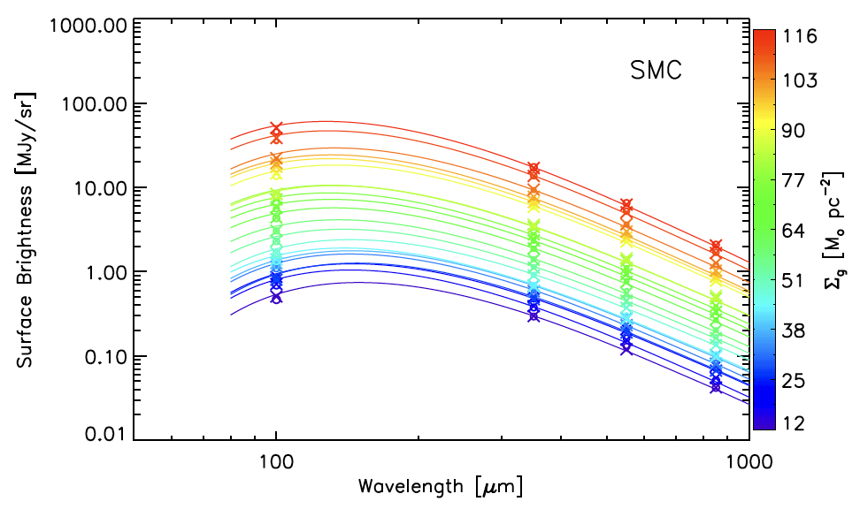
Probing dust in the LMC and SMC in the FIR
Stack the dust SEDs at 100, 350, 550, 850 μm in intervals of HI surface density (0.05 dex)
Model the stacked SEDs with modified black bodies (Σ_{d}, β, T_{d} free)
Notes:
Metion the issue with zero-points.

Slide 6
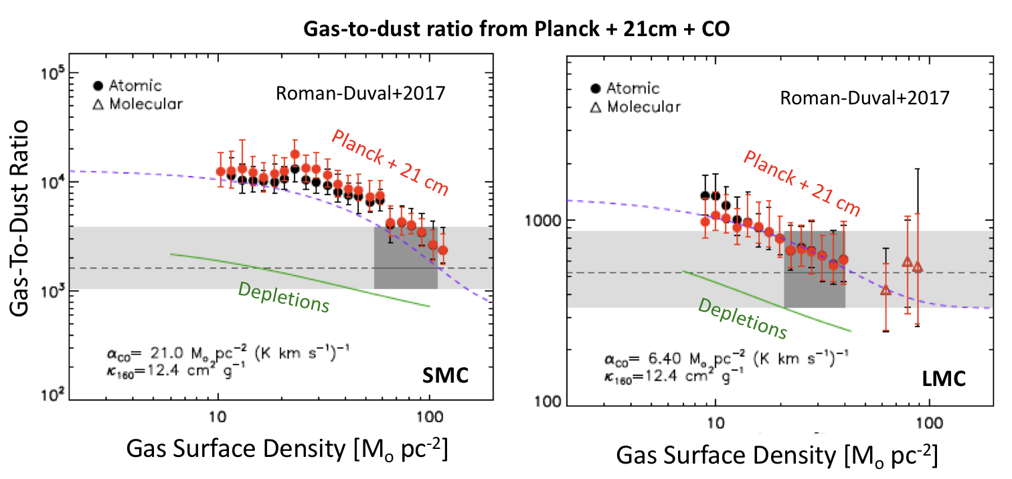
Probing dust in the LMC and SMC in the FIR
Gas-to-dust ratio decreases by factors 3 and 7 in the LMC and SMC between diffuse and dense ISM
  But dust surface density degenerate with opacity (could vary by factor ~3)
Mis-calibrated opacity?
Constant G/D in HI (Roman-Duval+2014)
Mis-calibrated opacity?
Notes:
Opacity/dust surface density degenerate so this result is ambiguous (though consistent with theoretical expectations and depletions)

Slide 7
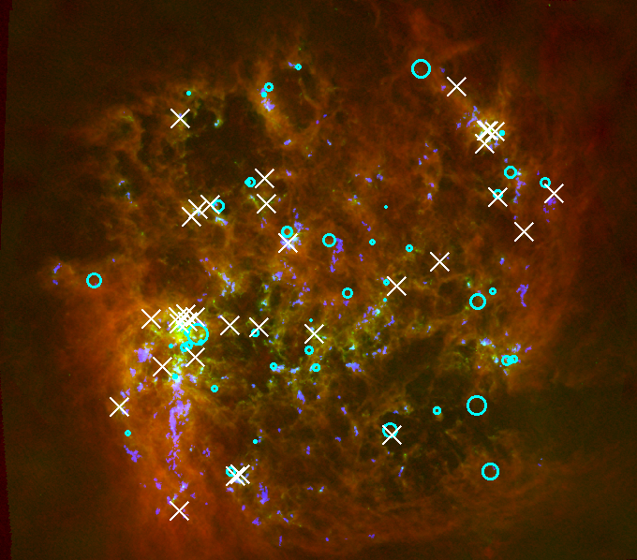
The METAL Large HST Program
Metal Evolution, Transport, and Abundance in the Large Magellanic Cloud
101 prime (STIS/COS) + 101 parallel (WFC3) orbits with HST to probe the variations of dust properties and abundance in the LMC
Medium-resolution UV spectroscopy of massive stars previously observed with FUSE (pencil beam HI and H₂ known)
GO- 13778 (PI Jenkins) is obtaining similar spectra in the SMC at Z = 0.2 Z_{o}
HI (Kim+2003)
CO 1-0 (MAGMA, Wong+2011)
Herschel/PACS 160 μm (Meixner+2013)
Metal Targets (33)
O SN remnants (Temim+2015)
Notes:
Show targets, uniform on HI disk, some close to CO, some not, some near SN, some not

Slide 8
The METAL Spectroscopy
BI253 (COS+STIS)
Mg II
Ni II
Mg II
Si II
Cr II ZnII
Fe II
Sk -67105 (STIS)
Mg II
Mg II
Si II
Cr II ZnII
Fe II
Notes:
Full UV coverage 1150 – 2400 A with COS and STIS

Slide 9
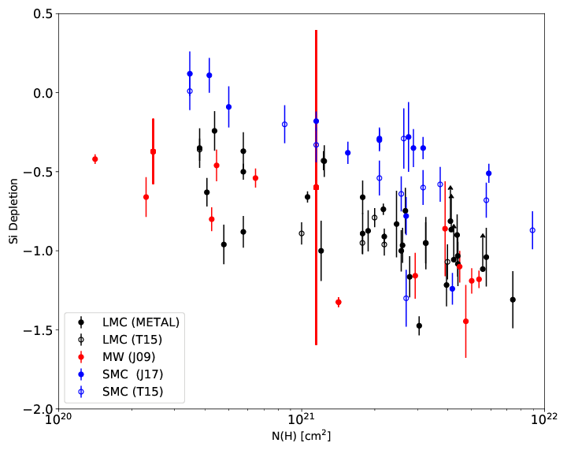
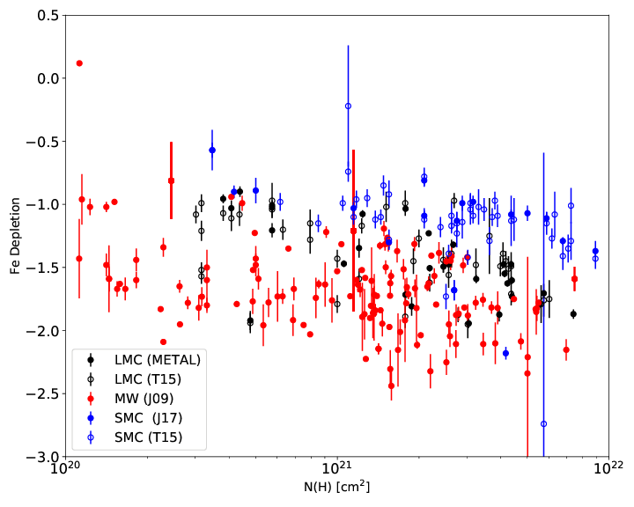
Interstellar depletions
Depletions for main constituents of dust (Fe, Si, Mg, Ni) and other metals used as metallicity tracers in DLAs (Zn, S, Cr)
Roman-Duval+2018
Iron
Silicon
LMC (METAL)
SMC (Jenkins+2017)
MW (Jenkins 2009)
LMC
SMC
MW

Slide 10
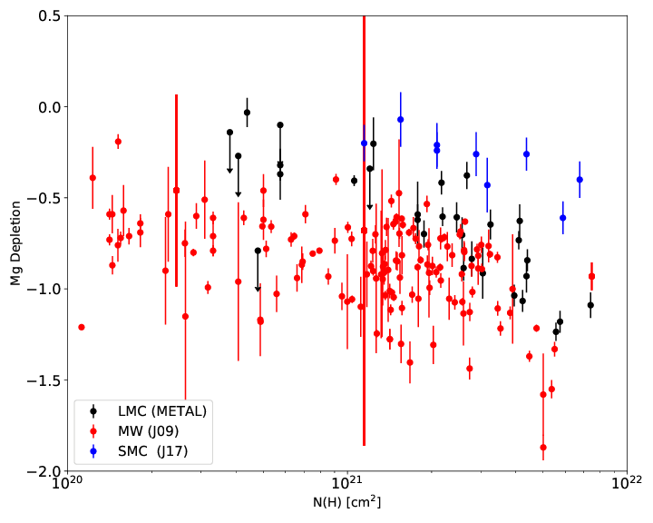
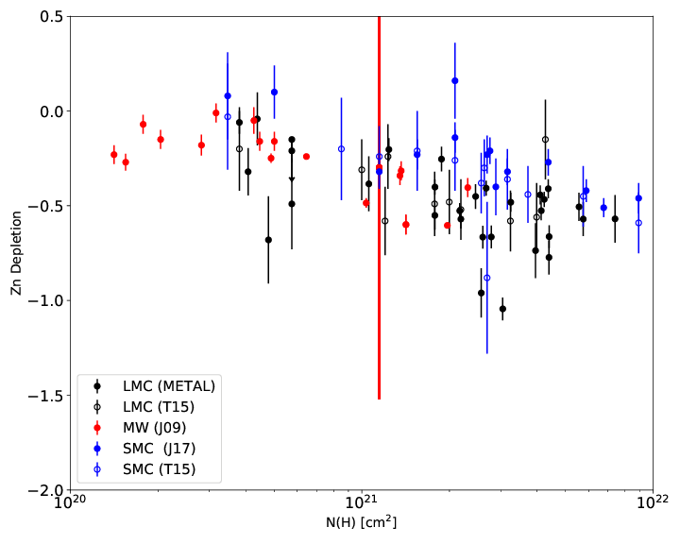
Interstellar depletions
Depletions for main constituents of dust (Fe, Si, Mg, Ni) and other metals used as metallicity tracers in DLAs (Zn, S, Cr)
Zinc
Magnesium
LMC
SMC
MW
LMC
SMC
MW
Notes:
Note that Zinc depletes, only element where D/M does not depend on metallicity

Slide 11
Interstellar depletions
Depletions for main constituents of dust (Fe, Si, Mg, Ni) and other metals used as metallicity tracers in DLAs (Zn, S, Cr)
Zinc
Magnesium
LMC
SMC
MW
LMC
SMC
MW
Zinc depletes!
Notes:
Note that Zinc depletes, only element where D/M does not depend on metallicity

Slide 12
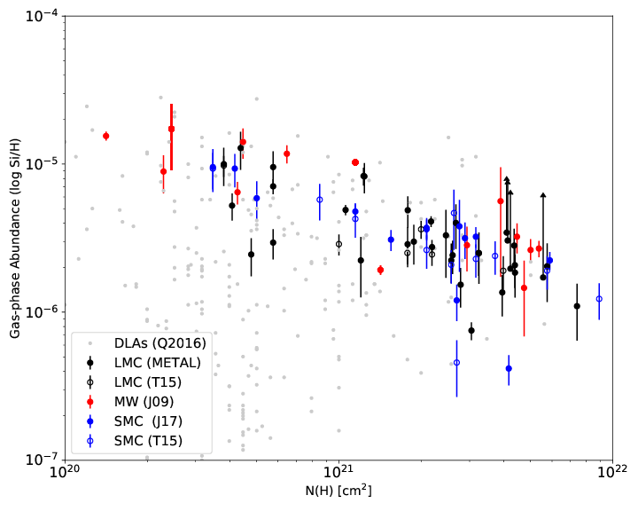
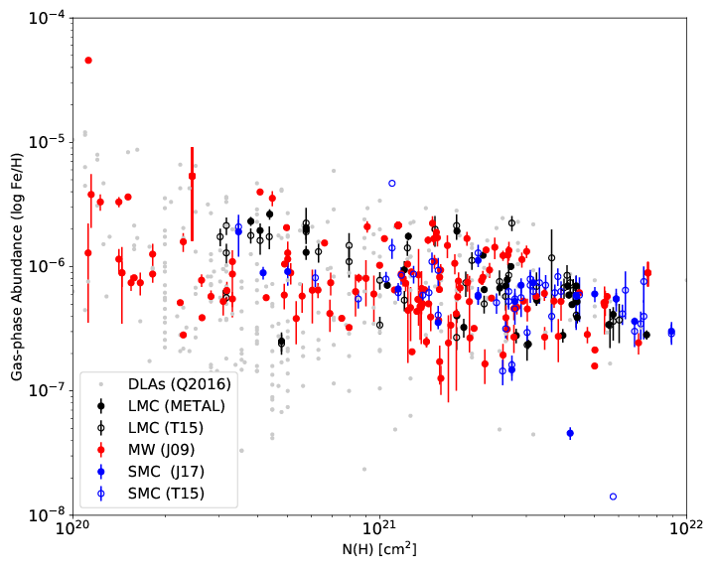
D/M varies with metallicity
The dust-to-metal ratio (D/M) variations between the MW, LMC, SMC offset almost exactly the metallicity differences, leading to constant gas-phase metallicities
Silicon
Iron
LMC
SMC
MW
DLAs
LMC
SMC
MW
DLAs
Notes:
Say zn does not follow this (constant D/M, varying gas-phase abundances).
This will have to be explained by models.

Slide 13
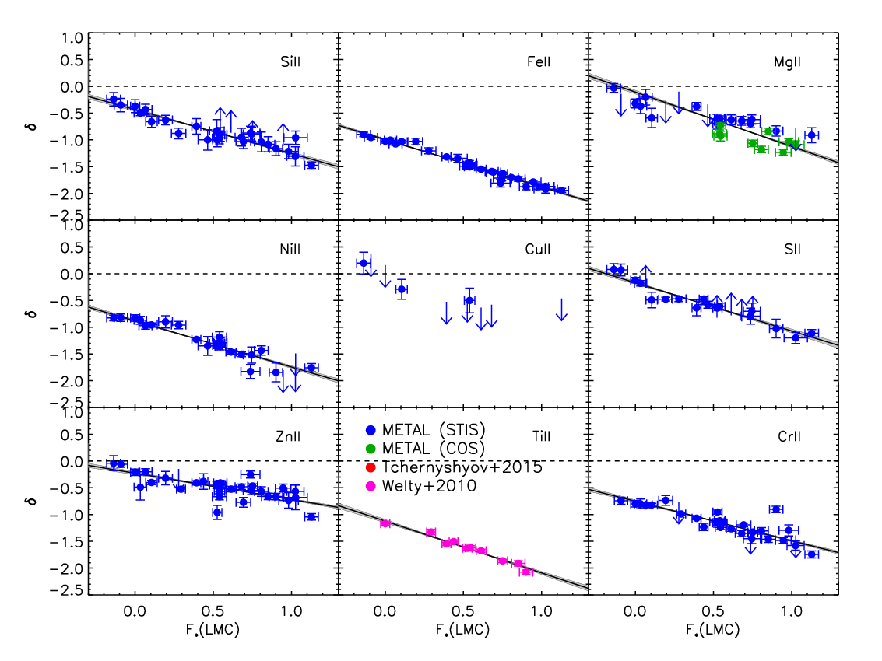
The Depletion parameter (F*)
Interstellar depletions for different elements correlate well with each other
The depletion parameter describes the collective advancement of depletions
Gas-phase fractions decrease by 1-2 dex between F* = 0 (low density) and F* = 1 (higher density)
The dust-to-gas ratio must increase by factor of a few between diffuse and dense gas
Need depletions for C and O, which contain the most mass
Si
Fe
Mg
Ni
Cu
S
Depletion (log fraction in gas-phase)
Zn
Ti
Cr
F* F* F*
Notes:
1-2 dex decrease in gas phase abundances means G/D must vary
Say why we can’t get C and O in the LMC.

Slide 14
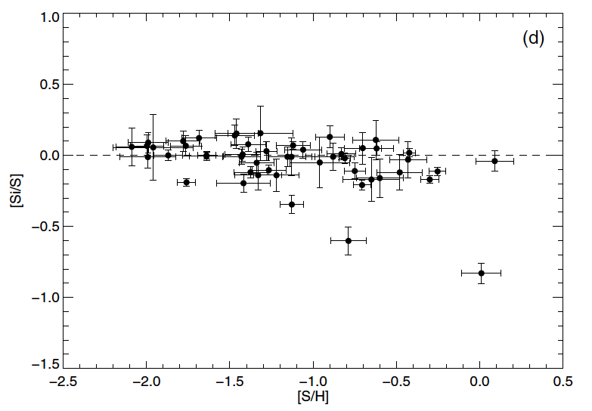
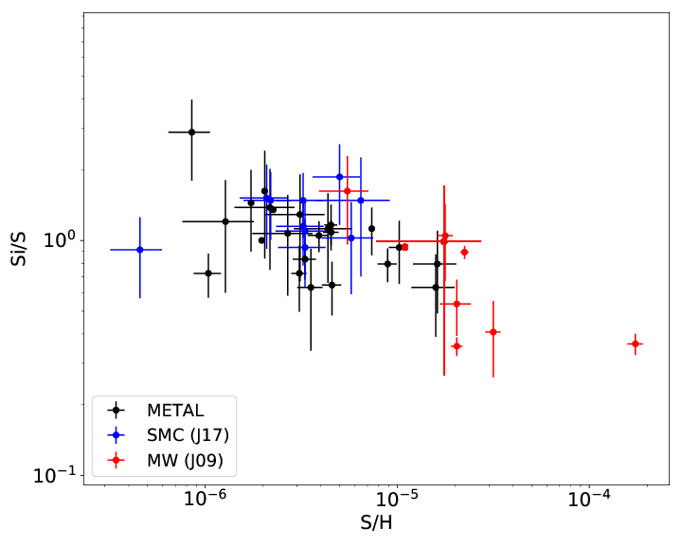
Implications for DLAs
Si, S, Zn used as metallicity tracers
Si/S used as a diagnostic of depletions (e.g., Rafelski+2012)
Rafelski+2012
Roman-Duval+, in prep
Notes:
Note that Zinc depletes, only element where D/M does not depend on metallicity

Slide 15
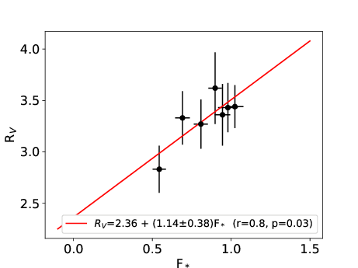
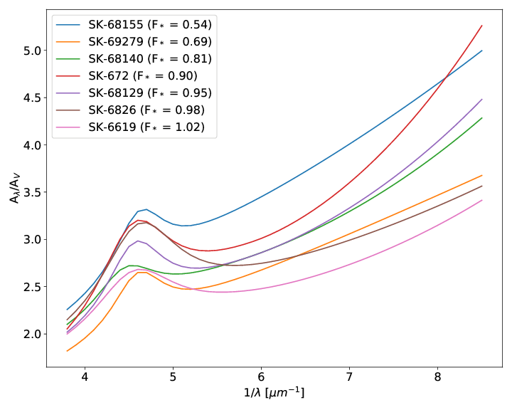
Depletions vs Extinction
Extinction curve parameter (including R_{V}) from Gordon+2003
Depletion parameter from METAL
The size of dust grains (from extinction curves) correlates with the depletion parameter
Gordon+2003
Notes:
Say we will derive more extinction curves from the METAL data add more constraints on the dust size and composition.

Slide 16
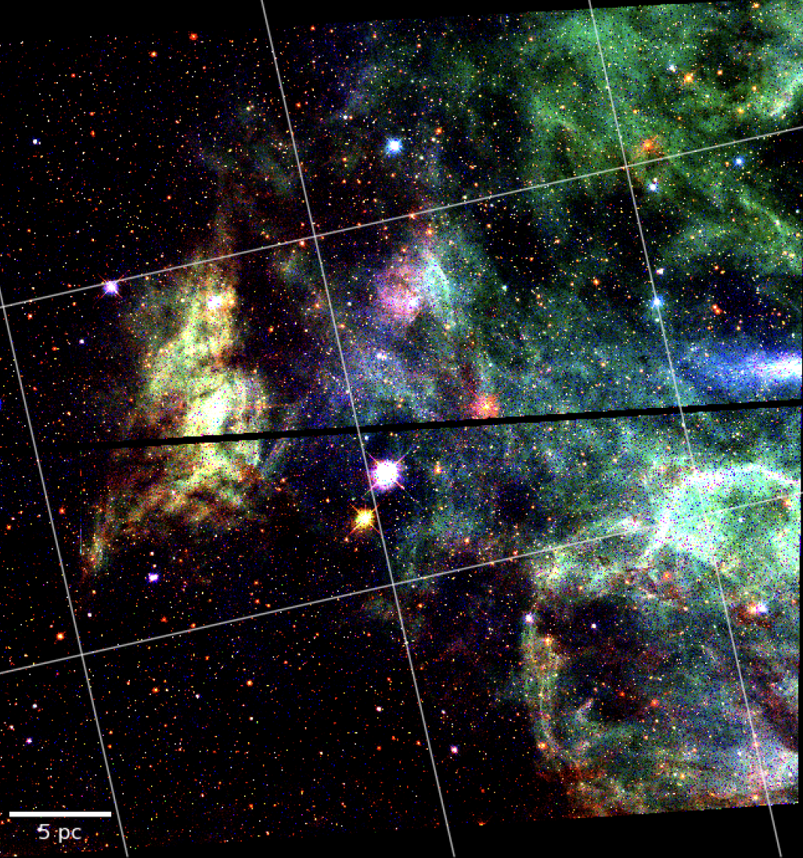
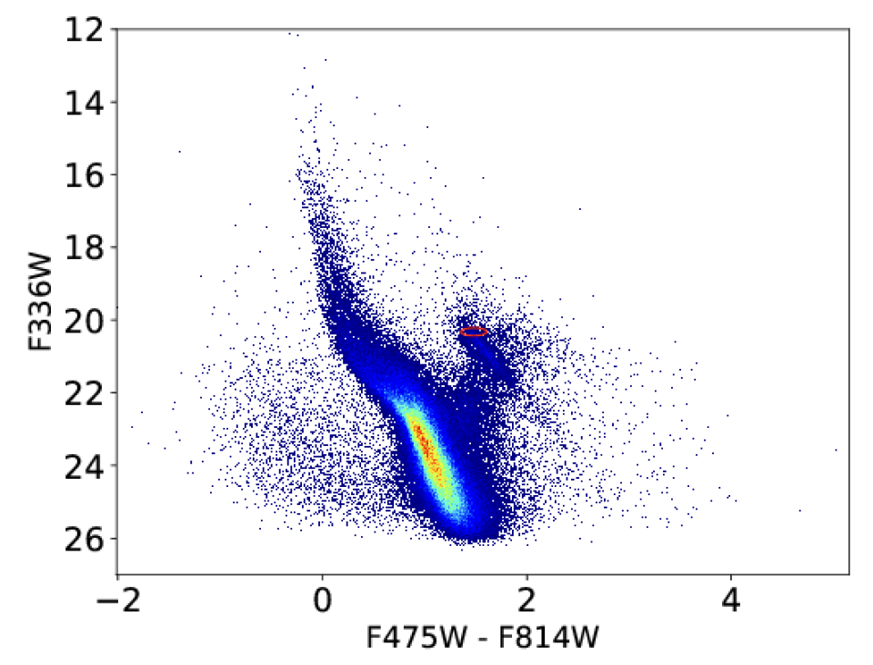
Parallel imaging with METAL
Parallel imaging in 7 filters in NUV-NIR (F225W, F275W, F336W, F475W, F814W, F110W, F160W)
Red clump
Reddening (A_{B} ~ 3)
WFC3 F814W
WFC3 F475W
WFC3F336W
Notes:
Explain colors images
Explain HST parallel imaging

Slide 17
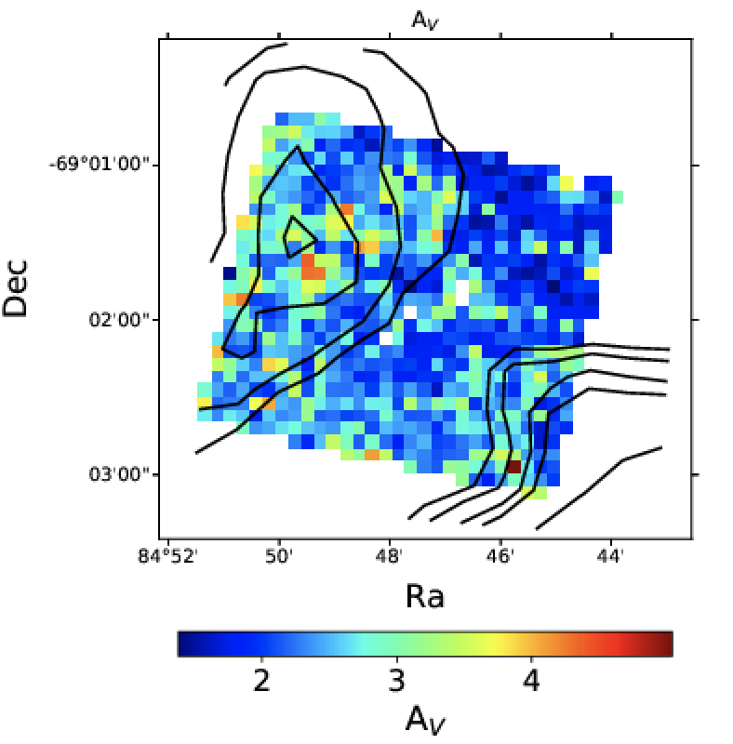
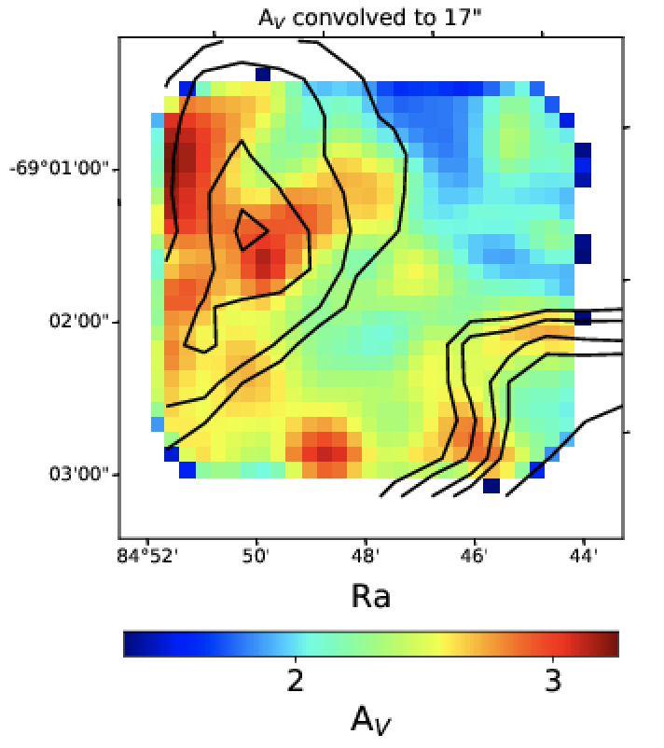
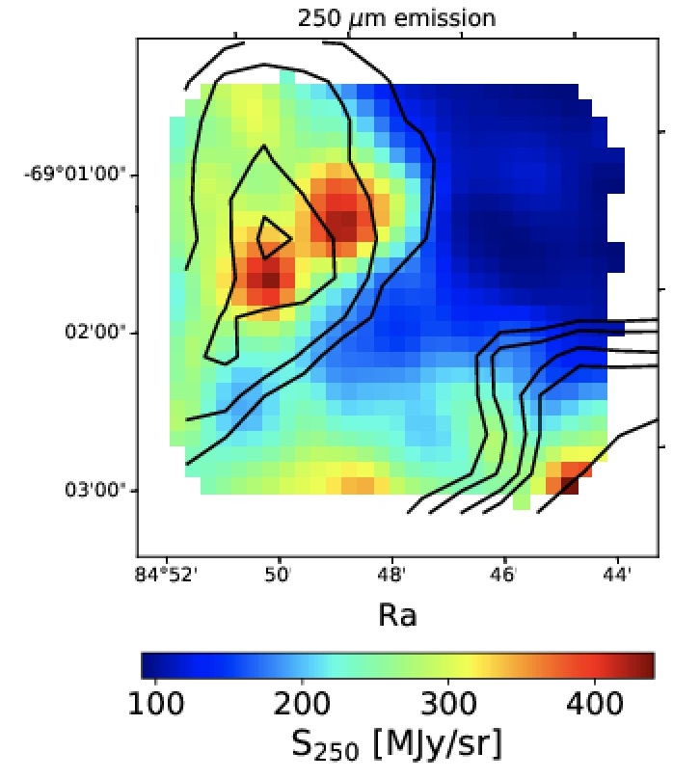
Extinction mapping with METAL
7 UV-IR filters resolve reddening/stellar mass degeneracy
SED fitting with the BEAST (Gordon+2016) yields A_{V}, R_{V}, stellar parameters (mass and age)
Combine the individual star measurements with a geometric model of dust and stellar disks and completeness → extinction maps at 1 pc resolution
Hagen et al., in prep
See Lea Hagen’s Poster
Notes:
S250 not corrected for temperature

Slide 18
Summary and Implications
METAL derived depletions for Fe, Si, Mg, Ni, Zn, S, Cr for 32 sight-lines in the LMC with HST STIS and COS
  D/G increases with density between diffuse neutral and molecular ISM
  D/M decreases with decreasing metallicity, offsetting the metallicity variations and leading to constant gas-phase metallicities in the MW, LMC, SMC.
  Correlation between depletions (composition and abundance of dust) and extinction curves (size of grains)
  Dust-based gas masses, derived assuming a constant G/D and opacity probably suffer from significant systematic error
  Chemical evolution model must reproduce depletion patterns
METAL parallel photometry allows us to derive extinction maps at 5” resolution in 32 fields
  Comparison of the FIR emission and extinction maps will allow us to determine how the dust opacity changes with environment
Notes:
Link to conference topics

Slide 19
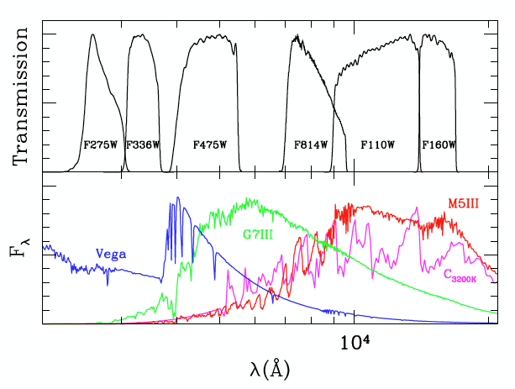
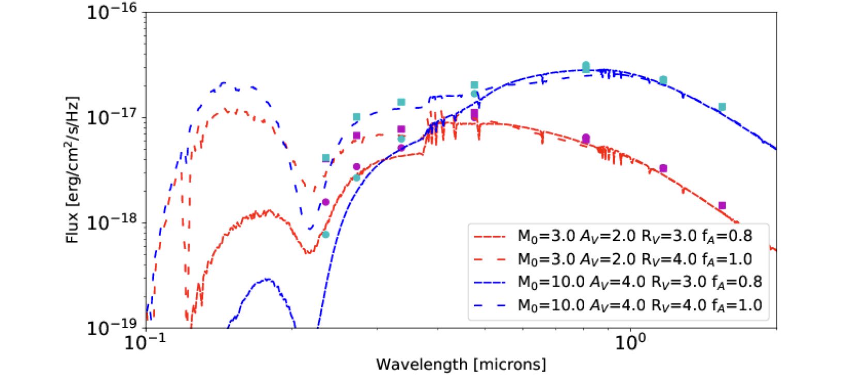
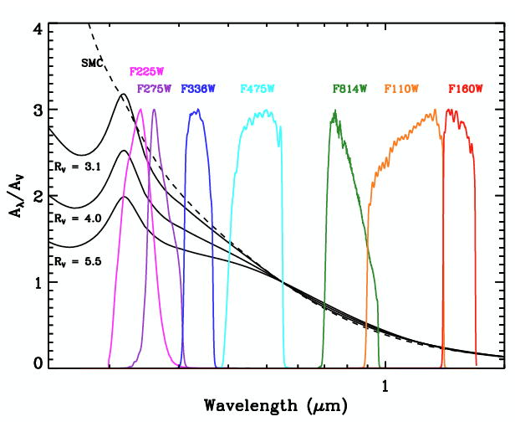
Extinction mapping with METAL
Notes:
S250 not corrected for temperature

Slide 20
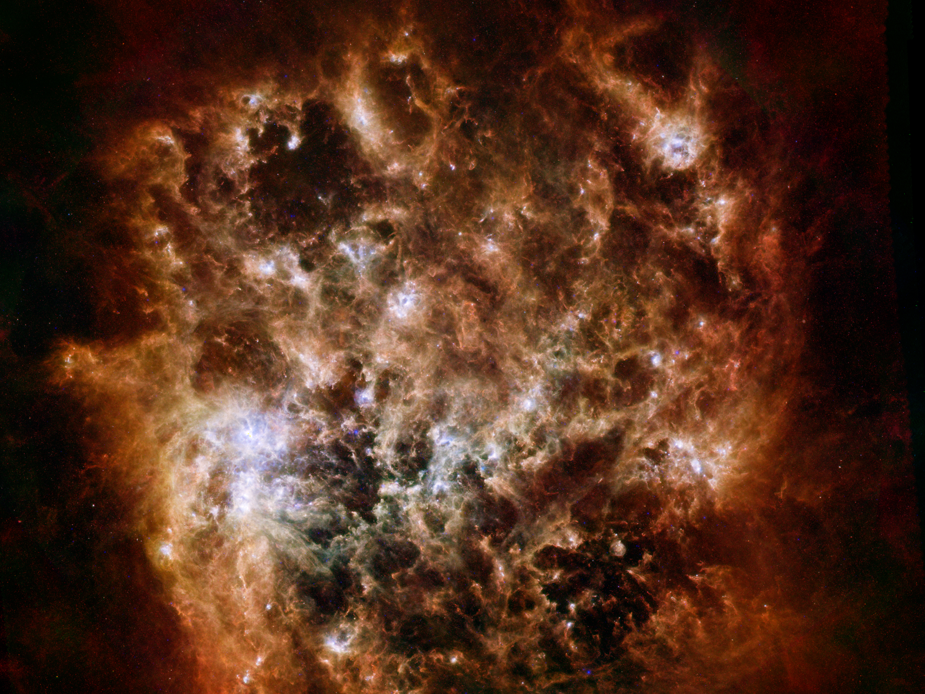
Requirements for constraining dust evolution in the ISM
Resolve the cold neutral phase, molecular clouds where high densities are conducive to dust growth
Avoid line-of-sight confusion (depletions)
Global view of galaxy (~face-on) to understand variations with environment (e.g., density)
LMC and SMC are good laboratories to study dust:
  Close-by, LMC at 50 kpc, SMC at 62 kpc
  LMC is nearly face-on (inclination 35º)
  Different metallicities: LMC at 0.5 Z_{o}, SMC at 0.2 Z_{o}
250 microns
100,160 microns
24,70 microns

Slide 21
Probing dust in the LMC and SMC in the FIR
High-resolution study of gas-to-dust ratio with Herschel (Roman-Duval+2014)
Use all-sky surveys (Planck 350 μm, 550 μm, 850 μm; IRAS 100 μm) to probe large-scale variations of dust abundance in the LMC and SMC (Roman-Duval+2017)
Notes:
Metion the issue with zero-points.

Slide 22
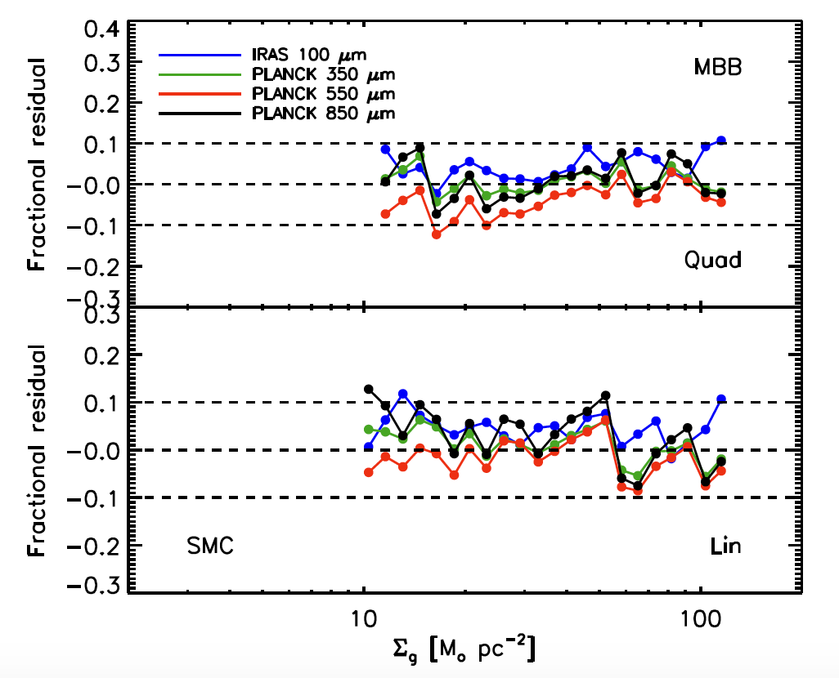
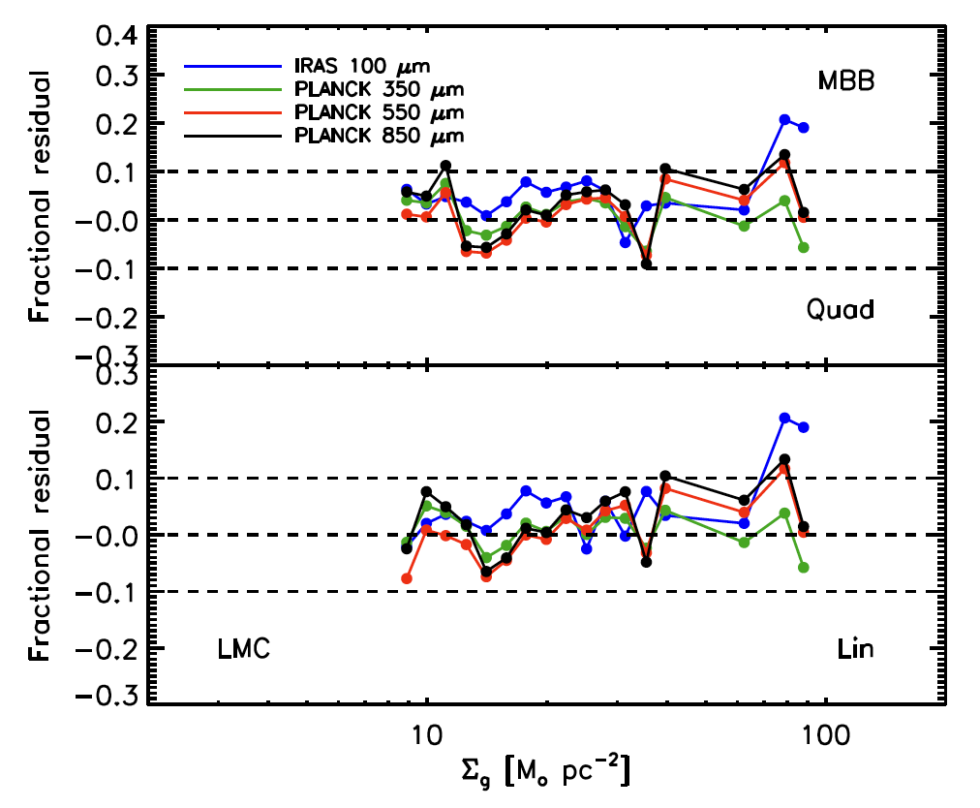
RESIDUALS FROM SED FITTING
Notes:
Metion the issue with zero-points.

