Slide 1
Copenhagen, 15th June 2018
Dusty Winds in AGN
Marta Venanzi
￼
David Williamson &
Sebastian Hönig
CPHDUST2018

Slide 2
What we thought we know….
Dusty Winds in AGN
Type 2 AGN
BH + Accretion disk
Dusty Torus
Type 1 AGN
Notes:
Doughnat shape going on
Higher resoutions,

Slide 3
A “torus” ? Not quite
Dusty winds in AGN
Asmus, Hönig & Gandhi 2016

Slide 4
Dusty winds modelling
Dusty winds in AGN
What is the physics behind these observed dusty winds?

Slide 5
Simulations
Dusty winds in AGN
Radiation hydrodynamics simulations show indication of a dusty wind scenario
Simulations features
3D smoothed particles hydrodynamics
Radiative transfer + CLOUDY tables
Self-gravity
D. Williamson, M. Venanzi, S. Hönig, in prep.

Slide 6
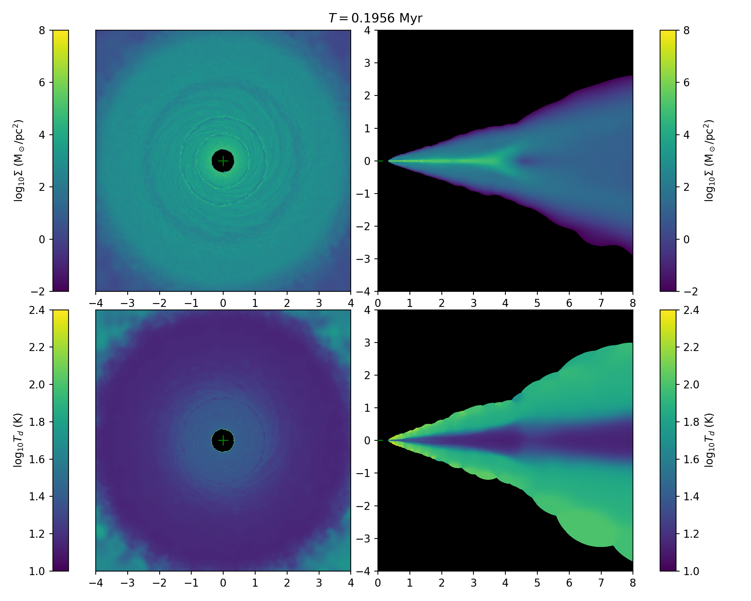
Simulations
Dusty winds in AGN
Poster 49

Slide 7
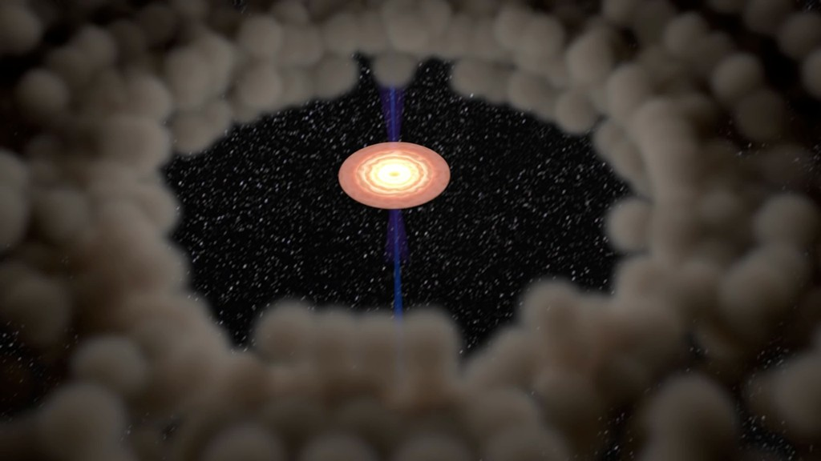
Secondary radiation
Dusty winds in AGN
The simulations only consider radiation from the AGN and the diffuse stellar radiation field
No secondary IR- reradiation yet
→ high computational cost
→ significant slowdown

Slide 8
Secondary radiation
Dusty winds in AGN
Where does the IR radiation matter?

Slide 9
The model
Dusty winds in AGN
Dusty cloud
$$R_{sub}$$
T(r)
AGN
Dusty disk

Slide 10
The model parameters
Dusty winds in AGN
$$cloud$$
Radiation pressure driven winds are typically described by:
$\frac{Radiation}{gravity}∝\frac{l_{edd}}{N_{H}}$
Opacity
Radiation
Gravity
AGN

Slide 11
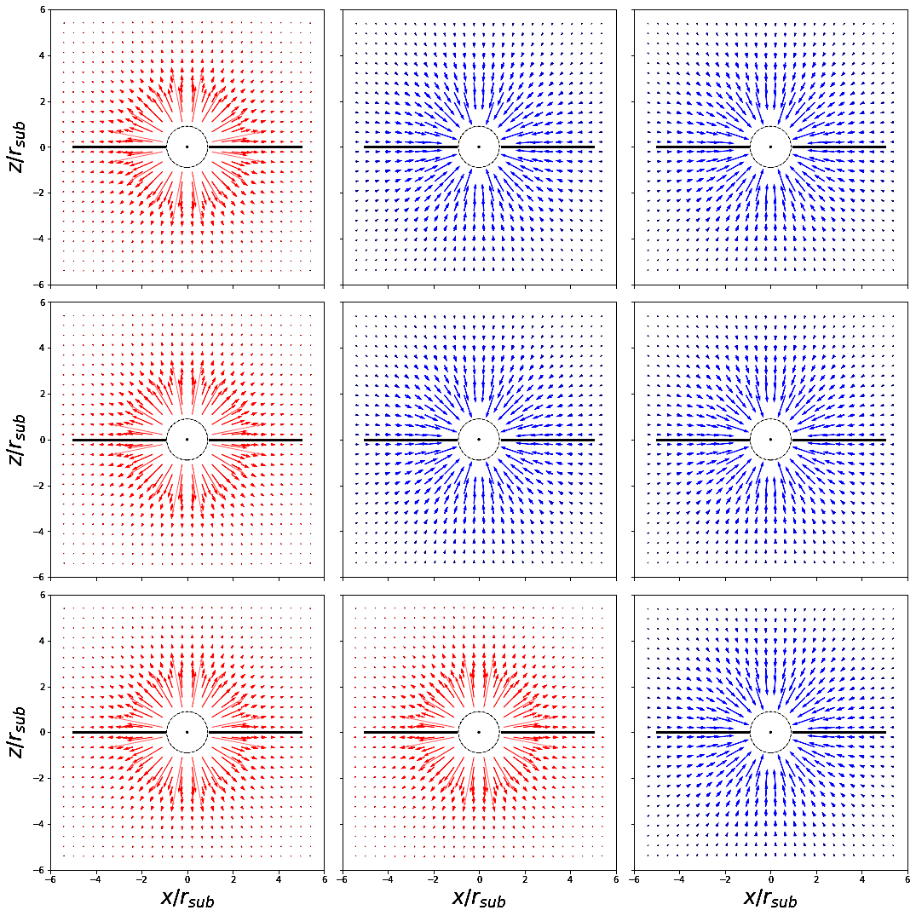
$$N_{h}={10}^{22}$$
$$N_{h}={10}^{23}$$
$$N_{h}={10}^{24}$$
$$l_{edd}=0.01$$
Typical radiation field considering radiation pressure from the AGN and gravity only
Radial profile
AGN fully dominates for moderately column density $N_{H}={10}^{22}$
No wind for high obscurations $N_{H}={10}^{24}$
NO WIND
$$l_{edd}=0.05$$
Acceleration
$$l_{edd}=0.1$$

Slide 12
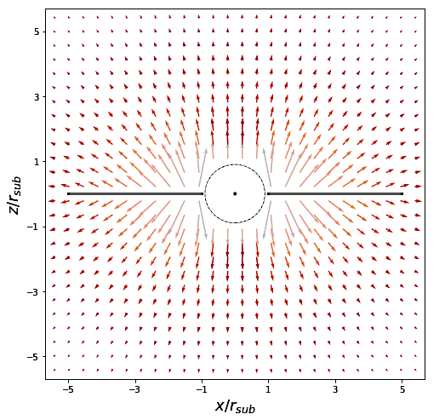
The disk radiation field
Dusty winds in AGN
Typical radiation field from the dusty disk
No more radial profile
Vertical component
IR radiation from the dusty disk breaks the radial symmetry!

Slide 13
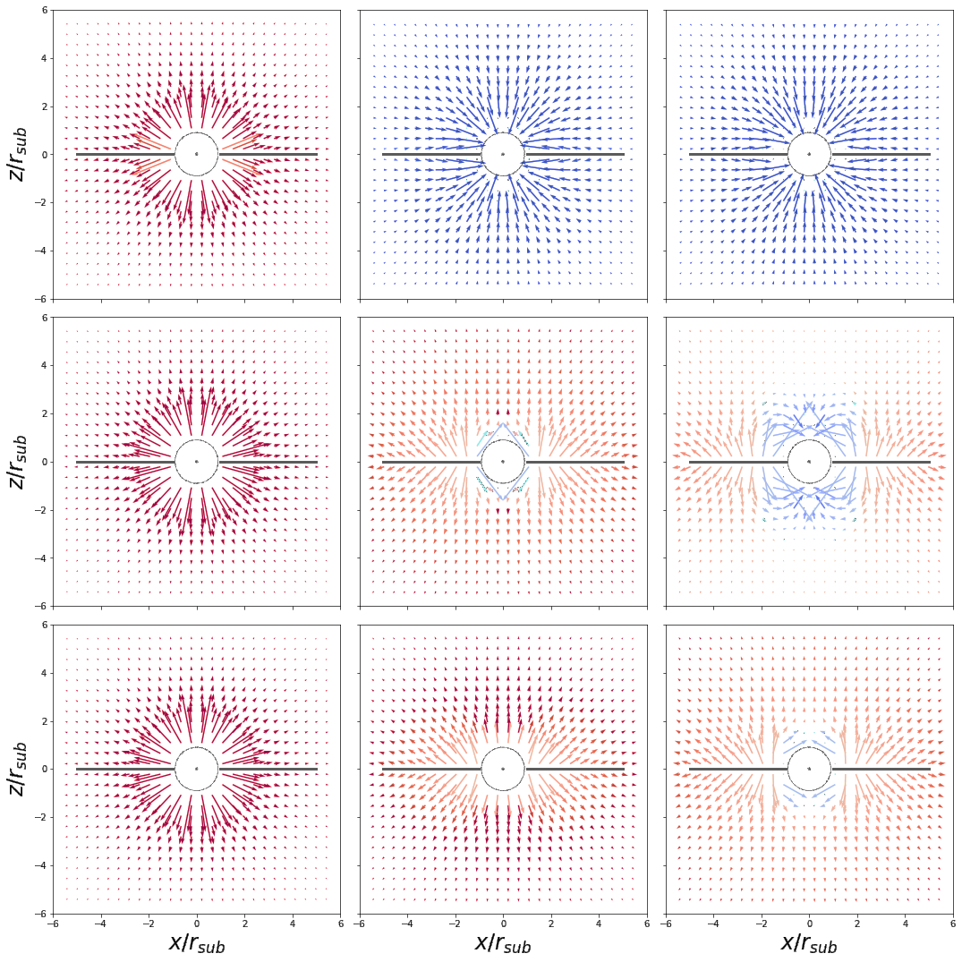
$$N_{h}={10}^{22}$$
$$N_{h}={10}^{23}$$
$$N_{h}={10}^{24}$$
NO WIND
Radiation field profile including gravity, the UV radiation pressure from AGN and the IR radiation pressure from the disk
The AGN radial profile profile still dominates for column densities lower than${ 10}^{22} {cm}^{−2}$
We start having winds for $N_{h}=$ ${ 10}^{24} {cm}^{−2}$ and $l_{edd}>0.05$
$$l_{edd}=0.01$$
$$l_{edd}=0.05$$
Acceleration
IR driven winds
$$l_{edd}=0.1$$

Slide 14
Summary and perspectives
Dusty winds in AGN
Summary
Polar emission features seen in the infrared suggest the presence of dusty winds in the parsec scales environment of AGN
Radiative Hydrodynamics simulations show indications of radiation driven dusty winds but the IR radiation is still missing
Using a semi-analytical model we see that the IR radiation pressure must be considered
Future work
Implement IR radiation in RHD simulations
Test against observations

Slide 15
Thank you
Dusty winds in AGN

Slide 16
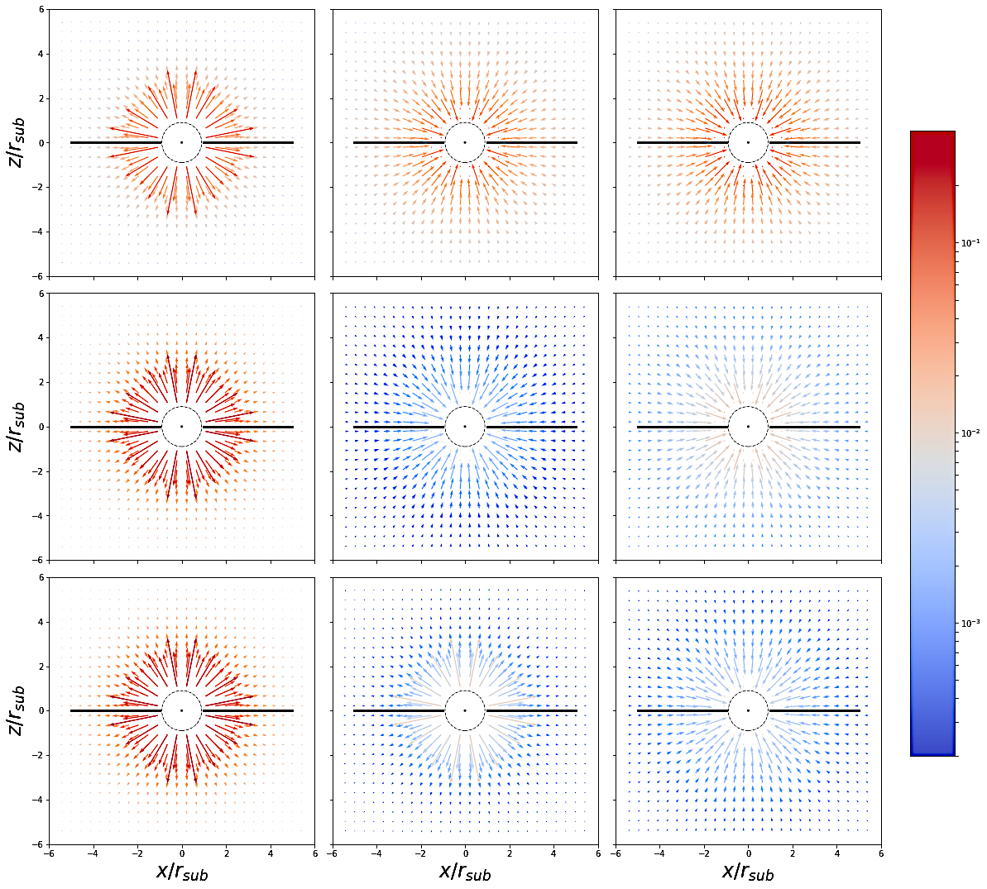
$$N_{h}={10}^{22}$$
$$N_{h}={10}^{23}$$
$$N_{h}={10}^{24}$$
$$l_{edd}=0.01$$
Radiation and gravity forces field profile
$$l_{edd}=0.05$$
Acceleration
Acceleration
$$l_{edd}=0.1$$

Slide 17
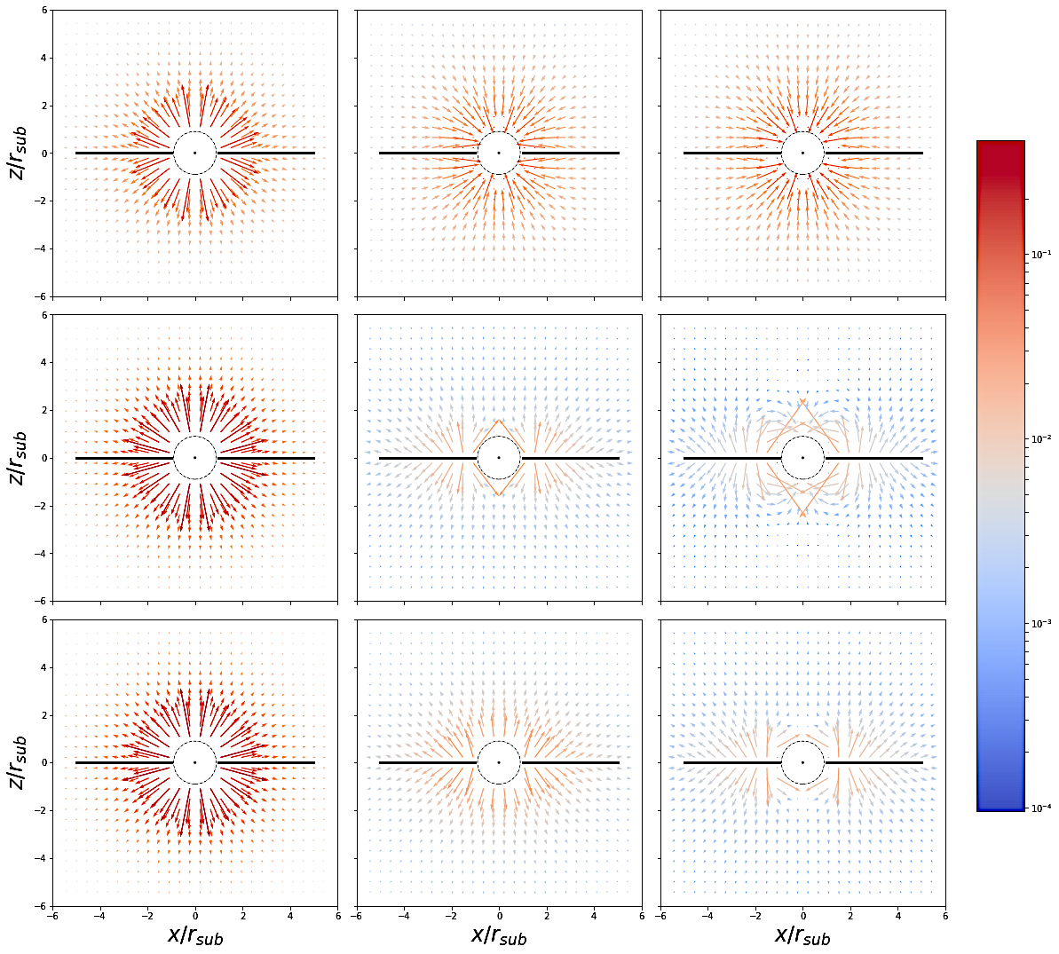
$$N_{h}={10}^{22}$$
$$N_{h}={10}^{23}$$
$$N_{h}={10}^{24}$$
Radiation field profile including gravity, the UV radiation pressure from AGN and the IR radiation pressure from the disk
$$l_{edd}=0.01$$
$$l_{edd}=0.05$$
Acceleration
Acceleration
$$l_{edd}=0.1$$

Slide 18
The disk radiation field
Dusty winds in AGN
Net total acceleration from the disk
${\overset{⃑}{a}}_{ir}= \frac{\int{{ k}_{ν}{πB}_{ν}(T)πr dr dν}}{4πcd^{2}}$
Frequency dependent opacities from CLOUDY
The temperature profile in the disk based on local thermal equilibrium

