Slide 1


Infrared light curves of dusty & metal-poor AGB stars
Steve Goldman
Space Telescope Science Institute
Baltimore MD, USA

Slide 2
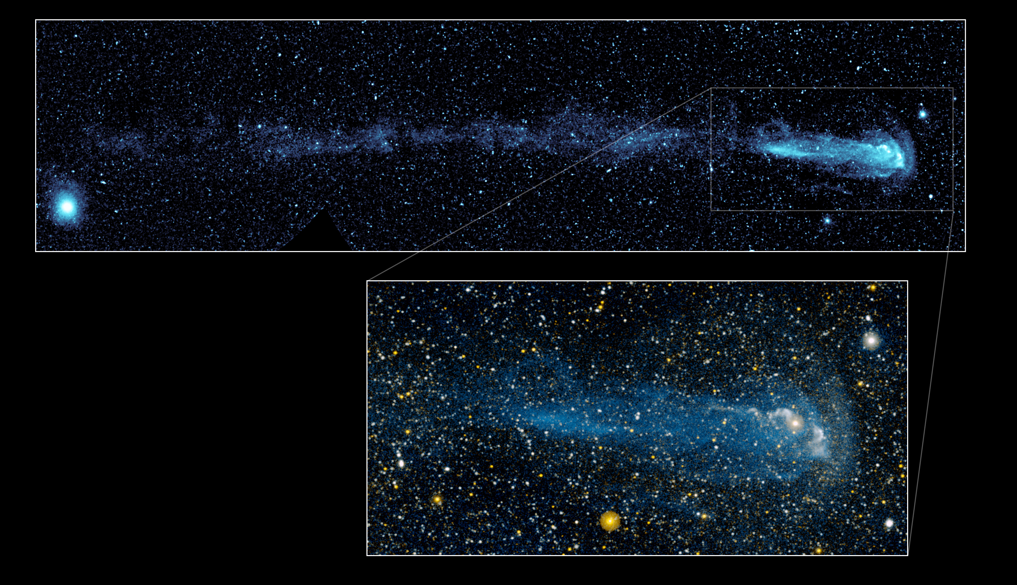
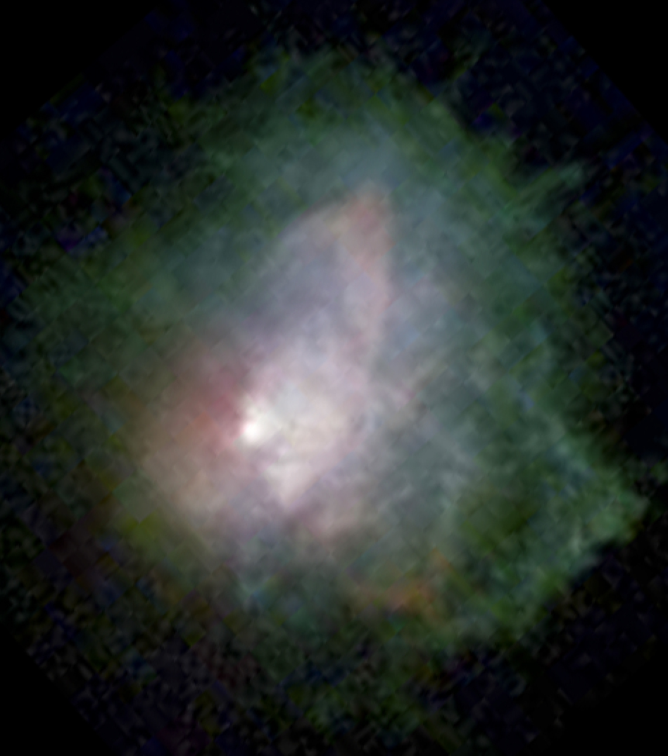
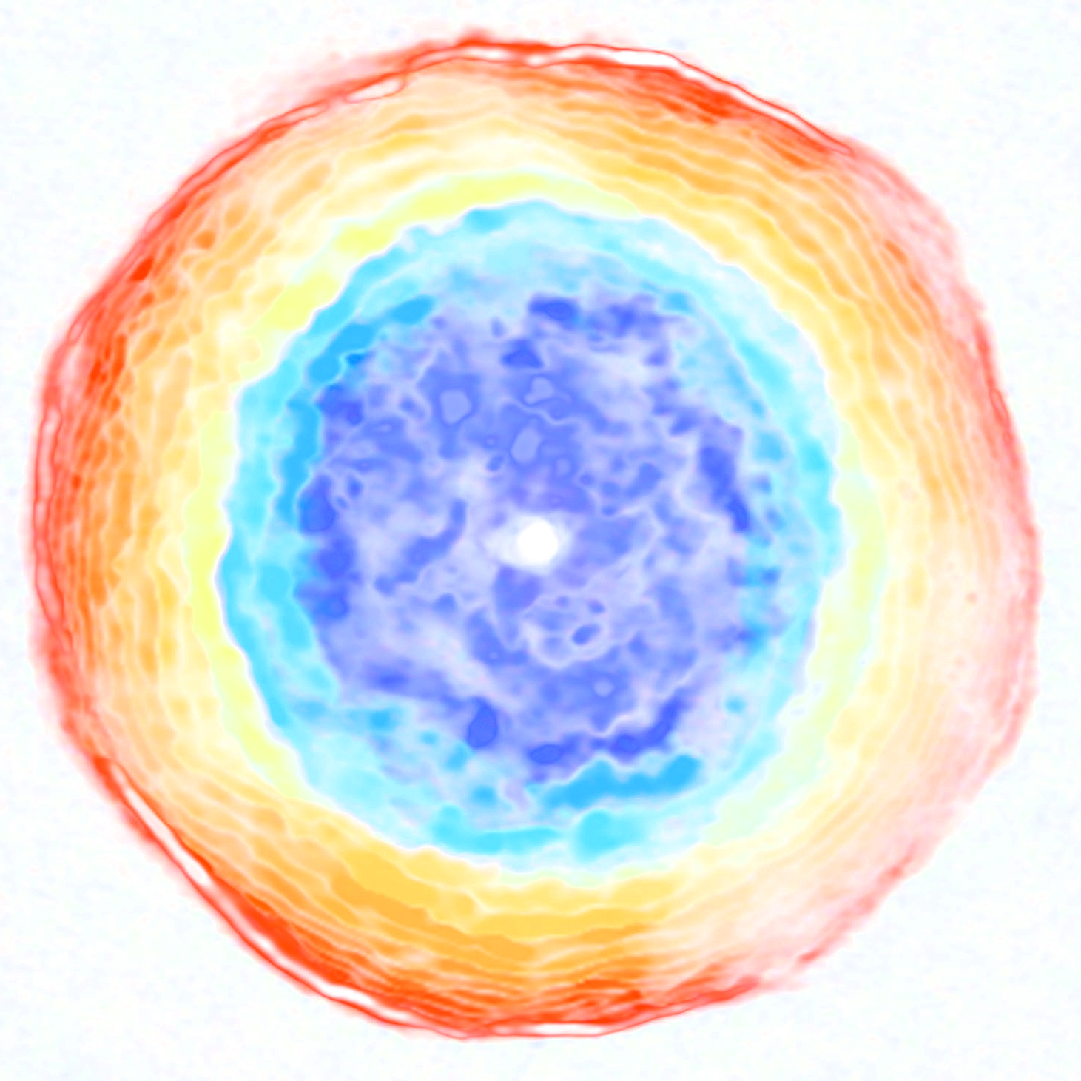
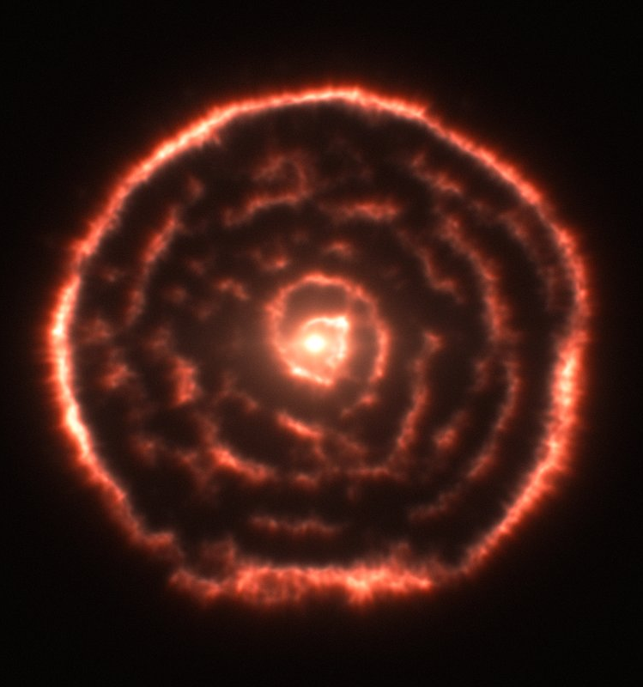
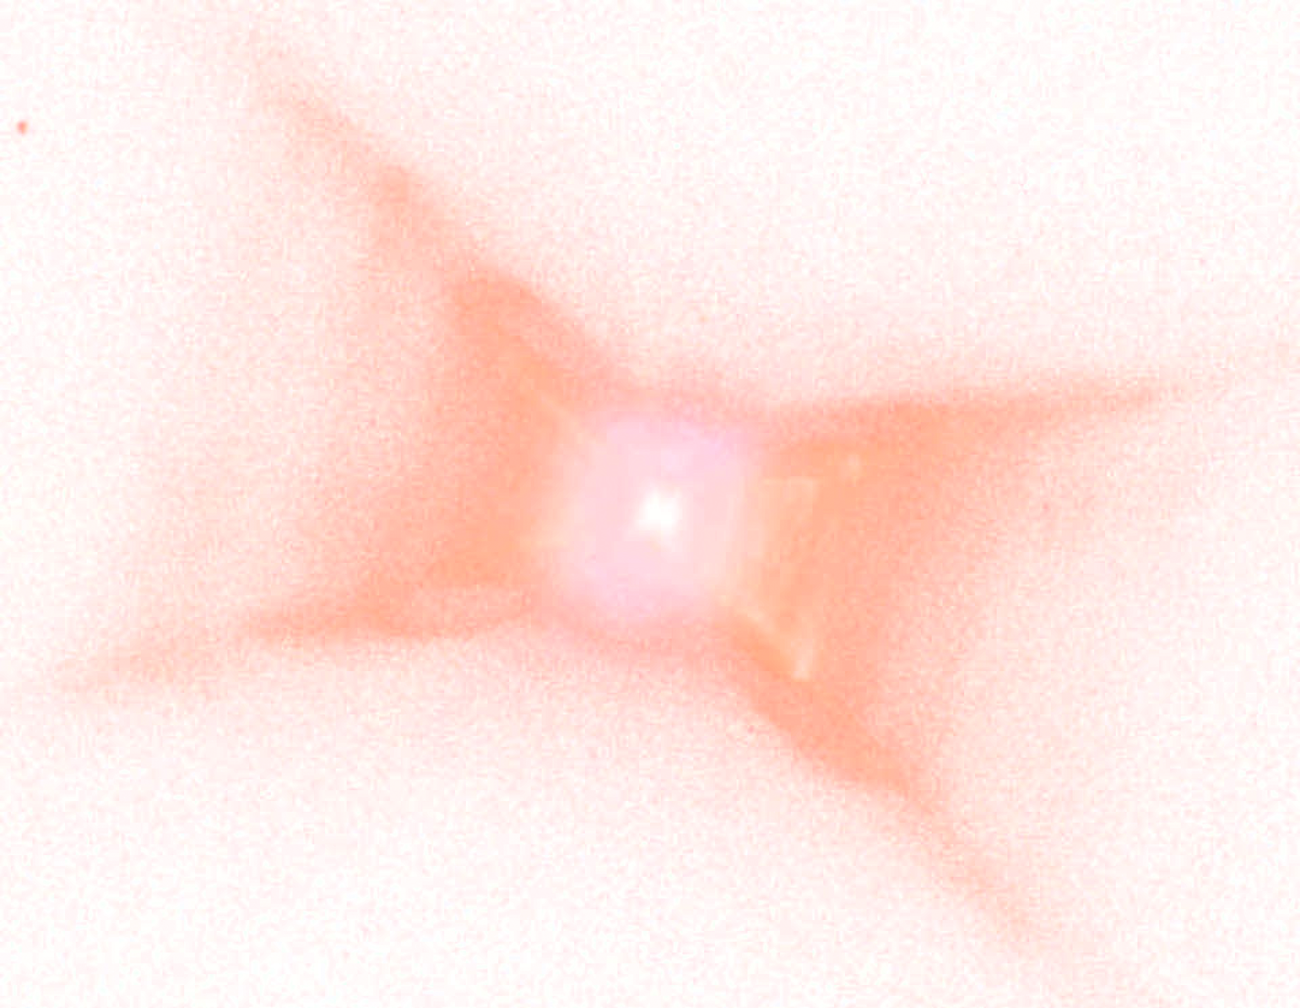

Slide 3
Long Period Variables

Slide 4
Long Period Variables
(LPVs)

Slide 5
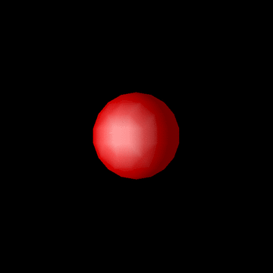
Long Period Variables
(LPVs)

Slide 6
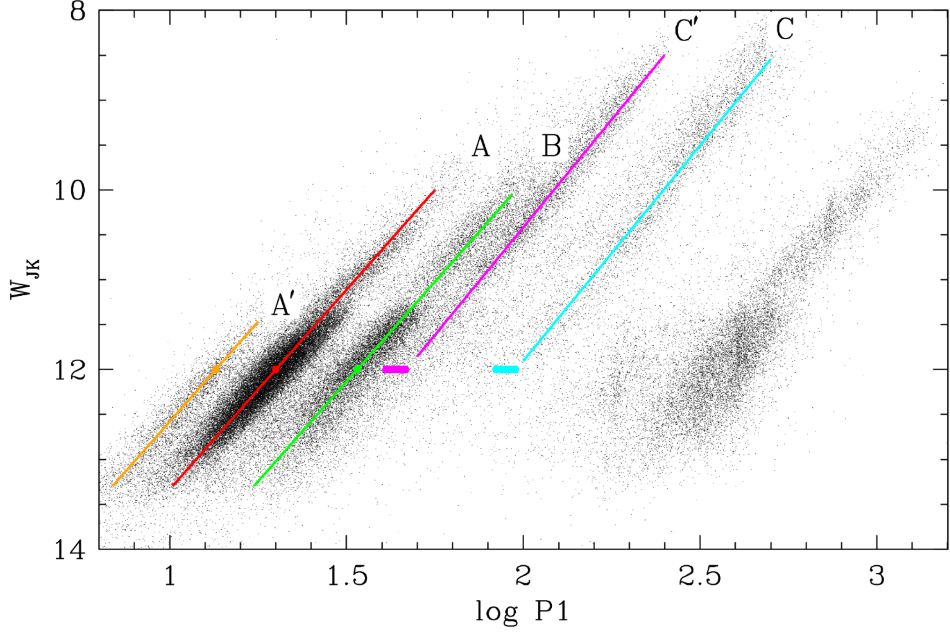
Wood 2015, MNRAS, 448, 3829
LPVs

Slide 7
Wood 2015, MNRAS, 448, 3829
LPVs

Slide 8
1st overtone =
1st
Wood 2015, MNRAS, 448, 3829
LPVs

Slide 9
1st overtone =
2nd
1st
Wood 2015, MNRAS, 448, 3829
LPVs

Slide 10
1st overtone =
2nd
1st
3rd
Wood 2015, MNRAS, 448, 3829
LPVs

Slide 11
D
?
Wood 2015, MNRAS, 448, 3829
LPVs

Slide 12
Pulsation-Enhanced Dust-DRiven Outflow (PEDDRO)
Höfner, S. & Olofsson, H. Astron Astrophys Rev (2018) 26: 1. https://doi.org/10.1007/s00159-017-0106-5;
Höfner, 2016, The 19th Cambridge Workshop on Cool Stars, Stellar Systems, and the Sun, Uppsala, Sweden (arXiv:1610.08937v1);
Freytag et al. 2017, A&A,60, A137; Nowotny et al. 2010, A&A, 514, A35, copyright by ESO
LPVs

Slide 13
Carbon Oxygen

Slide 14
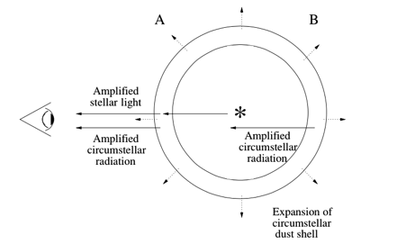
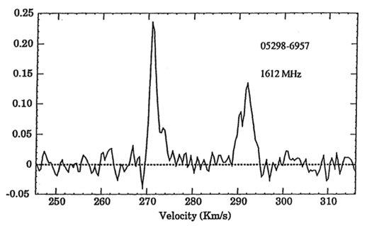
OH masers
Wood et al. 1992, ApJ, 397, 552
Marshall et al. 2004, MNRAS, 355, 1348
Masers

Slide 15
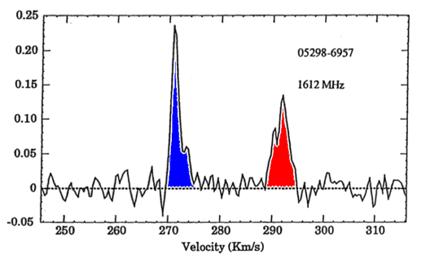
OH masers
Wood et al. 1992, ApJ, 397, 552
Marshall et al. 2004, MNRAS, 355, 1348
Masers

Slide 16
CO line emission
Ramstedt et al. 2008, A&A, 48, 645
CO emission

Slide 17
DUSTiNGS

Slide 18
DUSTiNGS
(DUST in Nearby Galaxies with Spitzer)

Slide 19
DUSTiNGS
(DUST in Nearby Galaxies with Spitzer)
Paper I: Boyer et al. 2015a, ApJS, 216, 10
Paper II: Boyer et al. 2015b, ApJ, 800, 51
Paper III: McQuinn et al. 2017, ApJ, 834, 78
Paper IV: Boyer et al. 2017, ApJ, 851, 152

Slide 20
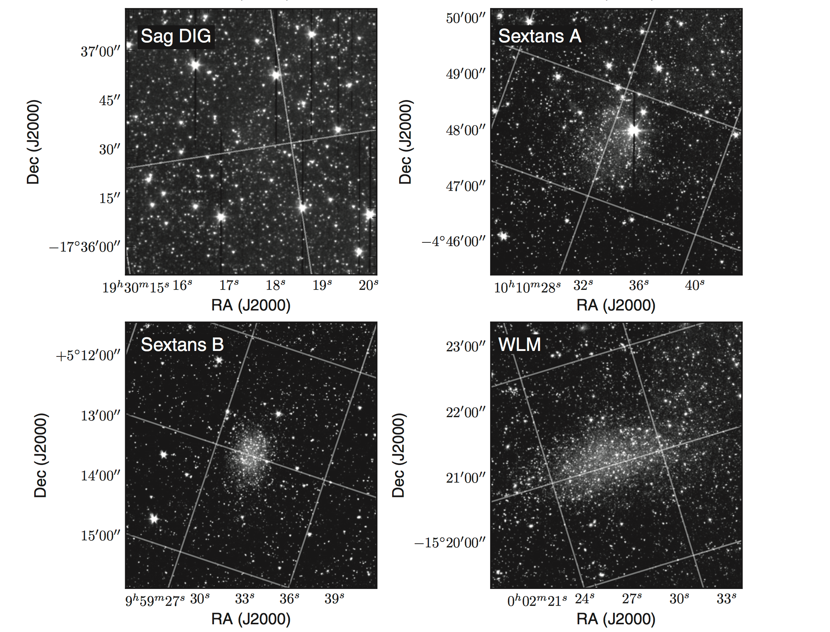
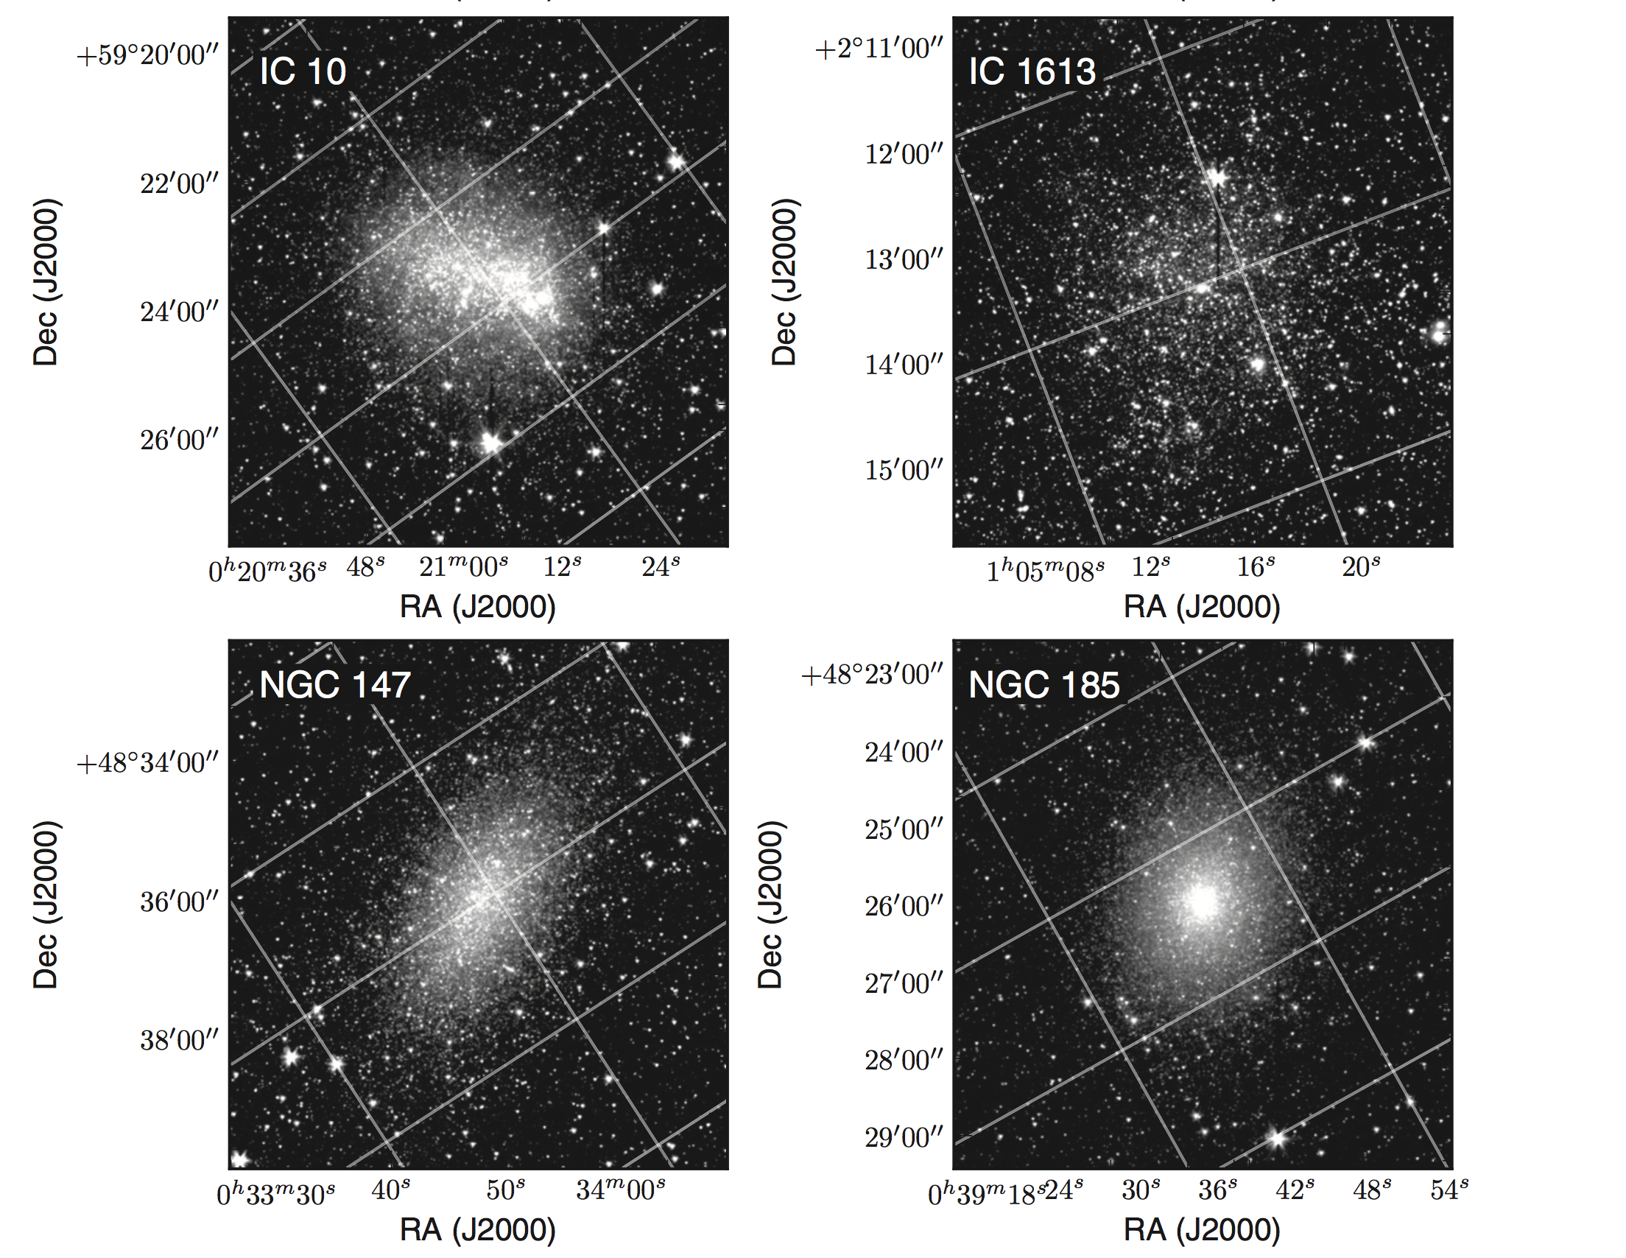
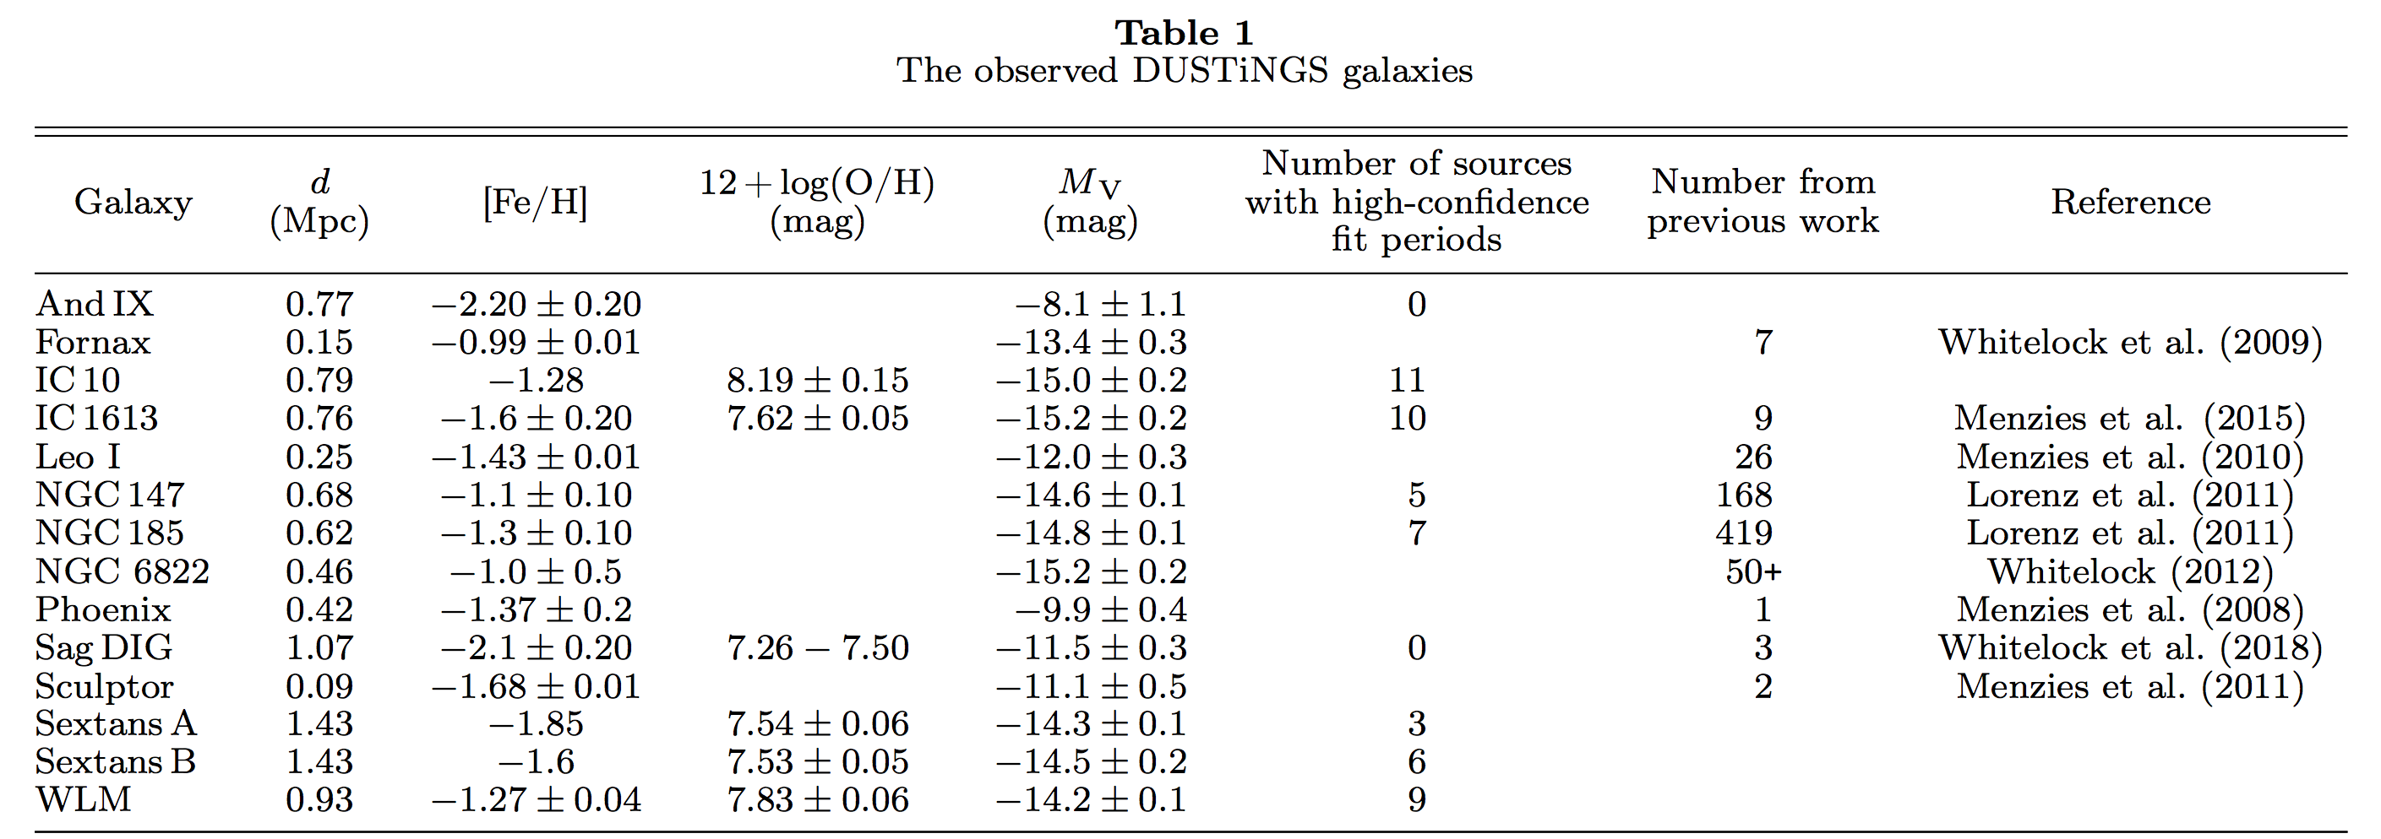
DUSTiNGS

Slide 21
DUSTiNGS
Typical lightcurve
Lightcurve
Phase-folded
3.6 μm
4.5 μm
DUSTiNGS

Slide 22
DUSTiNGS
Supplemental data
Lightcurve
Phase-folded
3.6 μm
4.5 μm
DUSTiNGS

Slide 23
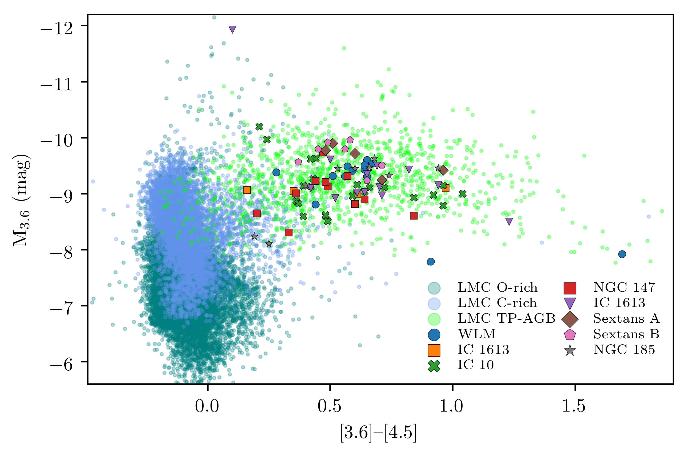
DUSTiNGS
Goldman et al. (in prep.)

Slide 24
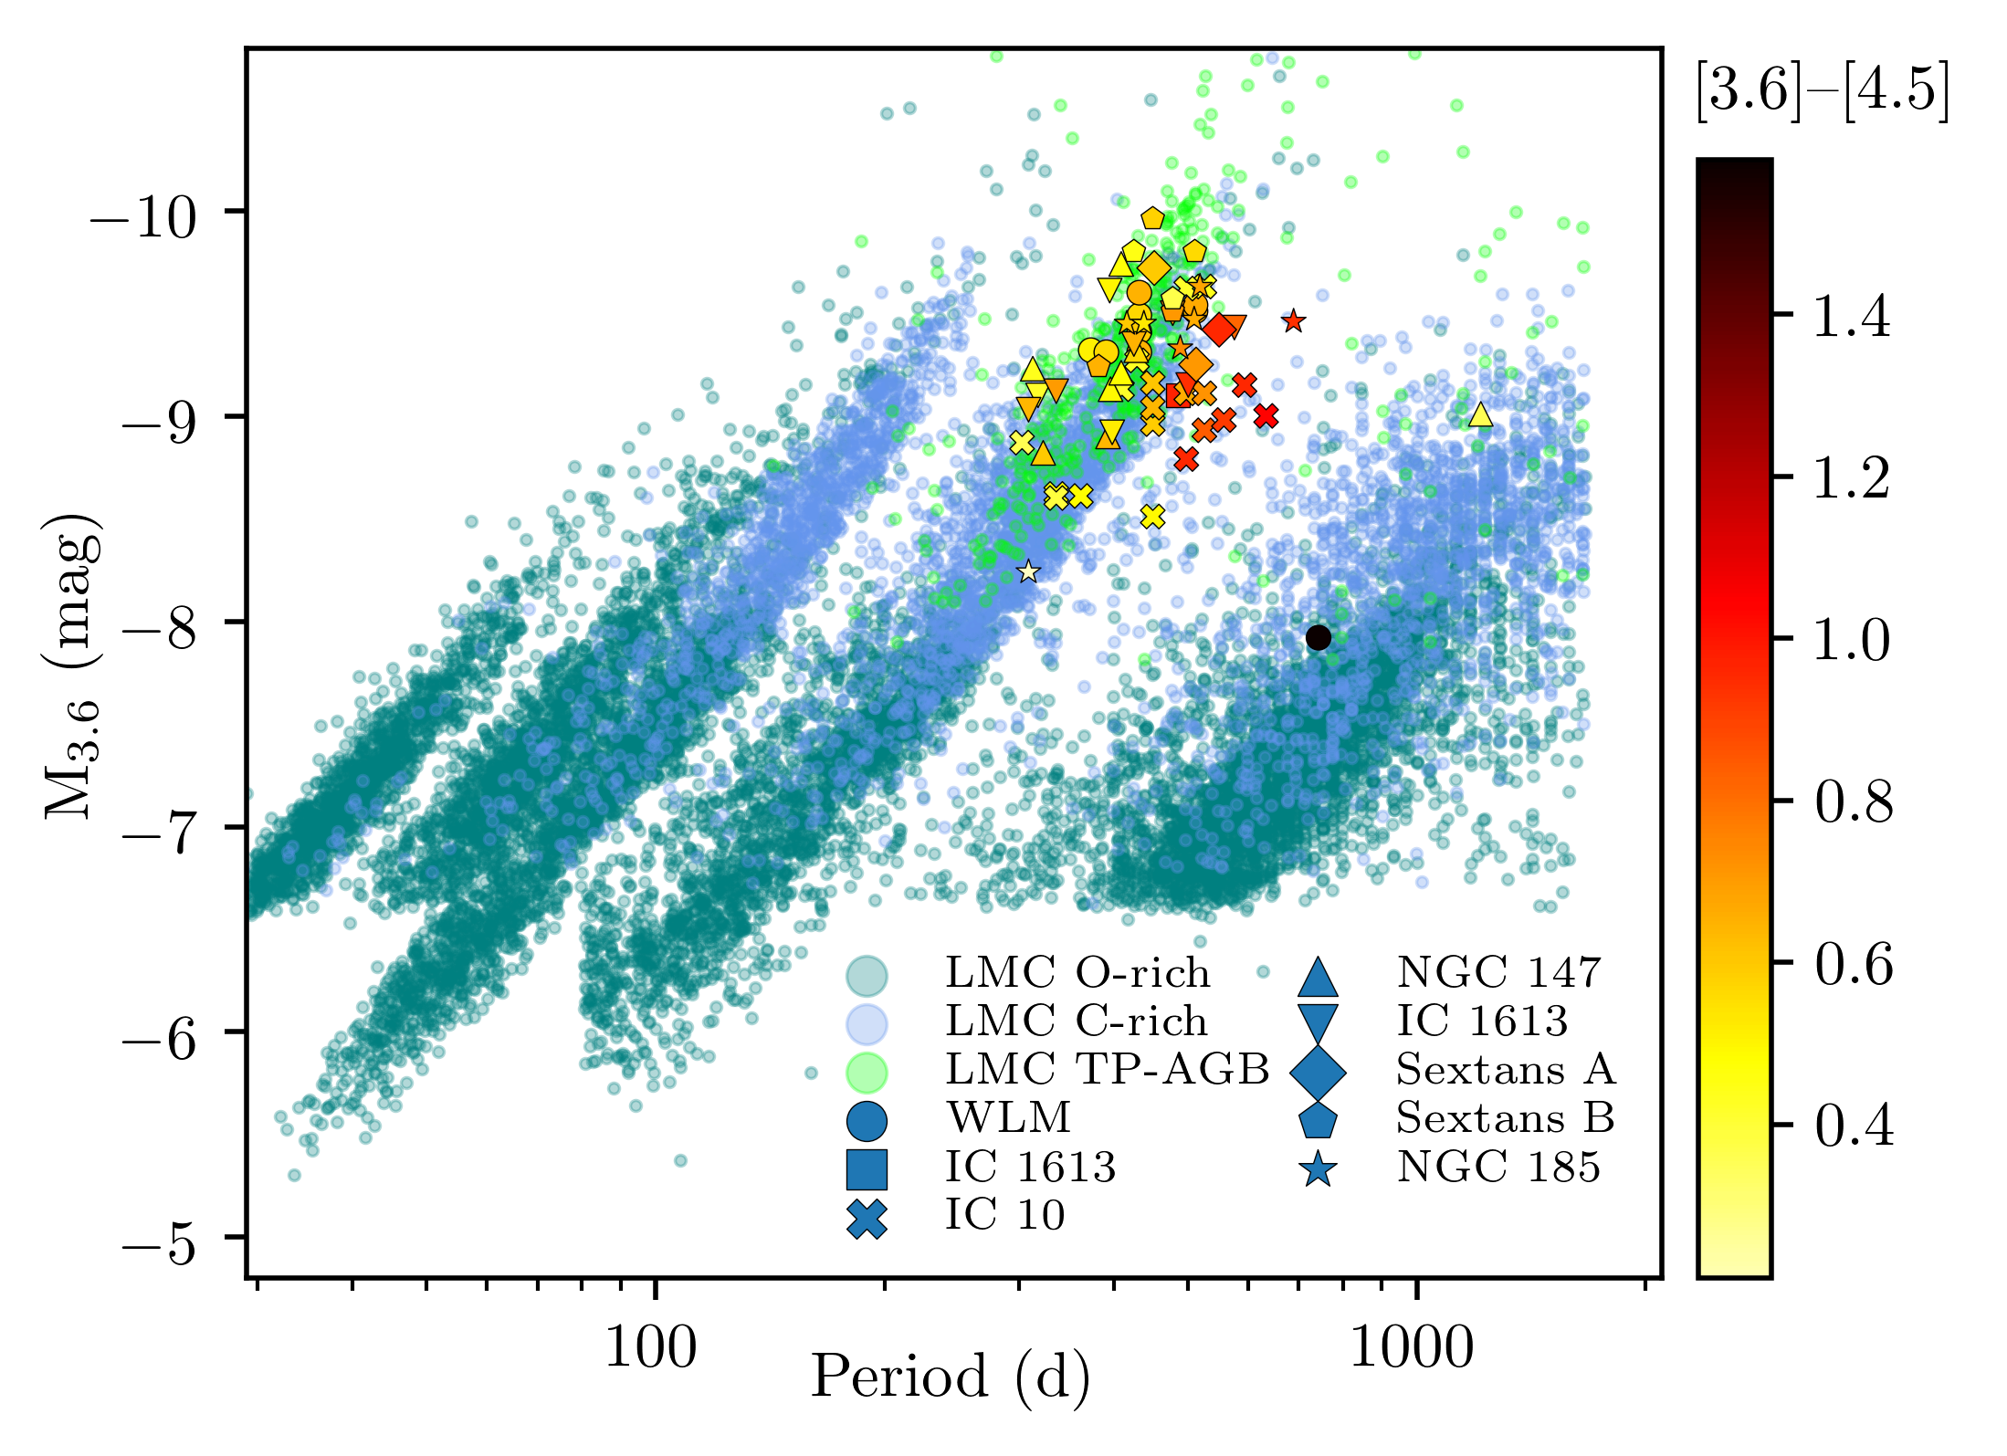
DUSTiNGS
Goldman et al. (in prep.)

Slide 25
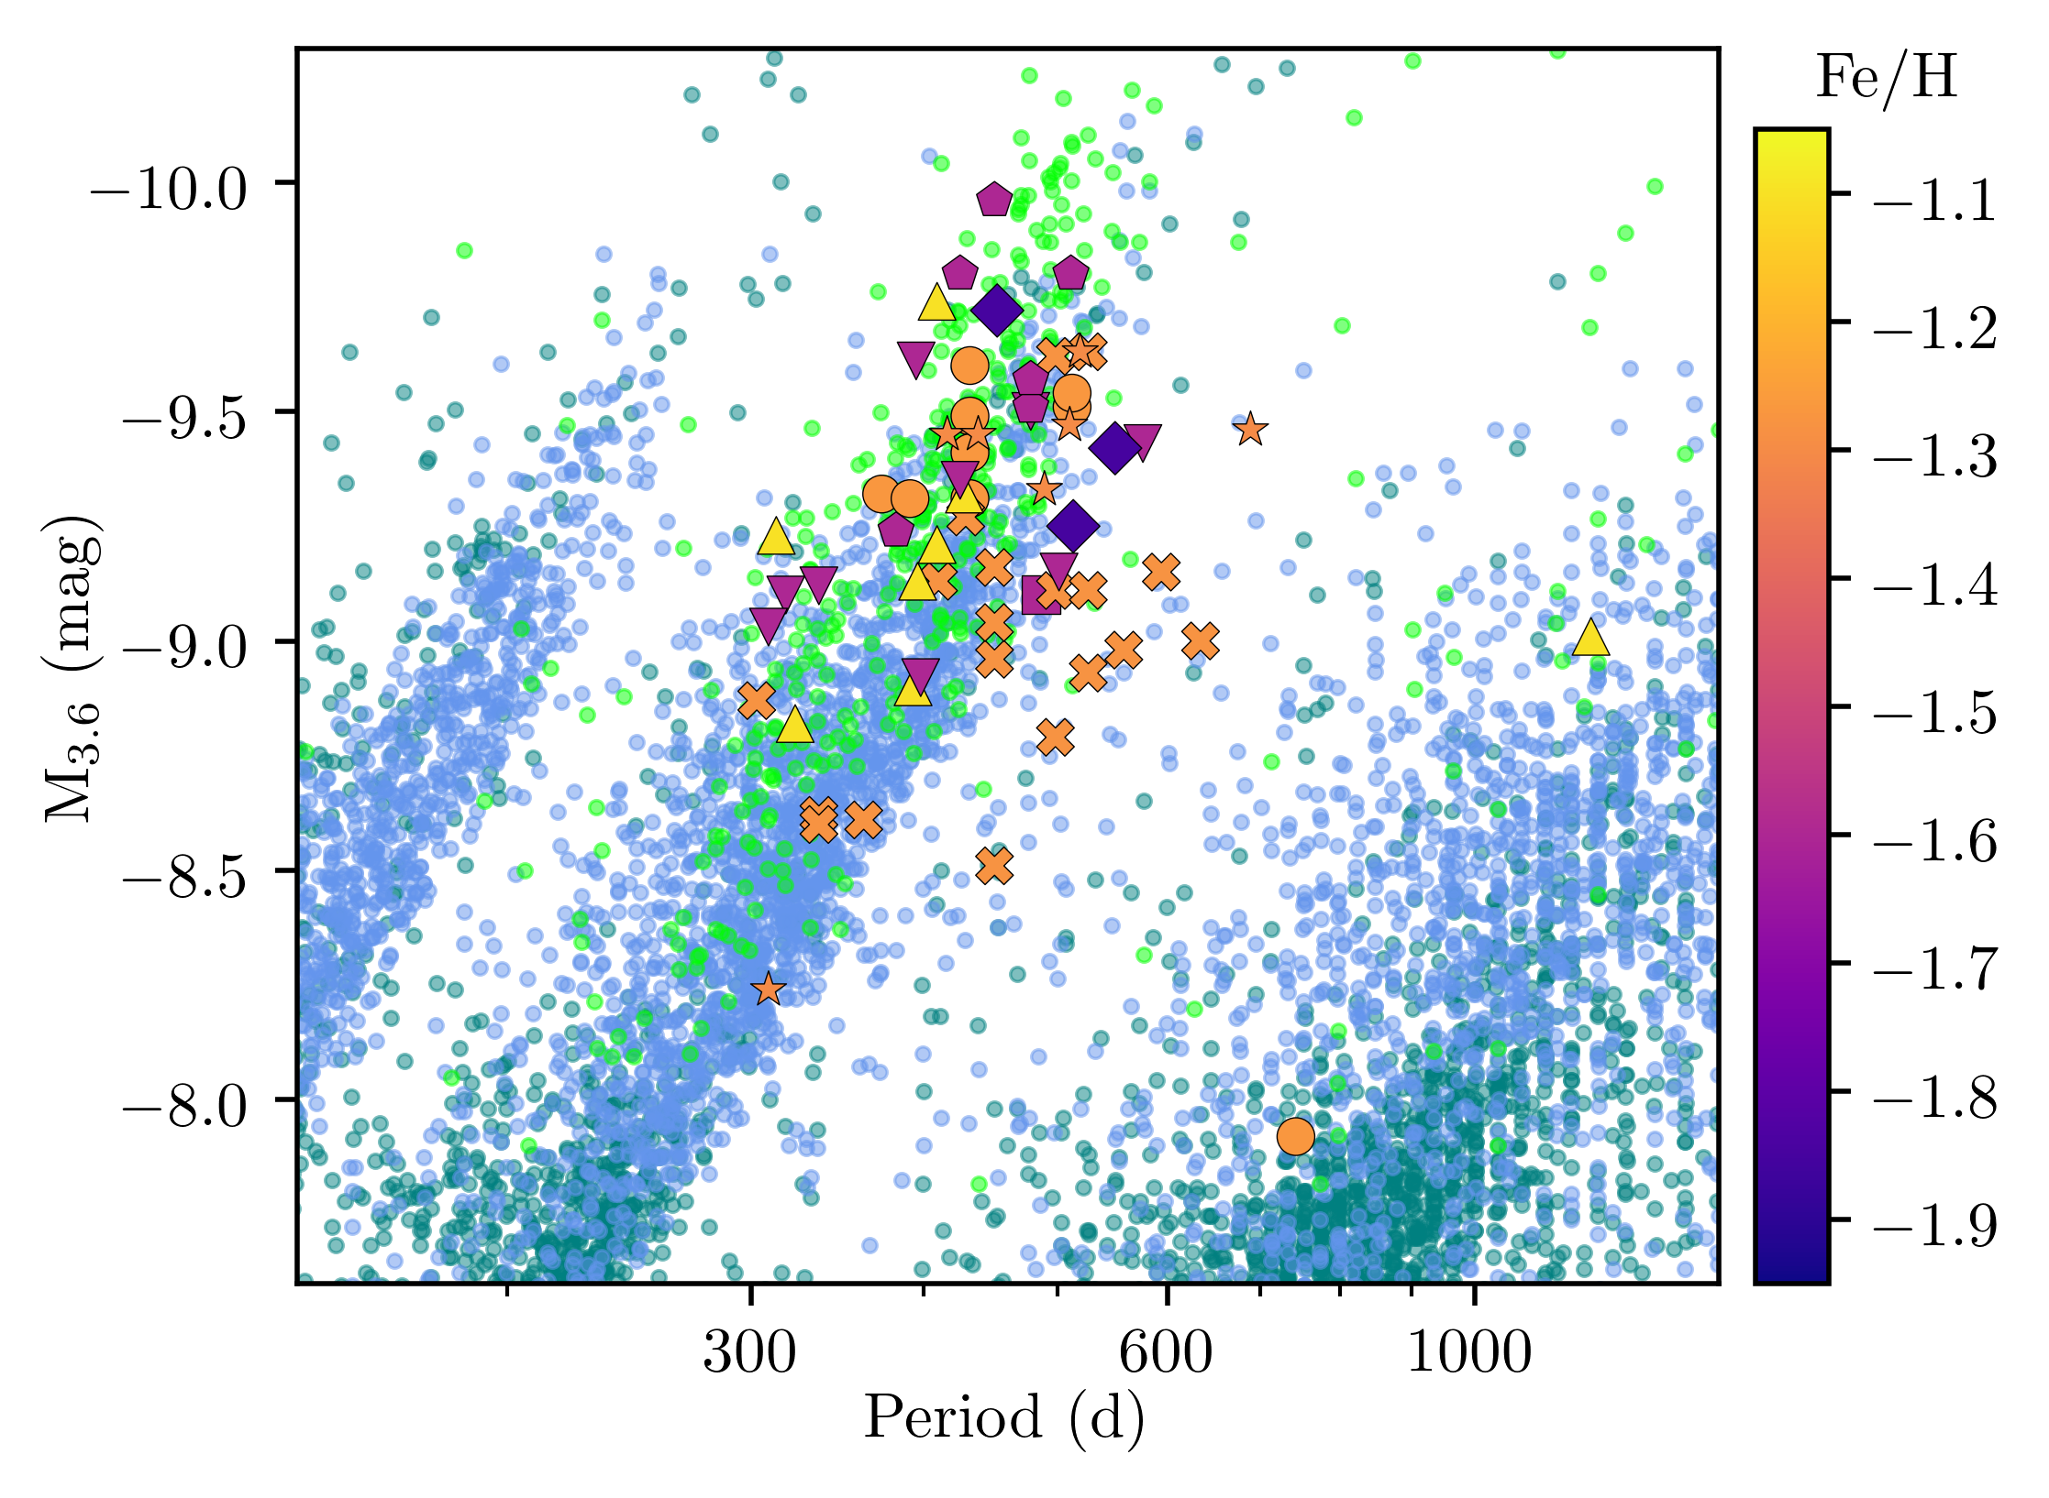
DUSTiNGS
Goldman et al. (in prep.)

Slide 26
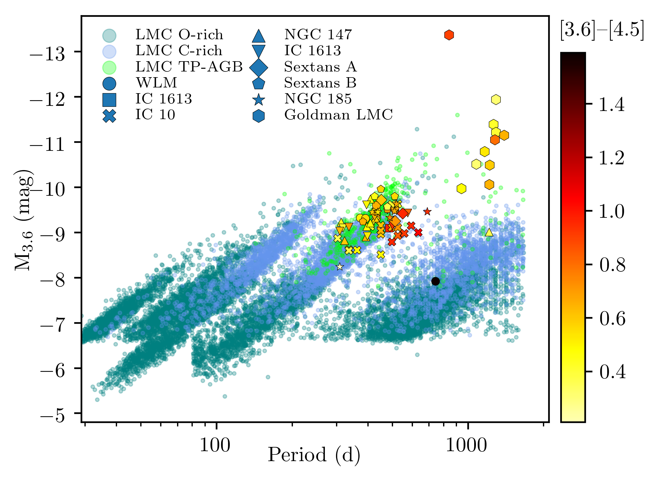
DUSTiNGS
Goldman et al. (in prep.)

Slide 27
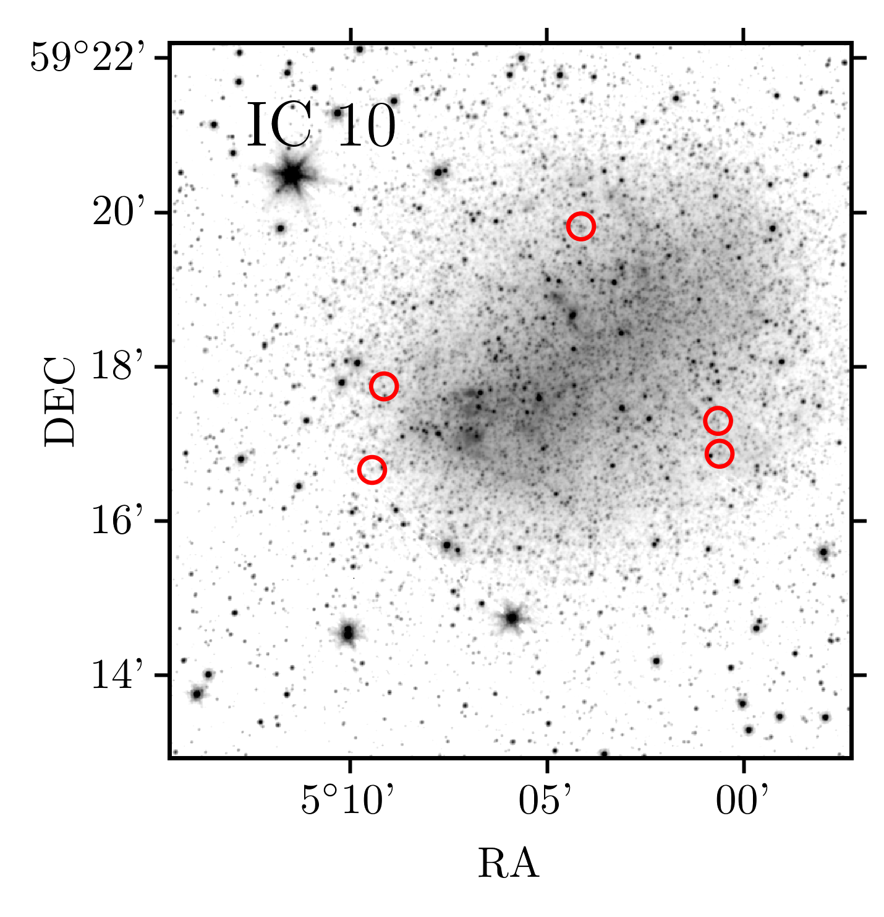
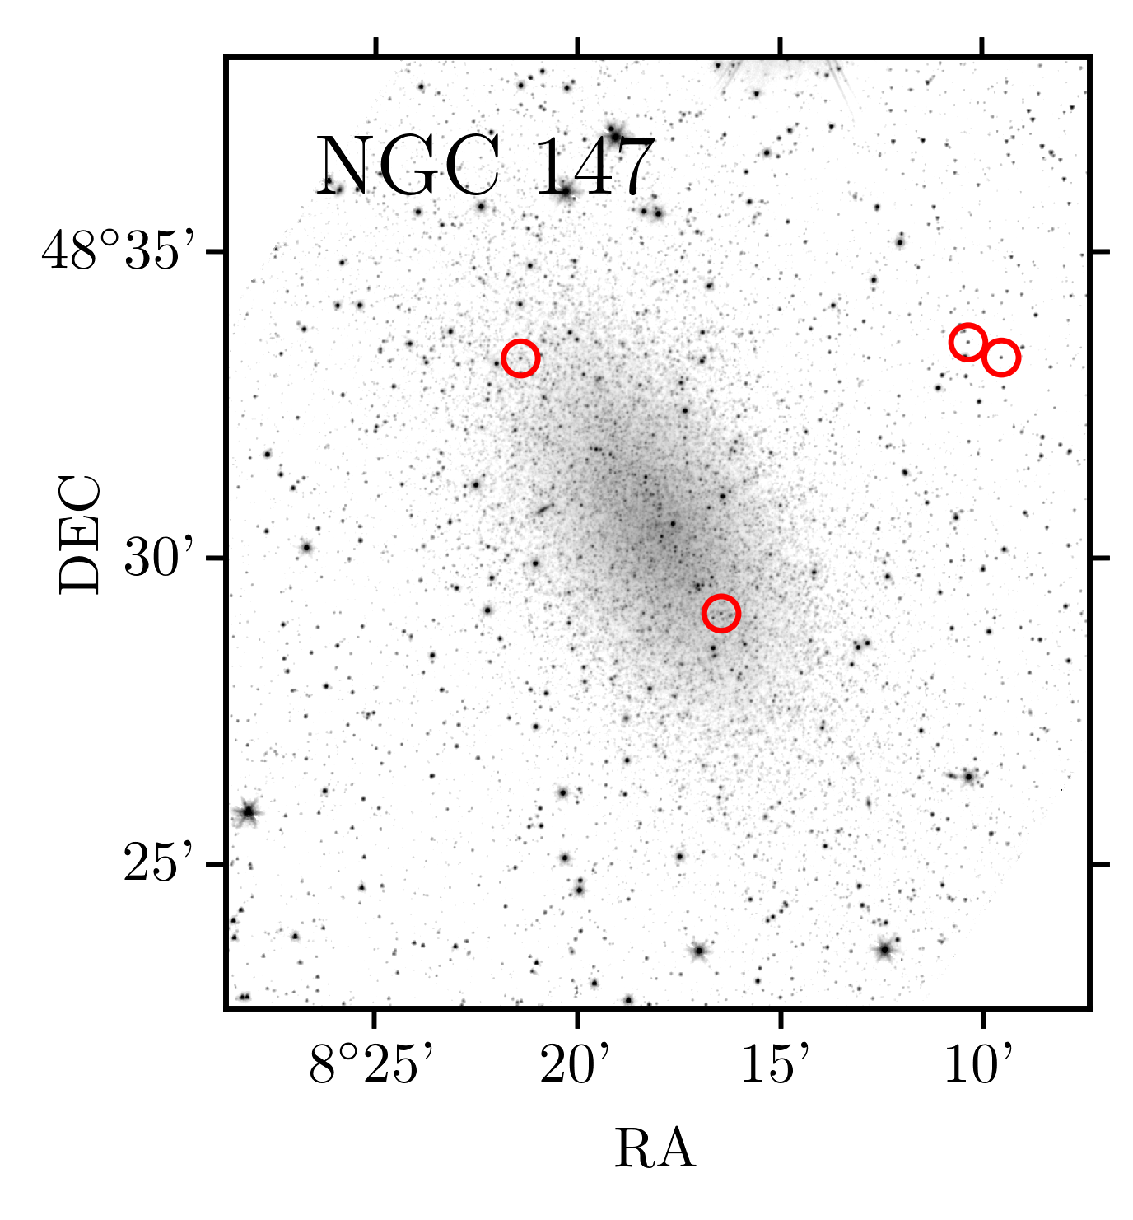
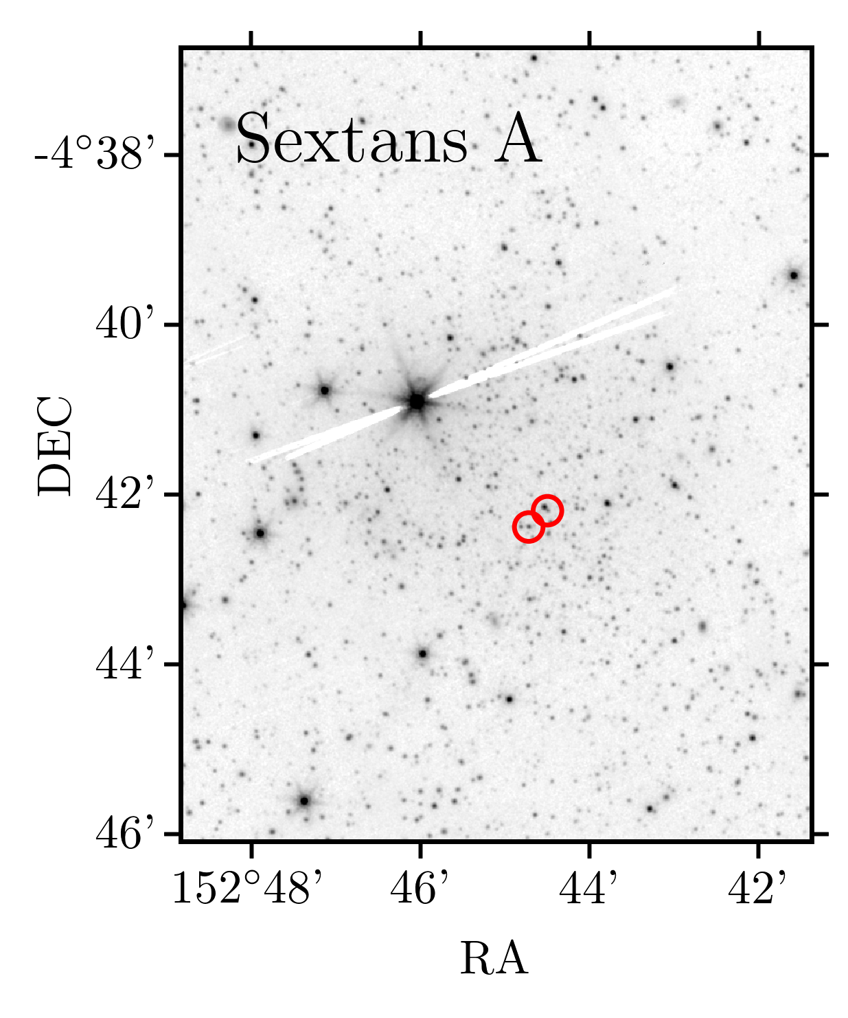
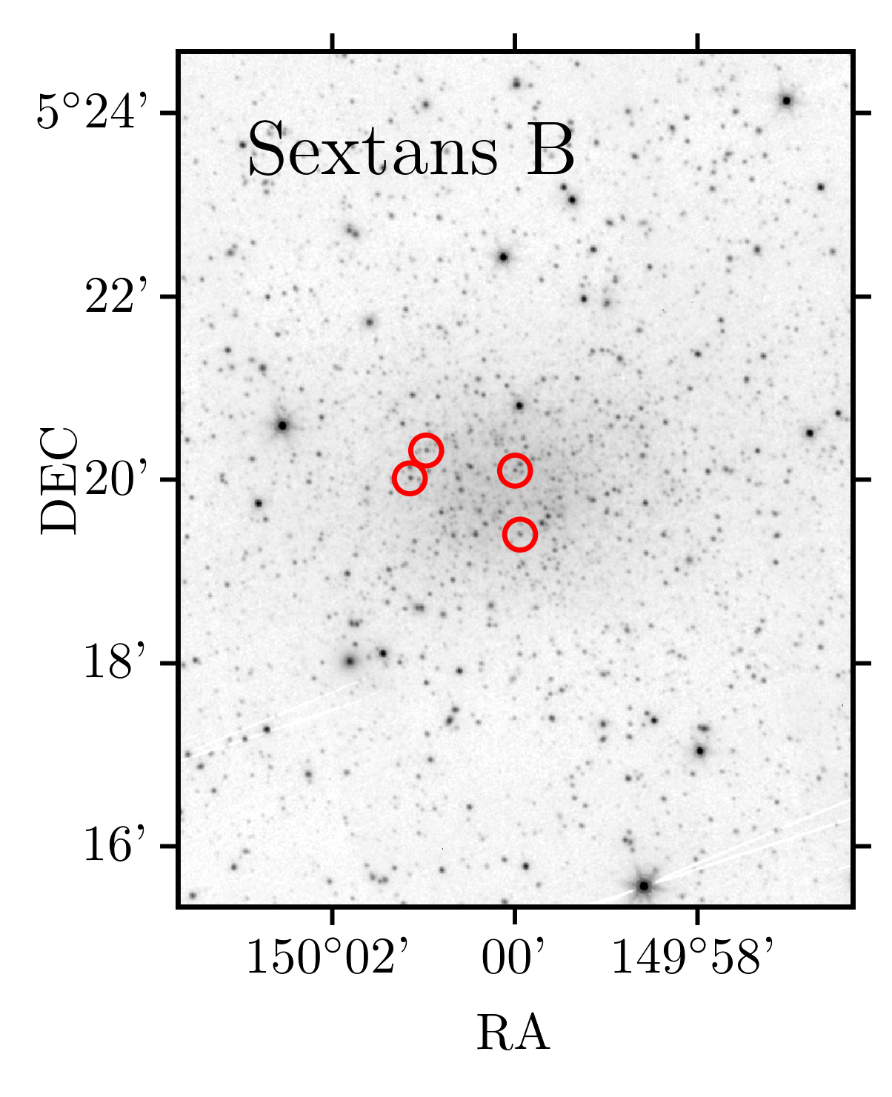

Slide 28
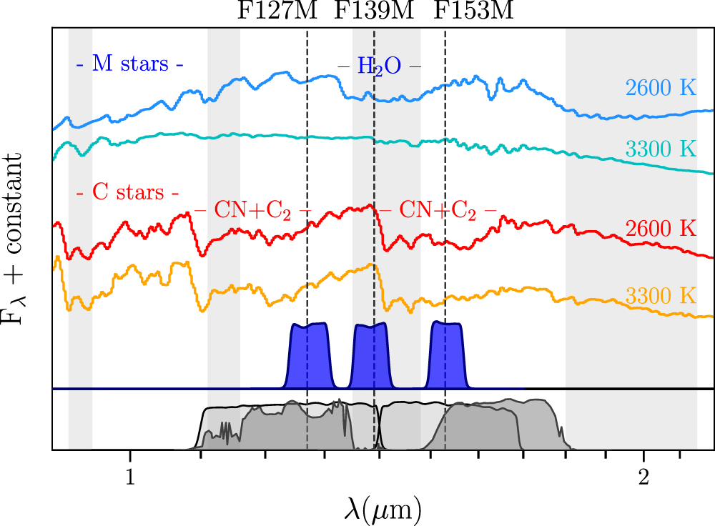
DUSTiNGS
Boyer et al. 2017, ApJ, 851, 152

Slide 29
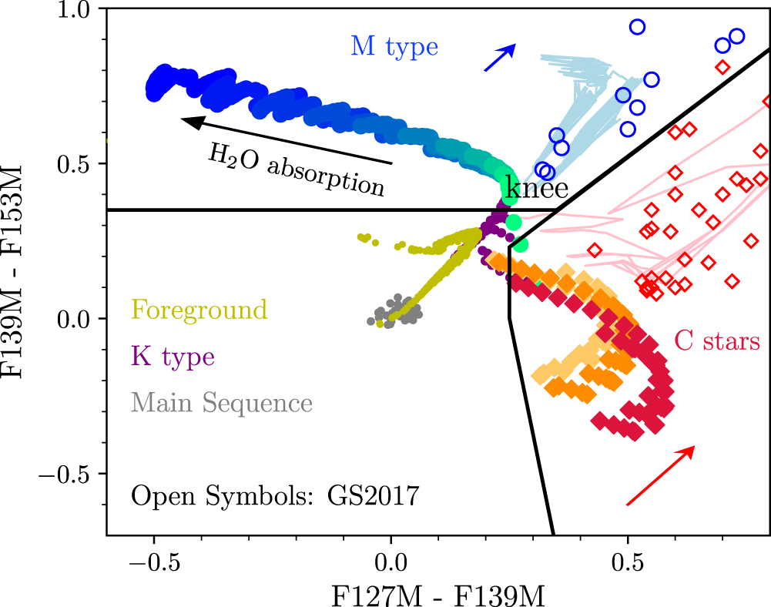
DUSTiNGS
Boyer et al. 2017, ApJ, 851, 152

Slide 30
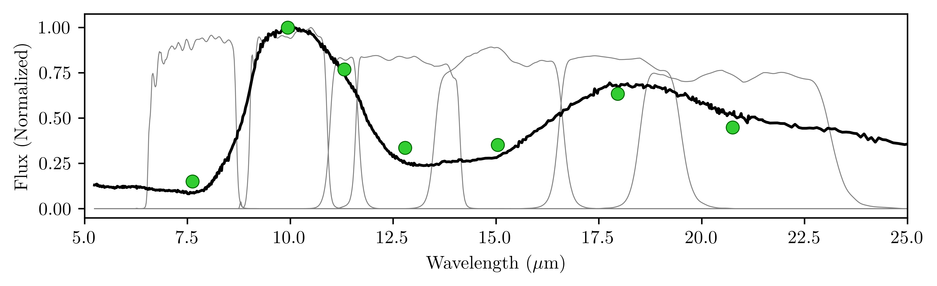
James Webb Space Telescope (JWST)

Slide 32
Dusty

Slide 33
Dusty Evolved

Slide 34
Dusty Evolved Star

Slide 35
Dusty Evolved Star Kit

Slide 36
Dusty Evolved Star Kit
Simple SED fitter for evolved stars using DUSTY models
Just add data!
Use your own dust optical constants
https://github.com/s-goldman

