Slide 1
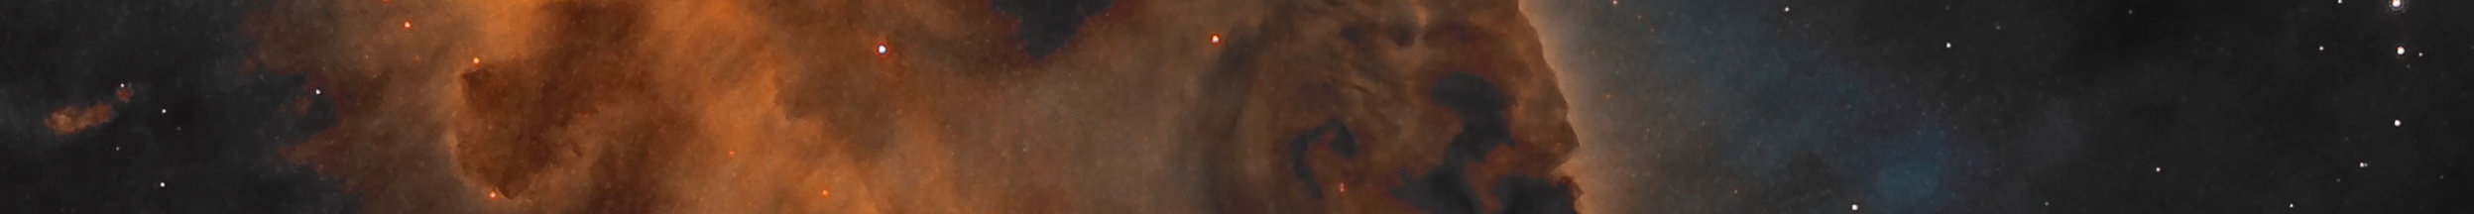

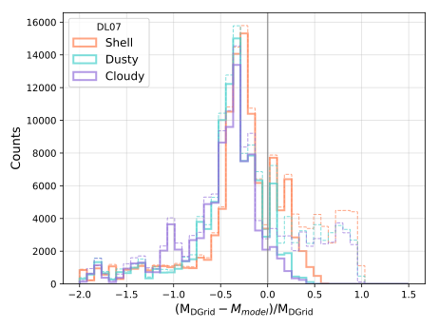
Systematics in dust emission modeling of nearby galaxies
Jérémy Chastenet, Karl Gordon, Caroline Bot, Karl Misselt, Karin Sandstrom
Dust mass are generally overestimated
by factors
1.5 - 2!

