Slide 1
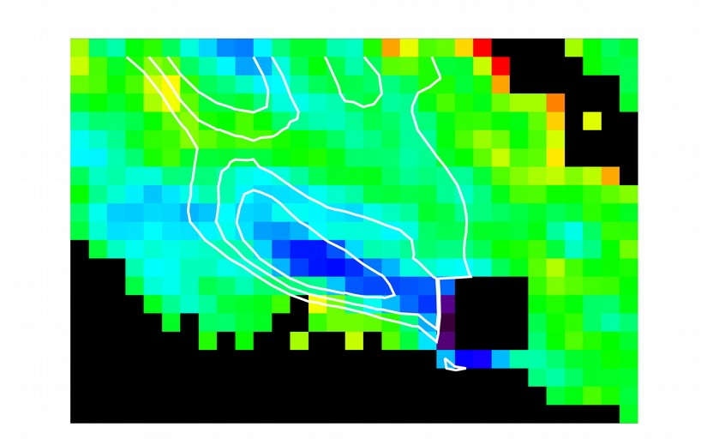
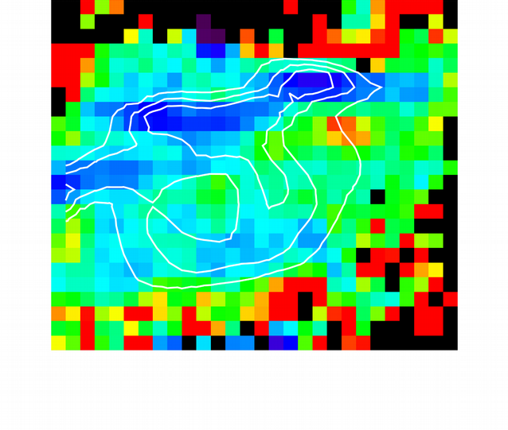
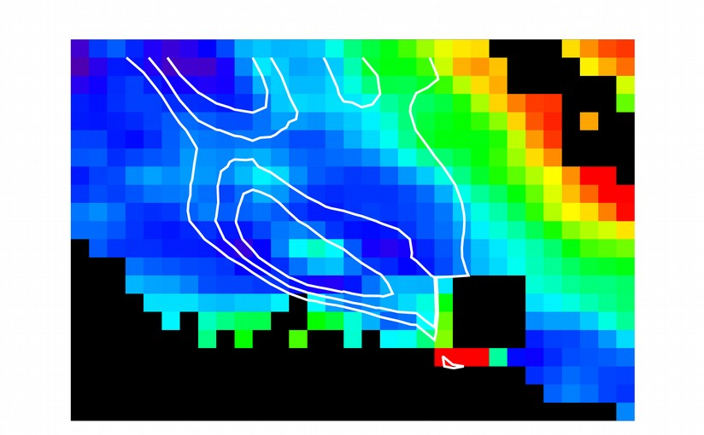
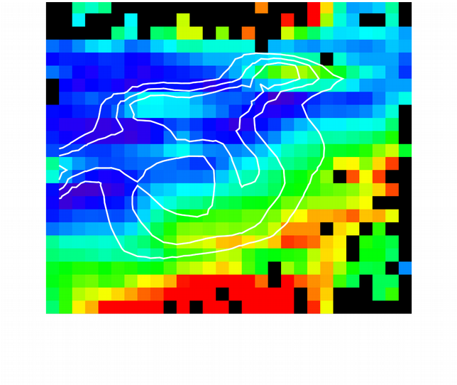
Using SOFIA and Spitzer to Probe the Size Distribution of PAHs
C. Knight¹, E. Peeters^{1,2}, A.G.G.M. Tielens³, O. Berné^{4,5}, D.J. Stock¹
(1) University of Western Ontario, (2) SETI Institute, (3) Leiden Observatory, (4) Université de Toulouse, (5) CNRS, IRAP
Board #108
●
We use MIR observations to probe the polycyclic aromatic hydrocarbon (PAH) size distribution and ionization balance in two prominent reflection nebulae.
NGC 2023 NGC 7023
PAH Size
11.2/3.3 um
Ionization
8/11.2 um
●
Find the average PAH size and ionization increases towards the illuminating source.
●
Implies a photochemical evolution of these species within these regions.

