Slide 1


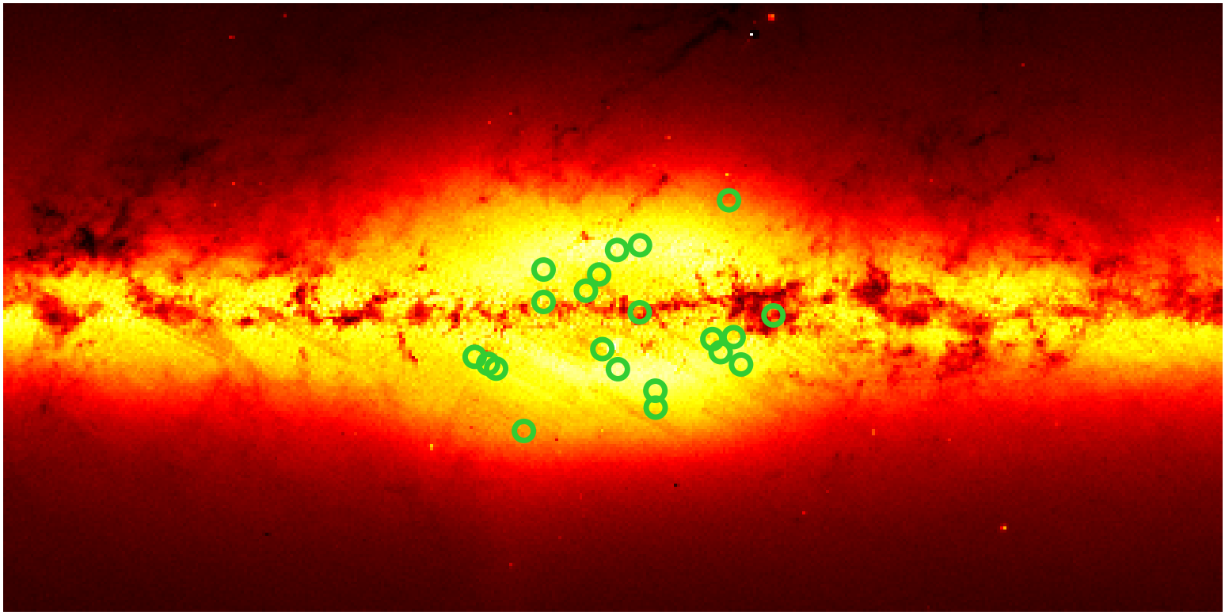
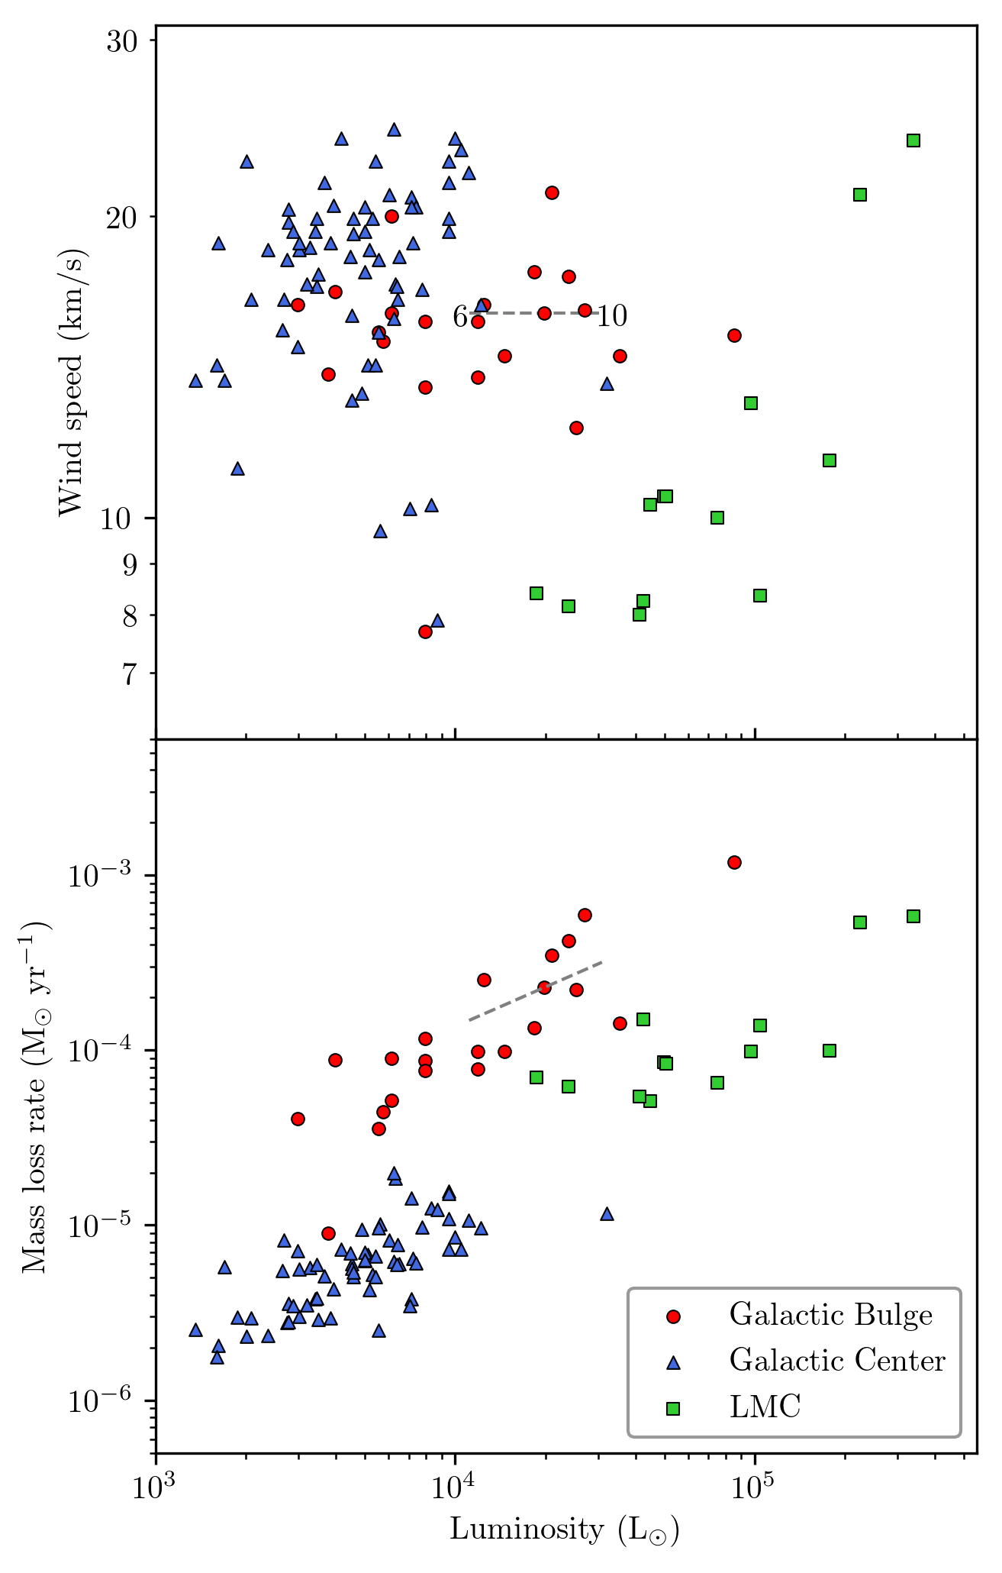
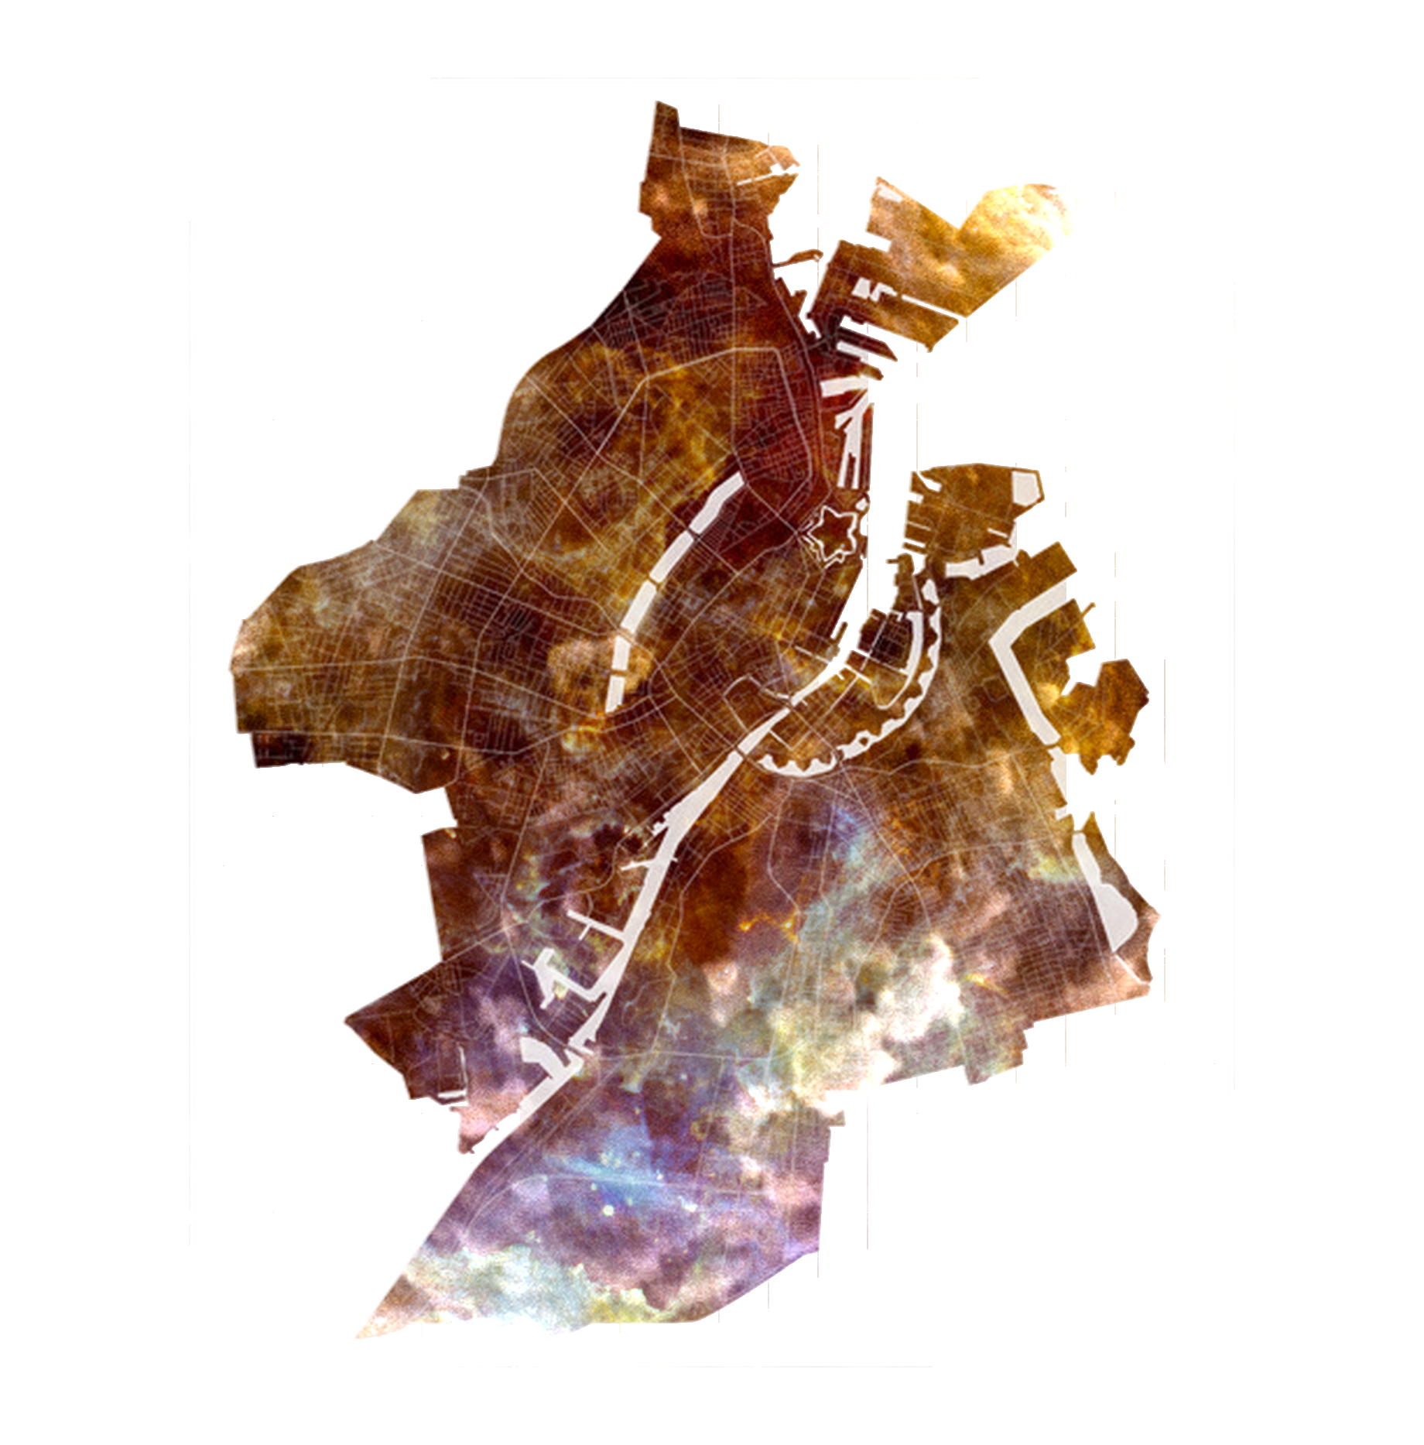
Mid-IR spectroscopic observations of
the dustiest AGB stars in the Galaxy
Steve Goldman¹, Jacco van Loon², Martha Boyer¹
¹ Space Telescope Science Institute, 3700 San Martin Drive, Baltimore, MD 21218 USA
² Lennard-Jones Laboratories, Keele University, ST5 5BG, UK
Intro: We have obtained low resolution mid-IR spectra for a sample of massive oxygen-rich AGB stars in the Galactic Bulge using the VISIR spectrograph on the VLT. The data allow us to more accurately model the 10 μm silicate feature, sensitive to optical depth, and obtain accurate values for the luminosity and mass loss rates. This will allow us to better understand the effects of luminosity and metallicity on the wind-driving and mass-loss mechanisms in evolved stars and allow us to study the geometry and dusty composition of these sources. It will also give us insight into the environment in which these evolved stars formed and to which they contribute.
Figure 1: The spatial distribution of a sample of massive oxygen-rich AGB stars in the Galactic Bulge overlaid on a 1.58 μm projected image from the 2MASS allsky survey.
Figure 3: SED fitting results of fitting VISIR@VLT low resolution spectra (blue) with 1-D radiative transfer models from the DUSTY code (Elitzur & Ivezić 2001). The best fit model is shown in the dotted line while available Spitzer IRS spectra are shown in solid black. The available photometry are also shown to scatter around the best fit model; this is expected from multi-epoch observations of these highly variable sources.
Median mass-loss rate ~ 10 ⁻ ⁴ M⦿ yr ⁻¹
Median derived gas-to-dust ratio ~ 97
For a given luminosity, the Galactic Bulge sample shows higher mass-loss rate than samples in either the LMC or Galactic Center
Future work: dust grain and geometry analysis
Figure 2: The observed wind speeds and mass loss rates as a function of luminosity for the Galactic Bulge sample as well as the Galactic Centre and LMC OH/IR samples from Goldman et al. (2017). Wind speeds are from 1612 MHz OH maser emission and luminosities and mass loss rates are from SED fitting. The dotted lines show how the mass-loss rate and luminosity of a typical source scale if the assumed distance is changed to 6 and 10 kpc.
References: Elitzur M., Ivezić Ž., 2001, MNRAS 327, 403; Goldman et al. 2017, MNRAS, 465, 403

