Slide 1
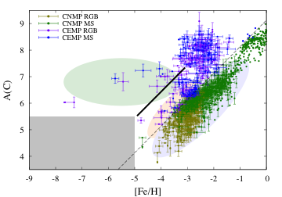
101
Constraint on properties of dust grains created by Population III supernovae
◯Gen Chiaki, Nozomu Tominaga (Konan Univ.), & Takaya Nozawa (NAOJ)
Introduction
Dust cooling is important to determine stellar mass.
Method & Results
C and Fe abundances of EMP stars
[C/Fe] = 0.7
Metal-free
● C-enhanced EMP
(CE-EMP) stars
★
stable to fragment
single massive star
No low-mass stars have been found
Metal-poor/Metal-rich
● C-normal EMP
(CN-EMP) stars
★
★
★
A_{cr}(C) ~ 6 for CE-EMP
[Fe/H]_{cr} ~ −5 for CN-EMP
No stars have been observed below
Below them, only massive stars are formed (no dust cooling).
unstable to fragment
Dust cooling
low-mass stars
However, it is hard to measure the dust properties
condensation rate of metal,
size distribution.
At A_{cr}(C) ~ 6 and [Fe/H]_{cr} ~ −5, energy balance is established
dust cooling rate vs. gas compressional heating rate
Λ_{dust} (r_{dust} / f_{dust←metal}, y_{metal}) = Γ_{comp}
^{cool}
r_{dust} dust radius
f_{dust←metal} condensation rate of
metal to dust
y_{metal} metal abundance
We here focus on extremely metal-poor (EMP) stars
metallicities [Fe/H] < −3
long-lived (~ 10 Gyr), i.e., low-mass (< 0.8 M☉)
r_{carbon} / f_{carbon←C} ~ 10 μm
r_{silicate} / f_{silicate←Mg} ~ 0.1 μm
^{cool}
^{cool}
^{cool}

