Slide 1
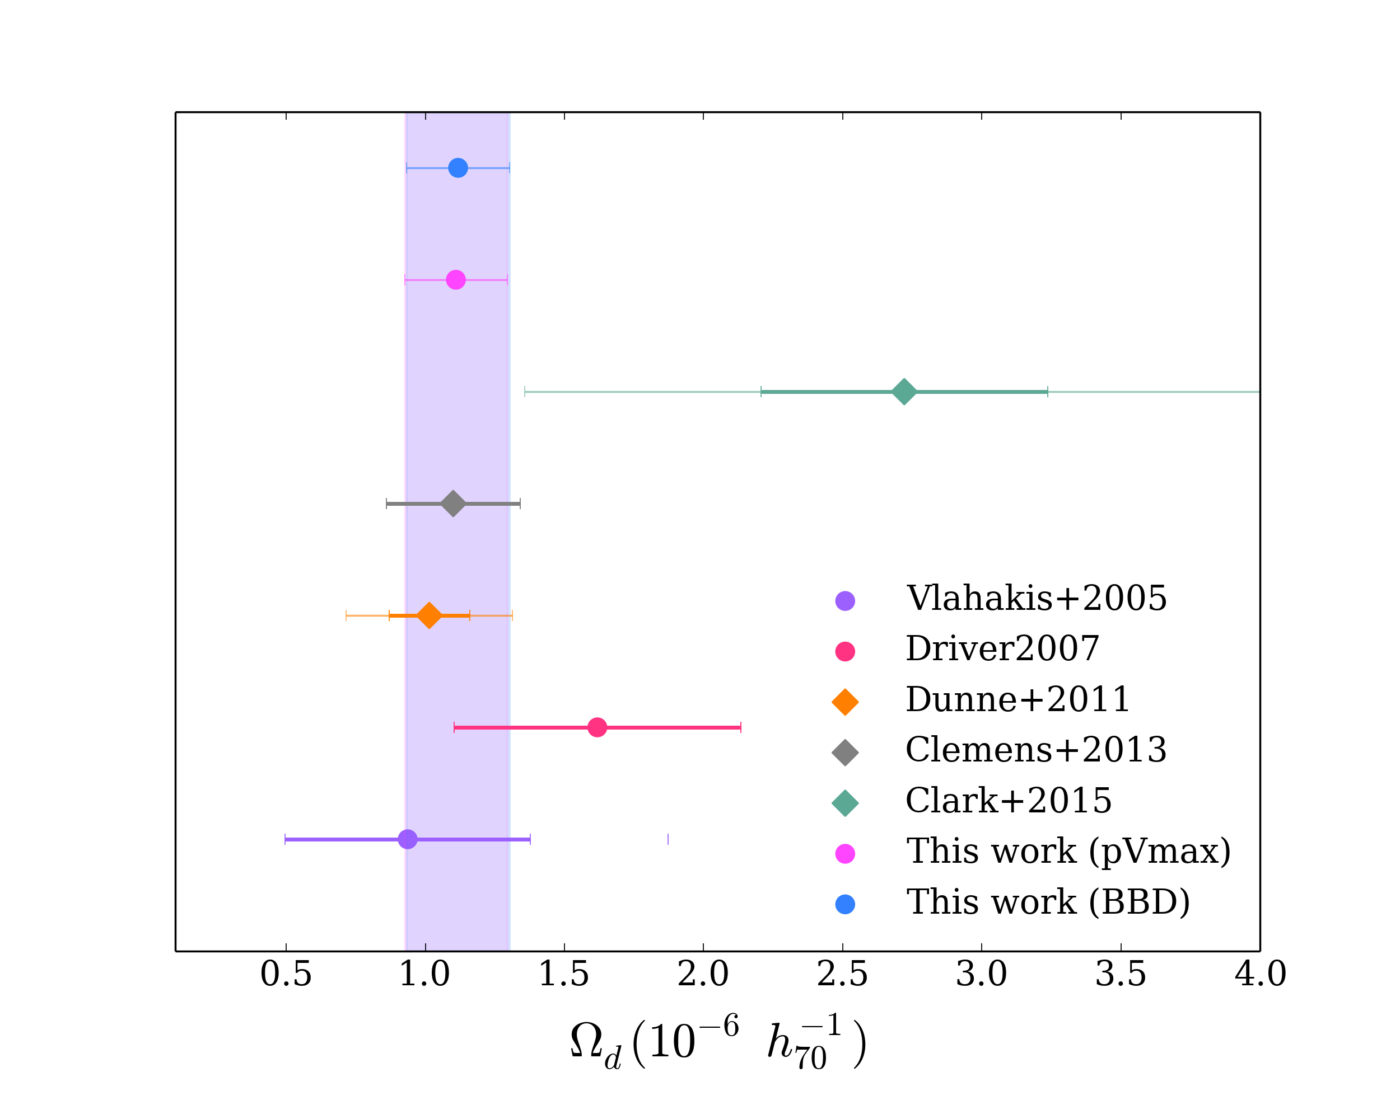
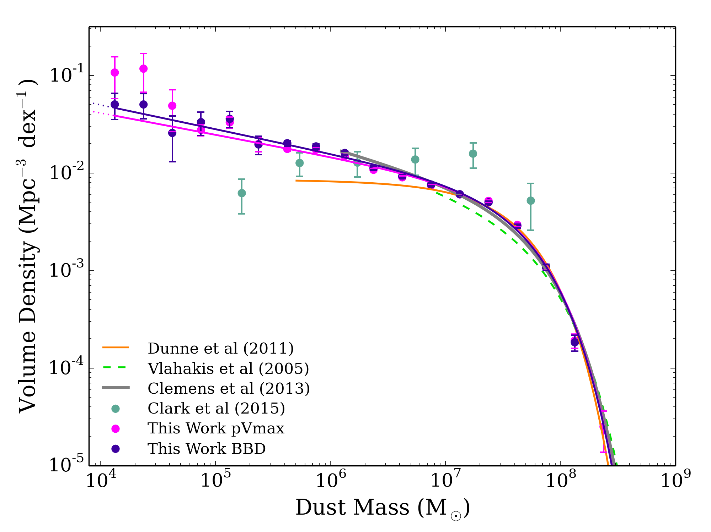
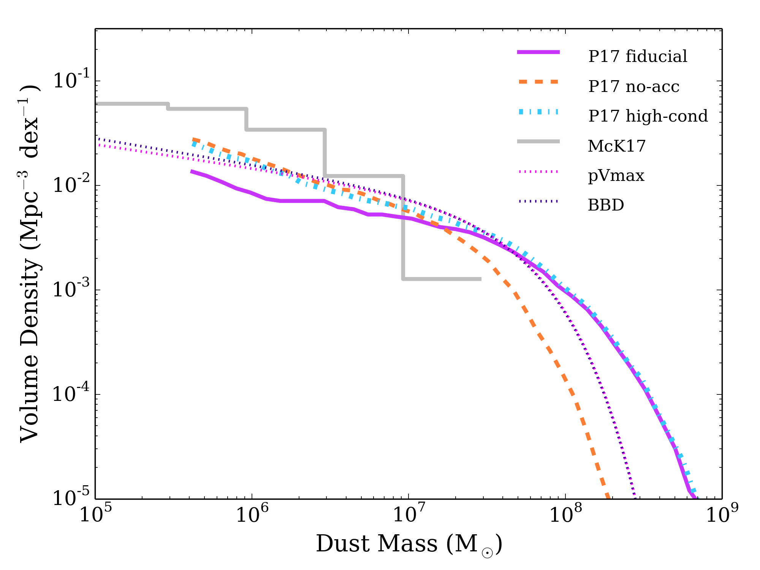
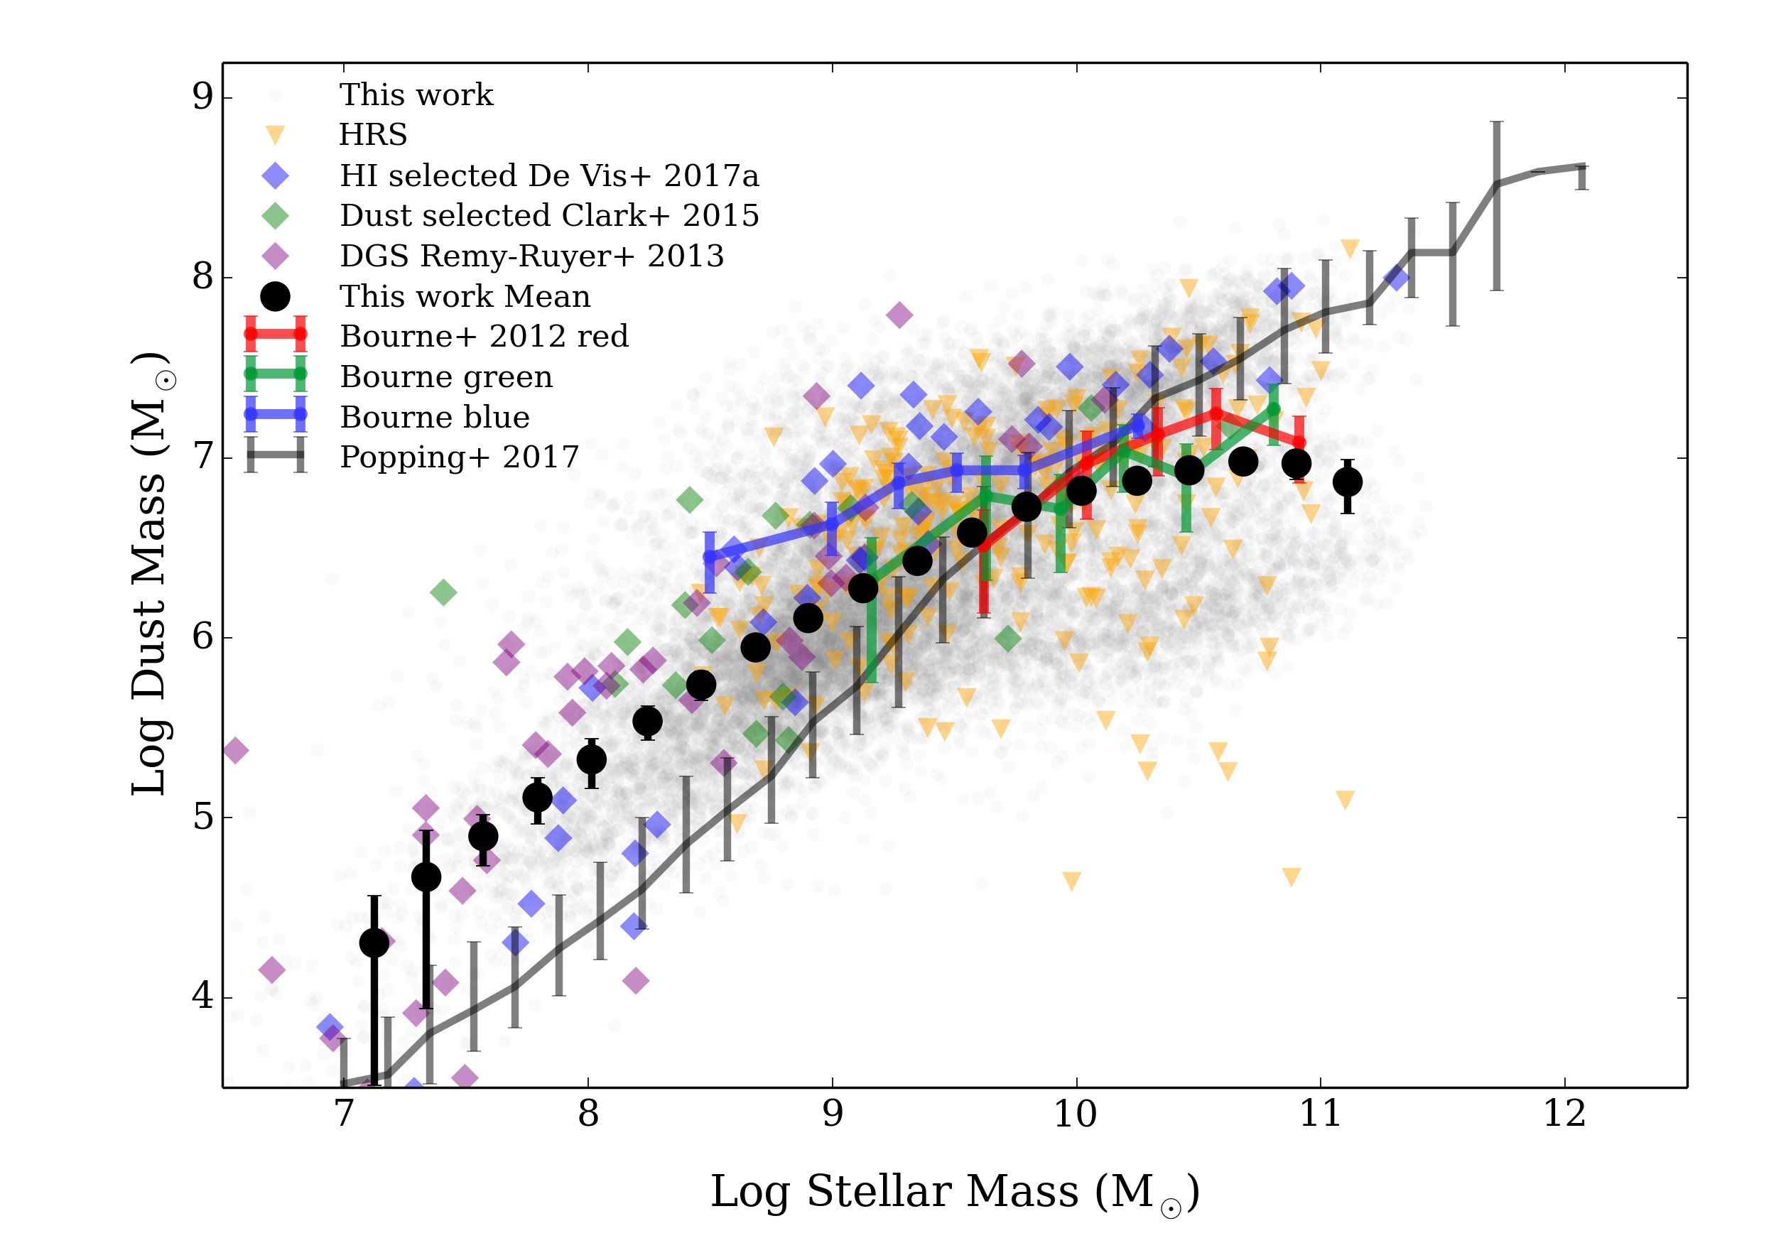
(a)
(b)
FIGURE 1
(Taken from Beeston et al., 2018)
(a) Comparison of the observed DMF data and best-fitting SFs with the best-fitting SFs from the literature of observations of the DMF
(b) Comparison of the cosmic dust density from this work to values the literature of observed DMFs
(c) Comparison of the best-fitting SFs from this work to DMFs arising from semi-analytic models from P17 and cosmological hydrodynamic simulations from McK17
(d) Dust/stellar mass plane for observations from this work and literature with the binned values from P17
(c)
(d)

