Slide 1




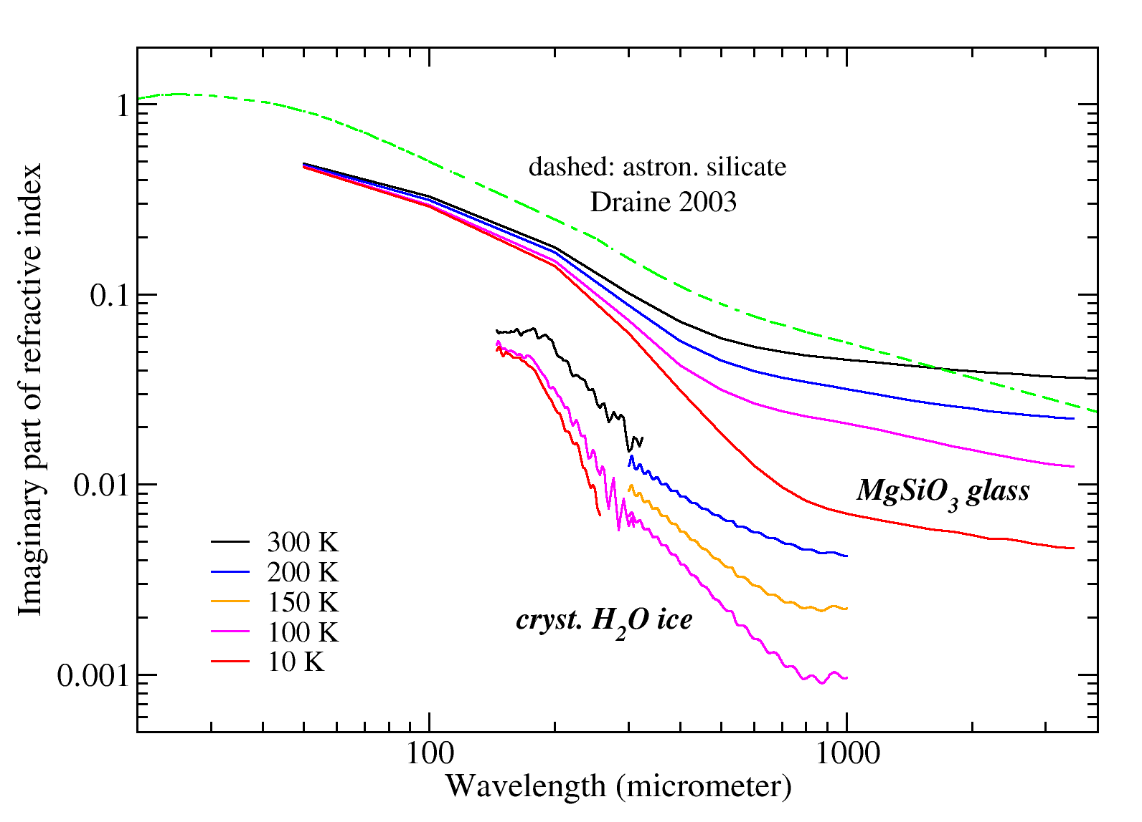
(Sub-)millimeter optical constants of silicates and water ice
¹Astrophysical Institute and University Observatory, FSU Jena
²Institute of Physics I, University of Cologne
³Institut für Geophysik und Extraterr. Physik, Univ. Braunschweig
FOR
2285
Harald Mutschke¹, Pierre Mohr¹, Denny Häßner¹, Frank Lewen², Jürgen Blum³, Tim Dressler², Alexey Potapov², Bastian Gundlach³
Laboratory data on the
far-infrared and mm-wave
absorptivity/emissivity
(T-dependent)
of
Dust analog materials:
am. Mg-Fe silicates
cryst. silicate (enstatite)
cryst. and am. H₂O ice
Poster #39

