Slide 1






Investigating Silicate Dust in Galaxies Using Quasar Absorption Systems
Monique C. Aller (Georgia Southern University)
Varsha P. Kulkarni (University of South Carolina)
Eli Dwek (NASA-GSFC)
Donald G. York (University of Chicago)
Daniel E. Welty (STScI)
Giovanni Vladilo (Osservatorio Astronomico di Trieste)
Alexander Kirby (University of South Carolina)

Slide 2
Outline
Introduction – Quasar Absorption Systems (QASs)
Using QASs to study distant galaxies
Evidence for dust in QASs
Evidence of variations in silicate dust in QASs
Multi-wavelength archival study of dust & gas in QASs
Silicate dust in QASs
Importance of quasar continuum normalizations
Silicate dust detections in local and higher redshift galaxies
Investigation into trends and correlations of dust and gas
Summary & Future Work
Notes:
1. Is the dust in distant galaxies different from that observed locally (e.g. composition, grain structure, spatial distribution), and if so, how?
2. How do the properties of the dust in distant galaxies connect to the observed gaseous properties of the galaxies (e.g. CGM, ISM)?

Slide 3
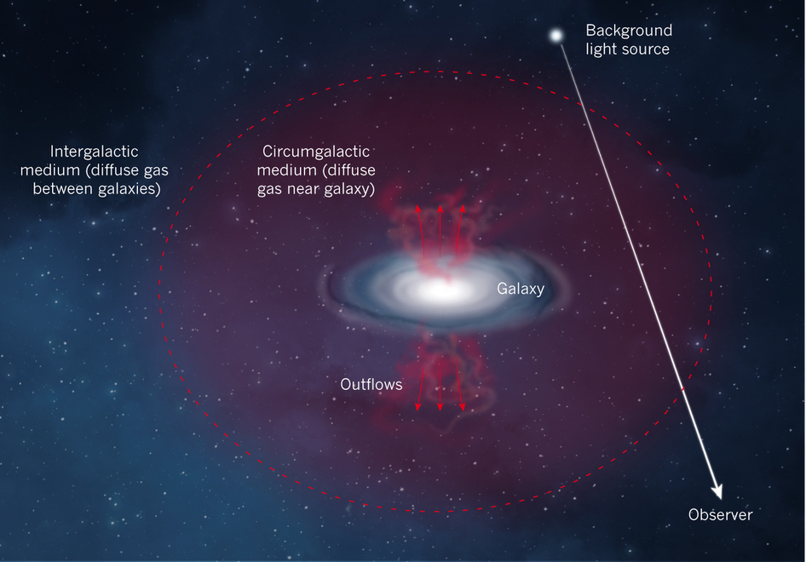
Absorption Features along Line of Sight to Luminous Background Source
Impact parameter
Peeples 2015

Slide 4
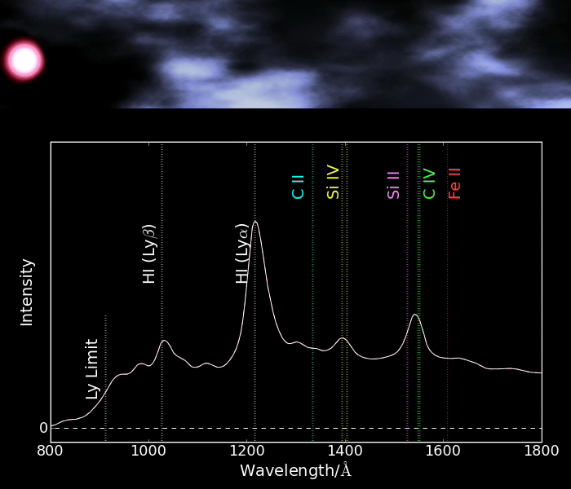
Credit: A Pontzen

Slide 5
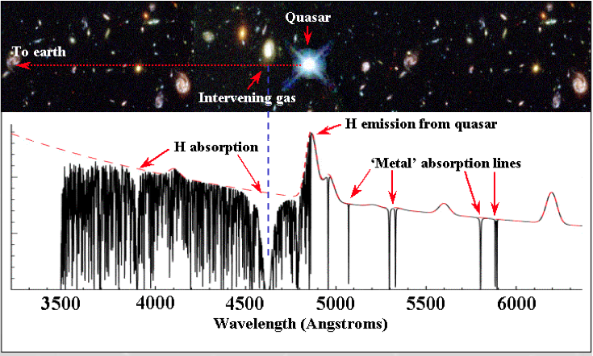
Quasar Absorption Systems (QASs)
Damped Lyman-α absorbers (DLAs): N_{HI} ≥ 2×10²⁰cm⁻²
sub-DLAs: 10¹⁹≤N_{HI}<2×10²⁰cm⁻²
Lyman limit
Si IV
(1393 Å)
C IV
(1548 Å)
From Webb; Pettini 2003
UV/Optical Spectra (gas properties):
abundances; kinematics; temperature; density; ionization parameter
Infrared Spectra (silicate dust):
grain property constraints from 10 and 18 μm absorption features
Notes:
QASs are the primary neutral gas reservoir for star formation (e.g. Storrie-Lombardi & Wolfe 2000) and sample galaxies by gas cross-section, rather than by galaxy brightness. Note that the UV/optical spectra can also be used to detect the 2175A feature and the IR spectra can be used to study PAHs.

Slide 6
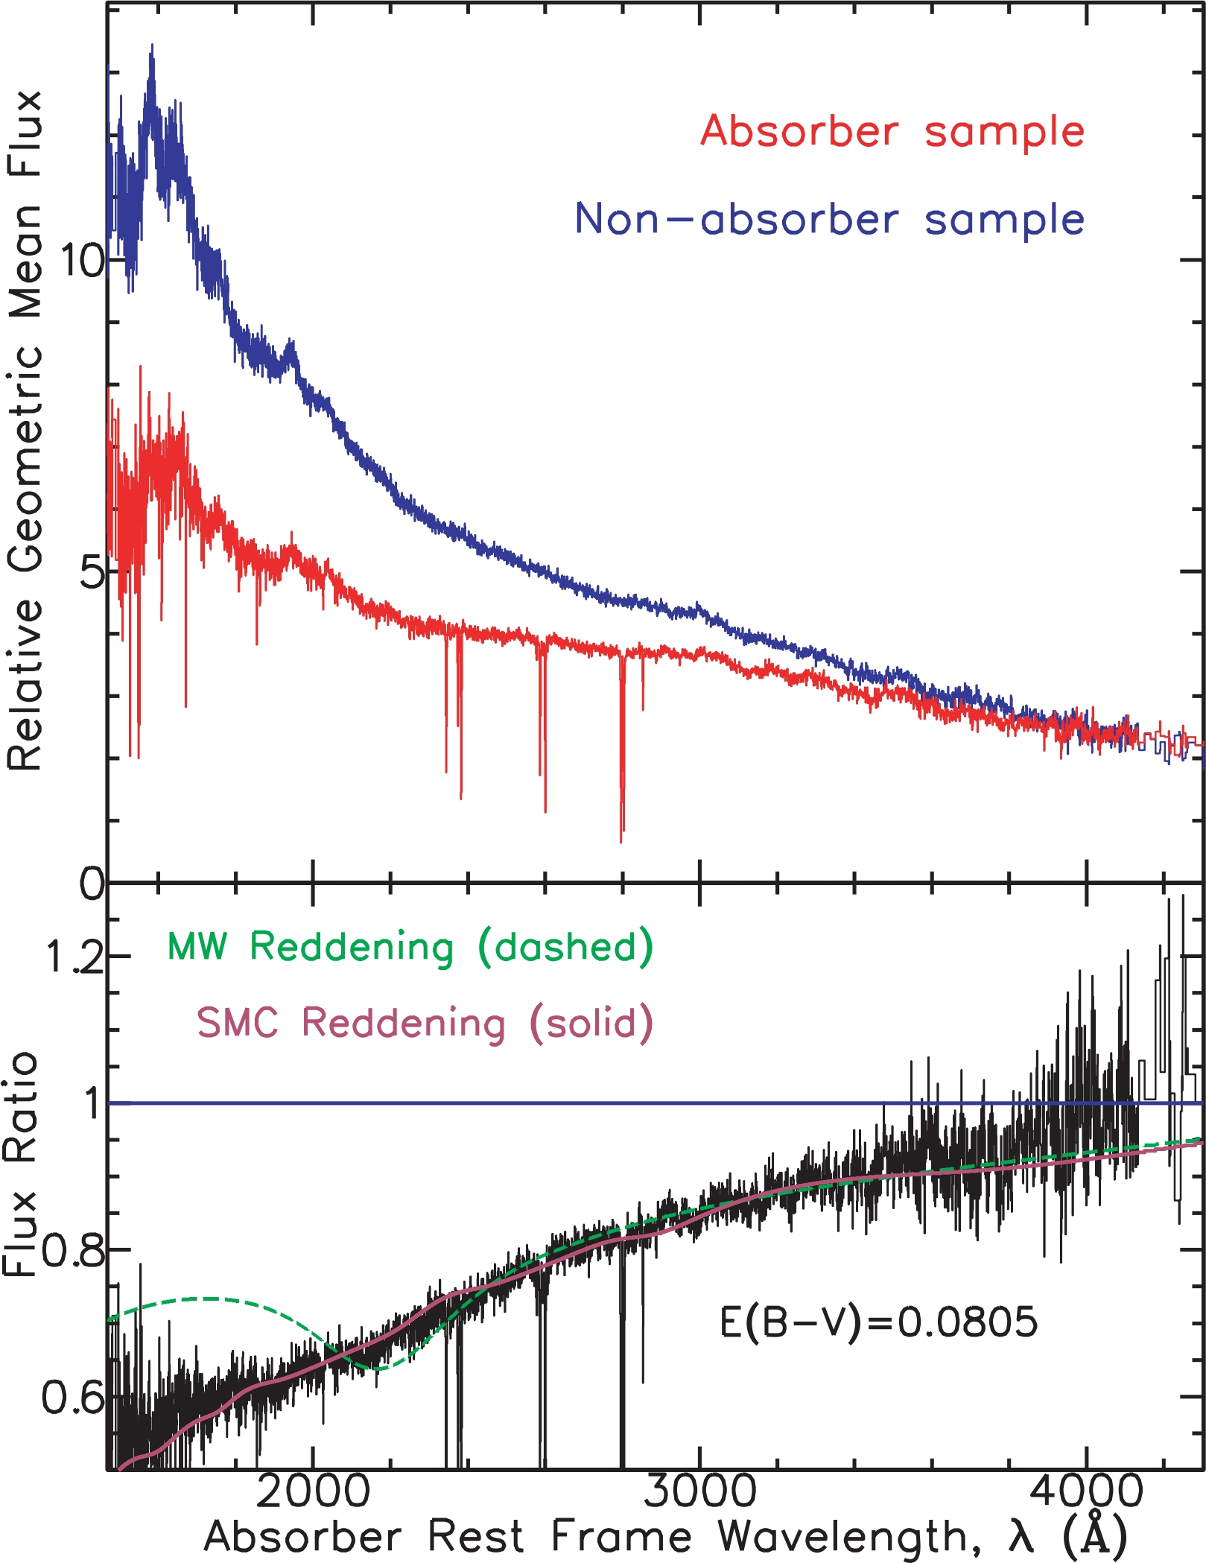
Evidence for Dust in QASs: reddening & depletions
SMC-like reddening for absorbers
809 SDSS absorbers 1<z<2
More severe depletions with increasing metallicity
(e.g., Ledoux et al. 2003; Meiring et al. 2006, 2009)
Kulkarni et al. 2015
X = Zn or S (if Zn unavailable)
York et al. 2006
York et al. 2006
Notes:
Statistical studies find evidence of reddening/extinction of light from background sources (extinction curves) and show depletions. As metallicity increases there is an increasing dust-to-gas ratio. As the total number of metal atoms increases, there are more atoms of refractory elements available to condense. This leads to a stronger depletion of the elements.

Slide 7
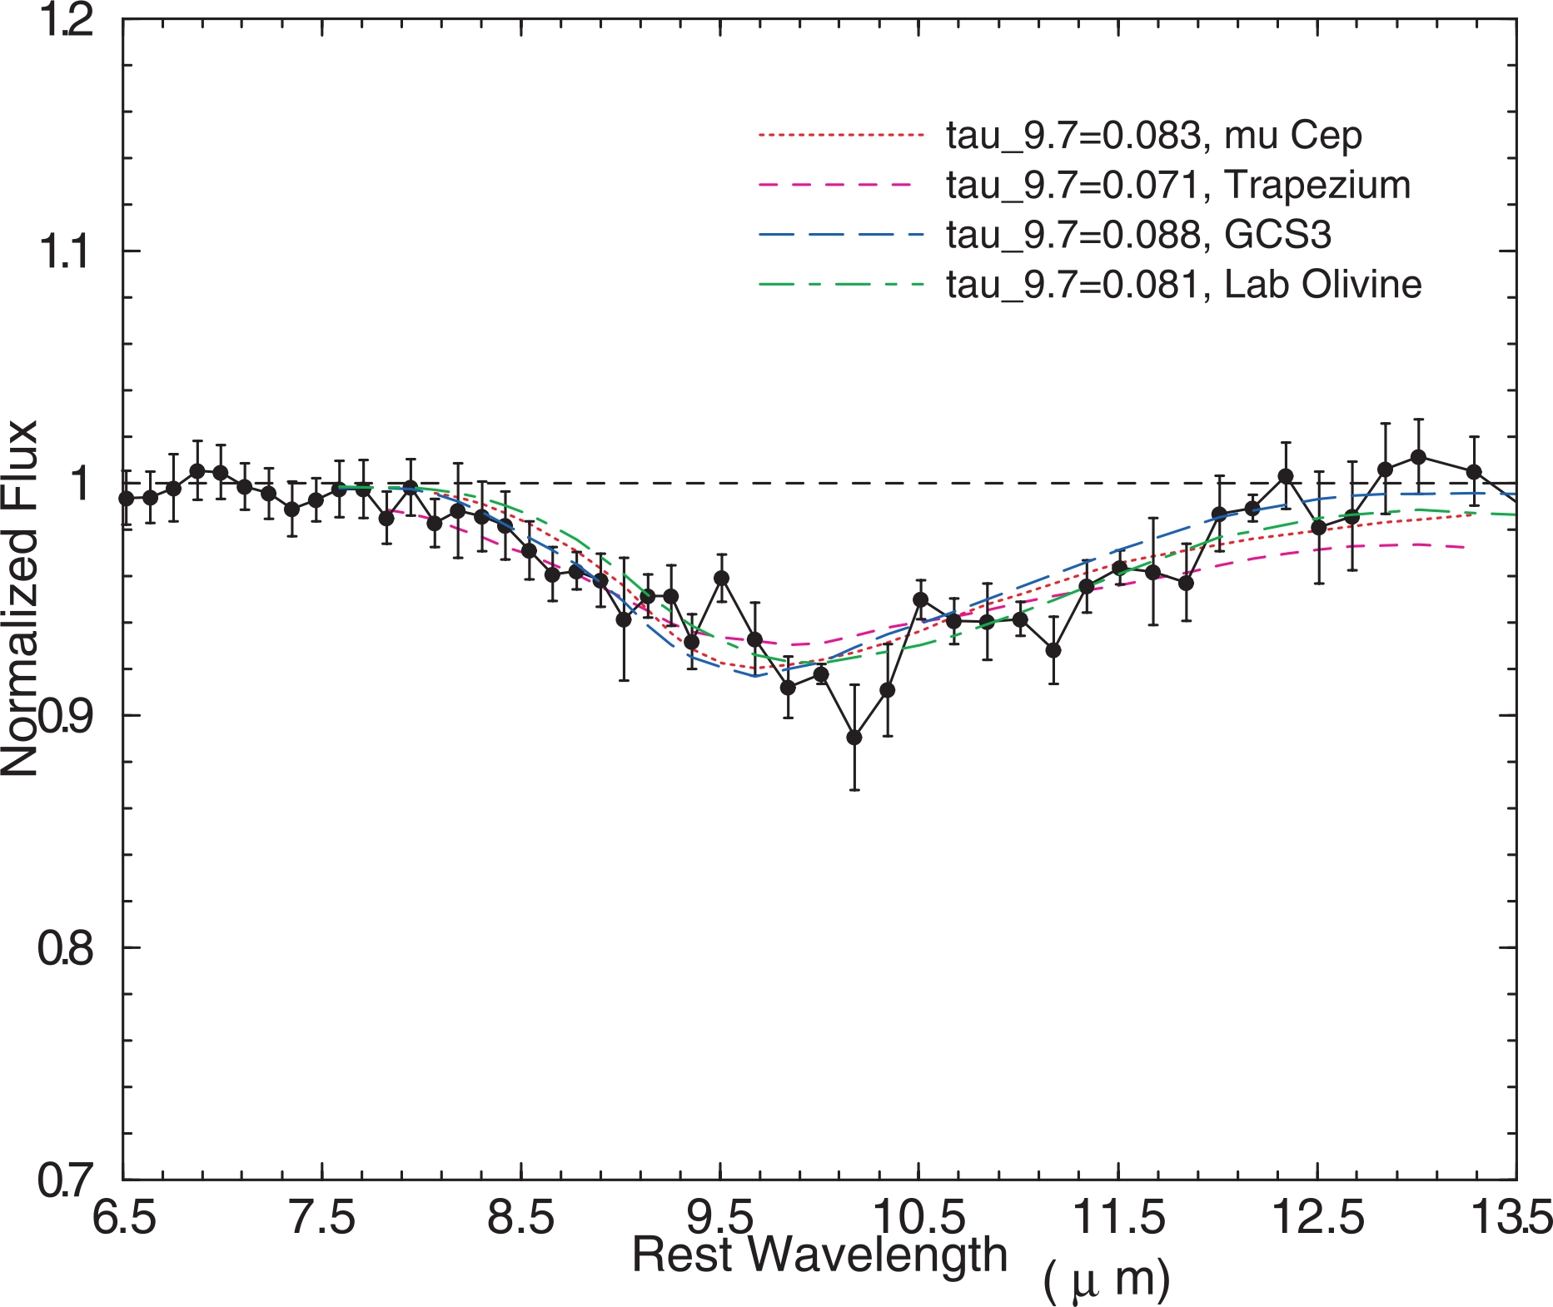
Evidence of Carbonaceous and Silicate Dust in Limited Number of Individual QASs
Silicate Dust in z=0.524 QAS toward blazar AO 0235+164
Dust extinction is present based on 2175 Å bump (carbonaceous)
Kulkarni et al. 2007
Junkkarinen et al. 2004
Feature best-matched by profiles for diffuse Galactic interstellar clouds or laboratory amorphous olivine – with a shallow peak optical depth (~0.08)
Led to dedicated Spitzer IRS mini-survey of 12 dusty gas-rich 0.2≤z_{abs}≤1.4 QASs to investigate silicate dust
Wavelength (Å vacuum)

Slide 8
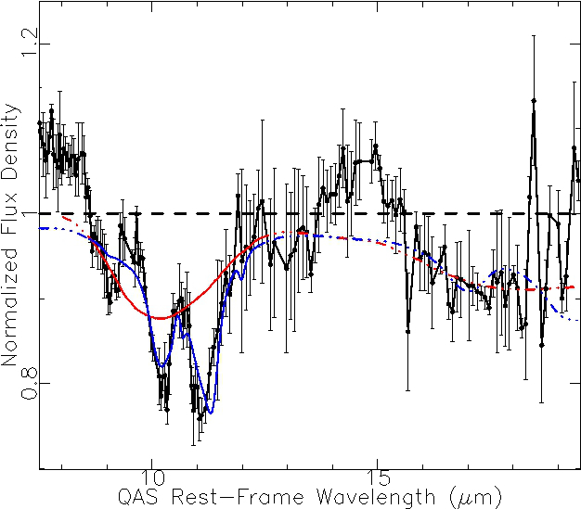
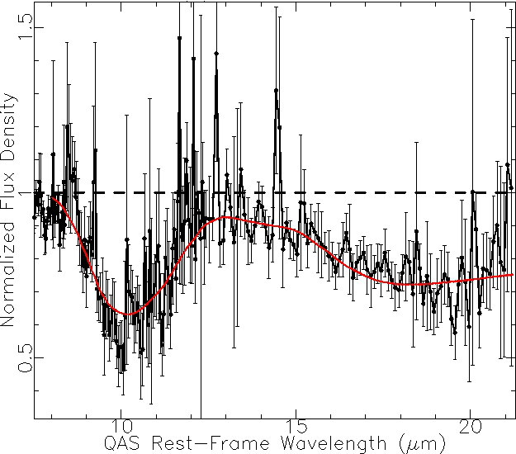
Variations in Silicate Dust in QASs
z=0.9 QAS (log N_{HI}~21.3-21.5)
molecules (e.g., CO, HCO⁺, HCN, H₂O, NH₃)
host galaxy: late-type spiral galaxy
background QSO: lensed blazar
z=0.7 QAS (log N_{HI}~21.1)
molecules (e.g., CO, HCO⁺, H₂O, NH_{3,} LiH)
host galaxy: face-on spiral galaxy
background QSO: lensed blazar
Hortonolite Crystalline Olivine Mg_{1.1}Fe_{0.9}SiO₄ Laboratory Amorphous Olivine
Laboratory Amorphous Olivine
Aller et al. 2012; 2013
Aller et al. 2014
Crystalline Silicates?
Amorphous Silicates?
Notes:
The amorphous template profiles are from Chiar & Tielens (2006), and the crystalline profile is from Jäger et al. 1998. Molecules (left) are discussed in Muller et al. 2011. The broken lines on the left show predictions based on the (solid) line fits.

Slide 9
NASA-ADAP programs to explore connections between gas and dust properties in QASs using archival space- and ground-based data:
DISTANT GALAXIES:
Moderately gas-rich QASs (0.1 <z_{abs}< 2.8)
Dust Measurements in QASs:
Silicate dust 10/18 μm feature in QASs (Spitzer IRS)
Signatures of silicate crystallinity?
Shapes of extinction curves for QASs
Relative abundance of carbon:silicate dust
Gas Measurements in QASs with Dust Information:
Ascertain gas metallicity and depletions
Estimate gas kinematics (e.g. velocity structure)
Connections Between Dust/Gas and Models:
Interrelation between gas and dust properties in connection to dust/ chemical evolution models
LOCAL GALAXIES:
Sightlines to background AGN close to Galactic plane or through local galaxies
Dust Measurements:
Silicate dust 10/18 μm feature
Extinction curves along sightlines
2175 Å features along same sightline to look at carbon:silicate ratio
Gas Measurements:
Gas phase element depletions
Connections Between Local and Higher Redshift Dust:
Examine dust properties and correlations at low redshift (<0.1) relative to those in higher redshift study
V. P. Kulkarni (PI, U. South Carolina); M.C. Aller (co-I/Science-PI; Ga. Southern U.); E. Dwek (co-I; NASA-GSFC)
V. P. Kulkarni (PI, U. South Carolina); M.C. Aller (co-I; Ga. Southern U.); E. Dwek (co-I; NASA-GSFC)
Notes:
Our high redshift sample includes sources with Log N_{HI}≥18.0 or EW_{Mg II}≥0.5 Å or EW_{Na} _{I}≥1.0 Å with Spitzer IRS spectra. The depletions are normally elements such as Fe, Cr, Si.

Slide 10
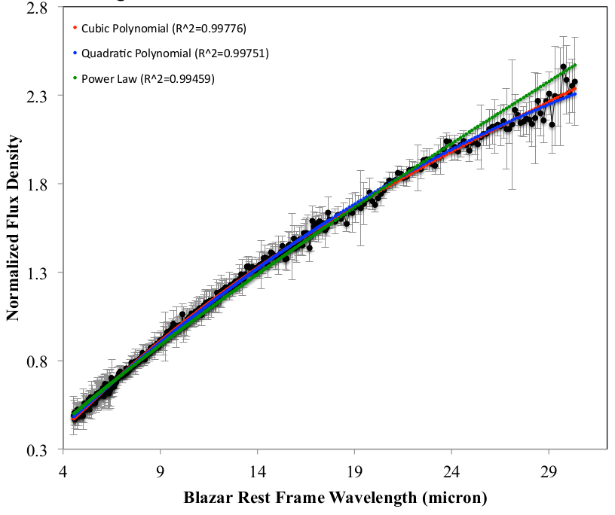
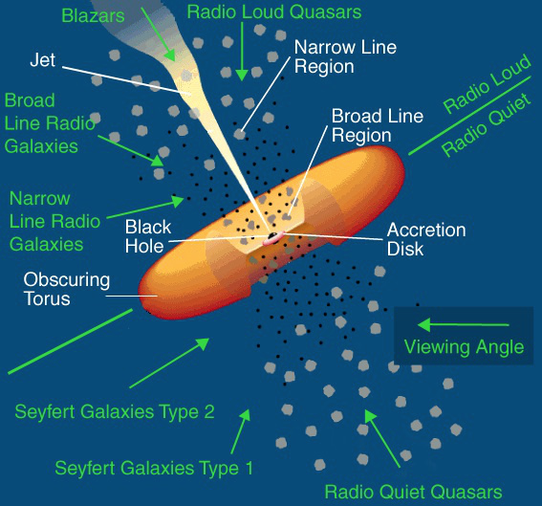
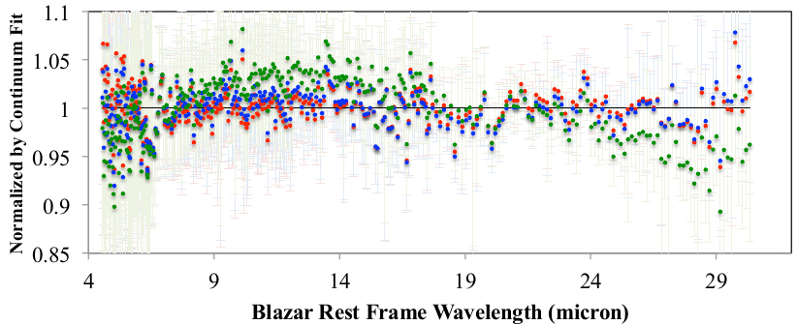
Quasar Continuum Normalization
LSP BL Lac without Absorber
Credit: Pierre Auger Observatory
Notes:
We begin our investigation with blazars, which can be in the form of BL Lacs or FSRQs (separated by properties such as the optical emission lines and polarization and structure in the jets).

Slide 11
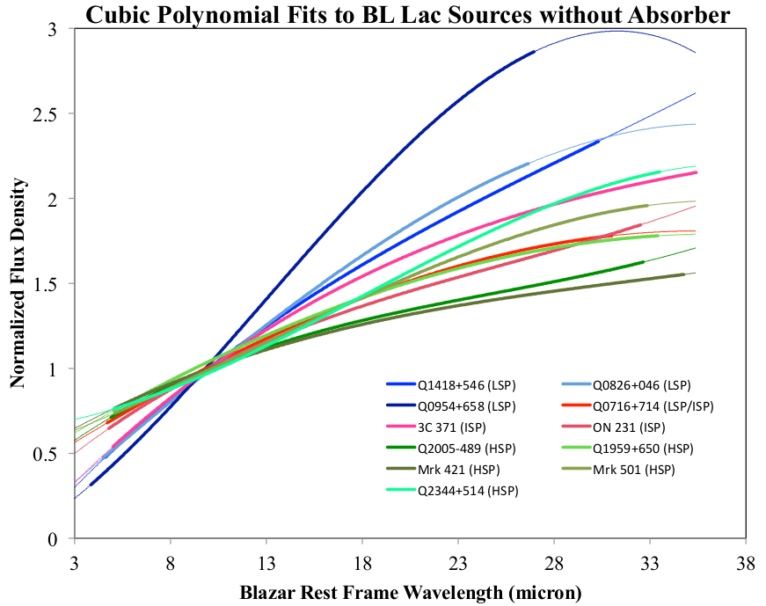
Quasar Continuum Normalization
Spectra from CASSIS (Lebouteiller et al. 2011; 2015)
Notes:
Lines are solid over the fitting region - fainter dotted lines over the region where extrapolated

Slide 12
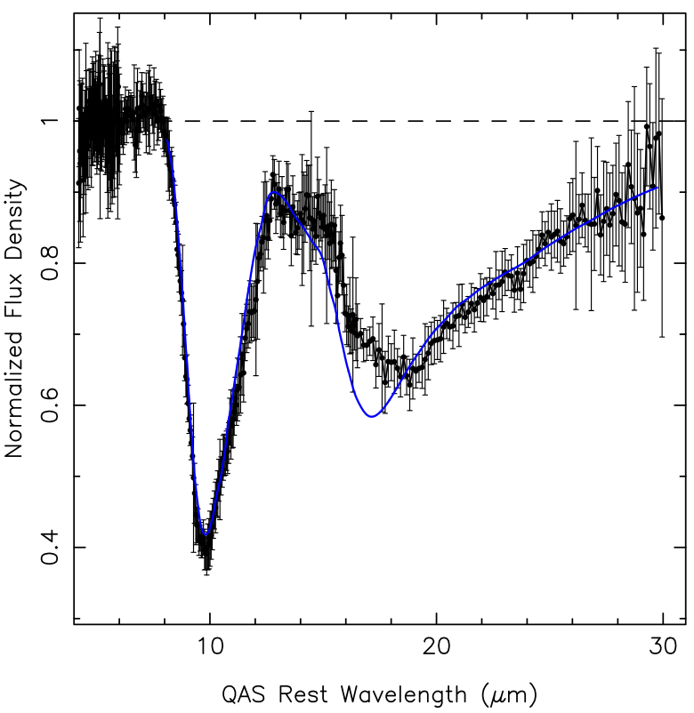
z=0.2 DLA (log N_{HI}~22) in a spiral host galaxy
τ₁₀=0.871
McHardy et al. 1991
in blazar host galaxy
blazar: LSP BL Lac
rich in molecules (e.g., CO, CN, OH, HCO⁺, HCN, HNC)
exhibits 21-cm absorption
Laboratory amorphous olivine profile
Notes:
Laboratory amorphous olivine profile (Chiar & Tielens 2006) fit over 10 & 18 μm features The system is rich in molecules (e.g., CO, CN, OH, HCO⁺, HCN, HNC; Wiklind & Combes 1997, Kanekar & Chengalur 2002) and exhibits 21-cm absorption (Kanekar & Chengalur 2003).

Slide 13
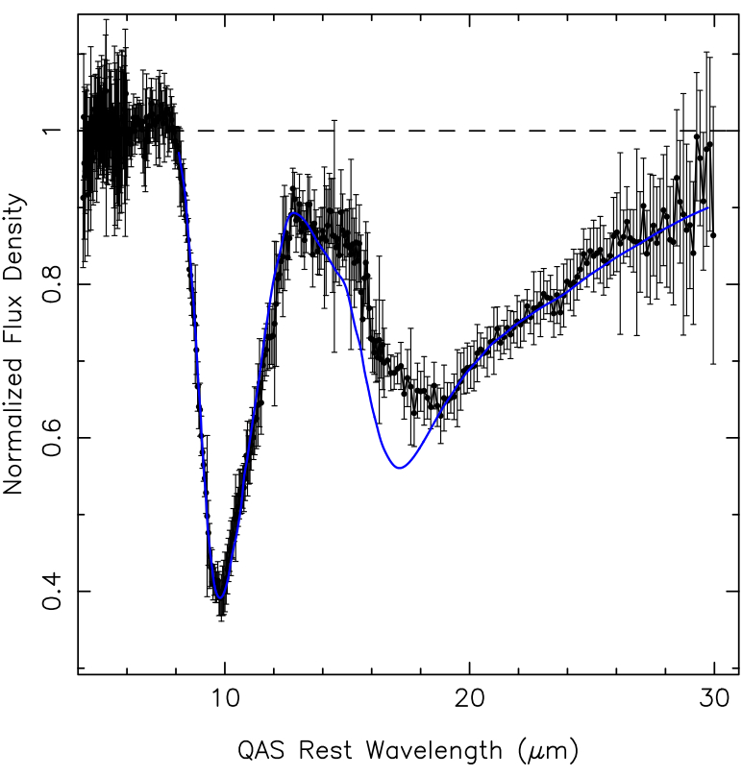
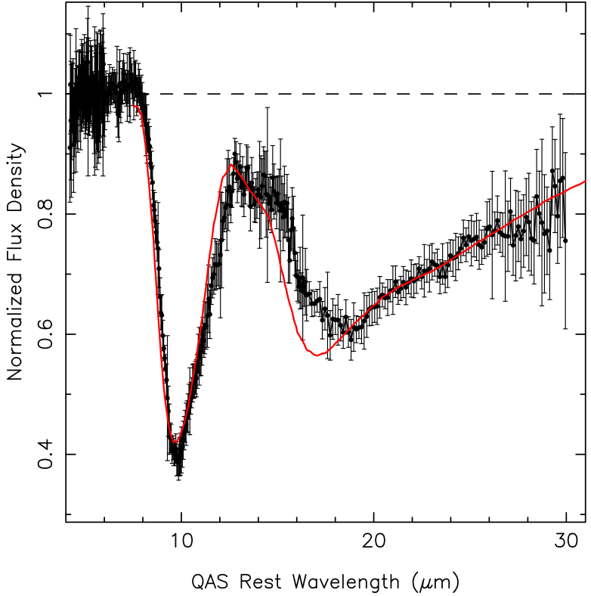
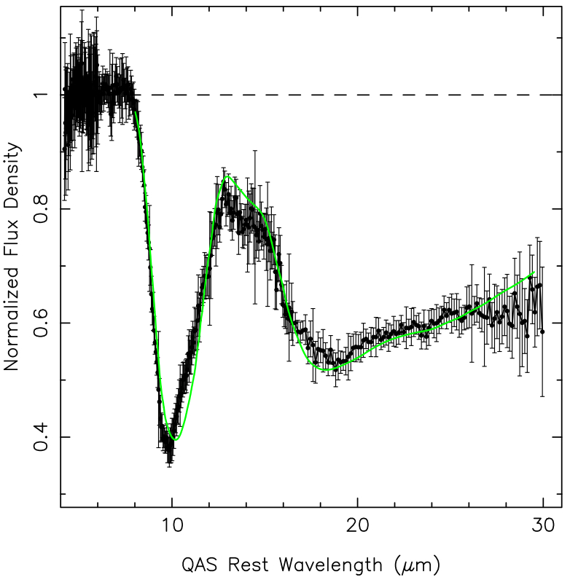
Variations in 10-18 micron ratio with Normalization
τ₁₀=0.94+0.01
τ₁₀=0.87+0.01
τ₁₀=0.92+0.01
Amorphous olivine (solid, spherical particles)
Laboratory amorphous olivine
Amorphous olivine (porous, ellipsoidal particles)
Different quasar continuum normalizations can significantly impact the 10:18 micron ratio
The background blazar is classified as an LSP BL Lac
Notes:
First and third template profiles are from from Chiar & Tielens 2006, and the central profile is from Spoon et al. 2006 (obtained from Fabian et al. 2001).
The fits are only performed over the 10 μm feature, and beyond 13.5 μm the predicted shape of the profile over the 18 μm feature is shown.

Slide 14
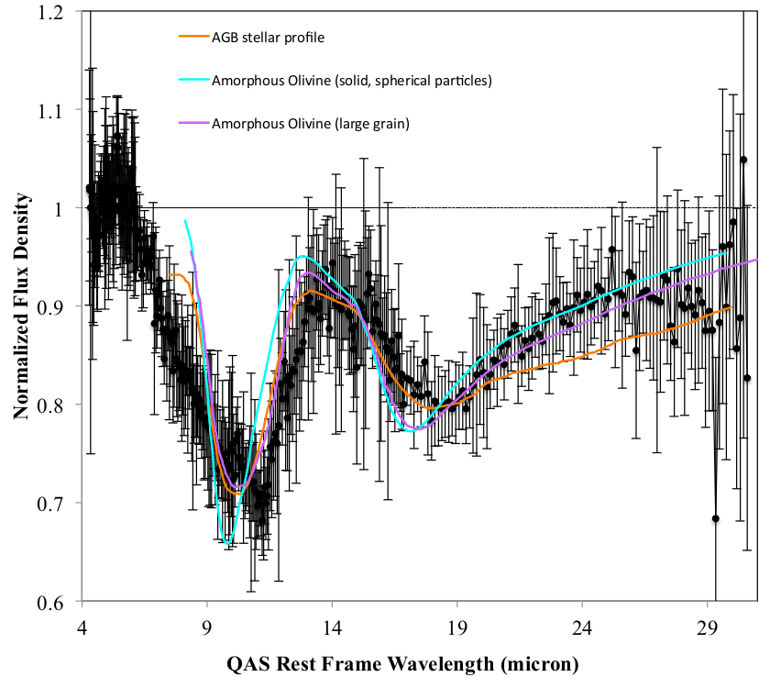
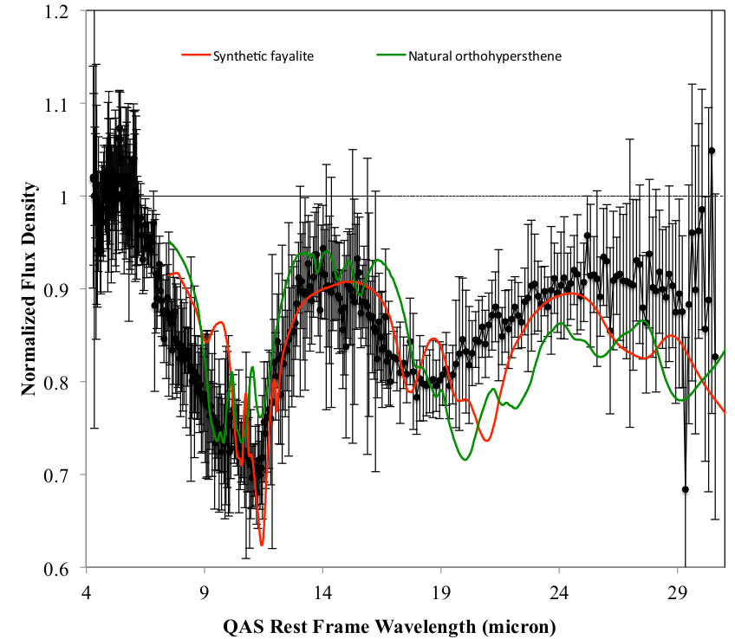
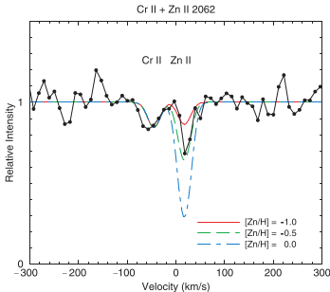
z=0.2 DLA (log N_{HI}~21) in early-type dwarf galaxy
τ₁₀=0.344
τ₁₀=0.418
τ₁₀=0.334
τ₁₀=0.472
τ₁₀=0.335
impact parameter 20 kpc
LSP FSRQ blazar
disk-dominated galaxy, with a B/D ratio of 0.34
SFR <0.3M/yr
< 20% solar metallicity
Kulkarni et al. (2005)
Notes:
Note that the breadth of the 10 micron feature is hard to match with amorphous olivine, which could be due to crystallinity or due to a contribution from the z=0.09 absorber along the sightline (although then the 18 micron feature would be missing for that absorber). The crystalline silicate profiles are from Jaeger et al. 1998 (Fayalite Fe₂SiO₄ & hypersthene Mg_{0.65}Fe_{0.35}SiO₃). The orange (O-rich AGB star) and cyan profiles are from Chiar & Tielens 2006, and the magenta template profile is from Dorschner et al. 1995. This galaxy appears disk-dominated, with a bulge/disk ratio of 0.34 (Chun et al. 2006) and a SFR <0.3M/yr (Turnshek et al. 2001).

Slide 15
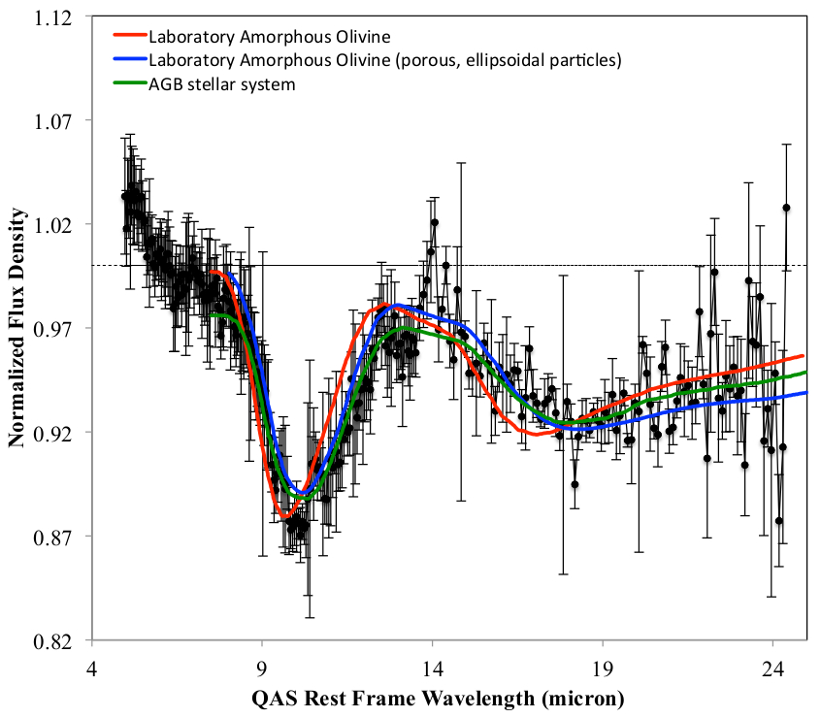
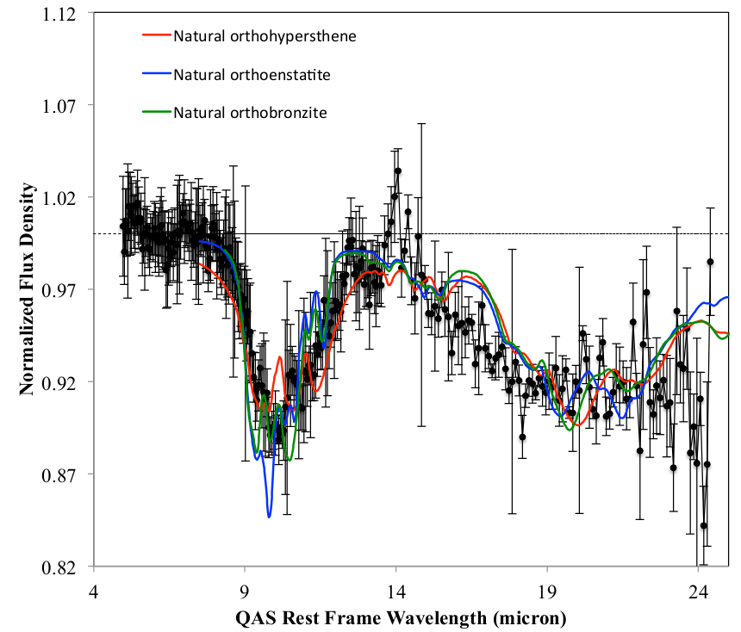
z=0.5 DLA (log N_{HI}=22) to LSP blazar
τ₁₀=0.129
τ₁₀=0.115
τ₁₀=0.119
τ₁₀=0.110
τ₁₀=0.131
τ₁₀=0.176
Absorber Properties:
21-cm and X-ray absorption
metallicity of 0.7 solar
strong 2175 Å bump
several diffuse interstellar bands
.
Notes:
The crystalline silicate profiles are from Jaeger et al. 1998 (hypersthene Mg_{0.65}Fe_{0.35}SiO₃; enstatite Mg_{0.96}Fe_{0.04}SiO₃; bronzite Mg_{0.88}Fe_{0.12}SiO₃), the red profile is from Spoon et al. 2006, the blue and green (O-rich AGB star) profiles are from Chiar & Tielens 2006. The QAS exhibits a strong 2175 Å bump, as well as several diffuse interstellar bands (e.g., 4428, 4482 Junkkarinen et al. 2004).

Slide 16
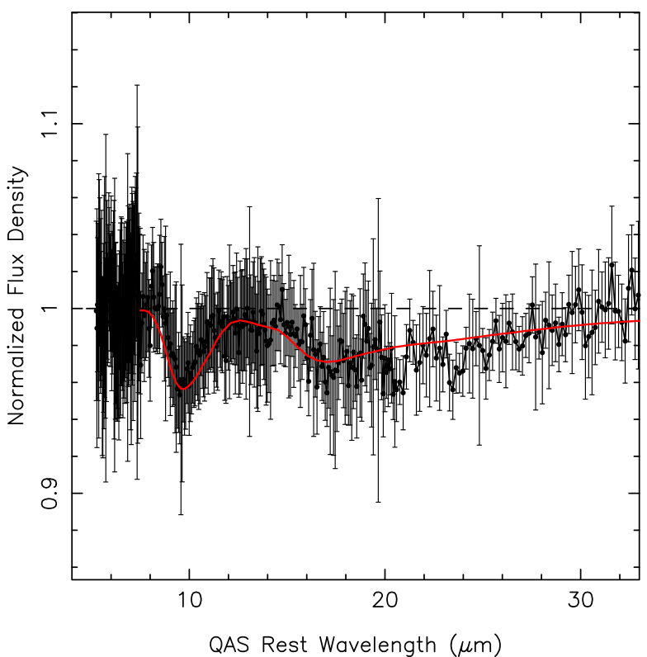
Local Universe: Milky Way Sightline
τ₁₀=0.045
As part of our investigation into the relationship between silicate and carbonaceous dust in the Milky Way galaxy and Local Group galaxies, we are examining all AGN sightlines passing close to the Galactic plane.
Laboratory amorphous olivine
This sightline to an LSP BL Lac blazar at a Galactic latitude of -10°.
Notes:
Laboratory amorphous olivine profile (from Spoon et al. 2006), fit over 10 & 18 μm features. The quasar continuum normalization is better defined because the data extends past 30 microns.

Slide 17
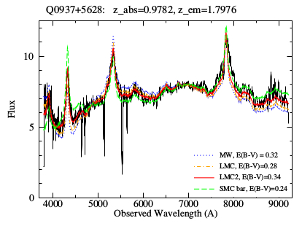
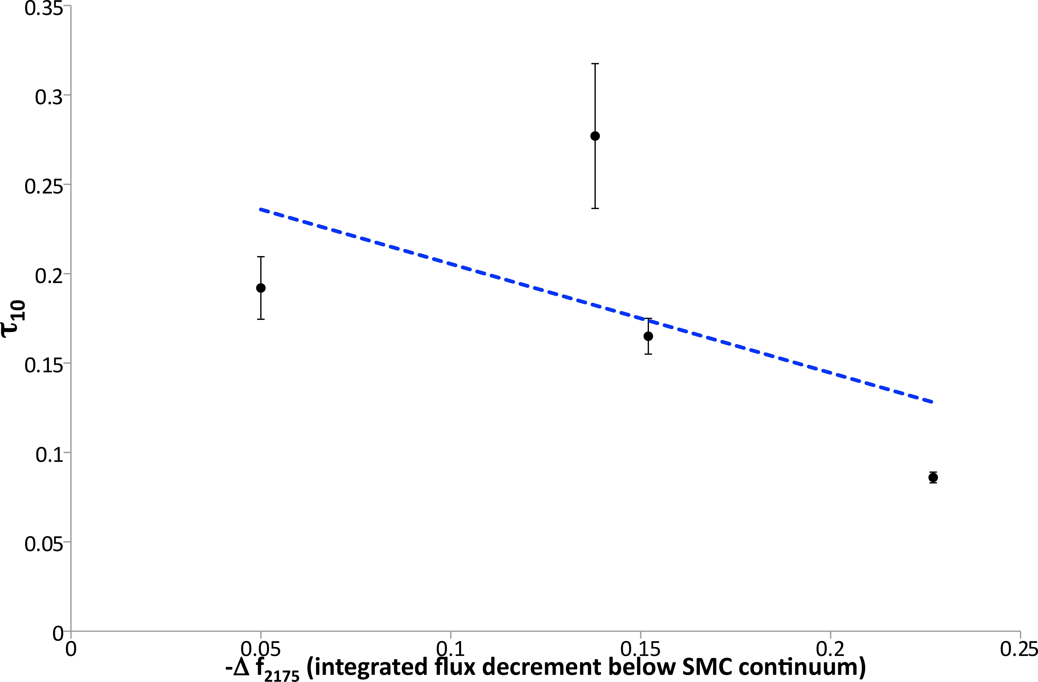
Extinction Curves & 2175 Å Bump
Fitting extinction curves to SEDs constructed for sightlines to 72 AGN with known z>0.1 absorption systems & measuring 2175 Å strength
Kulkarni et al. 2011
As part of our investigation into the relationship between silicate and carbonaceous dust in the Milky Way galaxy and Local Group galaxies, we are examining all AGN sightlines passing close to the Galactic plane. This sightline to an LSP BL Lac blazar at a Galactic latitude of -10° has weak absorption features consistent with silicate dust absorption in the Milky Way. The shape of these features are consistent with laboratory amorphous olivine over the 10 and 18 μm features.

Slide 18
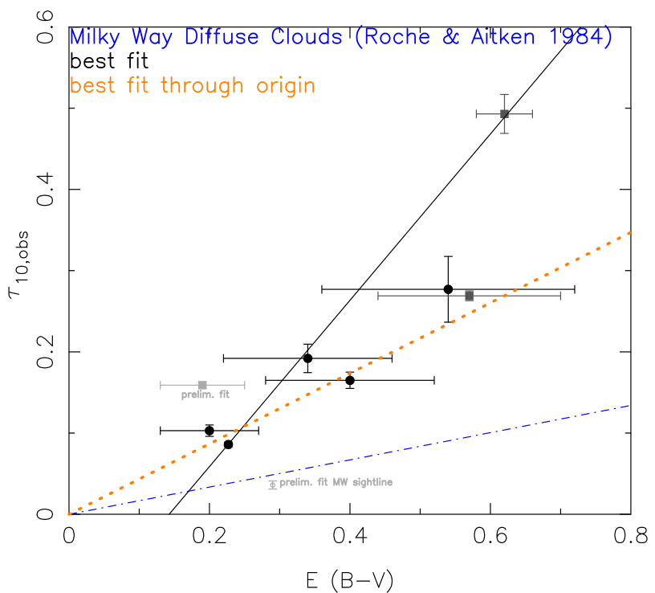
Silicate Dust vs. Reddening in QASs
Grain differences?
e.g. larger grains-low UV extinction
Sampling different dust grain population?
e.g. face-on vs. through MW disk
Different stellar populations?
e.g. more O-rich
Slope of relation is 3-6x higher for QASs than for Milky Way diffuse clouds
Milky Way diffuse clouds extrapolation
f_{cov}=1 assumed in all QASs

Slide 19
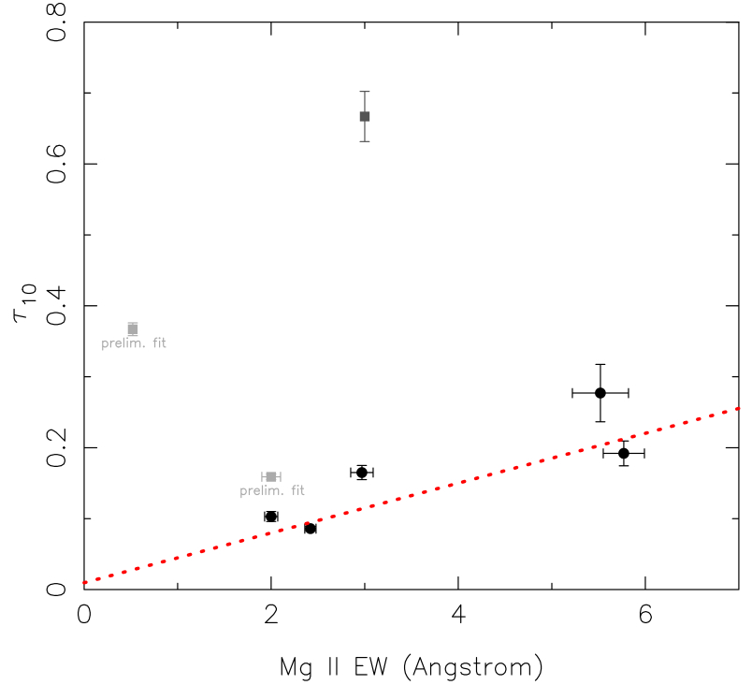
Silicate Dust vs Mg II EW in QASs
Suggestion of trend between Mg II EW and silicate 10 μm peak optical depth:
Are silicate-rich QASs more massive?
Mg II saturated in most systems, and is proxy for velocity spread (QAS mass; outflows)
Notes:
Dotted red line fit excludes the lensed QAS (which appears to be an outlier) and the two (light grey) QASs with preliminary silicate dust measurements

Slide 20
Summary & Future Work
Silicate dust in absorption in QASs
10 μm (and 18 μm) silicate absorption in gas-rich QASs at z<1.4
Variation in shape, breadth of absorption feature
Ratio of 10:18 μm feature & derived grain properties dependent on continuum normalization
➔Exploring more systems with non-blazar AGN (more structured)
Trends of τ₁₀ with other dust and gas properties of QAS
Correlation with E(B-V) – but steeper slope than in MW clouds
Possible Trend with Mg II EW – silicate rich are more massive?
Suggestion of anti-correlation with carbonaceous dust abs. strength
➔Investigating with larger/more diverse sample
Big Picture Questions Working to Address:
ISM metallicity vs. depletion? → enrichment of gas versus solid phase following peak era of SF
Dust composition –distant galaxies dominated by silicate or carbonaceous dust? → SFH; extinction corrections for distant galaxies
Silicate grain structure → Crystallinity implies recent SF or weaker ISM processing; grain structures crucial in dust models
Gas-Dust Interrelations: trends between metallicity-silicate dust-galaxy mass-dust abundance → is dust processing more efficient in high mass or higher SFR galaxies?

