Slide 1
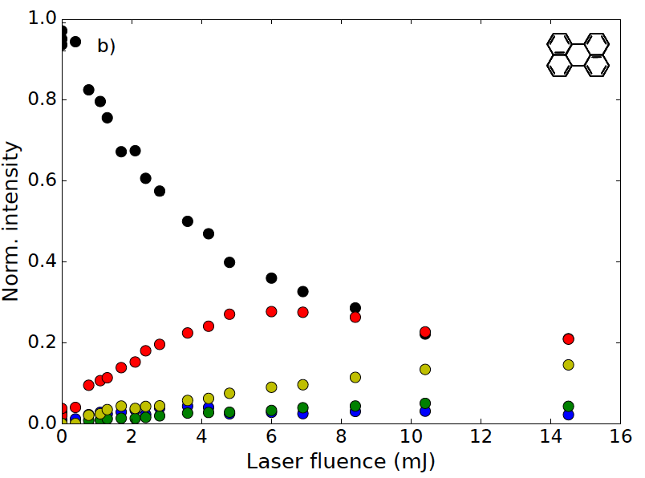
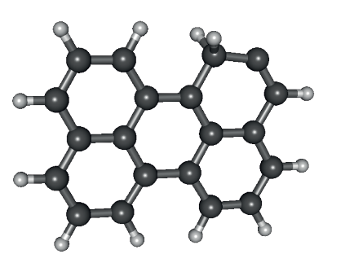
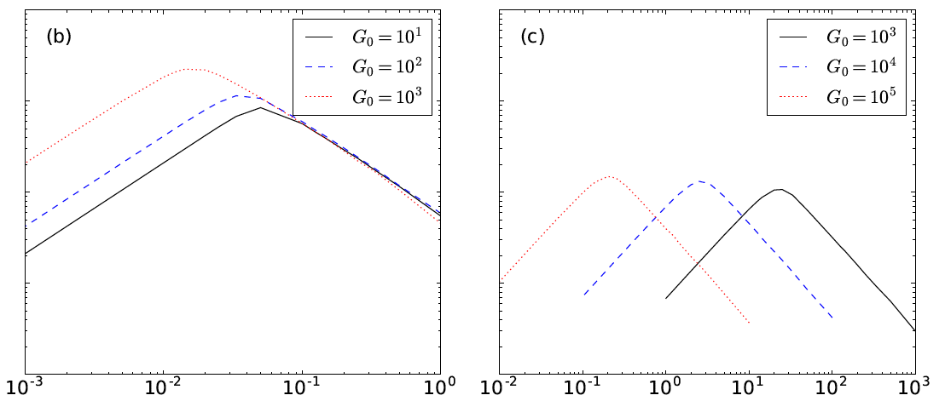

PAH⁺ dehydrogenation and the formation of H₂
P. Castellanos, A. Candian, H. Andrews, J. Zhen, H. Linnartz, A.G.G.M. Tielens
2H-loss
Odd –to-even peak ratio
Parent
1st H loss
2nd H loss
3rd H loss
4th H loss
H₂-loss
1
0.1
H₂ efficiency
PAPERS:
Castellanos, Candian et al, (2018a), arXiv:1806.02703
Castellanos, Candian et al, (2018b), arXiv:1806.02708
0.001
E-MAIL: candian@strw.leidenuniv.nl
POSTER ID: 141
G₀/n(H)

