Slide 1
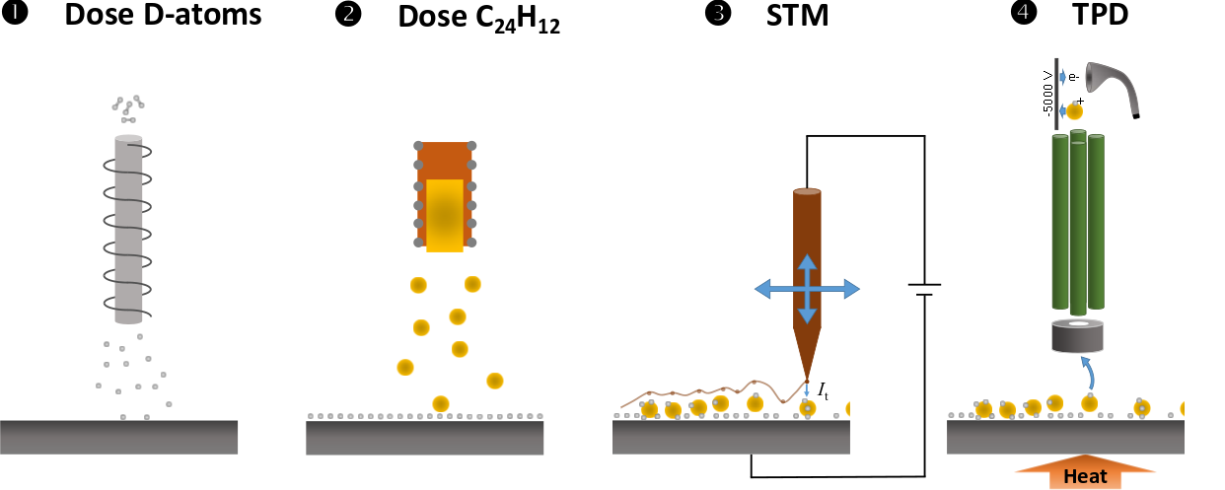
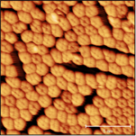
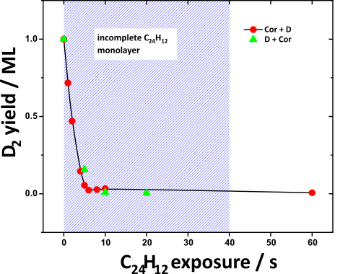
Superhydrogenation of PAHs through interaction with hydrogenated grain surfaces
PAHs pick up H from hydrogenated graphite.
#173

