Slide 1
Quantum Corrections to Holographic Wilson Loops
Konstantin Zarembo
(Nordita)
A. Cagnazzo, D. Medina-Rincon, K.Z., 1712.07730
D. Medina-Rincon, A. Tseytlin, K.Z., 1804.08925
IGST 2018, Copenhagen, 21.8.18

Slide 2
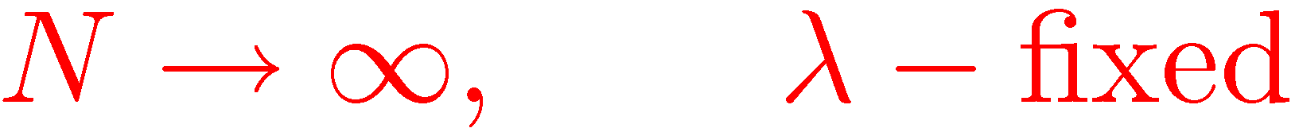
Wilson loops
Large-N limit:
’t Hooft’74
Area law:
Wilson’74

Slide 3
Holography
Maldacena’98
Rey, Yee’98
Q: What is ?
strong coupling
N=4
&
N=2*
SYM:
ABJM:

Slide 4
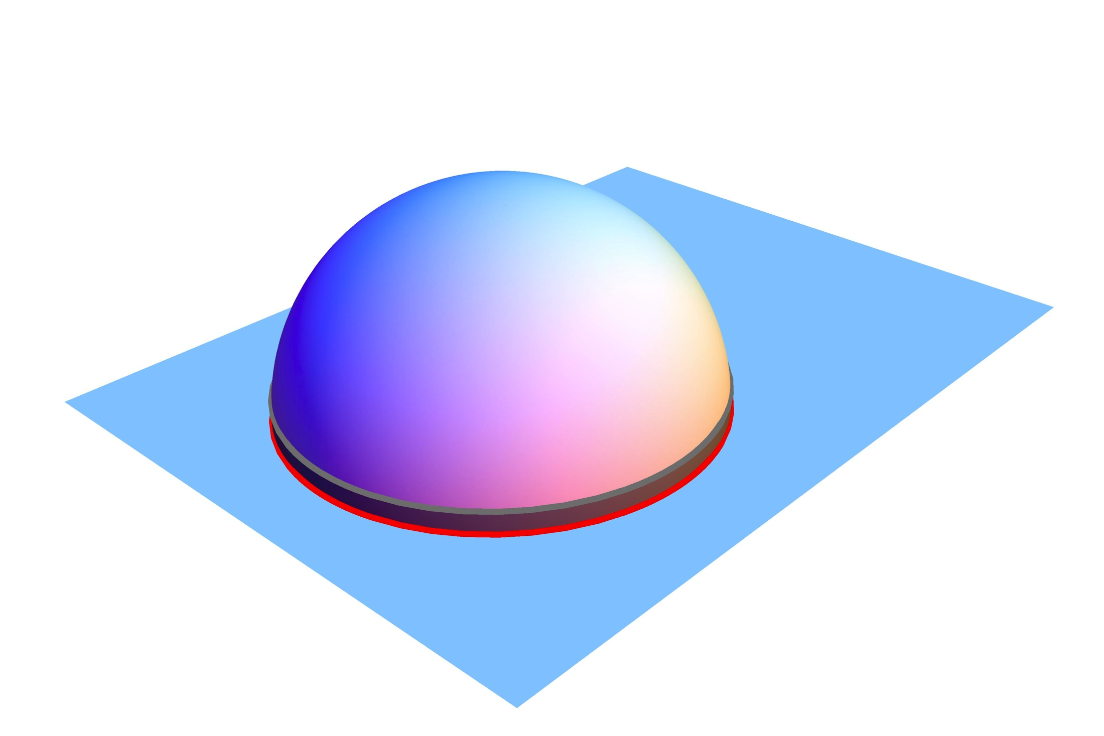

Example: circular loop
Drukker,Gross,Ooguri’99
Berenstein,Corrado,Fischler,Maldacena’98
Area:
regularized area

Slide 5
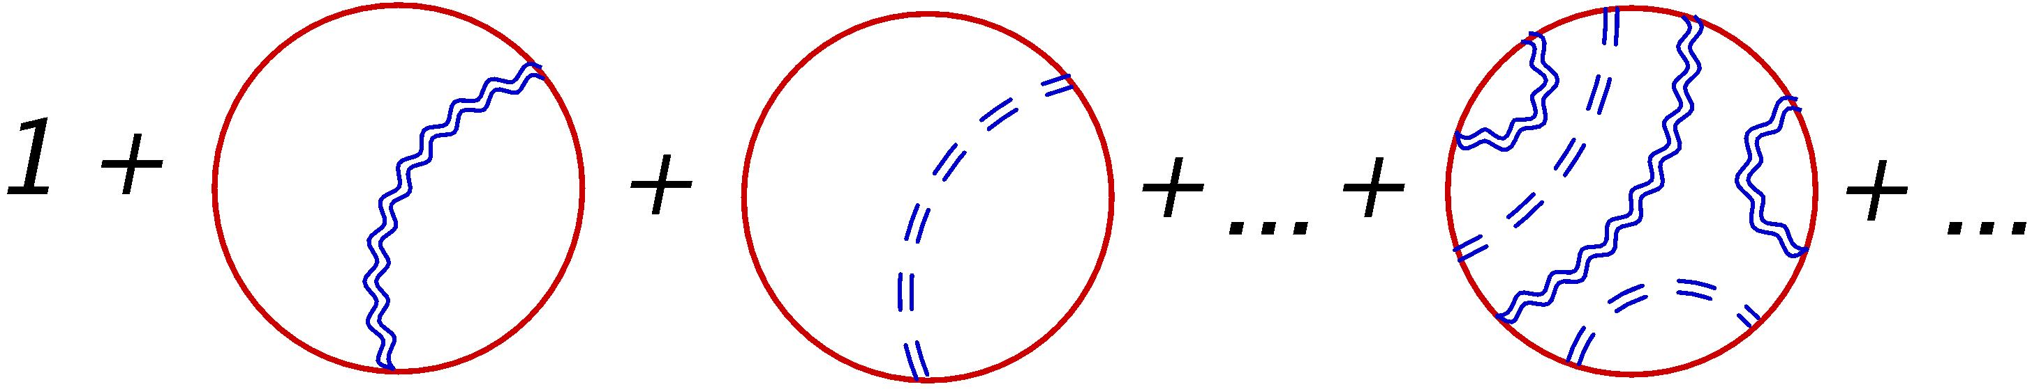
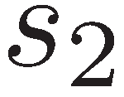
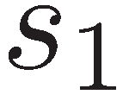

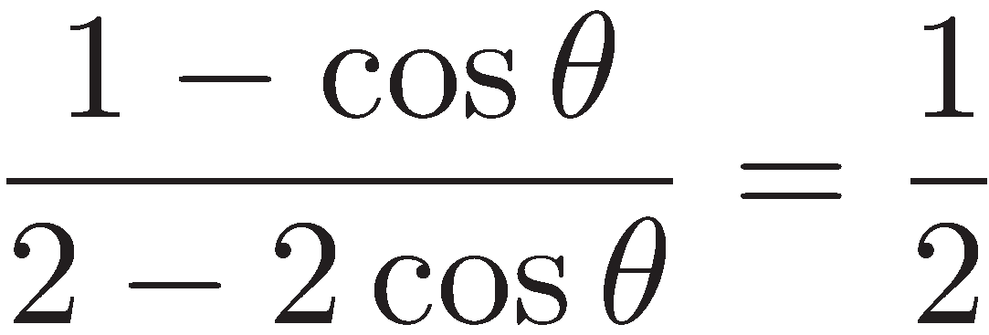
Circular loop: planar diagrams
θ
=

Slide 6
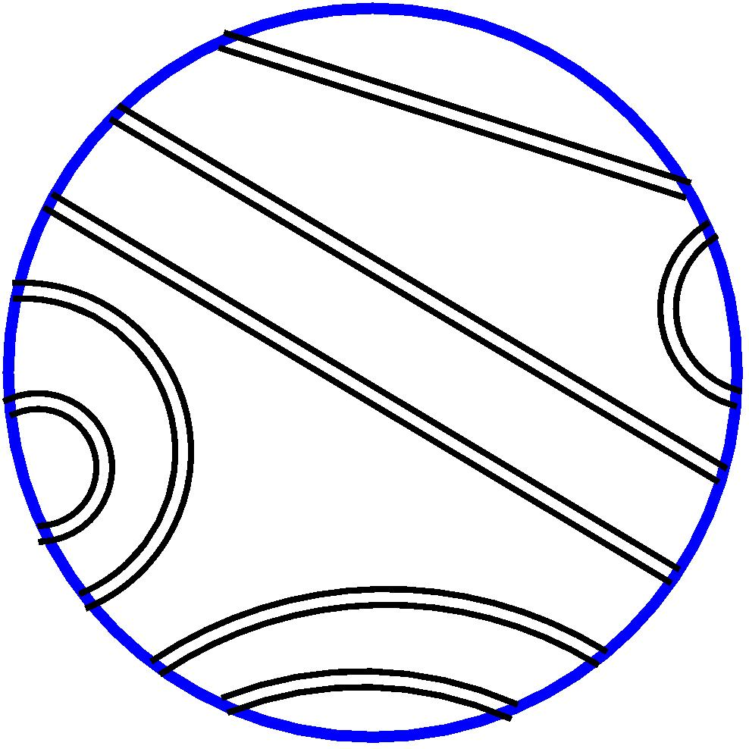
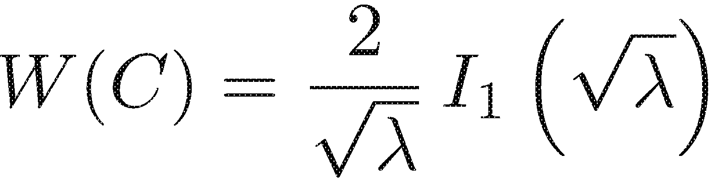
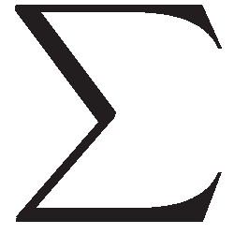

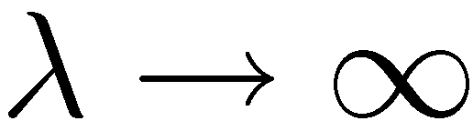
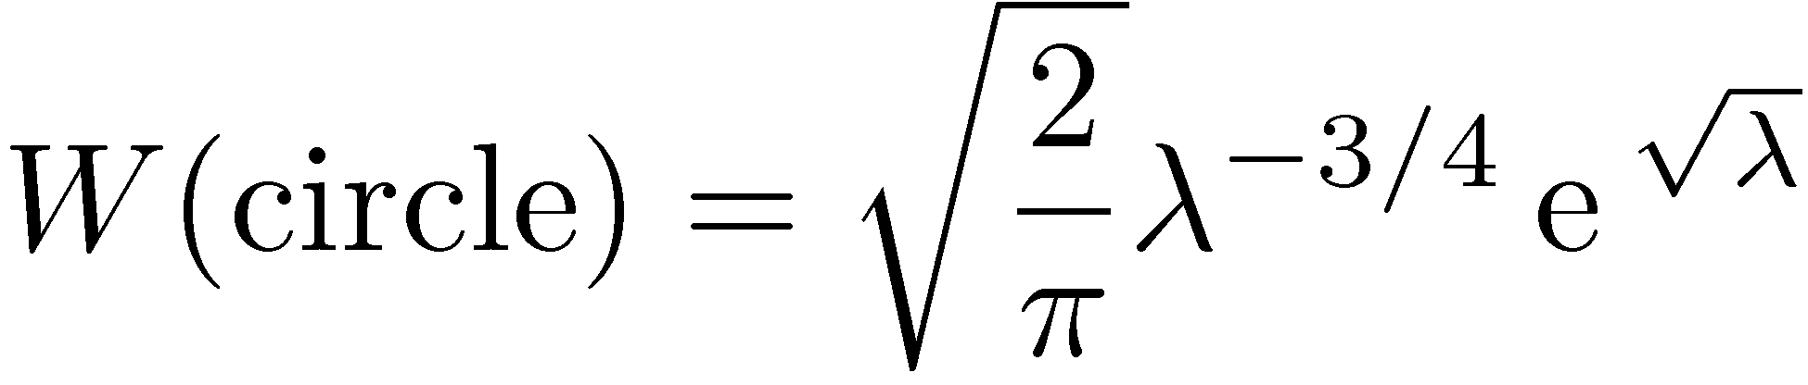
Circular loop: exact result
Erickson,Semenoff,Z.’00
Drukker,Gross’00
Pestun’07
String fluctuations
Vol(SL₂)?
Area law
Drukker, Gross,Tseytlin’00
Kruczenski,Tirziu’08
Kristjansen,Makeenko’12
Buchbinder, Tseytlin’14

Slide 7
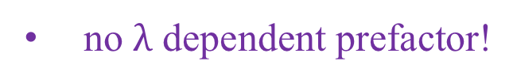
N=4:
?
ABJM:
Drukker, Marino, Putrov’10
no $λ$ dependent prefactor!

Slide 8
Latitude
Supersymmetric latitude:
Z.’02
One loop:
Guralnik, Kulik’03
Guralnik, Kovacs, Kulik’04

Slide 9
Ratios of Wilson loops
Forini, Puletti, Griguolo, Seminara, Vescovi’15
Faraggi, Pando Zayas, Silva, Trancanelli’16
Forini, Tseytlin, Vescovi’17
calculate W_{L}, with W_{C} as normalization factor
since W_{L} =1, this is equivalent to calculating W_{C}
Localization prediction at strong coupling:

Slide 10


Classical solution
AdS₅
S⁵
$$∈$$
$$∈$$
S³
S¹
C:
L:
3d moduli space!

Slide 11
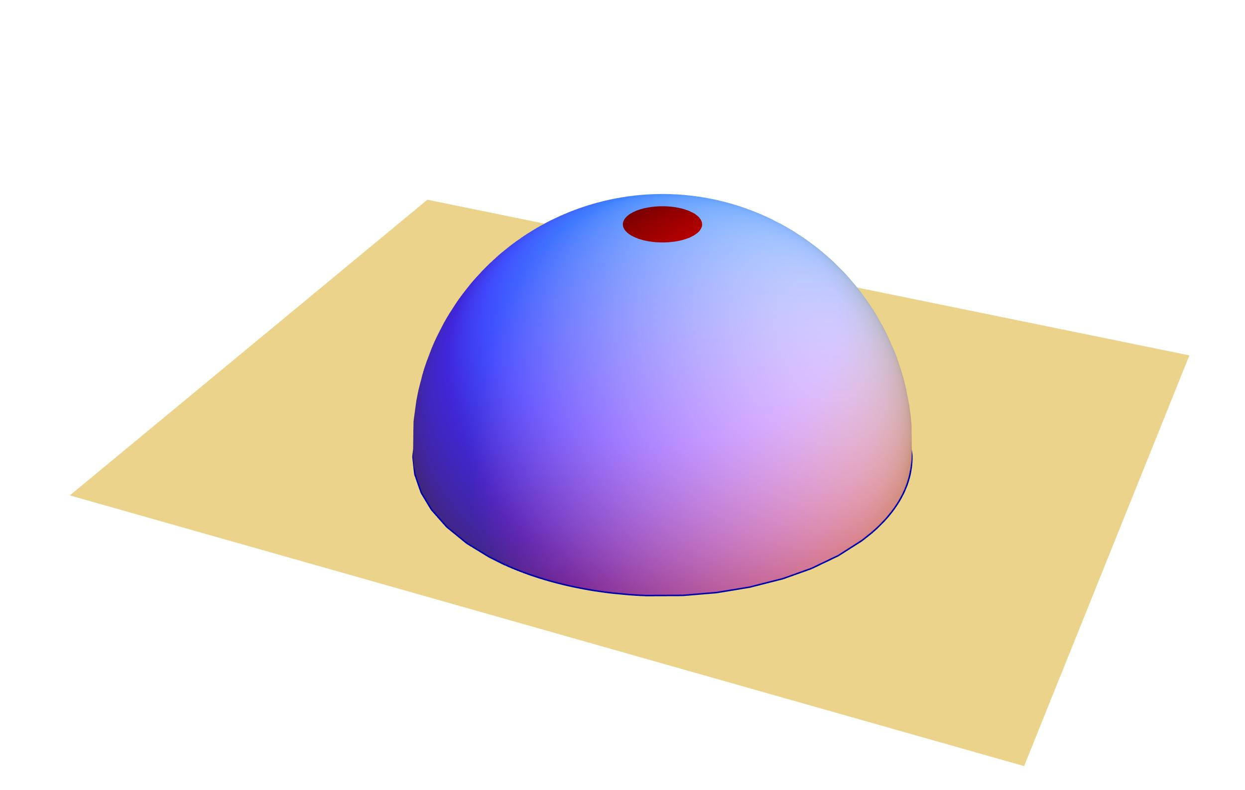
conformal gauge is singular!
IR regularization:
potentially breaks Diff invariance
Cagnazzo, Medina-Rincon, Z.’17

Slide 12
Collective coordinates
Zero modes:

Slide 13
Latitude in AdS₅xS⁵
angles on S³

Slide 14
Classical action
C:
L:
Dymarsky, Gubser, Guralnik, Maldacena’06
consequence of supersymmetry
Results in
✔️

Slide 15
Moduli integration

Slide 16
IR regularization

Slide 17
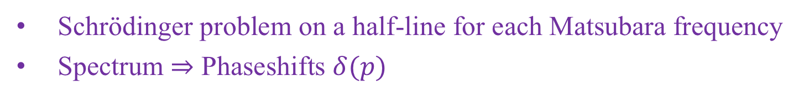
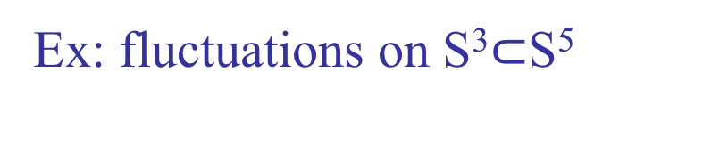
Determinants and phaseshifts
Ex: fluctuations on S³$⊂$S⁵
Schrödinger problem on a half-line for each Matsubara frequency
Spectrum $⇒$ Phaseshifts $δ(p)$

Slide 18
Zero mode:
Phaseshift:
IR anomaly contribution
Cagnazzo, Medina-Rincon, Z.’17
summation over Matsubara modes
IR divergence due to zero mode

Slide 19
Taking into account all string modes:
Explicit calculations give:

Slide 20
Circular loop in string theory
agrees with localization
one-loop correction comes entirely from zero modes
determinants cancel
SUSY cancellations?
true beyond one loop?
worldsheet localization?

Slide 21
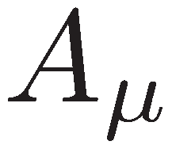

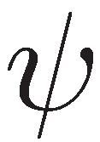

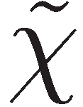
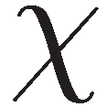
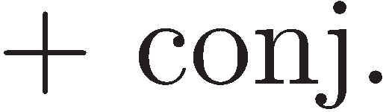
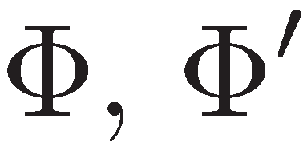
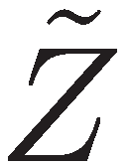

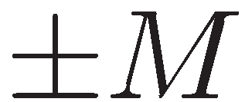
N=2* theory
vector multiplet
hypermultiplets
mass =
mass =
simplest relevant perturbation of N=4 super-Yang-Mills
Holographic dual: Pilch-Warner solution of type IIB supergravity
Pilch, Warner’00

Slide 22
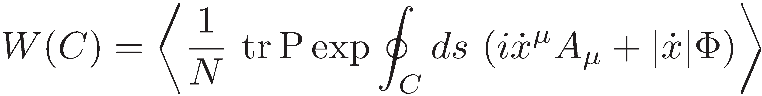
Wilson loops
Perimeter law:
Area=Perimeter in PW geometry
: effective string tension

Slide 23
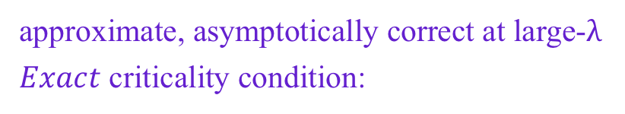
Localization predictions
Buchel, Russo, Z.’13
Chen-Lin, Gordon, Z.’14
Z.’14
Russo, Widén, Z., to appear
integer part
Quantum phase transitions at
approximate, asymptotically correct at large-$λ$
$Exact$ criticality condition:

Slide 24

String on PW background
$σ$-model
Fradkin-Tseytlin
Buchel, Russo, Z.’13
Chen-Lin, Medina-Rincon, Z.’17
✔️

Slide 25
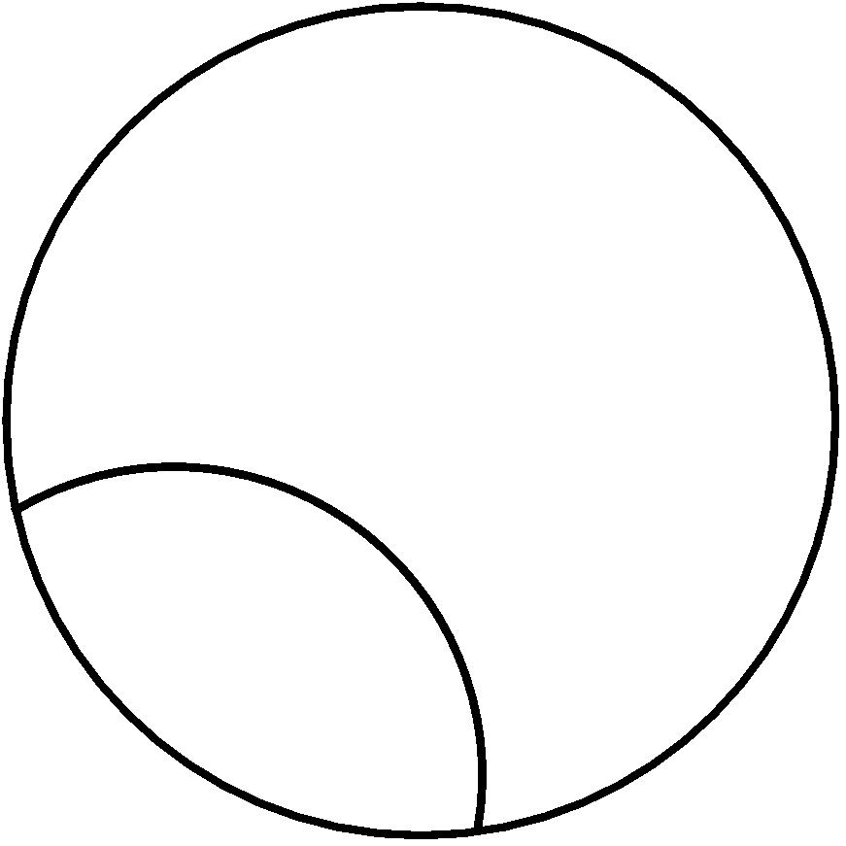
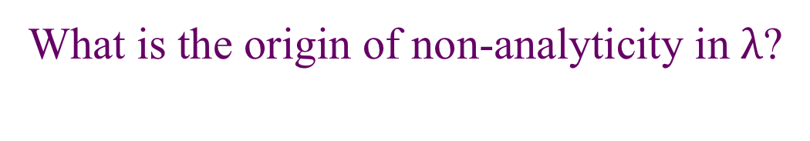
Phase transitions in the sigma-model?
=
What is the origin of non-analyticity in $λ$?
IR divergences in self-energy?
diagram resummation?

Slide 26
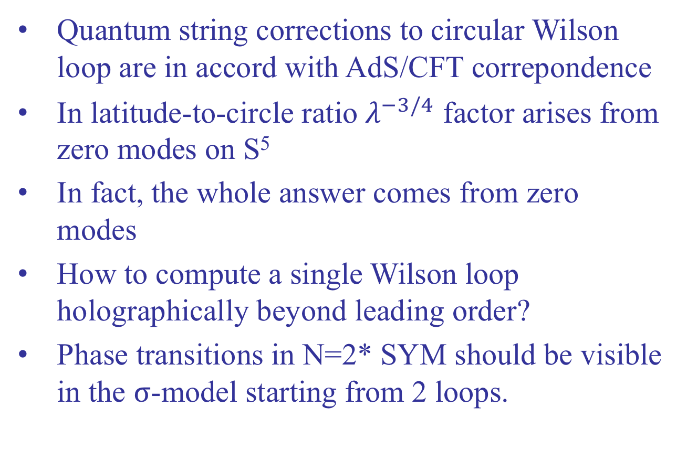
Conclusions
Quantum string corrections to circular Wilson loop are in accord with AdS/CFT correpondence
In latitude-to-circle ratio $λ^{−3/4}$ factor arises from zero modes on S⁵
In fact, the whole answer comes from zero modes
How to compute a single Wilson loop holographically beyond leading order?
Phase transitions in N=2* SYM should be visible in the $σ$-model starting from 2 loops.

