Slide 1
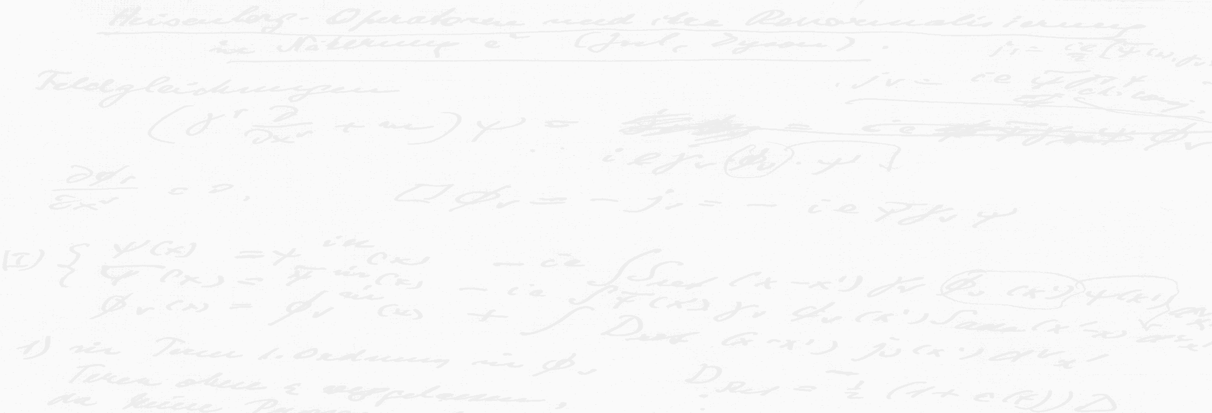
Schrödinger’s equation for Conformal Symmetry
Volker Schomerus
IGST 2018, Copenhagen
Based on work with M. Isachenkov, E. Sobko, P. Liendo, Y. Linke;
M. Cornagliotto, M. Lemos, I. Buric, T. Bargheer

Slide 2

0.1 CFT and Conformal Symmetry
CFT is everywhere: 2nd order phase transitions, IR dynamics
of many interesting QFTs, AdS/CFT correspondence ….
Understanding of perturbative & non-perturbative dynamics
is based on the study of both local and non-local observables
Primary fields $Φ_{Δ,ℓ}(x)$
‘t Hooft, Wilson line, surface,
defect, interface operators …
weights of SO(1,1) & SO(d)
Analyis and construction of their correlators relies on mathe-
matics of conformal symmetry G = SO(1,d+1) … yet …
our present knowledge of conformal symmetry is incomplete

Slide 3
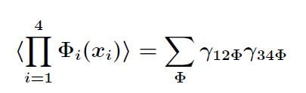
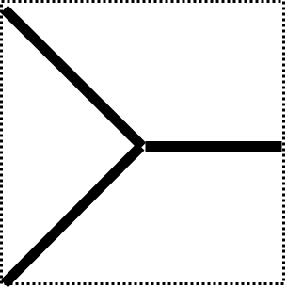
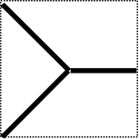

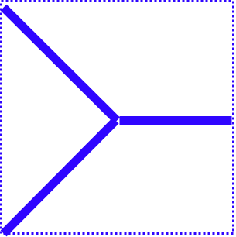
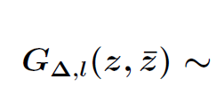
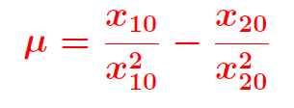
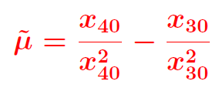
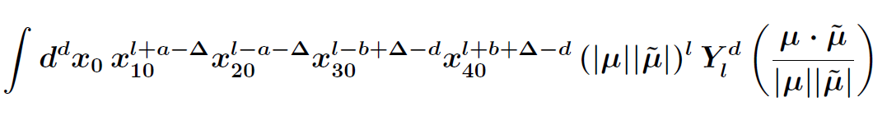
0.2 Conformal Partial Waves
… are the CFT-analogues of plane waves in Fourier theory
e.g. 4-pt fcts
(u₁,u₂)
CPW
3J symbol
=
~
Zonal spherical functions

Slide 4
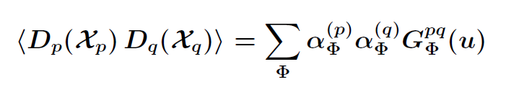
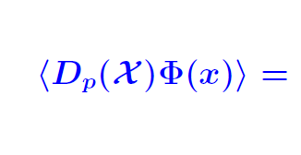
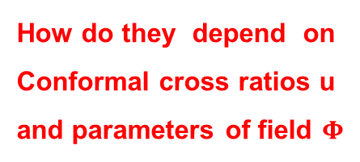

0.2 Conformal Partial Waves
… are the CFT-analogues of plane waves in Fourier theory
e.g. 4-pt fcts
(u₁,u₂)
CPW
3J symbol
Defect 2-pt fcts
p
q
CPW
$α_{Φ}^{\left(p\right)}$
p
How do they depend on
Conformal cross ratios u
and parameters of field $Φ$
What kind of functions are the CPWs ?

Slide 5

0.3 Main Results and Plan
CPWs are wave functions of integrable N-particle Schrödinger
problem in coordinate space and in weight/momentum space.
Hyperbolic Calogero-Sutherland
model for BC_{N} root system in u_{i}
Rational Ruiijsenaars -
Schneider model in $Δ,ℓ$
[Isachenkov, VS] [Isachenkov,Liendo,Linke,VS] …
``Euclidean’’ Heckman-Opdam hypergeometric functions
and degenerations of virtual Koornwinder polynomials
Review. CPWs and the Calogero-Sutherland potential
2. Extension. Defects blocks and the N-particle CS model
3. Integrability. Bi-spectral duality: weights ↔ coordinates

Slide 6
Review
Talks at IGST 2016 [VS], IGST 2017 [Sobko]

Slide 7
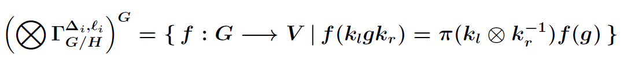
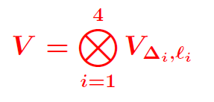




1.1 Conformal Partial Waves
… are G invariants in TP of 4 principal series representations
= sections of a vector bundle on 2-sided coset space K\G/K
with fiber V ^{SO(d-2)}
Space of
tensor structures
2 – dimensional
[cross ratios]
Principal series reps induced from fd irrep of K = SO(1,1) x SO(d) on $V_{Δ,ℓ}$
$V_{Δ,ℓ}$- valued functions on the coset space

Slide 8
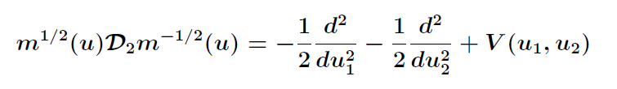


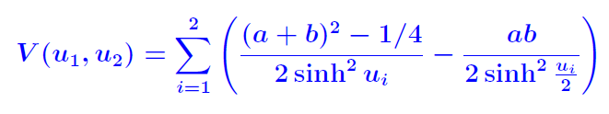
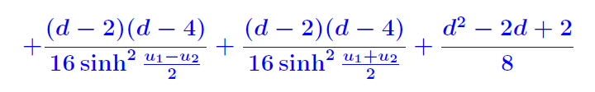
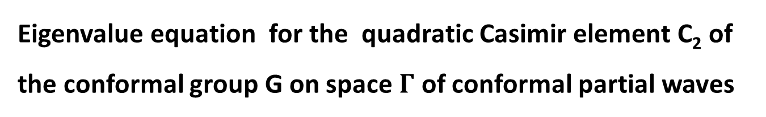
1.2 The Casimir Equation
Eigenvalue equation for the quadratic Casimir element C₂ of the conformal group G on space $Γ$ of conformal partial waves
m is volume of K x K orbit through u
[M. Isachenkov, VS, E. Sobko]
Scalar CPWs:
Calogero-Sutherland model
= 2 Poeschl-Teller particles
with interaction

Slide 9
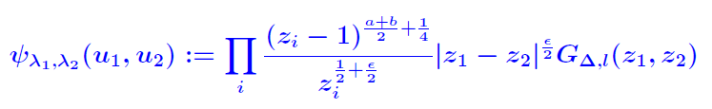





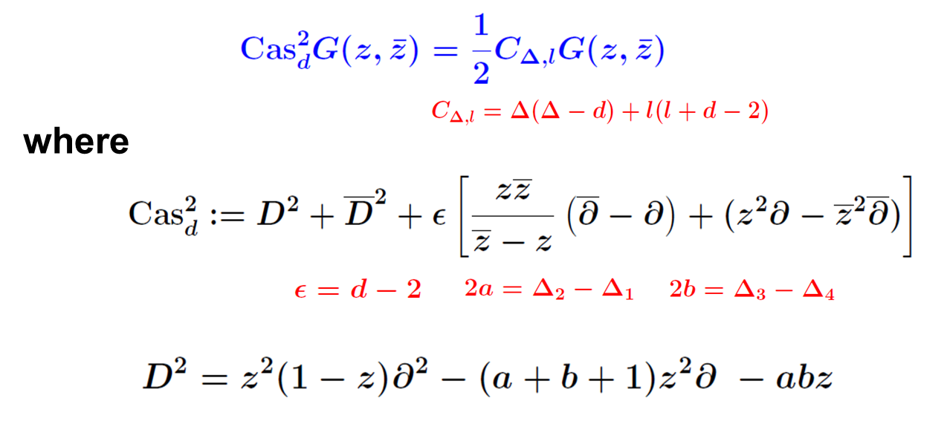
1.2 The Casimir Equation (contnd)
$G_{Δ,l}$ in Dolan-Osbon conventions ↔ CS eigenfunctions $ψ_{λ_{1},λ_{2}}$
[Isachenkov,VS]
u_{i} radial coordinates [Hogervorst,Rychkov]
[ Dolan,
Osborn]

Slide 10
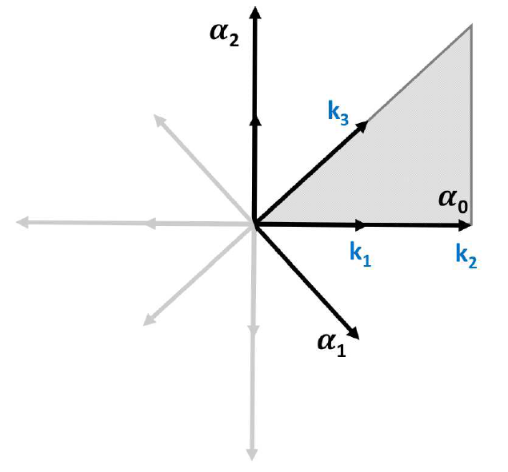
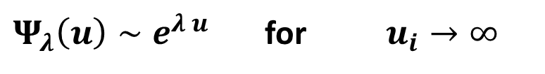
1.3 Calogero-Sutherland Models
[Calogero 71] [Sutherland 72]
Integrable multi-particle genera-
lization of Poeschl-Teller model
Associated with non-reduced
root system – here with BC_{N}
Eigenvalue problem ↔ hypergeometrics
The scattering problem for particles in a Weyl chamber is solved
$Ψ_{λ}\left(u\right)∼e^{λ u}$ for $u_{i}→∞$
[Heckman,Opdam]
Harish-Chandra functions: single plane plane waves asymptotics
Much is known: Poles in space of momenta $λ$, series representations ….

Slide 11
Extensions
Spinning blocks
Defect blocks
Superconformal blocks
Thermal blocks
Multi-point blocks

Slide 12
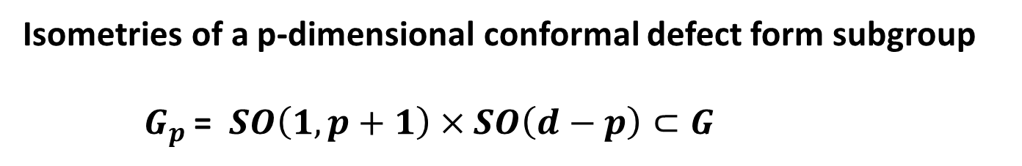
2.1 Conformal Defect Operators
Isometries of a p-dimensional conformal defect form subgroup
$G_{p}$ = $SO\left(1,p+1\right)×SO\left(d−p\right)⊂G$
p = 0: isometries of pair of points (dilations, rotations); $G_{0}=K$
Conformal defect possesses dim $G/G_{p}$ = (p+2)(d-p) parameters
D₀
D_{d-1}
e.g. D₀: 2d parameters D_{d-1}: d+1 parameters

Slide 13
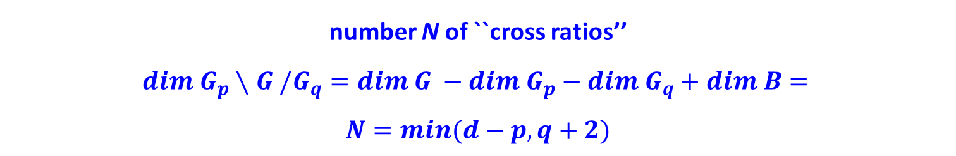
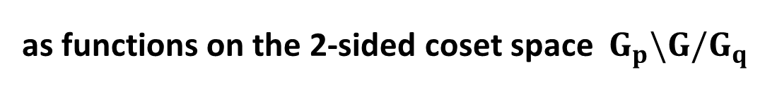
2.2 Conformal Partial Waves
Space of CPWs for two scalar defects D_{p} and D_{q} can be realized as
as functions on the 2-sided coset space ${ G}_{p}\backslash G/G_{q}$
number N of ``cross ratios’’
$$dim G_{p}∖G /G_{q}=dim G −dim G_{p}−dim G_{q}+dim B=$$
$$N=min(d−p,q+2)$$
↔ [Gadde]
$$B=SO\left(p−q\right)×SO\left(\left|d−p−q−2\right|\right) ⊂{ G}_{p,q}$$

Slide 14
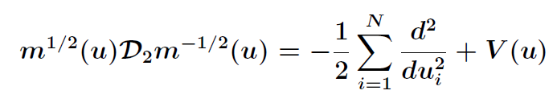
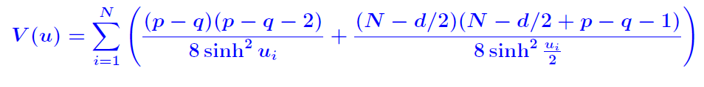
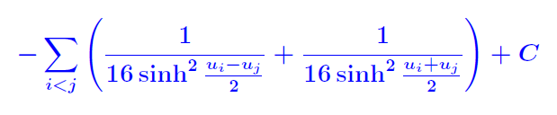

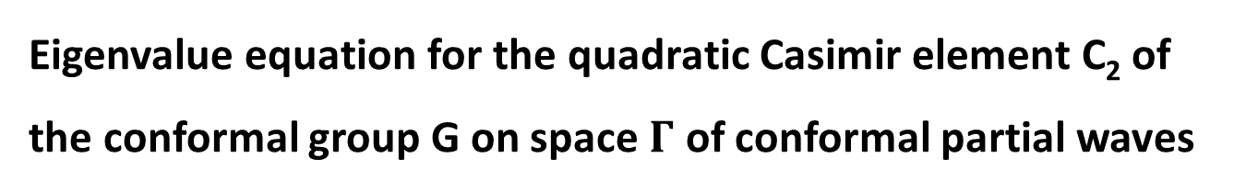
2.3 The Casimir Equation
Eigenvalue equation for the quadratic Casimir element C₂ of the conformal group G on space $Γ$ of conformal partial waves
m is volume of $G_{p}×G_{q}$ orbit through $u=(u_{1}, …,u_{N})$
[Isachenkov,Liendo,Linke,VS]
Scalar CPWs:
$N=min(d−p,q+2)$

Slide 15
2.4 Some Applications
All defect blocks for any value of N were constructed in terms of
multi-variate hypergeometrics.
[Liendo,Linke,Isachenkov,VS]
For N = 2 we found complete set of relations with 4-point blocks
extending results by
[Billo,Goncalves,Lauria,Meineri] [Liendo,Meneghelli]
We found a Lorentzian inversion formula extending
[Caron-Huot]
→ Computation of bulk-defect OPE coefficients for large spins.
work in progress
related with
[Alday et al.] [Caron-Huot][Lemos,Liendo,Meineri,Sarkar]

Slide 16
Integrability

Slide 17
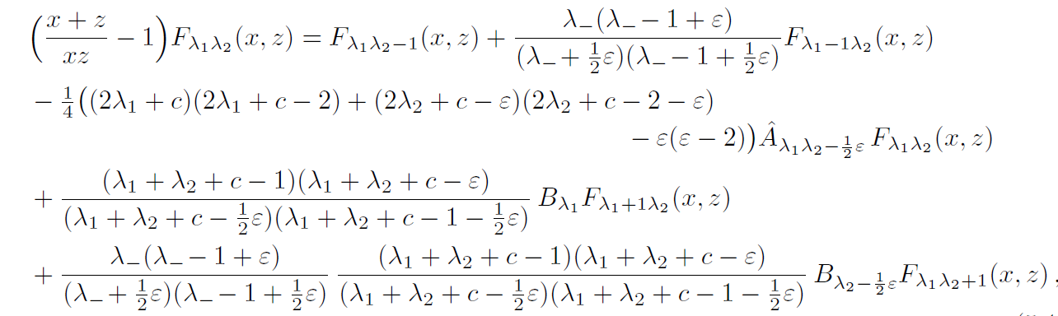
3.1 Dependence on weights/momenta
Dolan & Osborn noticed that scalar blocks obey shift equations
Eq. (5.1) from hep-th/0309180 [Dolan,Osborn]

Slide 18


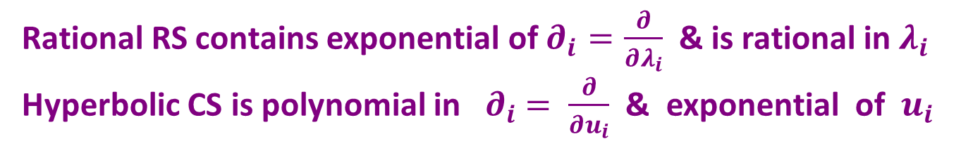

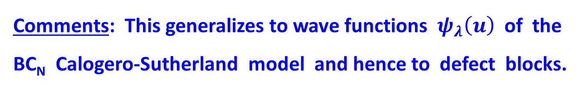
3.2 Ruijsenaars-Schneider model
After multiplication with some factor c = c($λ_{1}, λ_{2}$) one obtains
2nd order difference eq: rational Ruijsenaars-Schneider model
Comments: This generalizes to wave functions ${ ψ}_{λ}\left(u\right)$of the
BC_{N} Calogero-Sutherland model and hence to defect blocks.
note $ψ_{λ+e_{i}}=e^{∂_{i}} ψ_{λ}$
Rational RS contains exponential of $∂_{i}=\frac{∂}{∂λ_{i}}$ & is rational in $λ_{i}$
Hyperbolic CS is polynomial in ${ ∂}_{i} = \frac{∂}{∂u_{i}}$ & exponential of $u_{i}$

Slide 19
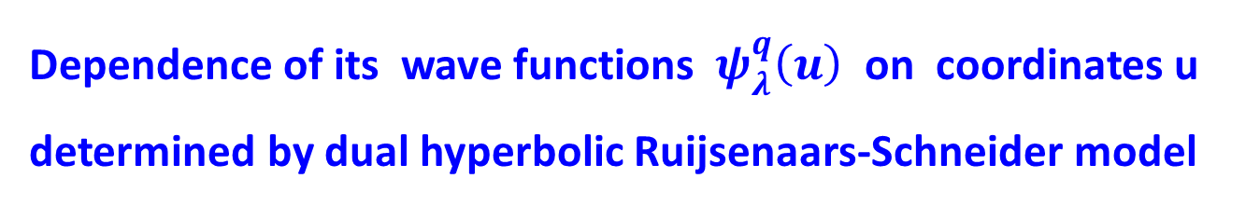
3.3 Hyperbolic RS model
Rational Ruijsenaars-Schneider model possesses integrable
hyperbolic/trigonometric deformation
deformation parameter q
Dependence of its wave functions ${ ψ}_{λ}^{q}\left(u\right)$ on coordinates u
determined by dual hyperbolic Ruijsenaars-Schneider model
Casimir differential equation obtained by degeneration q → 1
Wave functions of this bi-spectrally self-dual RS model are
(virtual) Koornwinder polynomials (functions)
Conformal partial waves obtained by degeneration

Slide 20
4 Outlook and Conclusions
Integrable quantum mechanics provides a new approach to CPWs that is powerful
is flexible
by embedding into modern theory of multivariate
hypergeometric functions
↔ SUSY gauge theory
Series expansions, recurrence relations, integral formulas
…
Applies to conformal defects, spinning correlators
superconformal symmetry
[VS,Sobko][Buric,VS,Sobko]
↔ [Cornagliotto,Lemos,VS] …
Many aspects need to be further developed

