Slide 1




Conformal Fishnet Theory
Integrability in Gauge and String Theory
Niels Bohr Institute, Copenhagen
August 20, 2018
Vladimir Kazakov
Ecole Normale Superieure, Paris
Collaborations with
Ӧ. Gürdogan arXiv:1512.06704
J. Caetano and Ӧ. Gürdogan arXiv:1612.05895
D. Grabner, N. Gromov, G. Korchemsky arXiv:1711.04786
N. Gromov, G. Korchemsky, S. Negro, G. Sizov arXiv:1706.04167
D. Chicherin, F. Loebbert, D. Mueller, D. Zhang arXiv:1704.01967, arXiv:1708.00007
E. Olivucci arXiv:1801.09844
N. Gromov, G. Korchemsky arXiv:1808.02688
S. Derkachev, E. Olivucci to appear
E. Olivucci, M. Preti to appear

Slide 2
Outline
Strongly coupled CFTs are important for description of many physical phenomena:
phase transitions, quantum gravity (through AdS/CFT duality), Regge limit for
high energy hadrons (BFKL), etc. Supersymmetry is not really ubiquitous
Not many such CFTs are explicitly defined in 3d (Ising,…), and almost none in 4d,
in spite of thorough study of their landscape by conformal bootstrap methods
We proposed a family of integrable non-supersymmetric 4D CFTs from double scaling limit of N=4 SYM: strong ɤ-deformation & weak coupling
Leads to non-unitary, logarithmic “chiral” CFT. Similar limit in D=3 ABJM model.
Its explicit integrability sheds some light on the origins of integrability of N=4 SYM
Gurdogan, V.K. 2015
Caetano
Caetano, Gurdogan, V.K. 2016
Notes:
2

Slide 3

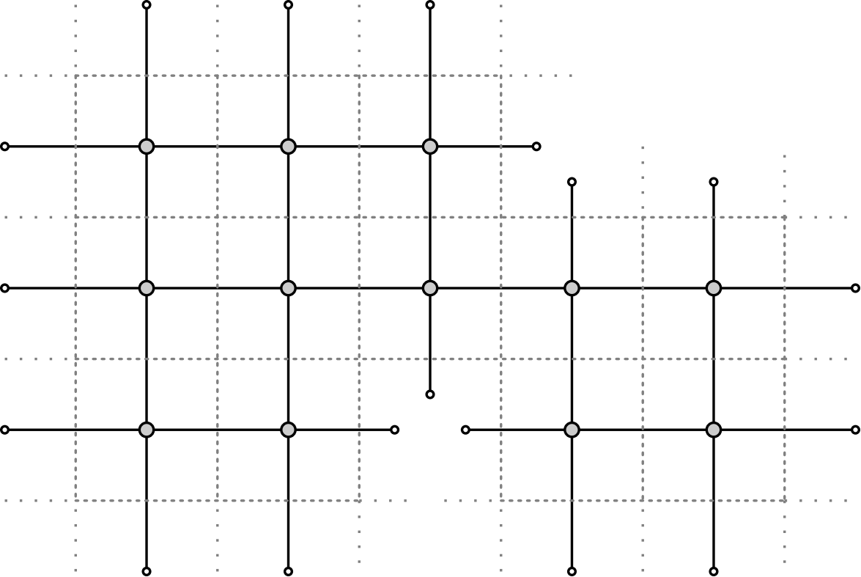
Outline
Dominated by specific, integrable (computable!) multi-loop 4D Feynman graphs:
Gurdogan, V.K. 2015
Caetano, Gurdogan, V.K. 2016
“fishnet’’
(massless, 4-scalar int.)
A. Zamolodchikov 1980
Gurdogan, V.K. 2015
“brick wall’’
(Yukawa ψψφ interaction)
Caetano, Gurdogan, V.K. 2016
or mix of both
Can be studied by N=4 SYM Quantum Spectral Curve
or direct map to non-compact SU(2,2) Heisenberg spin chain
Gromov, V.K. ,Leurent, Volin 2013
Chicherin, Derkachev, Isaev
Gurdogan, V.K. 2015
Gromov, V.K , Korchemsky, Negro, Sizov
A possibility of analytic insight into non-perturbative structure of CFTs in 3d and 4d
Generalization to any dimension.
Exact OPE data, 4-point correlators. Yangian symmetry of scattering amplitudes
V.K., Olivucci
Chicherin, V.K., Loebbert, Mueller, Zhong (2017)
Grabner, Gromov, V.K., Korchemsky 2017
Gromov, V.K., Korchemsky 2018
V.K.,Olivuccci, Preti 2018
Gromov, V.K , Korchemsky
4D → 2D
Basso, Dixon ‘17
Derkachev, V.K., Olivucci (to appear)
Notes:
3

Slide 4
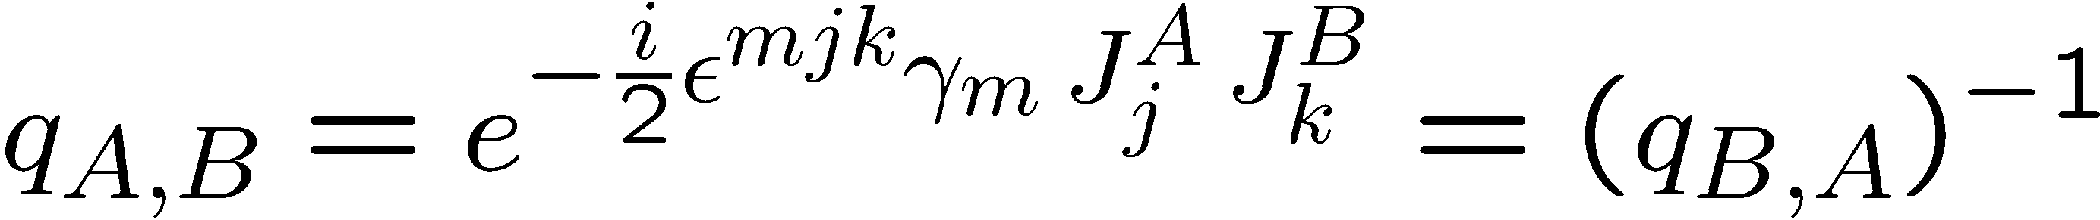
ɣ-twisted N=4 SYM
ɣ-twisting of N=4 SYM : product of N_{c}×N_{c} matrix fields → star-product
Leigh, Strassler
Frolov, Tseytlin
Beisert, Roiban
Lunin, Maldacena
where
Cartan charges
of R-symmetry
- twists
PSU(2,2|4)→SU(2,2)×U(1)³ - breaks R- symmetry and all supersymmetry
ɣ-twisted N=4 SYM is a non-unitary logarithmic CFT, integrable at N_{c}→ ∞

Slide 5
ɣ-twist as topological factor on Feynman graph
A typical 4-scalar term in the action
ɣ-twist is a topological factor on a planar graph:
localized on “defect” lines cutting graph of
given topology into a disc. On a cylinder, it
produces quasiperiodic b.c.

Slide 6
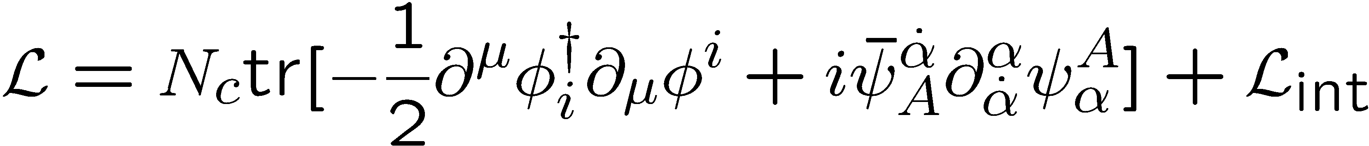
Double scaling limit
Gurdogan, V.K. 2015
Strong imaginary twist, weak coupling
ɣ-twisted N=4 SYM becomes in this limit a non-unitary, chiral CFT:

Slide 7
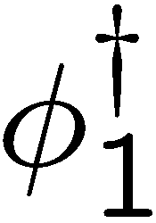
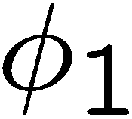
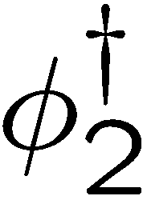
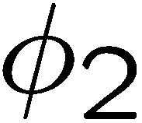
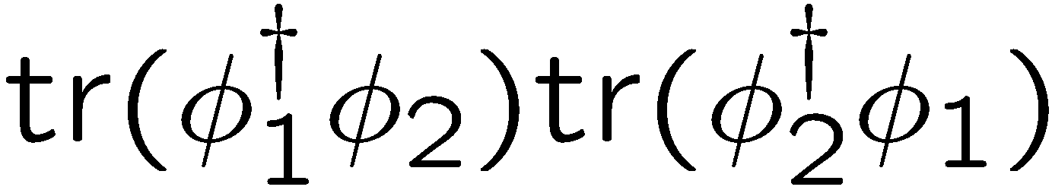
Gurdogan, V.K. 2015
Special case of bi-scalar, “fishnet” CFT₄
Single coupling:
Zero dimensional analogue:
Kostov, Staudacher 1995
Propagators
Missing
“anti-chiral” vertex
Very limited number of planar graphs. No mass or vertex renormalization!

Slide 8
Double trace terms
Tseytlin, Zarembo
Dymarsky, Klebanov, Roiban
Witten
Sieg, Wilhelm, Fokken
ξ doesn’t run in planar limit. Double-trace counter-terms do run:
Pomoni, Rastelli 2009
Beta-function quadratic in double-trace coupling (agrees with general arguments)
Grabner, Gromov, V.K., Korchemsky ‘17
A non-unitary CFT at any ξ, if we tune (trace)² couplings (as ϫ-deformed N=4 SYM)
Sieg, Wilhelm 2016
Grabner, Gromov, V.K., Korchemsky ‘17
The other double-trace coupling also tuned to the critical value
to renormalize the only type of divergent graphs:

Slide 9
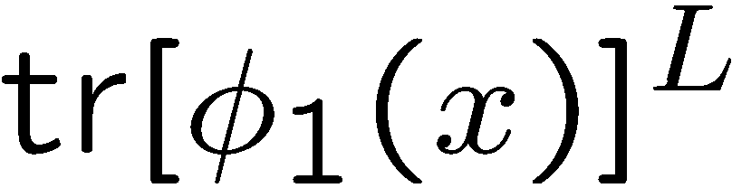
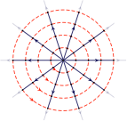
Caetano, Gurdogan, V.K , 2016
Operators, correlators, graphs…
Operators with M magnons in the “vacuum” of
anomalous dimension
Correlators
BMN “vacuum” operator renormalized by “wheel” graphs,
with L spokes and M frames:
Multi magnon operators renormalized by multi-spiral
(spider-web) graphs. Studied by Asymptotic Bethe ansatz
Caetano, Gurdogan, V.K , 2016
Typical “fishnets” structure in the bulk of graphs. Integrable!
Double wheels at any L and any multiple wheels at L=2,3 computed.
Generalization to multi-wheels at any L possible (in work)
Grabner, Gromov, V.K., Korchemsky
Ahn, Bajnok, Bombardelli, Nepomechie 2011
Gurdogan, V.K. 2015
Gromov, V.K , Korchemsky, Negro, Sizov

Slide 10
Bi-scalar fishnet CFT at any D
V.K., Olivucci 2018
Bi-scalar CFT can be defined at any D by a non-local action
D-dimensional “fishnet” graphs generalize 4D “fishnets”
Anisotropic “fishnet” at D=2, ω=2s -1/2, where s is the “on-site” spin
D=2, s=1 ↔ Lipatov’s reggeized gluon model (BFKL)
Isotropic fishnet model at D=2, s=1/4 with propagators
Integrable conformal SO(1,D) spin chain !

Slide 11
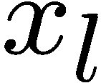
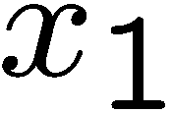
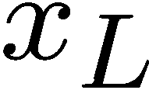
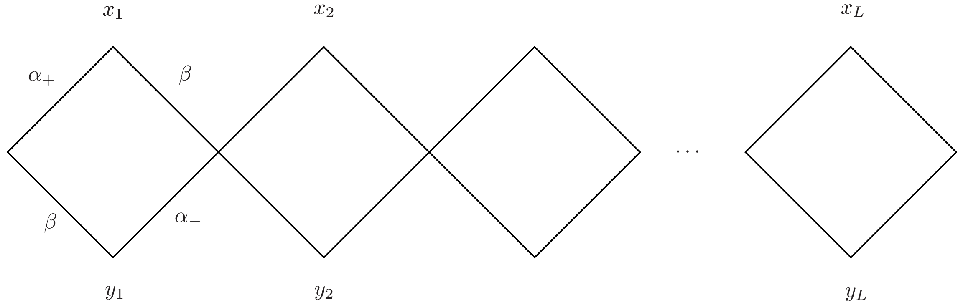
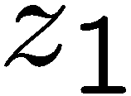
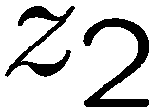
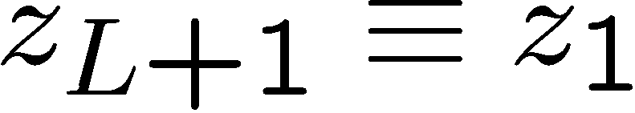
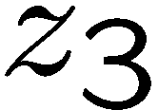
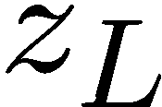
Wheel graphs and integrable SO(1,D+1) spin chain
Operator generating a wheel (fishnet) graph
Integrability: graph-generating operator emerges at special value of
spectral parameter of Transfer-matrix in physical irrep on 4D conformal group
Zamolodchikov 1980
Derkachev, Manashov (2001-…)
Derkachev, Korchemsky, Manashev (2001-2003)
Chicherin, Derkachev, Isaev 2012
δ
δ
δ
δ
Gurdogan, V.K. 2015
Gromov, V.K , Korchemsky, Negro, Sizov
V.K., Olivucci
Hence integrability of bi-scalar model is demonstrated explicitly in all orders!

Slide 12
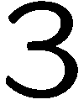
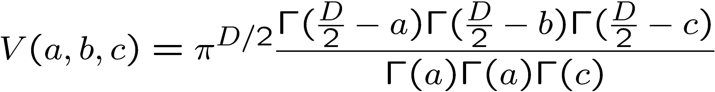



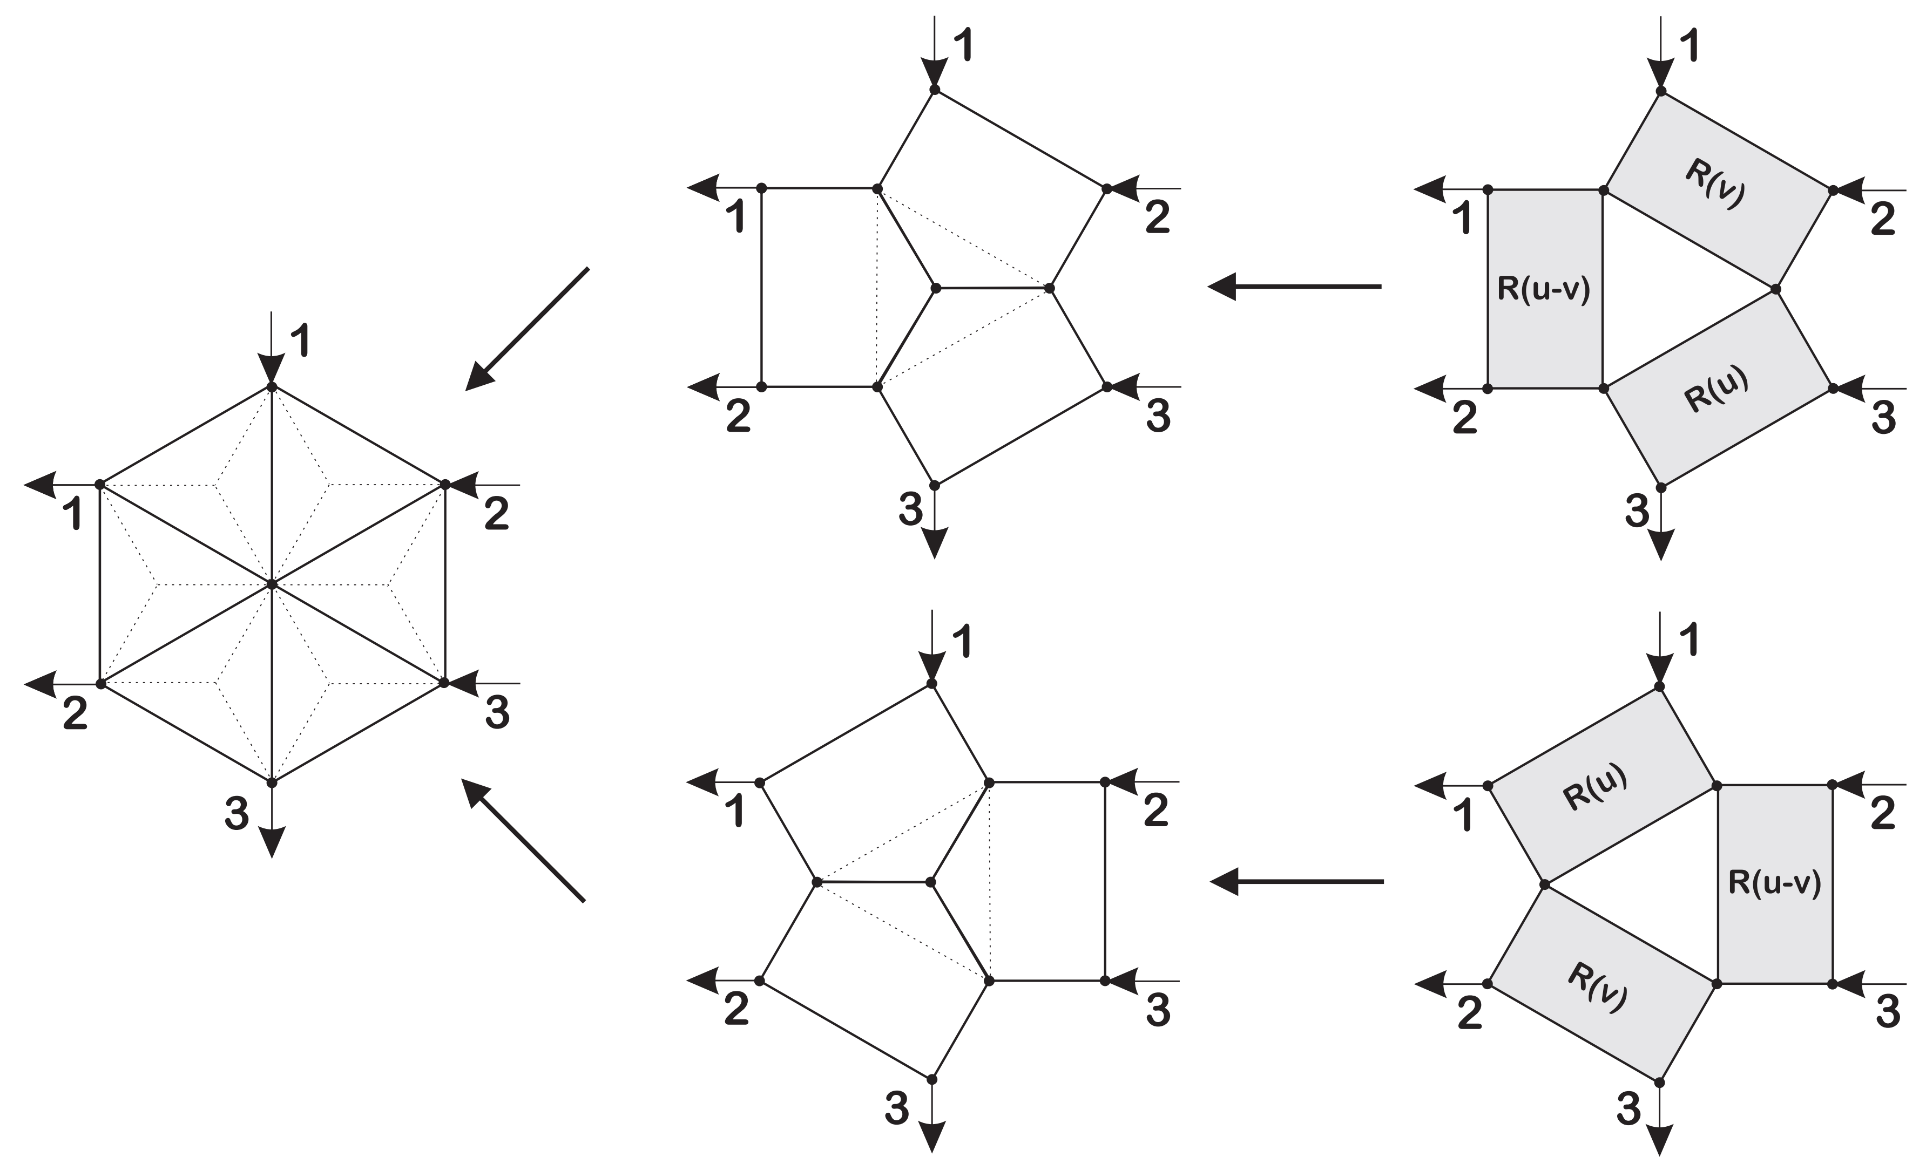
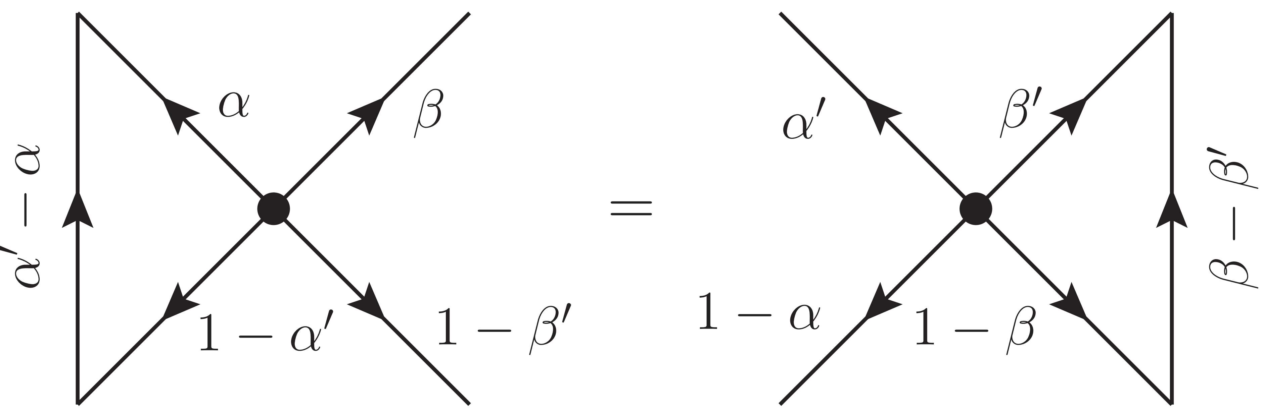
Star-Triangle relations and Yang-Baxter
Star-triangle relations
Yang-Baxter relations
Crossing relation

Slide 13
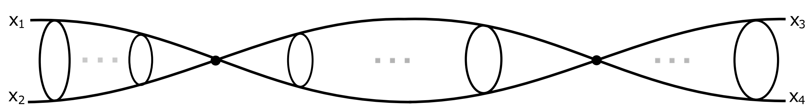
Grabner, Gromov, V.K., Korchemsky 2017
V.K., Olivucci 2018
Zero-magnon 4-point correlator and exact OPE data
Exact all-loop calculation of a 4-point correlator (only from conformal symmetry!)
cross-ratios
Defined by “wheel” graphs, generated by powers of graph-building operator
….
Summing up these graphs, we get
Due to conformal symmetry, diagonalized by 3-point correlation function with spin

Slide 14
Grabner, Gromov, V.K., Korchemsky 2017
V.K., Olivucci 2018
Example: anomalous dimensions at Spin=0
We apply the graph generating Hamiltonian to conformal eigenfunction at S=0
and use star-triangle relation:
From poles of formal expression we read off formula for dimensions
Perturbative expansion for operator starts from double-trace term
Generalization to any spin is rather straightforward

Slide 15
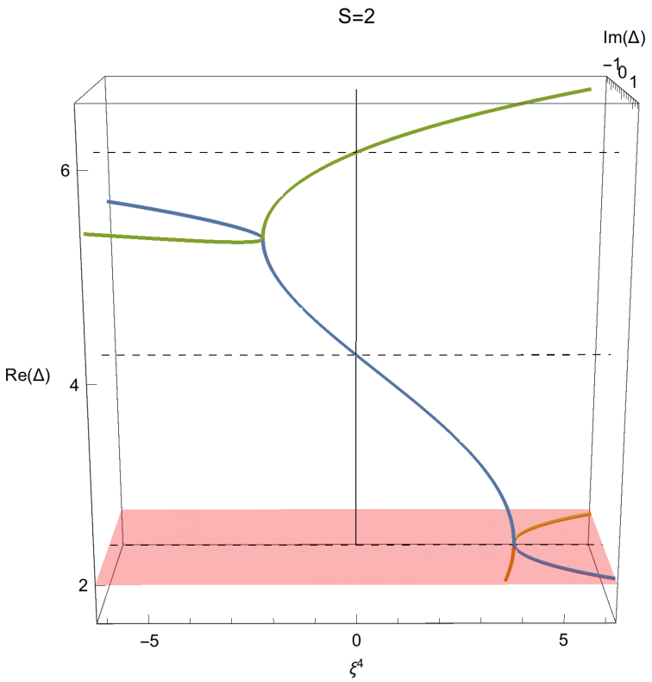
Grabner, Gromov, V.K., Korchemsky 2017
Olivucci, V.K. 2018
4-point correlator: exact results
We obtain integral representation for 4-point correlation function
conformal group measure conformal block
Integration by residues at poles (physical dimensions):
gives the exact OPE over exchange operators
- Dimensions :
Twist=0,2,4 are related by monodromies
- explicit OPE coefficients (structure constants) for exchange operators, e.g. for D=4

Slide 16
Grabner, Gromov, V.K., Korchemsky 2017
Perturbation theory for 4-point function at 4D
Weak-coupling expansion, using exact OPE data:
single-valued harmonic polylogarithms (SVHP)
+

Slide 17
Gromov, V.K., Korchemsky 2018
All-loop one-magnon 4-point correlator
Definition:
Dominated by “spiral” graphs.
Graph-building operator:
The eigenfunction is again a 3-point correlation function with spin
Dimensions of exchange operators from star-triangle:
Dimensions and structure constants especially simple in 4 dimensions:
No wrapping corrections!

Slide 18
Gromov, V.K., Korchemsky 2018
All-loop two-magnon 4-point correlator
Definition through local protected operators:
Defined by “double-spiral” graphs
Graph-building operator:
Dimensions (4D) of exchange operators (Konishi-like)
Structure constants are also available

Slide 19
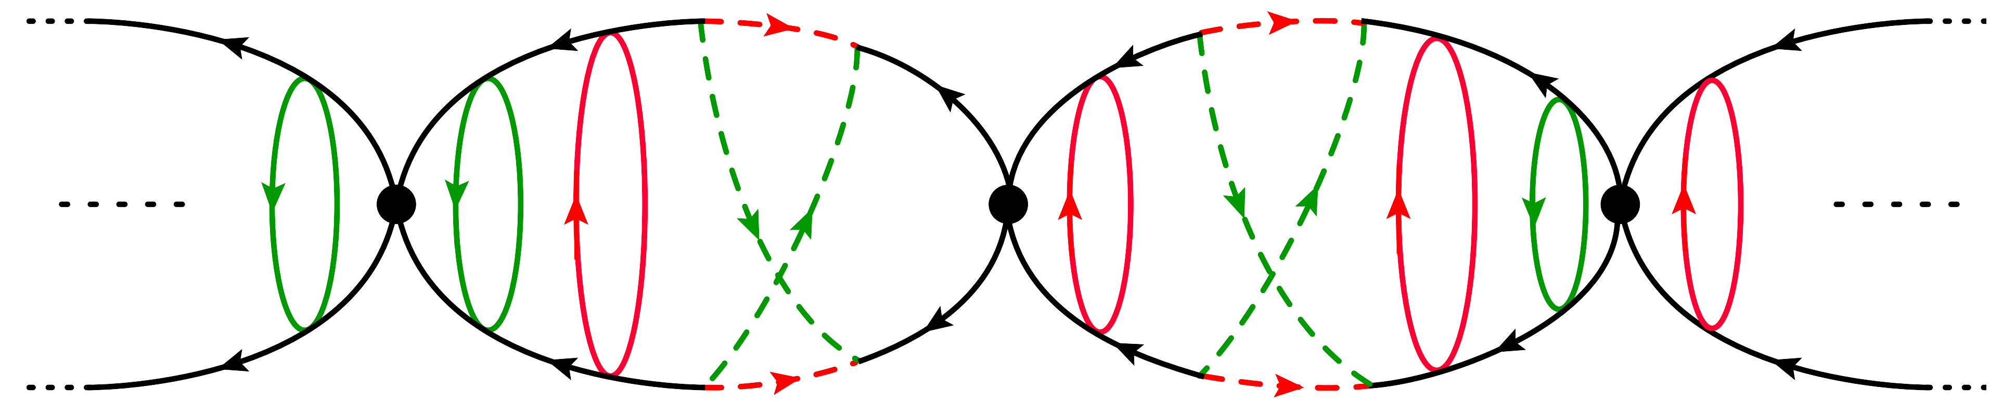
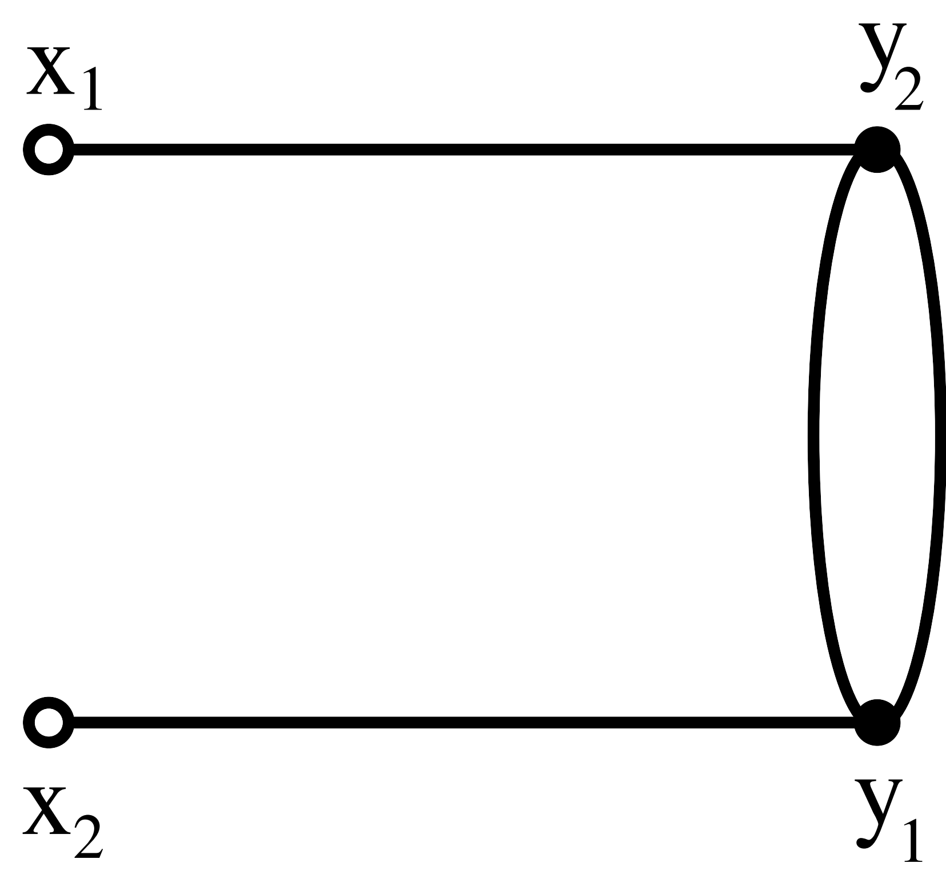
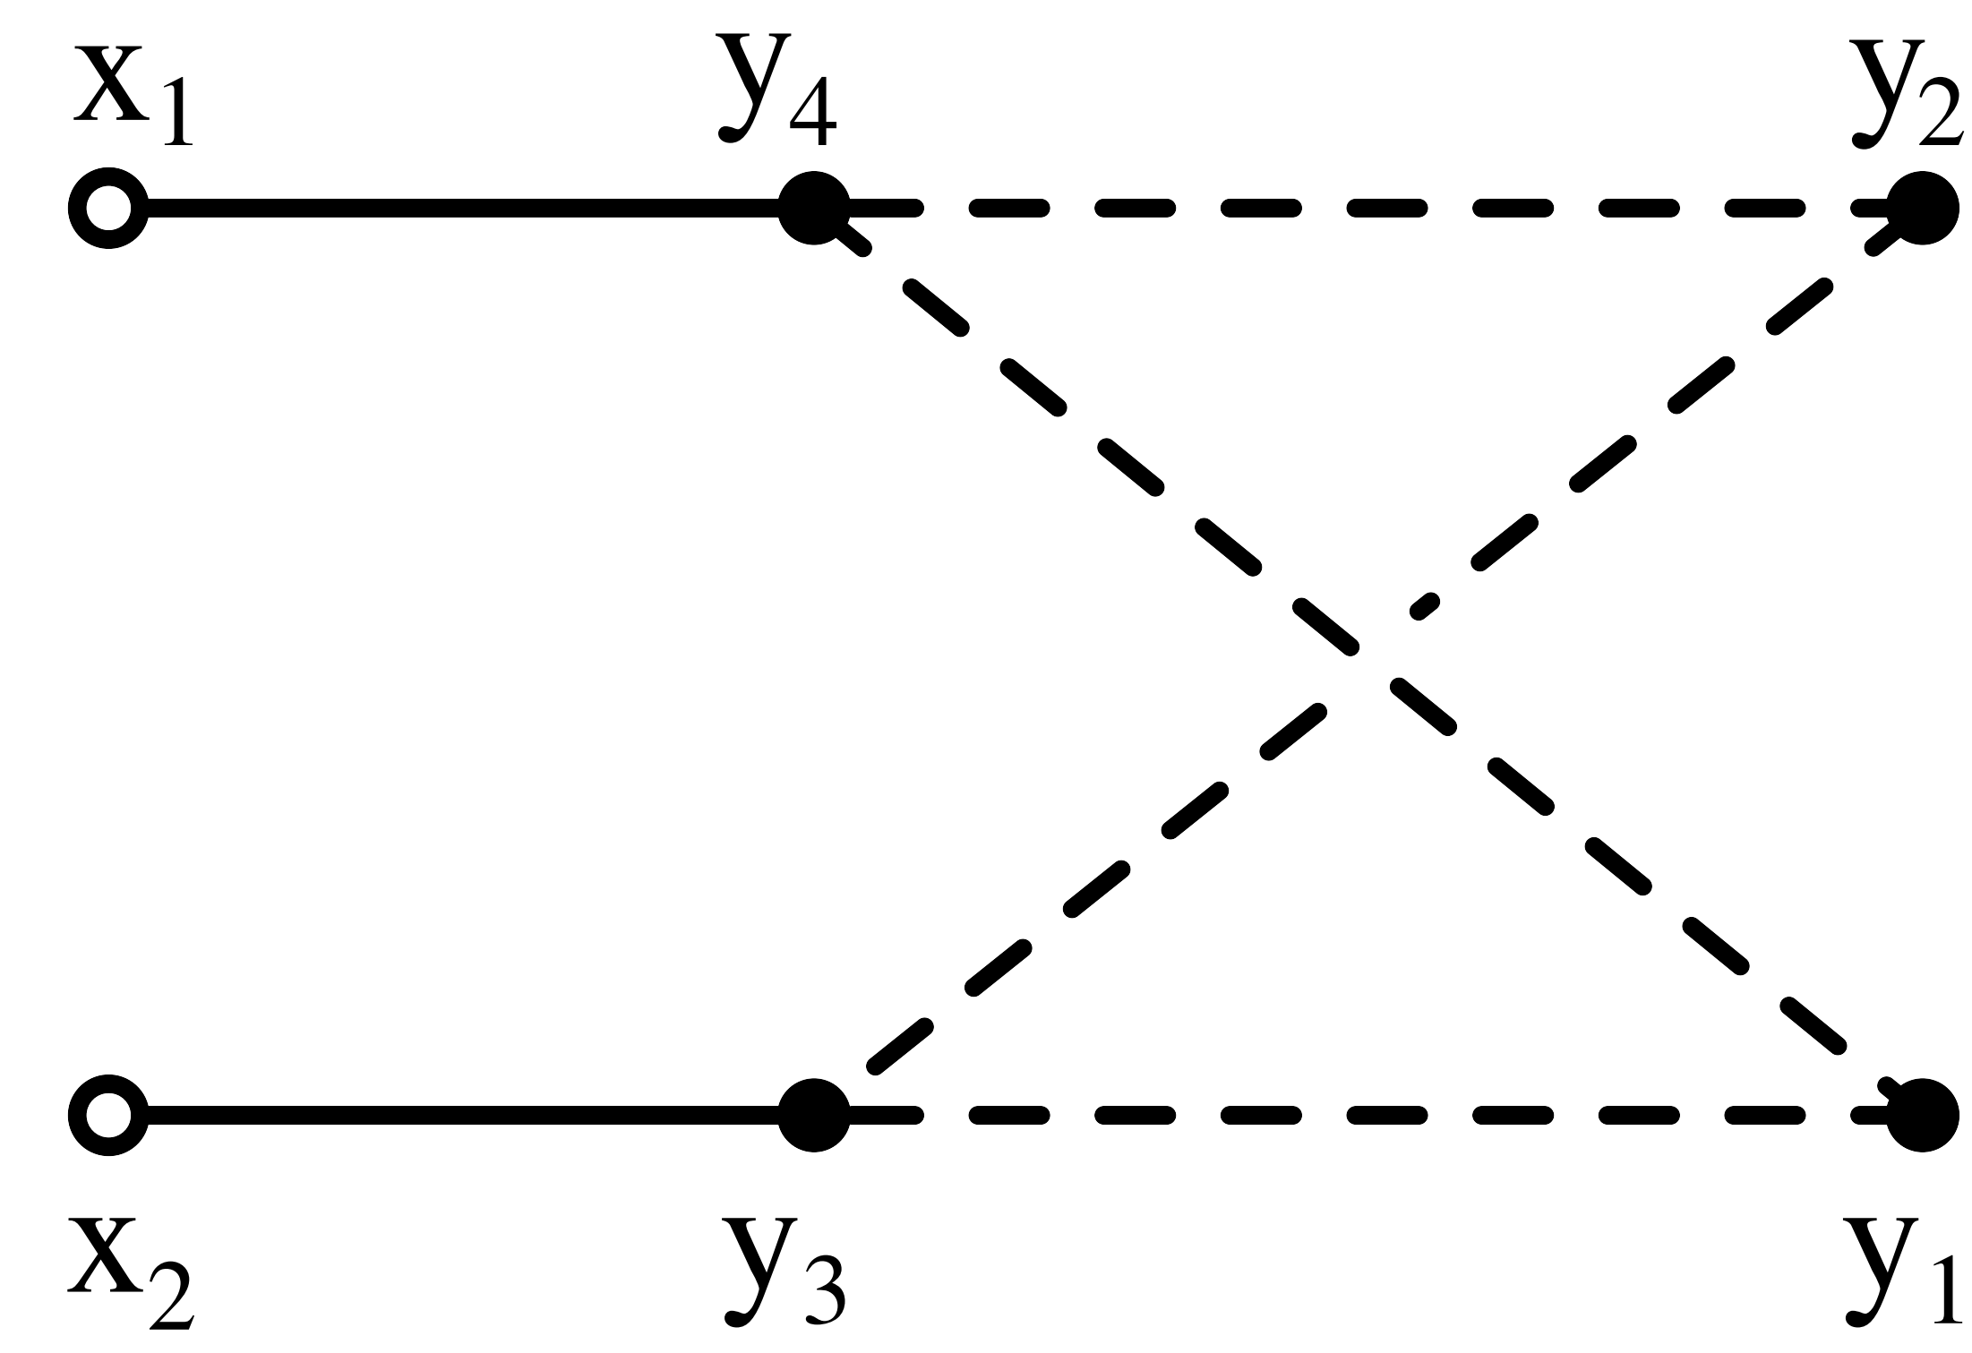
V.K., Olivucci, Preti 2018
Exact 4-point correlators in full DS theory
Consider again zero-magnon 4-point function
Dominated by two types of wheels and a single type of fermionic loops
Graph-building operators
Diagonalizing these operators and summing up the graphs we obtain
Here h_{B} is the known “wheel” eigenvalue and h_{F} is computed explicitly in terms of hypergeometric function.
The position of poles in this expression gives the spectrum of anomalous dimensions of exchange operators

Slide 20
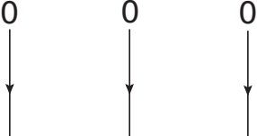
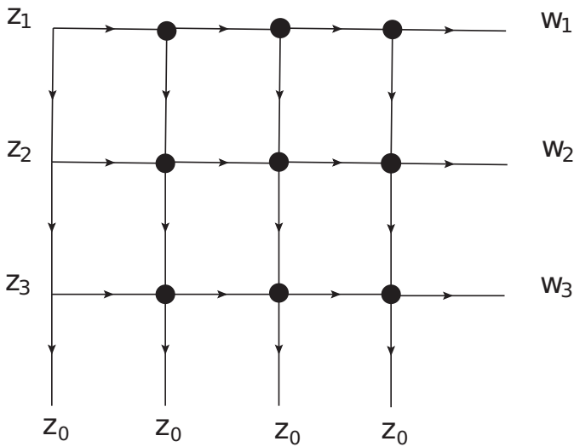
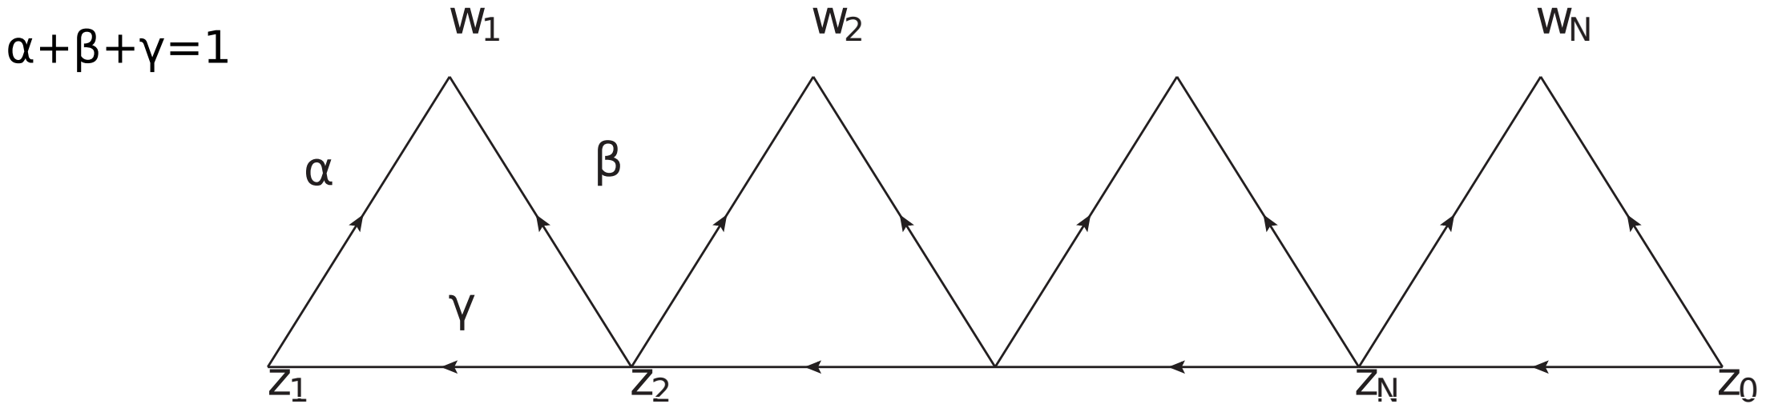
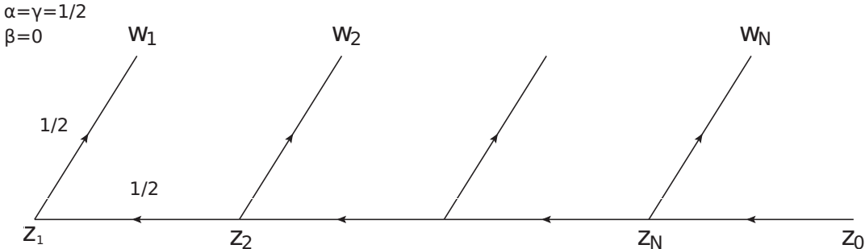
Derkachev, V.K., Olivucci 2018
Basso-Dixon formula in 2D
Basso, Dixon 2017
Remove from BD graph the
upper row of propagators
(due to conformality)
and add left column (not integrated)
“Comb” operator arises in a special limit of a more general object
We have to diagonalize it.
Use the SOV method
Sklyanin
Derkachev, Korchemsky, Manashev 2001, 2003
Derkachev, Manashov

Slide 21
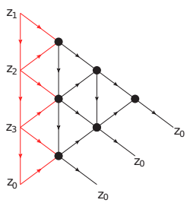
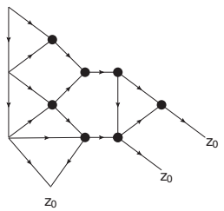
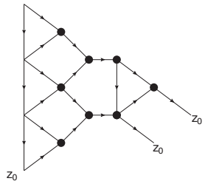
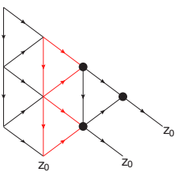
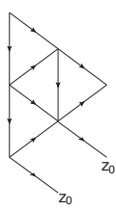
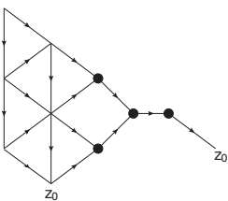
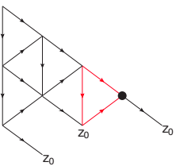
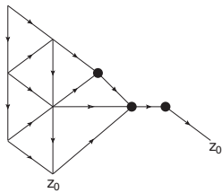
Diagonalization of graph-building operator
Derkachev, Korchemsky, Manashov 01‘-03’
Derkachev, Manashov ‘14
Derkachev, V.K., Olivucci ‘18
eigenfunction
star → triangle
cross-relation →
triangle → star
triangle → star
star → triangle
star → triangle
cross relation →
We reproduced the original eigenfunction!

Slide 22
Derkachev, V.K., Olivucci 2018
Explicit Basso-Dixon formula in 2D
Represented through N×N determinant of explicit functions
of size of fishnet L×N, of conformal ratio
and anisotropy parameter (irrep of SL(2,C))
where
and the last factor is represented through the hypergeometric functions:
The homogeneous fishnet BS formula is recovered at
Might be interesting application to BFKL limit

Slide 23
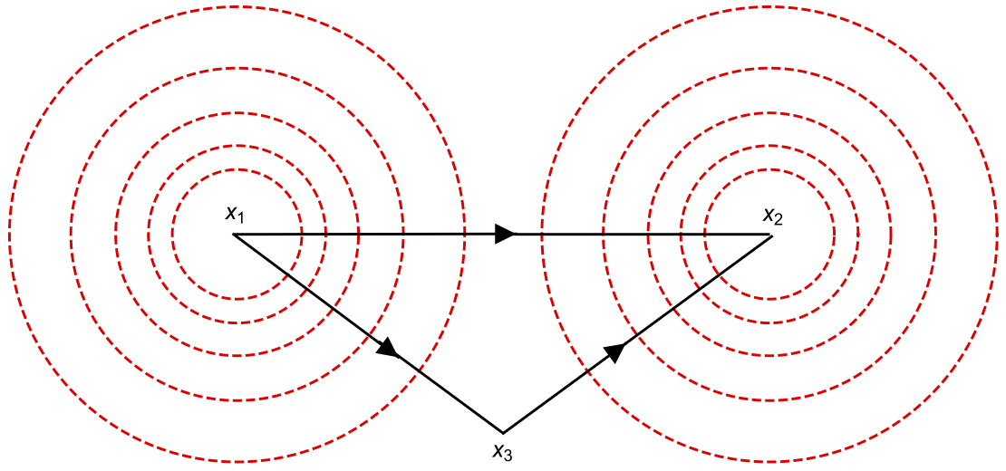
Other recent results
Large fishnet as a sigma model on AdS₅ Basso, Zhang 2018
Strong coupling asymptotics of fishnet four-point functions Gromov, V.K., Korchemsky ‘18
More complicated 3-point functions, glued from wheels Gromov, V.K., Korchemsky ‘18
(similar to computations in SYK model)
Klebanov, Tarnopolsky + … ’17-’18
Gross, Rosenhaus '17
Liu, Perlamutter, Rosenhaus, Simons-Duffin, ‘18
Problems to solve
Weak coupling expansions of 4-point functions in cross channel
Wheels and spider-webs of any L, M in 4D (or any D) from QSC and spin chain
Wheels in 2D from Sklyanin SOV in SU(2,L) spin chain
Finite T, Hagedorn transition, “black hole” regimes for fishnet CFT
More complicated 3- and 4-point functions
Systematic solution for spectra of non-compact integrable spin chains
Operators of L=2 in full gamma-deformed N=4 SYM
AdS dual of fishnet?
From fishnet integrability to full N=4 SYM integrability
Grabner, Gromov, V.K., Korchemsky (in work)
Derkachev, V.K., Olivucci (in work)
A-la Harmark, Wilhelm 17’

Slide 24
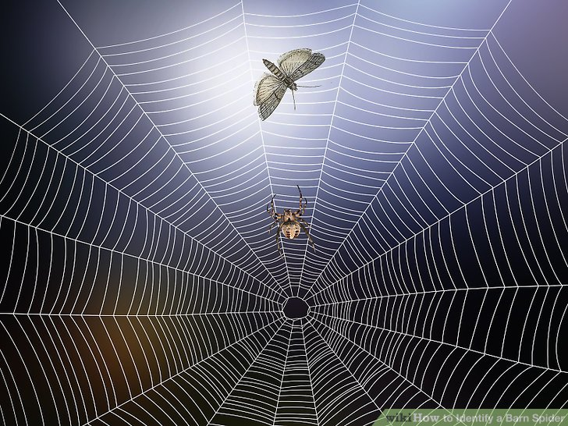
Thank you!
biobuild.mlsoc.vt.edu

Slide 25
Backup

Slide 26
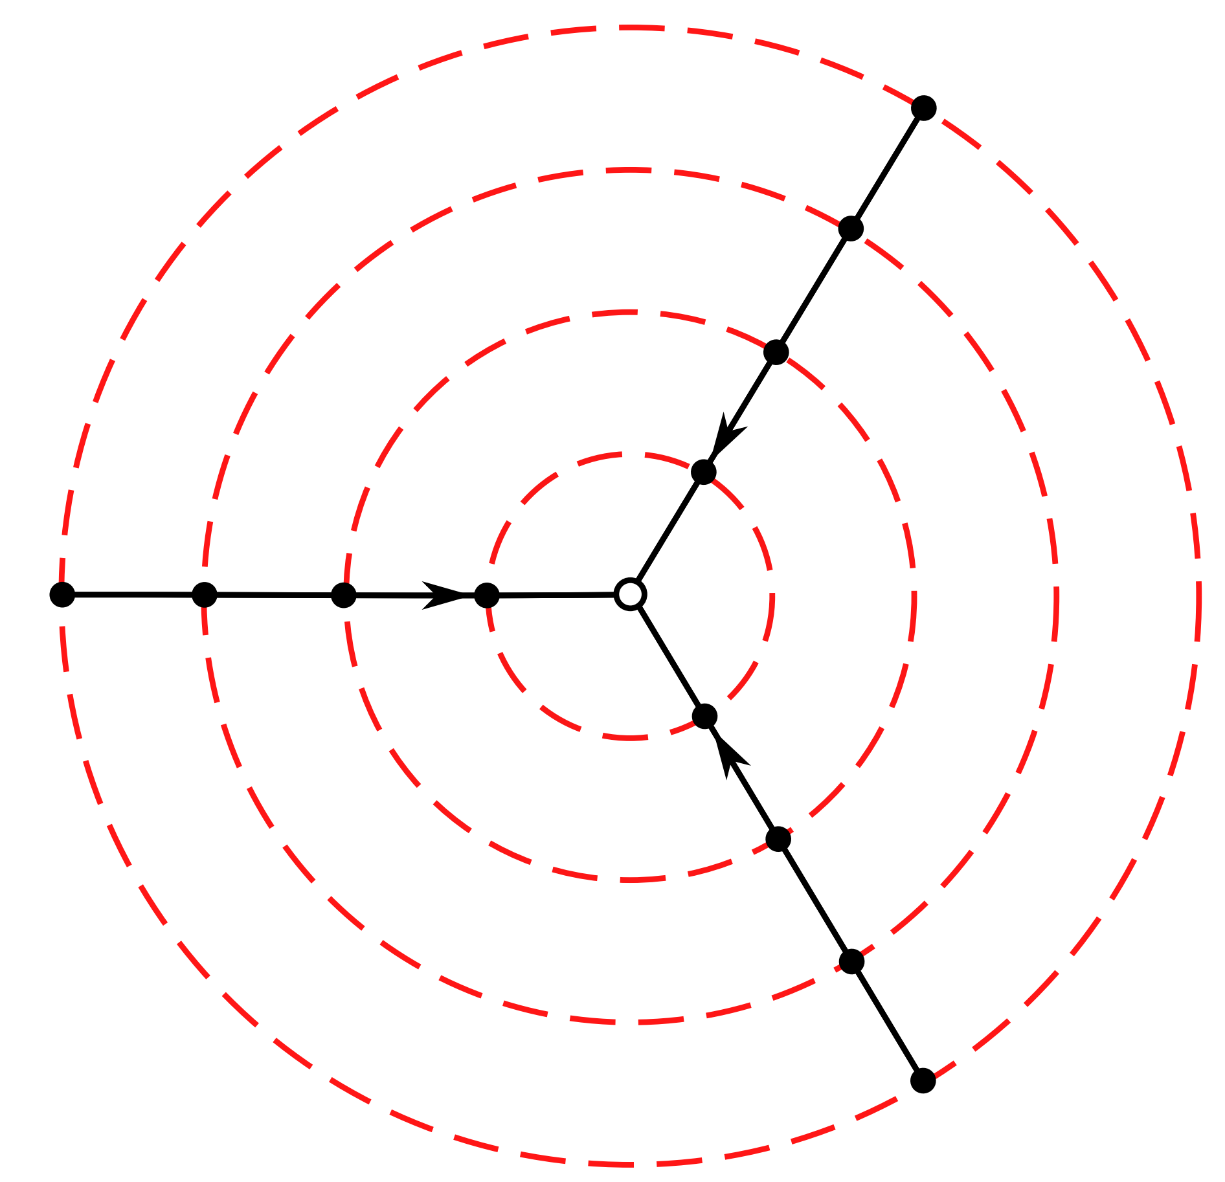
Gromov, V.K., Korchemsky, Negro, Sizov 2017
Solution for L=3 “vacuum” operator
Solution of the problem is obtained using Quantum Spectral Curve (QSC) of twisted N=4 SYM
Gromov, V.K. ,Leurent, Volin
V.K. ,Leurent, Volin
In double scaling limit, QSC gives 2nd order Baxter eq.
Two solutions satisfy the following quantization condition
These q-functions should obey “pure” large u asymptotics
Solved numerically for anomalous dimensions with virtually arbitrary precision at all relevant couplings
Perturbative solution in ξ gives the exact periods of “wheel” graphs

Slide 27
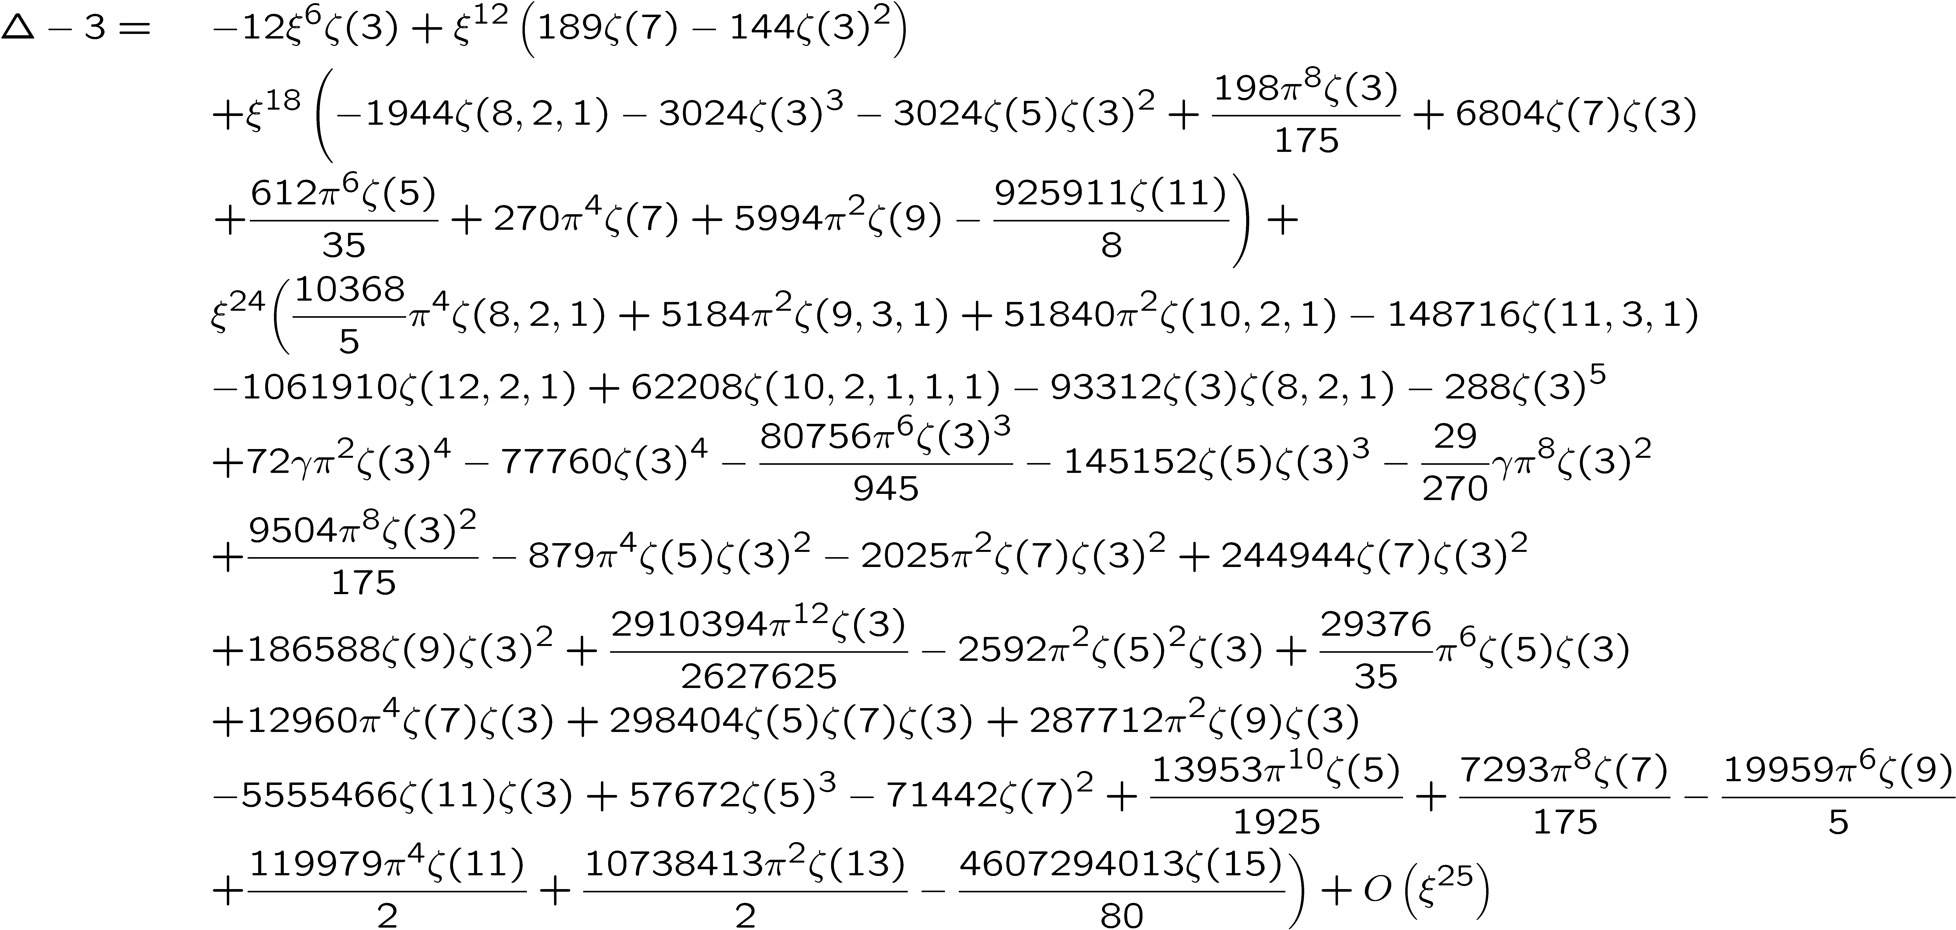
L=3 BMN vacuum and all-loop wheel graphs
Gromov, V.K , Korchemsky, Negro, Sizov (2017)
Ahn, Bajnok, Bombardelli, Nepomechie 2013
Broadherst 1980
E.Panzer, 2015
Riemann (multi)-zeta numbers
Generalization to any number of spokes L is in work
(Baxter equation is available)

Slide 28
Numerics for L=3 “BMN vacuum”
Around ξ³=0.2 dimension becomes imaginary: phase transition, finite convergence radius.
What happens to the string dual?

Slide 29
Wheel graphs at any L and dimension of
Broadherst 1980
Ahn, Bajnok, Bombardelli, Nepomechie 2013
Gurdogan, V.K. 2015

Slide 30
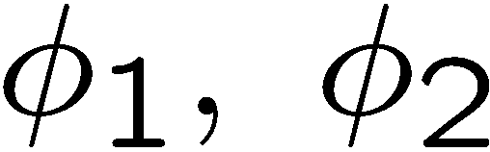
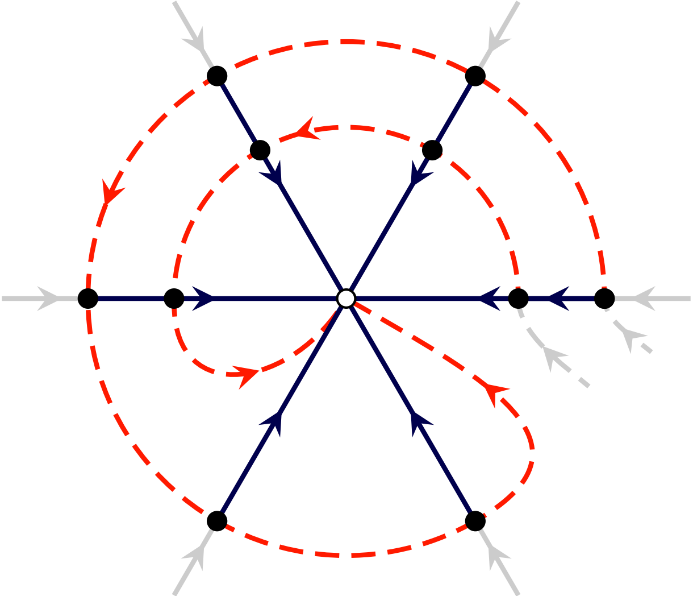
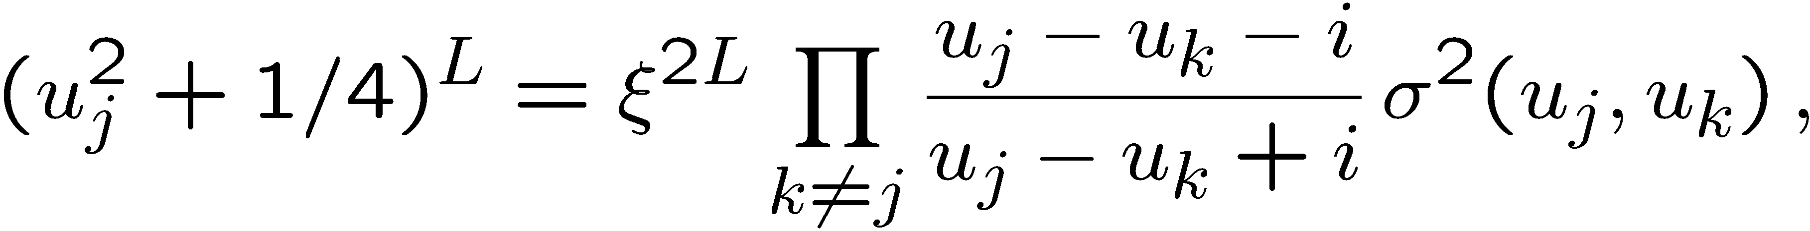
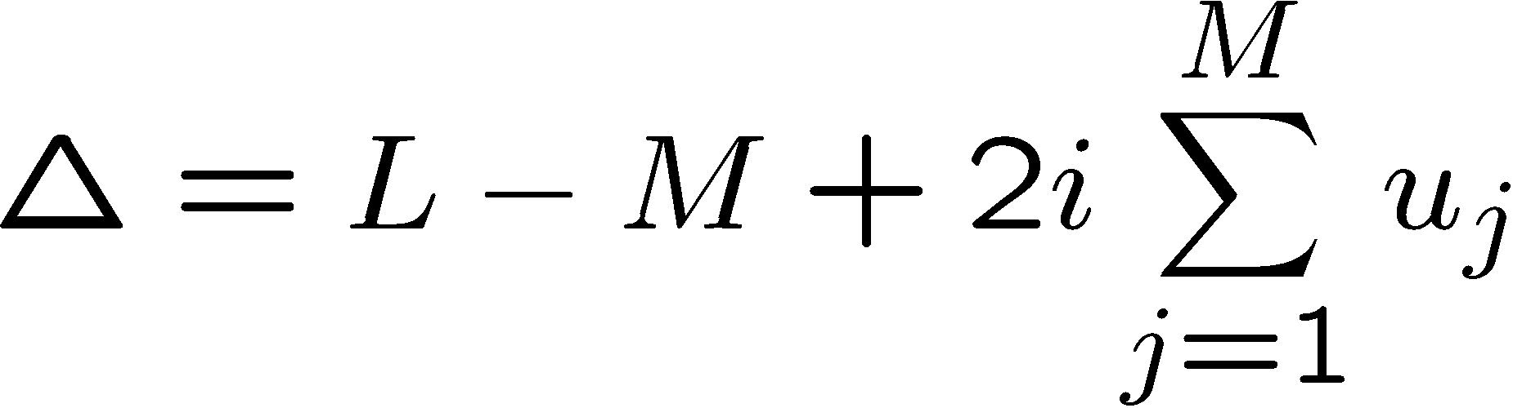


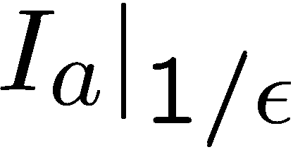
Dimensions from Asymptotic Bethe Ansatz
Eden, Beisert, Staudacher, 2005
Caetano, Gurdogan, V.K 2016
In bi-scalar model, rapidities live in “mirror” plane and the double-scaled
ABA in SU(2) subsector (made of )
Where σ is mirror-mirror ABA dressing phase in g=0 limit
The anomalous dimension are given by
Helps to compute unwrapped magnon graphs entering the mixing matrix:
“Minimally connected” Feynman graph is computed directly
Georgoudis, Goncalves, Pereira

