Slide 1
Correlators in N=4 SYM via QSC
By Nikolay Gromov based on 1802.04237
With A.Cavaglia, N.G., F.Levkovich-Maslyuk
And current work with A.Sever and D.Grabner

Slide 2
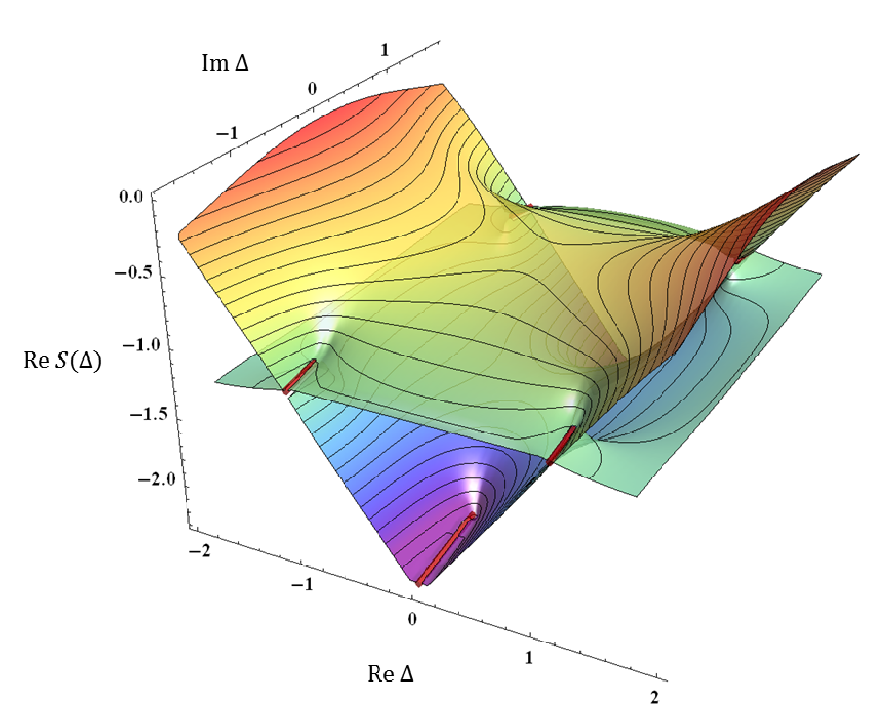
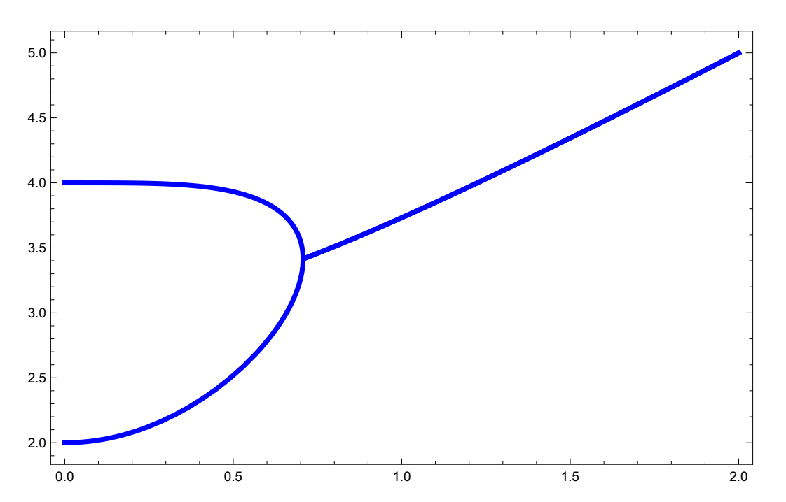
Finite coupling spectrum analytic structure

Slide 3
Correlation function with spin:
Need building blocks with the right analytic properties

Slide 4
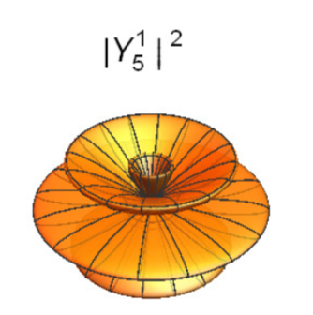
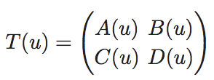
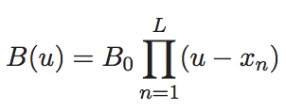
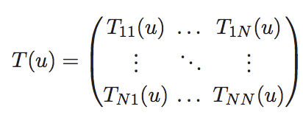
XXX Spin chains
Hydrogen atom:
Separation of variables (SOV) for SU(2) case:
Sklyanin `95
Separation of variables (SOV) for SU(N) case:
NG Levkovich-Maslyuk Sizov `16
- If we know Q – not only the spectrum but also the wave function!
- We know which exactly Q’s are appearing (out of 2^N Qs)

Slide 5
Generalization to N=4 SYM
Two main ingredients:
QQ-relations
Analyticity
- Twisted polynomial
- Twisted polynomial
In N=4 polynomials are replaced with analytic functions with cuts + monodromy condition
QQ-relations+monodromy = Quantum Spectral Curve (QSC)

Slide 6
Strategy (solving planar N=4 SYM)
We know the spectrum very well (QSC) [Gromov, Kazakov, Leurent, Volin `13]
The result is QQ-system with PSU(2,2|4) symmetry
The energy spectrum is an analytic multi-valued function of parameters – how can we inject these analytical properties into the structure constants?
Inspiration comes from Spin chains – where one can explicitly build wave functions and find a basis where it is given in terms of Q-functions
Luckily we know the Q-functions, they are part of QSC! We just need to know how to combine them into a correlation function
Important lesson from spin chains – symmetry should be broken by twists – quasiperiodic boundary conditions. This ensures spectrum non-degenerate, Q-function is in one to one correspondence with states
PSU(2,2|4) have to be broken, but that includes Lorentz symmetry!? We need something like Omega-background? Non-commutative theory?

Slide 7
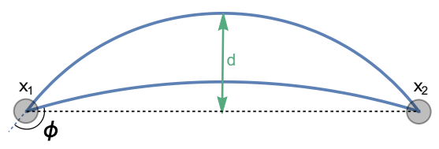
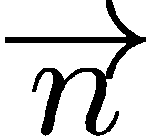
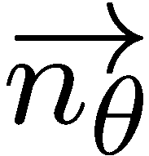
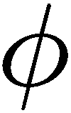
Cusp in N=4 SYM
Parameters:
Cusp angle
Angle between the couplings to scalars on two rays
‘t Hooft coupling

Slide 8
Cusp in N=4 SYM
Drukker, Fiorini
Drukker
Maldacena, Sever, Corea
Gromov,FLM 2016
O₁
O₁
Features:
Symmetries are twisted by WL, without spoiling the theory
Dilatation is still here!
Can insert any local operator at the cusp
The dimension is governed by integrability. Cusp QSC – is very similar to that of N=4

Slide 9
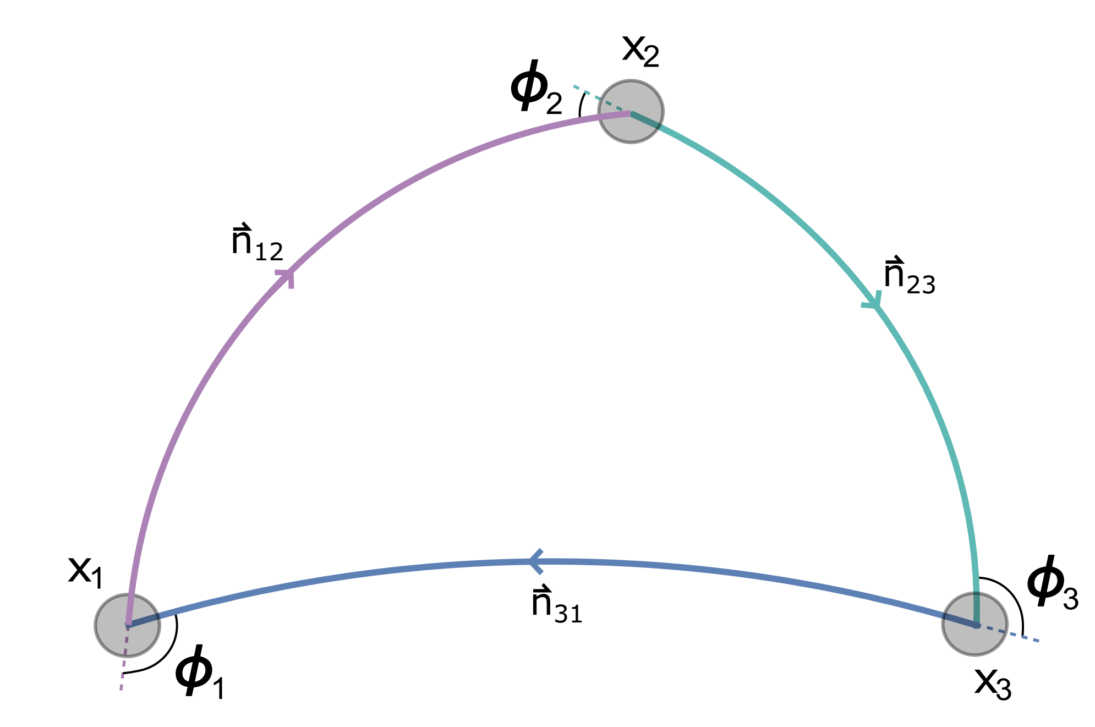
We got our ideal playground – explicit implementation of twists in both S5 and AdS5
We can start deducing the structure of 3-point function in terms of Qs
Perturbation theory?
Gets simpler in Fishnet (Ladders) limit

Slide 10
Selects only ladder diagrams, contributing to the spectrum (for some fixed phi):
Ericksson, Semenoff, Szabo, Zarembo 2000
Correa, Henn, Maldacen, Sever 2012
…
Double scaling limit

Slide 11
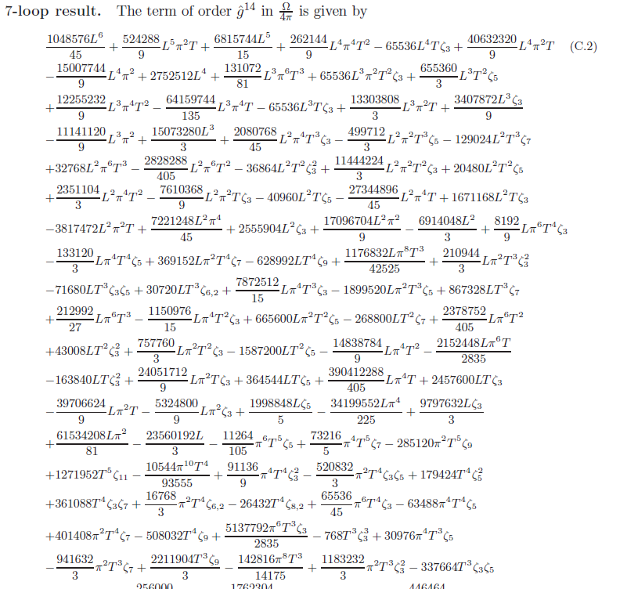
NG, Fedor L-M 2016

Slide 12
Only Ladder (a.k.a. Fishnet) diagrams survive:
We can hope that 3pt functions is doable in this limit, we can first compute that from diagrams and then
try to observe some general structure starting to pop-up from it (if we are lucky)

Slide 13
Set-up: what we are going to actually compute

Slide 14
propagator
With the boundary condition

Slide 15
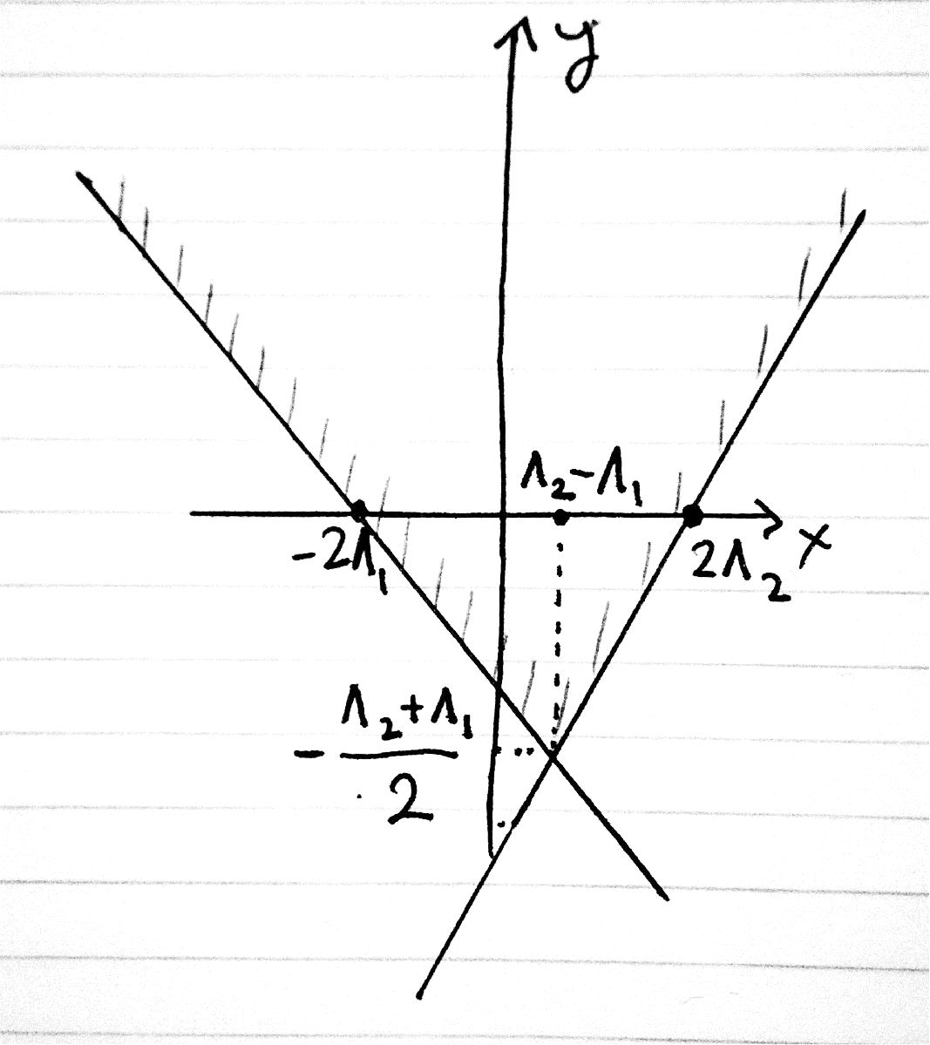
Nice parametrization:
The propagator became a function of difference:
After the change of coordinates we get a kind-of Schrodinger equation (but quadratic in time):

Slide 16
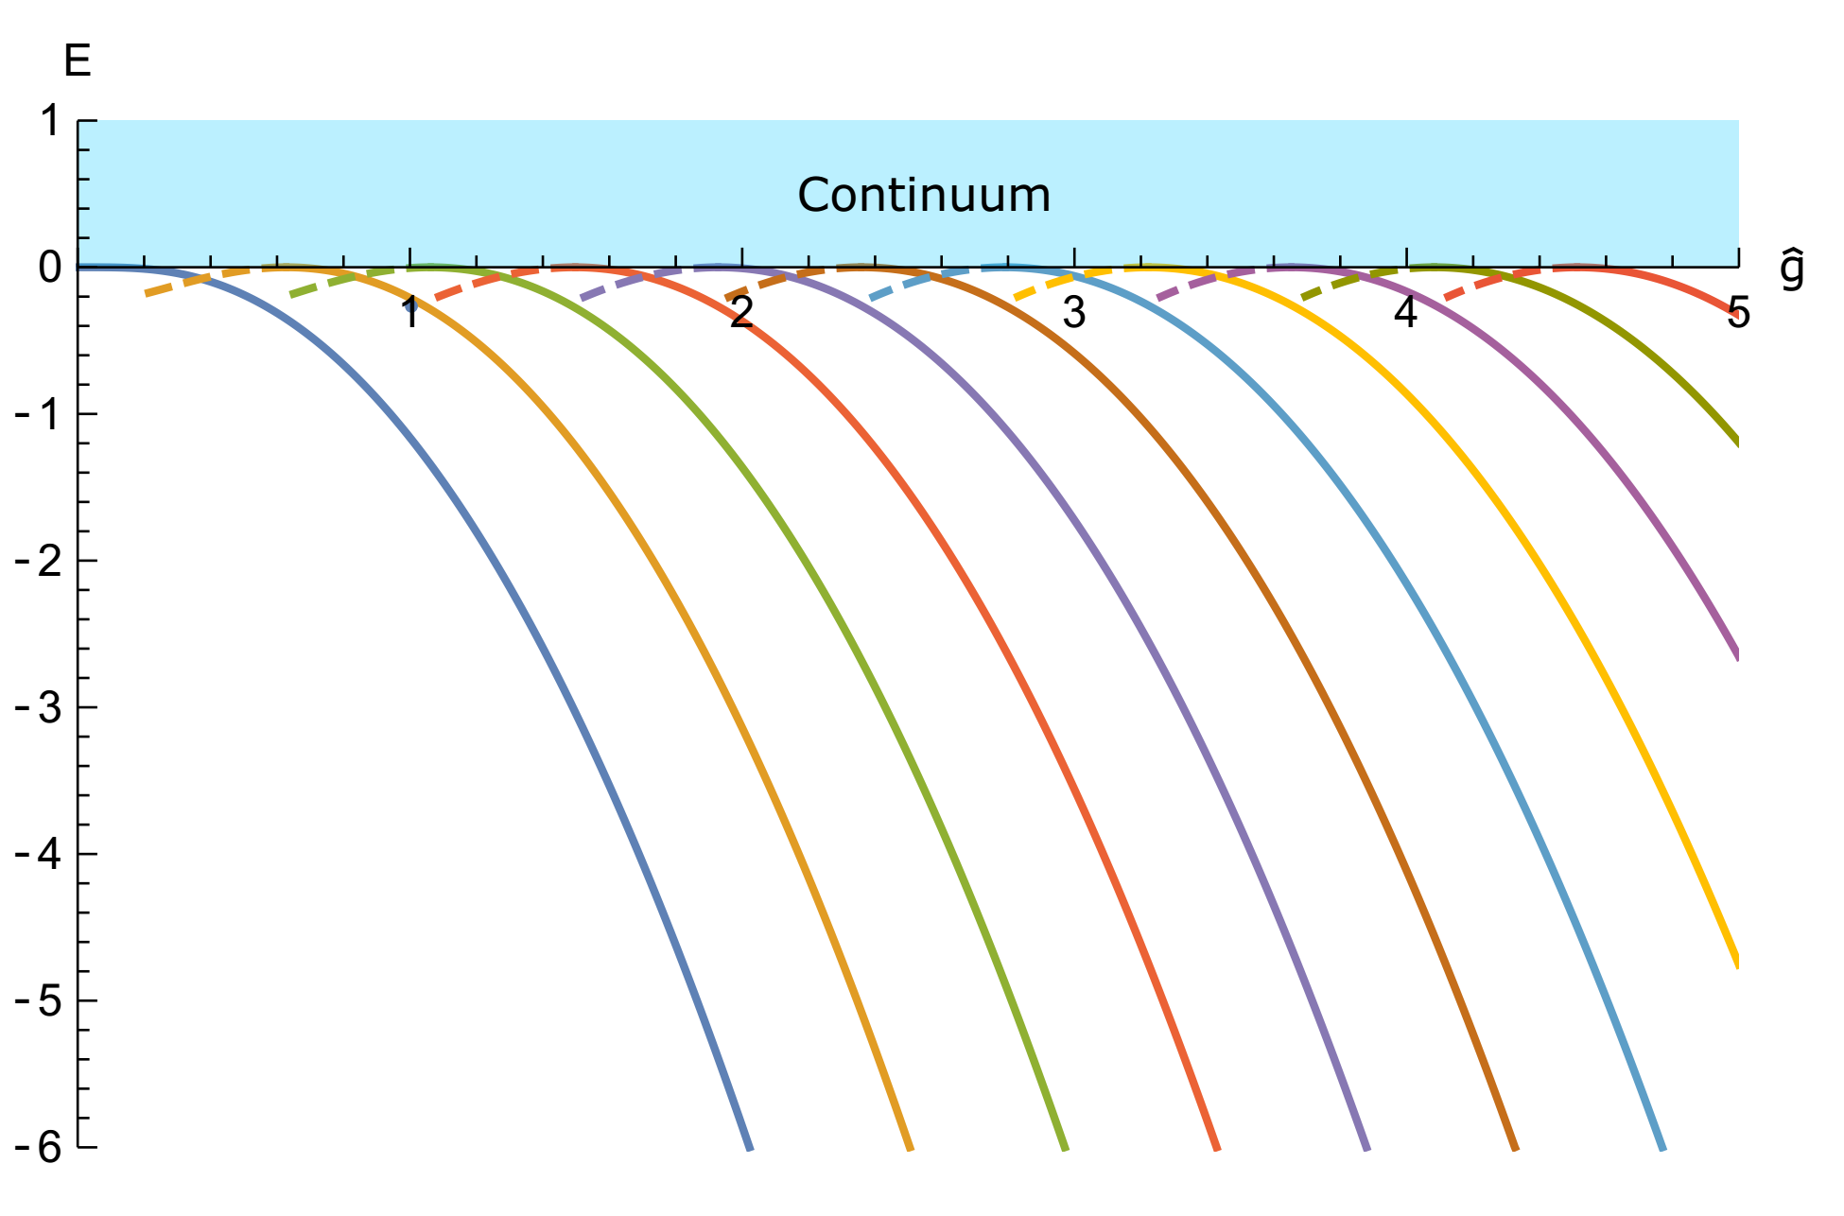

Slide 17
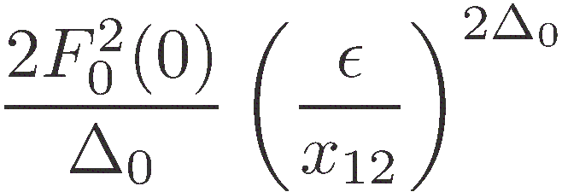
We are ready to compute the 2-point function (including finite part):
So the result is:

Slide 18
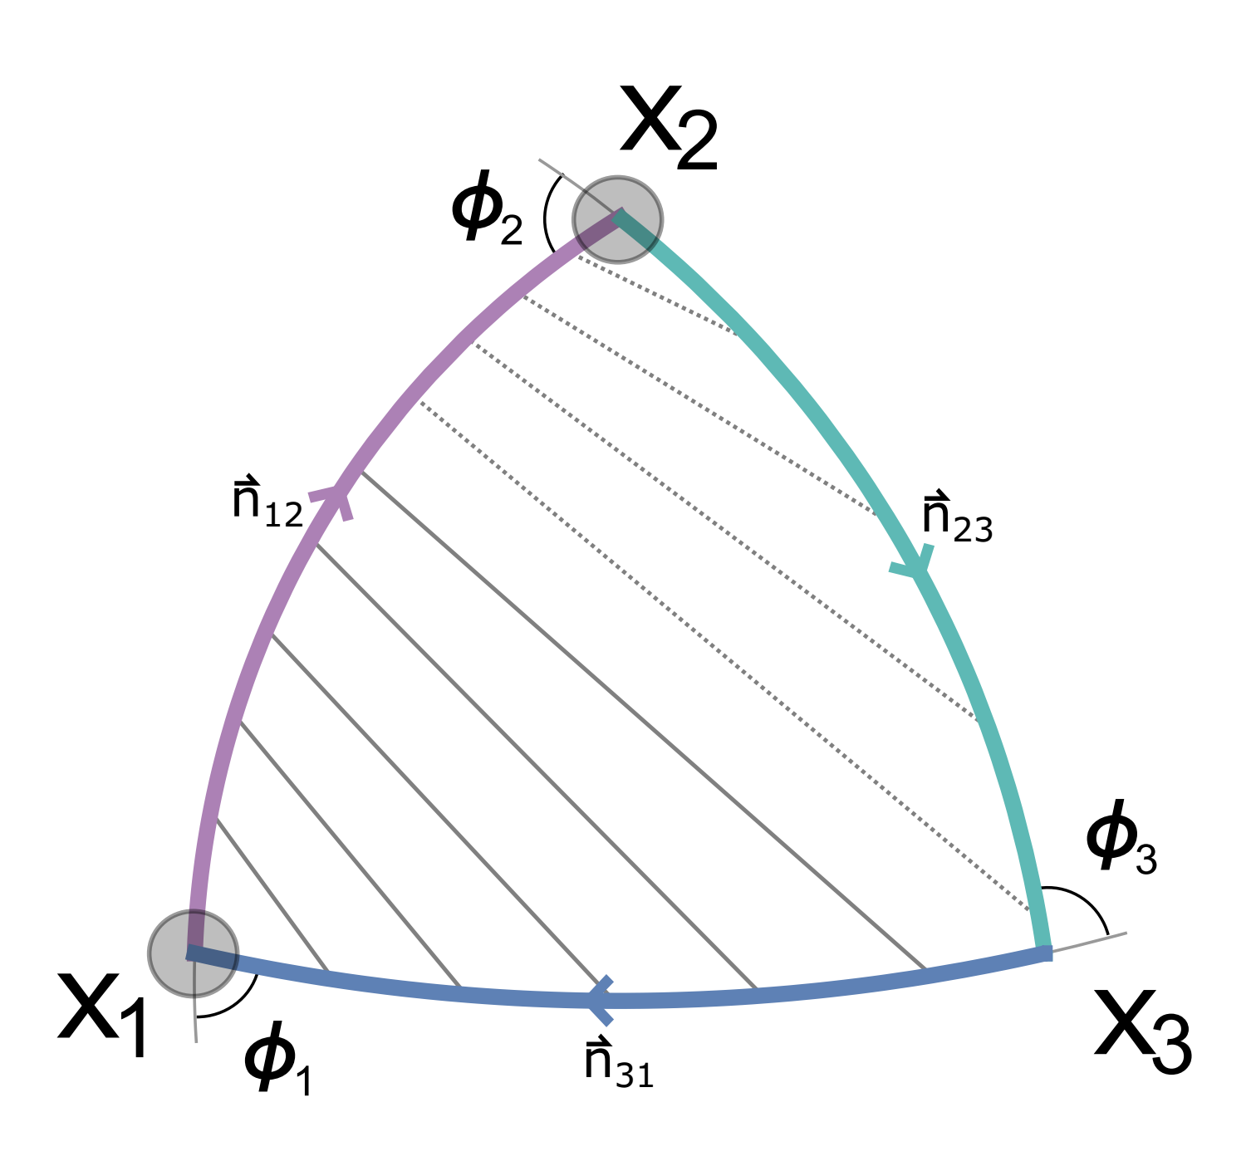
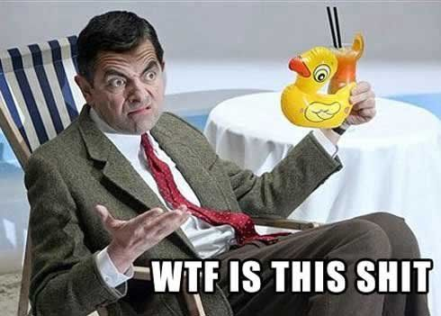
Next: 3-point correlator:
Where
Where
Where
Where
Where

Slide 19
Let’s try with integrability

Slide 20
Ladder limit? Only scalars survive
no-SUSY
at most we got SO(4,2) left from PSU(2,2|4)
half of QSC (S⁵ part should be trivial)
P functions become trivial and the general Baxter equation reduces to
Gromov,FLM 2016
Quatization condition (comes from analyticity of QSC):

Slide 21
Relation with the wave functions?
Where
Kind of a Melline transform. Baxter implies Schrodinger
In terms of q it simplifies drastically!
The structure constant simplifies to:

Slide 22
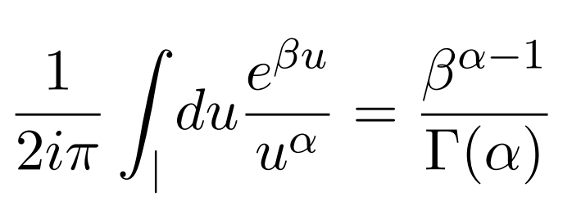
[Kim, Kiryu, Komatsy, Nishimura]
[Correa Henn Sever Maldacena]

Slide 23
About Excited states

Slide 24
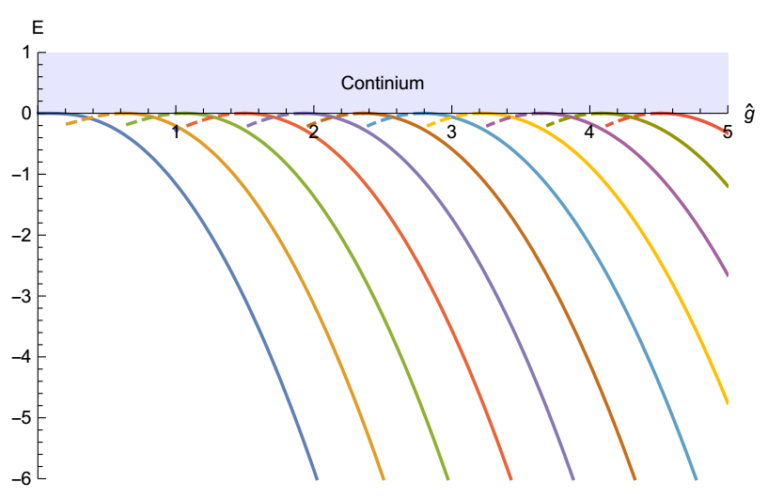
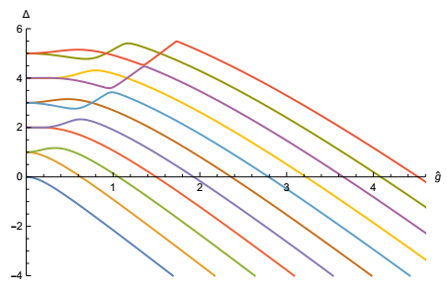
The Baxter equation has infinitely many solutions for any coupling:
Baxter:
Schrodinger:
Schrodinger has infinitely many resonances! (Spectrum on unphysical sheet of the resolvent, under the cut of the continuous spectrum)
Good luck finding them numerically or analytically from Schrodinger!
These are exactly the insertions, which Simone discussed!

Slide 25
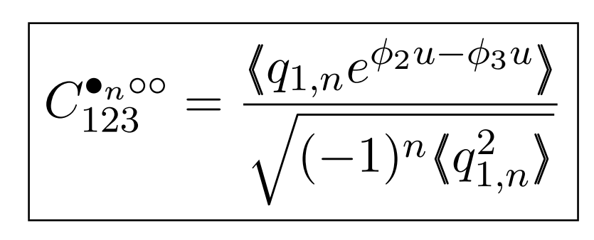

Slide 26
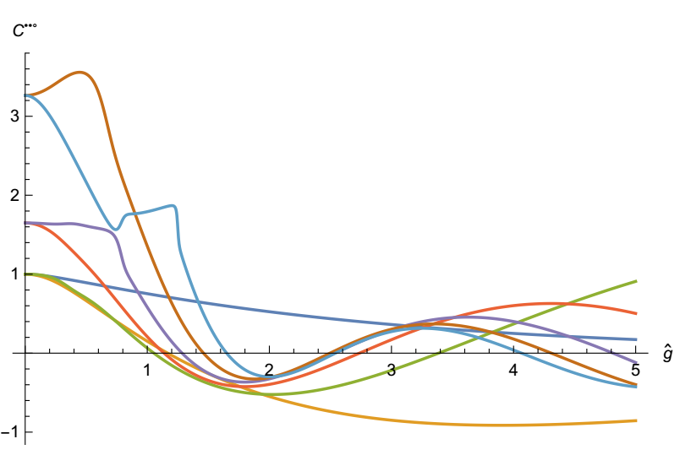
The 3-cusp correlator is given by just the same formula!
Numerical evaluation faster than for the spectrum!

Slide 27
4point and twisted OPE

Slide 30
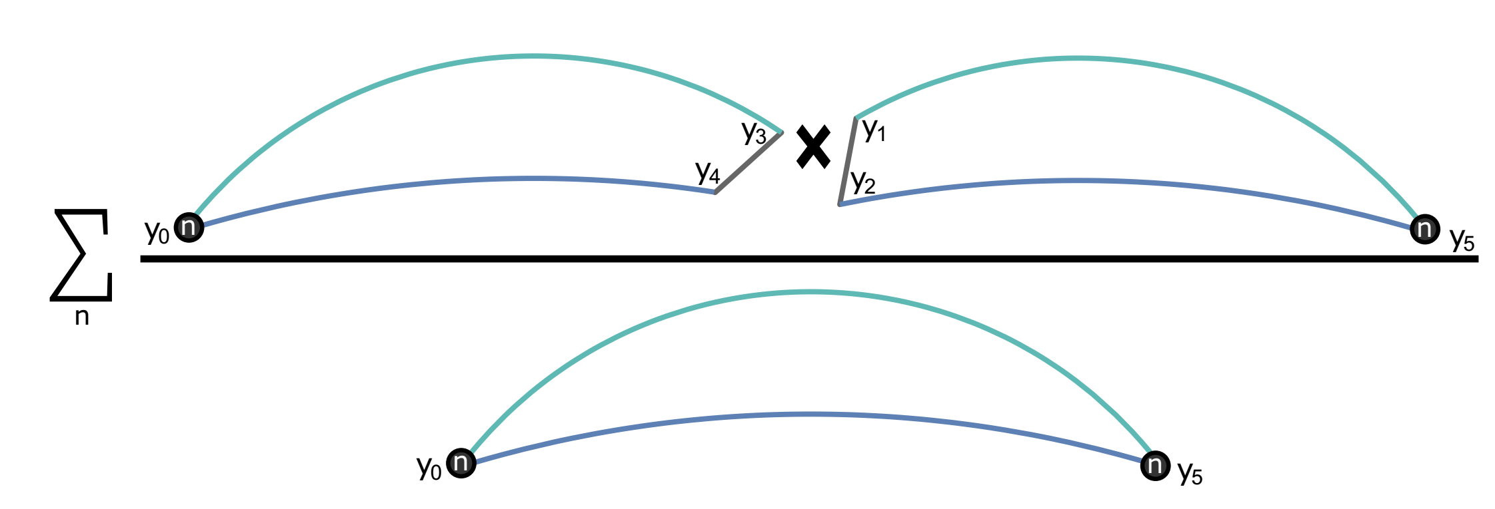

Slide 31
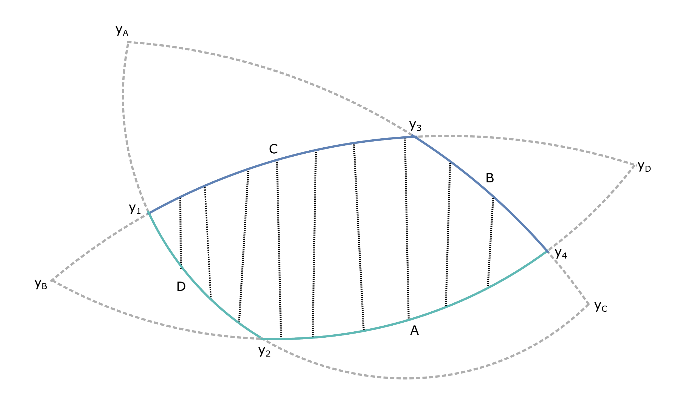
crossing relation?

Slide 32
CUTTING the "parachute cords "
Will it still work?

Slide 33
Grabner, NG, Cavalia, Sever, Levkovich-Masliuk
In progress

Slide 34
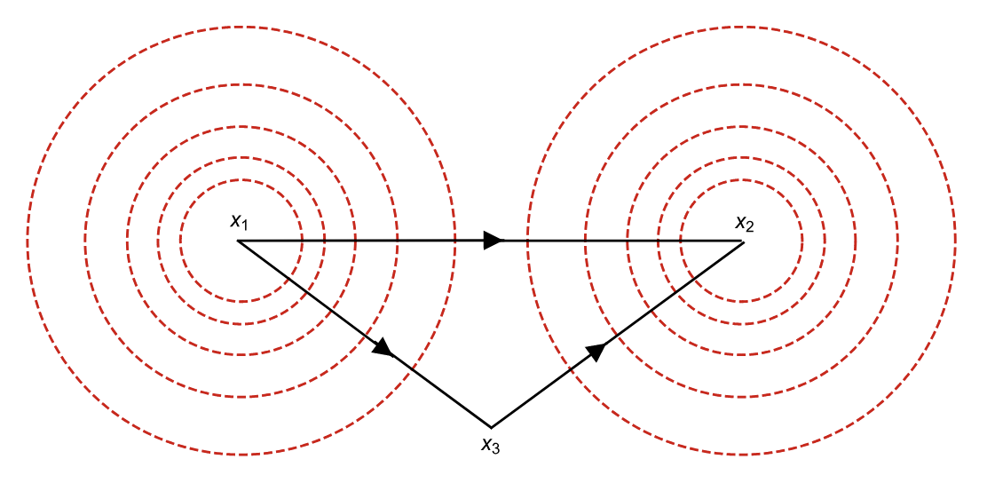
Fishnet
Cusp without WL = Fishnet
Know exact result for L=2 correlators
Grabner NG Kazakov Korchemsky `17
NG Kazakov Korchemsky `18

Slide 35
Similar to what we get in the cusp
Cusp in the straight line limit:
Fishnet:

Slide 36
Deforming the fishnet
- Need to brake the SU(4) symmetry – we know how to do that explicitly preserving integrability. Two extra twists
- We also know that SOV-like expression DOES work in the twisted fishnet!
NG Cavaglia Sever soon
Grabner NG Cavaglia Levkovich-Masliuk Sever soon

Slide 37
Conclusions
Very simple expression is found but must use q-functions, otherwise complete mess
Which is good – as QSC gives q-functions for any states, whereas the explicit wave function is not known
In the SOV (Separation of variables) method q-functions plays the role of the wave functions (worked out only for a few simple models)
Next step – fishnets may actually work too!
Going away from the fishnet limit
After that we solve planar N=4 SYM

