Slide 1




Characterization of the best high-mass prestellar core candidate found so far
Jordan MOLET
(Laboratoire d'Astrophysique de Bordeaux)
N. Brouillet, T. Nony, A. Gusdorf, F. Motte, D. Despois, F. Louvet, S. Bontemps, F. Herpin
Zooming in on Star Formation, Nafplio
13 June 2019
Notes:
10 min + 5min questions
1 : Intro
2 : Massive stars models
3 : Detection of a core in W43MM1
4 : Spectrum
5 : Line analysis
6 : Distribution
8 : Abundances
9 : Conlusion about the nature of the core
10 : Conlusion

Slide 2
High-mass star formation models
Quasi-static models
Turbulent core
(e.g. McKee & Tan 2003)

Slide 3
High-mass star formation models
Quasi-static models
Dynamical models
Collision and coalescence
(e.g. Bonnell & Bate 2002)
Competitive accretion
(e.g. Bonnell+ 2001)
Turbulent core
(e.g. McKee & Tan 2003)

Slide 4
High-mass star formation models
Quasi-static models
Dynamical models
Collision and coalescence
(e.g. Bonnell & Bate 2002)
Competitive accretion
(e.g. Bonnell+ 2001)
Turbulent core
(e.g. McKee & Tan 2003)
Existence of HM prestellar cores ?

Slide 5
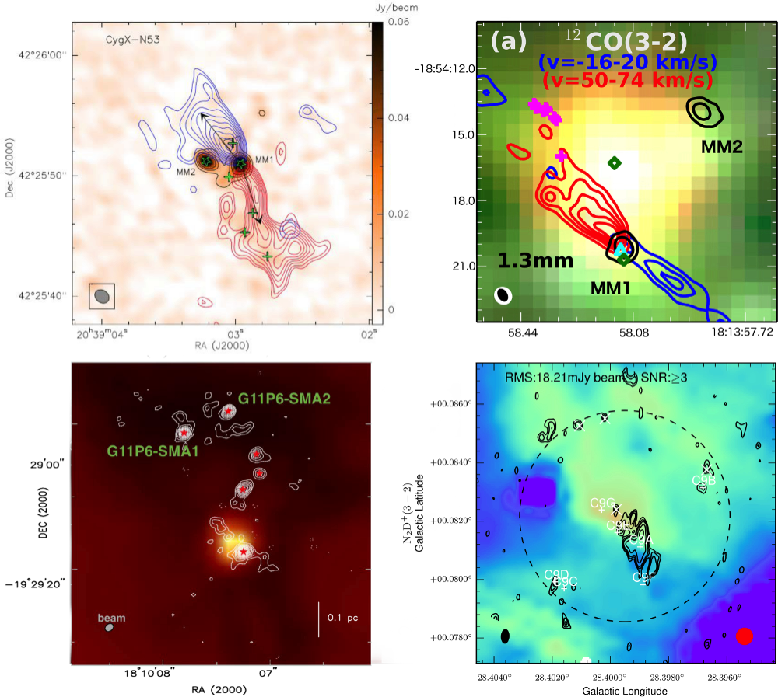
High-mass prestellar core candidates
CygX-N53-MM2
Duarte-Cabral et al. (2014)
G11.92-0.61-MM2
Cyganowski et al. (2014)
"In total, only five high-mass pre-stellar core candidates have been reported... which proves that, if they exist, they are very elusive " Review Louvet (2018)
And more recently :
W43-MM1#6 (Nony et al. 2018)
G11.11-P6-SMA1
Wang et al. (2014)
G028CA9
Kong et al. (2017)

Slide 6
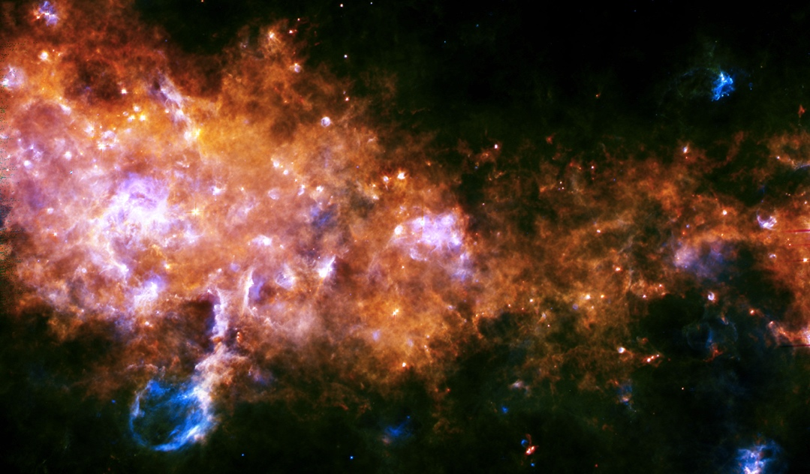
The W43-MM1 massive star forming region
Herschel ©ESA/Hi-GAL Consortium
W43 is the most active massive star forming region of the galaxy
(Hora et al. 2011)
Distance : 5.5 kpc from the sun
Location : Galactic bar
l = 30°, b = 0°
MM1
HII
region
2° = 100pc

Slide 7
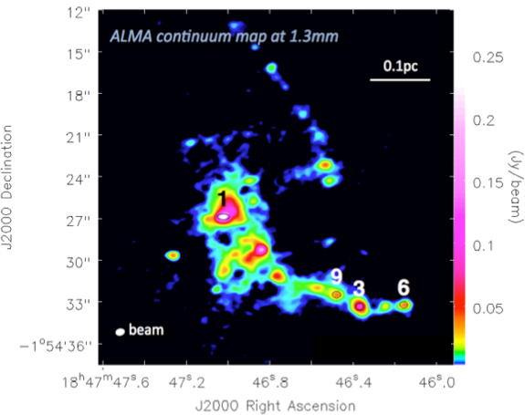
The W43-MM1 massive star forming region
Herschel ©ESA/Hi-GAL Consortium
W43 is the most active massive star forming region of the galaxy
(Hora et al. 2011)
Distance : 5.5 kpc from the sun
Location : Galactic bar
l = 30°, b = 0°
MM1
HII
region
2° = 100pc
Motte et al. 2018
13 massive cores (16-100 M) at the same distance, observed with the same high spatial resolution (2400 au)

Slide 8
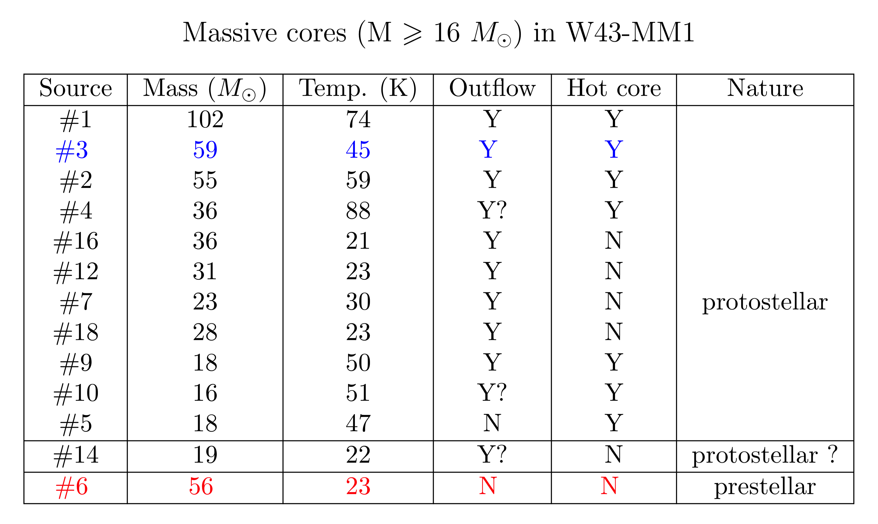
The W43-MM1 massive star forming region
Herschel ©ESA/Hi-GAL Consortium
W43 is the most active massive star forming region of the galaxy
(Hora et al. 2011)
Distance : 5.5 kpc from the sun
Location : Galactic bar
l = 30°, b = 0°
MM1
HII
region
2° = 100pc
?
Motte et al. 2018
13 massive cores (16-100 M) at the same distance, observed with the same high spatial resolution (2400 au) :
11 protostellar cores
  2 undetermined cores (1 prestellar candidate)

Slide 9
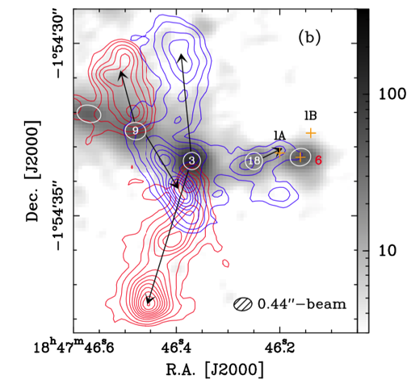
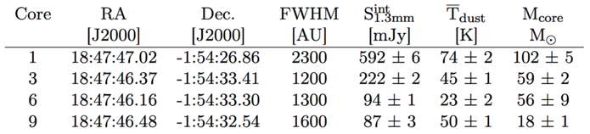
A new high-mass prestellar core candidate
SiO
9
3
6
Core #3 and 6 have the same mass (60M) in the same size (1300AU).
60-90 km.s⁻¹
104-134 km.s⁻¹
Outflows from core #3, but core #6 shows no outflow
Rich molecular content in core #3, while core #6 shows poor molecular content.
Core #6 is a good high-mass prestellar core candidate !
(Nony et al. 2018)
9

Slide 10
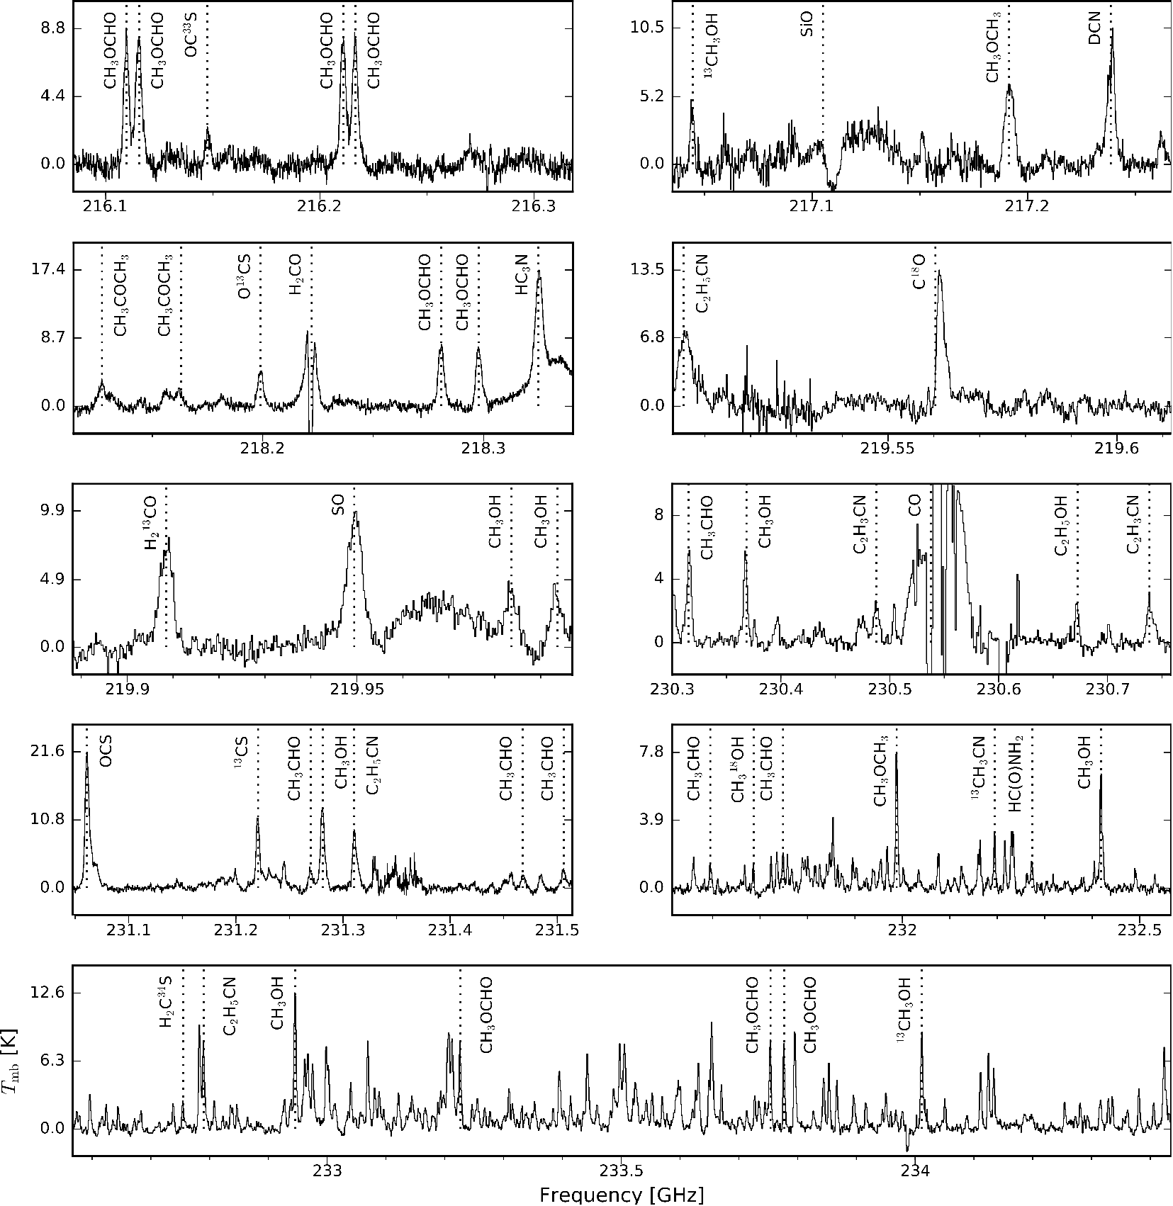
ALMA Data
Spectra from W43-MM1 #3
Characteristics
ALMA Cycles 2 & 3
Bandwidth : 5 GHz @ 1.3mm
Spatial res. : 0.5" (2400au)
Spectral res. : 0.1-1 MHz (0.17-1.27 km.s⁻¹)
7 line bands
2 GHz btw. 216.1 and 231.5 GHz
- Strong lines : SO, CO, OCS ..
- Isotopologues
- Few lines from COMs
2 "continuum" bands
3 GHz from 231.5 to 234.5 GHz
- A lot of lines in core #3, mainly from COMs

Slide 11
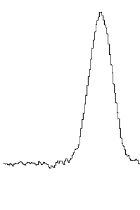
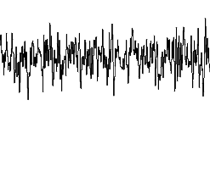
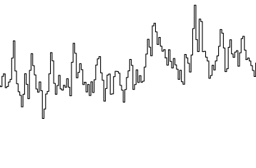
Continuum map
How to determine the continuum level of a spectrum?
lines ≫ noise
cont ~ min(values)
lines ≪ noise
cont ~ mean(values)
For more complex (realistic) spectra, the continuum level is not always easy to find
➔ Statistical method to estimate the continuum level

Slide 12
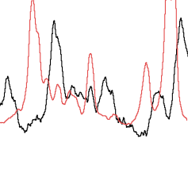
Continuum map
How to determine the continuum level of a spectrum?
A unique continuum map for a large field?
Each source is different from the others in :
- Velocity
- Molecular content
So each source must be treated independently
1st core
2nd core
lines ≫ noise
cont ~ min(values)
lines ≪ noise
cont ~ mean(values)
For more complex (realistic) spectra, the continuum level is not always easy to find
channel
➔ Statistical method to estimate the continuum level
➔ Automatic method to estimate the continuum level on each pixel

Slide 13
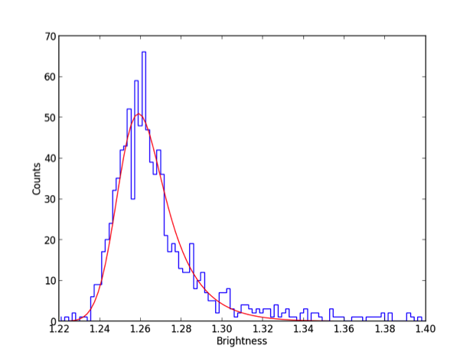
Continuum map
Use the distribution of intensity on each pixel :
- Gaussian part → Noise
- Tail → Molecular emission (right)
or absorption (left)
see Jørgensen+ 2016
Sanchez-Monge+ 2017 (STATCONT)
Well fitted by the Exponentially Modified Gaussian :
λ ≅ "symmetry" coefficient
Data
EMG fit
Continuum level

Slide 14
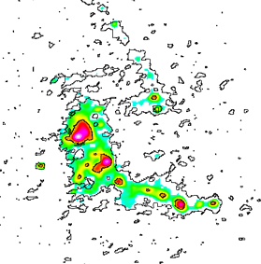
Continuum map
Use the distribution of intensity on each pixel :
- Gaussian part → Noise
- Tail → Molecular emission (right)
or absorption (left)
see Jørgensen+ 2016
Sanchez-Monge+ 2017 (STATCONT)
Well fitted by the Exponentially Modified Gaussian :
λ ≅ "symmetry" coefficient
Data
EMG fit
Continuum level
contours 1%, 2%
The relative error is obtained by synthetic spectra with parameters comparable to our observations

Slide 15
Line analysis : Core #3

Slide 16
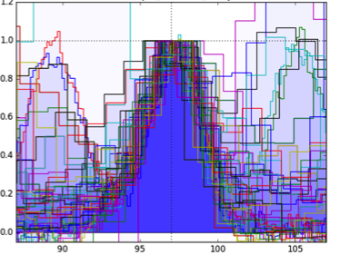
Line analysis : Core #3
For each molecule :
- Identification of transitions based on CDMS and JPL databases
- Superposition of the corresponding lines normalised
Lines without contamination have :
- same velocity
- same dispersion

Slide 17
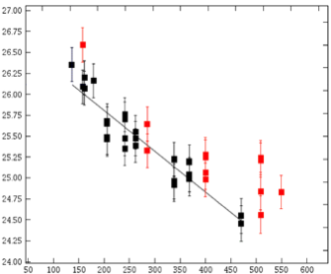
Line analysis : Core #3
For each molecule :
- Identification of transitions based on CDMS and JPL databases
- Superposition of the corresponding lines normalised
Rotationnal diagram
Contaminated line
Lines without contamination have :
- same velocity
- same dispersion
ln(N_{u}/g_{u})
Eup/k_{B} [K]
LTE conditions ➔

Slide 18
Line analysis : Core #3
25 species detected in core #3
CO (¹⁸O) | HC₃N | ¹³CS
SiO | DCN | OCS (¹³C, ³³S)
H₂CO (¹³C) | ¹³CH3CN | SO
CH₃OH (¹³C, ¹⁸O) | HC(O)NH₂ | H₂C³⁴S
CH₃CHO | C₂H₃CN
CH₃OCH₃ | C₂H₅CN
CH₃OCHO
CH₃COCH₃
C₂H₅OH
v = 97 km/s
Δv = 5.2 km/s
N_{X, #3}
Tex = 190 K

Slide 19
Line analysis : Core #3
3σ-level
25 species detected in core #3
CO (¹⁸O) | HC₃N | ¹³CS
SiO | DCN | OCS (¹³C, ³³S)
H₂CO (¹³C) | ¹³CH3CN | SO
CH₃OH (¹³C, ¹⁸O) | HC(O)NH₂ | H₂C³⁴S
CH₃CHO | C₂H₃CN
CH₃OCH₃ | C₂H₅CN
CH₃OCHO
CH₃COCH₃
C₂H₅OH
v = 97 km/s
Δv = 5.2 km/s
N_{X, #3}
Tex = 190 K

Slide 20
Line analysis : Core #6

Slide 21
Line analysis : Core #6

Slide 22
Line analysis : Core #6
17 species detected in core #6
CO (¹⁸O) | HC₃N | ¹³CS
SiO | DCN | OCS (¹³C, ³³S)
H₂CO (¹³C) | ¹³CH3CN | SO
CH₃OH (¹³C, ¹⁸O) | HC(O)NH₂ | H₂C³⁴S
CH₃CHO | C₂H₃CN
CH₃OCH₃ | C₂H₅CN
CH₃OCHO
CH₃COCH₃
C₂H₅OH
v = 95.5 km/s
Δv = 3.2 km/s
N_{X, #6} ≈ 0.1 N_{X, #3}
Tex = 15-90 K

Slide 23
Line analysis : Core #6
17 species detected in core #6
CO (¹⁸O) | HC₃N | ¹³CS
SiO | DCN | OCS (¹³C, ³³S)
H₂CO (¹³C) | ¹³CH3CN | SO
CH₃OH (¹³C, ¹⁸O) | HC(O)NH₂ | H₂C³⁴S
CH₃CHO | C₂H₃CN
CH₃OCH₃ | C₂H₅CN
CH₃OCHO
CH₃COCH₃
C₂H₅OH
v = 95.5 km/s
Δv = 3.2 km/s
N_{X, #6} ≈ 0.1 N_{X, #3}
Tex = 15-90 K
?
It was possible to make only 3 rotational diagrams (CH₃OH, CH₃CHO, CH₃OCHO), with big uncertainties on T_{ex} estimation
→ Need another method to constrain T_{ex}

Slide 24
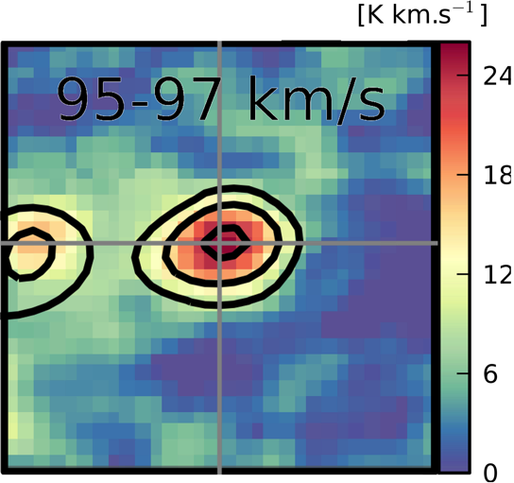
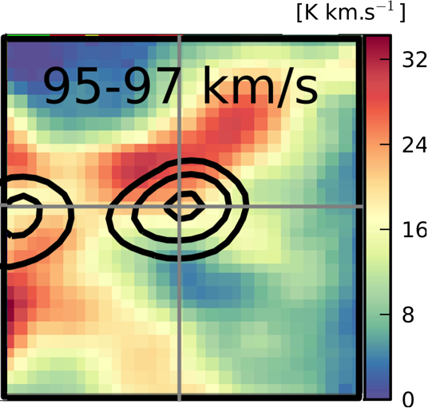
Distribution of the molecules
OCS
SiO
#18
#6
#18
#6
Associated to core #6
¹³CS, OCS, O¹³CS, OC³³S, C¹⁸O
CH₃OH, ¹³CH₃OH, CH₃CHO
CH₃OCHO, CH₃OCH₃
Not associated to core #6
SiO, SO, H₂CO, H₂¹³CO
HC₃N, DCN, CO

Slide 25
Distribution of the molecules
OCS
SiO
X
#18
#6
#18
#6
Associated to core #6
¹³CS, OCS, O¹³CS, OC³³S, C¹⁸O
CH₃OH, ¹³CH₃OH, CH₃CHO
CH₃OCHO, CH₃OCH₃
Not associated to core #6
SiO, SO, H₂CO, H₂¹³CO
HC₃N, DCN, CO
Origin of the peak outside core #6?
Interaction of its envelope with:
- the outflow from core #18
- a large scale shock

Slide 26
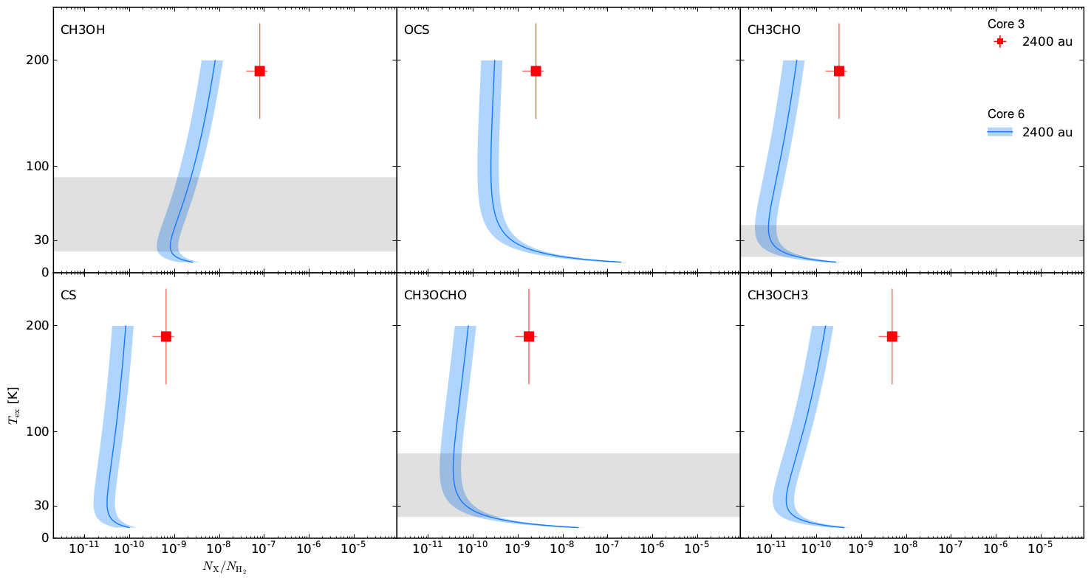
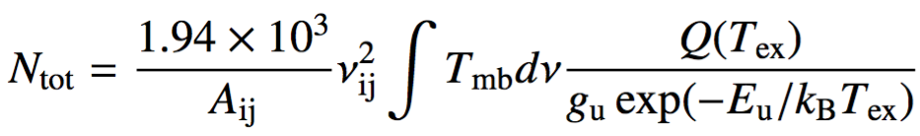
Comparison of abundances / H₂ :
Core size
=
spatial resolution

Slide 27
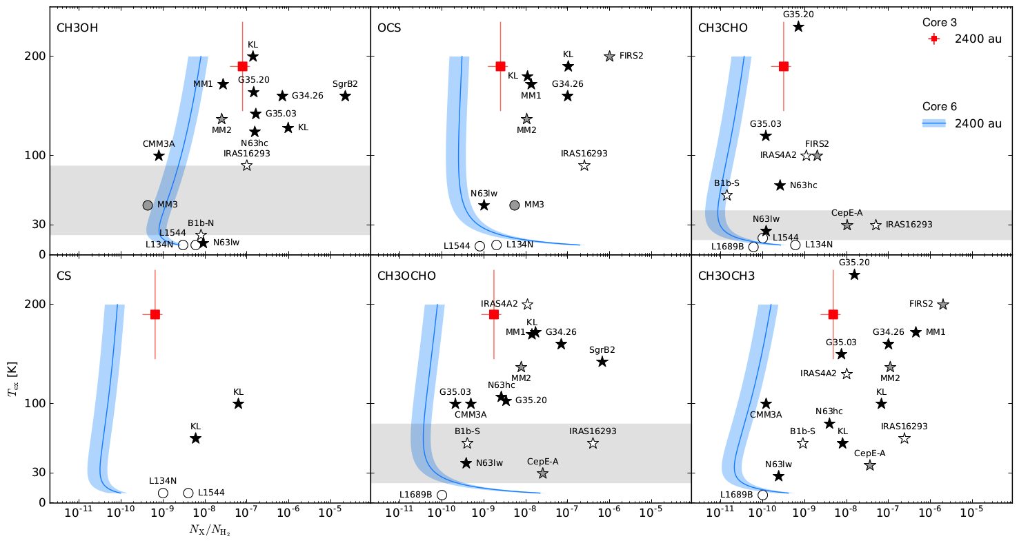
Comparison of abundances / H₂ :
Core size
=
spatial resolution
 | Low-mass | Intermediate-mass | High-mass
Prestellar | L134N – L1544 | NGC 7538S MM3 | -
Protostellar | IRAS 4 A2 -- IRAS 16293 | CepE-A – NGC 7129 FIRS2 | OrionKL -- SgrB2(N2)

Slide 28
Comparison of abundances / H₂ :
Different core sizes
considering unresolved emission
 | Low-mass | Intermediate-mass | High-mass
Prestellar | L134N – L1544 | NGC 7538S MM3 | -
Protostellar | IRAS 4 A2 -- IRAS 16293 | CepE-A – NGC 7129 FIRS2 | OrionKL -- SgrB2(N2)

Slide 29
Conclusions about the nature of core #6
Current resolution
Prestellar Core
2400 au
20 K
Starting Protostellar Phase
1000 au
20-30 K
Young Protostellar Core
or Hot Corino
500-1000 au
80 K
To decide, we need :
- Higher angular resolution (size? outflows?)
- More molecular lines (N and T)
ALMA Cycle 7 proposal :
0.1"
+
14.5 GHz bandwidth
@ 1.3mm

Slide 30
Conclusion
Detection of a high-mass prestellar core candidate (60M, 1300 AU) :
  No Outflow
  Weak emission lines
We studied its molecular content by carefully :
  Subtracting the continuum, estimated on each pixel
  Comparing the emission lines with its bright protostellar neighbour
  Mapping the distribution of the molecular emission
The abundances are compatible with low mass prestellar cores, but higher spatial resolution is needed to confirm its identity.
Thank You !

