Slide 1


Linking galactic scale star formation to planet formation
Andrew Winter
University of Leicester – a.j.winter@le.ac.uk
Cathie Clarke, Diederik Kruijssen, Giovanni Rosotti, Stefano Facchini,
Tom Haworth, Mélanie Chevance, Ben Keller, Steve Longmore

Slide 2
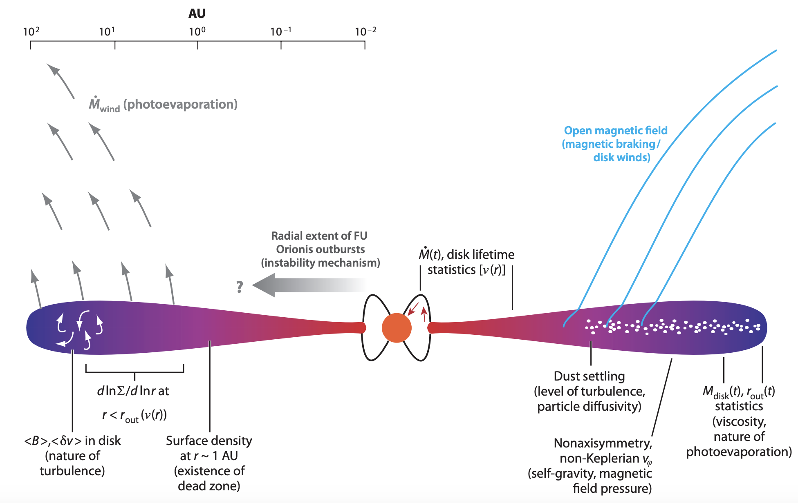
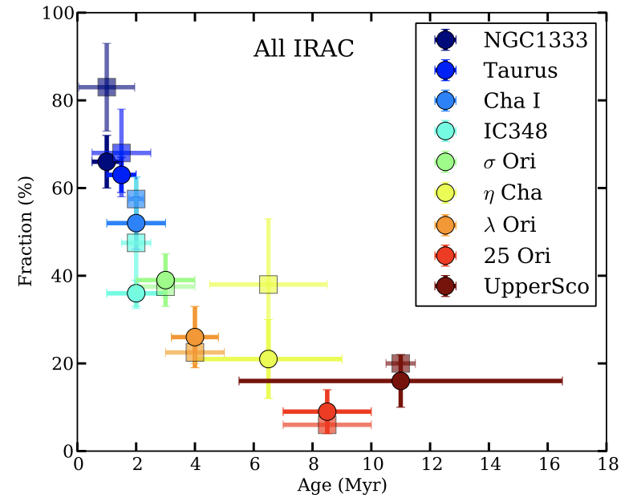
Protoplanetary disc (PPD) dispersal
Armitage 2011
Ribas+ 2014
1

Slide 3
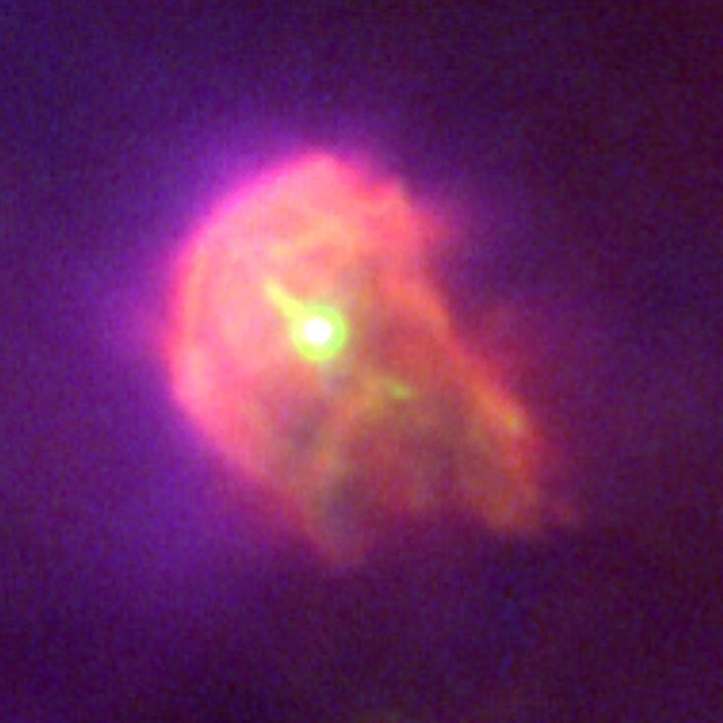
Environment & PPD dispersal
Ionisation front (EUV photons) causes contrast between EUV/FUV regions
Photo-dissociated region (PDR) optically thick to EUV
Thermal winds launched from the edge of the disc
'Cometary' tail points away from ionising source
Proplyd - HST
2

Slide 4
Local star forming regions
Thresholds for disc destruction in FUV-density space
FUV: viscous disc evolution models coupled with mass loss rate grids (FRIED – Haworth+ 2018)
Encounters: theoretical encounter rates + angular momentum loss fitting formulae
Encounters between unbound stars (not multiples) are rare over ~Myr
Winter+ 2018b

Slide 5



Star formation & PPD dispersal
Can we generalise to diverse star forming environments?
Ingredients:
Stellar density distribution (density defines mean flux parameter Ψ₀ in high mass star forming region limit)
Cluster mass ɸ distribution (most massive star in the region defines luminosity parameter Λ)
Dispersion from mean:

Slide 6
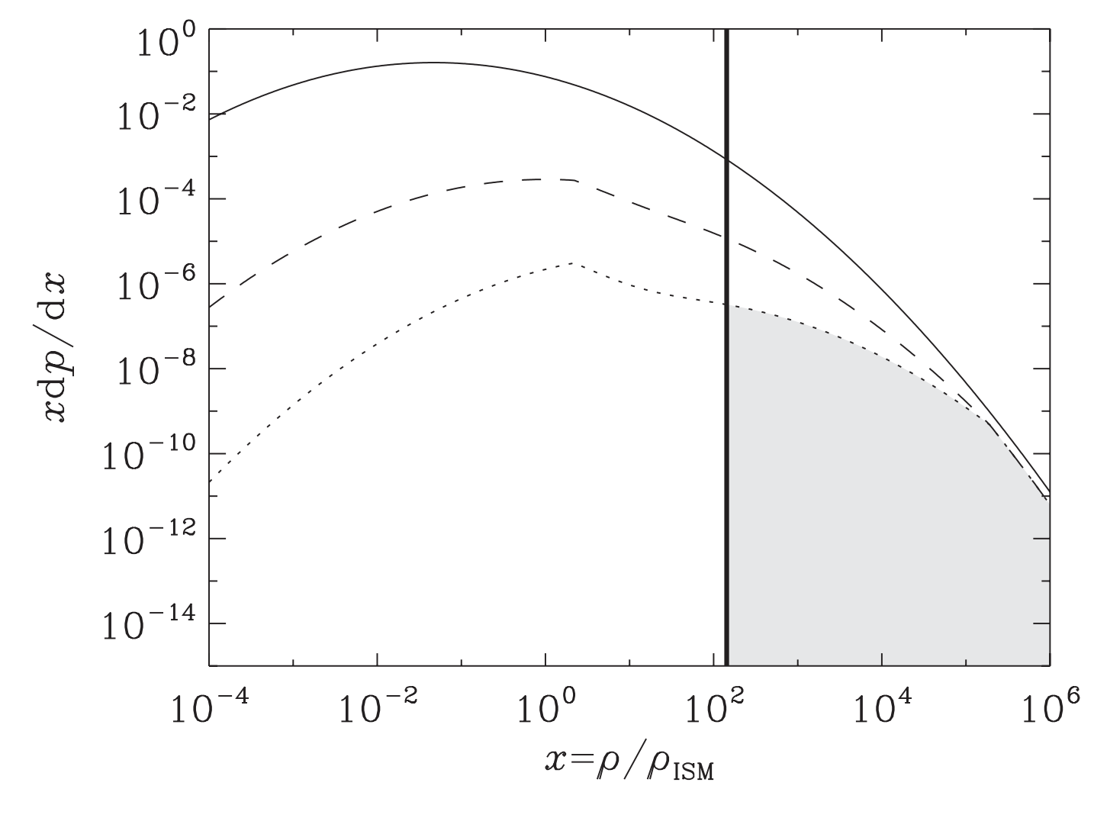
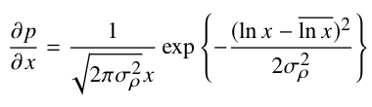
Stellar density distribution
Log-normal gas density probability density function (PDF):
This can be related to the stellar density PDF by weighting by SFE (and density)
Kruijssen 2012

Slide 7
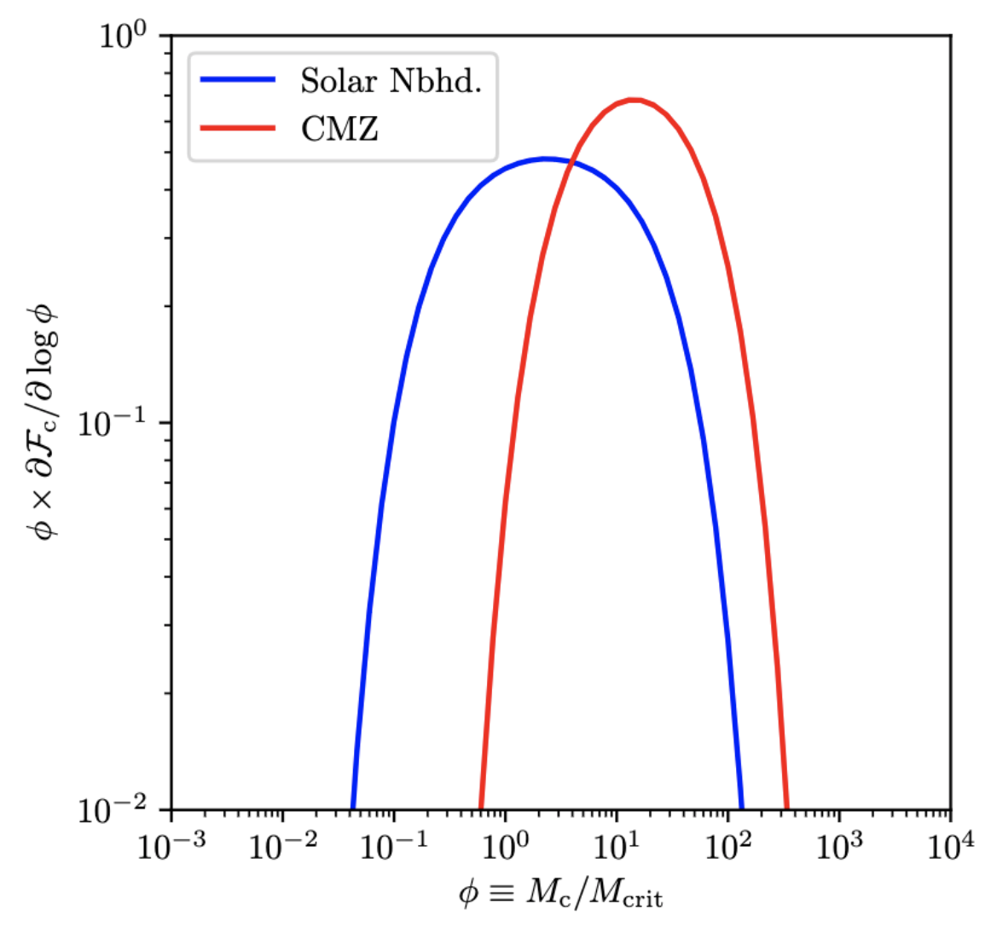
Initial cluster mass function (ICMF)
Maximum cluster mass dependent on Toomre mass (length scale on which ISM stable to perturbation – Reina-Campos+ 2017)
Minimum cluster mass defined by limit at which efficient star formation leads to early single-object mergers (Trujillo-Gomez + submitted)
Winter+ to be submitted

Slide 8
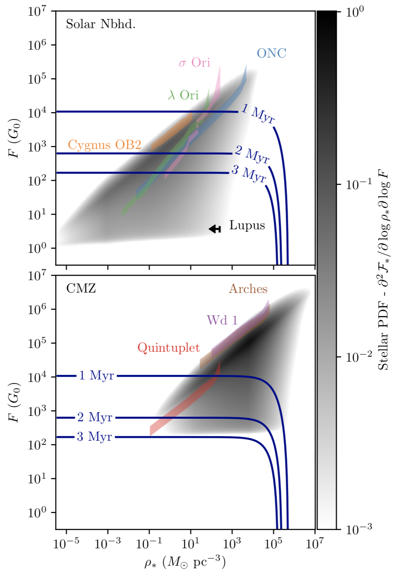
Solar neighbourhood vs.
Central molecular zone

Slide 9
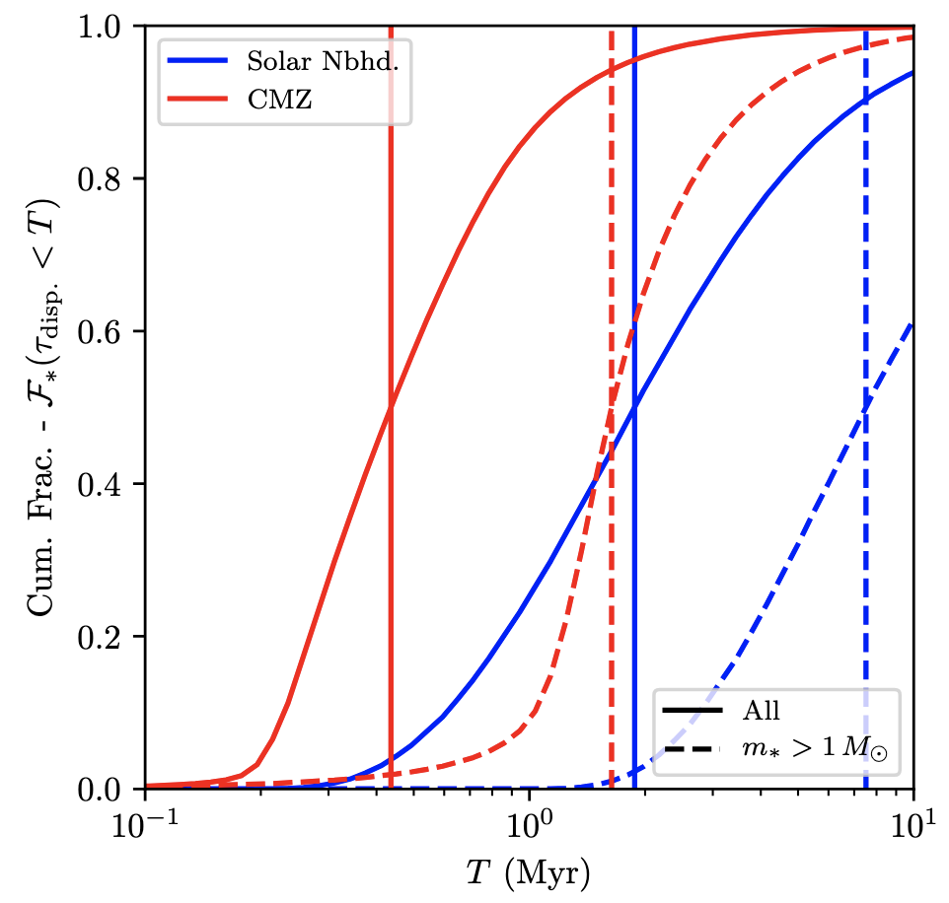
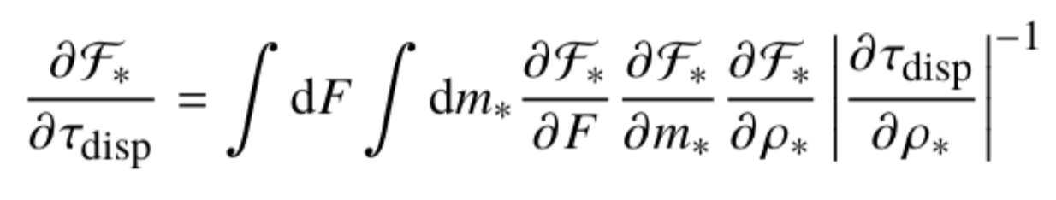
Rapid disc dispersal in the CMZ
Estimate dispersal time-scale distribution:
Rapid externally induced dispersal in the CMZ? Factor ~3 shorter than solar neighbourhood
NIR inferred disc fractions low (Stolte+ 2010 - ~3-10% in Arches)
External influences have a profound influence on planet formation

Slide 10
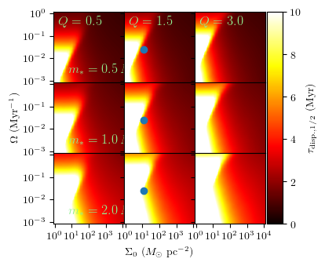
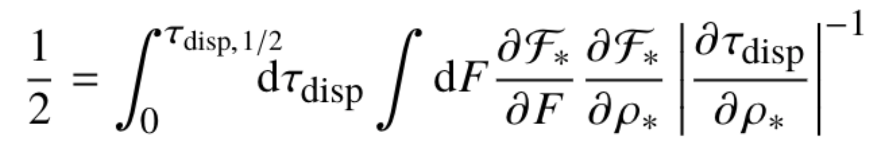
Is the Solar neighbourhood special?
Link the gas properties (Toomre Q, angular velocity, gas surface density) to dispersal timescale distribution
Median dispersal:
Approximately maximum number of stars before environmental influences disperse PPDs more rapidly

Slide 11
Summary 1
Secularly evolving discs have lifetimes of ~3 Myr
Strong FUV fields (>~ 1000 G₀) can disperse PPDs rapidly (< 3 Myr), reducing mass and time for planet formation
Stars in many local star forming regions experience such FUV fields
The Solar neighbourhood may not be a typical environment for planet formation
Questions:
What is the evidence for externally depleted PPDs in local environments?
What can PPD populations tell us about the star formation history?

Slide 12
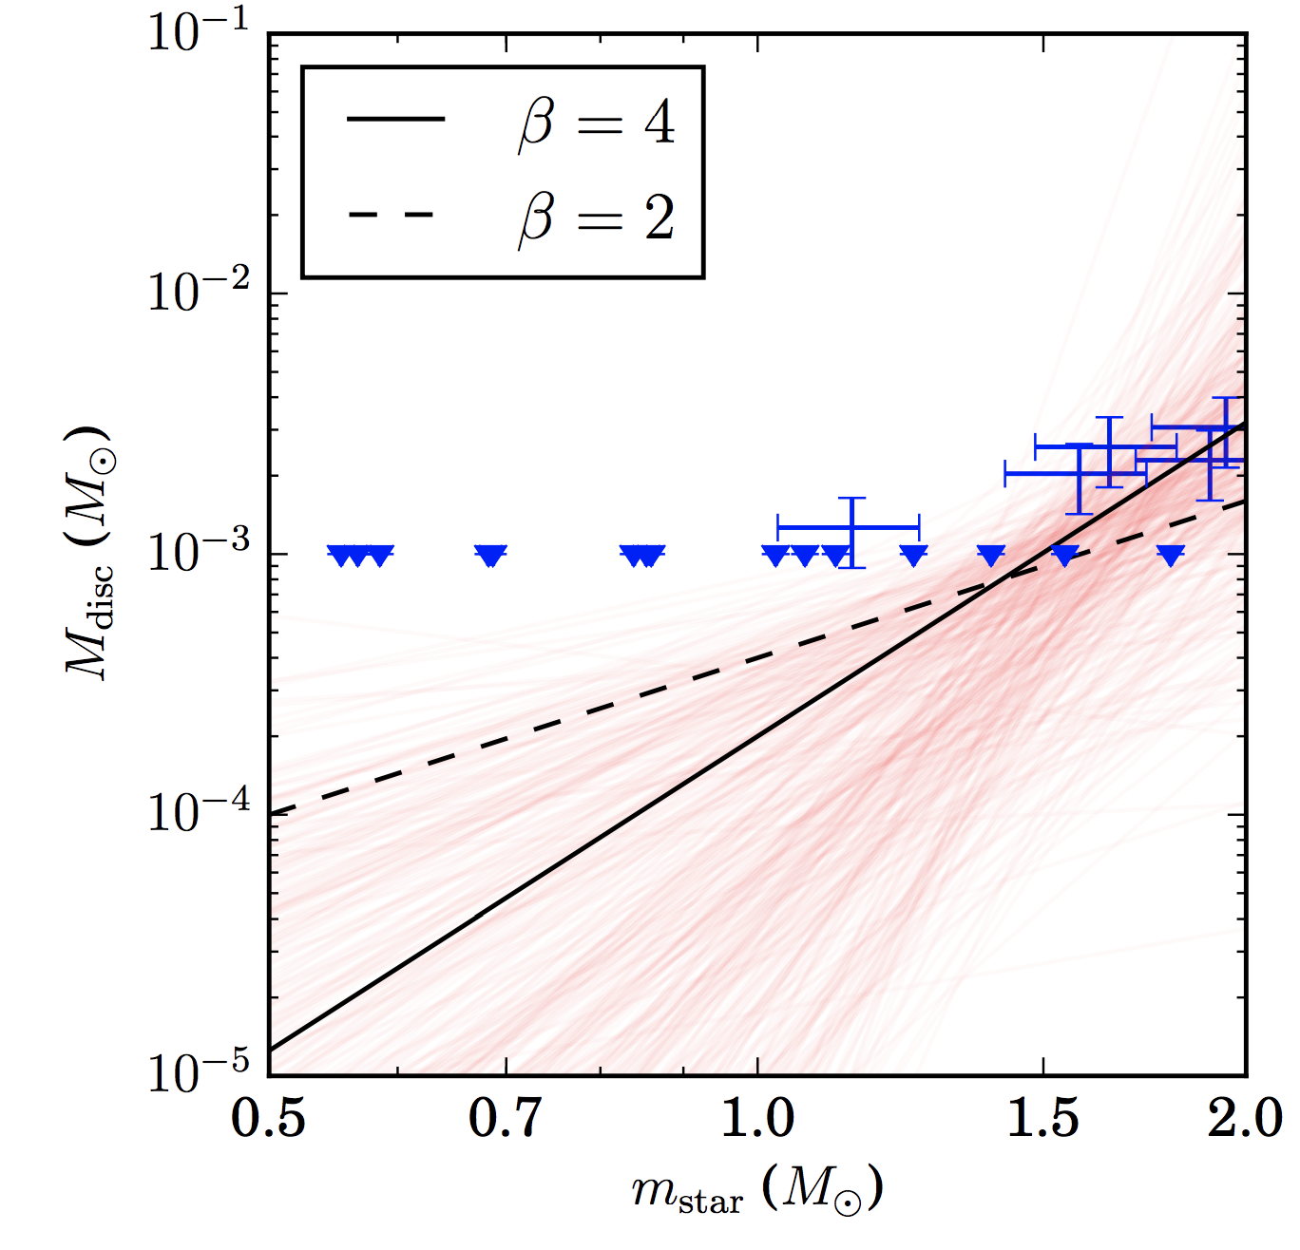
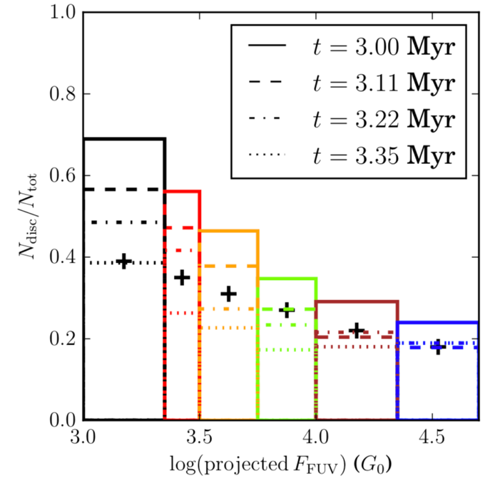
Disc fractions in Cygnus OB2
Guarcello+ 2016 (previous talk) mapped surviving disc fraction as a function of FUV flux in Cyg OB2
N-body model + photoevaporation calculations reproduce the observed survival rates (no secular dispersal included)
Predict a steep host-disc mass mass relationship…
Winter, Rosotti & Clarke 2019

Slide 13
Proplyd lifetime problem
A problem…
How have discs (80%) in the core of the Orion Nebula Cluster survived for so long?
Mass loss rates ~10⁻⁷ M☉/yr → ~3 Myr old members, initial disc masses >>0.1 M☉ or young (<< 1 Myr) age for ϴ¹C
Present disc masses ~ 0.01M ☉… coincidence?
Previous modelling unsuccessful (e.g. Scally & Clarke 2001)
However…

Slide 14
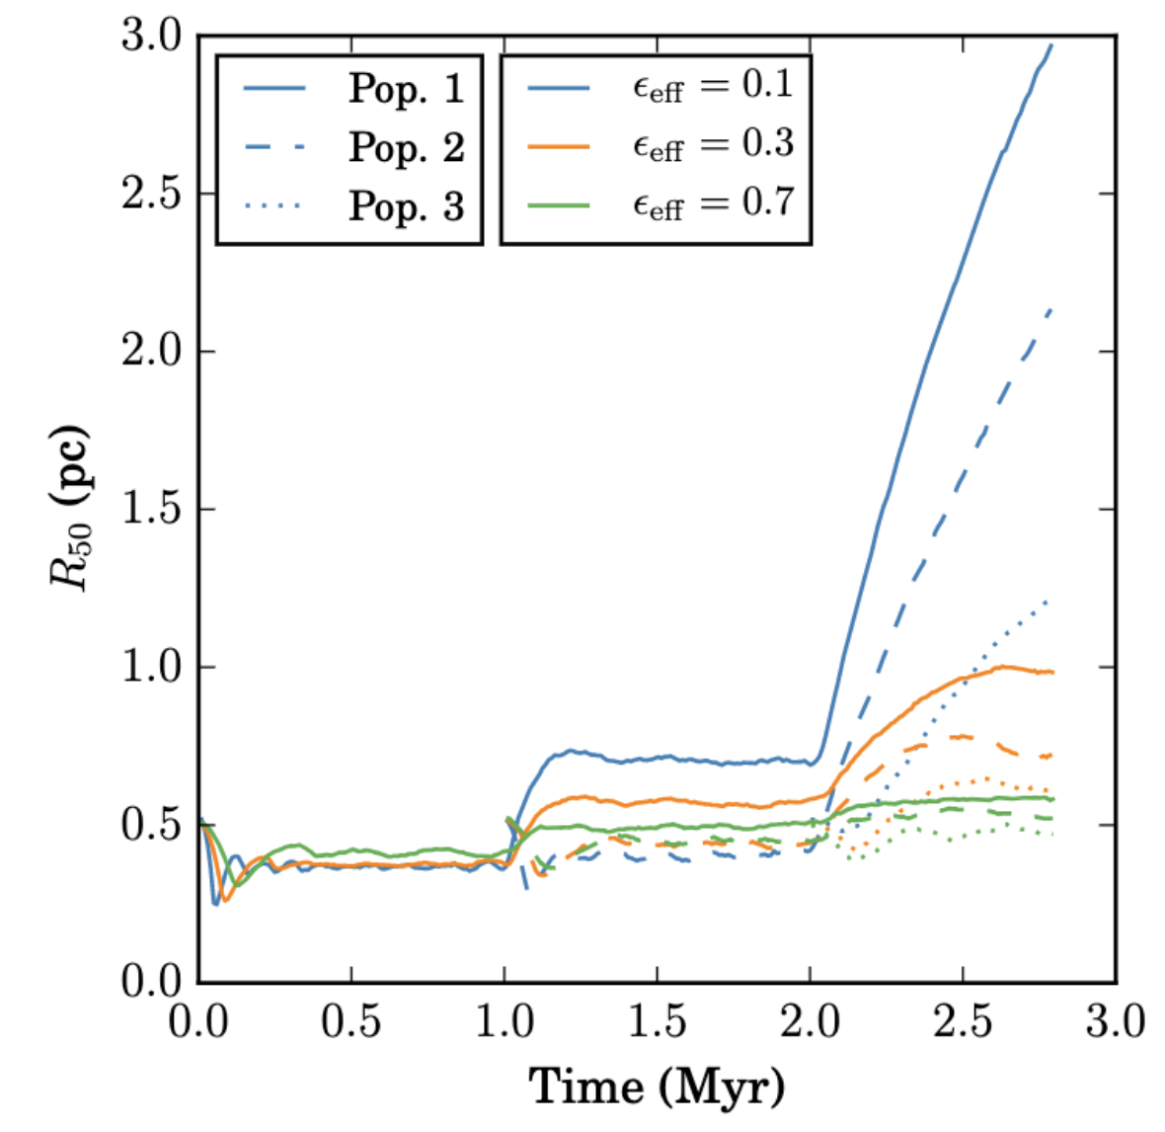
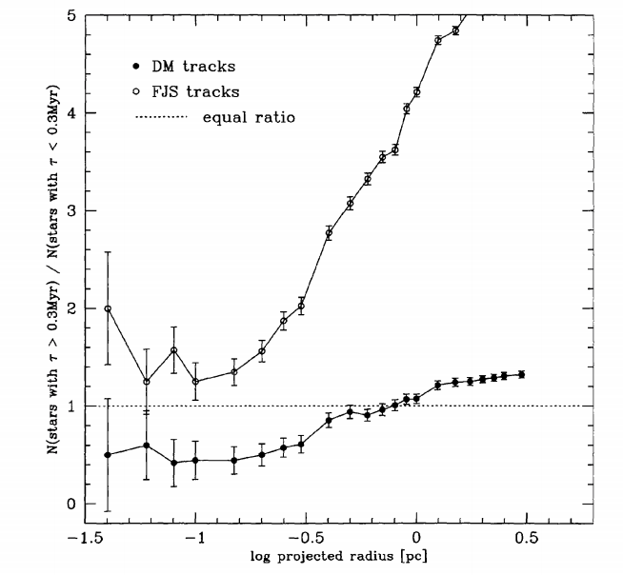
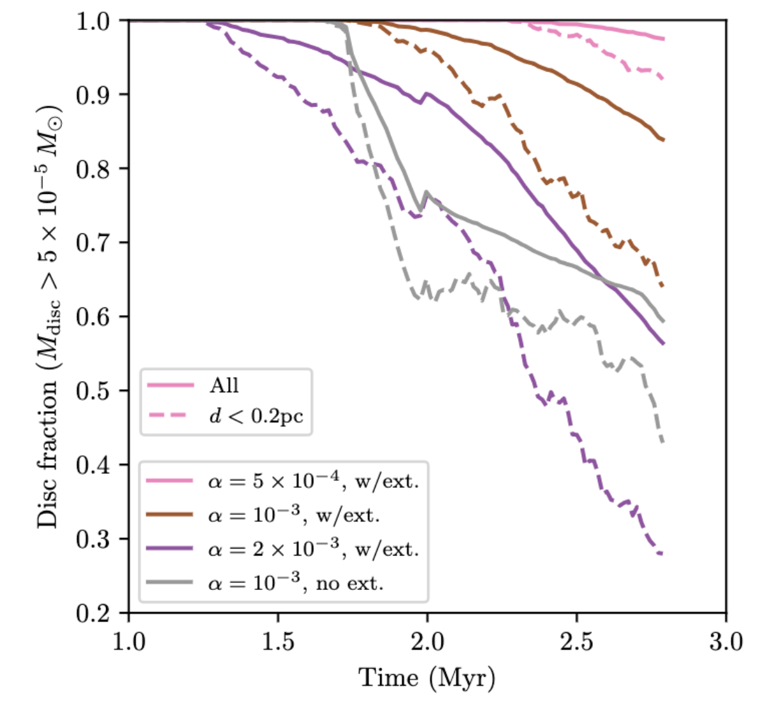
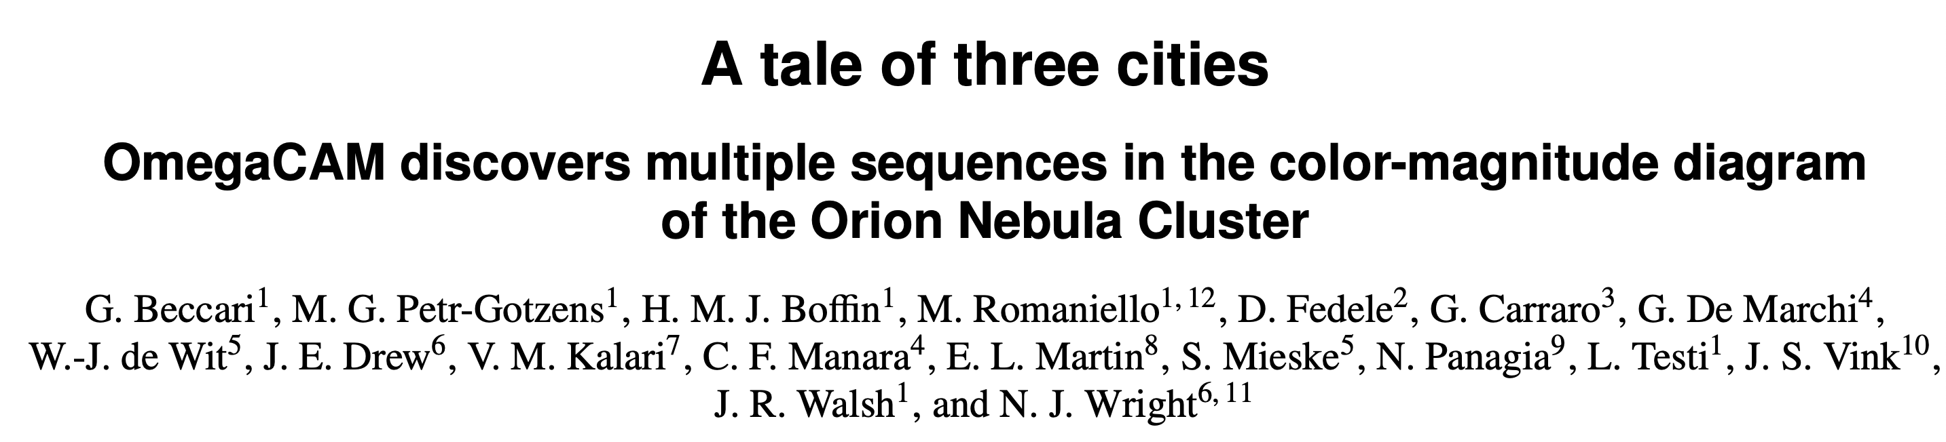
Stellar age gradient…
Winter+ in prep.
Hillenbrand 1997

Slide 15
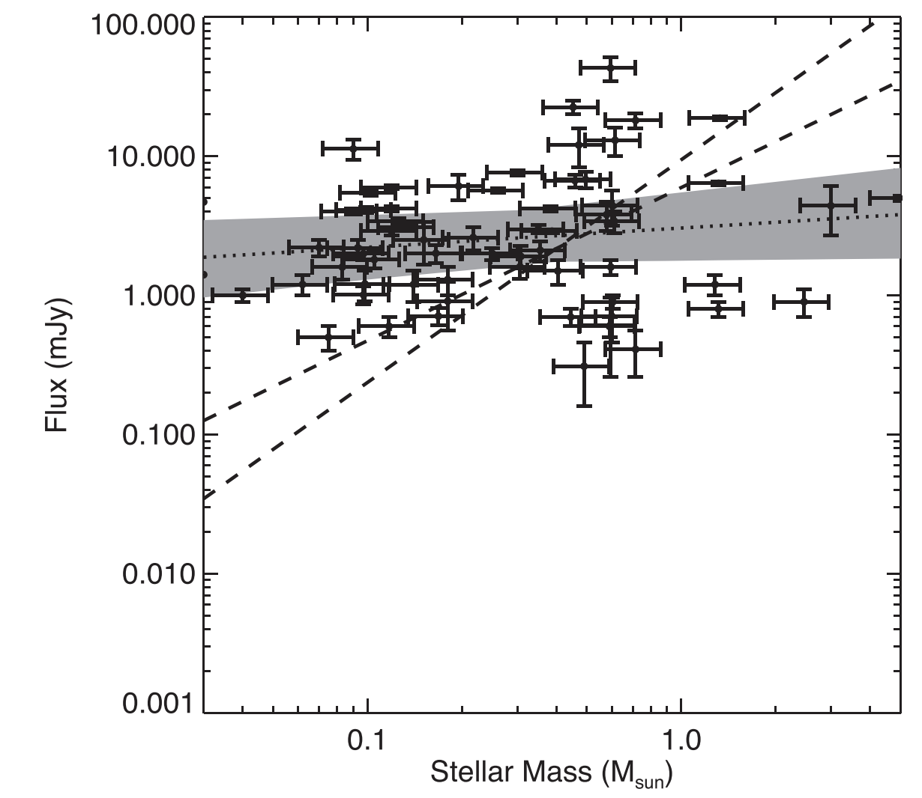
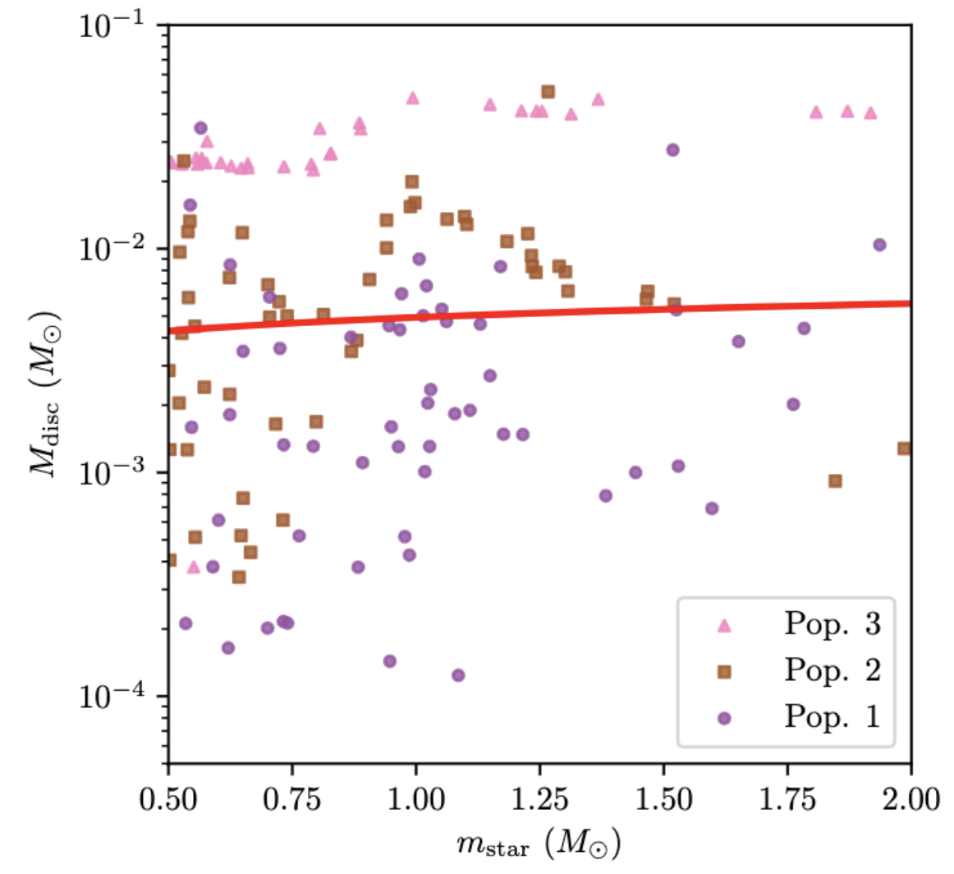
Stellar mass/disc property relations
Eisner+ 2018
Winter+ in prep.

Slide 16
Summary 2
Models for external photoevaporation of PPDs can successfully reproduce observed disc properties… but require careful modelling of the star forming environment
Star formation history and disc properties are linked → can learn about each from the other!
Disc fractions in Cygnus OB2 well explained by FUV induced mass loss, large scale substructure
Orion Nebula cluster – multiple stellar populations/extended period of star formation help to explain the high PPD fraction
Further detailed modelling for the role of interstellar extinction… same for example in cloud-cloud collisions? Very massive star forming regions?

Slide 17
Extra slides…

Slide 18
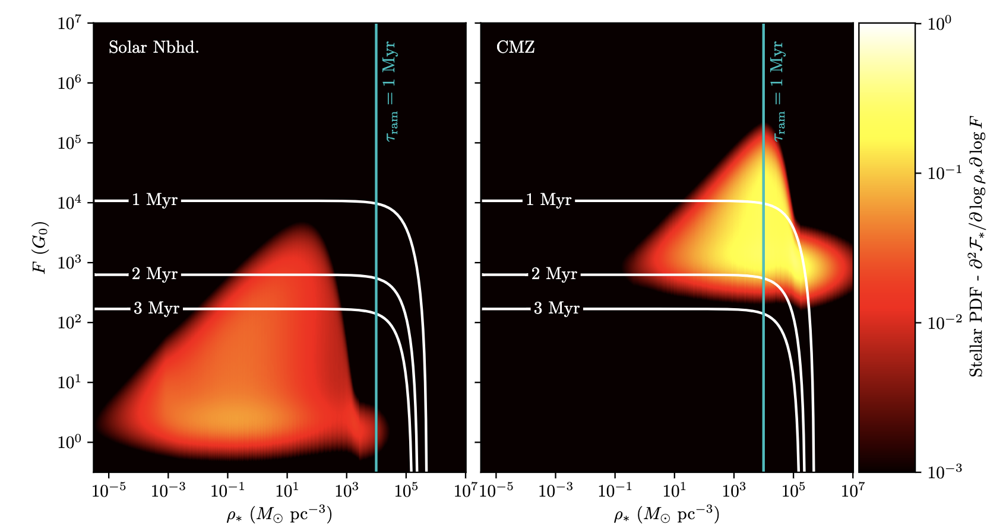
The role of interstellar extinction?
How important is extinction?
Can estimate the maximum extinction, immediately after stars form assuming smooth gas distribution
Strong influence in densest regions
Ram stripping still dominates encounters (see also Wijnen+ 2017)

Slide 19
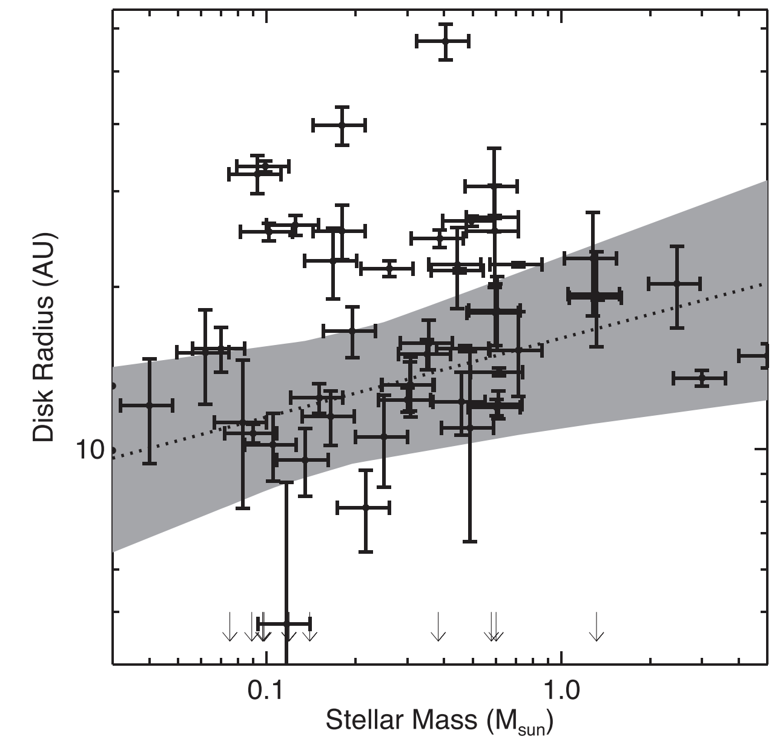
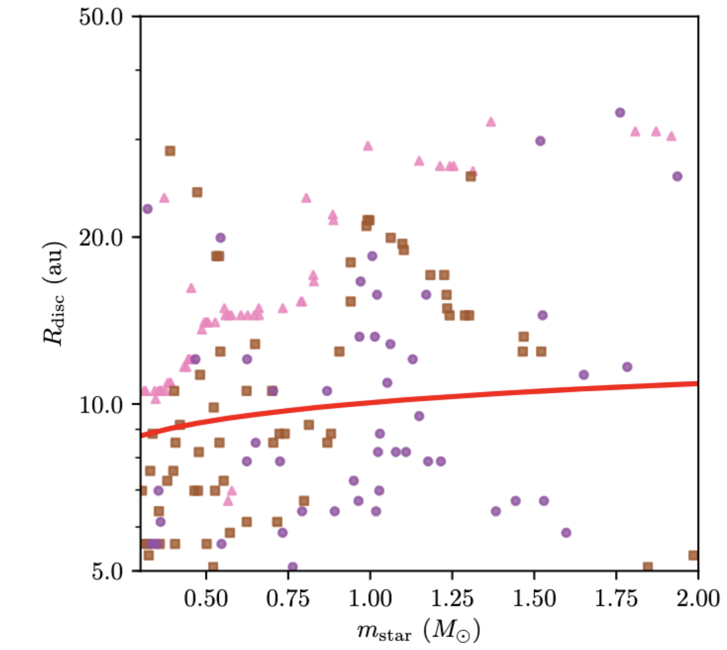
Stellar mass/disc property relations
Eisner+ 2018
Winter+ in prep.

Slide 20
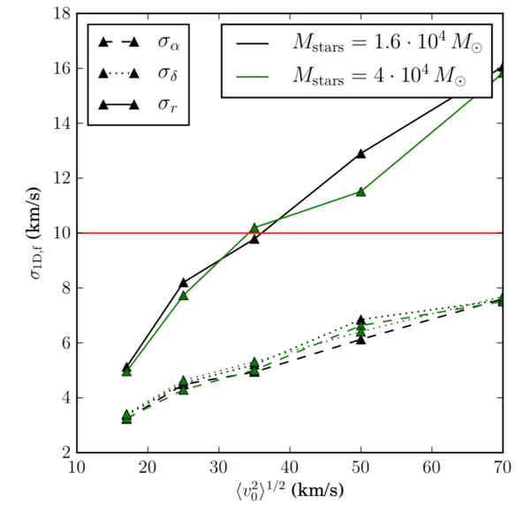
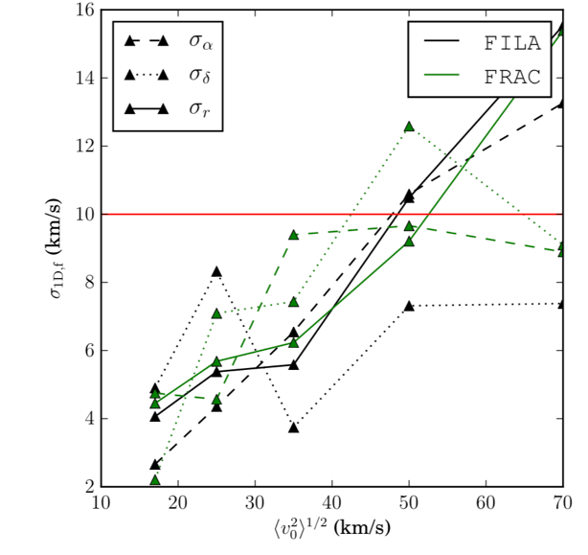
Cygnus OB2: velocity dispersion
Final velocity dispersion independent of stellar mass if M_{gas}>>M_{stars}
Velocity dispersion in the central ~ 8 pc x 8 pc is anisotropic with 𝜎⍺ ≅ 13 km/s, 𝜎_{ẟ} ≅ 9 km/s, 𝜎_{r} ≅ 8 km/s
Projection effects and velocity sorting → anisotropy with 𝜎_{⍺, ẟ} ~ 𝜎_{r} requires large filaments/clumps ~ 10⁴ M⊙
Initial 3D velocity dispersion ~50 km/s
Final 1D Velocity Dispersion (km/s)
Final 1D Velocity Dispersion (km/s)
Initial 3D Velocity Dispersion (km/s)
Initial 3D Velocity Dispersion (km/s)
Unstructured model after ~3 Myr
Structured model after
~3 Myr

Slide 21
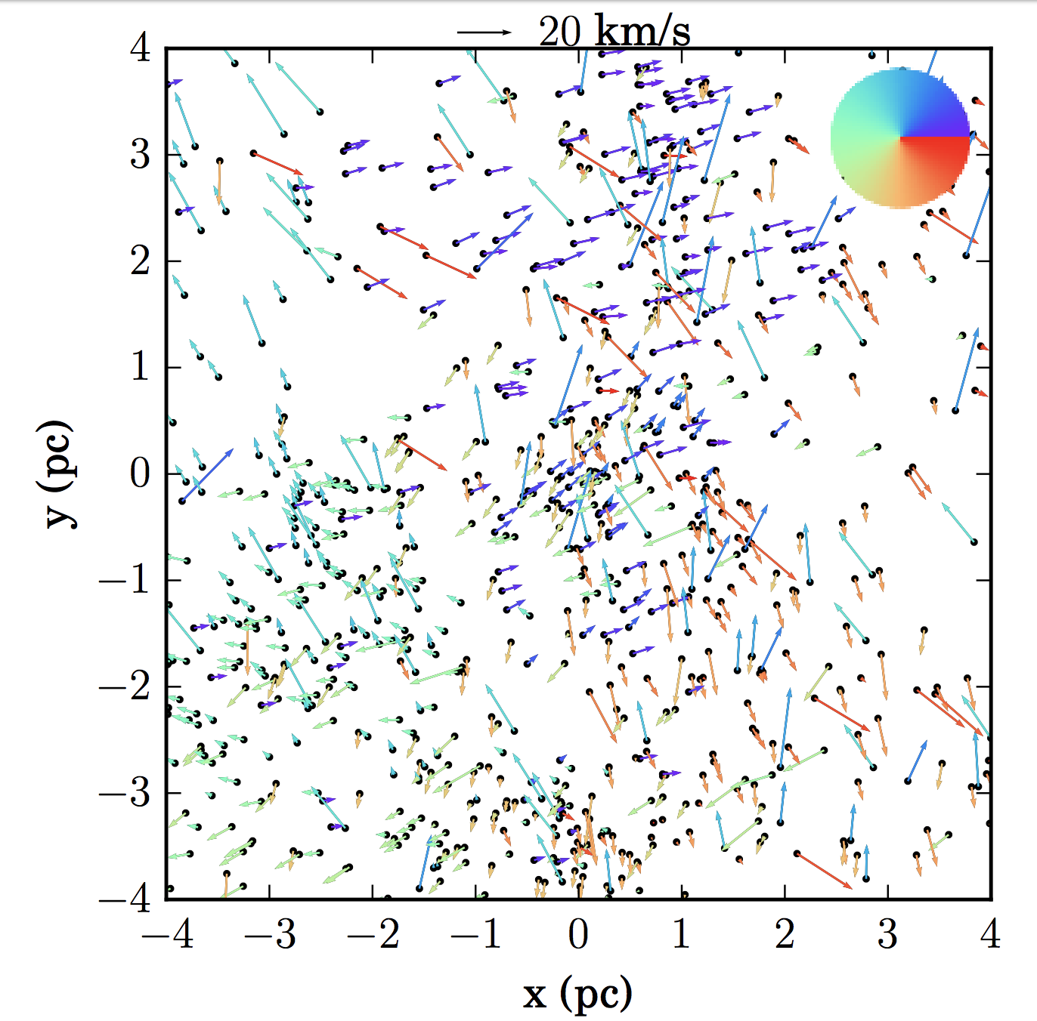
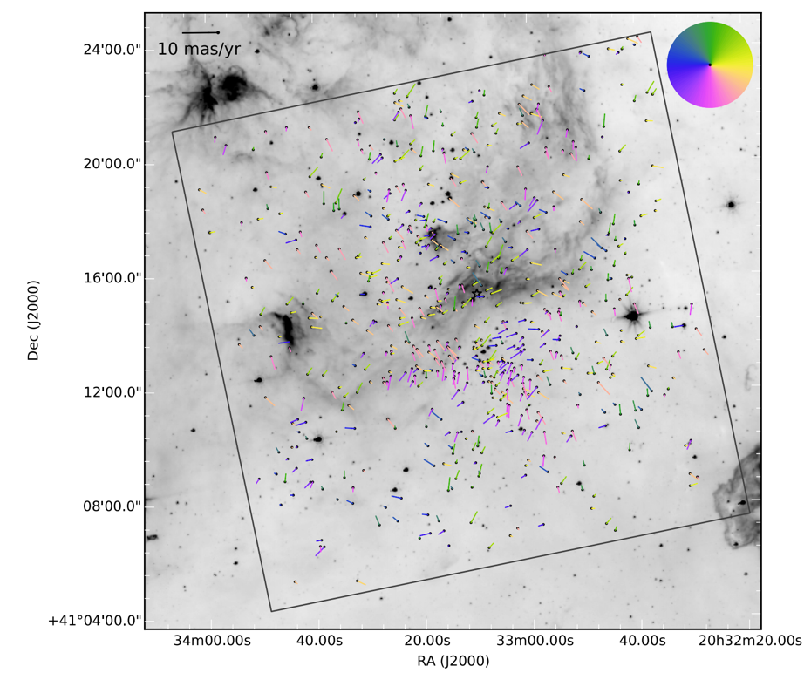
Cygnus OB2: substructure
Model – Winter, Clarke & Rosotti 2019
Observed – Wright+2016

Slide 22
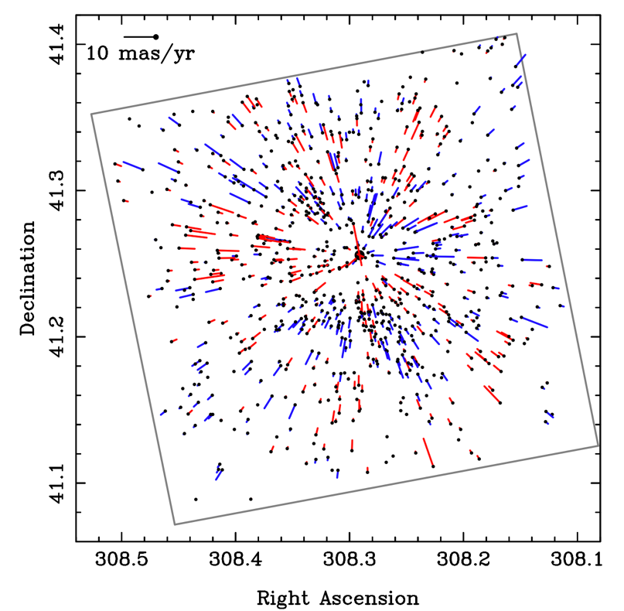
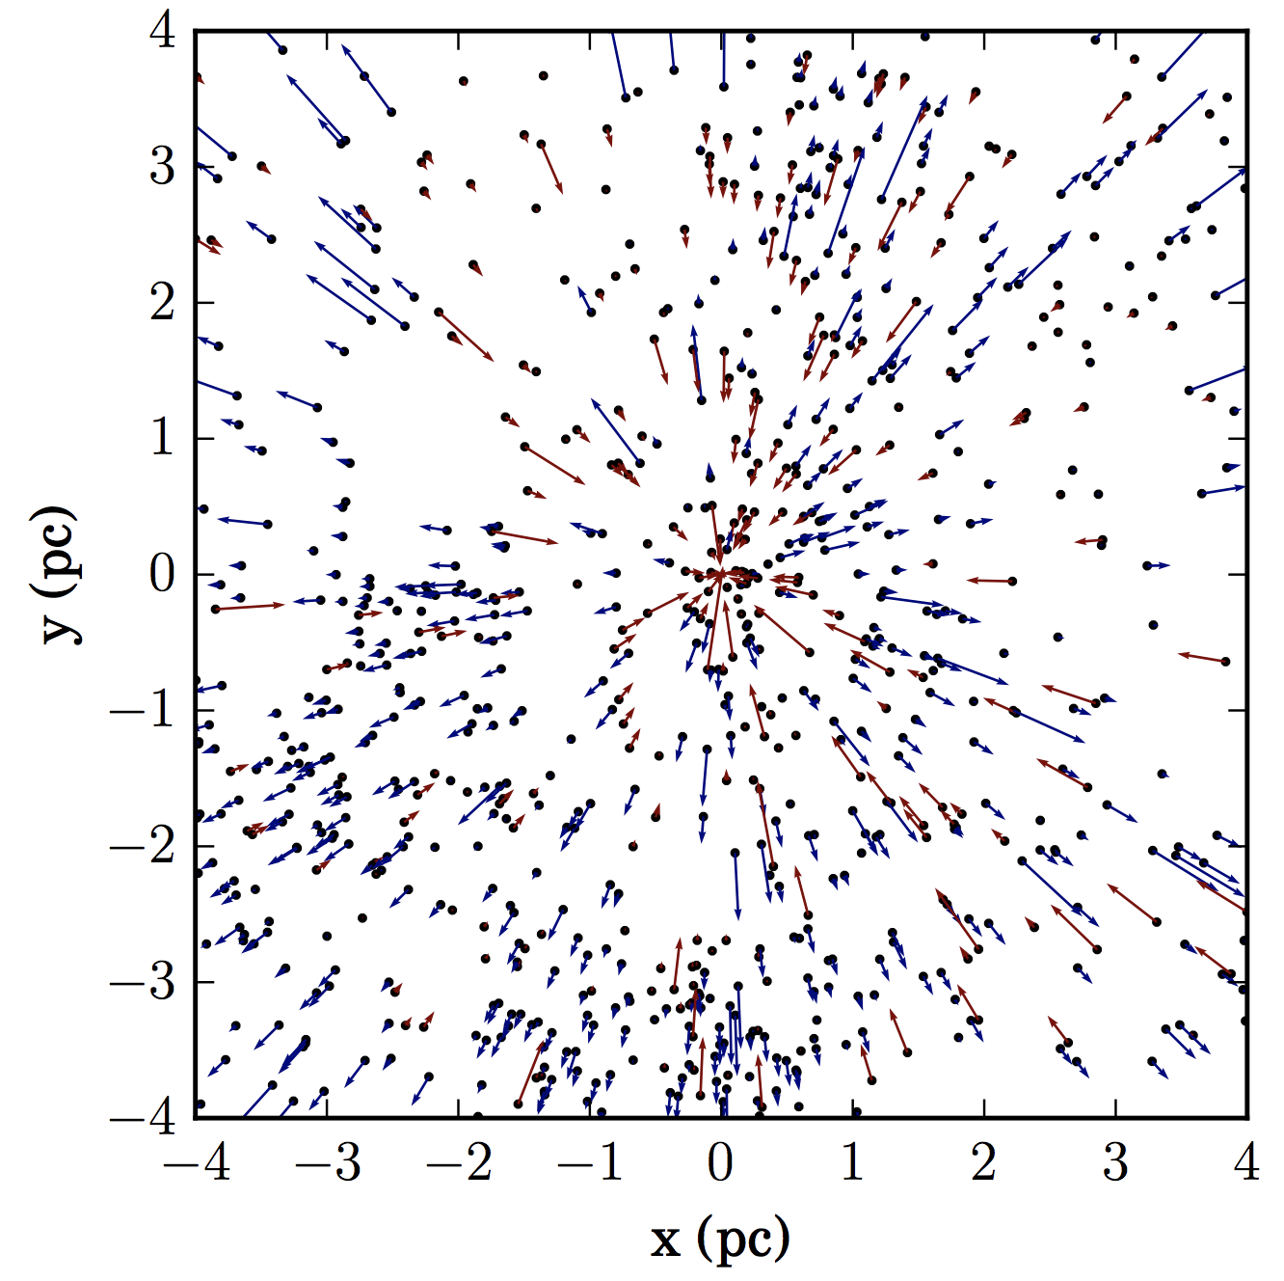
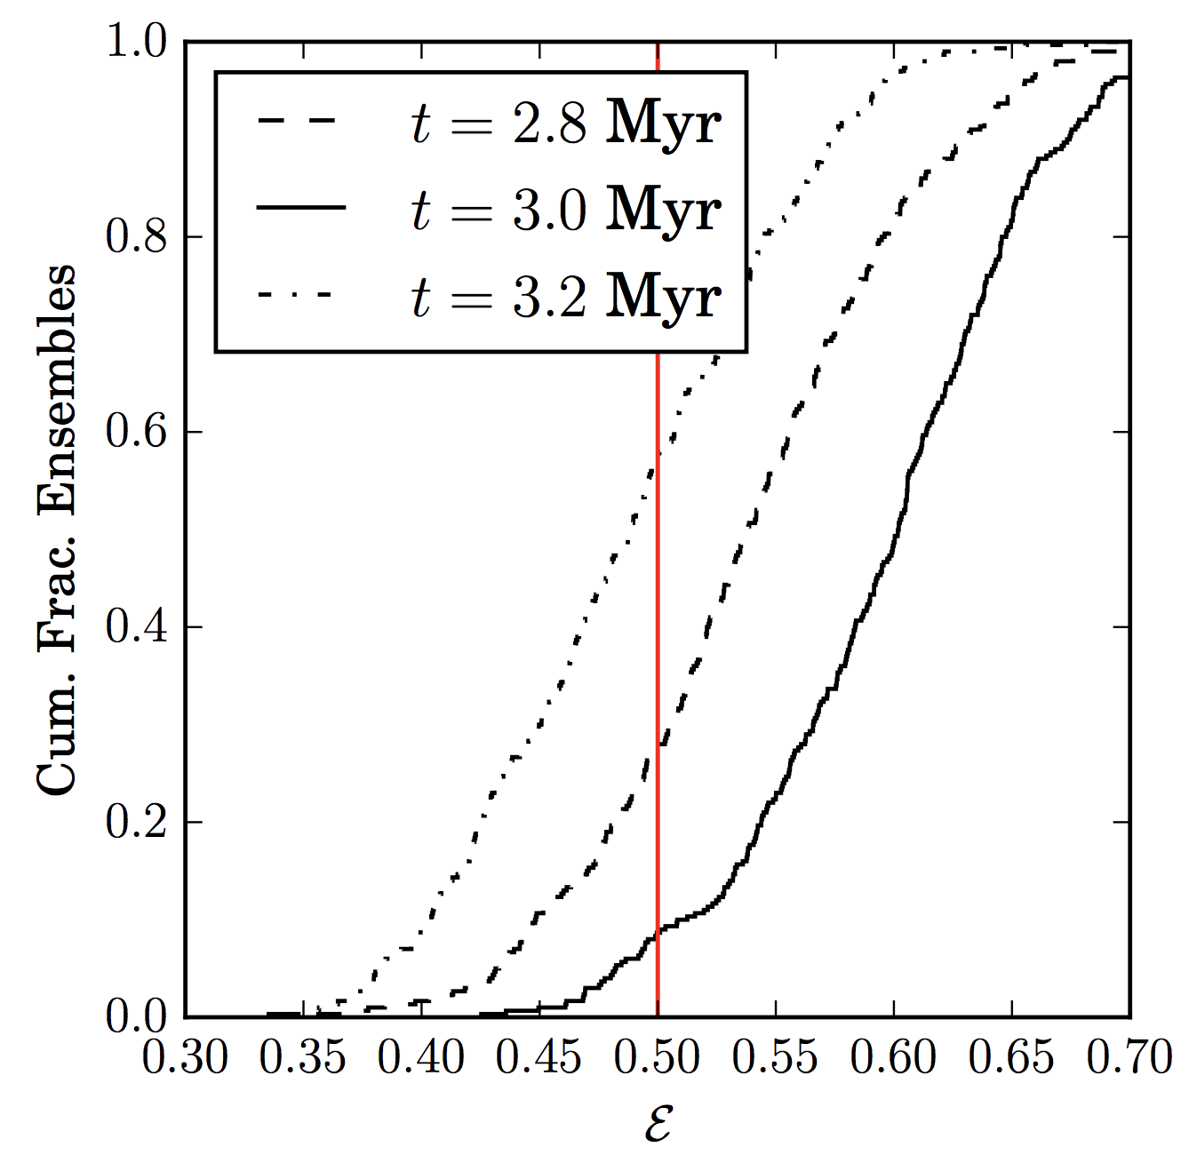
Cygnus OB2: expansion?
Observed – Wright+2016
Model – Winter, Clarke & Rosotti 2019

