Slide 1
Photoevaporation and close encounters: how the environment IN Cygnus OB2 affects the evolution of protoplanetary disks
Mario Giuseppe Guarcello– INAF Osservatorio Astronomico di Palermo
J. J. Drake, N. J. Wright, J. F. Albacete-Colombo, C. Clarke, B. Ercolano, E. Flaccomio, V. Kashyap, G. Micela, T. Naylor, N. Schneider, S. Sciortino, J. S. Vink

Slide 2
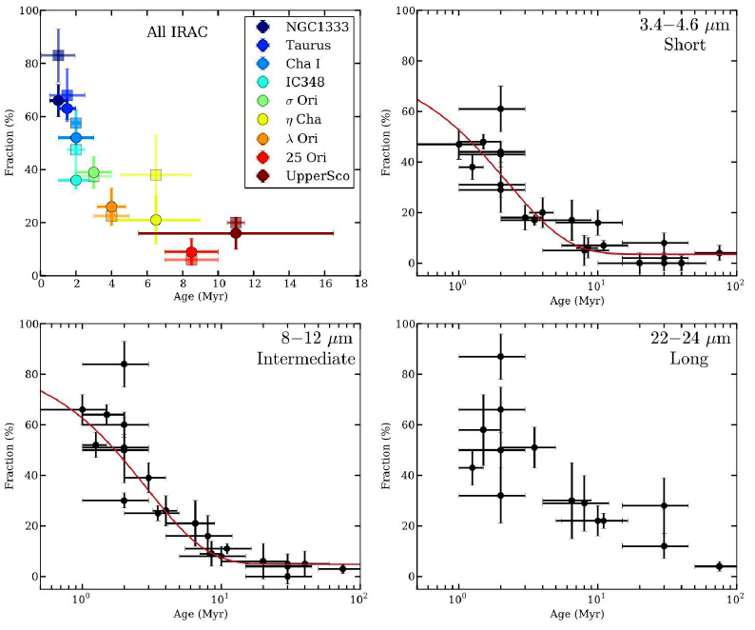
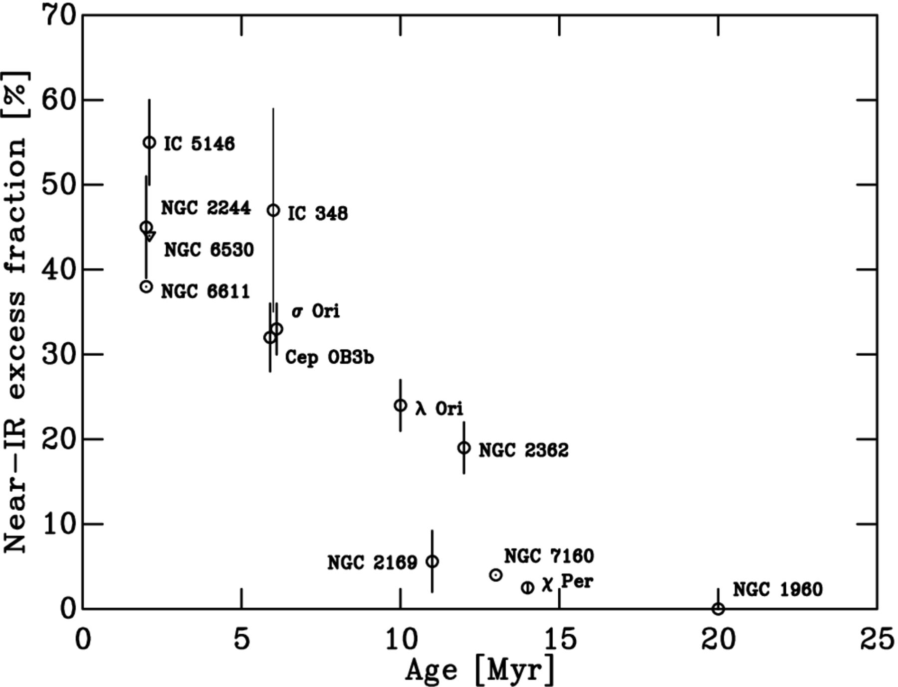
Disks dispersal timescale
Most [Lada & Lada 2003]/some [Krujessen 2012] stars in our Galaxy form in clusters. Observational clues of disks dispersal timescale is provided by the decline of the fraction of cluster members with disks with the age of the parental cluster.
[i.e. Haish+ 2001, Hernandez+ 2007, Mamajek+ 2009, Bell+ 2013
Ribas+ 2015]

Slide 3
Environment feedback on disks evolution
Typically stellar clusters disperse in a timescale longer than 10 Myrs [Lada & Lada 2003].
This means that typically protoplanetary disks which form in clusters evolve while the central star is still associated with the parental cluster, which can affect disks evolution.
Feedback from massive stars (M > 7 M⊙):
Externally induced disks photoevaporation
Triggering of star formation
Dissipation of protostellar envelopes
Supernovae explosions and chemical enrichment
Feedback from other cluster members
Close encounters and gravitational interaction

Slide 4
DISKS PHOTOEVAPORATION

Slide 5
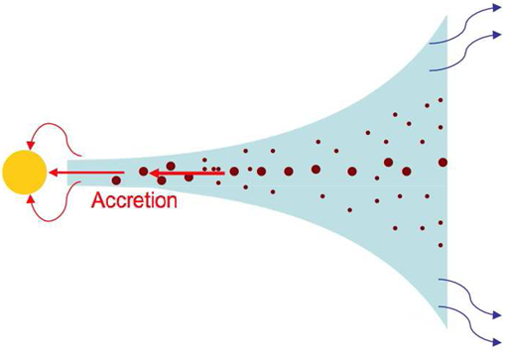
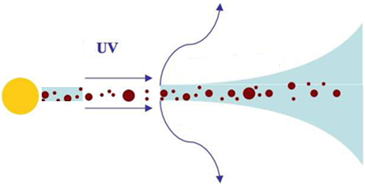
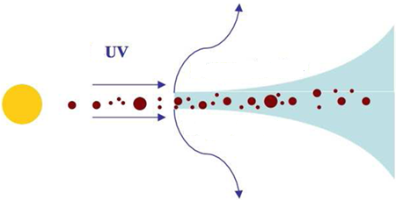
Disks photoevaporation
The gas in the disk is heated by incident FUV (6 eV < hν <13.6 eV, ̴3000K), and EUV photons (hν > 13.6 eV , ̴10⁴K), that ionize and dissociate H₂ molecules. A photoevaporating flow of gas from the disk is created by the intense thermal pressure.
Together with viscous accretion, photoevaporation is proposed as the main mechanism for disks dispersal.
e.g.: Bally & Scoville 1982; Johnstone+. 1998, Hollenbach+. 1990, 1994, 2000; Clarke+ 2001, 2011, Alexander+, 2006, 2014; Dullemond+ 2007; Ercolano+ 2008, 2009, 2011, 2017, 2018; Gorti & Hollenbach 2009; Armitage 2011; Owen et al. 2012; Koepferl+ 2013; Picogna+ 2019

Slide 6
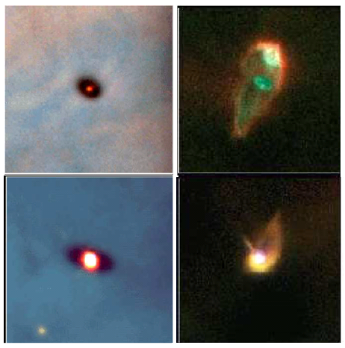
Can photoevaporation be induced by nearby O stars?
Clues of disks photoevaporation found in the core of intermediate massive clusters NGC 6611 [Guarcello+ 2007, 2009, 2010], Pismis 24 [Fang+2012]; NGC 2244 [Balog+ 2007]; NGC 6231 [Damiani+ 2016], TR14 and TR16 [Reiter+ 2019]
No feedback observed by the Mystix survey [Richert et al. 2015]
Tested by N-body simulations [Scally & Clarke 2001, Nicholson+2019] and ALMA observations [σ Orionis, Ansdell+ 2017]
Observed also in low-mass environments? [Haworth+ 2017]
1800 AU
HST observations of proplyds in the Orion Nebula Cluster
[O’dell & Wong 1996; Bally et al. 2000]

Slide 7
CLOSE ENCOUNTERS

Slide 8
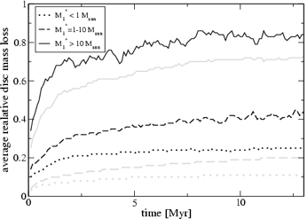
Close encounters
During the dynamical evolution of clusters, stars can get very close to each other. It has been proposed that close encounter can have serious consequences on disks evolution [i.e.: Clarke & Pringle 1993, Tamura+ 1998, Zapatero-Osorio+ 2000, Lucas & Roche 2000, Pfalzner+ 2005, 2006, Thies+ 2005, Adams+ 2006]. However, still debated…
For instance:
In Trapezium-like clusters, in
10 Myrs disks can loose between
80% and 30% of their initial mass
by close encounters [Pfalzner+ 2006]
Very large stellar density
(>10⁴ pc⁻³) are required to signifi-
cantly truncate disks in 3 Myrs
[Winter+ 2018]
Fraction of mass lost from disks in stars with different masses, in a Trapezium-like (black) and Orion-like(grey) cluster

Slide 9
CYGNUS OB2

Slide 10
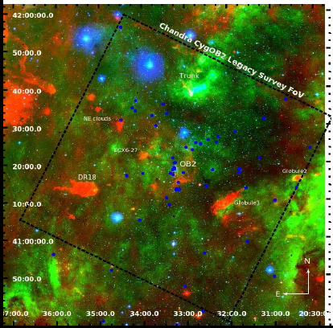
Cygnus OB2
1.4kpc from the Sun [Rygl+2012]; the next massive association (the Carina Nebula) is more than 1.5 times more distant.
Massive population known:
52 O stars (•)
3 Wolf – Rayet stars
114 B stars
Among which two O3 stars, a candidate BHG, and various B supergiant [Wright+ 2015]
The unidentified B population is larger [Knodlseder 2000]
Thousands of PMS stars 3-5 Myrs old [i.e.: Wright & Drake 2009]
Combined r (blue); Hα (green); 8.0µm (red)
CygOB2 is the best target in our Galaxy to study large scale star formation in presence of massive stars

Slide 11
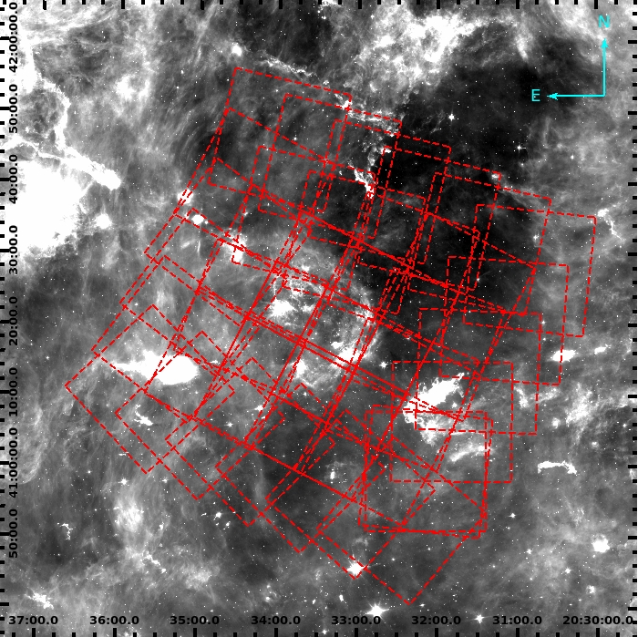
The Chandra Cygnus OB2 Legacy Project
1.08 Msec Chandra/ACIS-I observation. [Drake+ 2016]
36 pointings (30 ksec each) designed to have constant sensitivity in the central region. [Wright+ 2015]
Estimated completeness 90% at 1 solar mass in the center [Wright+ 2015]
X-ray catalog combined with deep optical and IR data [Guarcello+ 2015]
[8.0] image around CygOB2 with overplotted the survey observations

Slide 12
Membership and O-WR stars
7924 X-ray sources have been detected and validated [Wright+ 2014]
6563 X-ray sources are classified as members using a Naïve Bayes estimate of probability of being member or contaminant (4246 candidate class III sources) [Kashyap+ 2018, Guarcello+2014]
1843 stars with disks selected from optical and infrared photometry (439 X-ray sources) [Guarcello+ 2013]
FUV and EUV fluxes emitted by O and WR stars are calculated using published tables [Parravano+ 2003, Martins+ 2005], and projected across the field
The disk fraction is calculated across the field and its correlation with local FUV field, EUV field, and stellar density studied

Slide 13
Disk fraction vs. UV flux field
Disk fraction is observed to decline from ̴40% to ≤ 20% as a function of local FUV and EUV fluxes.
This decline of DF vs. local UV flux has been recently reproduced using N-body simulations of the evolution of CygOB2 and viscous disk evolution model. [Winter+ 2019]

Slide 14
Possible Bias explored
Inside out sequence of star formation
Decrease of sensitivity in OIR images around massive stars
2D projection effect
Results
Age difference of ̴3 Myrs inner region vs. outskirt required to explain the DF decline. Only ≤1 Myr observed.
The decline of DF is observed selecting members with J< 17, J< 16, J< 15; M> 0.4 M⊙, M> 0.7 M⊙, Fx >25% and 50% quantiles Fx distribution.
Performed 5000 simulations of the 3D morphology of the association randomly defining the inclination of the branches connecting stars in MSTs. The decline of DF is always observed

Slide 16
Mass loss rate induced by EUV radiation
EUV field calculated across the field and converted into Ṁ using:
The resulting Ṁ ranges from
1.5 × 10⁻⁸ M⊙ /yr to 3.9 x 10⁻⁷ M⊙ /yr.
This mass loss results in a total dis-
sipation of a 0.05 M⊙ disk in 3.3
and 0.1 Myrs, respectively .
For comparison, such mass loss rates
are induced by Ө¹ Ori within 0.44 pc.
The O-WR population of CygOB2
really creates a hostile environment
for disks, so.. .
Why do we still observe disks?
Adams+ 2010

Slide 17
What shields the disks from EUV radiation?
The equation for Ṁ does not account for the attenuation of EUV photons by the intracluster residual material
To have disk lifetime larger by a factor 5 → F_{EUV} must decrease by a factor 25 → a similar extinction can be achieved with Av being about 1 for FUV and 1.4 for EUV [using Cardelli+ 1989] both corresponding to realistic density particles within the association
Cygnus OB2 is almost clear of gas [Schneider+ 2006] but residual gas still present [Drew+ 2005] and significant dust in the outskirt [Guarcello+ 2013]
Hydrogen column density (both Cygnus Rift and intra-association) larger than 10²¹ atoms/cm²[Schneider+ 2016], large enough to be opaque to EUV radiation.

Slide 18
Conclusions
Environments can impact disks evolution by externally induced disks photoevaporation and close encounters. This feedback is not important in most of the star forming environments in our Galaxy
Cygnus OB2 is the closest massive association to our Sun, being the best target to study star formation in presence of massive stars.
In CygOB2, disk fraction is observed to decrease as function of the local FUV and EUV fields.
Stellar densities are not high enough to result in significant disks destruction by close encounters.
Mass loss rate by EUV radiation is high enough to destroy disks in few Myrs across the association. Disks can survive only thanks to the attenuation of EUV radiation by intracluster material.

Slide 19
What’s next? (a few suggestions…)
Disks evolution in low-metallicity (e.g. Dolidze25) and starburst (e.g. Westerlund1) environment, typical of the early Universe.
Evolution of disks, accretion and outflow across the Galactic plane, both in clustered and sparse environment (e.g. WEAVE/SCIPS)
Fold stars dynamics into this picture thanks to Gaia
Destructive feedback on disks evolution occurs in a few environment (massive associations and the core of intermediately massive clusters)… and planet formation seems to be common in our Galaxy (with some planet being flat…weird…)… can the environment affects the outcome of planetary formation in disks? The location where planets form and their migration? The chemistry of the planet-forming disks? The type of formed planets?

Slide 20
Thanks for YOUR ATTENTION

Slide 21
NGC6611 disk fraction is observed to decline toward the core of the cluster [Guarcello+ 2007, 2009, 2010] from ̴40% to ̴30%. The only significative difference is observed between first and last bin, with F_{FUV} similar to the last bin defined for CygOB2.
CygOB2 vs. IC1795
Disk fraction is constant across the cluster, with no variation as a function of the distance from the O stars [Roccatagliata+ 2011] . These two stars produce the median flux experienced by the stars in the high-FUV flux in Cygnus OB2 (54100 G₀) only within 0.2 pc, where just 9/525 members lie.

Slide 22
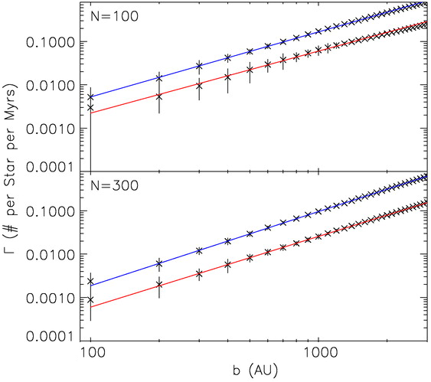
Low mass cluster: encounters
Distribution of close encounters for small clusters (probability of encounter per Myr) at different b, for average kinetic energy of cluster members
Frequency of close encounters too small to affect disk evolution
Adams+ 2006

Slide 23
Optical-infrared data
CATALOG | BANDS | N_sources | Depth
GTC/OSIRIS^{2,3} | r,i,z | 65349 | 0.16 M⊙
SDSS DR8³ | r,i,z | 27531 | 0.4 M⊙
IPHAS DR2³ | r’,i’, Hα | 24072 | 0.8 M⊙
2MASS/PSC³ | J, H, K | 43485 | 0.3 M⊙
UKIDSS/GPS³ | J, H, K | 273478 | <0.1 M⊙
SPITZER^{1,3} | [3.6] to [24.0] | 149381 | 0.5M⊙
SPECTROSCOPIC OPTICAL DATA
INSTRUMENT | TARGETS
Hectspec@MMT | About 4000 X-ray selected stars
GTC/OSIRIS | Candidate proplyds⁴ and massive stars
Beerer+2010, Guarcello+ 2012, Guarcello+ 2014, Guarcello+ 2015

Slide 24
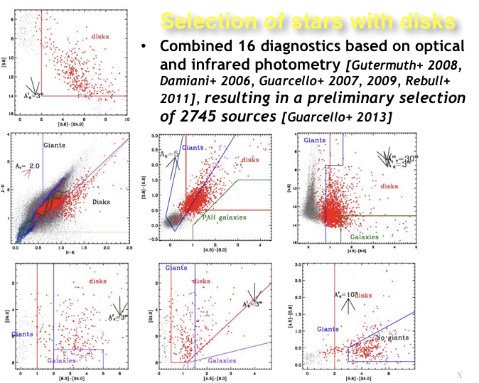

Slide 26
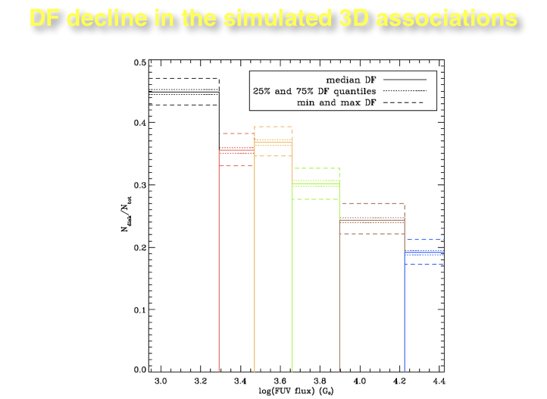

Slide 32
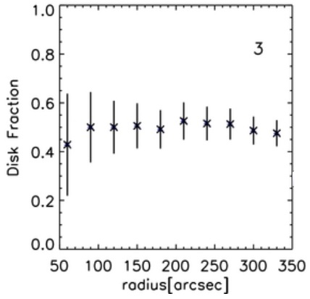
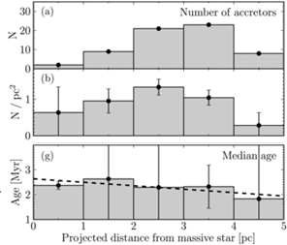
Low mass clusters: IC 1795 e IC 1396
IC 1795
About 3 Myr old [Oey+ 2005] with 2 O stars (O6.5V and O9.7I) [Mathis 1989]
Disk fraction is constant across the cluster, with no variation with the distance from the O stars [Roccatagliata+ 2011]
IC 1396
2-3 Myr old with 1 O star (O6.5V) [Kun, Kiss & Balog 2008]
Marginal variation of the fraction of accretors with the distance from the O star interpreted as an effect of triggered star formation [Barentsen+ 2011]

Slide 33
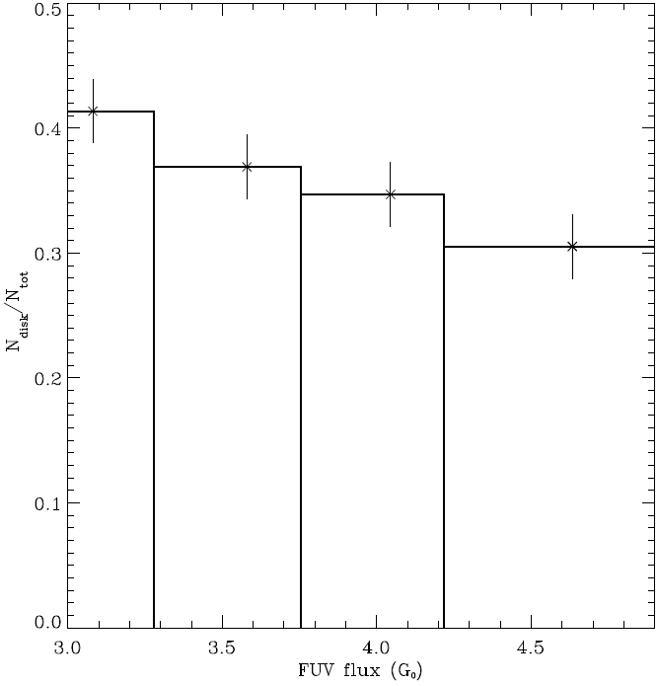
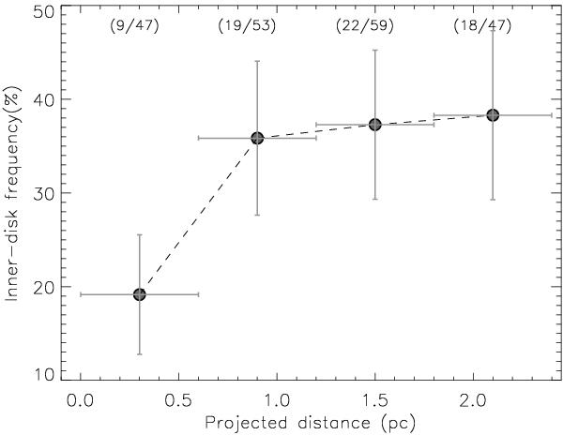
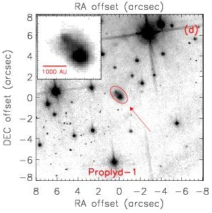
Intermediate mass cluster: ngc 6611 e Pis24
NGC6611
About 1Myr old [Hillenbrand+1993, Guarcello+2007] with 54 OB stars together with a O3 star [Walker 1961].
Disk fraction is observed to decline toward the core of the cluster [Guarcello+ 2007, 2009, 2010] from ̴40% to ̴30%.
Pismis24
About 1 Myr old with dozen of OB stars together with two O3 star [Massey+2001].
DF is ̴36% across the field and drops to 19% within 0.5 pc from Pis24-1 (O3I)
where F_{FUV}>21000 G₀ [Fang+2012]
Proplyds observed with HST.
[Hester&Desch 2005]

Slide 34
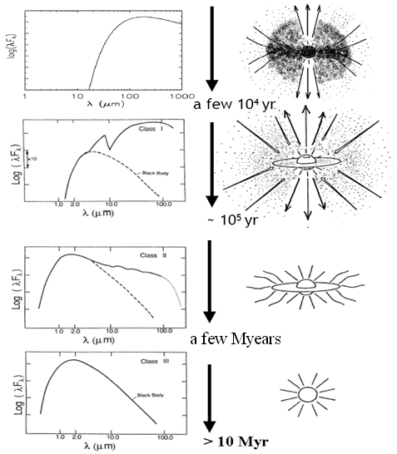
YSOs classification and disk evolution
Class 0: thick envelope
Class I: thick envelope; star
Class II: star; circumstellar disk
Classe III: star; young planetary system (?)

Slide 35
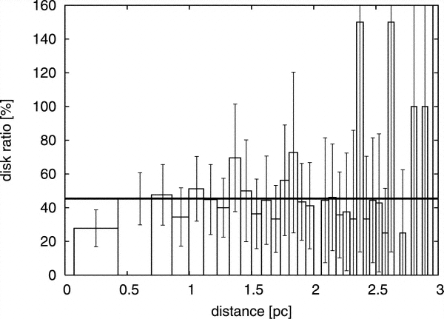
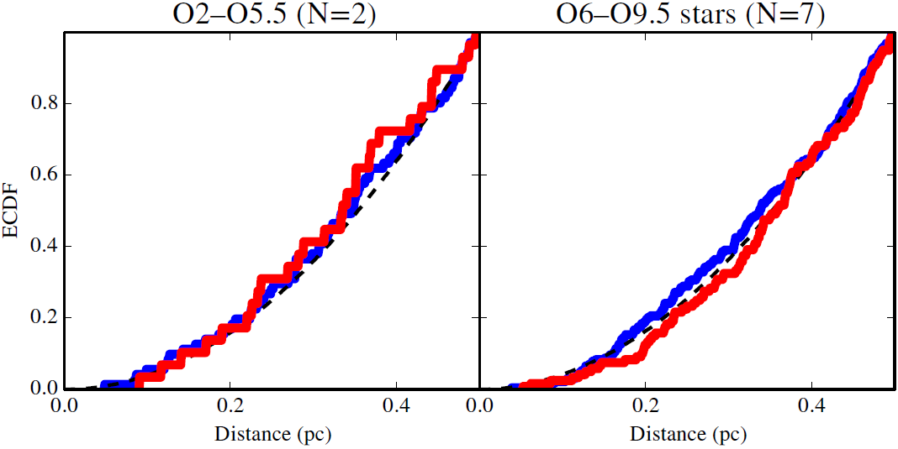
Intermediate mass cluster:
NGC 2244
2-3 Myr old [Park&Sung 2002] with 7 O stars.
Disk fraction is ̴40% across the field and drops to 23% within 0.5 the closest O star. [Balog+ 2007]
Mystix survey:
No evidence for disks destruction in 20 massive clusters closer than 0.5pc from O stars [Richert et al. 2015]

Slide 36
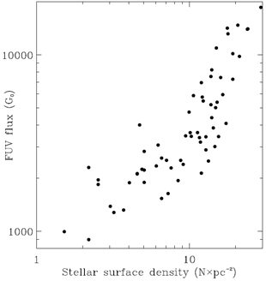
Stellar surface density and FUV flux calculated in 15×15 bins grid
A tight correlation observed between FUV flux field and the stellar surface density
Cubic stellar density is calculated from simulated 3D configurations of the association using equation defined for density particles in SPH simulations [Whitworth+ 1995]

Slide 37
Photoevaporation and planets
Most of the disks survive long enough to allow planets to form [Lissauer+ 2009]
However, only 10% among known exoplanets are known to be gaseous giants [Winn & Fabrycky 2015]
The removal of gas from the disk can affect the dynamic of planets and exoplanets and the gas to dust ratio

Slide 38
Photoevaporation and dust

Slide 39
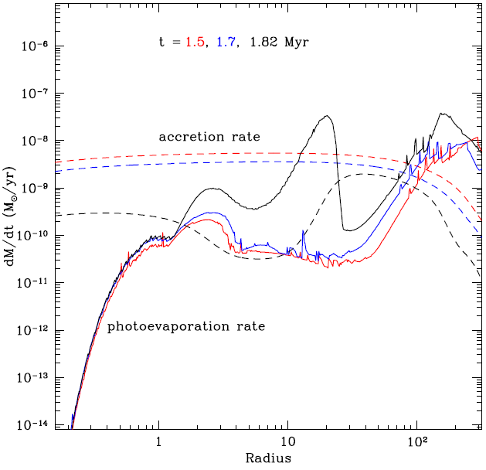
Photoevaporation vs. accretion
[Gorti et al. 2015]

