Slide 1
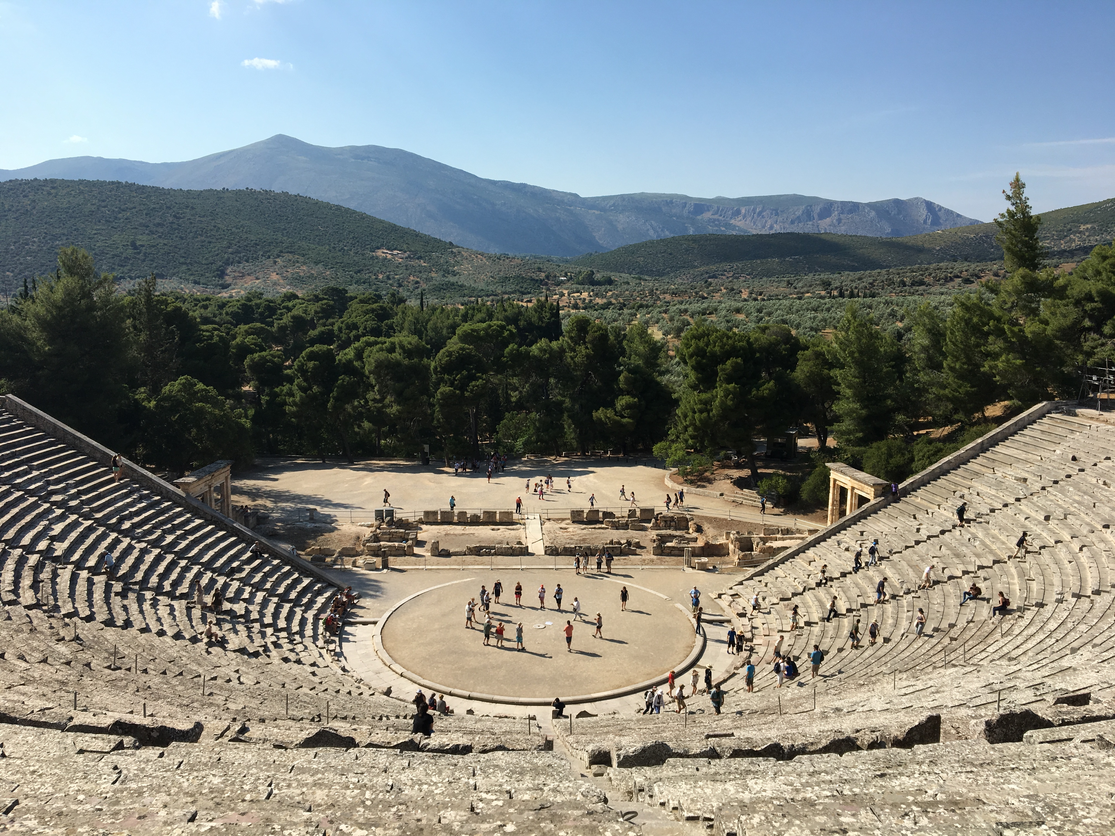


Planet FORMATION BY DISC INSTABILITY
IN M DWARF DISCS
ΔΗΜΗΤΡΗΣ ΣΤΑΜΑΤΕΛΛΟΣ
(with Anthony Mercer)

Slide 2
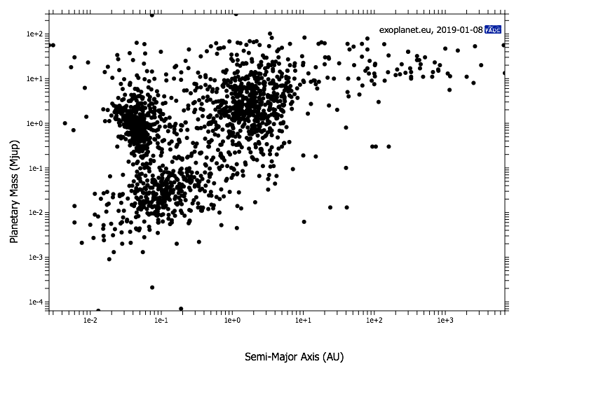
Exoplanets properties are diverse
4064 exoplanets (as of 4th June, 2019)
100
10
1
Planet mass (M_{JUPITER})
0.1
0.01
0.001
0.0001
www.exoplanet.eu
0.01
0.1
1
10
100
1000
Semi-major axis (distance from star) (AU)

Slide 3
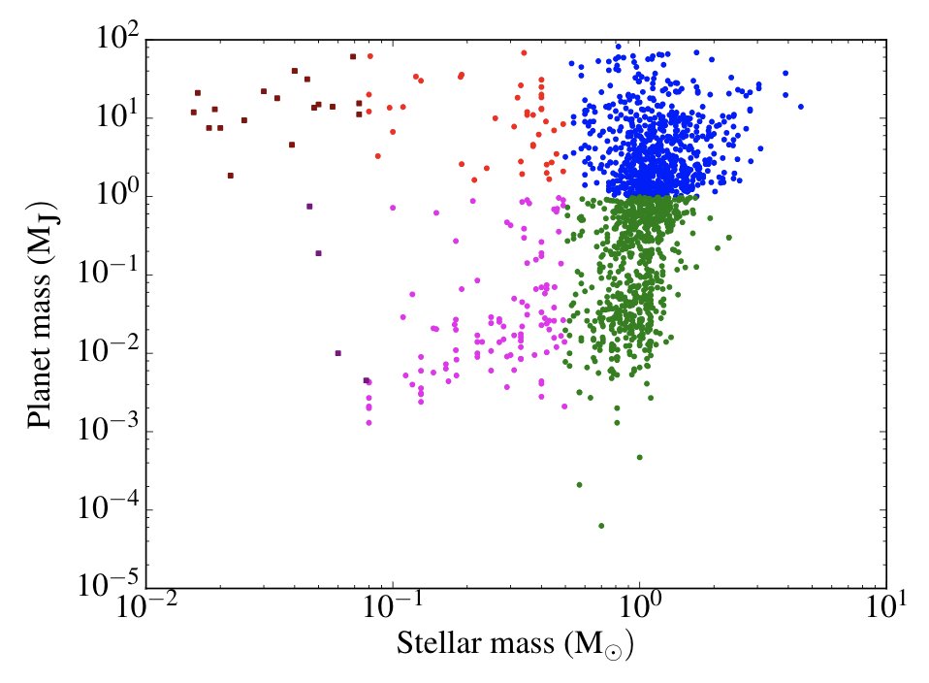
Exoplanets around M dwarfs (M<0.5 M)
www.exoplanet.eu
A fraction of the planets around M dwarfs are more massive than Jupiter

Slide 4
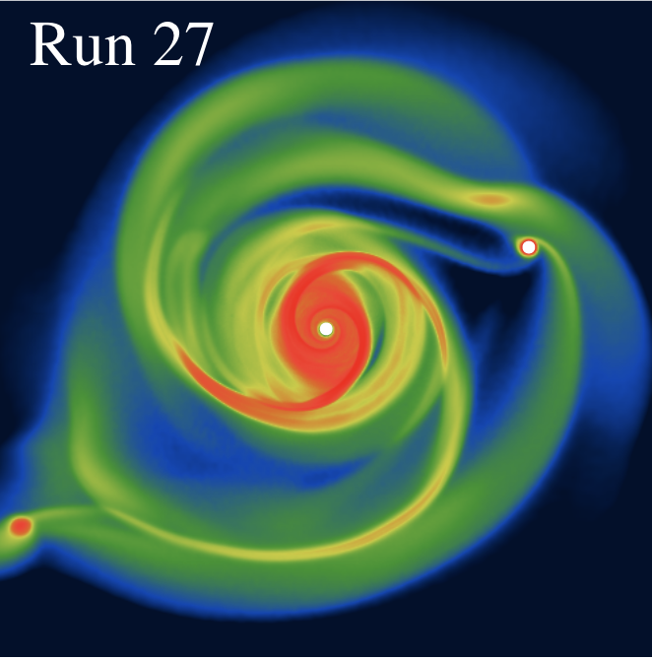
Disc fragmentation in M dwarf discs
GANDALF (3D, SPH code; Hubber et al. 2018)
“Realistic” prescription for radiative transfer (~diffusion approximation; Stamatellos et al. 2007)
Star is represented by a “sink” but its effect on heating the disc is included
Mercer & Stamatellos, 2019 in prep

Slide 5
Disc fragmentation in M dwarf discs
27 simulations
M_{star}= 0.2, 0.3, 0.4 M
R_{disc}=60, 90, 120 AU
Metallicity z=0.1, 1, 10
M_{disc}=0.04+ M
“Mass loading” (e.g. Zhu et al. 2012) to find minimum disc mass for fragmentation
Mercer & Stamatellos, 2019 in prep

Slide 6
Disc fragmentation in M dwarf discs
Evolution of fragments/clumps is followed up to densities 10⁻³ gcm⁻³ (first and second collapse are captured; see Poster by Bhandare on higher mass collapsing cores)
Mercer & Stamatellos, 2019 in prep

Slide 7
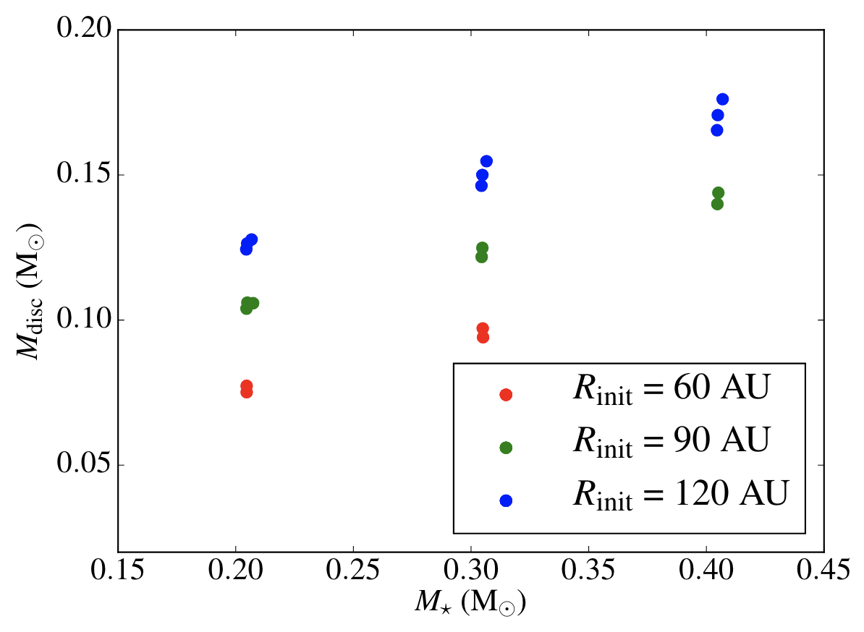
Disc minimum mass for fragmentation
[27 simulations]
High disc-to-stellar mass ratios are needed

Slide 8
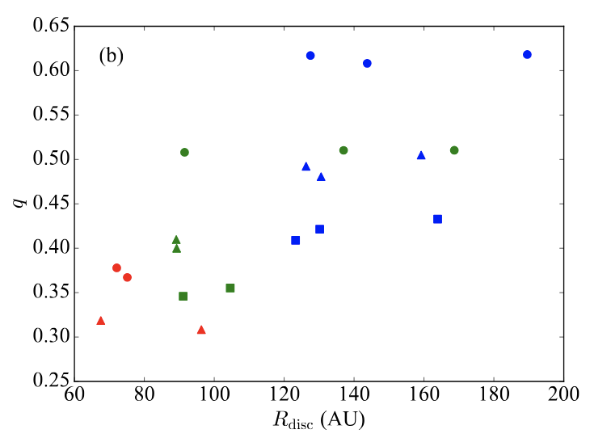
Disc minimum mass for fragmentation
z=0.1
z=1
z=10
High disc-to-stellar mass ratios are needed

Slide 9
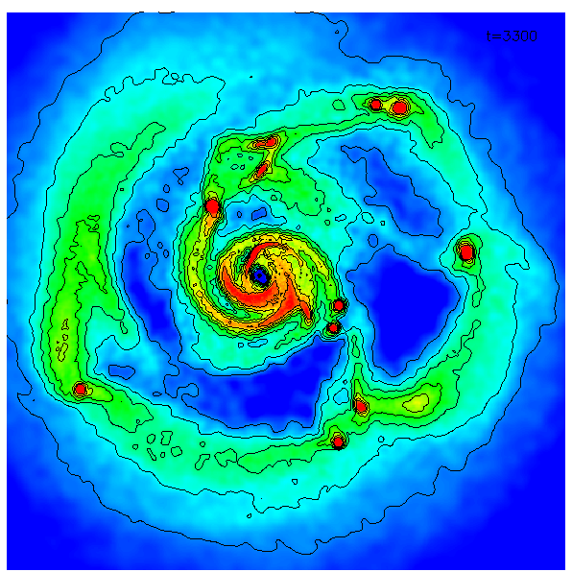
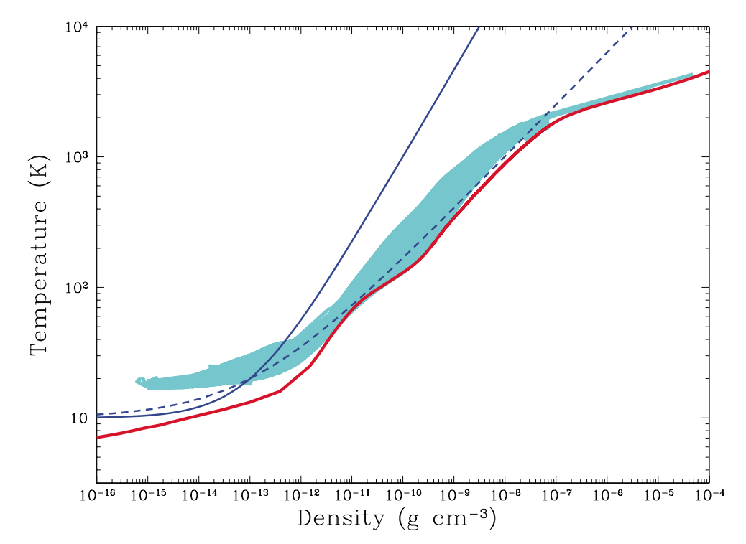
Protoplanets form the “same” way as stars
a few M_{J} fragment
Second collapse
10⁵ SPH particles !!!
First collapse
Equation of state
Vibrational & rotational
degrees of freedom of H₂
H₂ dissociation
H ionisation
Helium first and second ionisation
1M⦿ core

Slide 10
Prototoplanets formed by disc fragmentation are hot
Simulations are followed up to densities of ~10⁻³ g cm⁻³ (from an initial disc density of ~ 10⁻¹⁴ g cm⁻³).
A bound object forms after the “second collapse” (after molecular hydrogen starts dissociating at 10,000K)
Similar temperatures to the ones in the accretion shock around planets formed by core accretion (see Szulagyi & Mayer 2017)
10⁻³ g cm⁻³
DENSITY
1 AU
10⁴ K
TEMPERTURE
1 AU
RADIUS (AU)
Mercer & Stamatellos, 2019 in prep

Slide 11
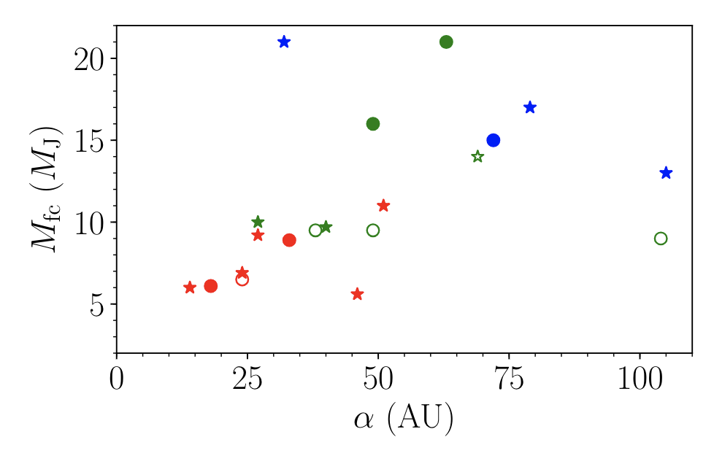
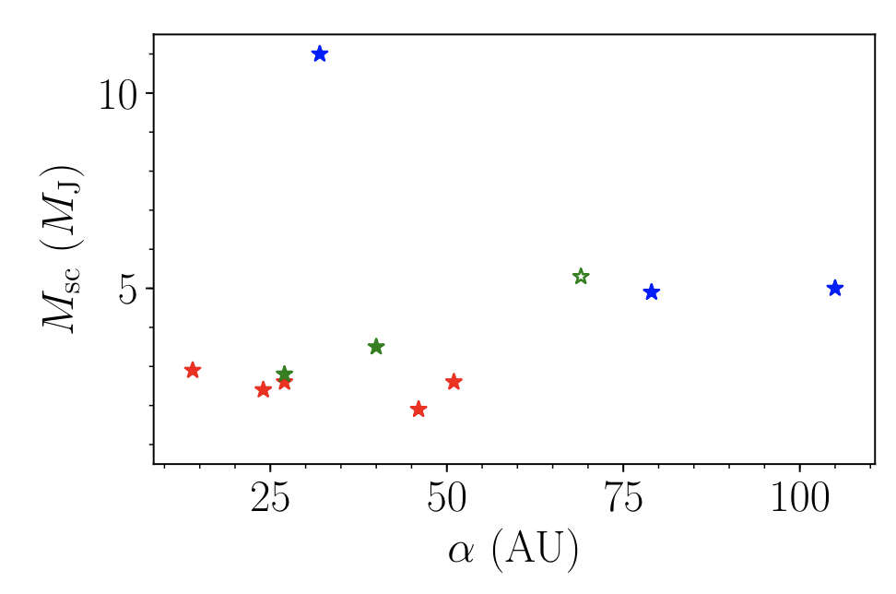
“Protoplanet” (1st and 2nd core) properties
Low-metallicity first cores have lower masses
Low-metallicity second cores also have lower masses
Disc-protoplanet and protoplanet-protoplanet interactions may increase the mass of first/second cores.
1st CORE MASS (M_{J})
z=0.1
z=1
z=10
2nd CORE MASS (M_{J})
DISTANCE FROM STAR (AU)

Slide 12
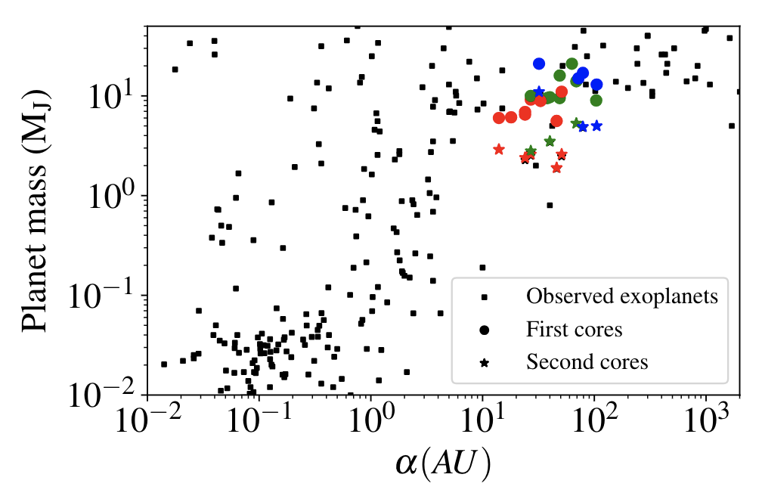
Disc instability protoplanets: Evolution is critical for their final properties
Stamatellos & Whitworth 2009
Gas accretion
Baruteau et al. 2011
Stamatellos & Inutsuka 2018
Migration
Migration
Nayakshin 2018
Tidal downsizing
PLANET MASS (M_{J})
z=0.1
z=1
z=10
DISTANCE FROM STAR (AU)

Slide 13
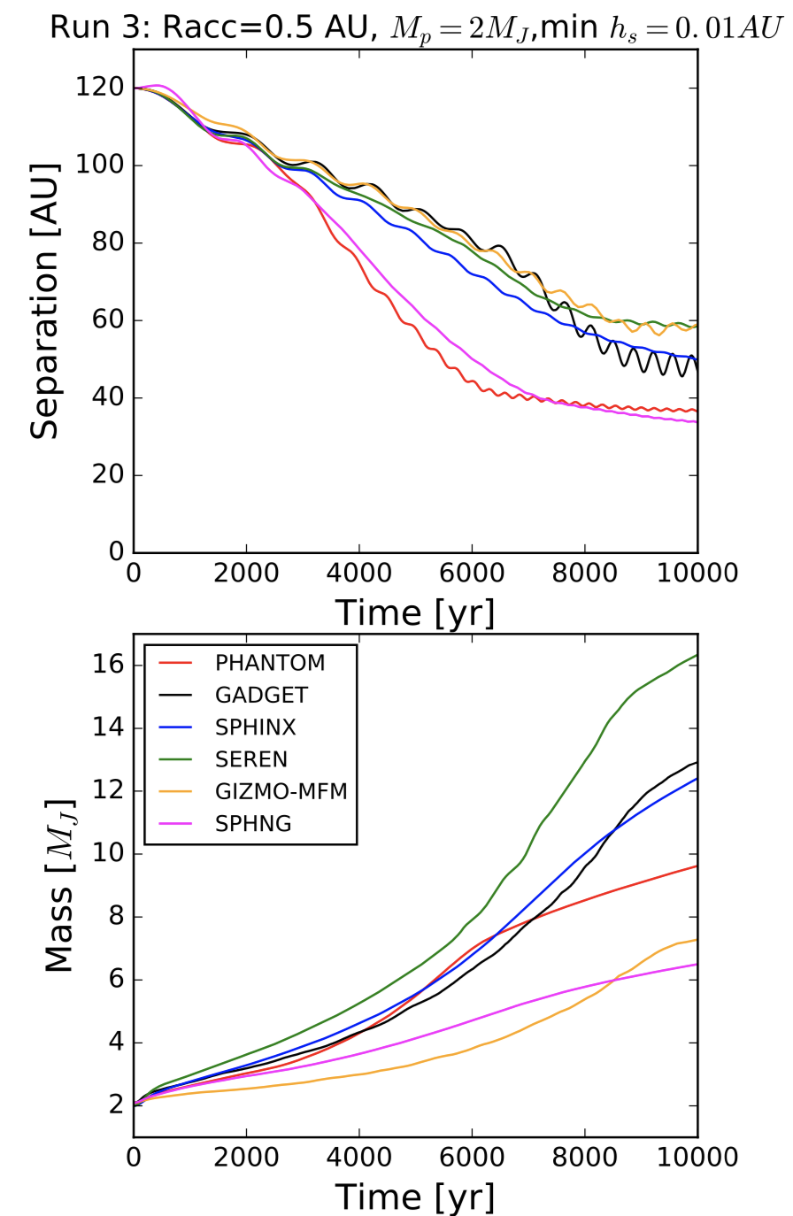
Disc instability protoplanets: Evolution is critical for their final properties
Protoplanet final mass and radius as estimated by hydrodynamic simulations are uncertain by a factor of ~2
Fletcher et al. 2019, MNRAS

Slide 14
Conclusions
Disc fragmentation can happen around M dwarf discs to form protoplanets
High disc-to-stellar mass ratios are needed (q>0.3)
Jupiter-mass fragments go through the 1st and 2nd collapse phase just like their solar-mass counterparts
Protoplanets formed by disc instability are hot (T~10⁴K)
Evolution (disc-protoplanet and protoplanet-protoplanet interactions) will determine the planet final properties

Slide 15
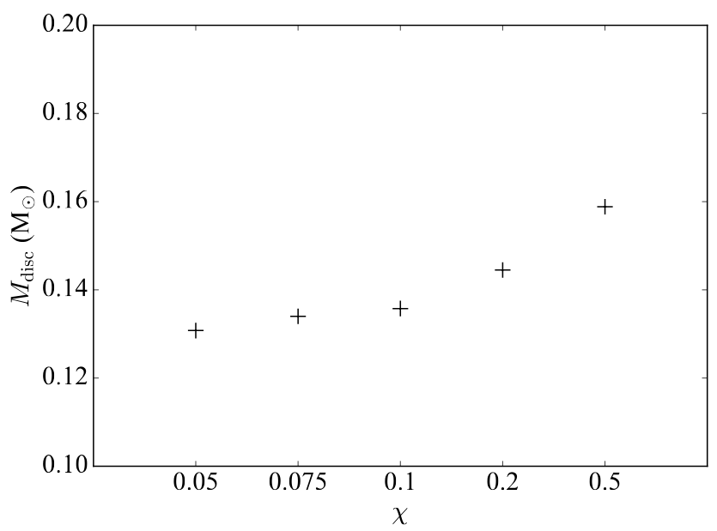
Mass loading technique
Disc mass is “slowly” increased (accretion from an envelope)
Test I: Ensure that “accretion rate” does not affect fragmentation mass
Test II: Ensure that mass loading method does not affect the fragmentation mass (0.15-0.2 M; increase in steps of 0.01 M)
Mdisc=0.12M
Rdisc=90AU
M_{star}= 0.4M
χ fraction of increase of disc mass per outer disc period

Slide 16
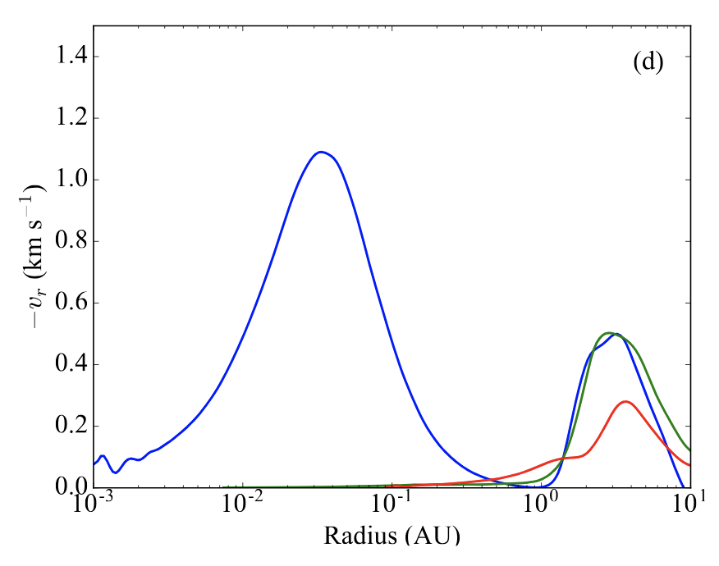
Prototoplanets formed by disc fragmentation: first and second core signatures
Accretion shock around 2nd core
Accretion shock around 1st core
IINFALL VELOCITY (km s⁻¹)
DISTANCE FROM STAR (AU)
Some fragments go through the second collapse phase but show no signatur of second core in the infall velocity profile due to high rotation

Slide 17
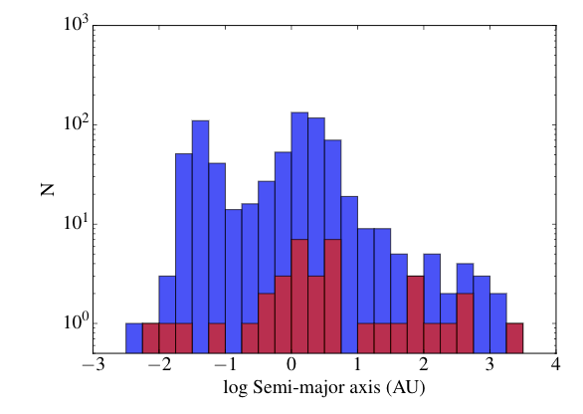
Giant planets (M>1M_{J}) around M dwarfs Semi-major axis
www.exoplanet.eu
Red: Giant planets around M dwarfs
Blue: Giant planets around higher-mass stars

Slide 18
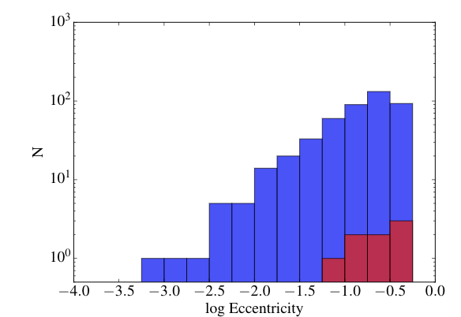
Giant planets (M>1M_{J}) around M dwarfs Eccentricity
www.exoplanet.eu
Red: Giant planets around M dwarfs
Blue: Giant planets around higher-mass stars

Slide 19
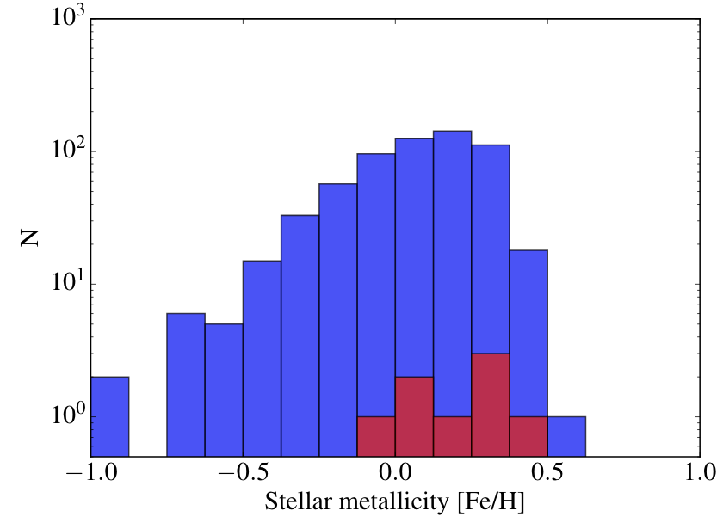
Giant planets (M>1M_{J}) around M dwarfs Metallicity
www.exoplanet.eu
Red: Giant planets around M dwarfs
Blue: Giant planets around higher-mass stars

