Slide 1
Theory of incompressible flocks
Leiming Chen (陈雷鸣)
China University of Mining and Technology
(中国矿业大学，徐州)
With:
Related: Order-disorder phase transition
in incompressible flocks:
New J. Phys. 17, 042002 (2015)
Mapping two-dimensional polar active fluids
to two-dimensional soap and
one dimensional sandblasting,
L. Chen, C. F. Lee, and J. Toner,
Nature Communications
10.1038/NCOMMS12215 (2016).
Chiu Fan Lee, Imperial College, London
Includes a free short film of me
(only 20 takes for 2 minutes of footage!)

Slide 2
Outline
I) What’s an incompressible flock? Are there any?
II) Hydrodynamic model (arbitrary d)
III) Linearized theory Weirdness:
fluctuations in d=2 << fluc’s in d=3 !
IV) Solving the non-linear theory:
Exact Mappings in d=2:
2d incompressible flock
2d “incompressible” magnet
1+1d KPZ equation (“sandblasting”)
2d smectic (“soap”)

Slide 3
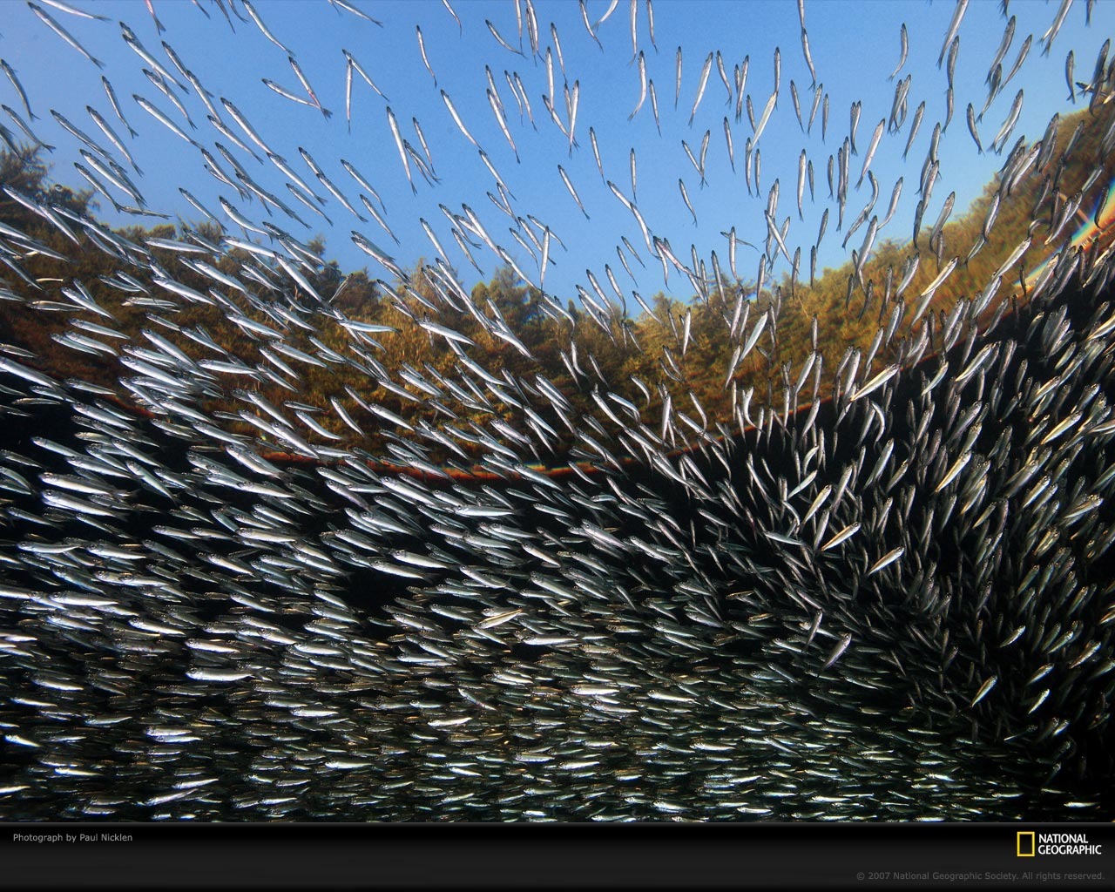
I) What are incompressible flocks? Are there any?
First, what’s a flock?
Ordered Active fluids (aka “flocks”): large numbers of self-propelled “particles” which tend to align their velocities along the same direction

Slide 4
Flocks: Essential Features
Only Local interactions: short ranged in space and time
No external fields (no signs, no compasses):”Rotation invariance”: order is spontaneous (“emergent”):
i.e., Picked by the system, not a priori
Ferromagnetic interactions (favor alignment)
“Birds” keep moving ( ) and making errors

Slide 5
I) What’s an incompressible flock?
As for fluids, “incompressible” means density can’t change
Very common in fluid mechanics to approximate fluids as incompressible
(valid for speeds
sound speed)
Can an incompressible flock exist in nature?
Hell, yes!

Slide 6
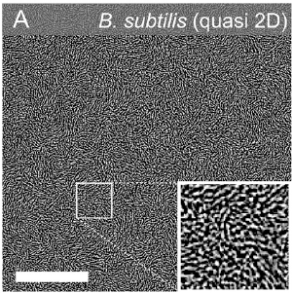
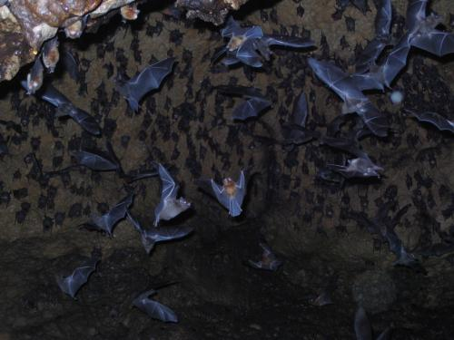
Examples of incompressible active fluids
Dense colony of B. subtilis bacteria
Picture from Wensink, Dunkel, Heidenreich, Drescher, Goldstein, Löwen and Yeomans (2012) PNAS
Bats in a cave
Picture from phys.org [Credit: Gerry Carter]
50μm
True incompressibility is possible via long-ranged repulsive interactions (a bat can “see” through the colony)
High density regime → compressibility ≈ 0
Notes:
Let’s illustrate with two examples. Imagine putting motile bacteria like Basillus subtilis in a quasi-2D environment. Now, increase the density of the bacteria until the system becomes almost incompressible. The incompressibility assumption is also employed in the theoretical analysis in this paper here. This is our first example of incompressible active matter. A second example is a colony of bats in a cave. Since each bat can see by echolocation through the whole colony, long ranged interactions are possible and so true incompressibility can be achieved in the thermodynamic limit.
So these are two particular examples, but generically, we consider systems that share the following five key ingredients:

Slide 7
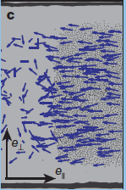
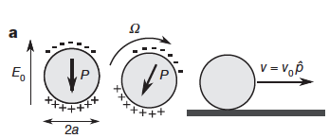
3) Systems with long-ranged hydrodynamic
Interactions (e.g., “quinke rotators” (1))
(1) A. Bricard, J-B. Caussin, N. Desreumaux, O. Dauchot, and D. Bartolo,
Nature, 503, 95 (2013)

Slide 8
II) Hydrodynamic Theory of Incompressible Flocks
Hard (impossible) to solve microscopic model with ~10^5 birds
Harder to figure out what happens if you change model (universal vs system-specific)
Historical analog: Fluid mechanics (Navier, Stokes, 1822):
No theory of atoms and molecules
No statistical physics
No computers, ipad, ipod, etc
So, how’d they do it?

Slide 9
Continuum Approach
Continuous fields:
Replace
:
Coarse grained number density
Coarse grained velocity
:
Valid for: Length scales L >> interatomic distance
Time scales t >> collision time

Slide 10
Our (Yu-hai Tu and JT) idea: same approach, different symmetry
No Galilean invariance (birds move through a
Special “rest frame” (e.g., air, water, surface
of Serengeti. Etc….))

Slide 11
Equations of motion for
Make ‘em up!
Rules:
-Lowest order in space, time derivatives
-Lowest order in fluctuations
Respect Symmetries (for flocks,
Rotation invariance)
Worked for fluids, should work for flocks

Slide 12
Hydrodynamic equations for
Compressible Flocks:
Velocity EOM:
Noise
Density EOM:
Number conservation
(“immortal” flock)

Slide 13
Hydrodynamic equations for Incompressible active fluids
Density EOM:

Slide 14
V equation of motion, incompressible case
constant
constant

Slide 15
How do you determine P?
(1)
(2)
(both sides of Eq. (1)); solve for in terms of | in Fourier space.
Plugging back into Eq. (1) , we obtain a closed non linear EOM of .

Slide 16
III) Linearized theory
First, look for uniform, steady state solution for
constant
Direction of arbitrary
(consequence of rotation invariance)

Slide 17
Now, look for small fluctuations about this for
: component
perpendicular
to
: Goldstone mode in the compressible case

Slide 18
The Mexican hat, massive and massless modes
“Mexican hat potential”
Due to rotation invariance

Slide 19
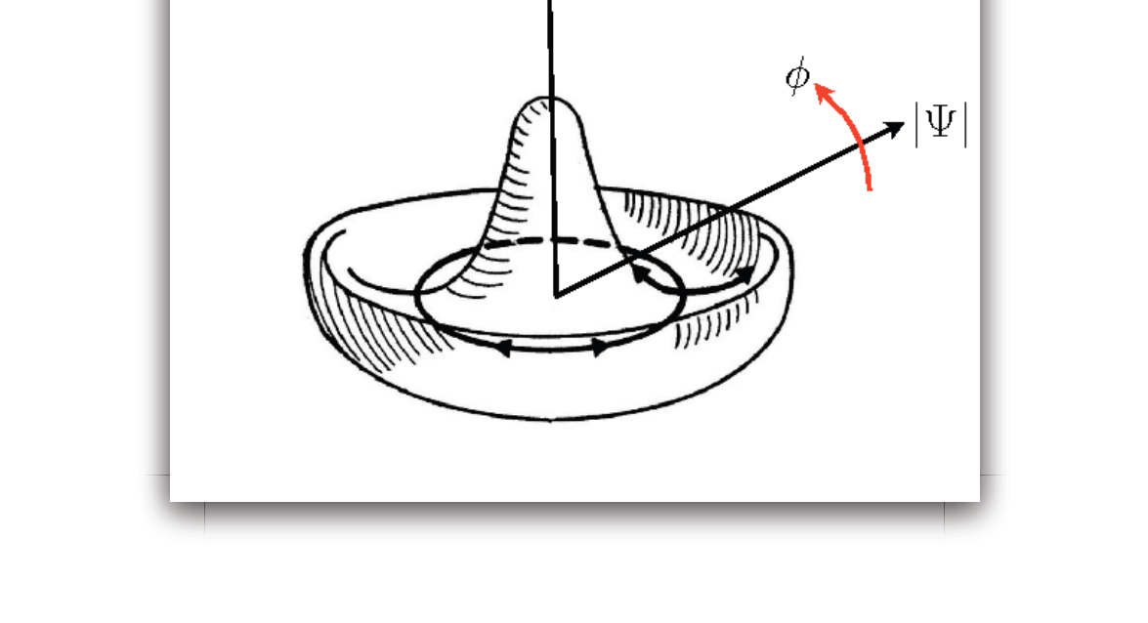
Slow mode
Fast mode
“Goldstone mode”

Slide 20
Linear theory: Fourier space: mode with wavevector
To go to Fourier space,

Slide 21
Two constraints:
1) Incompressibility
2) “softness” (i.e., Goldstone mode)

Slide 22
In d=3, no problem
But in d=2 ?
Smaller fluctuations
In d=2 than in d=3!
No “soft”directions in d=2

