Slide 1

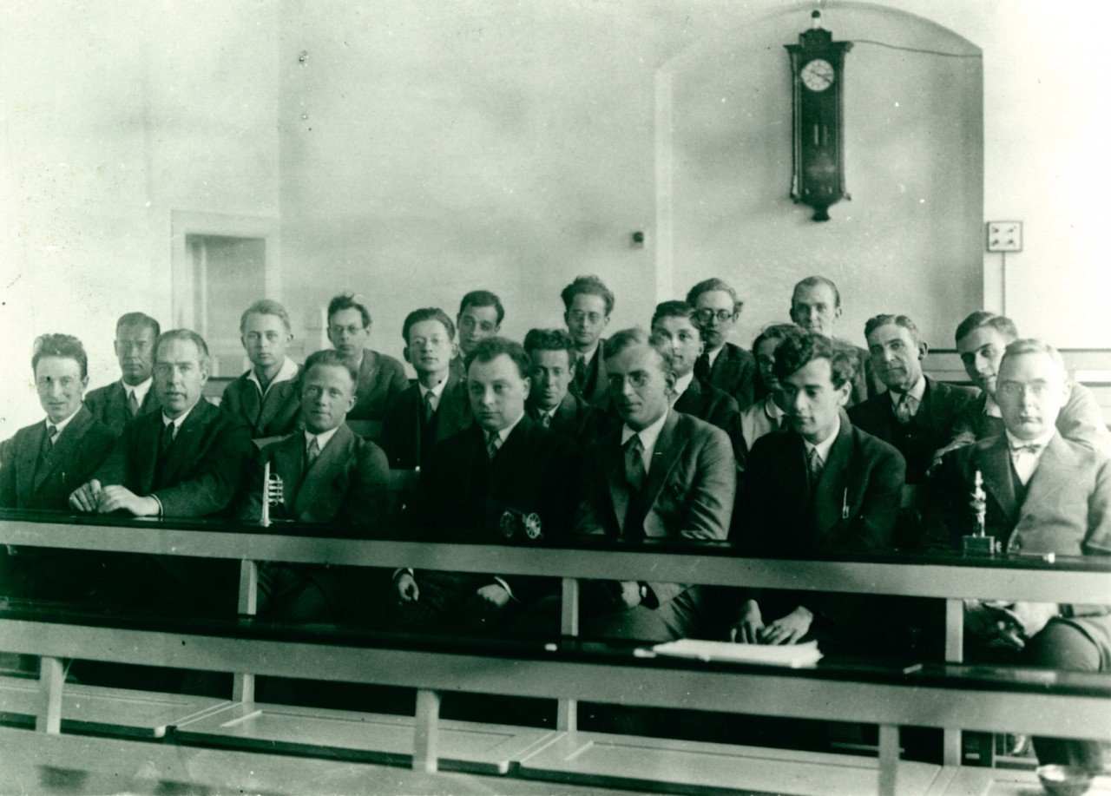



Measurement-Powered Engines
Quantum Limits of Knowledge, Copenhagen – Niels Bohr institute
June 19-21, 2019
Andrew N. Jordan

Slide 2

Conference Proceedings – Copenhagen (re)interpretation
Journal dedicated to quantum foundations
Philosophical contributions welcome
Due date: end of September

Slide 3
Talk Outline
Energy and Measurement: Harnessing wavefunction collapse to build an engine (Example is a little bit like the Einstein-Bohr debates).
Interaction free measurement engines
Diffraction based interaction free measurements

Slide 4







Thanks to my great students, and collaborators!
Areeya Chantasri (Griffiths University)
Justin Dressel
(Chapman University)
Cai Waegell
(Chapman University)
Cyril Elouard
Phil Lewalle
John Steinmetz
Irfan Siddiqi
(UC Berkeley)
+ group
Benjamin Huard
ENS Lyon
Kater Murch
(Washington University,
St. Louis)
+ group

Slide 5
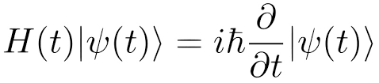
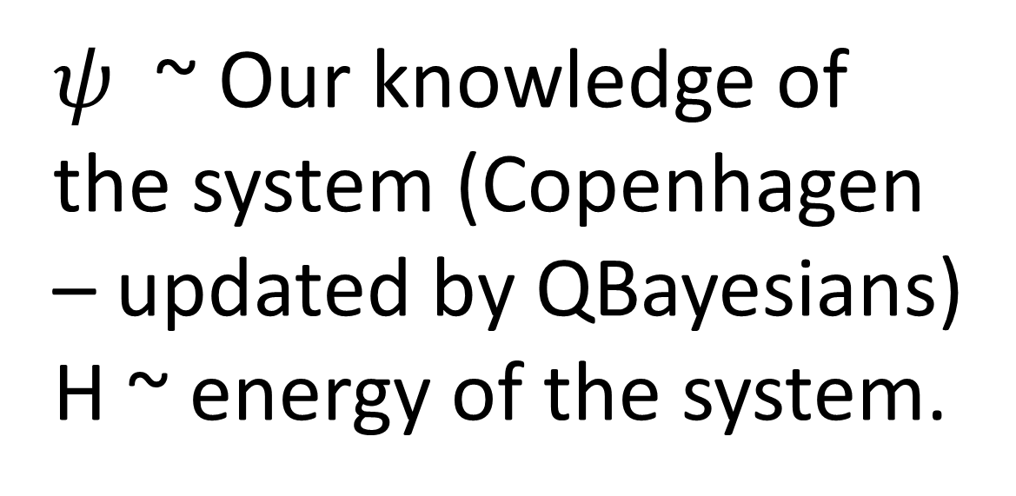
Introduction and Motivation
$ψ$ ~ Our knowledge of the system (Copenhagen – updated by QBayesians)
H ~ energy of the system.

Slide 6
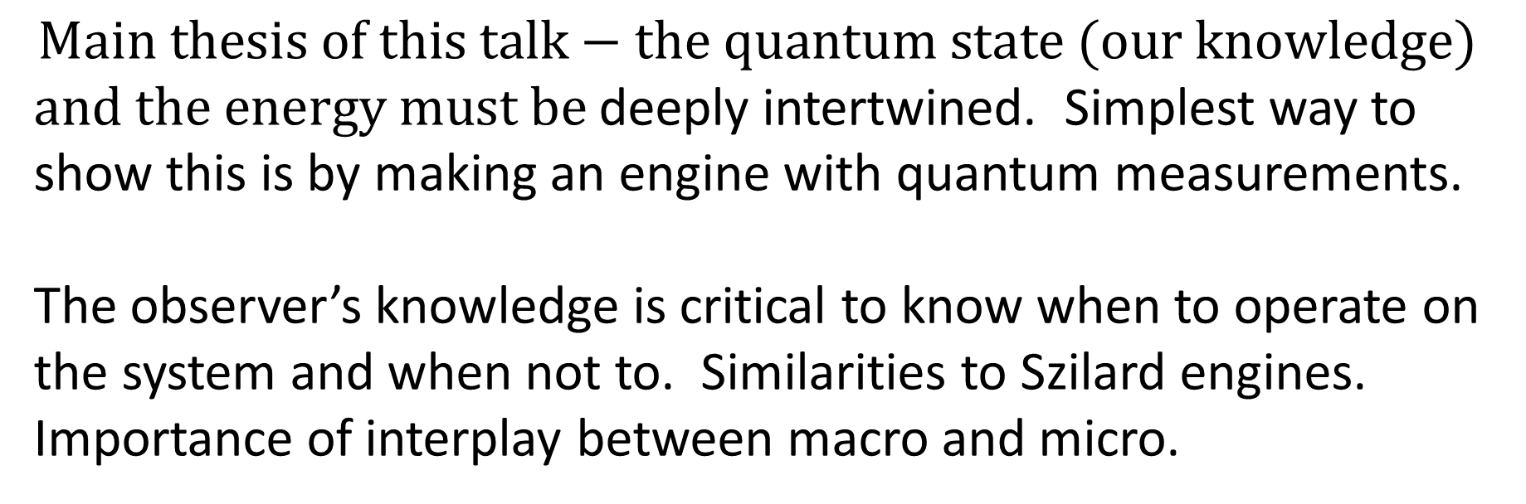
Introduction and Motivation
$$Main thesis of this talk−the quantum state (our knowledge)$$
$and the energy must be$ deeply intertwined. Simplest way to show this is by making an engine with quantum measurements.
The observer’s knowledge is critical to know when to operate on the system and when not to. Similarities to Szilard engines. Importance of interplay between macro and micro.

Slide 7
Quantum measurement powered engines
We can consider this stochastic energy exchange as analogous to heat “Quantum Heat” – Alexia Auffeves.
We can further design engines to extract this energy as useful work

Slide 8

Basic idea: Use quantum measurement as a source of energy to drive an engine.

Slide 9
Elementary Quantum Engines
Single atom elevator
Single electron battery

Slide 10
Quantum Measurement Elevator

Slide 11
Quantum Measurement Elevator

Slide 12
Quantum Measurement Elevator

Slide 13
Quantum Measurement Elevator

Slide 14
Quantum Measurement Elevator

Slide 15
Quantum Measurement Elevator

Slide 16
Quantum Measurement Elevator

Slide 17
Suppose we make a sharp inside/outside measurement….

Slide 18
Soften the measurement

Slide 19
Designer Measurements

Slide 20
Performance tradeoff

Slide 21
Possible realization of the measurement procedure
Generates the entangled state:
Let f(x) be a phase ramp, from 0 to π/2
Projection of spin on spin state 0 or 1 realizes the generalized measurement on the particle’s position.
Energy analysis indicates that we must prepare the spin with initial energy E_{o}-E_{i} . Upon successful finding of the particle away from the barrier, that energy is transferred to this system. Therefore, we must reenergize the measuring spin after each cycle if the result is successful.
f(x)
π/2
0
ε
ε+w
x

Slide 22
Interaction-free measurement engines:
Can we lift the world’s most sensitive bomb without blowing it up?
arXiv: 1904.09289v1
Take the single atom elevator engine, and place it inside a Mach-Zehnder interferometer

Slide 23
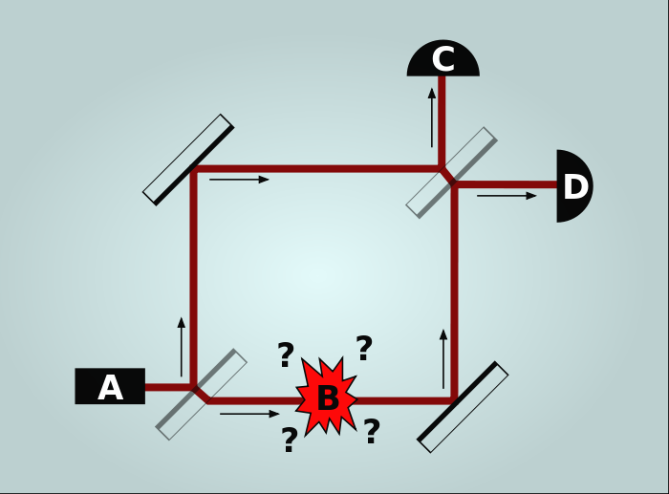
“Interaction free measurements”
a.k.a. The Elitzur-Vaidman bomb tester
Consider a tuned Mach-Zehnder interferometer, so every photon injected in A comes out the D (bright port)
If something – like the world’s most sensitive bomb sits inside the interferometer - then (a) the bomb can explode, or (b) the bright port can click, or (c) the dark port can click.
If the dark port clicks, then we can infer the bomb is there, without exploding it.
Retrodiction – predicting about the past – would say: The photon must have come through the other arm, otherwise, the bomb would have exploded.
Image credit: Wikipedia

Slide 24
Doing spooky work on the bomb
Suppose we let the bomb have its many internal degrees of freedom, but also a motional degree of freedom – it can be lifted against the force of gravity. But…. If a photon is present, it will blow up.
The bomb can be treated quantum mechanically with its motional degree of freedom and all internal degrees of freedom in its ground state.
The ground state wavefunction extends for some distance in space.
We arrange for a photon to pass nearby, so there is a local interaction if the atom extends into the photon’s path. Otherwise there is not.
The other degrees of the bomb are treated as a zero temperature open quantum system, than can absorb the photon, and excite one of its modes.

Slide 25
Doing spooky work on the bomb
The bomb is now part of the interferometer in its ground state.
We post select on instances when the dark port clicks.
If the dark port clicks, then the bomb must have been present inside of the interferometer. It also did not explode.
Therefore, the bomb’s position must be localized inside of the interferometer.
But, that has a higher energy then it started with, and can be extracted as part of the engine cycle. Where did it come from?
It must have come from the meter – in this case, the photon. But, the photon passed via the other arm of the interferometer. Or did it?
Explicit calculation reveals there is average balance in the system – that is, no energy is created or destroyed in the postselected system.

Slide 26
Where did the energy come from?
Our trilemma:
It was given to the bomb nonlocally by the photon.
It was really there, even though the bomb did not explode (i.e. the retrodictive inference is incorrect).
A virtual photon in arm I locally gave the bomb the energy locally, and interfered with the real photon in arm II at the beam splitter (i.e. the quantum Cheshire cat).
Regardless of interpretation, this system is able to lift the most sensitive bomb, without exploding it.

Slide 27
Diffraction based interaction free measurements
Excluding the Feynmann paths that hit the bomb leads to diffraction, permitting the detection of the bomb without blowing it up.
Momentum exchange with the bomb, when a single photon would set it off ….
Work with Spencer Rogers, Yakir Aharonov and Cyril Elouard.

Slide 28
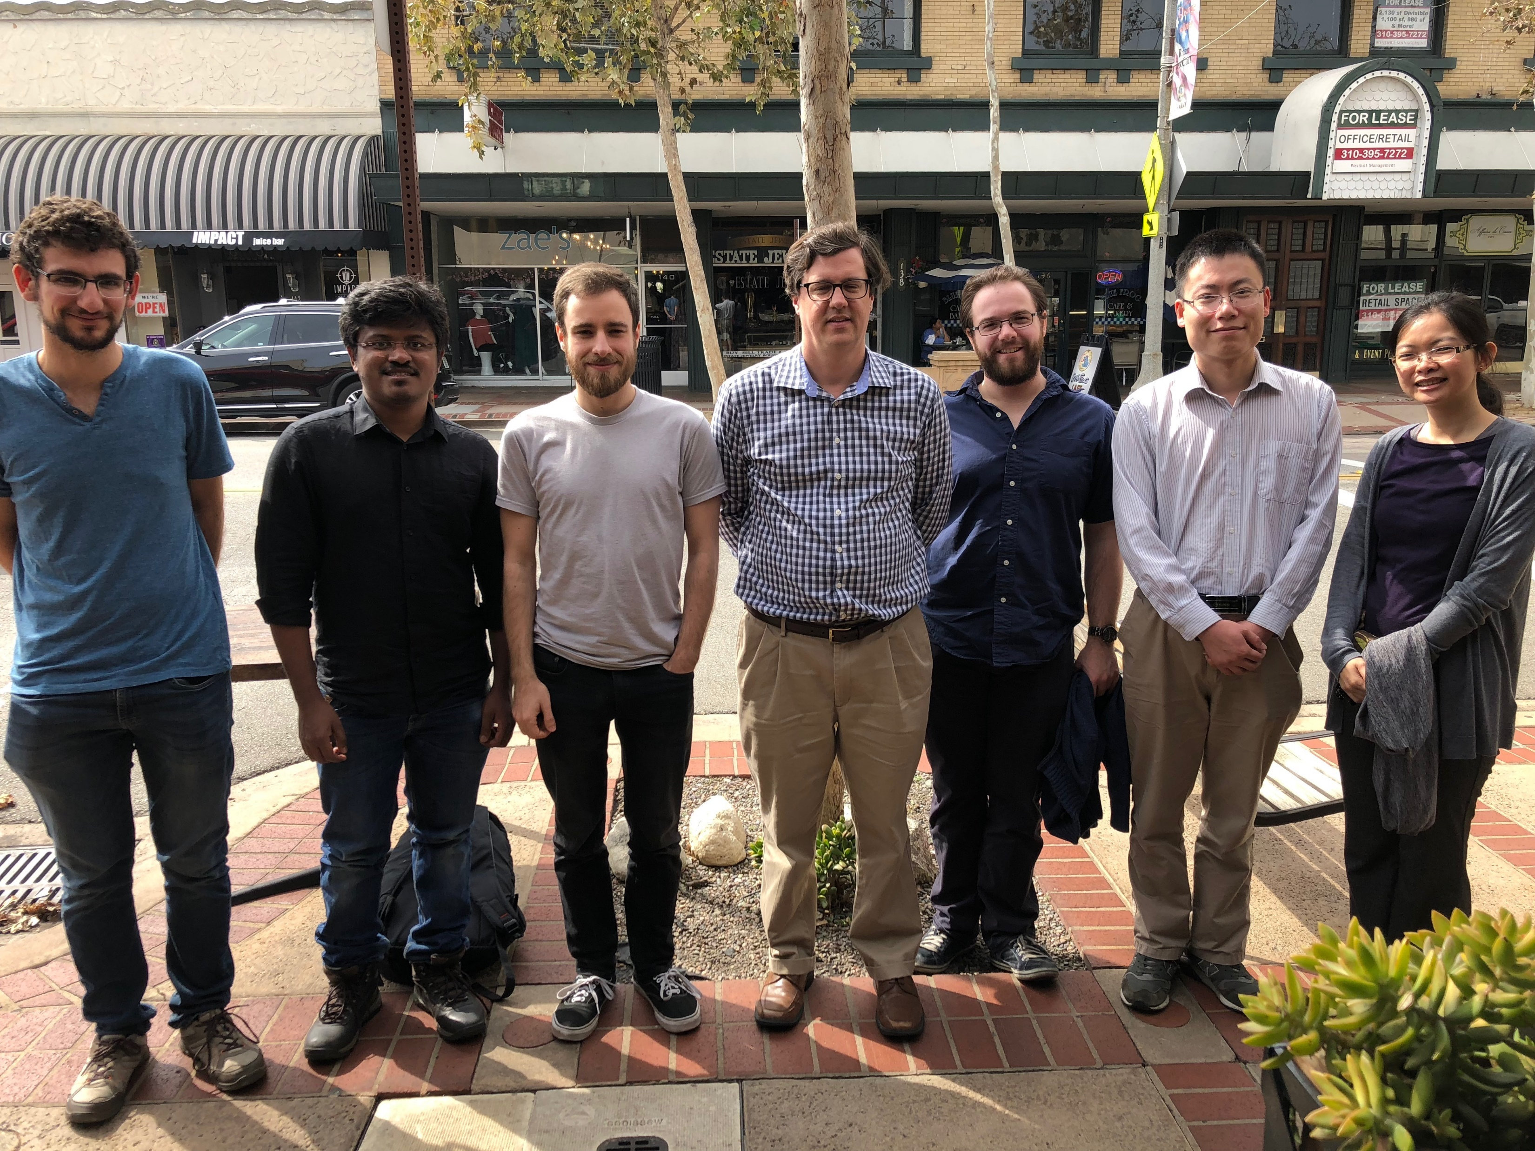
Conclusions
Quantum engines
Lifting the most sensitive bomb
Diffraction based interaction free measurements

Slide 29
Additional References
Spooky Work at a Distance: an Interaction-Free Quantum Measurement-Driven Engine
Cyril Elouard, Mordecai Waegell, Benjamin Huard, Andrew N. Jordan
arXiv:1904.09289
Phys. Rev. Lett. 120, 260601 (2018)
Efficient Quantum Measurement Engines
Cyril Elouard, Andrew N. Jordan

