Slide 1
Bohr’s relational holism and the classical-quantum interaction
M. Dorato
Department of Philosophy, Communication and Performing Arts
Università degli Studi Roma 3
Quantum limits of knowledge, Copenhagen 19-21 June 2019

Slide 2
Bohr’s view, the main problem and my very modest answer
«The quantum theory is characterised by the acknowledgment (Erkenntnis) of a fundamental limitation in the classical physical ideas when applied to atomic phenomena. The situation thus created is of a peculiar nature, since our interpretation of the experimental material rests essentially upon the classical concept.» Supplement to Nature, p. 550 13/4/1928)
how do we distinguish the classical from the quantum (atomic world)?
Bohr’s holism about the classical-quantum interaction makes the interaction theoretically unexplainable, though accountable in practice, for any given experimental context. Should we be content with this pragmatic solution?

Slide 3
Plan and dialectical strategy
Introduction: motivation, two attitudes toward physics, and the current situation in the philosophy of QT
Bohr’s philosophy of QT, and his «separation thesis» (ST)
The difficulties raised by the (ST) and Bohr’s responses: Kantianism about classical concepts, contexualism, holism
Extant problems of Bohr’s philosophy of QT

Slide 4
1.1. The motivation: the swinging pendulum
After 1930 (Solvay) and until the late sixties, Bohr has been unanimously considered the winner of his debate with Einstein
Later, both among physicists and philosophers claimed that Bohr has …“brainwashed a whole generation of physicists into thinking that the job was done 50 years ago” (Gell-Mann 1976).
“Rather than being disturbed by the ambiguity in principle ... Bohr seemed to take satisfaction in it. He seemed to revel in contradictions, for example between "wave" and "particle," (Bell 1987, 189)
We need a more balanced evaluation of his philosophy

Slide 5
1.2 The two attitudes: principle theories vs and constructive theories
“…the kinetic theory of gases seeks to reduce mechanical, thermal, and diffusional processes to movements of molecules – i.e., to build them up out of the hypothesis of molecular motion. When we say that we have succeeded in understanding a group of natural processes, we invariably mean that a constructive theory has been found which covers the processes in question
“The elements which form their basis and starting-point [of principle theories] are not hypothetically constructed but empirically discovered ones, general characteristics of natural processes”… “the science of thermodynamics seeks by analytical means to deduce necessary conditions, [….] from the universally experienced fact that perpetual motion is impossible ….The theory of relativity belongs to the latter class”

Slide 6
1.3 The current situation in the philosophy of QT: theories of principle vs constructive theory attitudes
Bohm/GRW: the wave function is “either not everything or is wrong” (a constructive-theory approach about the wave function postulating beables)
QT is new theory of probability, deriving from the mathematical structure of the theory (Pitowsky) or is about information, (Bub, Qbism) --> a theory-of-principle
Bohr? he refuses the fruitfulness of a constructive explanation of the classical-quantum interaction by using Einstein 1905
In my view, these two attitudes are not incompatible! Einstein’s worries have been heuristically fruitful.
Two different ways of explaning in physics

Slide 7
Plan
Introduction: motivation, a distinction, and the current situation in the philosophy of QT
Bohr’s philosophy of QT: the quantum postulate and its 3 consequences: complementarity, no-preexisting value, and the ST
The difficulties raised by the (ST) and Bohr’s responses: Kantianism about classical concepts, contexualism, holism
Extant problems of Bohr’s philosophy of QT

Slide 8
2.1 The quantum postulate: discontinuity and individuality
"The quantum postulate, ...attributes to any atomic process an essential discontinuity, or rather individuality, completely foreign to the classical theories and symbolised by Planck's quantum of action.» (the Como lecture, 16/09/1927)
Why individuality? It is a consequence of discontinuity: Planck's constant is a new form of atomism (discretization of action)

Slide 9
A deep analogy between QM and STR
The quantum postulate and the light postulate present two deep analogies:
they are universal constants of nature entering in the most fundamental physical laws
By constraining what can be known of the physical world – h because of its discreteness, c because of its finiteness – they are universal empirical generalizations (metalaws) that all phenomena must satisfy (theory of principles!)

Slide 10
2.3 The three consequences of the quantum postulate
«This [the quantum] postulate implies a renunciation as regards the causal space-time co-ordination of atomic processes.» (complementarity) compare with STR
«it ... implies that any observation of atomic phenomena will involve an interaction with the agency of observation not to be neglected» (which is not a «disturbance», but a «no preexisting value»)
«Accordingly, an independent reality in the ordinary physical sense can neither be ascribed to the phenomena nor to the agencies of observation. (holism)»

Slide 11
Plan
Introduction: motivation, a distinction, and the current situation in the philosophy of QT
Bohr’s philosophy of QT: the quantum postulate and its 3 consequences: complementarity, the interaction, the separation thesis
The «separation thesis» and its 3 difficulties
Bohr’s responses: the need of the classical language-Kantism, contextualism
Extant problems of Bohr’s philosophy of QM and the holistic approach

Slide 12
1st difficulty: the conflict between holism and ST
«Accordingly, an independent reality in the ordinary physical sense can neither be ascribed to the phenomena nor to the agencies of observation. (holism, or nonseparability)»
“The essentially new feature in the analysis of quantum phenomena is, however, the introduction of a fundamental distinction between the measuring apparatus and the objects under investigation.” (On atomic physics and human knowledge, 1963, pp.3-4) :
How can a classical object be distinct from a quantum entity (phenomena…) if it does not possess a reality that is independent from it?

Slide 13
2nd difficulty: vagueness of the ST: the movable shift
Where and how do we draw a boundary, given that there are mesoscopic systems, whose length -- 100 nm (virus) to 1000 nm (bacterium) -- is intermediate between typical micro (0.5 nm= atoms) and macrophenomena, and that are subject to quantum effects, like interference?

Slide 14
3.3 Contextualism of the ST and the 5° Solvay conference
If a classical mascroscopic apparatus can sometime be regarded as a quantum object, depending on the task at hand, then the ST is also contextual and essentially pragmatic
«After all, the concept of observation is in so far arbitrary as it depends upon which objects are included in the system to be observed.» (1928)

Slide 15
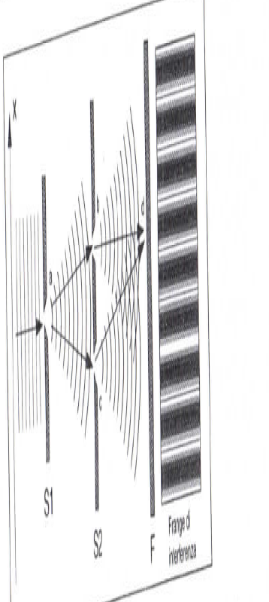
We know which slits the particle went through by looking at the upward or downward motion of S1 without destroying the interference

Slide 16
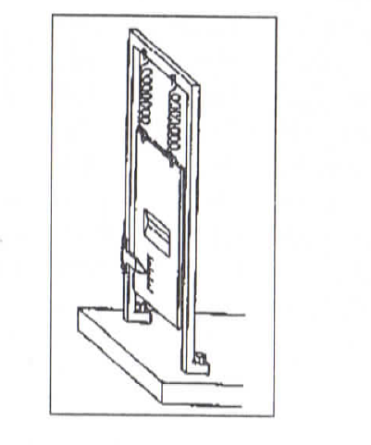
B’s response: in order to measure the motion of S1, we need an extremely precise determination of its vertical motion, which entails an indeterminatess of it position: the macroscopic object is subject to Heiseberg’s’indetermnacy relations

Slide 17
In a word: objections from Bohr’s critics
the classical/quantum distinction (the ST)
Is in tension with B’s holism
is hopelessly vague (inexact): the shifty split
Contextual: what to include in the observational context is somewhat arbitrary
Consequently Bohr’s philosophy of QT has the germs of a contradiction
It is hopelessly vague and inexact
Due to its contextuality, it depends on the aims of the agent (“the concept of observation is arbitrary”), even if the complex system + environment is physical

Slide 18
Plan
Introduction: motivation, a distinction, and the current situation in the philosophy of QT
Bohr’s philosophy of QT and his «separation thesis» (ST)
Three difficulties raised by the (ST)
Bohr’s responses: the need of the classical language and holism
Extant problems of Bohr’s philosophy of QM and holism

Slide 19
4.1 Four reasons for the need of classical physics
Shared language to avoid observers’ subjective mental states : sorry for Qbists or bettabilitists!)
Condition of possibility to attribute empirical meaning to QM (Kant, Strawson)
QM is a theory of principle → describing the interaction between quantum systems and classical apparatuses in a constructive/dynamical way is superfluous (empirical equivalence)
Recovery of classical physics in the limit

Slide 20
4.2 → Bohr’s descriptive metaphysics
Classical concepts are conditions of possibility to refer to quantum systems
“There is a shared and universal conceptual scheme which we human beings have, and know that we have, and for which no justification in terms of more fundamental concepts or claims can be given”. Strawson (2009, 32)
We cannot explain human experience and classical physical concepts by using the language of QM! Because this explanatory task would call in its turn classical physics…
Conceptual primacy, not ontological primacy: Bohr is an entity realist

Slide 21
4.3 QT as a Principle Theory that relativizes previously absolute magnitudes
“… a comparison of purely logical aspects of relativistic and complementary argumentation reveals striking similarities as regards the renunciation of the absolute significance of conventional physical attributes of objects. Also, the neglect of the atomic constitution of the measuring instruments themselves, …is equally characteristic of the applications of relativity and quantum theory.” (Bohr 1949, 236)
Velocities, spatial and temporal intervals are relational (STR)
Position, momentum, energy, time, spin directions are relational in QT (or measurement-dependent).
in STR there is an invariant element internal to the theory, in Bohr’s formulation the invariant is the non-commutativity of the algebraic structure

Slide 22
4.4 The correspondence principle and analogies with STR
Correspondence principle: “a rational generalization of classical physics, which would permit the harmonious incorporation of the quantum of action” (Bohr 1963, 2, my emphasis). Analogy with the relativity principle in STR (Jeff) in the role of c and h
«in relativity theory the separation between time and space depends on the smallness of the rate (v/c), «in quantum theory … the appropriateness of our usual causal space-time description depends entirely upon the small value of the quantum of action»

Slide 23
Plan
Introduction: motivation, a distinction, and the current situation in the philosophy of QT
Bohr’s philosophy of QT and his «separation thesis» (ST)
Three difficulties raised by the (ST)
Bohr’s responses: the need of the classical language
Bohr’s holism and extant problems in his philosophy of QM

Slide 24
According to Bohr, measurements are physical processes
The problem of measurement: completeness of QM, linearity of Ψ, definite outcomes: contradiction!
Bohr defines a measurement as a physical interaction in two difference ways:
“finite, uncontrollable interaction” between system and apparatus”, that, for this very reason, are not further describable from a dynamical perspective
“suitable amplifications devices with irreversible functioning such as, for example, permanent marks on a photographic plate” (Bohr 1954, 73).
CAN, AND SHOULD, WE EXPLAIN IN CONSTRUCTIVE TERMS WHAT THESE PHYSICAL INTERACTIONS ARE? IT DEPENDS ON YOUR PHILOSOPHY…

Slide 25
3 possible responses, 3 types of interaction between quantum systems and apparatuses
The disturbance view (abandoned after 1935)
The no-preexisting-value view of a physical, irreversible interaction producing a definite value
the “nonseparability” or “indivisibility” view: the measurement apparatus and the measured entity have no-independent reality (as they are entangled)

Slide 26
1st sense: The disturbance view: wrong!
The disturbance view (Heisenberg) is wrong because
it it is compatible with the claim that quantum system have a definite value beforehand, a fact that Bohr obviously denied
he abandoned the disturbance view after EPR (see Faye)

Slide 27
2nd Sense: no previously definite magnitudes
For a neopositivist, there is no difference between
the claim that there are definite magnitudes before measurement that cannot be measured due to a “disturbance” (first sense), and
the claim that it is the measurement that causes the acquisition of a definite spin value previously undetermined (second sense).
For a neopositivist, in both cases it would be meaningless to talk about magnitudes without a measurement, but if one distinguishes between the two senses of interaction one is not a neopositivist
NB By rejecting the disturbance view Bohr refuses neopositivism!

Slide 28
3rd sense: holism and nonseparability
“the quantum postulate implies that any observation of atomic phenomena will involve an interaction with the agency of observation not to be neglected. Accordingly, an independent reality in the ordinary physical sense can neither be ascribed to the phenomena nor to the agencies of observation” (recall 1928’s paper, my emphasis).
in quantum physics this interaction thus forms an inseparable part of the phenomenon.” (Bohr 1963, 4, my emphasis)
The third sense is linked to B’s view of the measurement interaction

Slide 29
Three attempts to clarify Bohr’s view of the interaction in the third sense (measurement)
Landau & Lifschitz (1981): entanglement with a part of the apparatus
Howard (1994-2004): entanglement with the whole classical apparatus
Zinkernagel (2016): entanglement with a part

Slide 30
5.1) LANDAU-LIFTSHITZ’S
classicality is given by the existence of a well-defined trajectory.
in order to describe the trajectories of atomic particles one needs apparatuses that can be regarded as classical “to a sufficient degree of accuracy” (Landau and Lifshitz 1981, 2).
Such apparatuses need not be macroscopic
the track in a bubble chamber is classical to the extent that it is very large with respect to the electrons, so that the latter becomes a quasi-classical object.
On the other hand, they continue, the track measures the electron path with a very low degree of accuracy, which is the necessary price to pay for having definite outcomes and well-defined paths.

Slide 31
5.2) Howard 1996
Define an experimental context with the relevant observables
Relatively to that context, a mixture gives all the appropriate responses that we get out by treating the oucomes as pure states
His is essentially a solution that invokes decoherence: after many experiments, we cannot distinguish an ensemble of pure systems that have an indefinite state from an ensemble of reduced states. (ignorance interpretations)
However: a universal theory cannot be based on an approximation

Slide 32
Zinkernagel’s controversial solution (2006)
Zinkernagel follows Landau and Lifshitz’s in claiming that the atomic entity interacts (and is entangled with) only with a part of the instrument and there is no entanglement between quantum systems and the macro-instrument (Zinkernagel 2016, 11).
However, how are we to distinguish the “part” of a classical object from the whole of it? How big must the part be?

Slide 33
WRAPPING UP
Measurements in QM do not reveal preexisting magnitudes
However, the need to explain the “interaction” without invoking decoherence remains, even if so far no decisive empirical test has been proposed in the the constructive theory camp
Bohmian mechanics is in principle equivalent to standard QM…
Dynamical reduction models (GRW) are experimentally much more promising, but the constants of nature can be shifted ad hoc
The many-word is ontologically extravagant, must explain where probabilities come from

Slide 34
The end

