Slide 1
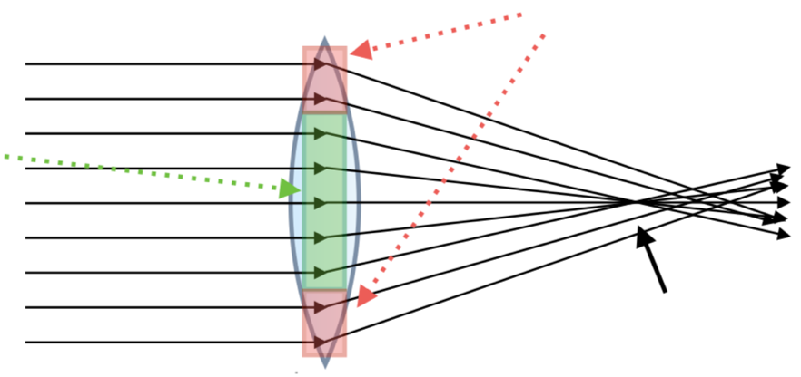
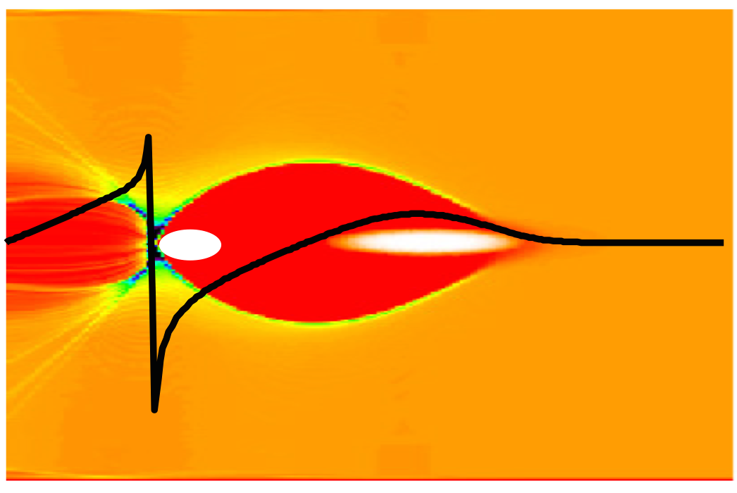
The Oslo plasma lens at the CERN electron test accelerator
for plasma-based acceleration and colliders: see my talk later tonight
Erik Adli
Department of Physics, University of Oslo, Norway and CERN
Team: Kyrre N. Sjøbæk (Oslo), Carl A. Lindstrøm (Oslo, now at DESY),
W. Farabolini, D. Gamba, G. Ravida, T. Lefevre, R. Corsini (CERN)
L. Schaper, M. Meisel, J.H. Roeckemann, J. Osterhoff (DESY)
A. Dyson, S. Hooker (Oxford)
Spaatind 2020 - Nordic conference on Particle Physics
Skeikampen, Norway
January 4, 2020
https://clear.web.cern.ch

Slide 2
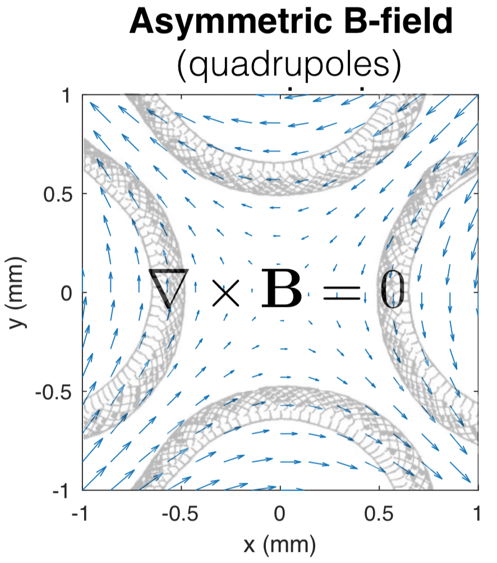
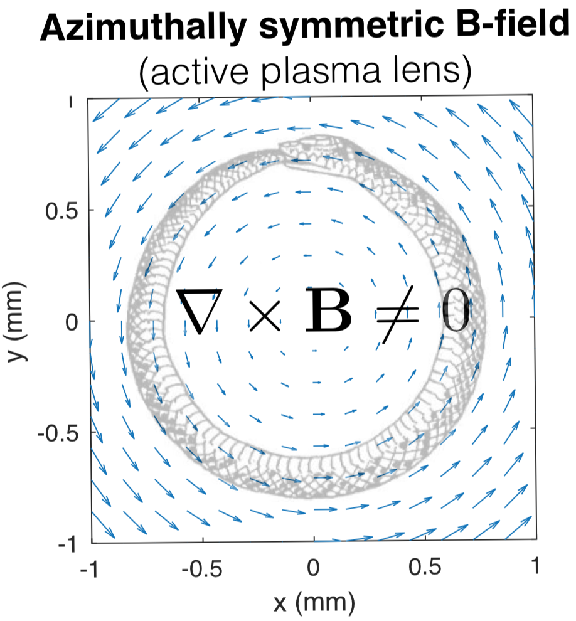
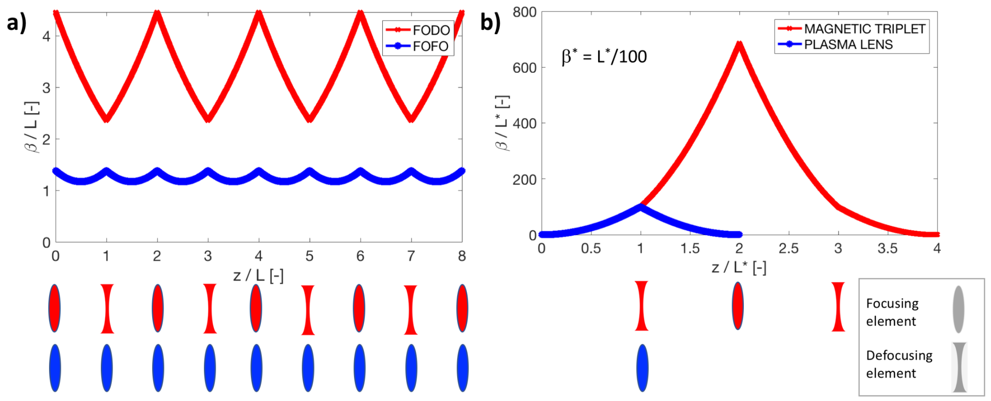
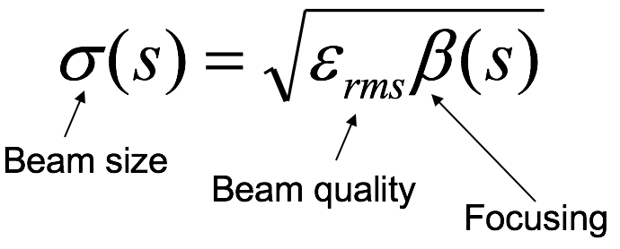
Why active plasma lenses? A step towards compact accelerators
Compact, strong particle beam focusing (kT/m)
Radial symmetric focusing - focusing or defocusing, for positive or negative charged beams

Slide 3
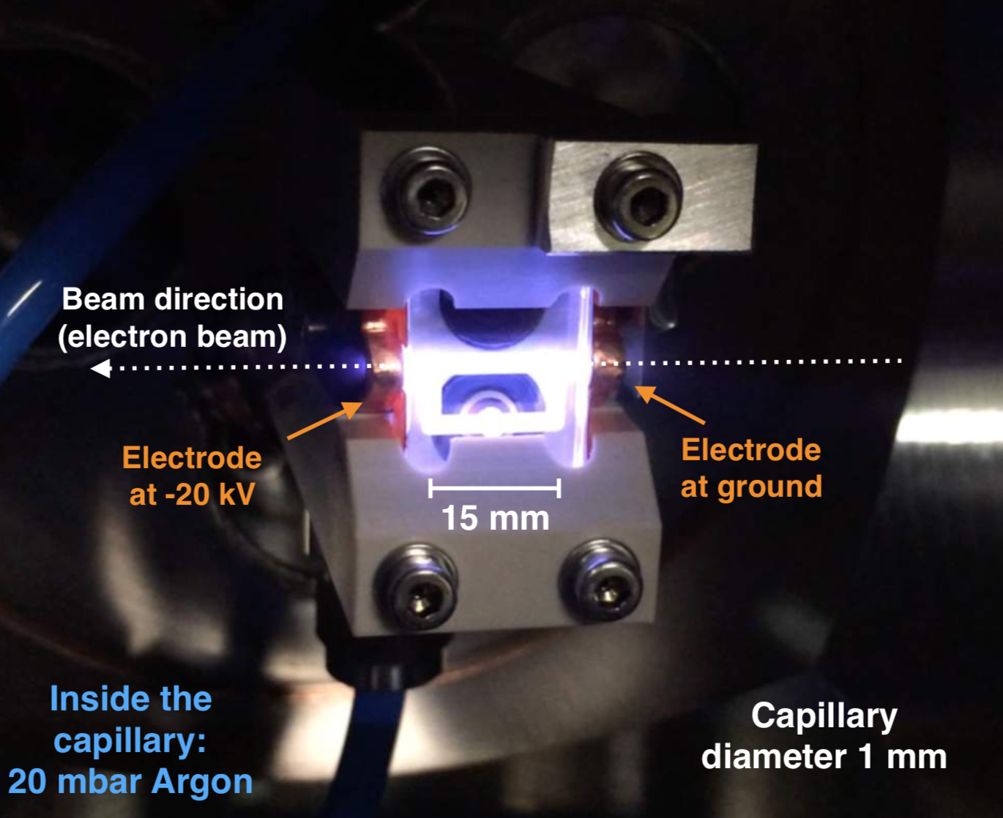
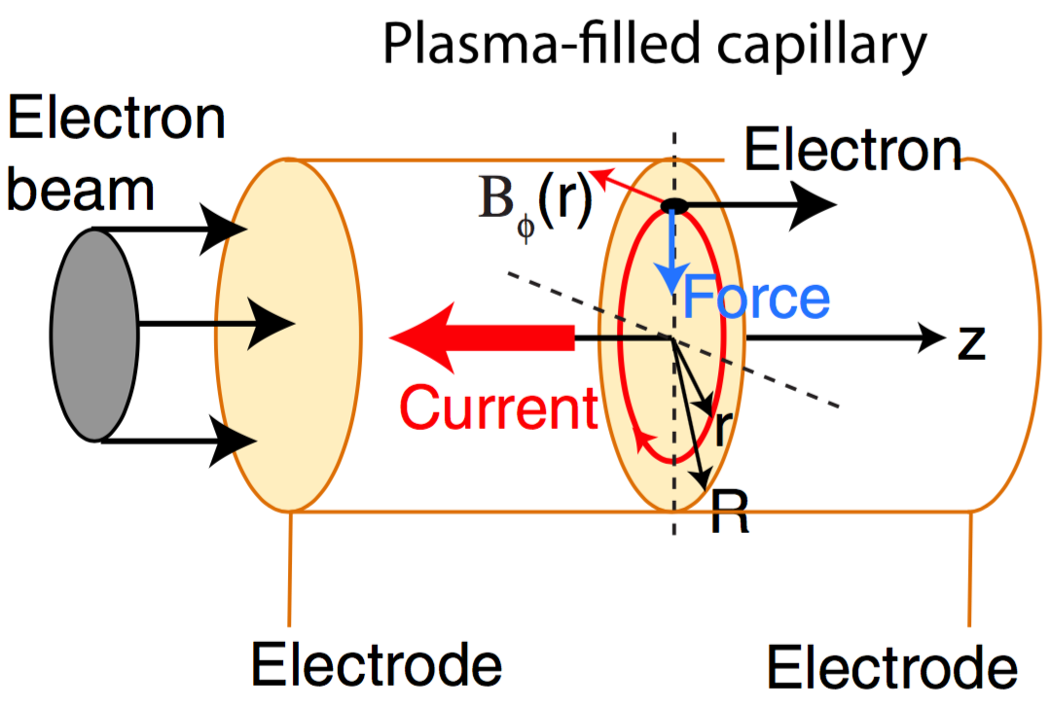
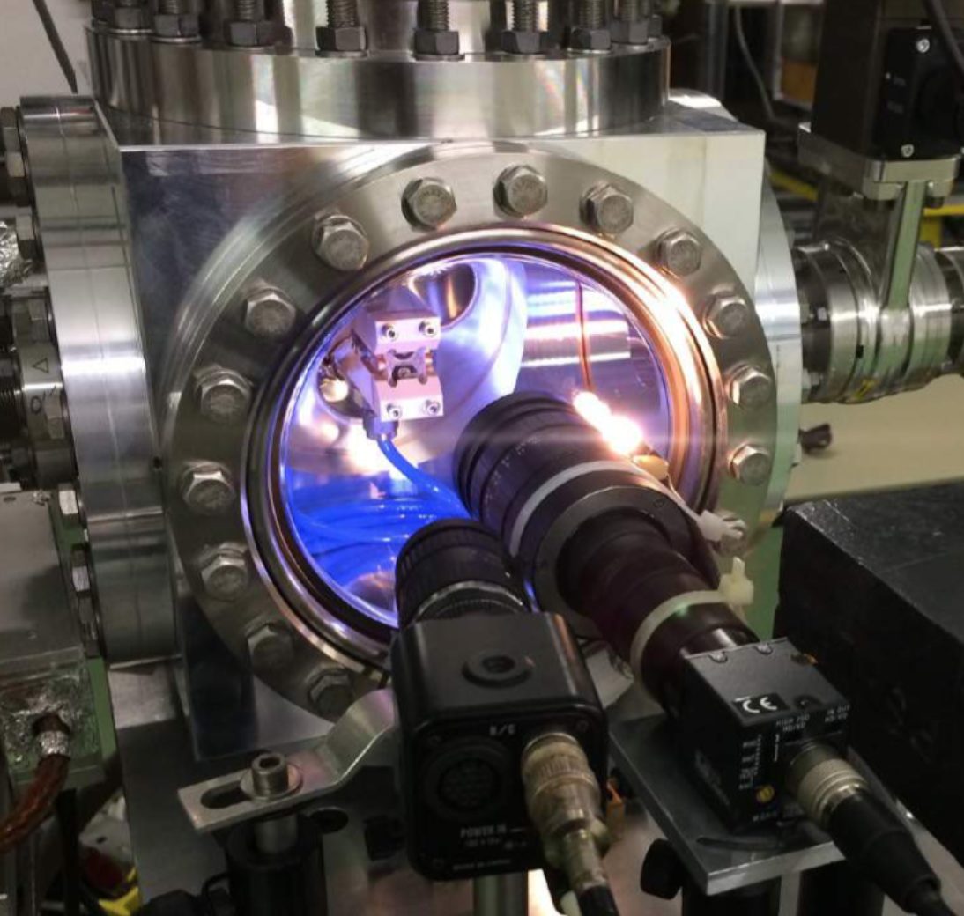
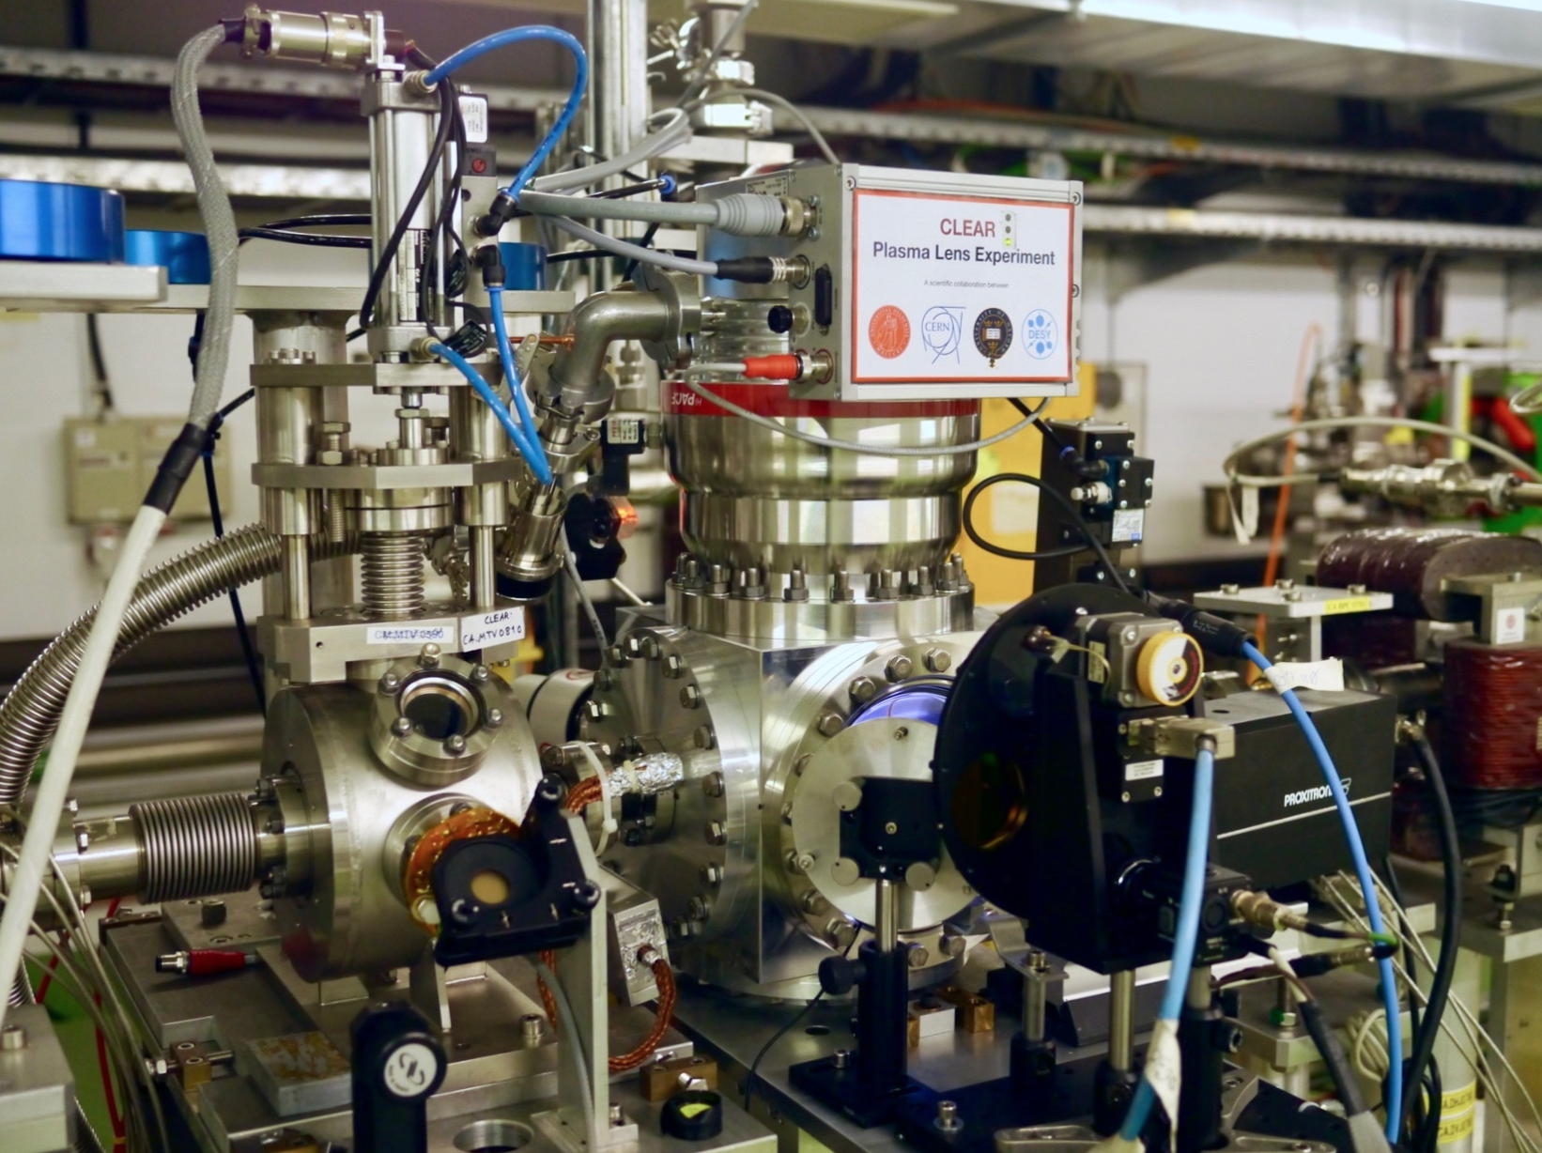
Active plasma lens principle
Figure: J. van Tilborg et al.
Sapphire capillaries
Turbo with 700 l/s
Lens design details:
C. A. Lindstrøm et al. (11 authors), “Overview of the CLEAR plasma lens experiment”, EAAC 2017, Nucl. Instrum. Methods Phys. Res. A 909, 379 (2018)

Slide 4
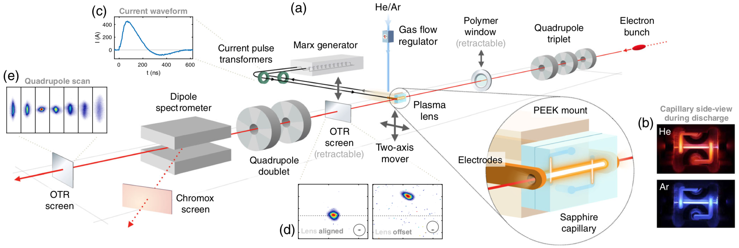
CLEAR: recent user facility at CERN Reuse of the CLIC test facility 200 MeV electron linac S-band linac with photoinjector, norm. emittances down to about 1 um, for 10-100 pC
Experimental setup
Experimental set-up [C. A. Lindstrøm et al., PRL 121, 194801 (2018)]

Slide 5
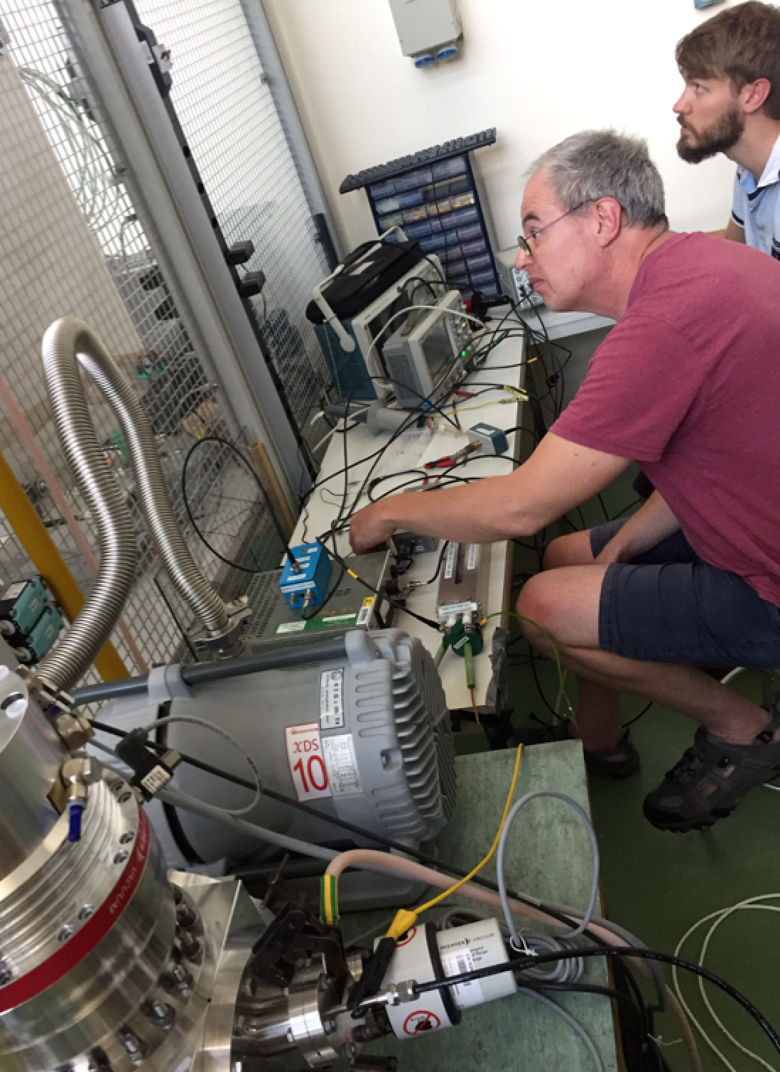
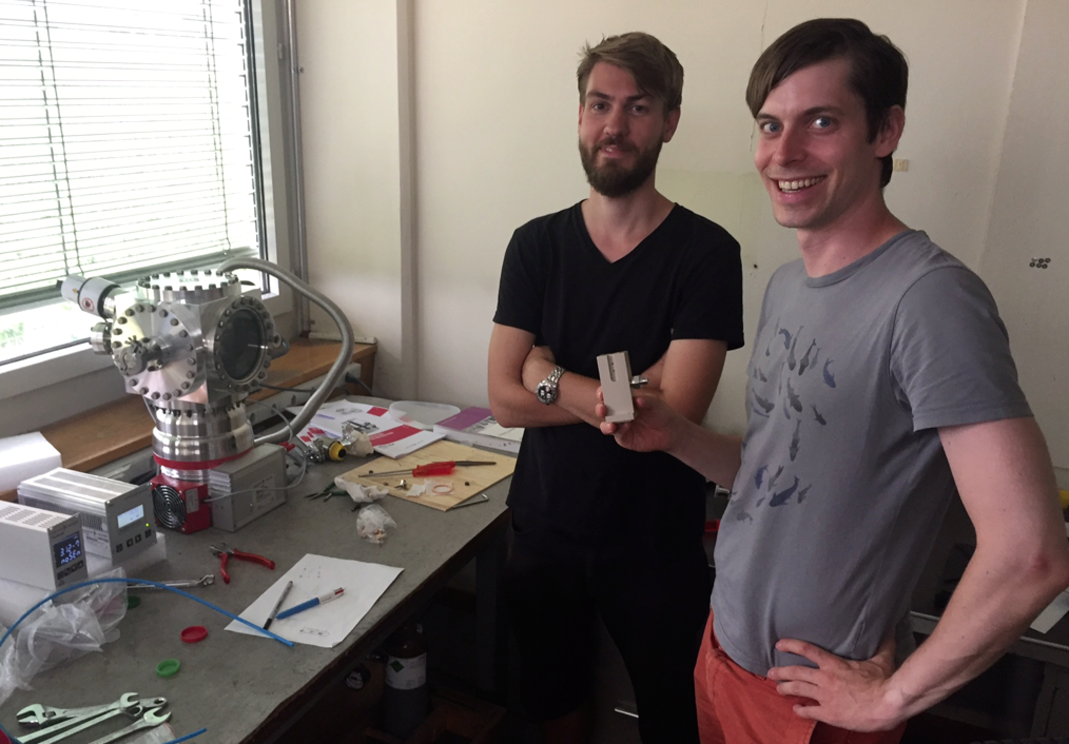
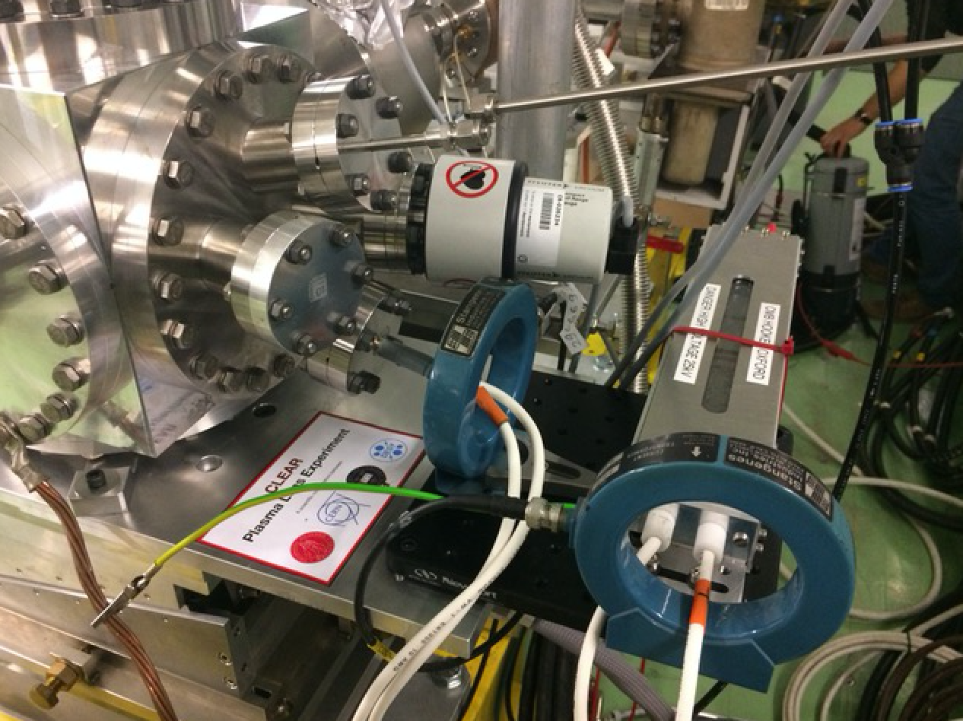
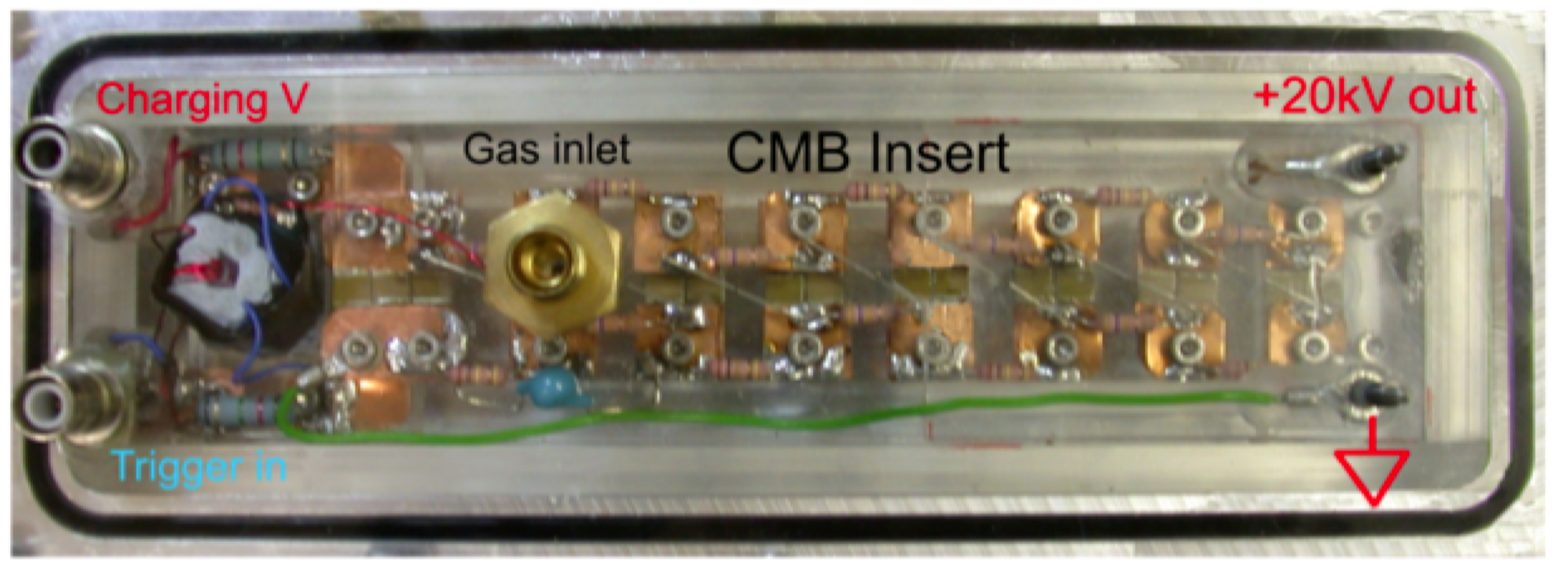
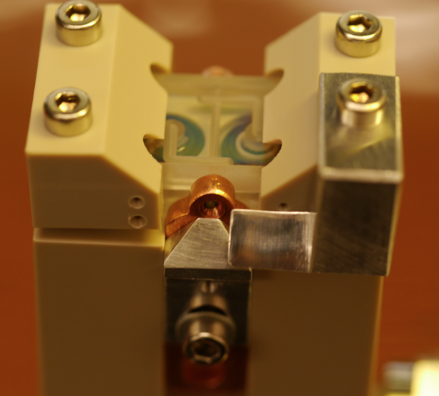
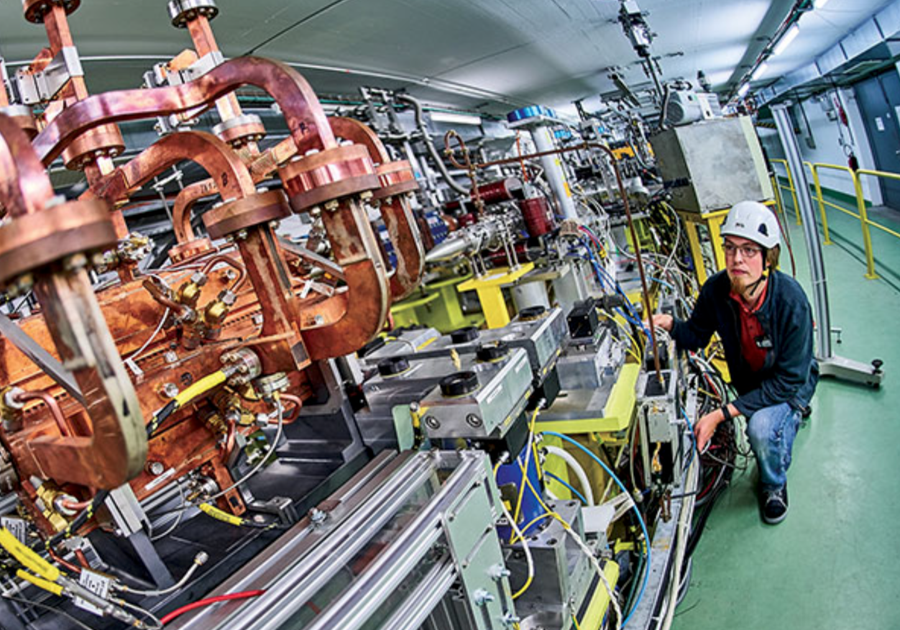
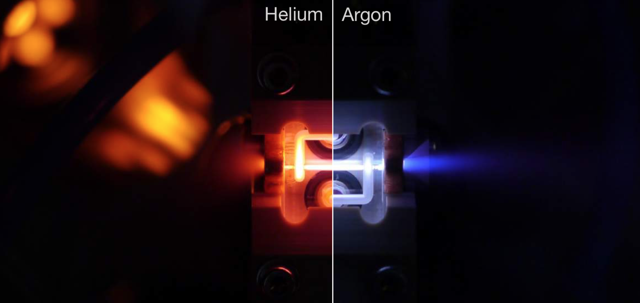
Integration of a plasma devices in an electron beam facility :
Integration of gas lines (He, N, Ne, Ar)
HV (20 kV, 1 kA power supply based on a Compact Marx Bank)
Vacuum (Large Turbo dump directly on top of plasma lens chamger)
Beam windows (3 um Mylar window upstream to protect the linac).
Compact Marx bank outside vacuum, but close to capillary.
Peak plastic holder
Machine tuning: stable, low emittance beams required.

Slide 6
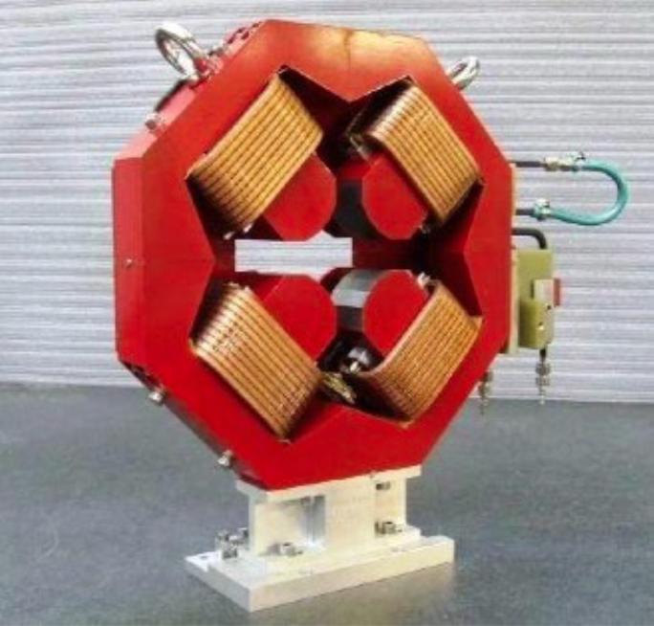
Main question for plasma lenses :
Can plasma lens fields be made stronger, and as linear as quadrupole fields ?
Emittance of Gaussian beams is preserved by periodic focusing in linear fields.
Conventional quadrupoles: field linearity to rel. error of 10⁻⁵
Quadrupole focusing
F_{r}
Permanent magnet quadrupoles:
up to ∼500 T/m
r
Plamsa lenses: field linearity requires uniform current
Our research :
Non-linear aberrations from plasma temperature gradients
Non-linear abberations from plasma wakefield distortion
Maximising field gradient, pinch effect

Slide 7
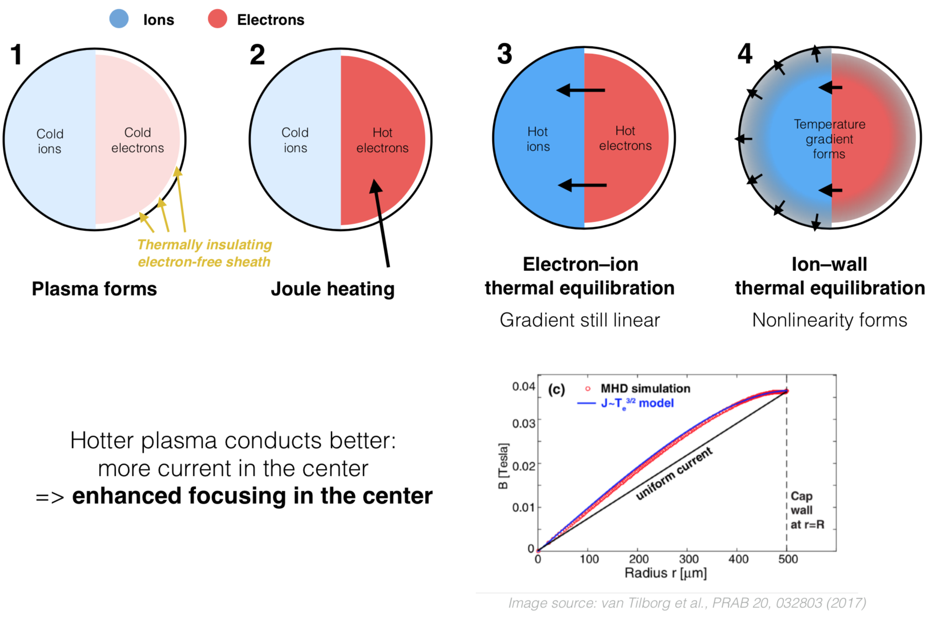
Aberrations from plasma temperature gradients
Earlier experiments at other labs used light gases (H, He) for their plasma lenses, and indeed measured non-linear fields and emittance growth in their lenses.
At CLEAR we serendipitously started experiments with Argon, and could, for the first time, observed strong plasma lensing with emittance preservation!

Slide 8
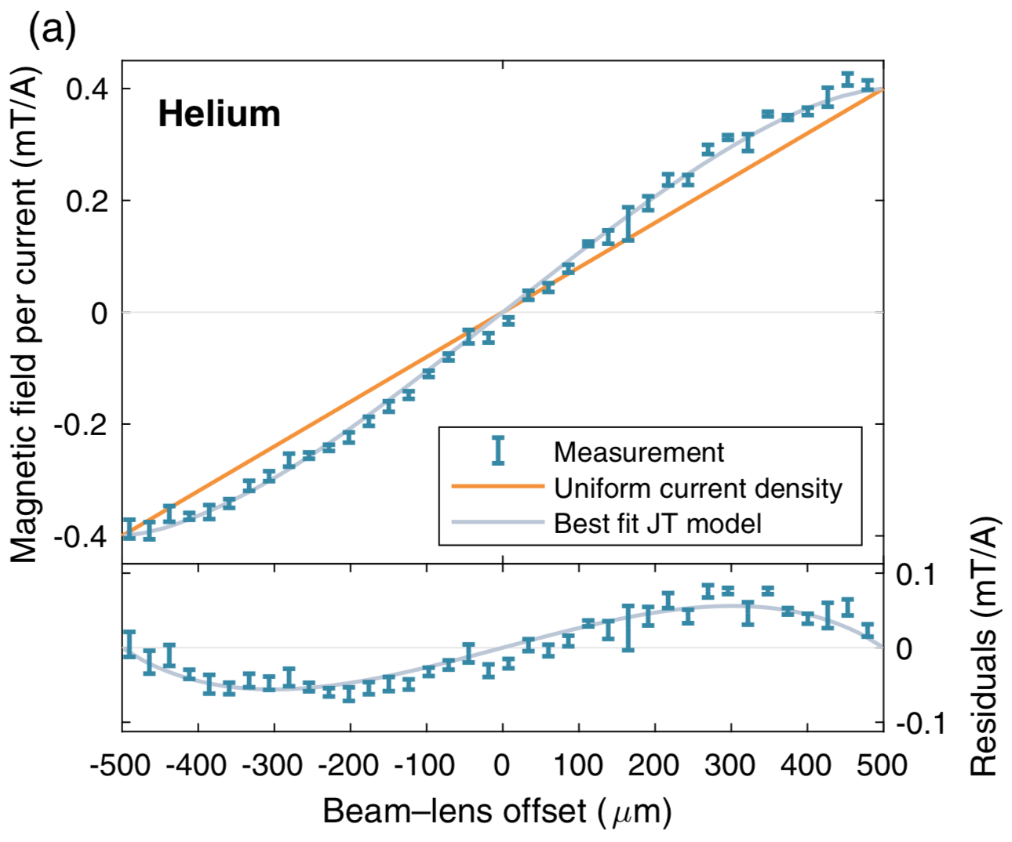
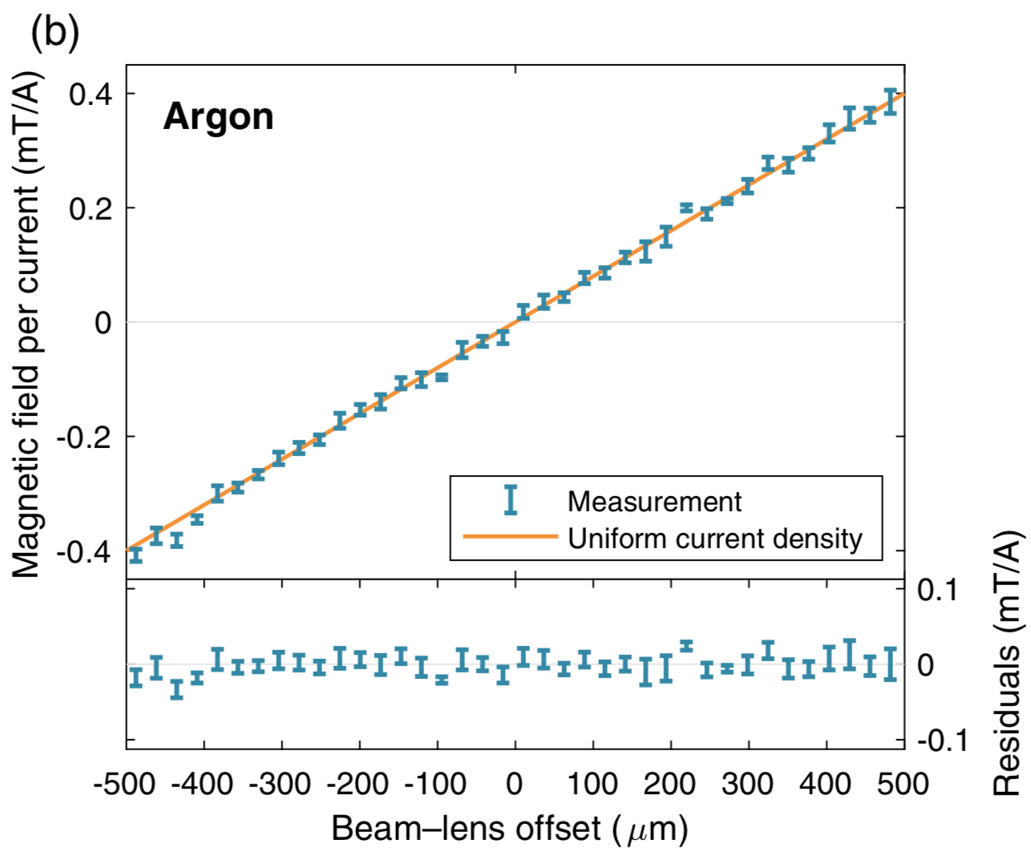
Aberrations from plasma temperature gradients - results
C. A. Lindstrøm et al., PRL 121, 194801 (2018)
23 mbar
6 mbar
JT model: J. van Tilborg et al., Phys. Rev. Accel. Beams 20, 032803 (2017)
Emittance of about 3 um norm preserved while focusing. Bunch charges about 20 pC.
Emittance preservation also discussed in R. Pompili et al., Phys. Rev. Letter 121, 174801 (2018)

Slide 9
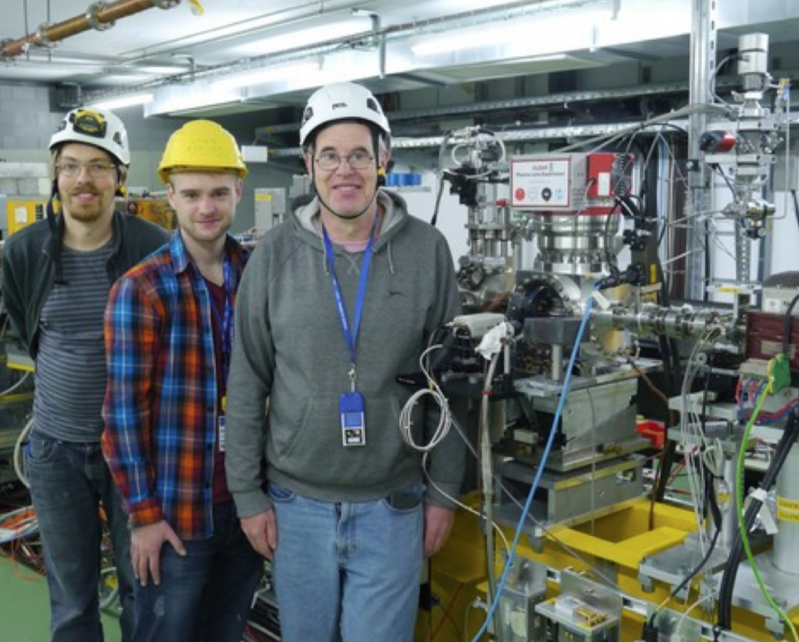
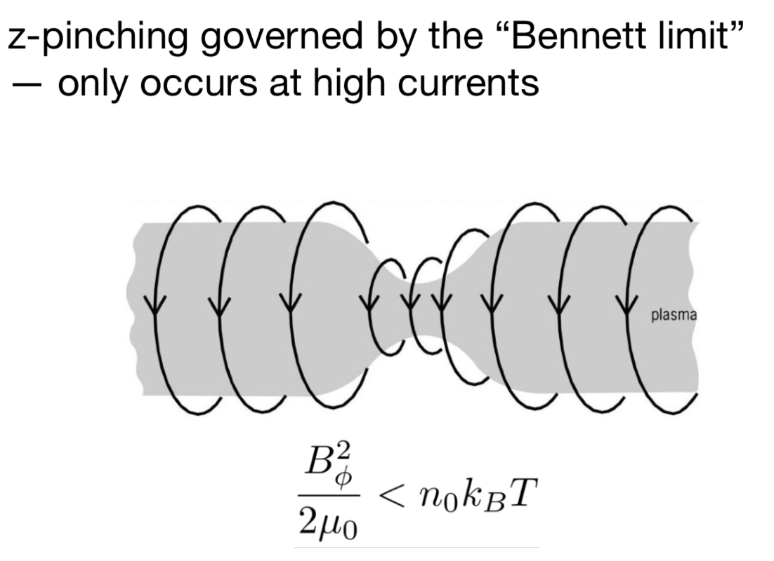
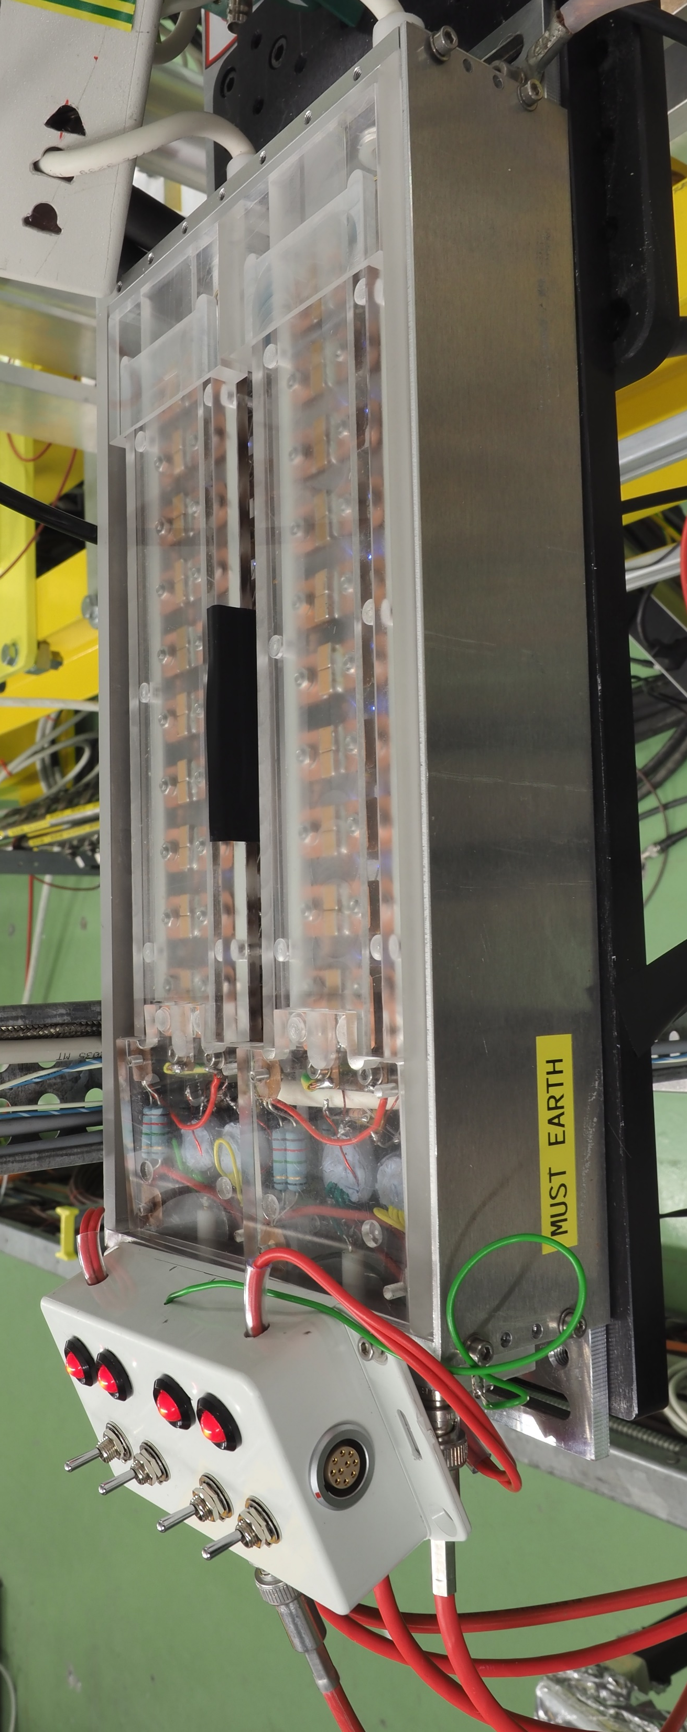
Maximising gradients, pinch effect
Connected three Marx Banks in parallel, reached 1.2 kA !
Marx banks built using surface-mount high-voltage capacitators
Several banks can be connected in parallel for redundancy and control
Produces high currents with an initially high voltage, and low amplitude and timing jitter
Have observed gradients in excess of 2.8 kT/m in Argon and 4.4 kT/m in Helium
No pinch observed so far
WORLD RECORD!

Slide 10
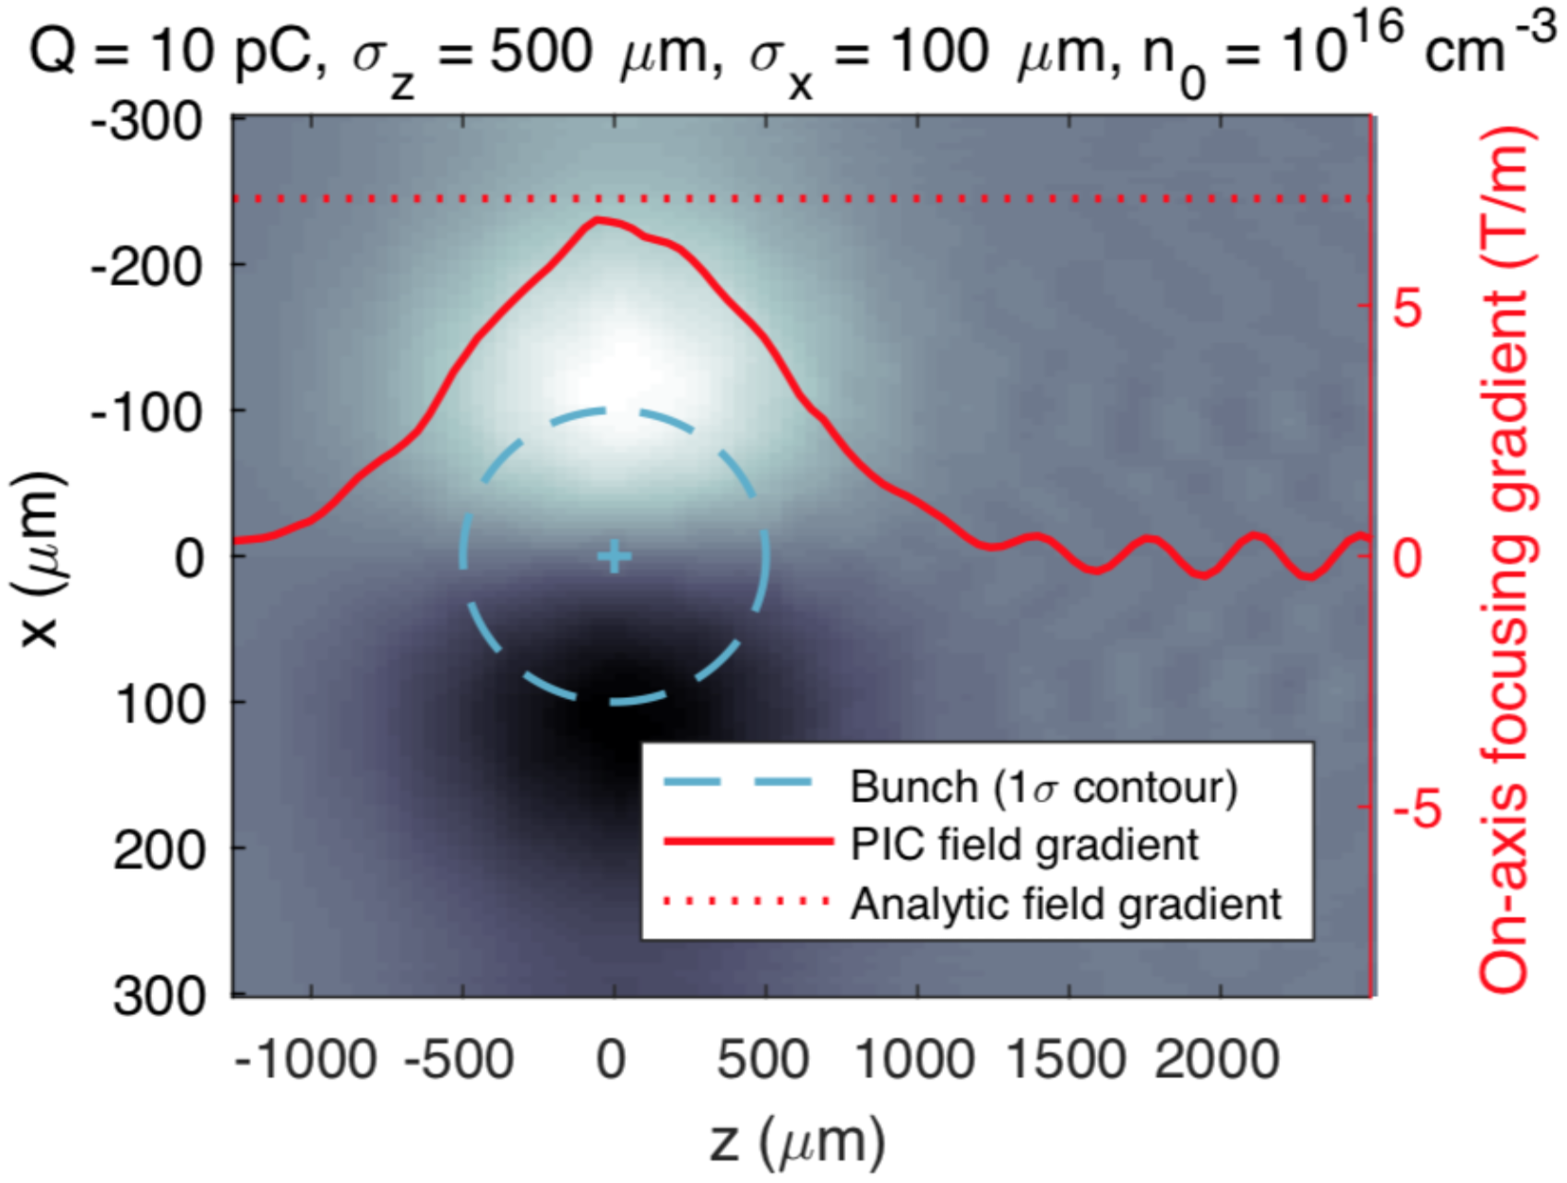
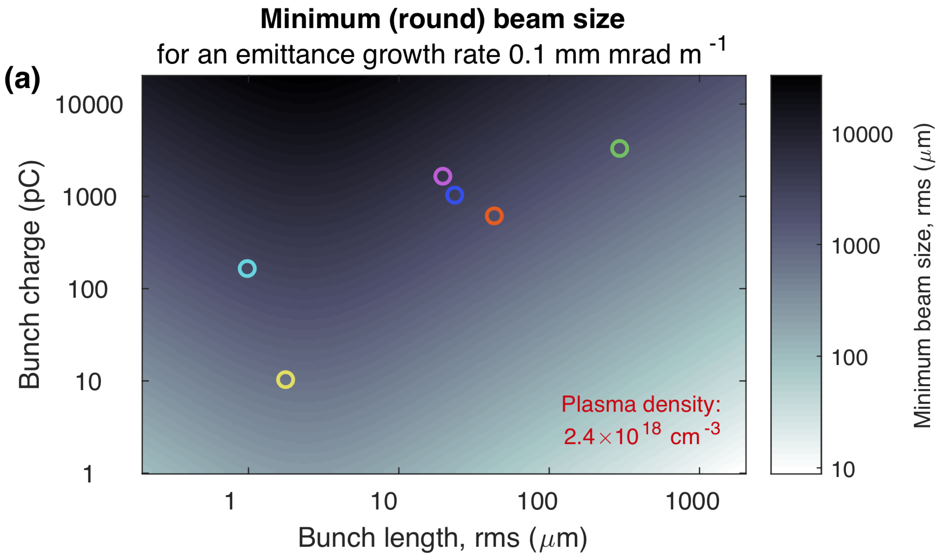
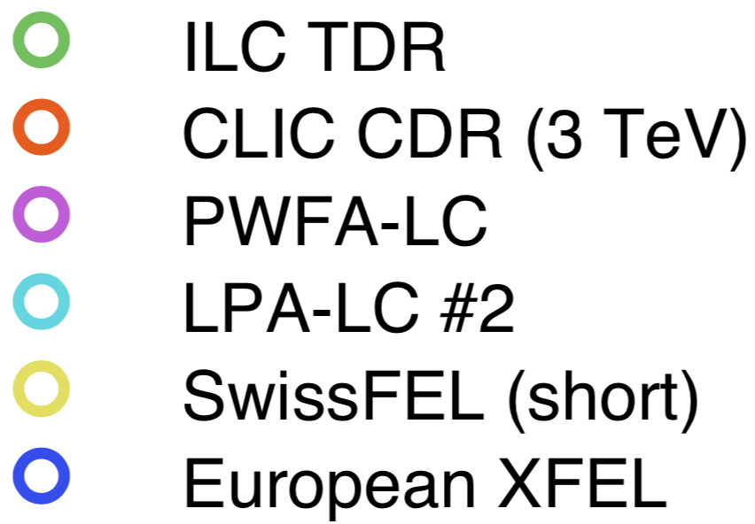
Aberrations from plasma wakefield distortion
Studied theoretically: C. A. Lindstrøm and E. Adli, arXiv:1802.02750, C. A. Lindstrøm, PhD thesis
Example of wakefield
inside a plasma lens
Criterion for negligible wake:
in terms of beam and plasma parameters
Limits on aberrations found analytically, backed up by Particle In Cell simulations :
-> too intense beams will see non-linear fields and emittance growth
-> not straight forward to use plasma lenses in main linacs for colliders

Slide 11
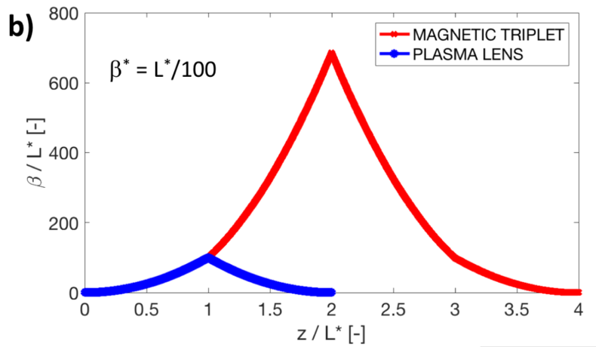
Conclusion and outlook
Successful demonstration of focusing from Active Plasma Lens, with emittance preservation at the 3 um level – among world’s first
Initial demonstration of gradients of 2.8 kT/m in Argon and 4.4 kT/m in Helium – world record
Our improved Marx Bank design simplifies connecting more banks in parallel
Improved redundancy and shot-to-shot stability
Capability to vary current by enabling/disabling capacitor banks
Active plasma lenses are not linear for too intense beams due to additional wakefields effects
Very interesting for other applications requiring fast beam capture

Slide 12
Extra

Slide 13
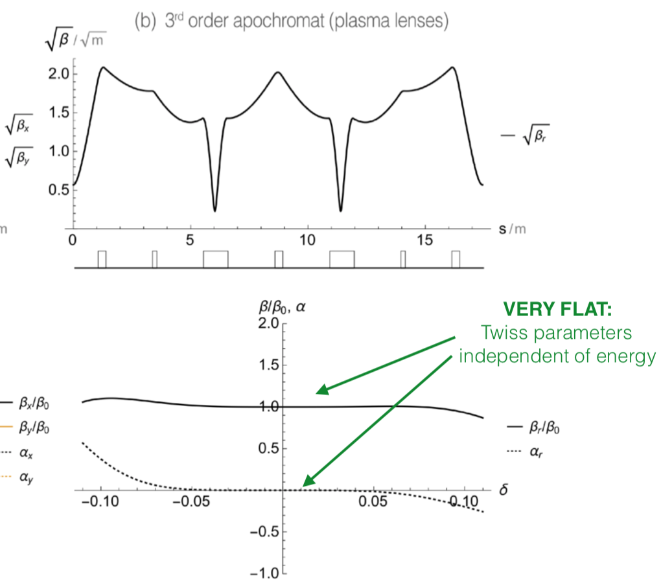
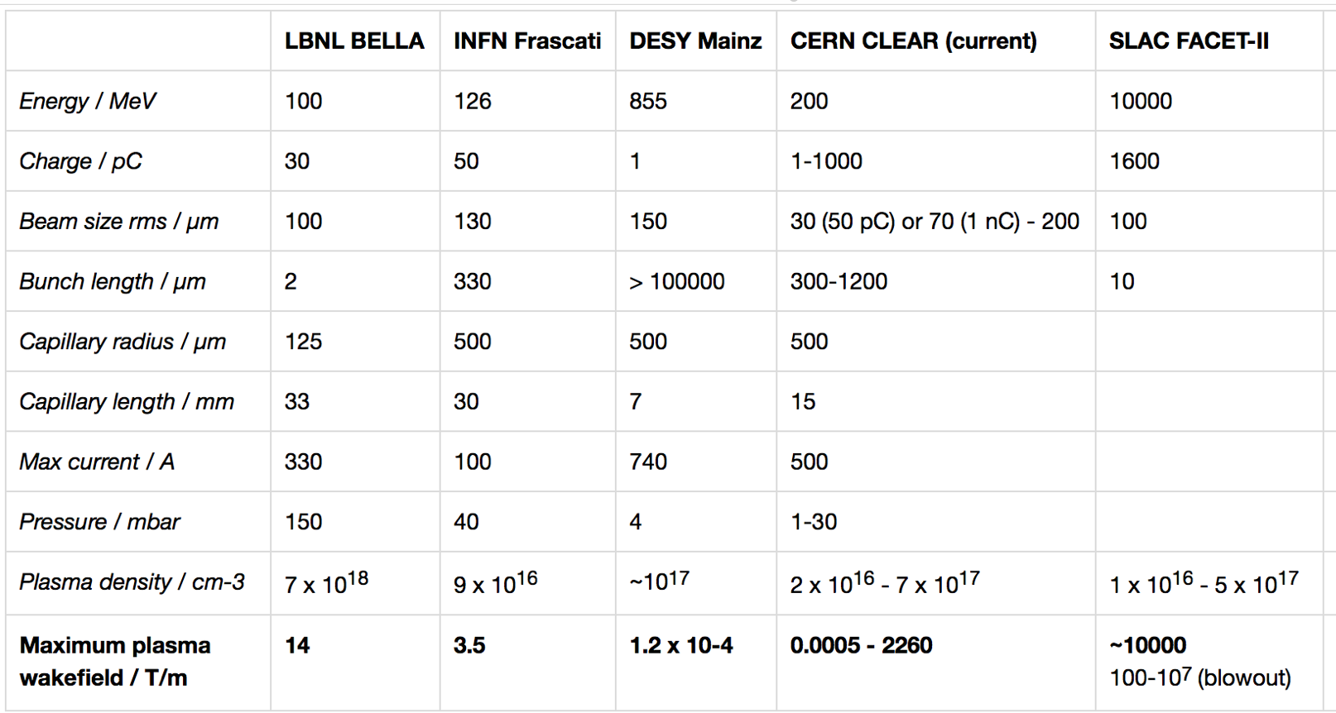
Original motivation for the experiment
Theoretical studies: plasma collider interstage, using plasma lenses
-> looked for opportunities to implement idea of a ”lattice of plasma lenses”
Proposed to do this in CALIFES/CLEAR
CLEAR has unique parameters for
plasma lens lattice expeirments
With a new test-facility CLEAR approved at CERN (start 2017), we joined with partners DESY, Oxford and CERN to design, build and run a prototype active plasma lens.

Slide 14
Capillary limitations
Maximising gradients, pinch effect
Due to very strong heat, capillaries where “melting” when running at very high currents
Observed at CLEAR. Will limit gradients, depending on material
No systematic studies so far (by us)

Slide 15
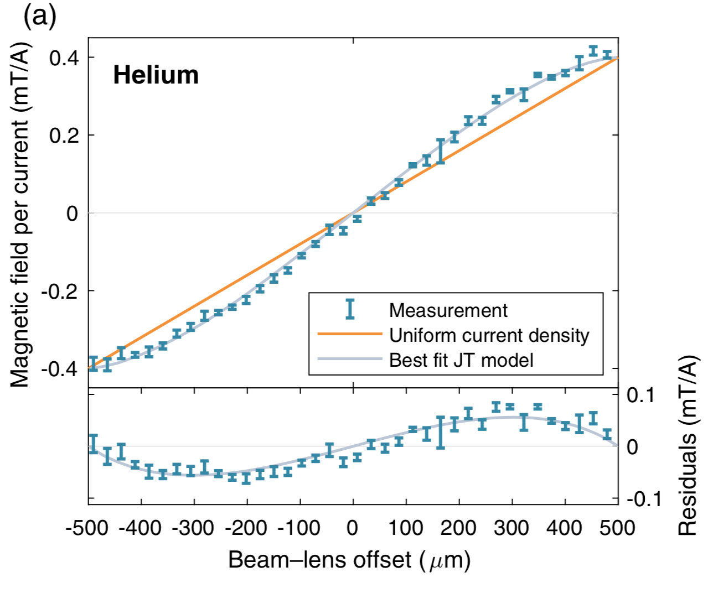
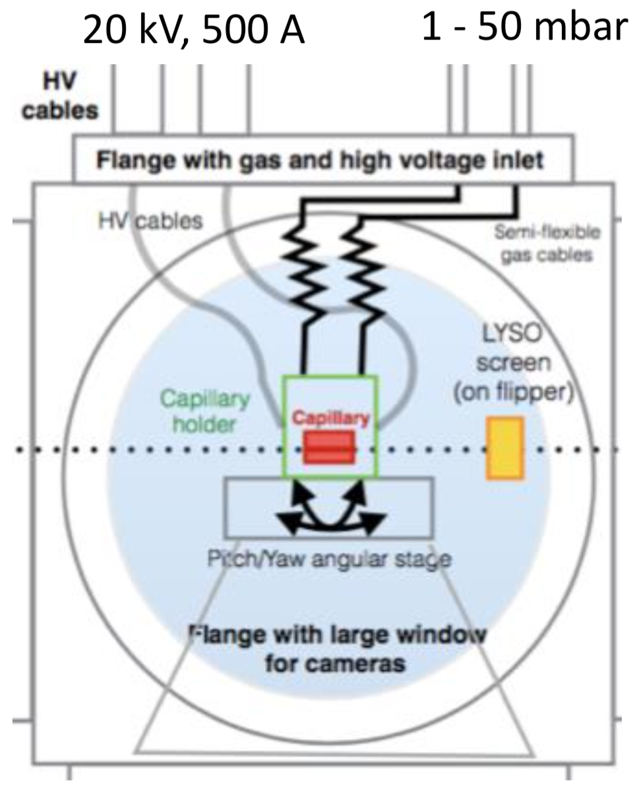
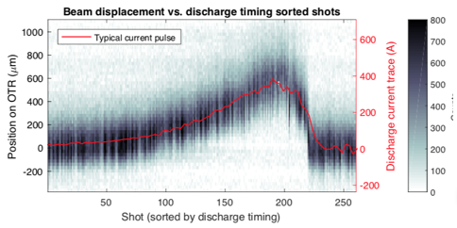
Timeline
PhD
student
arrive
at CERN
(COAS)
Idea for
plasma lens
lattices
published
PL
build
and
HV-tested
in the lab
PL
integrated
in CLEAR
CLEAR
approval
First experimental
results
CALIFES
workshop
Dedicated experimental
weeks
Publication
in
PRL
10/2016
12/2016
3/2018
5-6/2018
data
analysis
7/2016
5/2017
8/2017
10/2017
12/2017
11/2018
Setting up
external coll.
J. Osterhoff (DESY)
S. Hooker (Oxford)
Building
and testing
PL
(at CERN)
Integrating and
debugging
PL
(at CERN)
Learning,
planning,
designing
CLEAR PL
(in Oslo)

Slide 16
Timeline
2017
2018
2019
PhD
student
arrive
at CERN
(COAS)
Idea for
plasma lens
lattices
published
PL
build
and
HV-tested
in the lab
PL
integrated
in CLEAR
CLEAR
approval
First experimental
results
CLEAR
workshop
Dedicated experimental
weeks
Publication
in
PRL
10/2016
12/2016
3/2018
5-6/2018
data
analysis
7/2016
5/2017
8/2017
10/2017
12/2017
11/2018
Setting up
external coll.
J. Osterhoff (DESY)
S. Hooker (Oxford)
Building
and testing
PL
(at CERN)
Integrating and
debugging
PL
(at CERN)
Learning,
planning,
designing
CLEAR PL
(in Oslo)

Slide 17
Other groups doing plasma lenses experiments:
J. van Tilborg et al., Phys. Rev. Lett. 115, 184802 (2015)
S. Steinke et al., Nature 530, 190 (2016)
R. Pompili et al., Appl. Phys. Lett. 110, 104101 (2017)
R. Pompili et al., AIP Advances 8, 015326 (2018)
A. Marocchino et al., Appl. Phys. Lett. 111, 184101 (2017)
J. van Tilborg et al., Phys. Rev. ST Accel. Beams 20, 032803 (2017)
J. H. Roeckeman et al., to be published
R. Pompili et al., Phys. Rev. Letter 121, 174801 (2018)
...
.

Slide 18
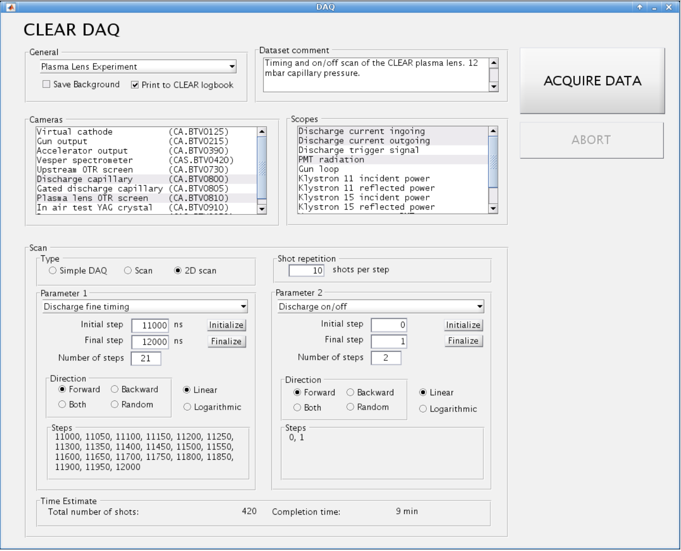
Plasma lens research (as well as wake field monitor work) also led to Oslo contribution to general CLEAR infrastructure:
General Improvement of CLEAR linac (alignment, emittance).
Improved online model.
Systematic data taking-instant analysis approach, based on our experiments from FACET/SLAC), new tools available to all experiments.
Kyrre N. Sjøbæk contributed greatly to improvement of machine and model.

Slide 19
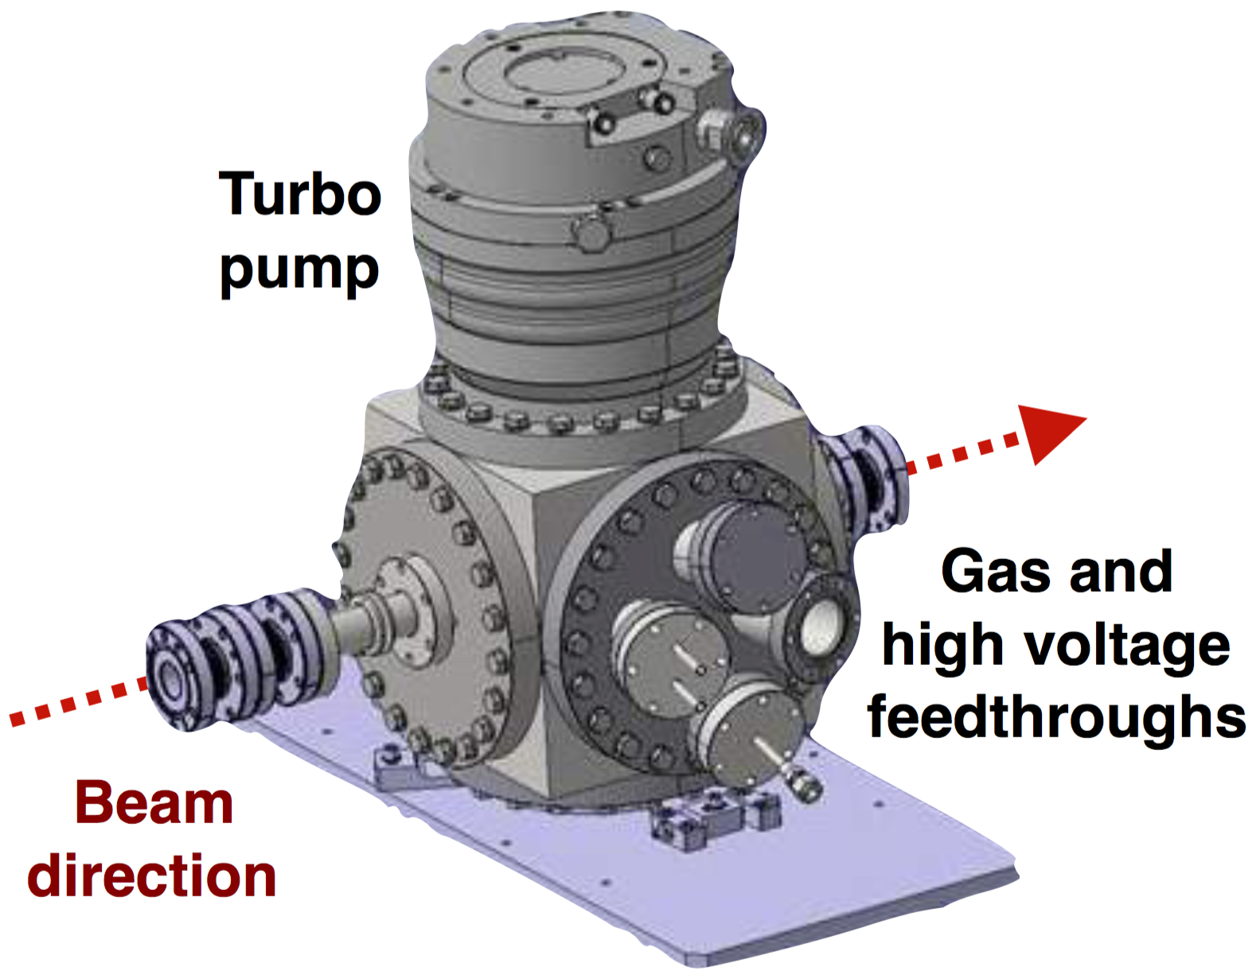
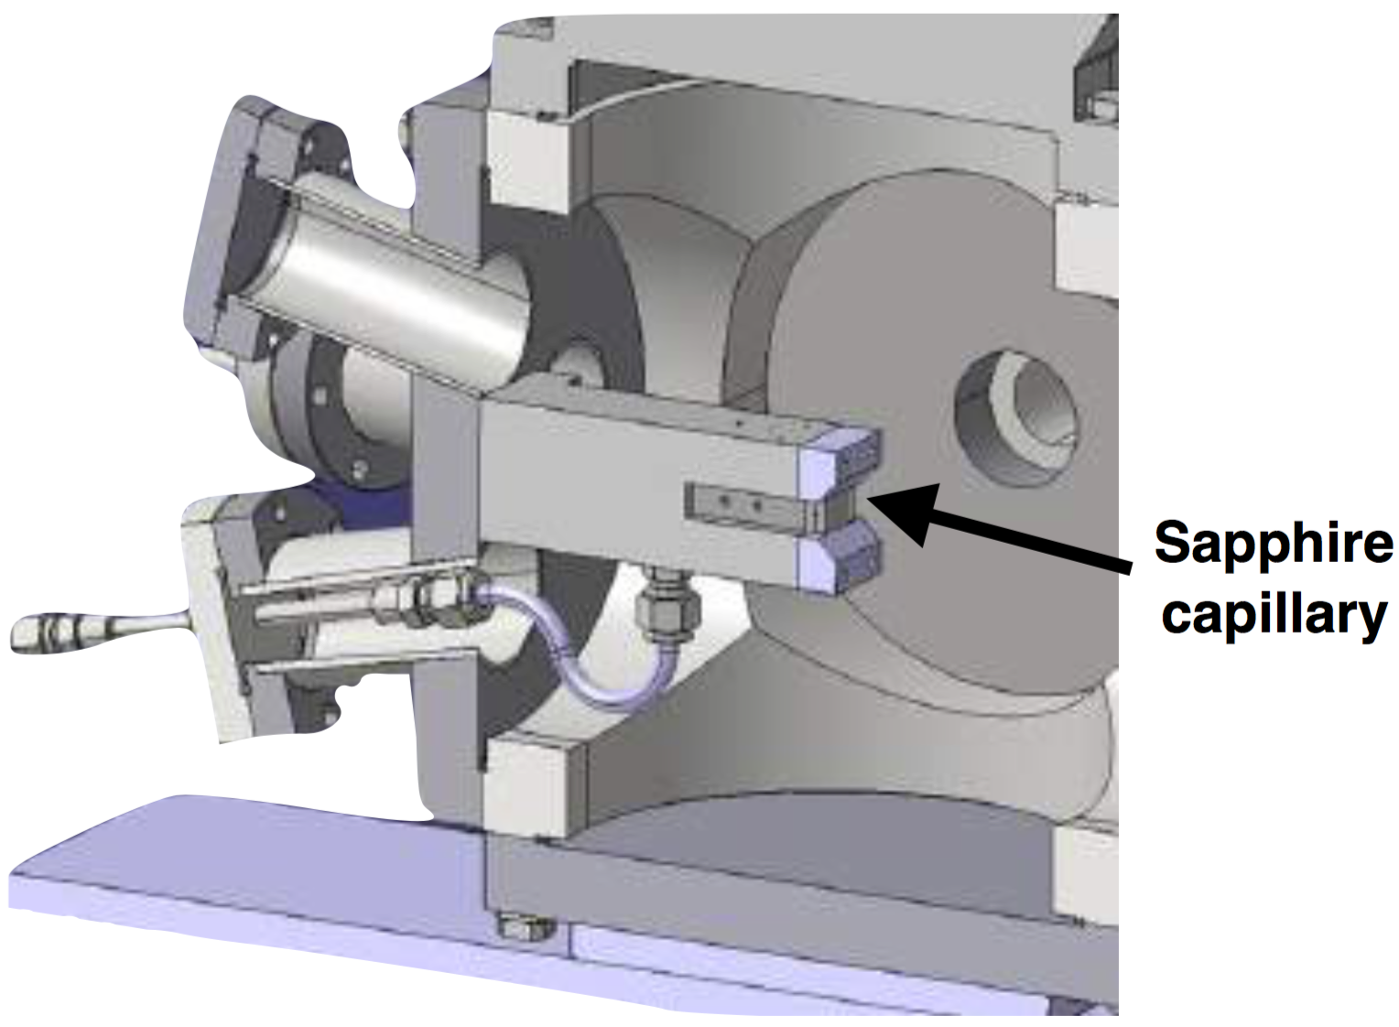
Compact plasma lens
Goal: strong, linear radial focusing from driving current a gas discharge.
Novelty for CTF3:
Gas in beamline
HV in beamline
New materials
Thin-foil vacuum barriers
Overall experiment design, and assembly, integration and test, by Oslo.
Capillary and holder design by DESY, based on experience from DESY and Oxford
Oxford Compact Marx Bank:
Inexpensive and precise source of ~20 kV, ~500 A discharges
A. E. Dyson, C. Thornton, and S. M. Hooker, Rev. Sci. Instrum. 87, 093302 (2016)

