Slide 1
Classical Gravity from Quantum Scattering Amplitudes Lecture I
David A. Kosower Institut de Physique Théorique, CEA–Saclay
Nordic Winter School, Feb 5–10, 2022

Slide 2
Introduction
Six years since “first shaking” at LIGO/VIRGO
LIGO/VIRGO sees incredibly small distortions in the gravitational metric
What can high-energy physics, indeed the deepest of quantum regimes (QCD) teach us about such feeble and deeply classical phenomena?
Many different approaches to theoretical aspects of gravitational waves

Slide 3
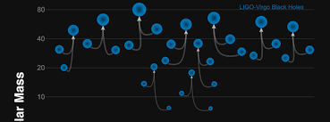
Science Goals
You’ll have heard about the instrument and analyses from Maria Haney
Determine presence and distribution of heavy compact objects
Already discovered unexpected class of black holes, tens of solar masses, indeed binaries of such black holes
More surprises?
Neutron stars
Determine equation of state
Contribution to transferric element production
Measure Hubble constant?
Limits on exotic compact objects
Precision strong-field tests of Einstein gravity
Insight in quantum gravity [in the LISA era]?

Slide 4
Theorists’ Role
One aspect of detection & analysis
High noise level: 400 times larger than signal! Rehman [1711.07421]
To extract the signal, we need theoretical templates
That’s where theorists come into the picture
Also need theoretical calculations to measure parameters of mergers once seen — masses, spins, etc.

Slide 5
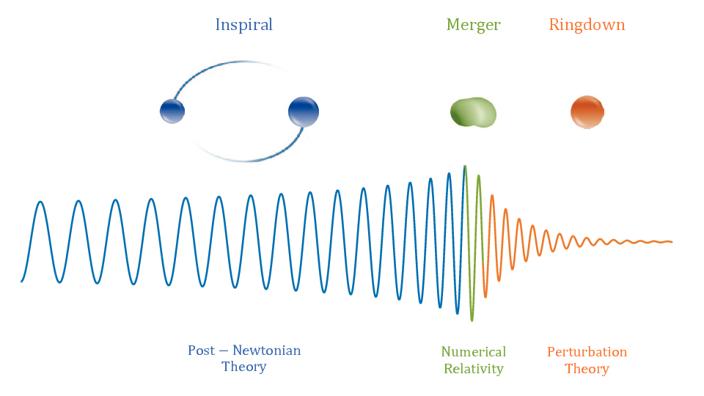
Basic Setup in Mergers
Two slowly inspiralling compact objects
Ringdown
Perturbation theory: normal modes of final black hole
Merger
Strong fields: numerical relativity
Inspiral
Weak-field perturbation theory
Antelis et al

Slide 6
Inspiral phase
Traditional approach, within General Relativity:
Post-Newtonian (PN) expansion: expand in powers of $v$
Field theorists:
Perturbative expansion in powers of Newton’s constant $G$ (or its square root up to factors of $π$, $κ$)

Slide 7
Subjects I won’t cover
Classical GR: you’ll see some aspects in Adam Pound and Alex Nielsen’s lectures
Traditional approach: solve GR equations of motion in classical perturbation theory
Most of what we know, and what LIGO/VIRGO use, comes from decades of hard work in this approach

Slide 8
Subjects I won’t cover
Usually phrased in Hamiltonian form, focusing on the two-body problem,
$$H^{PN}=H_{Newton}+H_{1PN}+H_{2PN}+⋯$$
$$=m_{1}+m_{2}+\frac{p_{1}^{2}}{2m_{1}}+\frac{p_{2}^{2}}{2m_{2}}+V^{PN}(r_{12},p_{1},p_{2})$$
$$V^{P}=−\frac{Gm_{1}m_{2}}{\left|r_{12}\right|}+corrections$$
Still needed at present to interface to analyses
Bound state $↔$ scattering connection

Slide 9
Subjects I won’t cover
Effective Field Theory
In the weak-field regime, well before merger, there are three distinct scales
Size of compact objects $r$
Separation of compact objects $R$
Wavelength of emitted radiation $λ$
Hierarchy: $λ≫R≫r$
Hierarchy of scales can be used to write down an effective field theory Michele Levi’s lectures
Originated with Goldberger and Rothstein
Intellectual debt to Steven Weinberg
Plays a role in some developments connecting scattering amplitudes to gravitational waves

Slide 10
Subjects I won’t cover
Can resum the $v$ dependence to organize the potential in a standard perturbative expansion
$$V\left(p,r\right)=\sum_{n=1}^{∞}{{\left(\frac{G}{\left|r_{12}\right|}\right)}^{n}C_{n}(p^{2})}$$
Use $V$ to compute a scattering amplitude in terms of unknown coefficients $C_{n}$
Match to a scattering amplitude for gravity computed using amplitude techniques and isolating classical terms in order to fix the coefficients
Then use the potential in bound-state calculations

Slide 11
Subjects I won’t cover
This is the approach used by Bern, Cheung, Roiban, Shen, Solon, & Zeng in their breakthrough $𝒪(G^{3})$ computation that went beyond what was known from GR
This approach has some overlap with the rest of my lectures — in the scattering amplitudes and analysis of integrals
World-line integrals, related to EFT
Eikonal approach
Study of amplitude internals

Slide 12
Observables-Based Approach
with O’Connell, Maybee, Gonzo, Cristofoli
Why would we want to use quantum scattering amplitudes at all?
Philosophy:
Calculate only what’s needed for physical observables
No need for auxiliary Hamiltonians or potentials
Manifestly gauge invariant
Pretty thin motivation, unlike in scattering applications when contrasted with Feynman diagrams

Slide 13
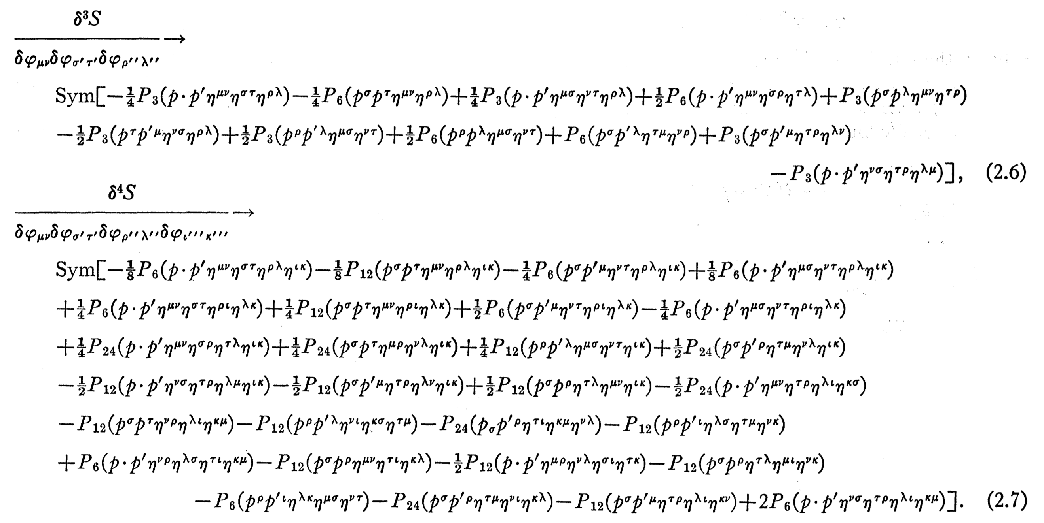
Why Amplitudes?
Real promise is the double copy — simplify the calculation of gravitational amplitudes
Feynman rules for GR: three-point vertex has ~100 terms; & we have infinite number of vertices of increasing complexity
DeWitt

Slide 14
Why Amplitudes?
In Yang–Mills theory, only three- and four-point Feynman vertices; three-point vertex has only 3 terms
Vastly greater complexity in GR
Double copy
Gravitational Amplitude ~ (Yang–Mills Amplitude)²
More in Henrik Johansson’s lecture

Slide 15
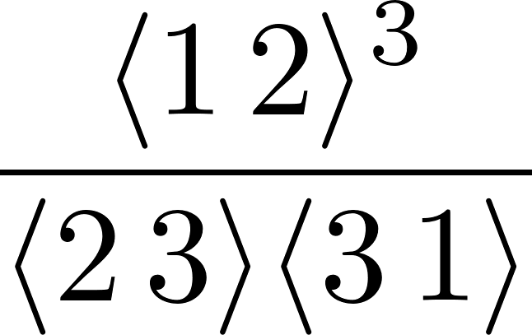
Double Copy
Yang–Mills three-point amplitude
Gravity three-point amplitude
Field-theory equivalent of Kawai–Lewellen–Tye expression for closed-string amplitudes in terms of open-string ones

Slide 16
Double Copy
More generally, at tree level: a discrete convolution
Example: $M_{4}\left(− − ++\right)=s_{14} A_{4}\left(1^{−}2^{−}3^{+}4^{+}\right) A_{4}(1^{−}3^{+}2^{−}4^{+})$
Generalization to higher multiplicity is known and proven
Yang–Mills quantum scattering amplitudes + double copy ⇒ simpler way to compute gravity amplitudes and any quantities dependent on them

Slide 17
Observables-Based Formalism
Pick well-defined observables in the quantum theory
that are also relevant classically
Express them in terms of scattering amplitudes in the quantum theory
Understand how to take the classical limit efficiently

Slide 18
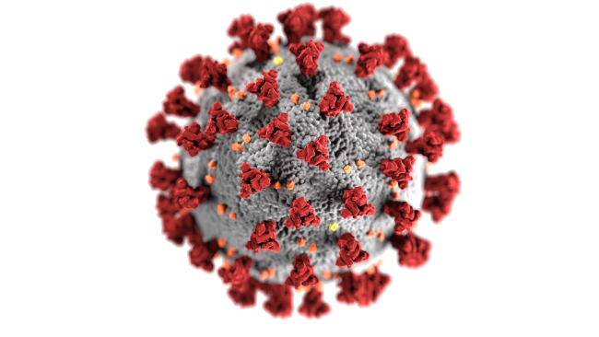
Set-up
Scatter two massive particles
Look at observables:
Change in momentum (‘impulse’) of one of them
Radiated waveform
We all love scattering amplitudes
But they aren’t the final goal or physically meaningful on their own
impact parameter b
distinguishable particles

Slide 19
Classical Limit, part 1
Classical limit requires $ℏ→0$: restore $ℏ$
We’re still relativistic field theorists: keep $c=1$
Dimensional analysis
$\left[M\right]≠{\left[L\right]}^{−1}$
$[|p⟩]={[M]}^{−1}$
[Ampl_{n}]$={\left[M\right]}^{4−n}$
$ℏ$ in couplings:
$e→e/\sqrt{ℏ}$ photon
$κ→κ/\sqrt{ℏ}$ graviton
$g→g/\sqrt{ℏ}$ either/generic

Slide 20
Classical Limit, part 1
Distinguish wavenumber from momentum: $\overline{p}=p/ℏ$
n-point tree amplitude in QED scales as
$$e^{n−2}$$
n-point, L-loop amplitude in QED scales as
$$e^{n−2}e^{2L}$$

Slide 21
Classical Limit, part 1
In terms of $ℏ$, an n-point L-loop amplitude scales as
$$ℏ^{1−\frac{n}{2}−L}$$
Seemingly singular behavior!
This isn’t the whole story though

Slide 22
Initial State
In collider applications, we use plane-wave states
Here, we want localized states
Build them out of plane-wave states
$$δ^{(+)}\left(p^{2}−m^{2}\right)=Θ\left(p^{0}\right) δ(p^{2}−m^{2})$$
Clean up $π$s: ${\hat{d}}^{4}p≡\frac{d^{4}p}{{\left(2π\right)}^{4}}$
$\hat{δ}(x)≡2π δ(x)$
Abbreviate $dΦ\left(p\right)≡{\hat{d}}^{4}p {\hat{δ}}^{\left(+\right)}(p^{2}−m^{2})$

Slide 23
Initial State
One-particle initial state is then
$$\int{dΦ\left(p\right)}φ\left(p\right) {\left|p\right\rangle }_{in}$$
Dimensions:
$\left[dΦ\left(p\right)\right]={\left[M\right]}^{2}$; for $[|ψ_{1}⟩]={[M]}^{0}$, we need $\left[φ\right]={\left[M\right]}^{−1}$
Two-particle initial state:
$${\left|ψ\right\rangle }_{in}=\int{dΦ\left(p_{1}\right)dΦ\left(p_{2}\right)}φ_{1}\left(p_{1}\right)φ_{2}\left(p_{2}\right) {e^{ib⋅p_{1}/ℏ} \left|p_{1}p_{2}\right\rangle }_{in}$$
Normalize state so that ${}_{in}^{}{⟨ψ}{|ψ⟩}_{in}=1$, requires
$∫dΦ\left(p\right){\left|φ\left(p\right)\right|}^{2}=1$

Slide 24
Observables
Now we can start to build observables
Final momentum of (say) particle 1
$$\left\langle p_{1,out}^{μ}\right\rangle ={}_{out}^{}{⟨ψ|}ℙ_{1}^{μ}{|ψ⟩}_{out}$$
Write the final state in terms of the S matrix, thinking of it as the evolution operator from the far past to the far future
$${\left|ψ\right\rangle }_{out}=S{\left|ψ\right\rangle }_{in}$$
Then
$$\left\langle p_{1,out}^{μ}\right\rangle ={}_{in}^{}{⟨ψ|S^{†}}ℙ_{1}^{μ}S{|ψ⟩}_{in}$$

Slide 25
Momentum Observable
We can insert a complete set of states to rewrite
Evaluation in terms of scattering amplitudes

Slide 26
Impulse Observable
This isn’t exactly what we set out to compute
We want the (integrated) change in $p_{1}$
$$\left\langle Δp_{1}^{μ}\right\rangle =\left\langle p_{1,out}^{μ}\right\rangle −\left\langle p_{1,in}^{μ}\right\rangle$$
$$=\left\langle {ψ|S}^{†}ℙ_{1}^{μ}S | ψ\right\rangle −\left\langle ψ|ℙ_{1}^{μ} | ψ\right\rangle$$
Write out $S=1+i T$
$$\left\langle Δp_{1}^{μ}\right\rangle =\left\langle ψ\left|\left(−i T^{†}\right)ℙ_{1}^{μ}+ℙ_{1}^{μ}\left(i T\right)\right|ψ\right\rangle +⟨ψ\left|T^{†}ℙ_{1}^{μ}T\right|ψ⟩$$
$$=i\left\langle ψ\left|\left[ℙ_{1}^{μ}, T\right]\right|ψ\right\rangle +\left\langle ψ\left|T^{†}\left[ℙ_{1}^{μ}, T\right]\right|ψ\right\rangle$$
$−i\left\langle ψ | (T^{†}−T\right)ℙ_{1}^{μ}\left|ψ\right\rangle +⟨ψ\left|T^{†}Tℙ_{1}^{μ}\right|ψ⟩$
Next use unitarity $S^{†}S=1=1−i\left(T^{†}−T\right)+T^{†}T$

Slide 27
Impulse Observable
Using unitarity, the last two terms cancel and we’re left with
$$\left\langle Δp_{1}^{μ}\right\rangle =i\left\langle ψ\left|\left[ℙ_{1}^{μ}, T\right]\right|ψ\right\rangle +\left\langle ψ\left|T^{†}\left[ℙ_{1}^{μ}, T\right]\right|ψ\right\rangle$$
$$= I_{(1)}^{μ} + I_{(2)}^{μ}$$
$$𝒪\left(g^{2}\right) + 𝒪(g^{4})$$
We may label these terms “conservative” and “radiative”, but not in the same sense as the potential separation (which is arbitrary)
Also may label them “virtual” and “cut”
Expression is valid to all orders in perturbation theory

Slide 28
Impulse Observable, First Term
Let’s play around with this expression, starting with the first term
Note that both $|ψ⟩$s appearing are the initial state; this is an in–in formalism, not the usual in–out one
Put in our earlier expression for the initial state

Slide 29
Impulse Observable, First Term
Linear in an amplitude
Amplitude links different copies of the initial state
$$\left\langle p_{1}^{′}p_{2}^{′}\left|T\right|p_{1}p_{2}\right\rangle =A\left(p_{1}p_{2}→p_{1}^{′}p_{2}^{′}\right) {\hat{δ}}^{(4)}(p_{1}^{′}+p_{2}^{′}−p_{1}−p_{2})$$

Slide 30
Impulse Observable, First Term
Let’s change variables $q_{i}=p_{i}^{′}−p_{i}$ and integrate over $q_{2}$, drop index on $q_{1}$
$q$ looks like a momentum transfer from the point of view of the amplitude
It isn’t; we should think of it as a momentum mismatch between two copies of the initial state

Slide 31
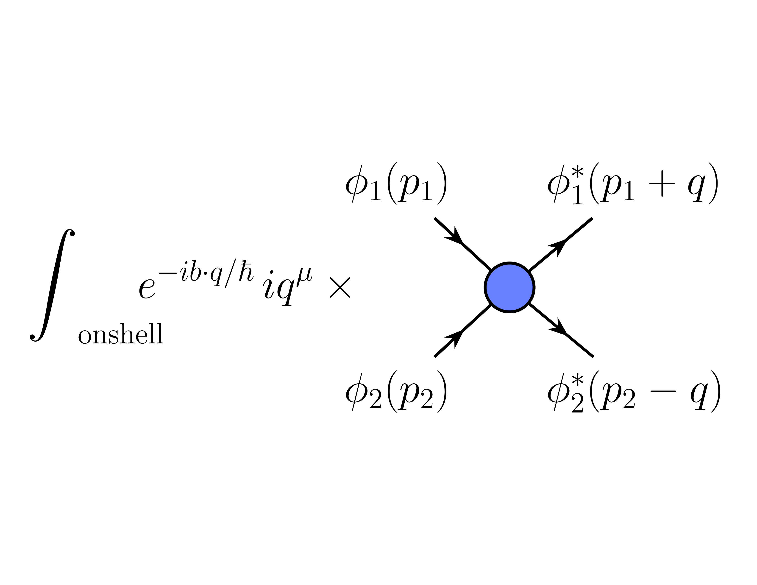
Impulse Observable, First Term
We can write this diagrammatically
There can be additional messengers, showing up as virtual particles inside the amplitude
This expression is exact
Lowest-order contribution is $𝒪(g^{2})$, has tree-level amplitude

Slide 32
Impulse Observable, Second Term
Let’s continue with the second term
Introduce a complete set of intermediate states $|r_{1}r_{2}X⟩$
$$I_{\left(2\right)}^{μ}=\left\langle ψ\left|T^{†}\left[ℙ_{1}^{μ},T\right]\right|ψ\right\rangle$$
$$=\sum_{X}{\int{dΦ\left(r_{1}\right)dΦ\left(r_{2}\right) \left\langle ψ\left|T^{†}\right|r_{1}r_{2}X\right\rangle \left\langle r_{1}r_{2}X\left|\left[ℙ_{1}^{μ},T\right]\right|ψ\right\rangle }}$$

Slide 33
Impulse Observable, Second Term
Write out $|ψ⟩$ again
$r_{X}$ is total momentum in $X$
Lowest-order contribution: $X=∅$
Cut of one-loop amplitude, i.e. four-point tree squared $𝒪\left(g^{4}\right)$

Slide 34
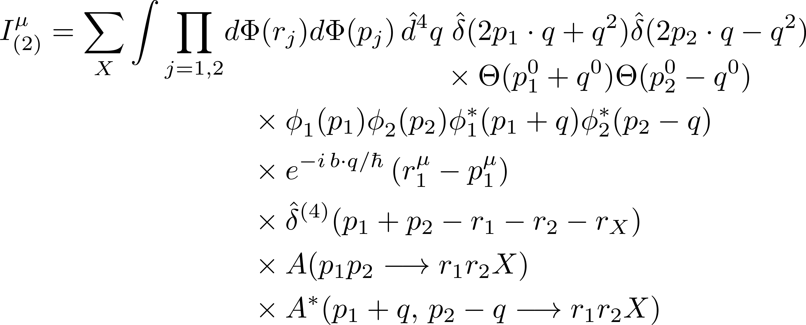
Impulse Observable, Second Term
Again change variables $q_{i}=p_{i}^{′}−p_{i}$, integrate over $q_{2}$, drop index on $q_{1}$

Slide 35
Impulse Observable, Second Term
$q$ is again a momentum mismatch

Slide 36
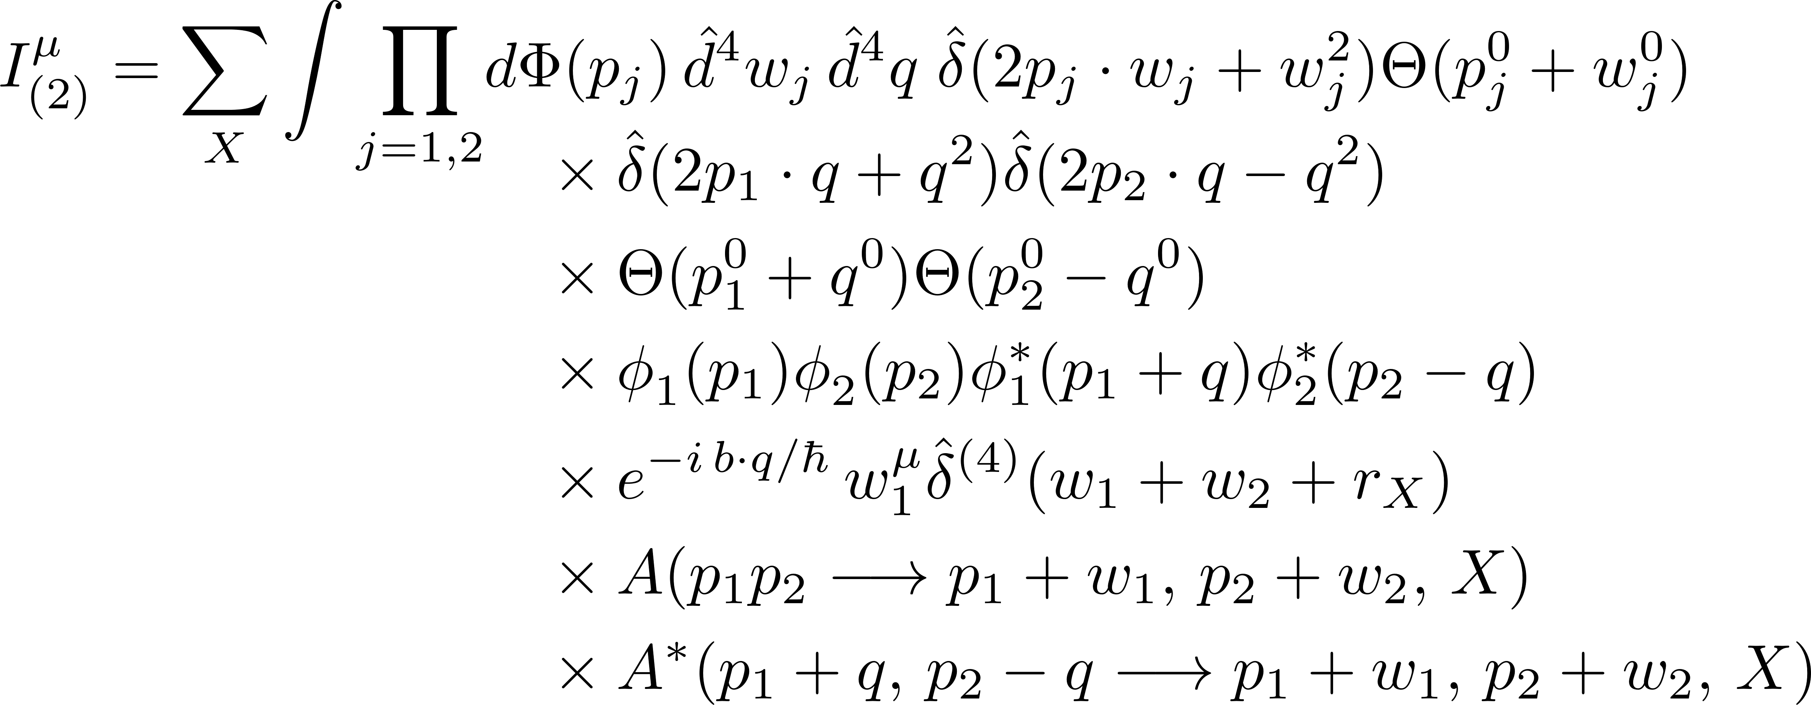
Impulse Observable, Second Term
Re-express in terms of momentum transfers $w_{i}=r_{i}−p_{i}$

Slide 37
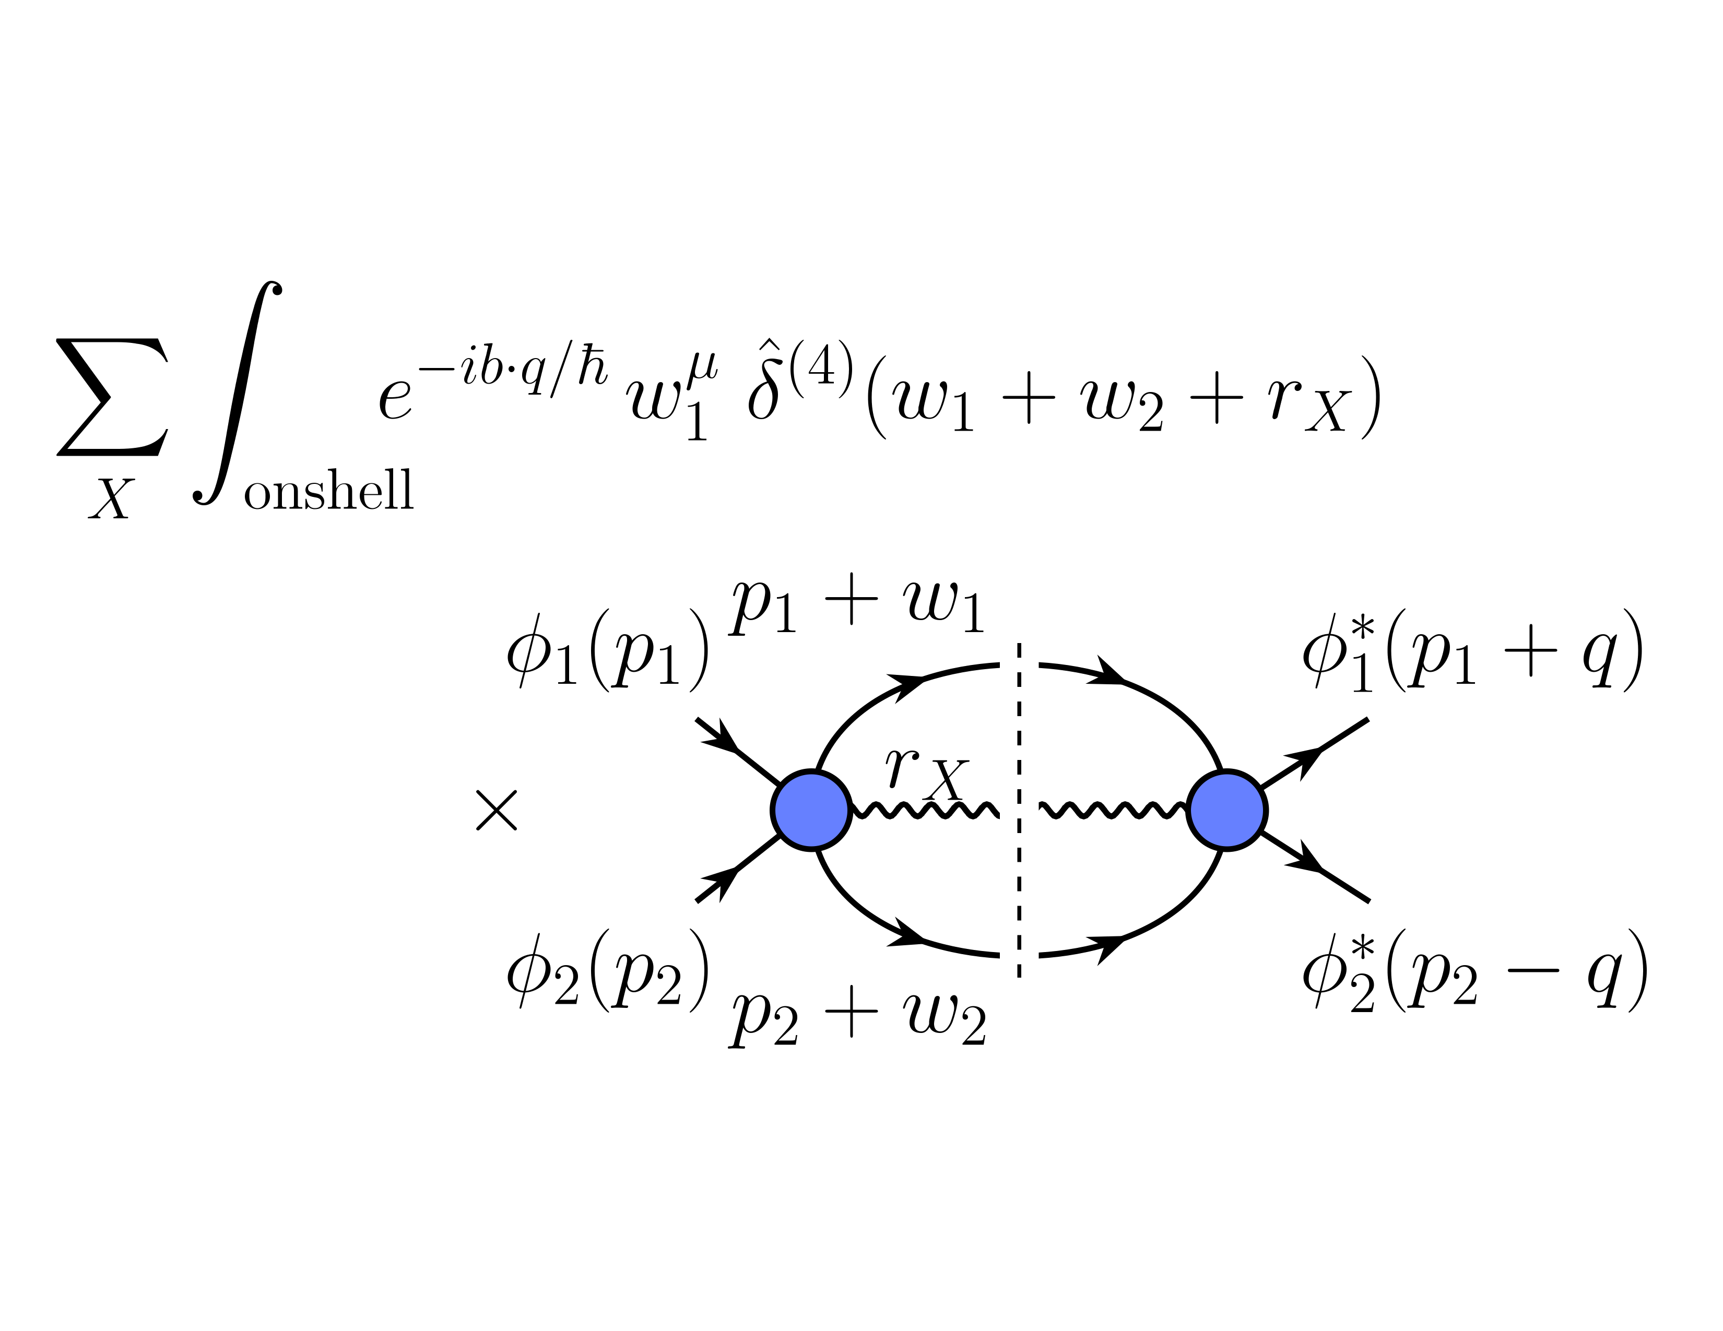
Impulse Observable, Second Term
Let’s represent this diagrammatically again
An all-orders expression: corrections both through loops and intermediate particles

Slide 38
Classical Limit, part 2
Next task: obtain classical limits of these expressions
Choose specific class of point-particle wavefunctions $φ(p)$
Three different scales in our problem:
the Compton wavelength of the particles, $ℓ_{c}^{\left(i\right)}=\frac{ℏ}{m_{i}}$
The wavepacket size of $φ$, $ℓ_{w}$
the scattering length of the amplitude $ℓ_{s}$ , which will be $\sim$impact parameter $|b|$
Let’s start by thinking about a nonrelativistic wavefunction

Slide 39
Classical Limit, part 2
Minimum-uncertainty non-relativistic wavefunction
$$exp\left(−\frac{p^{2}}{{\left(2m^{2}ℓ_{c}^{2}\right)}/{\left(ℓ_{w}^{2}\right)}}\right)$$
$ℓ_{c}$: Compton wavelength
$ℓ_{w}$: Wavefunction spread
The position-space wavefunction would be
$$exp\left(−\frac{{(x−x_{0})}^{2}}{2ℓ_{w}^{2}}\right)$$
So $ℓ_{w}$ tells us how well we know the particle’s position

Slide 40
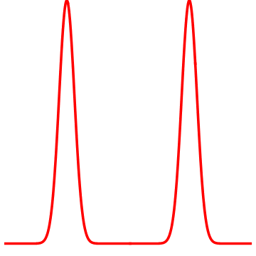
Classical Limit, part 2
Relativistic quantum theory: notion of a particle’s position is not well-defined
Can still use $ℓ_{w}$ as a measure of localization
Physically we want to take the $ℏ→0$ limit, or $ℓ_{c}→0$
Also ${ℓ_{c}}/{ℓ_{w}}→0$
Define $ξ={ℓ_{c}^{2}}/{ℓ_{w}^{2}}$ dimensionless
Also need the particle wavefunctions to be well-separated, that is ${ℓ_{w}}/b→0$
$$b$$

Slide 41
Classical Limit, part 2
Minimum-uncertainty non-relativistic wavefunction
$$exp\left(−\frac{p^{2}}{{\left(2m^{2}ℓ_{c}^{2}\right)}/{\left(ℓ_{w}^{2}\right)}}\right)$$
$ℓ_{c}$: Compton wavelength
$ℓ_{w}$: Wavefunction spread
Take relativistic wavefunction to be controlled by ${ξ=ℓ}_{c}^{2}/ℓ_{w}^{2}$ as well
Needs four-momentum parameter $u$: four-velocity
Simplest dependence $p⋅u/(mξ)$

Slide 42
Classical Limit, part 2
All together, we want the conditions
$$ℓ_{c}≪ℓ_{w}≪b\sim ℓ_{s}$$
I call these the “Goldilocks” conditions
Let’s see how they emerge in a bit more detail by looking at a specific choice of relativistic wavefunction
We need another four-vector: with the momentum $p$ we have only one invariant $p^{2}=m^{2}$ — constant
Introduce a four-vector parameter $u^{μ}$ with $u^{2}=1$
Will turn out to be the classical four-velocity

Slide 43
Classical Limit, part 2
Now have a non-constant invariant, $p⋅u$
Make it dimensionless: ${p⋅u}/m$
$ξ$ is the dimensionless parameter controlling the limit
Build functions of $\frac{p⋅u}{mξ}$
Simplest useful function is
$$φ\left(p\right)=\frac{𝒩}{m} exp\left[−\frac{p⋅u}{m ξ}\right]$$
At first glance, this looks wrong: won’t it blow up in some direction?

Slide 44
Classical Limit, part 2
$$φ\left(p\right)=\frac{𝒩}{m} exp\left[−\frac{p⋅u}{m ξ}\right]$$
No! If we boost to the rest frame of $u$, the argument of the exponential is
$$−\frac{\sqrt{m^{2}+{\left|p\right|}^{2}}}{m ξ}<0$$
so it falls off in all directions
Indeed, it gives a Gaussian in the nonrelativistic limit

Slide 45
Classical Limit, part 2
What happens to this $φ(p)$ as $ξ→0$?
Compute $\frac{⟨{\left(Δp\right)}^{2}⟩}{⟨p^{2}⟩}$
We find an expression in terms of Bessel functions
[modified Bessel functions of the second kind]
$$1−\frac{K_{2}^{2}\left(2/ξ\right)}{K_{1}^{2}\left(2/ξ\right)}→−\frac{3}{2}ξ+𝒪(ξ^{2})$$
Exercise: do this

Slide 46
Classical Limit, part 2
What happens to our observable?
Look first at a toy integral
$$T_{1}=\int{dΦ\left(p\right) φ\left(p\right)φ\left(p+q\right)\hat{δ}(2p⋅q+q^{2})}$$
Plug in $φ(p)$ and change variables $q=ℏ\overline{q}$
Evaluate integrals (note ${\overline{q}}^{2}<0$)

Slide 47
Classical Limit, part 2
As $ℏ$,$ξ→0$, we expect this function to be concentrated in a small region in $\overline{q}$
Clean up some of the weeds
$$\frac{1}{K_{1}(2/ξ)}\sim \frac{2}{\sqrt{π}\sqrt{ξ}} exp\left[\frac{2}{ξ}\right]$$
Now $ℏ\sqrt{ξ}\sim ξ$, so
$$T_{1}\sim \frac{1}{ξ} exp\left[−\frac{f(\overline{q})}{ξ}\right]$$
looks like a $δ$ function as $ξ→0$

Slide 48
Classical Limit, part 2
Work in rest frame of $u$; parametrize ${\overline{q}}^{μ}=E_{\overline{q}}(sinhξ,coshξ \hat{n})$
Exponent becomes
$$−\frac{2}{ξ}\left[coshξ \sqrt{1+{ℏ^{2}E_{q}^{2}}/{(4m^{2})}}−1\right]$$
which will localize $\overline{q}⋅u+𝒪(ℏ^{2})$
need to treat corrections carefully if we have spurious singular contributions
$$→δ(\overline{q}⋅u)$$
In general, peaking will force $\frac{ℏ}{m}\overline{q}⋅u \frac{ℓ_{w}^{2}}{ℓ_{c}^{2}}≪1$, or
$$\overline{q}⋅u ℓ_{w}≪\sqrt{ξ}$$

Slide 49
Classical Limit, part 2
We’re considering a more general integration, with two $p_{i}$ and a more complicated function, but the same feature will emerge
Function will depend on the dimensionless ratios
$ℓ_{c}\sqrt{−{\overline{q}}^{2}}$ and $\frac{\overline{q}⋅u_{i}}{\sqrt{−{\overline{q}}^{2}}}$
Call $\frac{1}{\sqrt{−{\overline{q}}^{2}}}$ a “scattering length” $ℓ_{s}$ calculation will give $ℓ_{s}\sim b$
Dimensionless ratios are
$\frac{ℓ_{c}}{ℓ_{s}}$ and $\overline{q}⋅u_{i} ℓ_{s}$

Slide 50
Classical Limit, part 2
Function is polynomial in the ratios, angular integrations implicit in $dΦ(p_{i})$ will force all to be localized to an appropriate power of $ξ$
What power?
Nonrelativistic limit suggest $\sqrt{ξ}$ as the lowest possible one
$\frac{ℓ_{c}}{ℓ_{s}}≲\sqrt{ξ}$ and $\overline{q}⋅u_{i} ℓ_{s}≲\sqrt{ξ}$
Higher power would give stronger constraints
Combining we get $ℓ_{w}≪ℓ_{s}$, matches physical intuition

