Slide 1
Classical Gravity from Quantum Scattering Amplitudes Lecture II
David A. Kosower Institut de Physique Théorique, CEA–Saclay
Nordic Winter School, Feb 5–10, 2022

Slide 2
Summary of Lecture I
Study physical observables: impulse
Restore $ℏ$ by dimensional analysis
Build two-particle initial state using relativistic wavefunctions
$${\left|ψ\right\rangle }_{in}=\int{dΦ\left(p_{1}\right)dΦ\left(p_{2}\right)}φ_{1}\left(p_{1}\right)φ_{2}\left(p_{2}\right) {e^{ib⋅p_{1}/ℏ} \left|p_{1}p_{2}\right\rangle }_{in}$$
Observables will typically have the form
$$\left\langle {ψ|S}^{†}𝕆S | ψ\right\rangle −\left\langle ψ|𝕆 | ψ\right\rangle$$
All-orders master formula for impulse
$$\left\langle Δp_{1}^{μ}\right\rangle =i\left\langle ψ\left|\left[ℙ_{1}^{μ}, T\right]\right|ψ\right\rangle +\left\langle ψ\left|T^{†}\left[ℙ_{1}^{μ}, T\right]\right|ψ\right\rangle$$
$$= I_{(1)}^{μ} + I_{(2)}^{μ}$$
Require “Goldilocks” conditions
$$ℓ_{c}≪ℓ_{w}≪b\sim ℓ_{s}$$

Slide 3
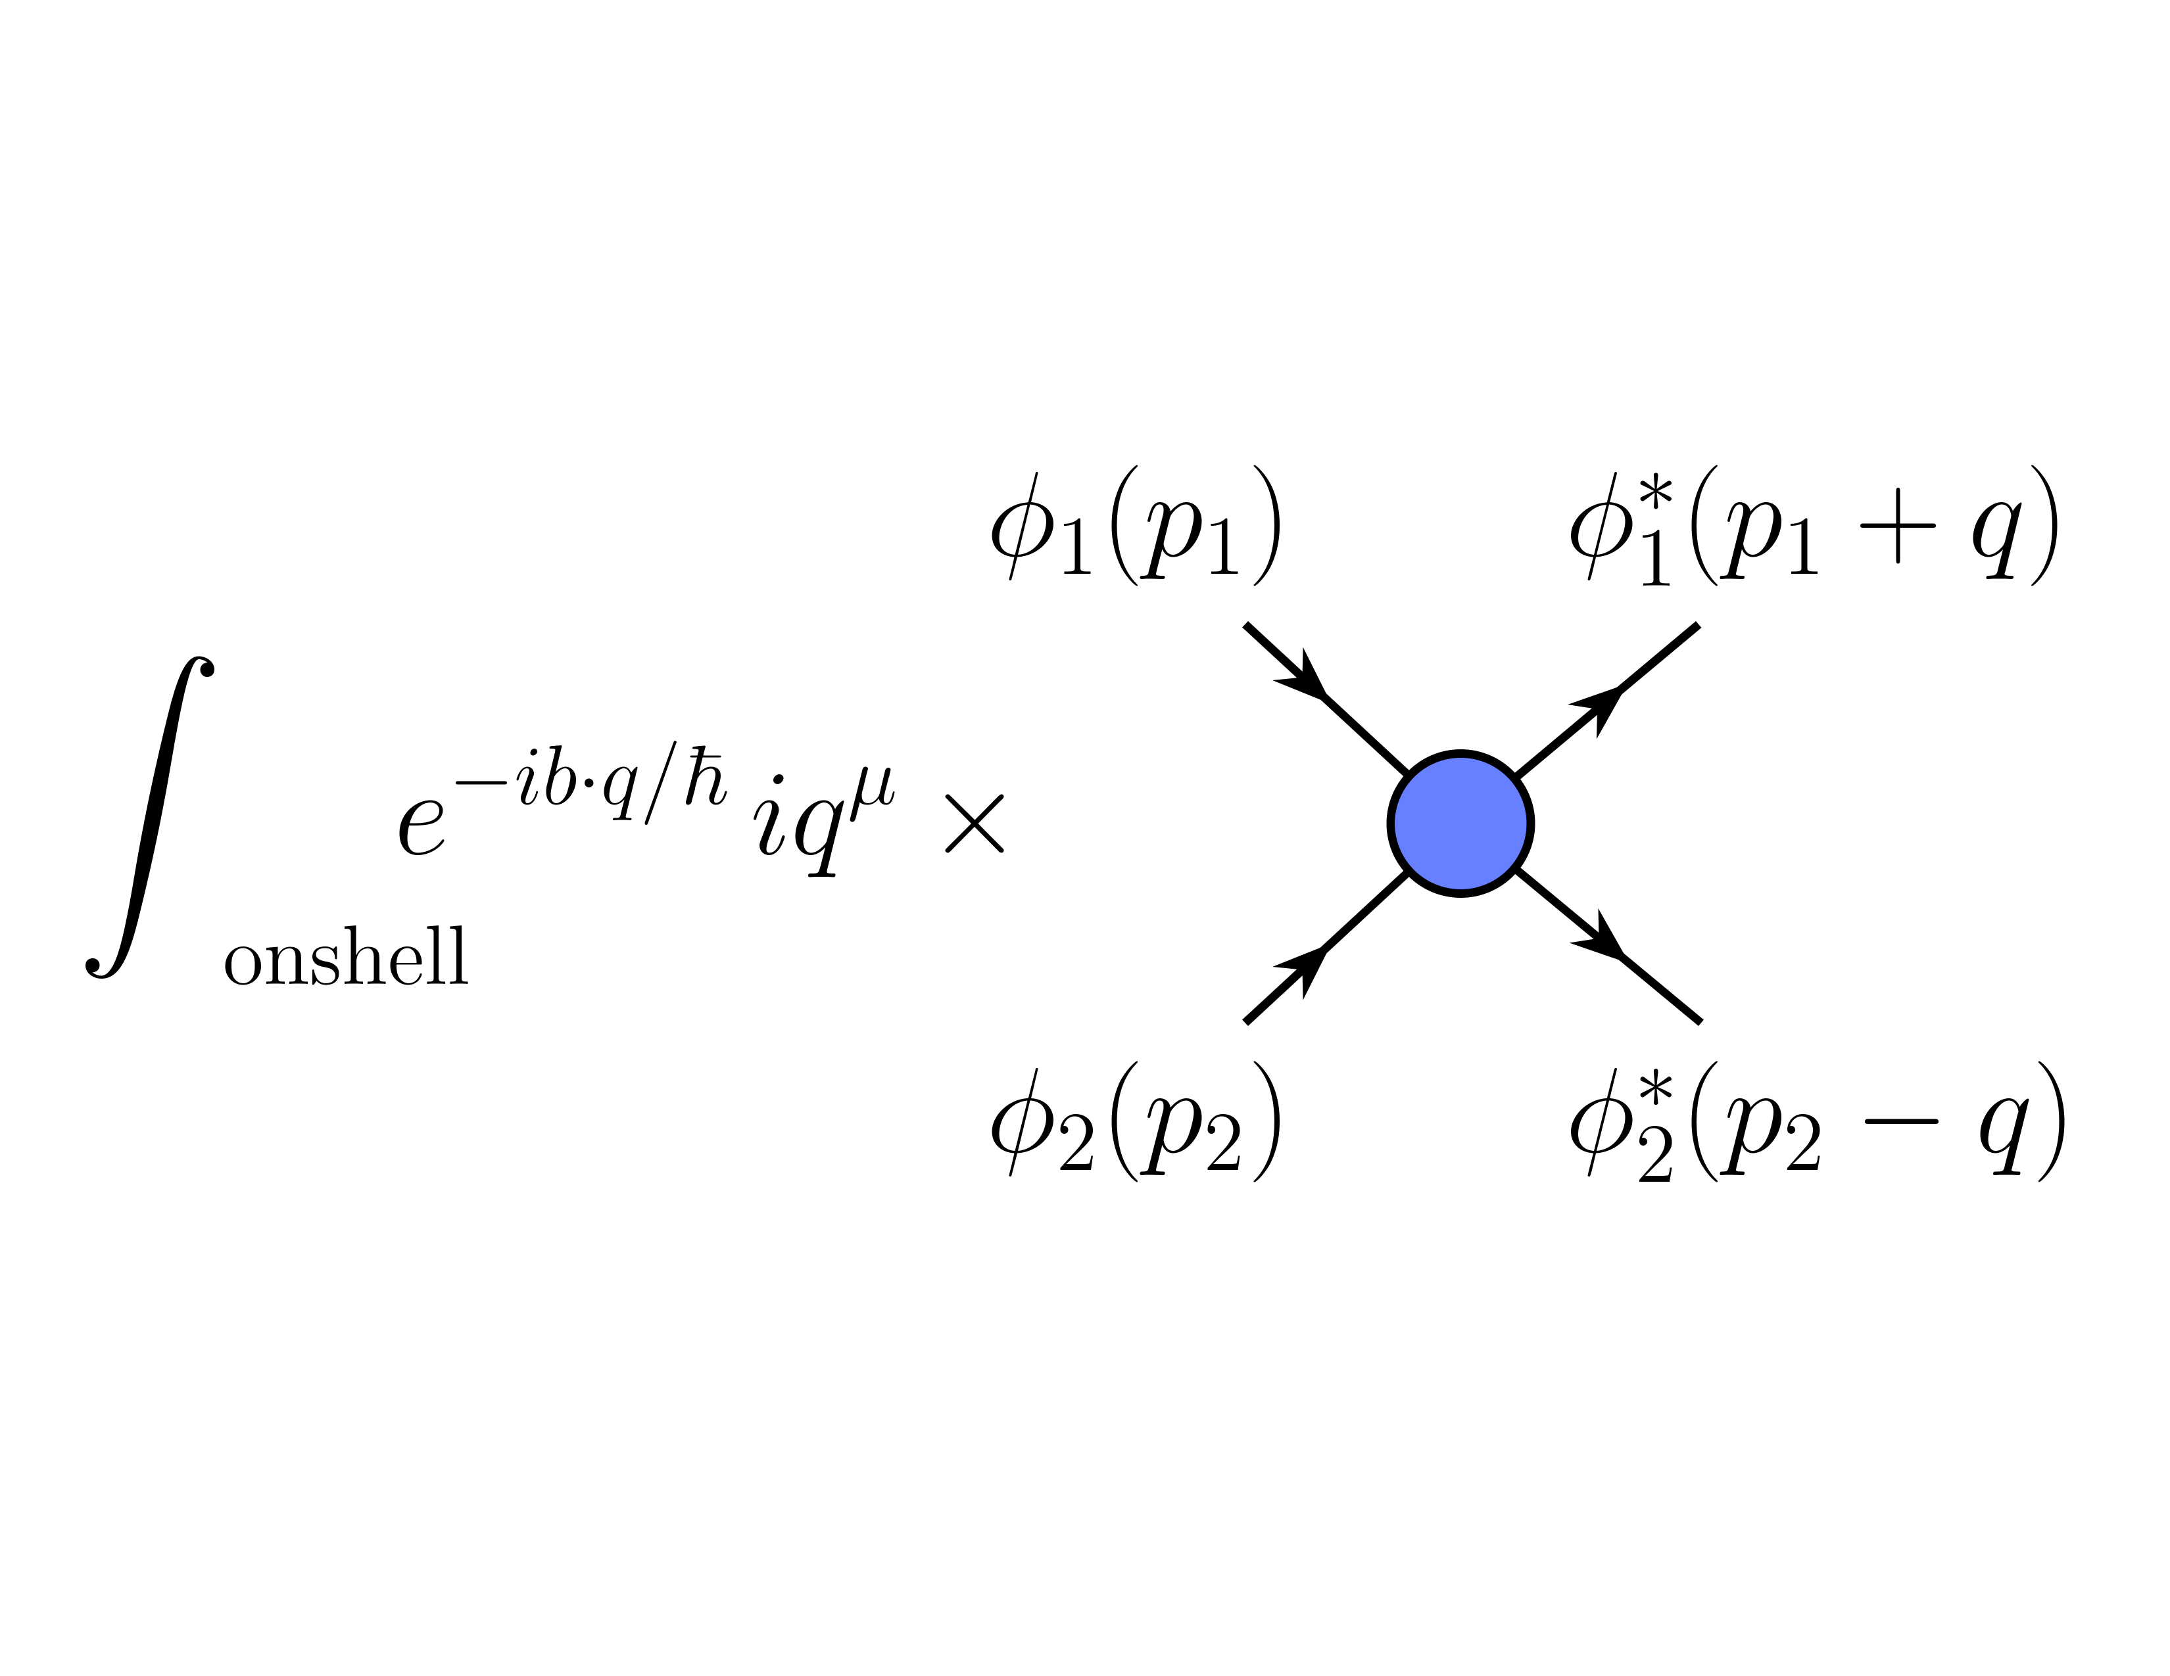
$$I_{\left(1\right)}^{μ}$$

Slide 4
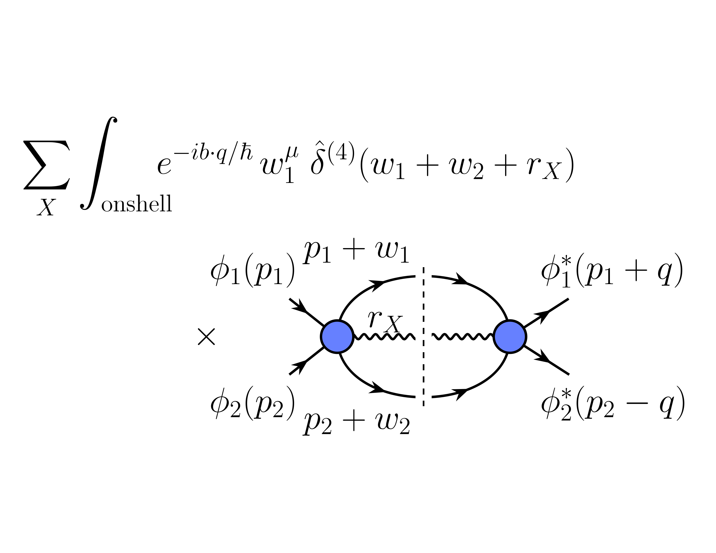
$$I_{\left(2\right)}^{μ}$$

Slide 5
Classical Limit, part 2
Caveats
Two terms inside on-shell $δ$ functions $δ(\overline{q}⋅u_{i}±ℓ_{c} {\overline{q}}^{2})$
Second is parametrically smaller and can be ignored unless there are other factors singular in $ℏ$
This actually happens beyond leading order
Need to Laurent-expand around $ξ→0$
Singularities cancel between terms in physical observables
For this reason, and on more general grounds, we cannot simply set $ξ=0$

Slide 6
Classical Limit, part 2
Key point: correct quantity to integrate over is not the momentum mismatch $q$, but the wavenumber mismatch $\overline{q}$
Associated with messenger exchange
What about other momenta?

Slide 7
Classical Limit, part 2
Final-state momenta
Expect: small distortion of wavepackets under perturbative scattering, narrow peaking to be maintained
Practically: hard to recast state sums in terms of wavepackets
Look at peaking indirectly
$$\frac{σ^{2}(r_{i})}{m_{i}^{2}}=\frac{σ^{2}(p_{i})}{m_{i}^{2}}+perturbative corrections$$
Implies that momentum transfers $w_{i}$ must also be small compared to $\sqrt{ξ}$, and that correct variables are ${\overline{w}}_{i}$
Likewise for additional emissions
Unitarity implies that virtual messenger momenta also must be traded for messenger wavenumbers

Slide 8
How Does This Work in Practice?
We see right away that there are additional powers of $ℏ$
We can’t just count those at the vertices
$$\int{{\hat{d}}^{4}q} \hat{δ}\left(2p_{1}⋅q+q^{2}\right)\hat{δ}\left(2p_{2}⋅q−q^{2}\right) q^{μ} \\ → ℏ^{3} \int{{\hat{d}}^{4}\overline{q}}\hat{δ}\left(2p_{1}⋅\overline{q}+ℏ{\overline{q}}^{2}\right)\hat{δ}\left(2p_{2}⋅\overline{q}−{ℏ\overline{q}}^{2}\right) {\overline{q}}^{μ}$$
Introduce simplifying notation

Slide 9
General Form of $I_{\left(1\right)}^{μ}$ at Leading Order
The classical limit of $I_{\left(1\right)}^{μ}$ at leading order is
Extract factors of coupling from $A^{\left(0\right)}$, drop $ℏ{\overline{q}}^{2}$

Slide 10
QED Example
We now need the tree-level amplitude for scattering of massive particles
Let’s look at the scattering of charged scalars

Slide 11
QED Example
We can substitute this to obtain
Evaluate the integral

Slide 12
Simple Example of Double Copy
Squaring relation in its Bern–Carrasco–Johansson form tells us to square the numerator,
$${\overline{ℳ}}^{\left(0\right)}\left(p_{1}p_{2}→p_{1}+ℏ\overline{q}, p_{2}−ℏ\overline{q}\right)=\frac{16{\left(p_{1}⋅p_{2}\right)}^{2}}{ℏ^{2}{\overline{q}}^{2}}+⋯$$
This isn’t quite GR, it’s GR + dilaton
Impulse here is
Exactly same integral — only difference inside is constant ${\left(u_{1}⋅u_{2}\right)}^{2}$ vs $u_{1}⋅u_{2}$

Slide 13
Simple Example of Double Copy
The result here is
It turns out to be straightforward here to subtract out the dilaton and obtain the classical GR result
which has been known since the ‘70s/’80s

Slide 14
Local Observables
Impulse is an example of a global variable
More extreme example would be the total radiated momentum
Can be computed in similar form
We’re interested in finer-grained observables, such as the emission waveform in a given direction
Waveform $W(t,\hat{n};x)$
Spectral waveform given by Fourier transform
$$f\left(ω,\hat{n};x\right)=\int_{−∞}^{∞}{dt} W\left(t,\hat{n};x\right) e^{iωt}$$

Slide 15
Local Observables
Idealization of scattering and radiation
Closest approach at $(0,0)$
Box of temporal length $Δt_{s}$, spatial size $Δx_{s}$
Radiation emitted inside box during scattering, then spreads out
Details of scattering determine radiation but do not affect propagation out to the observer

Slide 16
Radiation
Details of scattering define a current
Field strength current (wavenumber space) ${\tilde{J}}_{\vec{μ}}\left(\overline{k}\right)$ $\left\{\begin{aligned}0 indices:scalar \\ 2 indices:EM \\ 4 indices:GR \end{aligned}\right.$
Position space $J_{\vec{μ}}\left(x\right)=\int{{\hat{d}}^{4}\overline{k} }{\tilde{J}}_{\vec{μ}}\left(\overline{k}\right) e^{−i\overline{k}⋅x}$
Radiation propagates in $\hat{n}$ direction
Scattering region ${\tilde{J}}_{\vec{μ}}\left(\overline{k}\right)$

Slide 17
Radiation
General form of radiation observable
Need ${\tilde{J}}_{\vec{μ}}\left(−\overline{k}\right)={\tilde{J}}_{\vec{μ}}^{∗}(\overline{k})$
Through a few manipulations we can rewrite this

Slide 18
Radiation
Large-distance expansion, $J_{\vec{μ}}\left(y\right)$ is concentrated near $y≃0$
Expand there, using $|x|≫|y|$
$$\left|x−y\right| \sim \sqrt{x^{2}−2x⋅y} \\ \sim \left|x\right|\left(1−\frac{\hat{n}⋅y}{|x|}\right)+⋯$$
Do the $y$ and $\overline{k}$ integrals to get
Drop terms of $1/x^{2}$

Slide 19
Radiation
Waveform is the coefficient of $1/x$
Relative phase between nearby observers is measurable
Spectral waveform

Slide 20
Waveform
Next task is to obtain explicit expressions for $f_{\vec{μ}}$
Simplest case is electromagnetic radiation
Observable is the field strength
$$\left\langle F_{μν}^{out}\left(x\right)\right\rangle = {}_{out}^{}{\left\langle ψ\right|}𝔽_{μν}\left(x\right){\left|ψ\right\rangle }_{out} \\ = {}_{in}^{}{⟨ψ|S^{†}𝔽_{μν}\left(x\right)S{|ψ⟩}_{in}}$$
What is the form of the operator $𝔽_{μν}(x)$?
Take a brief interlude to write it down

Slide 21
Electromagnetic Field
Electromagnetic field operator $𝔸_{μ}\left(x\right)$
Commutation relations are
$$\left[a_{\left(η\right)}\left(k\right),a_{\left(η^{′}\right)}^{†}\left(k′\right)\right]=δ_{ηη′} {\hat{δ}}_{Φ}(k−k^{′})$$
where
$${\hat{δ}}_{Φ}\left(k−k^{′}\right)≡2E_{k}{\hat{δ}}^{\left(3\right)}(k−k^{′})$$
Single-particle positive-helicity state is
$$\left|k^{+}\right\rangle ≡a_{\left(+\right)}^{†}\left(k\right)\left|0\right\rangle ={\left[a_{\left(+\right)}\left(k\right)\right]}^{†}|0⟩$$

Slide 22
Electromagnetic Field Strength
From $𝔸_{μ}\left(x\right)$, it’s easy to write down $𝔽_{μν}\left(x\right)$
We can plug this back into our expression for $⟨F_{μν}^{out}\left(x\right)⟩$

Slide 23
Current & Spectral Waveform
This has exactly the form of our general radiation observable
Spectral waveform
Forms valid to all orders in perturbation theory

Slide 24
Gravity
In gravity, the corresponding observable is the Riemann tensor $⟨R_{μνλσ}^{out}\left(x\right)⟩$
The corresponding spectral waveform is the double copy of the electromagnetic one ($κ$ to match conventional normalization)
Nonlinear terms in the Riemann tensor fall off faster (Weyl tensor is equivalent for large-$x$ terms)

Slide 25
Newman–Penrose Scalars
Convenient to make polarizations $(±)$ manifest
Do this with Newman–Penrose formalism, related to spinor-helicity method
Pick complex basis of vectors
$$L^{μ}=\frac{{\overline{k}}^{μ}}{ω}=\left(1,\hat{n}\right), { N}^{μ}=ζ^{μ}, \\ M^{μ}=ε^{\left(+\right)μ}, M^{∗μ}=ε^{\left(−\right)μ}$$
with $ζ$ null such that $ζ⋅ε^{\left(±\right)μ}=0$, $L⋅ζ=1$
Note that $M⋅M^{∗}=−1$

Slide 26
Newman–Penrose Scalars
Only non-zero components of $f_{μν}$ in Newman–Penrose basis
$$f_{μν}M^{∗μ}N^{ν} and f_{μν}M^{μ}N^{ν}$$
$${\tilde{Φ}}_{2}^{0} and {\tilde{Φ}}_{2}^{0∗}$$

Slide 27
Newman–Penrose Scalars
The spectral NP scalar in gravity is similar

Slide 28
Waveform
Expand $S=1+i T$
$$\left\langle F_{μν}^{out}\left(x\right)\right\rangle =\left\langle ψ\left|𝔽_{μν}\left(x\right)\right|ψ\right\rangle +2 Re i\left\langle ψ\left|𝔽_{μν}\left(x\right)T\right|ψ\right\rangle +⟨ψ\left|T^{†}𝔽_{μν}\left(x\right)T\right|ψ⟩$$
Alternatively, use unitarity to write (with no incoming radiation)
$$\left\langle F_{μν}^{out}\left(x\right)\right\rangle =2 Re i\left\langle ψ\left|{[𝔽}_{μν}\left(x\right),T]\right|ψ\right\rangle +⟨ψ\left|T^{†}[𝔽_{μν}\left(x\right),T]\right|ψ⟩$$
reminiscent of the impulse (but less useful here)
At lowest order only the first term contributions [$𝒪(g^{3})$]
The second term enters at next-to-leading order [$𝒪(g^{5})$]

Slide 29
Waveform, First Term
Substitute two-particle wavefunction
Work out the matrix element

Slide 30
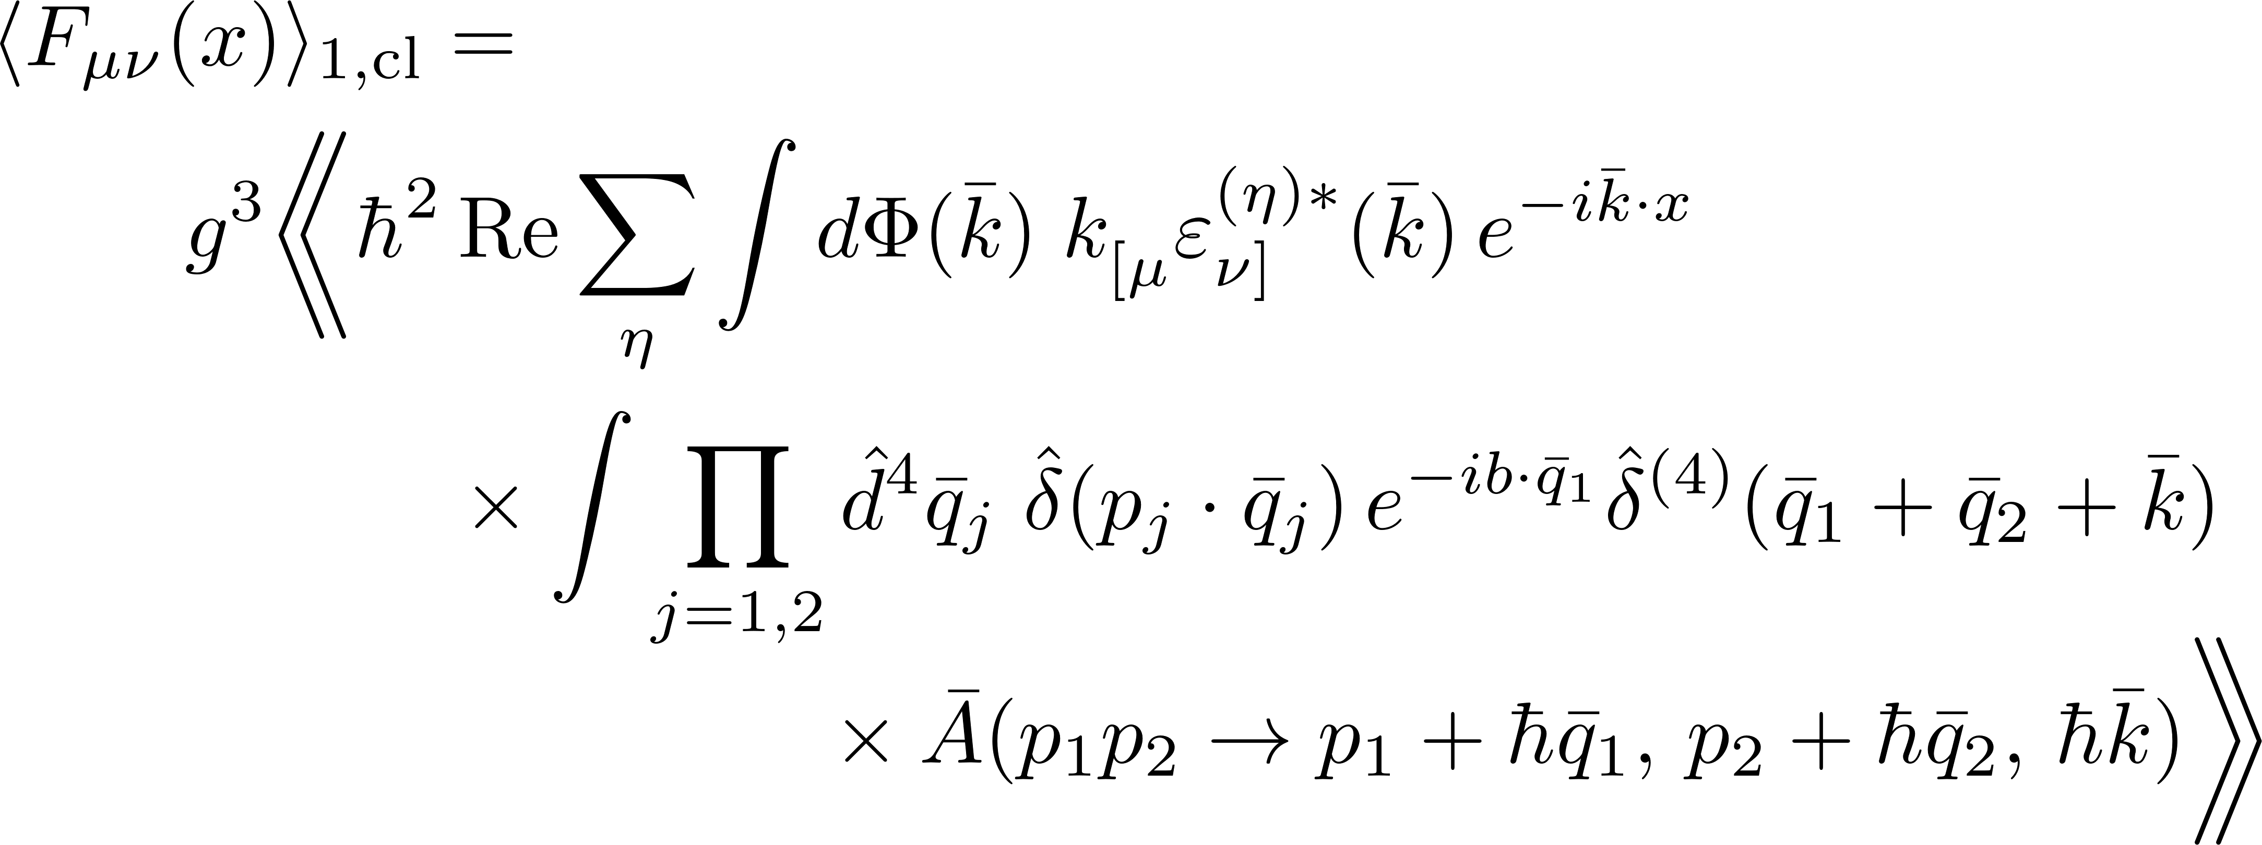
Waveform, First Term
Define the momentum mismatches
$$q_{i}≡p_{i}^{′}−p_{i}$$
Trade integrals over $p_{i}^{′}$ for integrals over $q_{i}$
Change to wavenumber variables ${\overline{q}}_{i}$ and $\overline{k}$
In classical limit, at leading order

Slide 31
Radiation Kernel
Same object appears in total radiated momentum
Using it we can write
which again has the form of a radiation observable

Slide 32
Spectral Waveform
Spectral waveform
Fourier-space NP scalar

Slide 33
Evaluating $ℛ$
Integral over a five-point amplitude
Leads to modified Bessel functions of the second kind
Evaluate $Φ_{2}^{0}(t,\hat{n})$: Fourier-like integrals of these

Slide 34
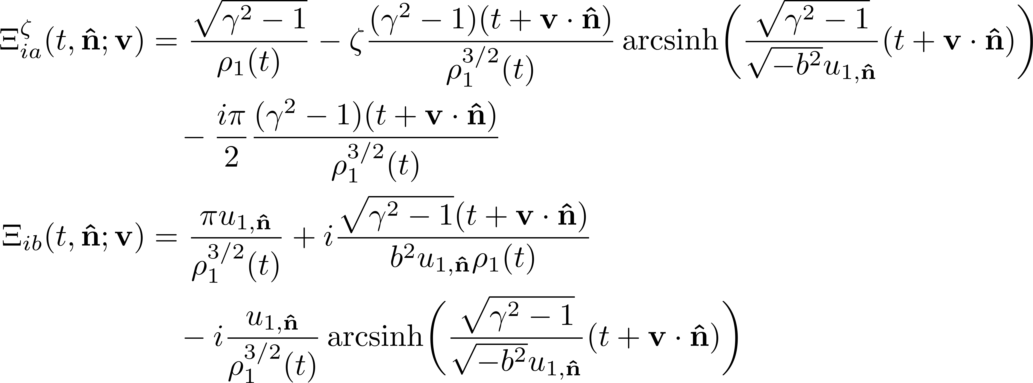
Auxiliary Functions
Definitions
Functions from transforming Bessels

Slide 35
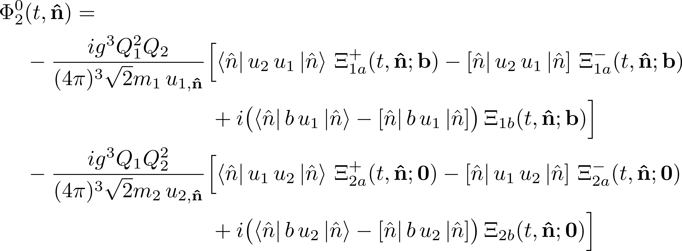
Time-Domain Waveform
Newman–Penrose scalar
where $|\hat{n}⟩$ and $|\hat{n}]$ are spinors for the null vector $(1,\hat{n})$

Slide 36
Scattering Massless Particles
We can’t use this formalism for massless (or very light) particles
Compton wavelength diverges
Classically, massless particles don’t exist
We only have classical waves

Slide 37
Classical Waves
General classical field: solution to classical vacuum equation
where ${\tilde{A}}_{η}\left(k\right)$ is a function
This looks very much like the expression for the field operator
with the creation/annihilation operators replaced by functions
Want a quantum state that effectively makes this replacement

Slide 38
Classical–Quantum Correspondence
Such states are coherent states, eigenstates of creation/annihilation operators
Function $α$ is ‘waveshape’
Creates coherent states (e.g. + helicity)

Slide 39
Classical–Quantum Correspondence
Evaluate the expectation of the field in a coherent state
if we define $\overline{α}\left(\overline{k}\right)≡ℏ^{3/2} α(k)$

Slide 40
Properties of Would-Be Wave States
Coherence is not enough; can’t have quantum correlations
Glauber’s “complete coherence condition”
One can show that
Number of photons

Slide 41
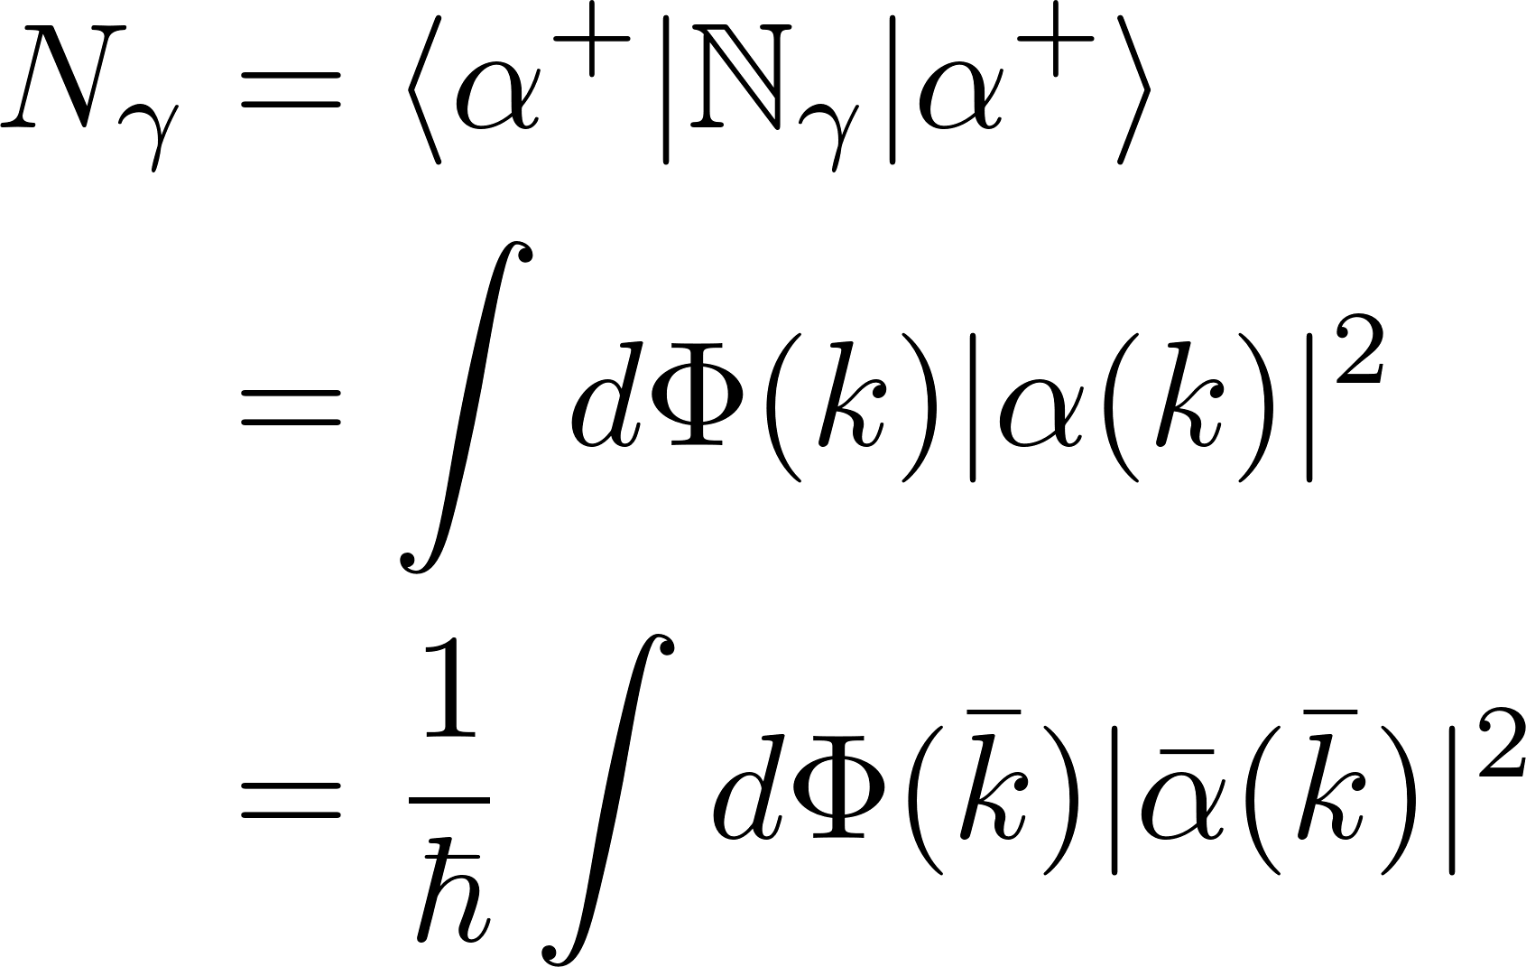
Properties of Would-Be Wave States
How many photons are in our state?
Classical limit ⇔ $N_{γ}≫1$ many photons!
Also $\overline{α}(\overline{k})$ well-defined and not parametrically small as $ℏ→0$

Slide 42
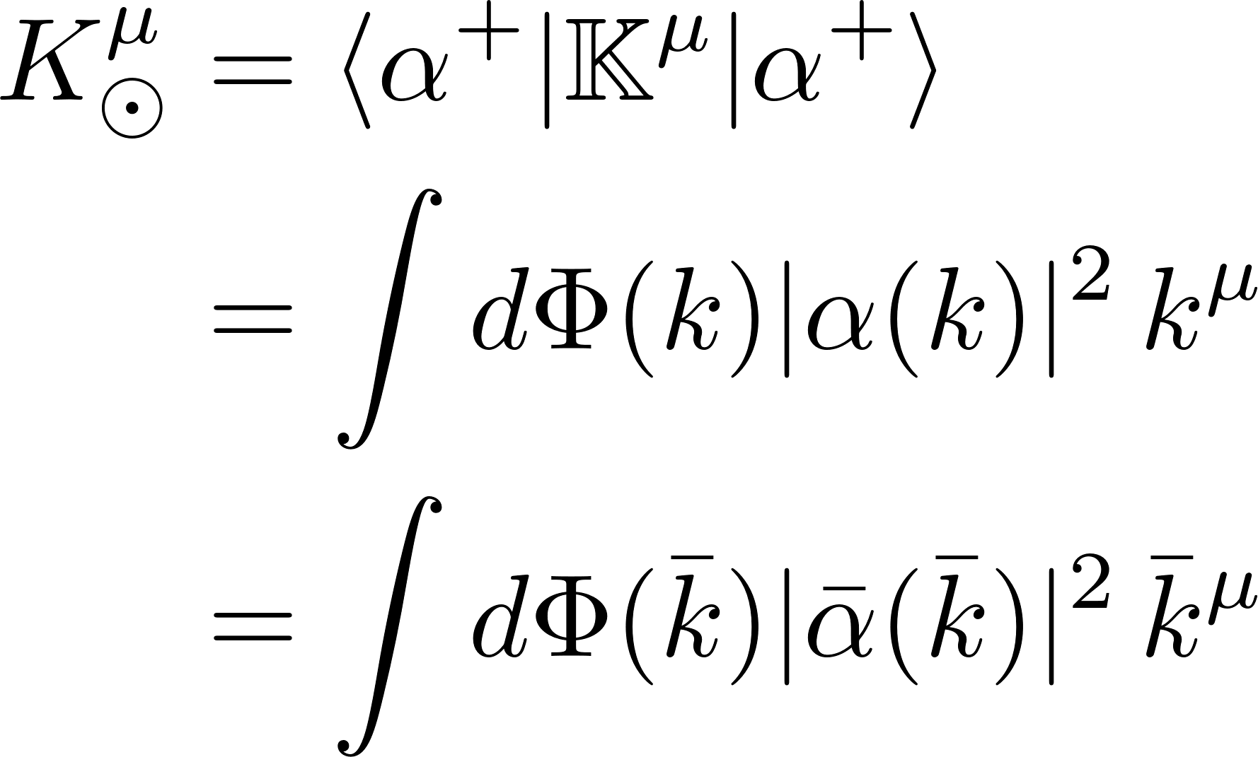
Properties of Would-Be Wave States
What momentum does it carry?
Finite in classical limit

Slide 43
Wave–Particle Scattering
There’s only one kind of spinless structureless point particle
There are many kinds of classical electromagnetic waves
The wave is specified by $\overline{α}(\overline{k})$
Compton wavelength of particle must be very small
No such requirement for wavelength $λ$ of classical wave
Just need the wave to not be able to probe the particle quantum-mechanically, nor see its structure
$$ℓ_{c}≪ℓ_{w}≪λ$$

Slide 44
Wave–Particle Scattering
Scattering length $ℓ_{s}\sim \frac{1}{\sqrt{{\left|\overline{q}\right|}^{2}}}$
Particle–particle scattering $ℓ_{s} \sim b$
For light scattering off a charged particle, $ℓ_{s} \sim offshellness \sim λ$

Slide 45
Initial State
Basis of plane-wave $×$ coherent states
$${\left|p_{1}α_{2}^{η}\right\rangle }_{in}=\left|p_{1}\right\rangle |α_{2}^{η}⟩$$
Initial state
$${\left|ψ_{w}\right\rangle }_{in}= \int{dΦ(p_{1})} φ_{1}\left(p_{1}\right)e^{ib⋅p_{1}/ℏ} |p_{1}α_{2}^{η}⟩$$
Impact parameter separates beam center from particle
Particle’s classical four-velocity hidden inside $φ_{1}$
Wave’s overall momentum hidden inside $α_{2}$

Slide 46
Impulse in Wave–Particle Scattering
Same master formula as before
$$\left\langle Δp_{1}^{μ}\right\rangle =i\left\langle ψ_{w}\left|\left[ℙ_{1}^{μ}, T\right]\right|ψ_{w}\right\rangle +\left\langle ψ_{w}\left|T^{†}\left[ℙ_{1}^{μ}, T\right]\right|ψ_{w}\right\rangle$$
$$= I_{w(1)}^{μ} + I_{w(2)}^{μ}$$
$$𝒪\left(g^{2}\right) + 𝒪(g^{4})$$
Look at the first term
Plug in the form for the initial state

Slide 47
Evaluation
Matrix elements of coherent states are not of definite order in perturbation theory
Would ordinarily introduce complete sets of states of definite particle number on both sides of $T$
Sums over $X$, $X′$ over different numbers of messengers, include phase-space integrals

Slide 48
Evaluation
Drop pair creation
Each intermediate state contains one massive particle, momenta $r_{1}$, $r_{1}^{′}$
On-shell conditions require at least one messenger, momenta $k_{2}$, $k_{2}^{′}$
Temptation: leading-order contribution arises from
$X=X^{′}=∅$

Slide 49
Evaluation
Don’t give in to temptation!
Dominant contribution arises when most messengers pass directly from initial to final state
Need to sum over additional messengers in the coherent states
Needed to recover correct normalization

Slide 50
Evaluation
One can carry out these sums explicitly, but that’s very cumbersome and tedious
Instead, introduce alternate representation for the $T$ matrix
Evaluate matrix element

Slide 51
Evaluation
Remaining matrix element introduces scattering amplitude
Messenger superscripts are physical helicities, flip after crossing in usual amplitudes convention
Substitute and sum over intermediate helicities

Slide 52
Evaluation
You know the drill…
Change variables to $q_{1}=p_{1}^{′}−p_{1}$, $q_{2}=k_{2}^{′}−k_{2}$; integrate over $q_{2}$; drop subscript on $q_{1}$
Analysis of point particle is the same as before
At leading order, no worries about $ℏ^{−1}$

Slide 53
Evaluation
Extracting couplings, we have our classical limit

Slide 54
Light Deflection
Work in geometric optics domain: $λ≪b$
Work with narrow, well-collimated beam: ${λ≪ℓ}_{⊥}≪b$
${\overline{α}}_{2}^{}\left({\overline{k}}_{2}\right)$ is steeply peaked around ${\overline{k}}_{⊙}$
Light scattering gravitationally: $t$-channel, $ℓ_{s} \sim b$
Overall
$$ℓ_{c}≪λ≪ℓ_{⊥}≪ℓ_{s} \sim b$$
$$ℓ_{c}≪ℓ_{w}≪ℓ_{s}$$
Scales
$${\overline{k}}_{2} \sim 1/λ$$
$$\overline{q} \sim 1/{ℓ_{s}}$$

Slide 55
Light Deflection
Simplifications
$$\left|\overline{q}⋅{\overline{k}}_{2}\right|≫|{\overline{q}}^{2}|$$
$${\overline{α}}_{2}^{∗}\left({\overline{k}}_{2}−\overline{q}\right)≃{\overline{α}}_{2}^{∗}\left({\overline{k}}_{2}\right)$$
Impulse of the wave

Slide 56
Light Deflection
Integral over ${\overline{k}}_{2}$ is analogous to integral over $p_{1}$
Sharply peaked ${\overline{α}}_{2}$, slowly varying amplitude
Convolution with $δ$ function will produce a sharply peaked function, which we approximate as a $δ$ function
We recognize the remaining integral as $ℏ×$ number of photons

Slide 57
Light Deflection
It’s not precisely clear what ${\overline{k}}_{⊙}$ means physically
We can relate it to the total momentum carried by the beam
Substitute into the beam’s impulse

Slide 58
Light Deflection
Amplitude is photon scattering gravitationally off a massive particle
Substitute it in
We’ve seen this integral before…

Slide 59
Light Deflection
Result for the impulse
Convert to scattering angle

Slide 60
Observables-Based Formalism: Summary
Pick well-defined observables in the quantum theory also relevant classically
Express them in terms of scattering amplitudes in the quantum theory
Take classical limit
Extract $ℏ$s in couplings
Wavenumbers for messengers, momenta for particles: extract $ℏs$
Take $ℏ→0$ limit, Laurent-expanding in $ℏ$ where needed
Scattering domain at the moment
Examples:
Impulse
Waveform
Light Deflection

