Slide 1
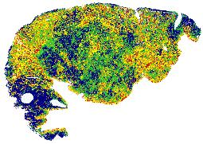



AstroPath:
Astronomy Meets Pathology
Alex Szalay, Janis Taube
and the AstroPath Team
in collaboration with Akoya Biosciences

Slide 2
AstroPath: Atlas of Cancer Cells
Astronomy meets Pathology
  Project started by Prof. Janis Taube (JHMI BKI) and Alex Szalay (JHU IDIES)
Studying the tumor microenvironment to understand cancer immunotherapy
  Spatial interactions of activated T cells and tumor near the tumor boundaries
Transitioning to the “industrial revolution”
Goal: increase data collection by a factor of >1,000
  400GB mosaic of 35-band multiplex images/slide (from 10 to 2000 images/slide)
  7 markers (lineage + PD-1, PD-L1), more markers via additional panels
  Use a farm of automated microscopes => 2PB/year
  Heavy use of parallel processing
Parallels sky surveys (as of 20 years ago)
  “Disruptive assistance” from astronomy to pathology
  Using techniques astronomers learned the hard way (flat field, unwarp, calibrate)
Tumor boundaries, cell geometries represented as GIS polygons
Dynamic computation of nearest neighbors, spatial relations
Interactive viewer like the SkyServer, or Google Maps
Processing workflows mostly automated
Working on validating a large enough training set for Deep Learning
Databases linked to SciServer, collaborative Jupyter, Keras/TensorFlow, R
Collaboration with Akoya BioSciences (microscopes)

Slide 3

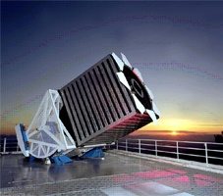
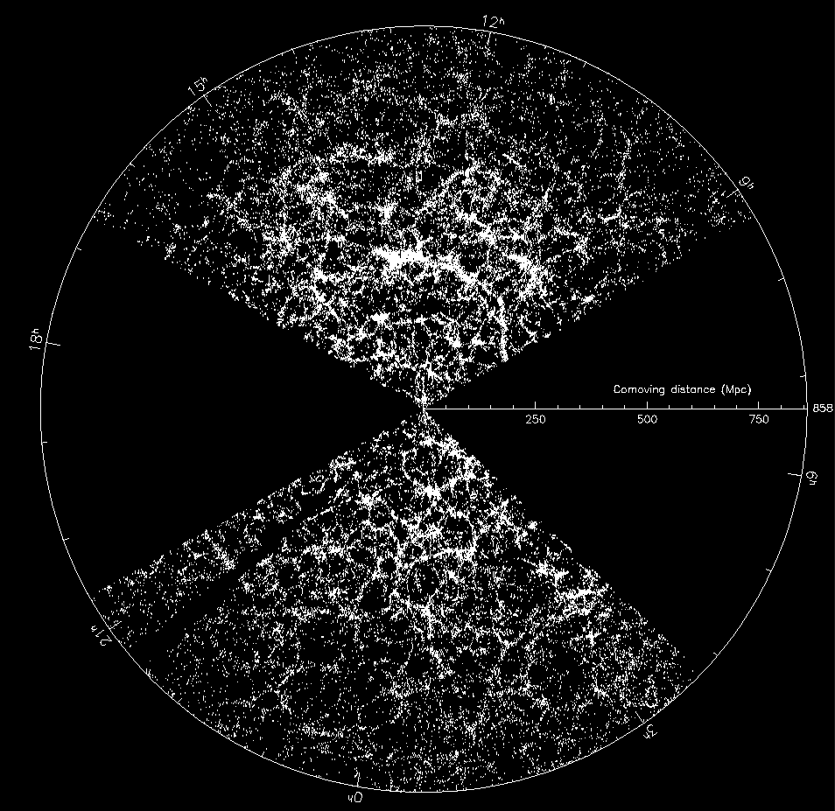
Sloan Digital Sky Survey
“The Cosmic Genome Project”
Started in 1992, finished in 2008
Data is public
  2.5 Terapixels of images => 5 Tpx of sky
  10 TB of raw data => 100TB processed
  0.5 TB catalogs => 35TB in the end
Database and spectrograph
built at JHU (SkyServer)
Now SDSS-4, data served from JHU

Slide 4
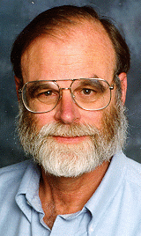
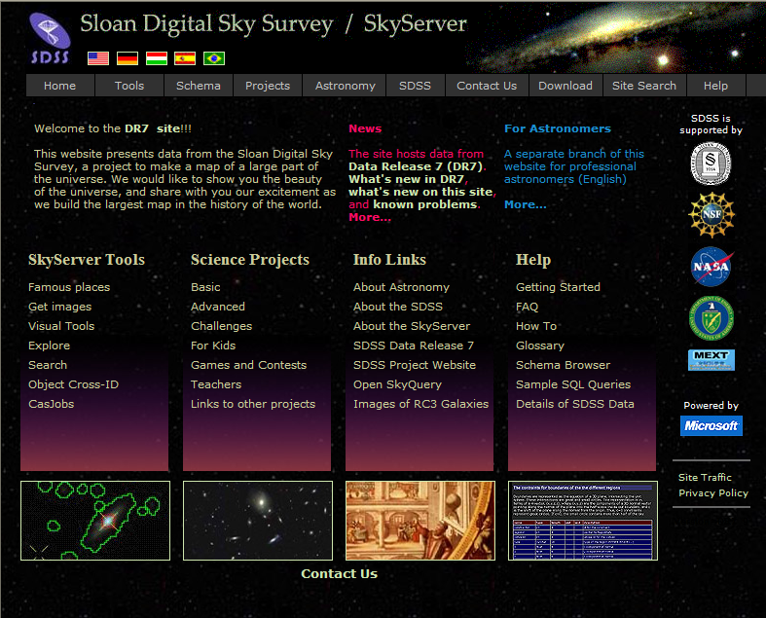
Skyserver
Prototype in 21st Century data access
  2.8B web hits in 16 years
  414M external SQL queries
  7,000 refereed papers and 450K citations
  5,000,000 distinct users vs. 15,000 astronomers
  The emergence of the “Internet Scientist”
  The world’s most used astronomy facility today
  Collaborative server-side analysis
  done by 9,000 astronomers
  Morphed into the SciServer recently
Jim Gray

Slide 5
From Stars to Cells
Strong parallels between medicine today and astronomy 25 years ago
Stars and galaxies are like the cells in pathology
  Multicolor photometry, image segmentation, locality
  Spatial relations, spatial searches, outlines
Deep links to the raw files
Astronomy lessons:
  Statistical analyses and collaboration easier in DB than flat files
  Find a common processing level that is “good enough”
  and earn the TRUST of the community
  Automation is needed for statistical reproducibility at scale
  Scaling out was much harder than we ever thought
  Moving many terabytes of data is hard

Slide 6
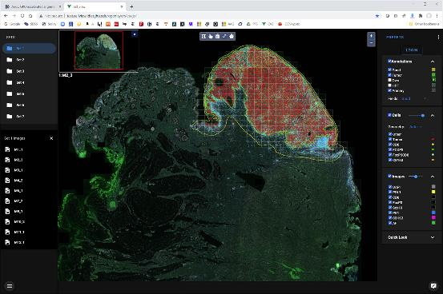
This will require:
Bespoke approaches to cell segmentation, image analysis, and data management
Focus on scaling workflow

Slide 7

Our First Slide
1226 High Powered Fields, 200GB / slide, 1344x1004 pixels, at 0.5μ/pix
1.6B pixels x 35 narrow band filters = 60B pixels /slide
Overlaps provide repeated segmentations and measurements for intrinsic validation and quality control
800-1000 times more data collected for each slide

Slide 8
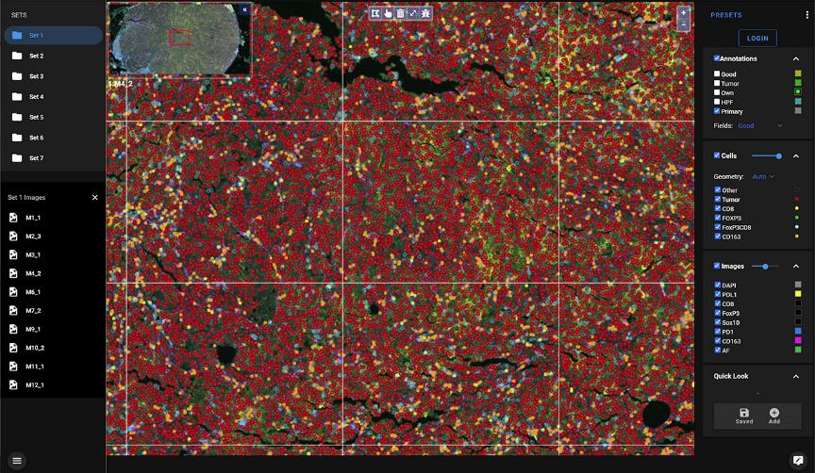
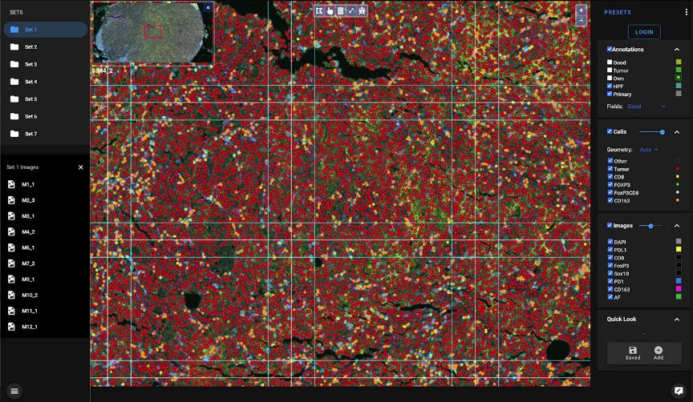
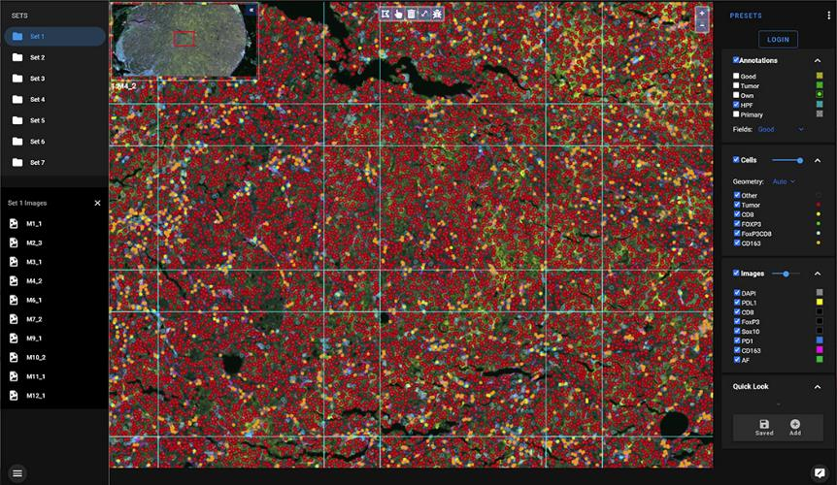
Geometry: Overlaps and Primary Regions
Primary area is the part of a field closest to its center.
These form a seamless
tiling of the whole area
Cells detected here form
the statistical sample
Overlaps are observed
multiple times
Secondary cells serve as
QA tests to determine
internal uncertainties

Slide 9
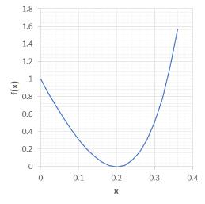
Rationale Behind Overlaps
Overlaps provide independent photons from the same cells
Repeated measurements – able to determine uncertainties
in individual cell fluxes
  More overlaps: better signal-to-noise
  Too much overlap: waste of resources
Measuring systematic errors
  Microscope systematic errors largest in the corners:
  overlaps give information on how to correct them
Questions:
  How can we justify how much overlap should we take
  Overlaps must be big enough to characterize microscope model
  But too much overlap is costly
  Statistical error 1/sqrt(N), good balance between primary and
  secondary objects
  How can we use it in practice
20% is the optimum!

Slide 10
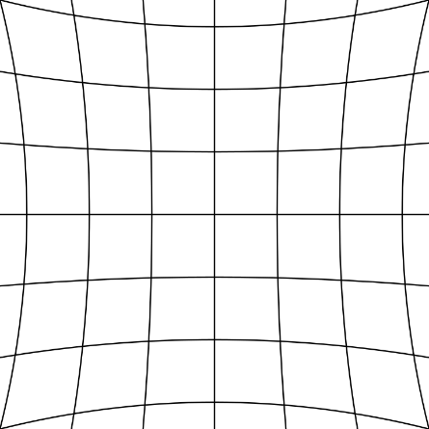
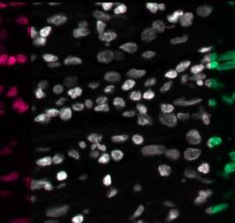
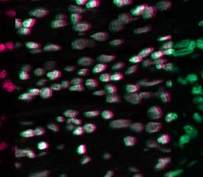
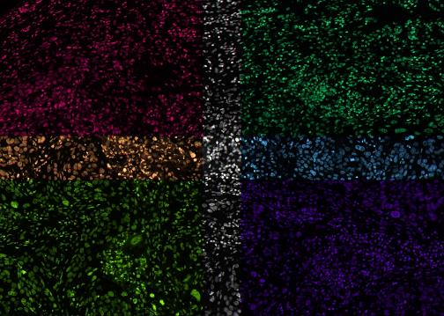
Using the Overlap Areas for Quality Control
Signs of uncorrected image warping (“pincushion”)
Developed lens model and corrected the image

Slide 11
Automated Alignment of Image Mosaics
The Vectra 3 microscope has a positioning “jitter” (3-6 pixels)
Solved for optimal relative shifts of each pair of overlapping fields
Consider each shift as a spring
Pin down center, and let physics work -> equilibrium (minimum energy)

Slide 12
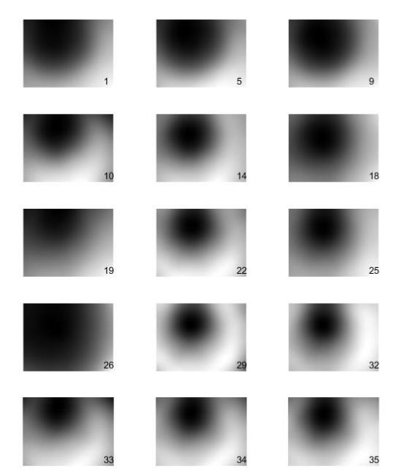
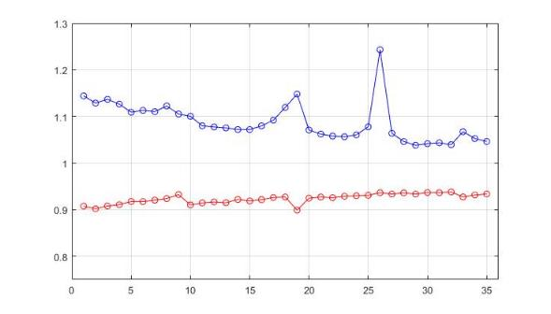
Improve Flat Fielding
Originally: smoothed stack of 8,000
raw HPF images in the 35 filters
Range of flat field correction aligns
with the broad- and narrow filters

Slide 13
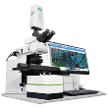
Preprocessing Workflow
manual
matlab
dbload
annotate
flatwarp
segment
merge
im3,
Annotations
Unpack
im3 bytes
Flat-field,
Warp
Reinsert
into im3
Segment im3
InForm/dual
Object list
merger
Cell tables
in CSV
Extract
DAPI
geom
Tissue Geometry
Cell Geometry
Geom tables
in CSV
Slide
metadata
prepDB
align
DAPI
images
Scan
geometry
Read XML
annotations
shift
zoom
Annotation
geometry
Compute overlaps
Pairwise
shifts
Solve
stitching
Build
mosaic
Build tile
pyramid
Overlap
geometry
HPF
rel shifts
Final HPF
geometry
Tile
pyramid
Tile
metadata

Slide 14
DB Hiearachy with Two-Phase Load
Slide {n}
Sample DBs
WSI
DBload{n}
parallel
M10_2
M10_2
M10_2
Cell CSV{n}
M{n}
M10_2
M10_2
M10_2
Img tiles{n}
M10_2
M10_2
Global loadfiles
WSICore
Batch
Calibrations
Clinical

Slide 15
Imaging Improvements
Switching to Python packages from Matlab
Better Flatfield model (M. Eminizer)
Better Warping corrections (M. Eminizer)
Capture all the Akoya XML metadata (R. Wilton)
Substantially improve image stitching accuracy (H. Roskes)
Cross-registration of different imaging modalities (J. Doyle)
Built whole slide visualization and used it for QA (D. Medvedev)
Data processing + loading is almost fully automated with multi-level logging, arbitrarily parallel design, increasing use of GPUs (B. Green)

Slide 16
Spatial Features in the DB
Represented as spatial polygons, using GIS grammar
Geometries represented
  HPF outlines and primary regions
  Manual annotation of good tissue
  Manual annotation of tumor boundaries
  Automatic tumor boundaries
  Membrane outline for each cell
  Nucleus outline for each cell
Distances and areas
  Each cell has its signed distance from tumor boundary computed
  Areas of different buffers around
  tumor boundary precomputed
  Fractional area of each HPF inside good tissue and tumor computed

Slide 17
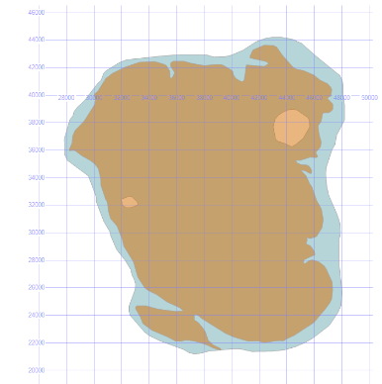
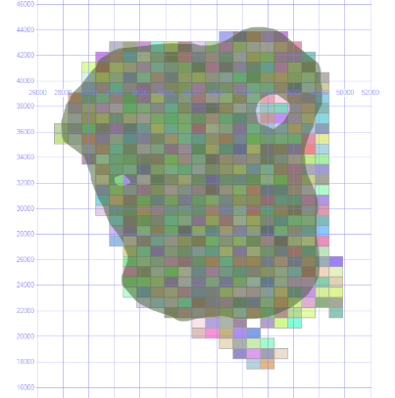
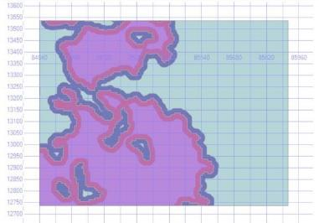
Annotations and Buffer Regions

Slide 18
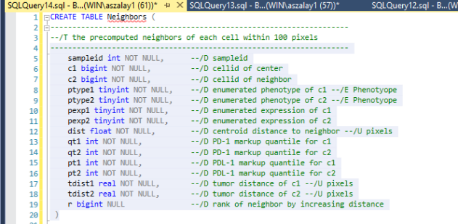
Precomputed Neighbors

Slide 19
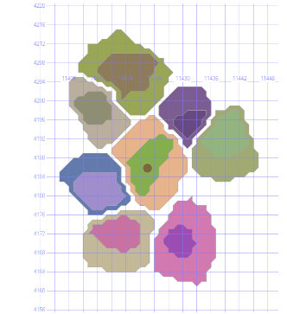
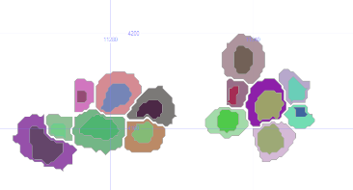
ContactNeighbors
insert ContactNeighbors with (tablock)
select n.*
from Neighbors n, CellGeom a, CellGeom b
where n.c1 = a.cellid
and n.c2 = b.cellid
and n.dist<=50
and n.sampleid=@sampleid
and a.btype=0
and b.btype=0
and a.geom.STDistance(b.geom)<2

Slide 20
Data Analysis Developments
Tumor
Stroma
Random samples extremely useful for estimating cell density
in complex geometries
  E.g. how far inside the regression area, and how far from tumor
  Now added precomputed distance from regression boundary
Perform two queries and a division
  Build histogram of distances of the real cell count
  Build identical histogram of random cells with known density
  Their ratio is the density of the cells of interest in each distance bin
Works with arbitrary geometries
Working to introduce more advanced spatial statistics and ML tools
  Correlations, mark-correlations, neighbor statistics, tSNE, UMAP
Starting to look at genomics integration (w. Alex Baras)

Slide 21
CellView: Designed for Speed
Images built from hierarchical DeepZoom tiles (256x256)
What is different from others that
we use a lightweight client, all
heavy lifting is done server-side
We store the tiles of the original
8 component layers
They are mixed on the server, using
a user-defined color mixing
These can be saved as presets

Slide 22
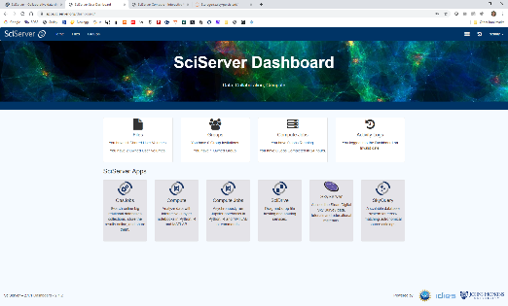
SciServer Integration
The database is now linked to the SciServer (JHU data analytics platform)
Collaborative sharing
Enables easy data aggregation
  With genomics etc
Each user can have their own DB
for value added data, linked to
main database
Various options:
  CasJobs/MyDB (SQL access)
  Compute (Python, R)
  Compute Jobs (queues)
  Preconfigured containers with AI
    PyTorch
    Tensorflow
    Choice of Python2, Python3
    Geo (spatial tools)
sciserver.org

Slide 23
Current data in the database
3 Cohorts, 235 slides
84,320 High Powered Fields
226M detected cells
97M unique cells
3.5B neighboring cell pairs precomputed
8.7 trillion pixels (whole SDSS was 6.5 Tpixels!)
Additional 200+ slides already scanned
with multiple tumor types, processing in
various stages

Slide 24
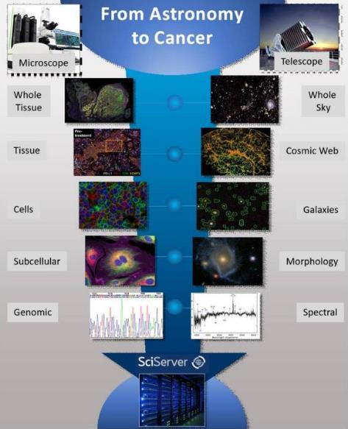
Conclusions
Early results indicate that mIF assays are reproducible
Found a predictive biomarker for immuno- therapy using AstroPath (Science, June 11, 2021)
Next generation of tissue-based biomarkers are likely to be identified using large, well-curated datasets
Established a standardized protocol to process thousands of tissue samples per year on many microscopes
Developed a scalable facility to produce petabytes of robust tissue imaging data on par with large sky surveys
Working towards an Open Cancer Cell Atlas with many billions of cells

Slide 25
Acknowledgements
Taube Lab members
Sneha Berry, MS
Nicholas Giraldo, MD, PhD
Benjamin Green
Tricia Cottrell, MD, PhD
Liz Engle, MS
Haiying Xu
Aleksandra Ogurtsova
AI/Computer Vision
Alan Yuille, PhD
Seyoun Park, PhD
Yixiao Zhang
Astronomy/IDIES
Heshy Roskes, PhD
Maggie Eminizer, PhD
Richard Wilton, MD
Joshua Doyle, MD
Sahil Hamal, CS
Dmitry Medvedev, CS
Josh Rabichaud (UG, Physics)
Nate Eisenberg (UG, math)
Akoya collaborators
Cliff Hoyt, MS
Chi Wang
BKI collaborators
Drew Pardoll, MD, PhD
Robert Anders MD, PhD
Suzanne Topalian, MD
Evan Lipson, MD
BMS collaborators
Robin Edwards, MD

Slide 26








