Slide 1
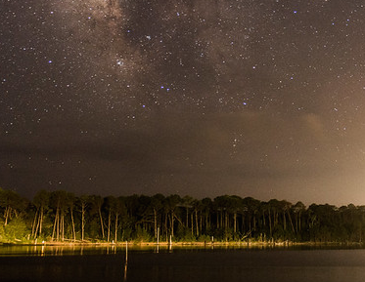
where the earth meets the sky
inter-disciplinary workshop
27th and 28th of May 2021
https://indico.nbi.ku.dk/e/earthandsky
photo: G. Brammer

Slide 2
Welcome!
on behalf of the organizers:
Adriano Agnello, Iary Davidzon, Theis Lange, Tom Mellan
Nikki Arendse, David Blanquez-Sese, Nina Bonaventura, John Weaver
and the staff at
cosmicdawn.dk

Slide 3
supported by

Slide 4
Some numbers…
>140 registrations,
of which 2/3rd from astro and 1/3rd from med/public health…
…but also 10 persons with a different background!
At least 6 different time zones.
7 keynote speakers + other 26 talks/posters (thanks for contributing!)
word cloud of participants’ research interests

Slide 5
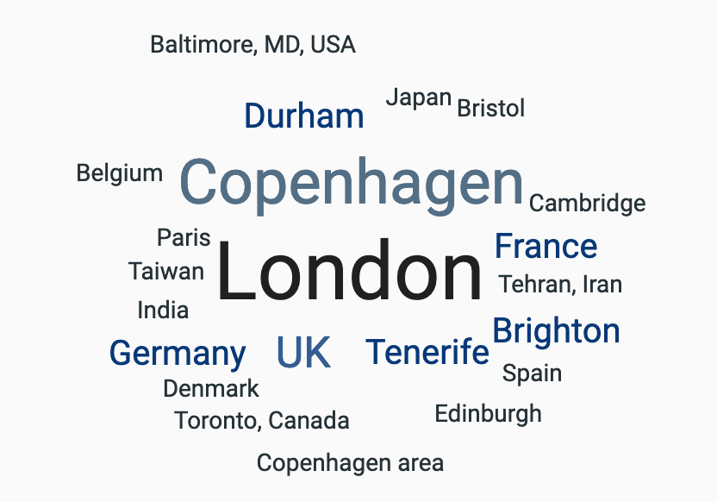
Some numbers…
>140 registrations,
of which 2/3rd from astro and 1/3rd from med/public health…
…but also 10 persons with a different background!
At least 6 different time zones.
7 keynote speakers + other 26 talks/posters (thanks for contributing!)

Slide 6
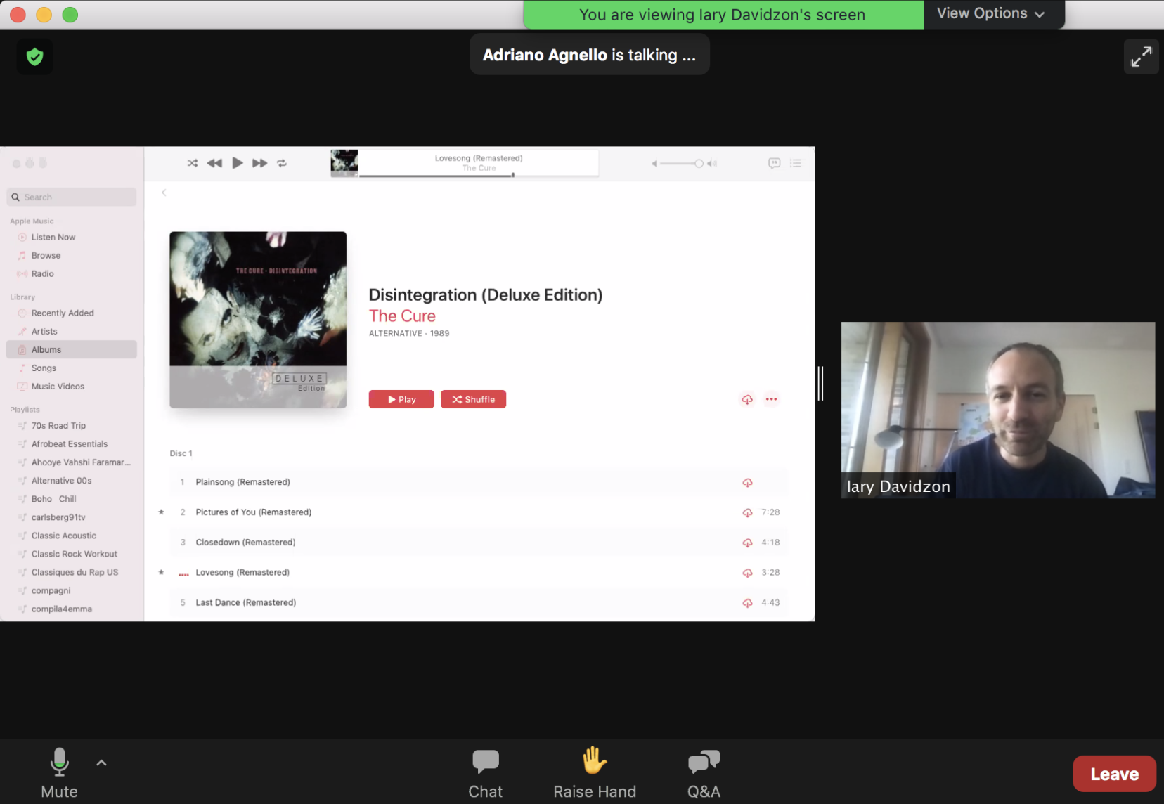
Zoom Webinar Chat for technical issues or general comments Rise Hand and Q&A to interact with the speaker
presenter’s screen
webcam
The workshop will be recorded. You can ask being removed from the video before we publish it (just send an email to dawn_workshops@nbi.ku.dk).

Slide 7
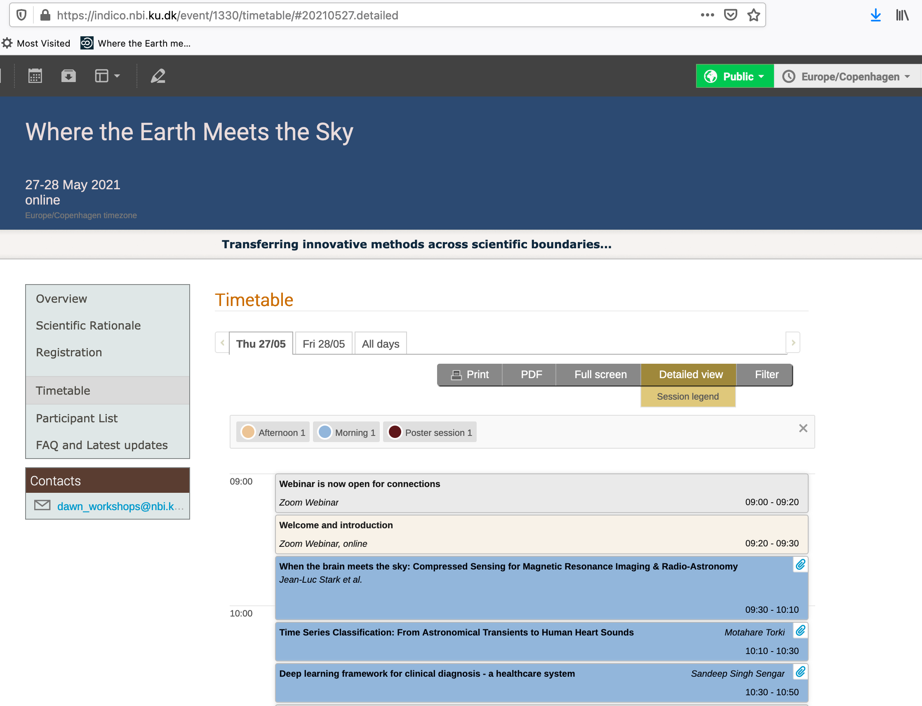

Slide 8
Discussion session (Friday at 16:05)
organized by Fionagh Thompson (fionagh.thomson@durham.ac.uk)
and Larry Fitzpatrick (laurence.w.fitzpatrick@durham.ac.uk)
Where are the similarities and opportunities?
Where are the differences and barriers?
What are the potential solutions?

Slide 9
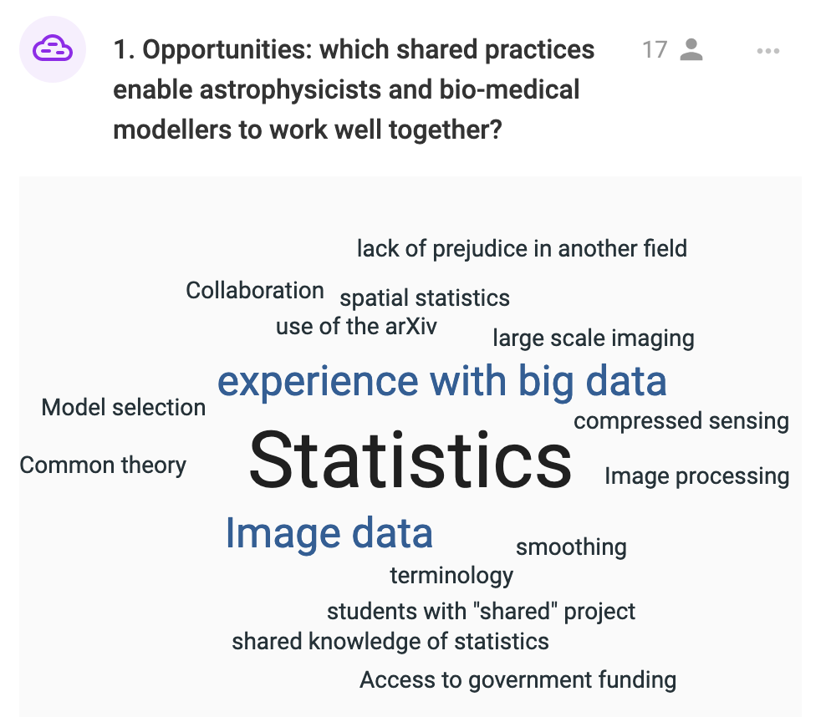
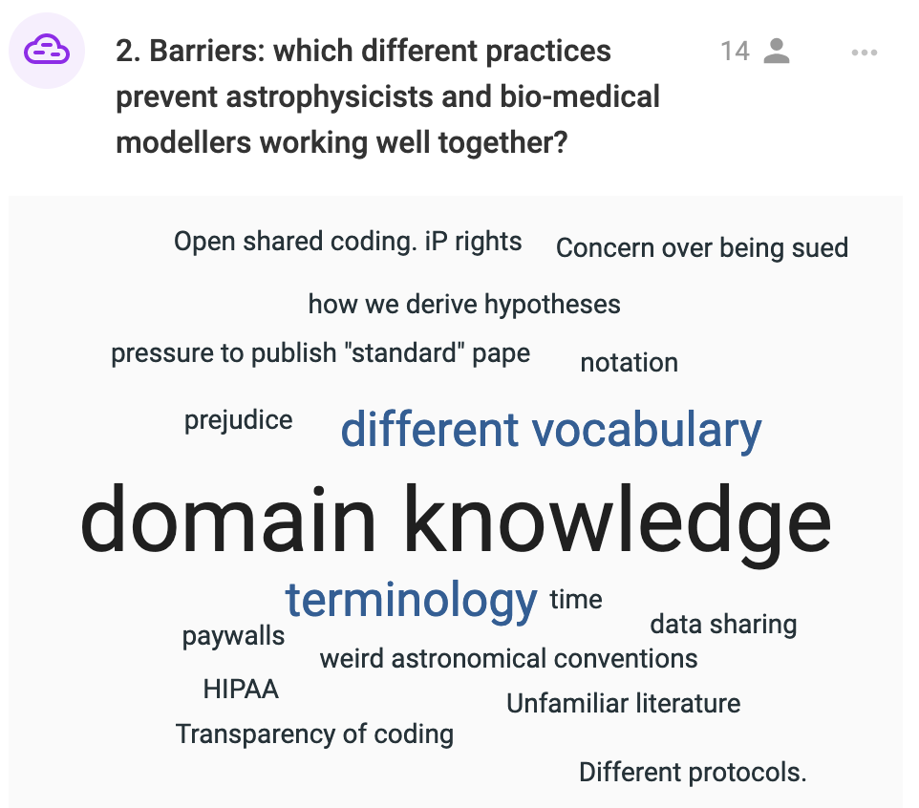
on www.sli.do (or Slido app) enter code # earth-sky

Slide 10
Let’s start!
more info on the website
https://indico.nbi.ku.dk/e/earthandsky
or ping us on the Webinar Chat

