Slide 1
RIDE Update
Sofus Stray

Slide 2
Summary
Use TCN to predict stopped muons
Calculate RIDE on the stopped muon data

Slide 3
Summary
$$RIDE_{i}=\frac{{\left( \frac{\sum_{events}{q}}{\sum_{events}{hit}}\right)}_{i}}{{\left( \frac{\sum_{events}{q}}{\sum_{events}{hit}}\right)}_{monitor}}$$
Where q is the charge, hit is if we expect a charge, summing over all events.
Denominator takes the median of the group each DOM is part of (grouped by z-position)

Slide 4
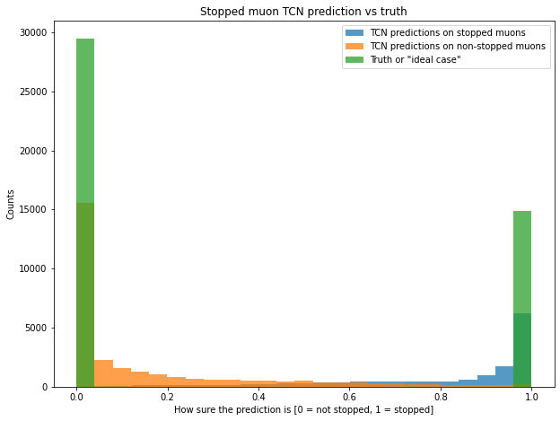
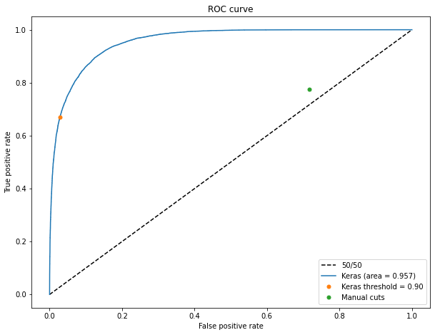
TCN results

Slide 5
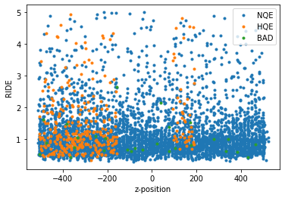
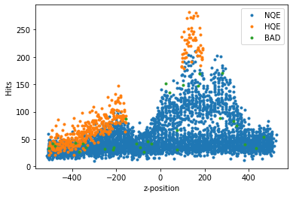
RIDE
Calculate on 0.9 threshold data to get a very pure sample (around 10k)

