Slide 1
RIDE Update – 12-02-2021
Sofus Stray
Weekly NBI Meeting

Slide 2
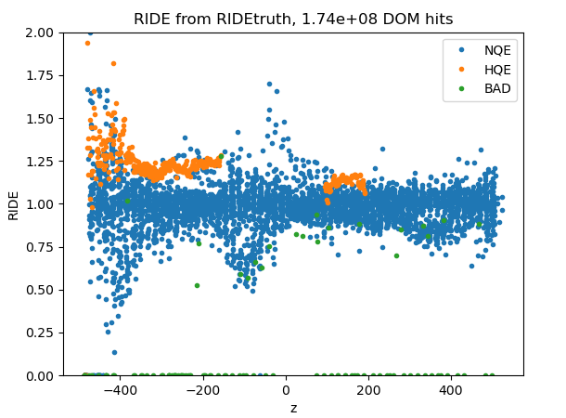
Stopped muon selection in MC truth
Selection:
r < 75m
SMT8 filter
Track endpoint within 100m of detector

Slide 3
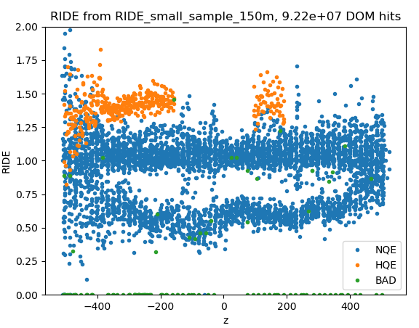
Stopped muon selection in MC truth
Selection:
r < 150m
SMT8 filter
Track endpoint within 100m of detector

Slide 4
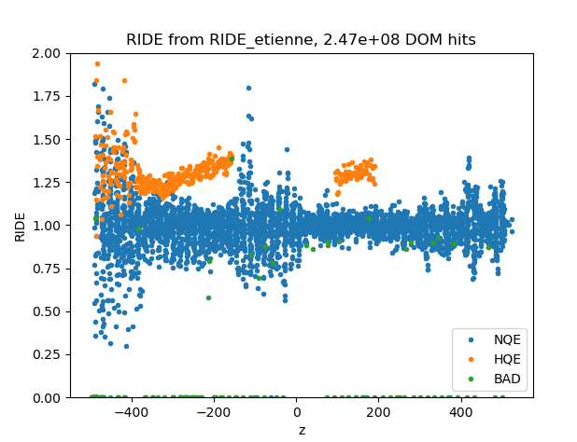
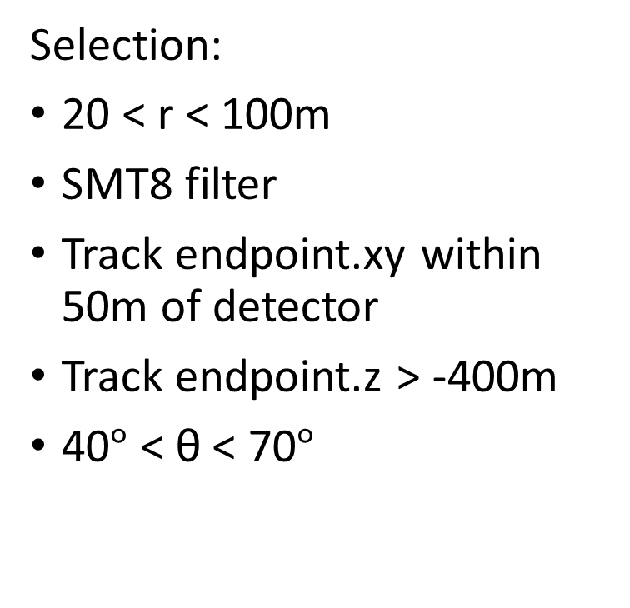
Stopped muon selection in MC truth
Selection:
20 < r < 100m
SMT8 filter
Track endpoint.xy within 50m of detector
Track endpoint.z > -400m
40$°$ < θ < 70$°$

Slide 5
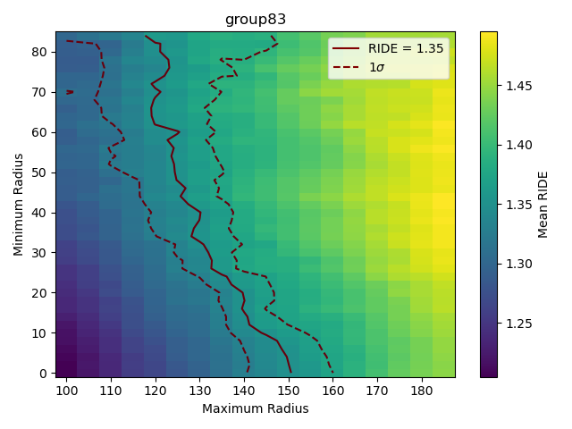
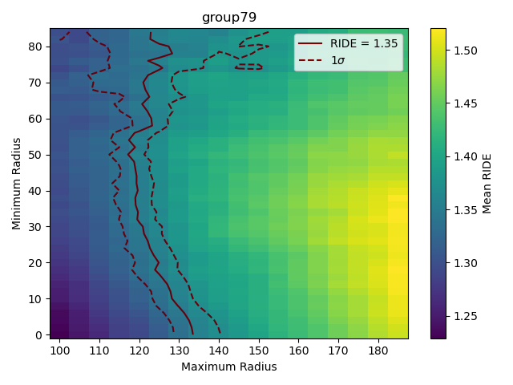
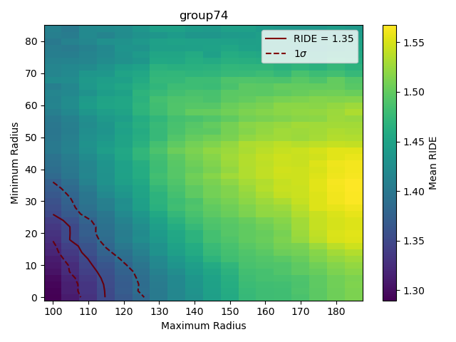
HQE RIDE by group (40° < θ < 70°)
Radius cut scan:
Find the RIDE = 1.35 points and compare

Slide 6
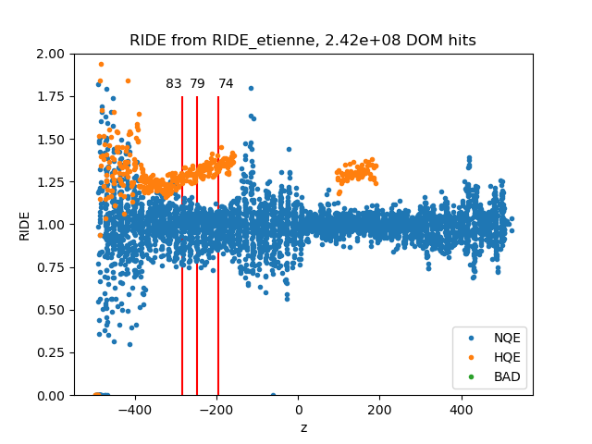
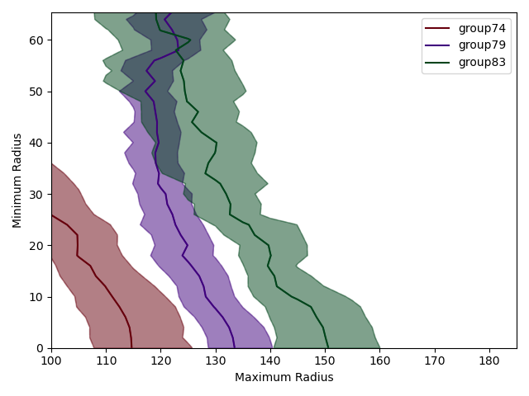
HQE RIDE by group (40° < θ < 70°)
Selection:
40° > θ > 70°
…
20 < r < 100m
No overlap between all groups within 1σ

Slide 7
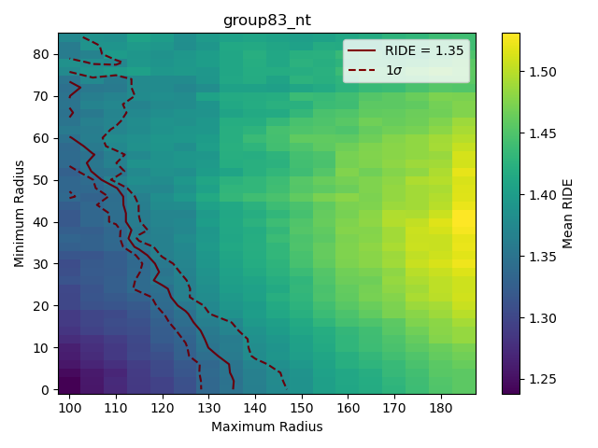
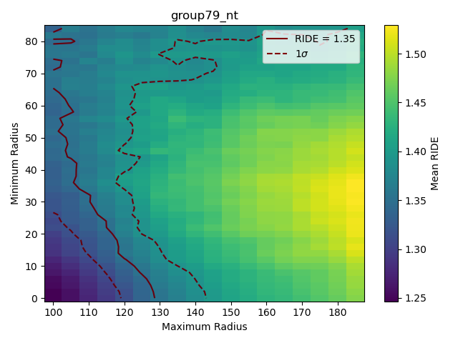
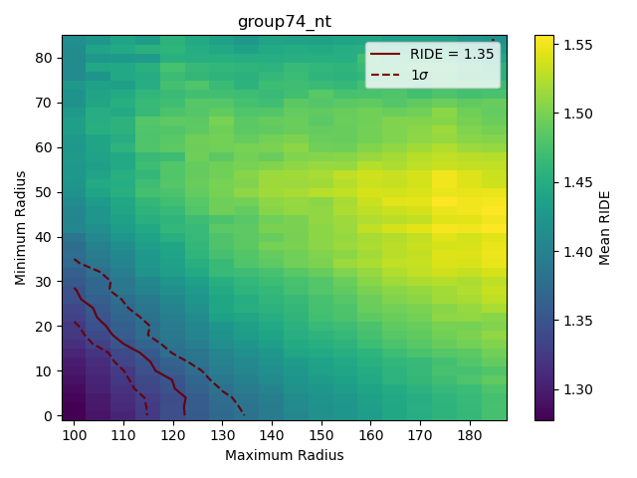
HQE RIDE by group (0° < θ < 180°)
Radius cut scan:
Find the RIDE = 1.35 points and compare

Slide 8
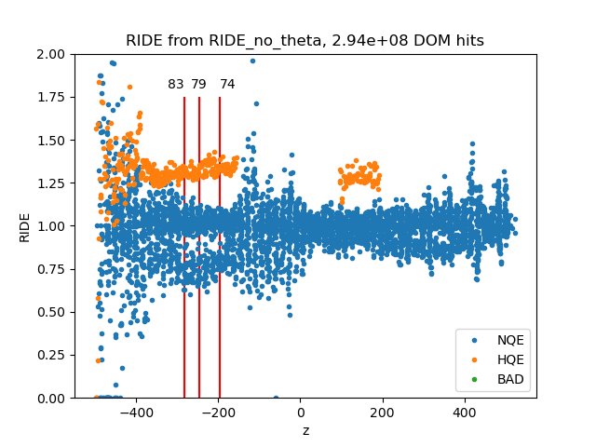
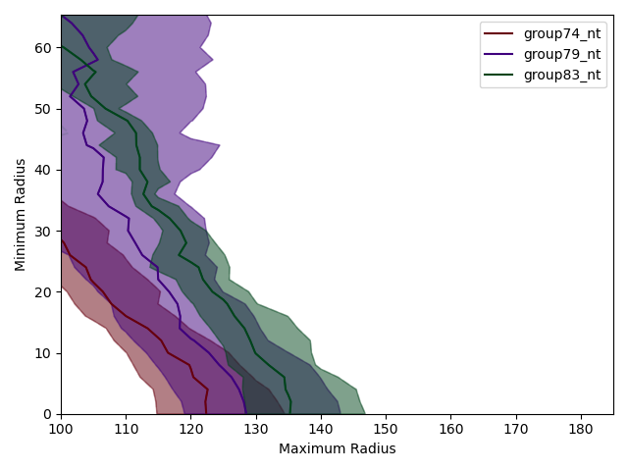
HQE RIDE by group (0° < θ < 180°)
20 < r < 100m
Overlap between all three groups at low minimum radius

Slide 9
Next steps:
Expand radius scan
See if “no theta cut” selection works with more groups
Fix radius (20 < r < 100m) and scan over theta

