Slide 1
Relative Individual DOM Efficiency
Relative Individual DOM Efficiency
Summary of Sofus Stray’s project
12/03/2021
Calibration Call

Slide 2
Motivation
DOM charge response in situ does not precisely match laboratory charge response
Calibration of in situ charge response needed when simulating DOMs
We want to calibrate Relative Individual DOM Efficiency (RIDE)

Slide 3
Motivation
Previously showed agreement with theory on 2012 simulation
Uses iceprod1
No anisotropy
Current goals: Get consistent RIDE values on 2016 simulation
Uses spice3.2
Includes anisotropy

Slide 4
RIDE
$RIDE_{i}=\frac{{\left( \frac{\sum_{events}{q}}{\sum_{events}{hit}}\right)}_{i}}{{\left( \frac{\sum_{events}{q}}{\sum_{events}{hit}}\right)}_{monitor}}$
Initial Expectations: NQE DOMs have RIDE value of 1, HQE of 1.35
Monitor definition based on 10m-bin spacings in the z-axis

Slide 5
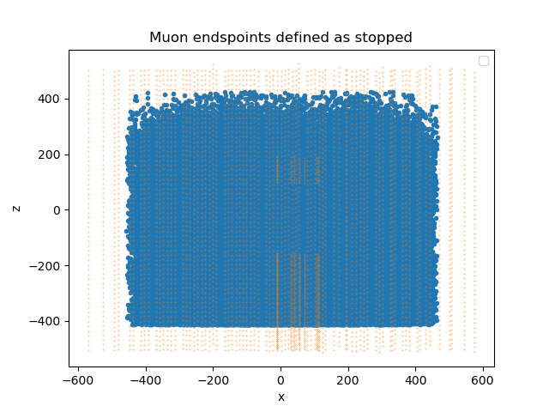
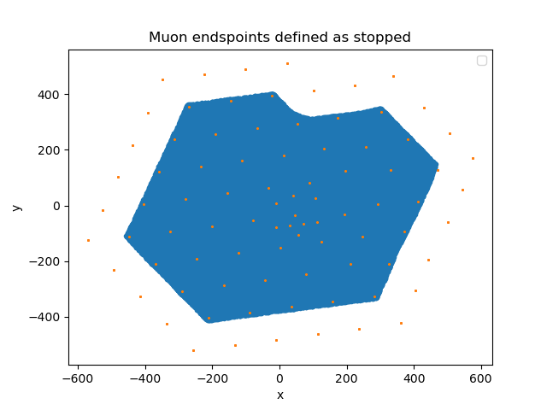
Particle light sources
The RIDE assumption only works for well modelled particle sources
In this study we focus on minimum ionizing muons
Known stopping point
Known energy
Constant light source
Approximate with stopped muons
SMT8 filter
Track endpoint.z > -400m
Track endpoint.xy > 100m from detector edge
DOM radius from track filter

Slide 6
2012 results
NQEs not quite at 1.0, HQEs still have gradient
Overall mean and std within expectations
0m < r < 130m

Slide 7
Initial 2016
No gradient
HQE mean below expectations
0m < r < 130m

Slide 8
Icelayer binning
Icelayer groups

Slide 9
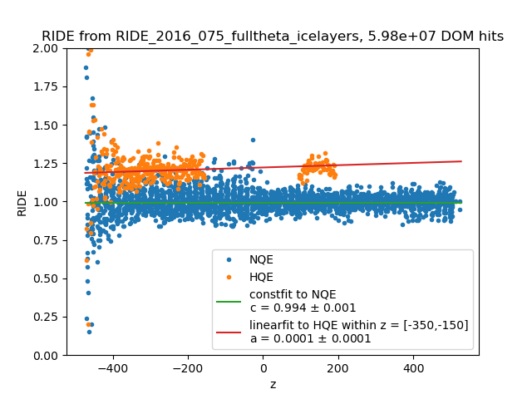
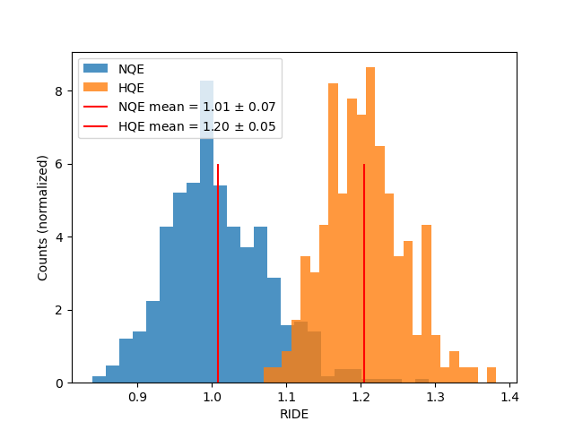
Z-binning vs icelayers
Tilted Icelayers
Z-binning
0 < r < 75

Slide 10
Group analysis
Pick three separate groups in DeepCore
Find radius from track corresponding to 1.35

Slide 11
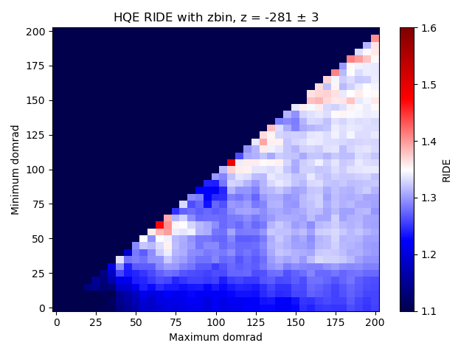
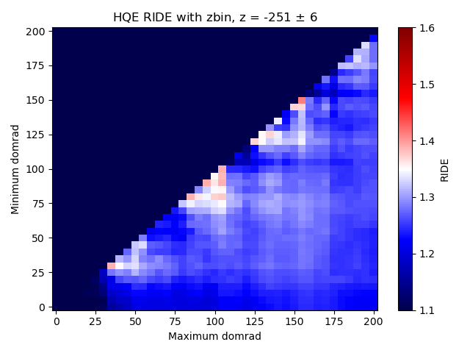
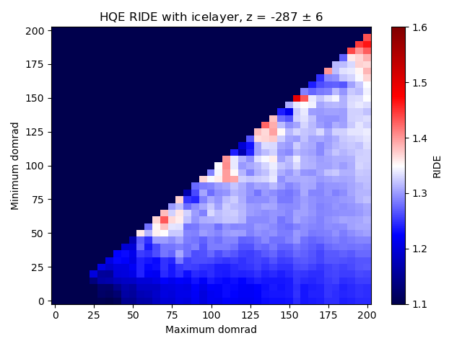
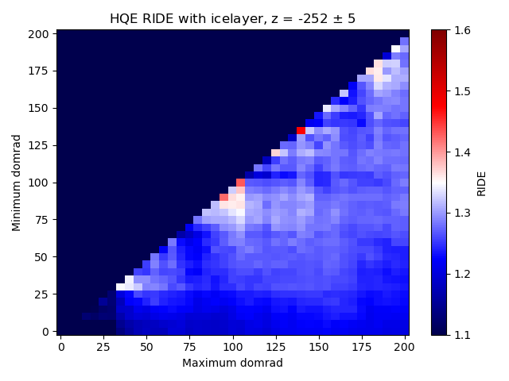
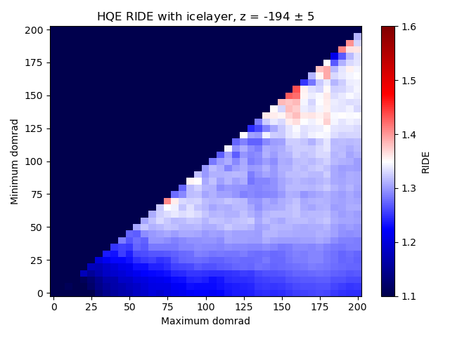
Group analysis

Slide 12
RDE in CLSim
CLSim HQE λ-acceptance
13/02/2019 - Summer

Slide 13
RDE factor

Slide 14
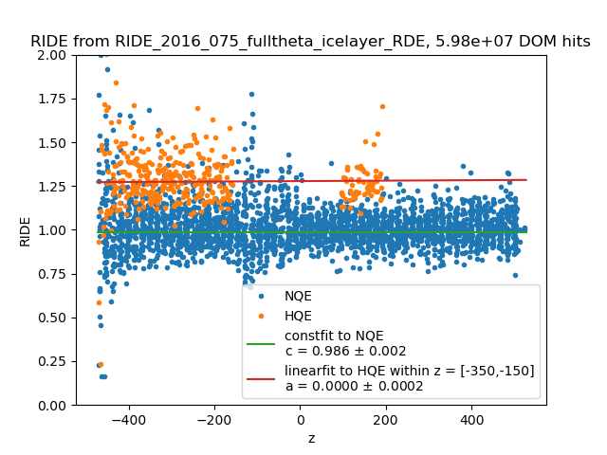
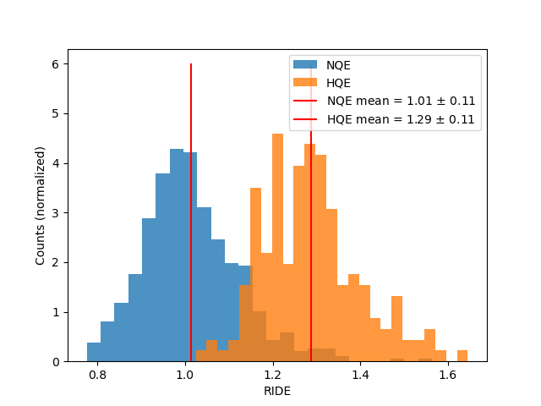
eff_f2k factor divided out
Icelayers
Z-binning
0 < r < 75

Slide 15
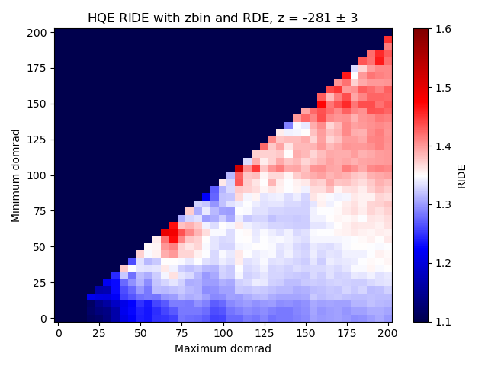
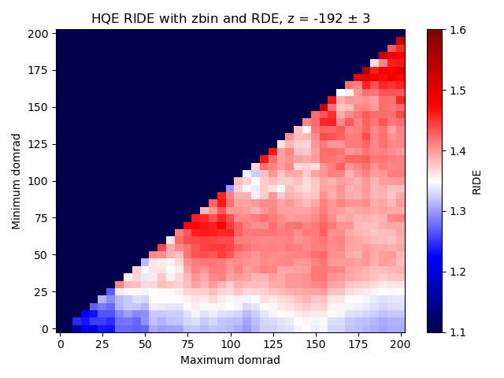
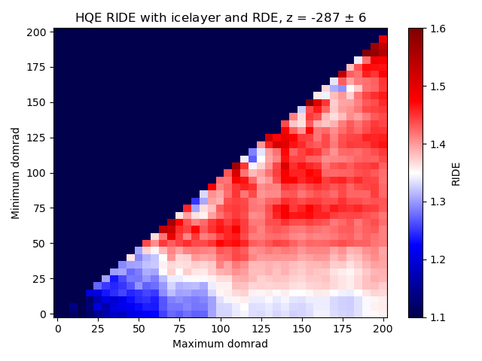
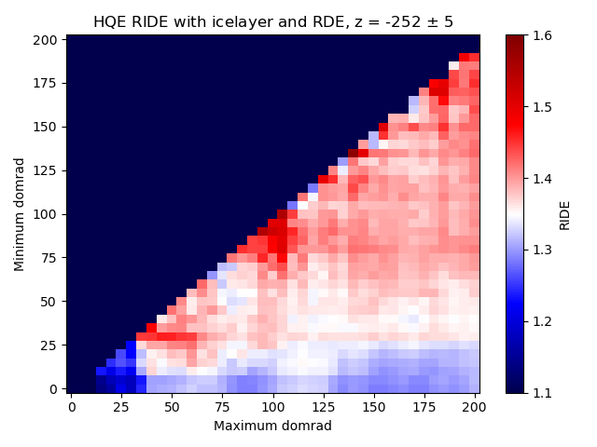
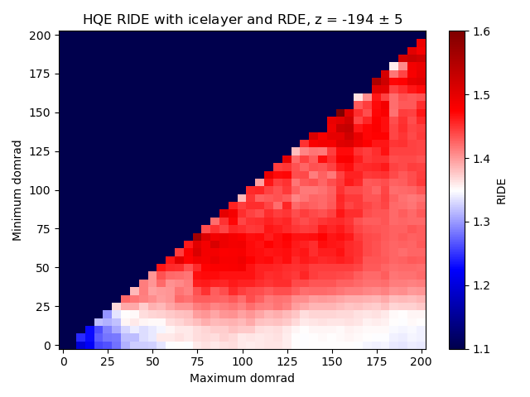
Group analysis

Slide 16
Updated 2016
Less scatter below dust layer
HQE mean at expectations
10m < r < 125m

Slide 17
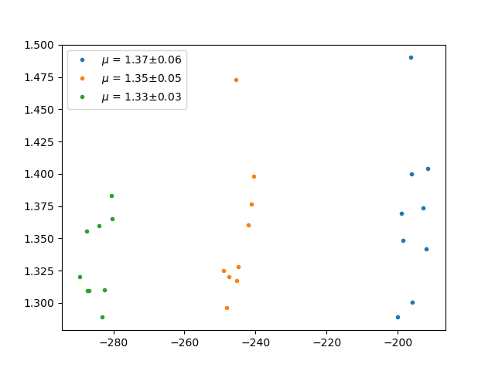
Change of focus
$σ_{μ}=0.016$, $σ_{max}=0.06$
Minimize HQE RIDE spread
Drop chase of 1.35 (for now)
$σ_{μ}=$ standard deviation of mean RIDE of each group
$σ_{max}=$ max standard deviation between DOMS in all groups
Goal: Agreement between groups, make sure stddev is not too high

Slide 18
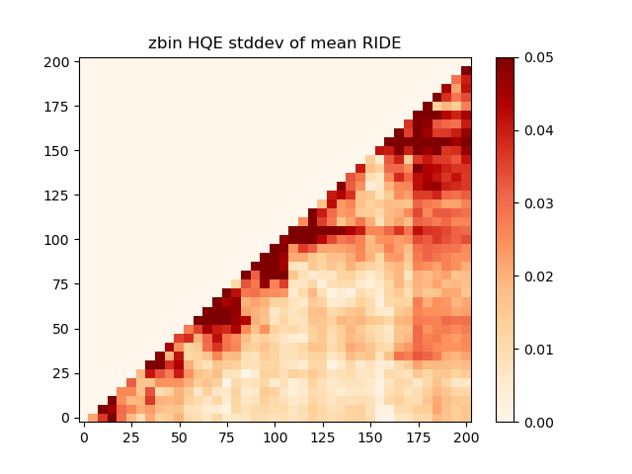
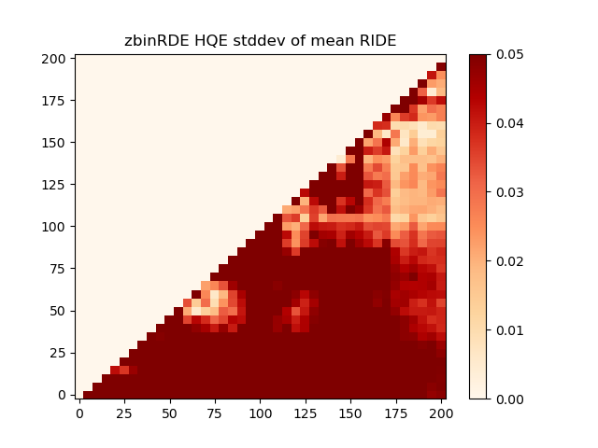
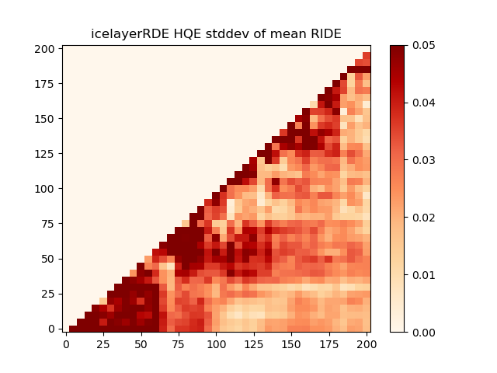
Group analysis 2

Slide 19
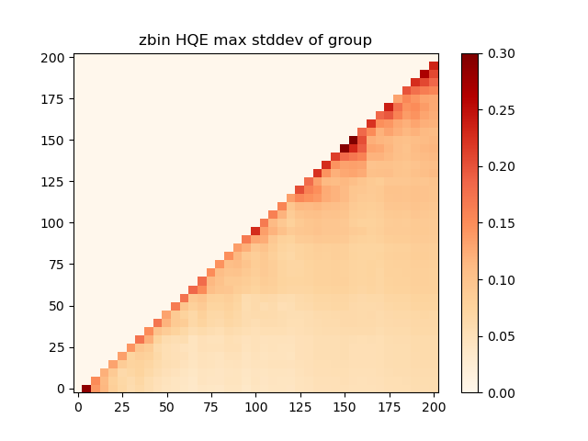
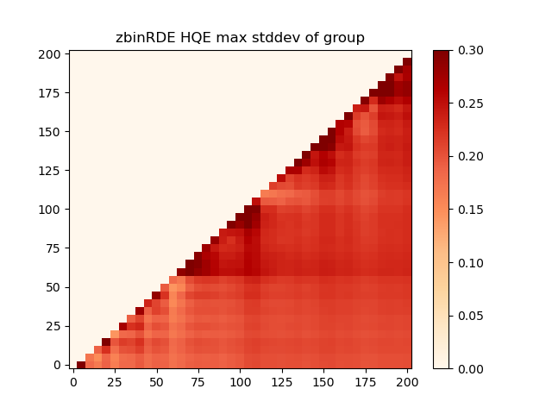
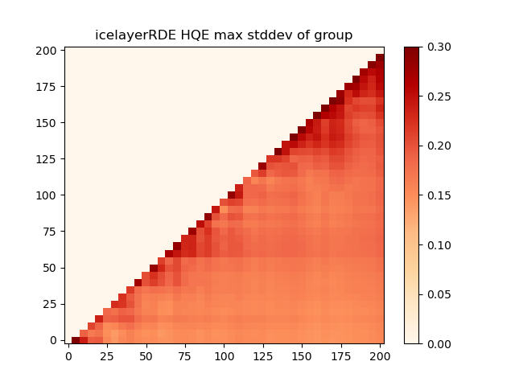
Group analysis 2

Slide 20
Next steps
Confirm RDE factors
Attempt further constraint on $σ_{μ}$
Full detector plots
Move to reconstruction

