Slide 1
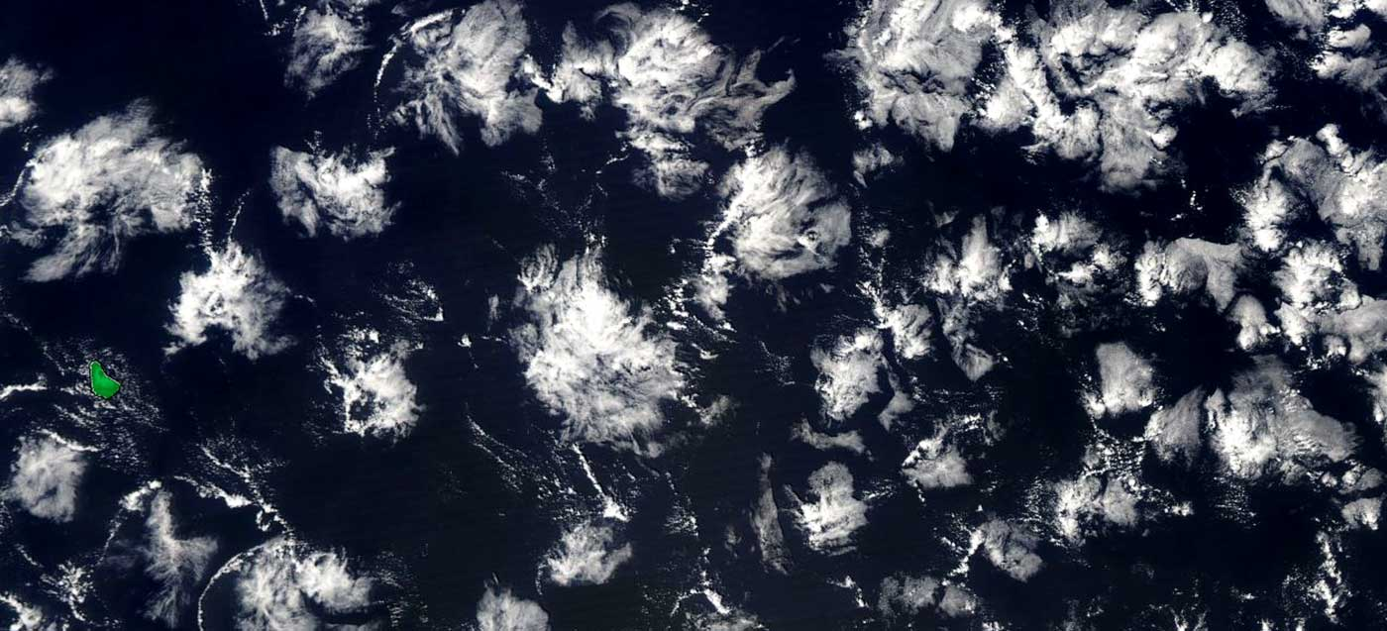
Organisation in Shallow Cumulus Convection
Pier Siebesma, Graham Feingold & Louise Nuijens
Workshop on Spatial Organisation of Convection, Clouds and Precipitation
Kopenhagen May 5-7 2021
a.p.siebesma@tudelft.nl

Slide 2
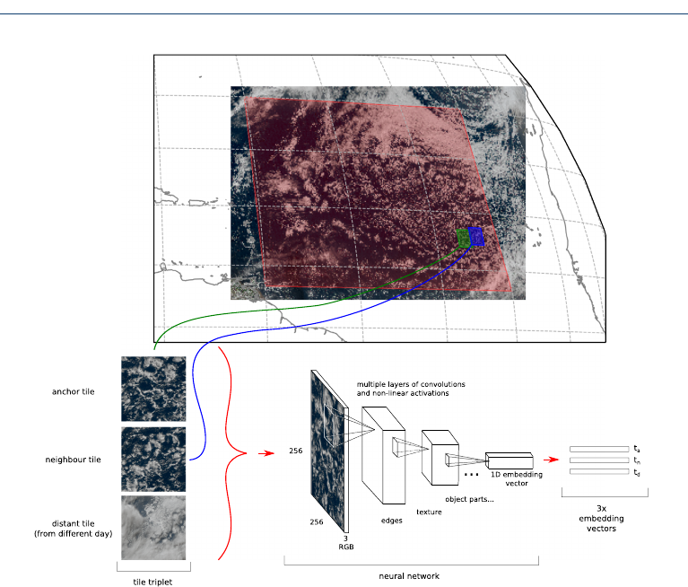
How do we characterise the different modes of organisation?
Sugar
gravel
flowers
fish
Are there well defined states of organisation in shallow cumulus convection?
If so, are we happy with sugar, fish , gravel and sugar , if not how do we proceed ? ( i.e. defining organisation, evaluating concepual models, parameterisations etc)

Slide 3
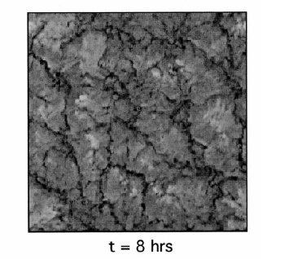
How do internal processes influence organisation?
25km
Internal feedback loops
Boing et al 2013
De Roode (2004) : how large is large enough?
Seifert & Heus ACP (2013))
This poster Session:
How essential is precipitation for organising shallow cumulus convection?
Jule Radtke: relation organisation and precipitation (patterns)
Witte: influence of microphysics
Siebesma internal growth of humidity fluctuations

Slide 4
(How) Does organisation depend on environmental (external) conditions?
Bony et al GRL 2019
This poster Session:
Louise Nuijens : dependance on shear
Graham Feingold : dependance on aerosols
Heike Schultz: dependance on subsidence, synoptic conditions
Isabel McCoy: dependance on global warming ( cloud feedback!)
FL = Flowers
FI = Fish
GR = Gravel
SU = Sugar
Which are the key external factors that promote certain modes of organisation?
Is cloud organisation mainly internal driven ( upscale) or external driven ( downscale)?

Slide 5
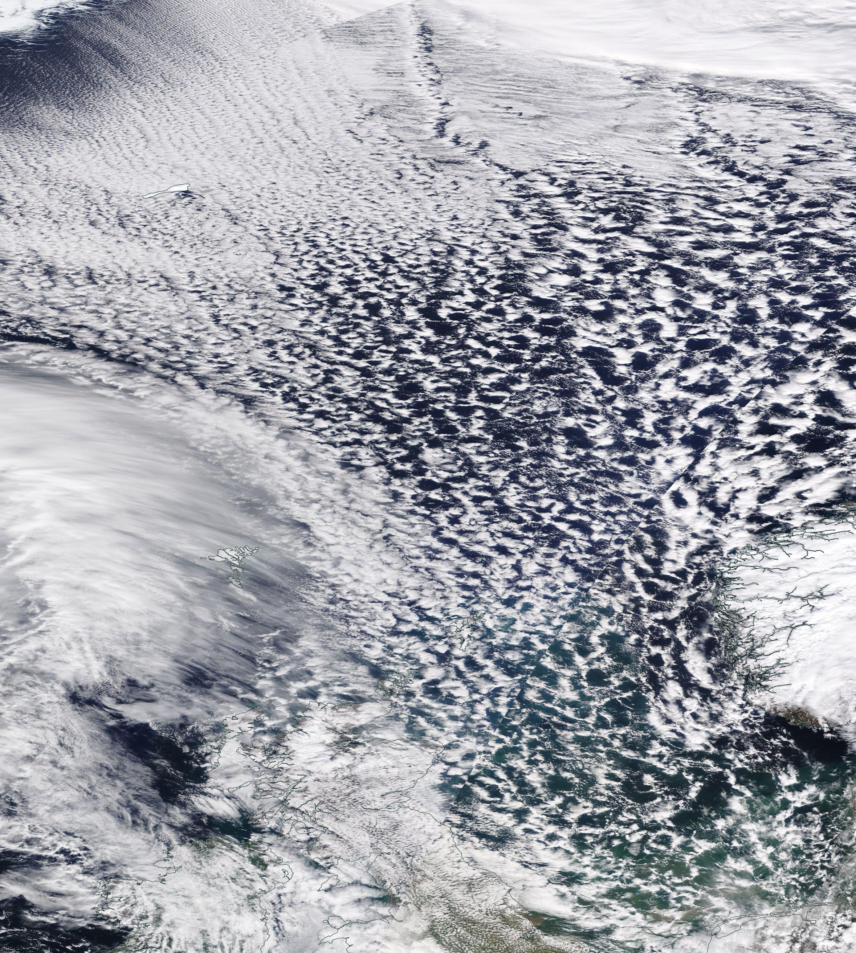
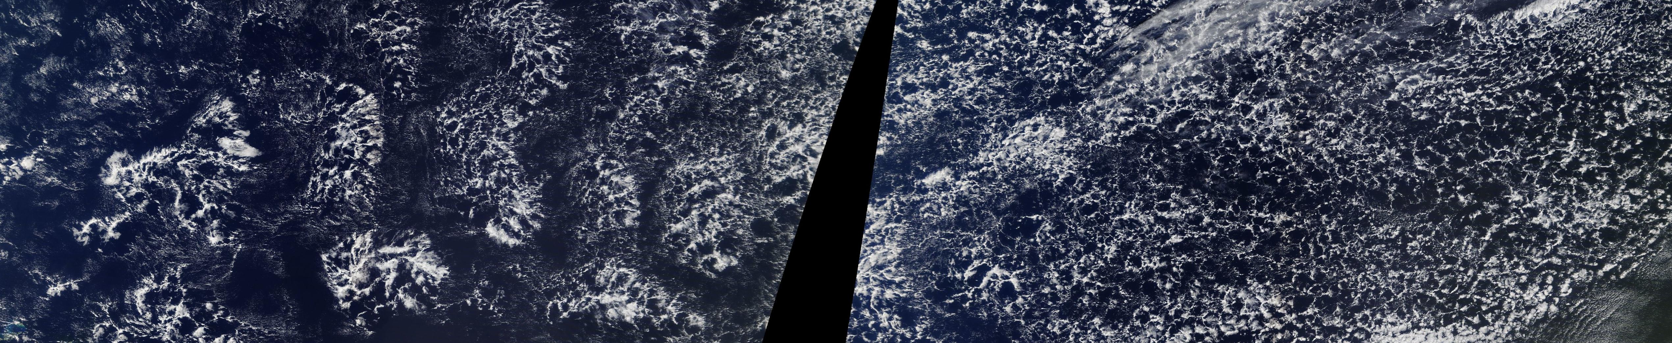
Transitions between different modes of organisation
Greenland (April 7 2021)
Gravel => Flowers (Feb 7 2021)
Atlantic Ocean
This poster Session:
Eastman: transition Scu -> Cu , closed open cells
Jan Kazil transition closed open cells
Narenpitak: transition sugar to flower (simulation)
Blossey: transition sugar to flower (simulation)
Siebesma cold air outbreak
Kurowski transition from shallow to deep convection
Feingold transitions in stratocumulus regimes
What do we know now about the transition mechanisms of shallow cumulus convection?
Cold air outbreak (April 7 2021)
NL, Ger. Dk

Slide 6
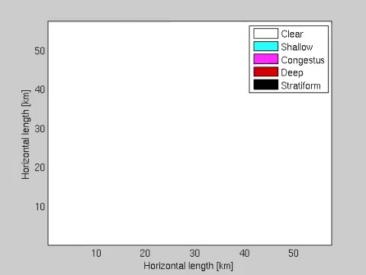
Building Conceptual Models /Parameterisations that incorporate organisation mechanisms
This poster Session:
Boualem Khouider: stochastic multicloud model
Roel Neggers: interacting plumes
Philip Griewank: plume-plume interaction
Doug Parker; Rainy-Benard Model
Marcin Kurowski interacting multiplume model
Chen cloud-cloud interaction
Combining ”old school” multiplume models with:
Dorrestijn et al 2015
Cellular automata that let clouds/plumes interact
How sure are we about the interaction mechanisms that essentially determine the dynamics of conceptual model / parameterisation?

Slide 7
Discussion Points for low clouds
What is an appropriate measure for organisation?
Are there distinct organisational modes?
What drives cloud organisation ( external vs Internal, transition)?
Do we have enough understanding to build conceptual models.
How essential is precipitation for the formation of low cloud organisation
How will the relative frequencies of the various organisation modes change in a warmer climate
Will it matter for cloud feedback?
Can the various organisation modes be considered as equilibrium states
To what extent can we simulate it ( explicit or with conceptual lower dimensional models)

