Slide 1
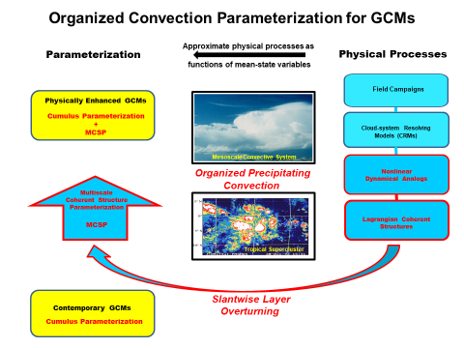
Despite half-a-century of extensive field & satellite observations, numerical simulations, and theoretical studies, the parameterization of organized convection in GCMs languishes.
This deficiency has far-reaching implications because convective organization significantly affects Earth’s water cycle; distribution, intensity, and frequency of precipitation; variability of weather and climate; efficacy of GCMs; and much more.
Treatment of organized convection in GCMs is a challenging research imperative, the following is a minimalist parameterization, summarized later in this workshop session:

