Slide 1
Is the stellar initial mass function universal?
I. Template Fitting
II. Updated SFMS
III. Mass growth & Quiescence
C Steinhardt, A Jermyn, A Sneppen, H Hensley, B Mostafa, J Weaver & COSMOS Team

Slide 2
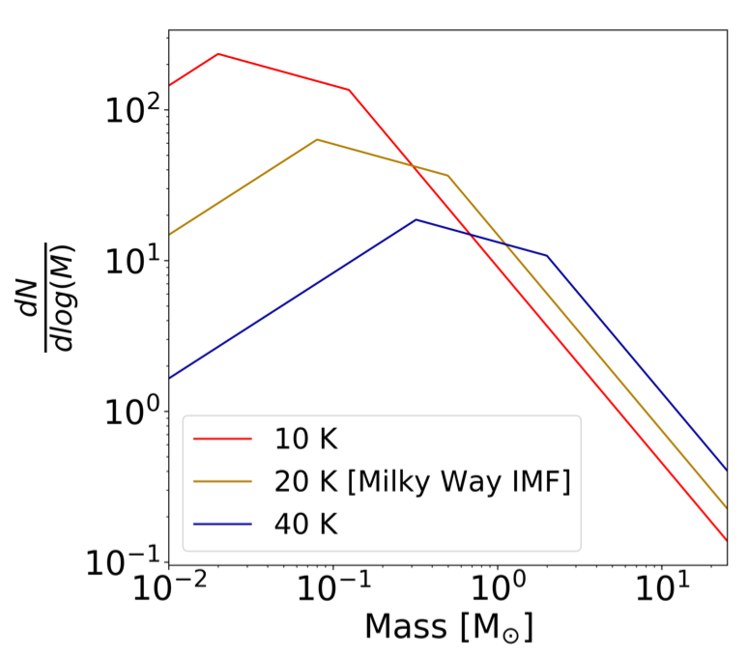
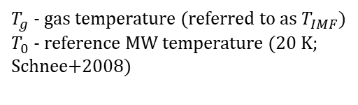
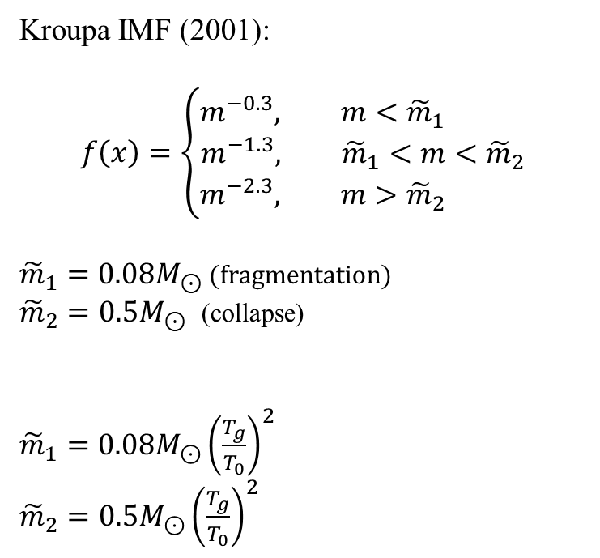


Variable IMF
Kroupa IMF (2001):
$$f\left(x\right)=\left\{\begin{aligned}m^{−0.3}, m<{\tilde{m}}_{1} \\ &m^{−1.3}, {\tilde{m}}_{1}<m<{\tilde{m}}_{2} \\ m^{−2.3}, m>{\tilde{m}}_{2} \end{aligned}\right.$$
${\tilde{m}}_{1}=0.08M_{⊙}$ (fragmentation)
${\tilde{m}}_{2}=0.5M_{⊙}$ (collapse)
${\tilde{m}}_{1}=0.08M_{⊙}{\left(\frac{T_{g}}{T_{0}}\right)}^{2}$
${\tilde{m}}_{2}=0.5M_{⊙}{\left(\frac{T_{g}}{T_{0}}\right)}^{2}$
[Jermyn+2018]
$T_{g}$ - gas temperature (referred to as $T_{IMF}$)
$T_{0}$ - reference MW temperature (20 K; Schnee+2008)
$$N\left(M\right)∝ M^{−2.35}−M^{−1.3}$$
$$L∝M^{3.5}$$
Notes:
Reduce time at the beginning
Stress on the ‘Why’ – esp. for BUFFALO ()
1 – DM, baryons (SBF, abundance matching), faint stars are an issue to probe theory
- Argue with physical reasons for T-dependence
- Connection to BUFFALO (z>6)

Slide 3
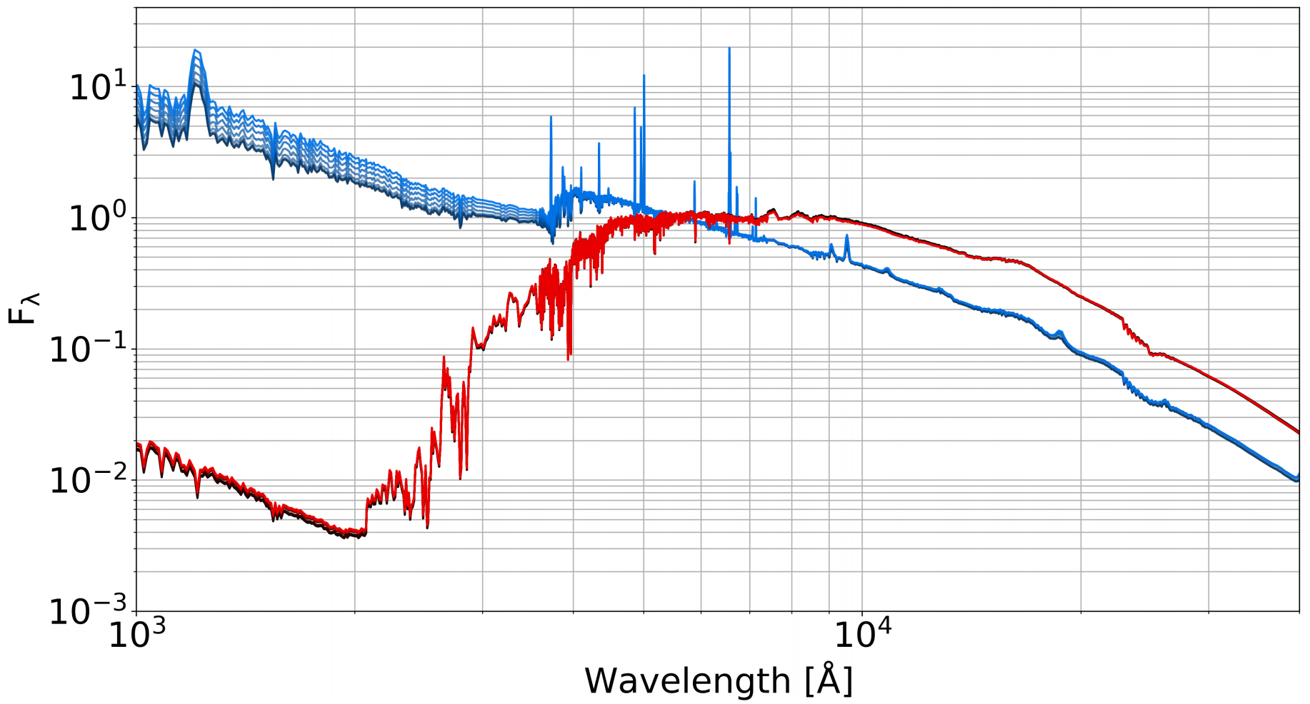
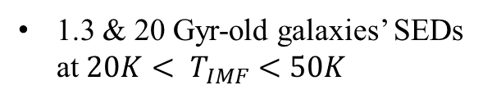
Template Fitting
Produce SED templates (FSPS; Conroy+2009; Conroy & Gunn 2010)
1.3 & 20 Gyr-old galaxies’ SEDs at ${20K< T}_{IMF}<50K$

Slide 4
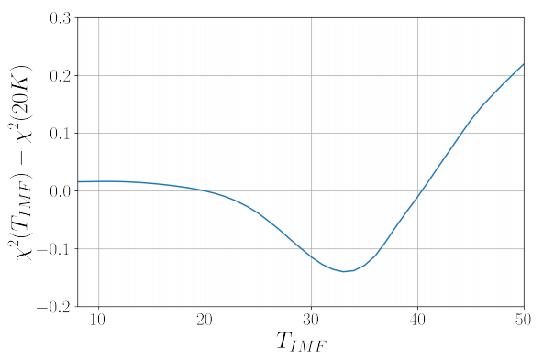
Template Fitting
Produce SED templates (FSPS; Conroy+2009; Conroy & Gunn 2010)
1.3 & 20 Gyr-old galaxies’ SEDs at ${20K< T}_{IMF}<50K$
2. Reduce, redshift and fit templates 35 bands from COSMOS2015 (Laigle+2016).
560
NNMF
12 (EAZY; Brammer+2008)

Slide 5
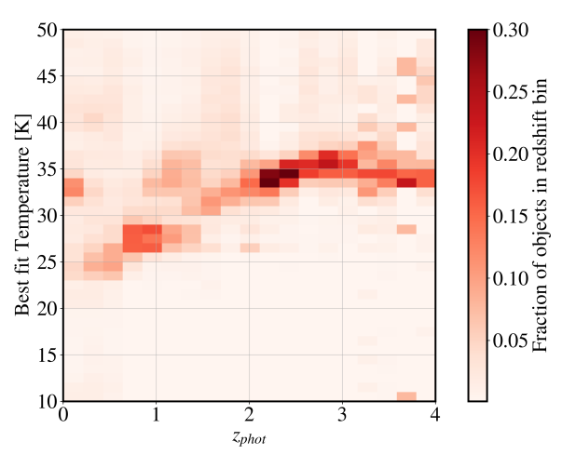

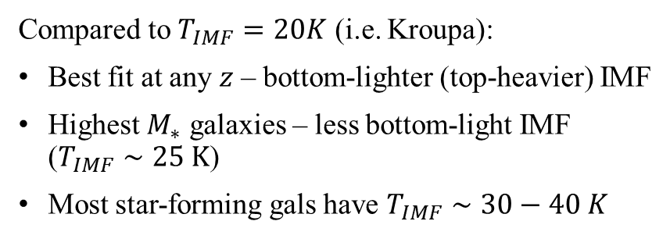
Best-fit $T_{IMF}$
Compared to $T_{IMF}=20K$ (i.e. Kroupa):
Best fit at any $z$ – bottom-lighter (top-heavier) IMF
Highest $M_{∗}$ galaxies – less bottom-light IMF ($T_{IMF}∼25 K$)
Most star-forming gals have $T_{IMF}∼30−40 K$

Slide 6
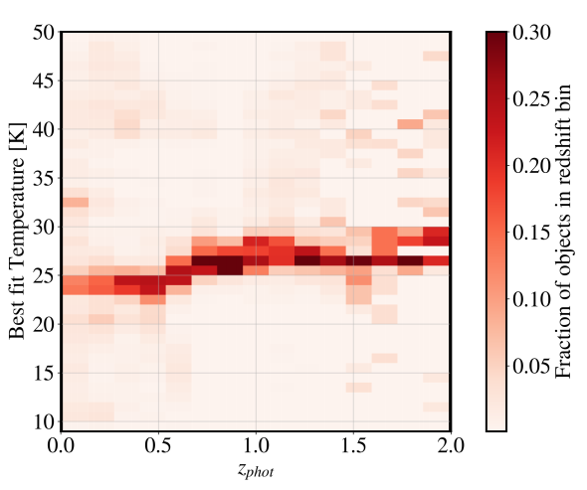
Best-fit $T_{IMF}$
Compared to $T_{IMF}=20K$ (i.e. Kroupa):
Best fit at any $z$ – bottom-lighter (top-heavier) IMF
Highest $M_{∗}$ galaxies – less bottom-light IMF ($T_{IMF}∼25 K$)
Most star-forming gals have $T_{IMF}∼30−40 K$
Quiescent galaxies

Slide 7
Best-fit $T_{IMF}$
Compared to $T_{IMF}=20K$ (i.e. Kroupa):
Best fit at any $z$ – bottom-lighter (top-heavier) IMF
Highest $M_{∗}$ galaxies – less bottom-light IMF ($T_{IMF}∼25 K$)
Most star-forming gals have $T_{IMF}∼30−40 K$
Quiescent galaxies
Two mechanisms or one?
Interplay between gas temp and stellar/cosmic radiation? (Maybe no; Steinhardt+2020)
ISM is responsible (e.g., iron vs. carbon dust)?

Slide 8

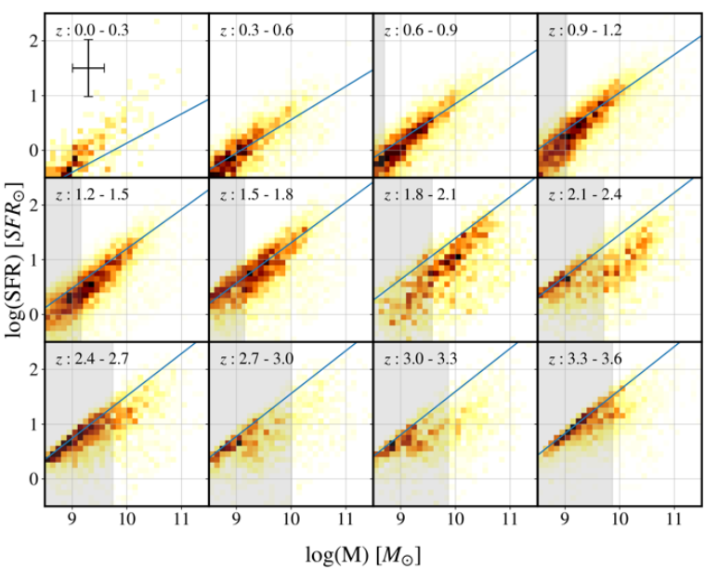
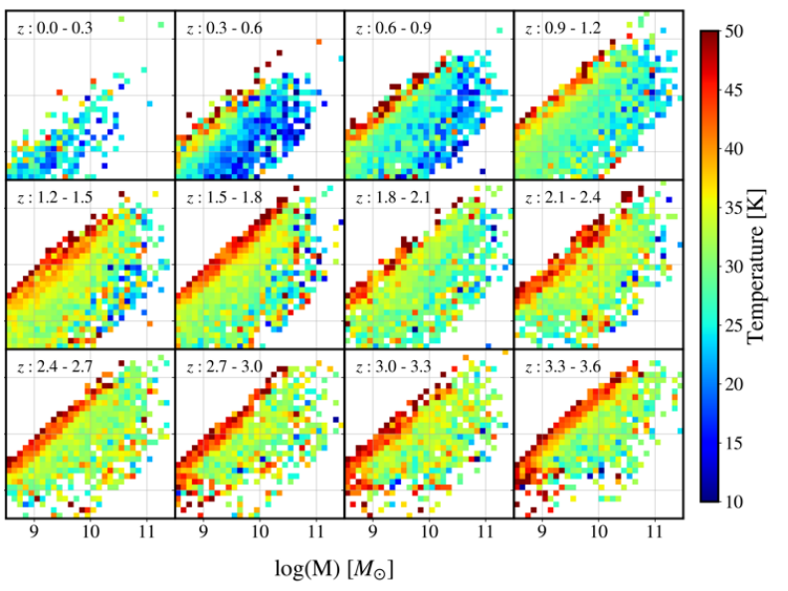
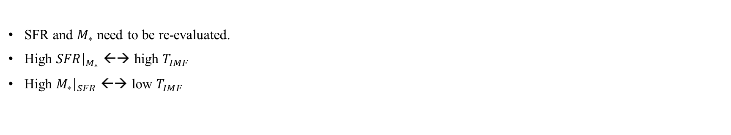

Implications: Star Forming Main Sequence
Best fits from Speagle+2014
$$Ψ(M_{∗})$$
SFR and $M_{∗}$ need to be re-evaluated.
High $SFR{\left.​\right|}_{M_{∗}}$ ←→ high $T_{IMF}$
High $M_{∗}{\left.​\right|}_{SFR}$ ←→ low $T_{IMF}$

Slide 9
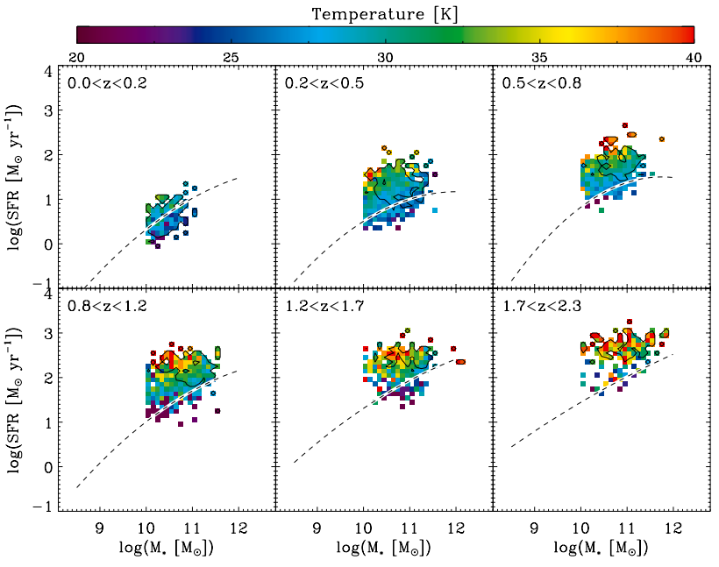
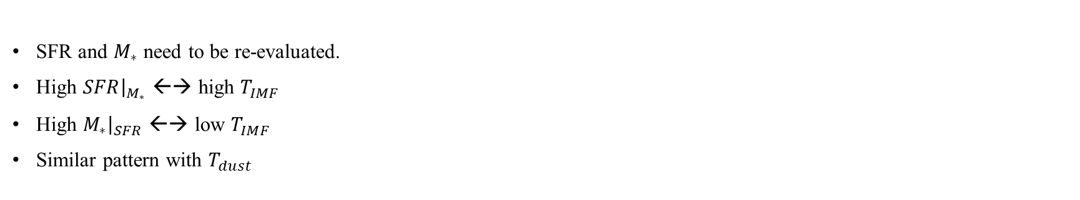
Implications: Star Forming Main Sequence
Best fits from Speagle+2014
Magnelli+2014
SFR and $M_{∗}$ need to be re-evaluated.
High $SFR{\left.​\right|}_{M_{∗}}$ ←→ high $T_{IMF}$
High $M_{∗}{\left.​\right|}_{SFR}$ ←→ low $T_{IMF}$
Similar pattern with $T_{dust}$

Slide 10
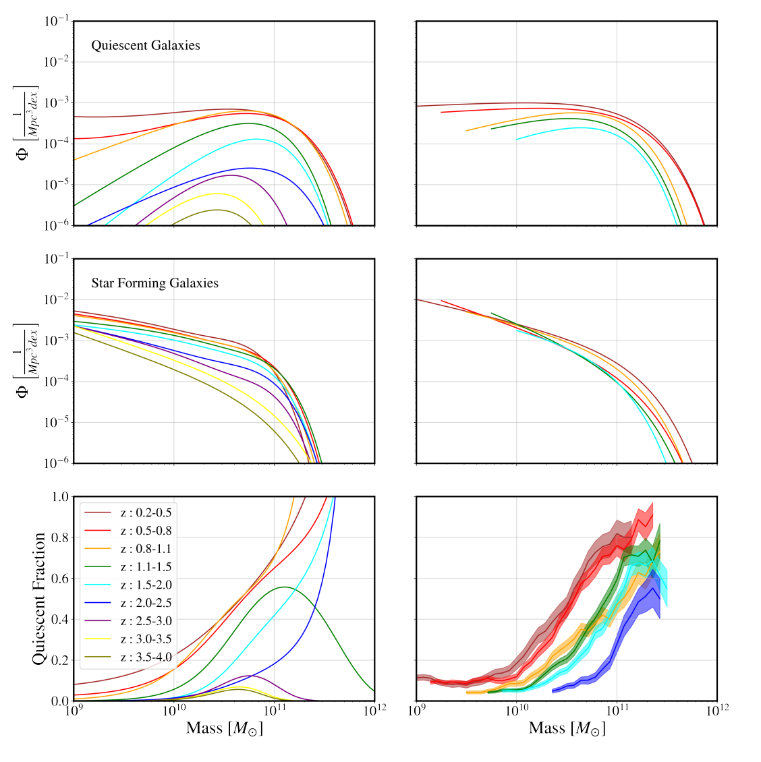
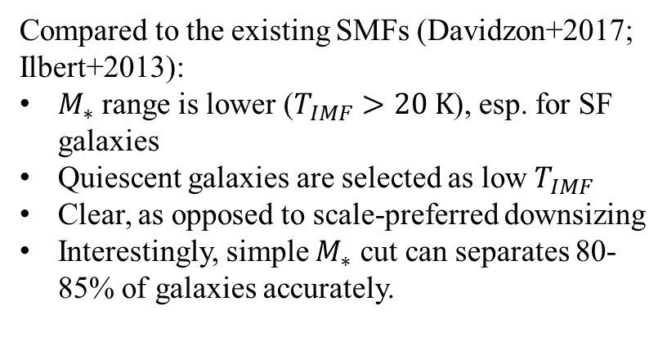
Implications: Quiescent Galaxies
Compared to the existing SMFs (Davidzon+2017; Ilbert+2013):
$M_{∗}$ range is lower ($T_{IMF}>20 K$), esp. for SF galaxies
Quiescent galaxies are selected as low $T_{IMF}$
Clear, as opposed to scale-preferred downsizing
Interestingly, simple $M_{∗}$ cut can separates 80-85% of galaxies accurately.
Davidzon+2017
Steinhardt+2021 (in prep.)

Slide 11
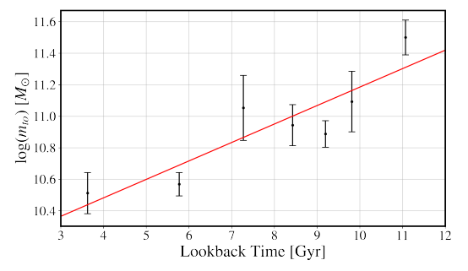
Implications: Quiescent Galaxies
Compared to the existing SMFs (Davidzon+2017; Ilbert+2013):
$M_{∗}$ range is lower ($T_{IMF}>20 K$), esp. for SF galaxies
Quiescent galaxies are selected as low $T_{IMF}$
Clear, as opposed to scale-preferred downsizing
Interestingly, simple $M_{∗}$ cut can separates 80-85% of galaxies accurately.
Davidzon+2017
Steinhardt+2021 (in prep.)

Slide 12
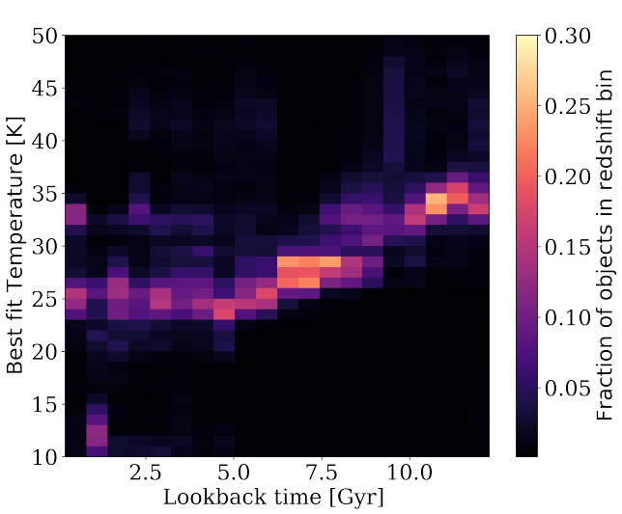
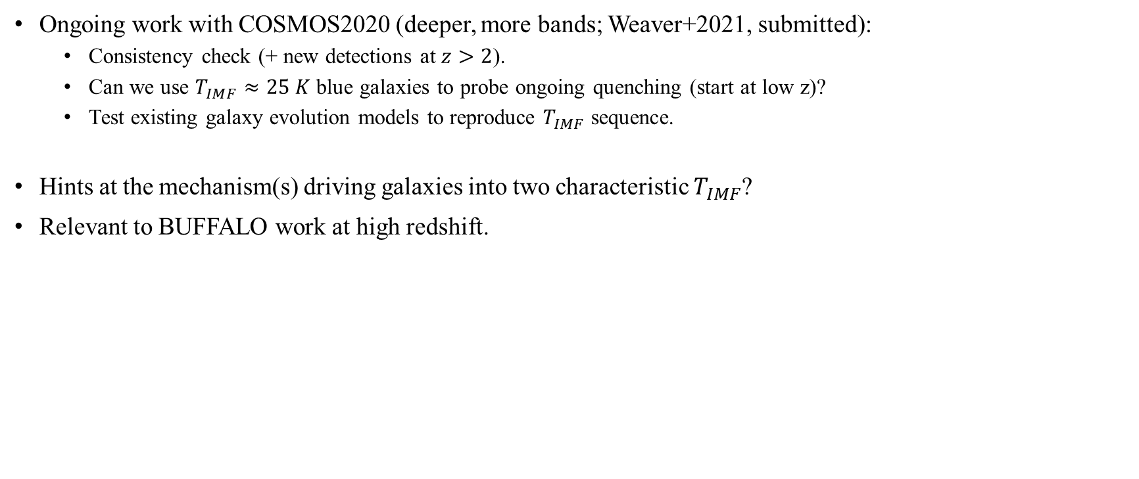
Final Notes
Ongoing work with COSMOS2020 (deeper, more bands; Weaver+2021, submitted):
Consistency check (+ new detections at $z>2$).
Can we use $T_{IMF}≈25 K$ blue galaxies to probe ongoing quenching (start at low z)?
Test existing galaxy evolution models to reproduce $T_{IMF}$ sequence.
Hints at the mechanism(s) driving galaxies into two characteristic $T_{IMF}$?
Relevant to BUFFALO work at high redshift.

