Slide 1
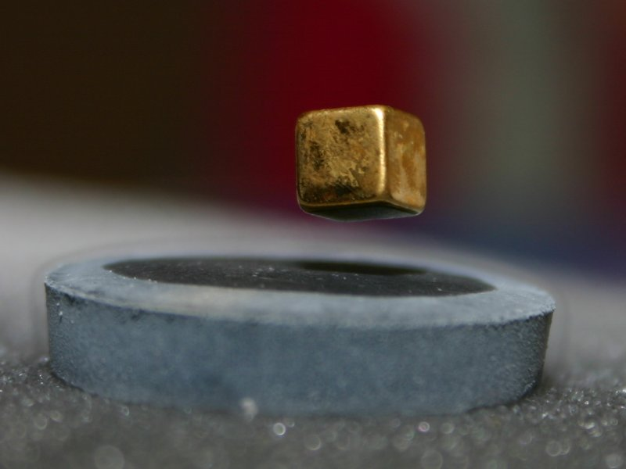

Investigation on
passing and drop-out
on the Physics b.sc.
Kim Lefmann
NBI Teachers Workshop, 17/6 2021

Slide 2
The investigation
Hypothesis: Students stumble over particular b.sc. courses
Politics: We MUST reduce dropout
Investigation: Passing and grading for courses
Number of exam attempts
Student progression and study time
Drop-out and drop-out prediction
Investigator: Study Board, Study Leaders, NBI Management
Conclusions: Found later, by discussion
Data provider: Science

Slide 3
Available data
Information per Physics and Nano student enrolled 2015-19
Background data: entry exam type + average grade + A-levels
Grades and dates for all exams on mandatory courses
Dates for enrolment, drop-out/degree dates

Slide 4
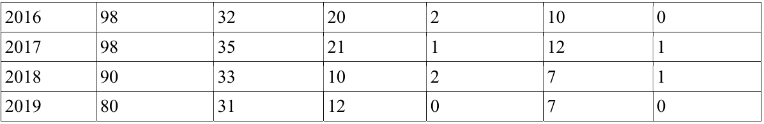
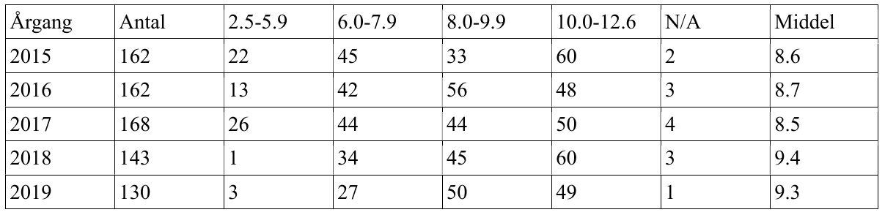
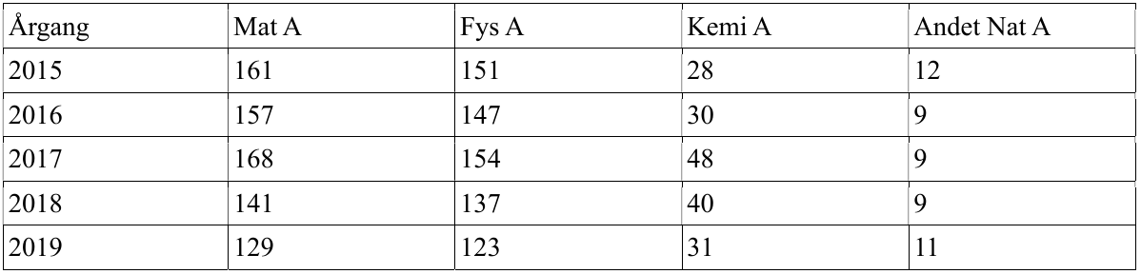
Data on student background

Slide 5
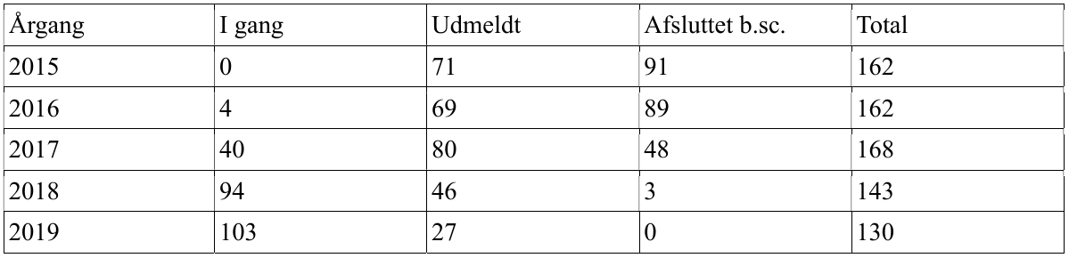
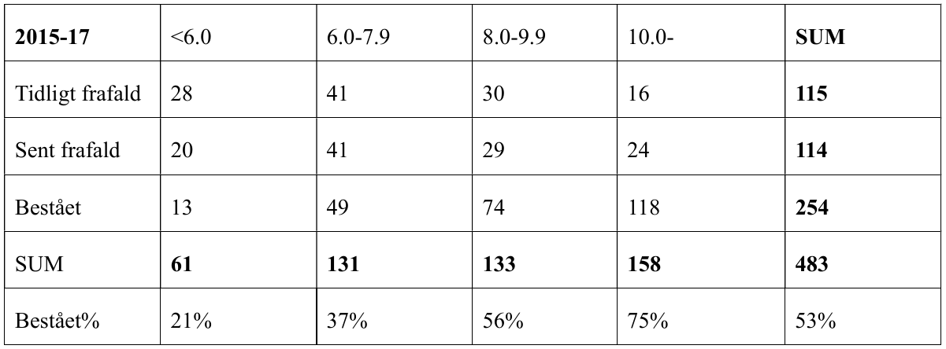
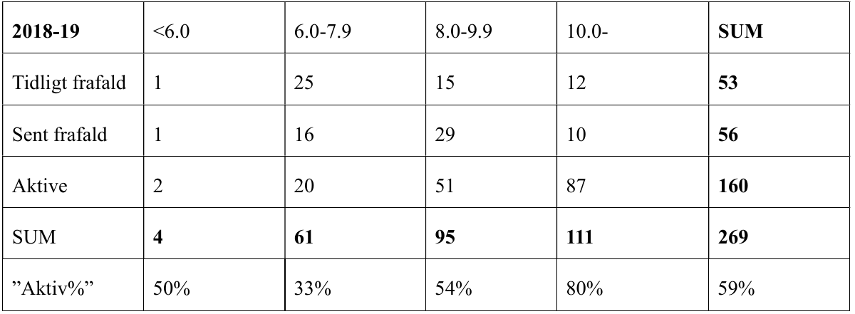
The overall progress

Slide 6
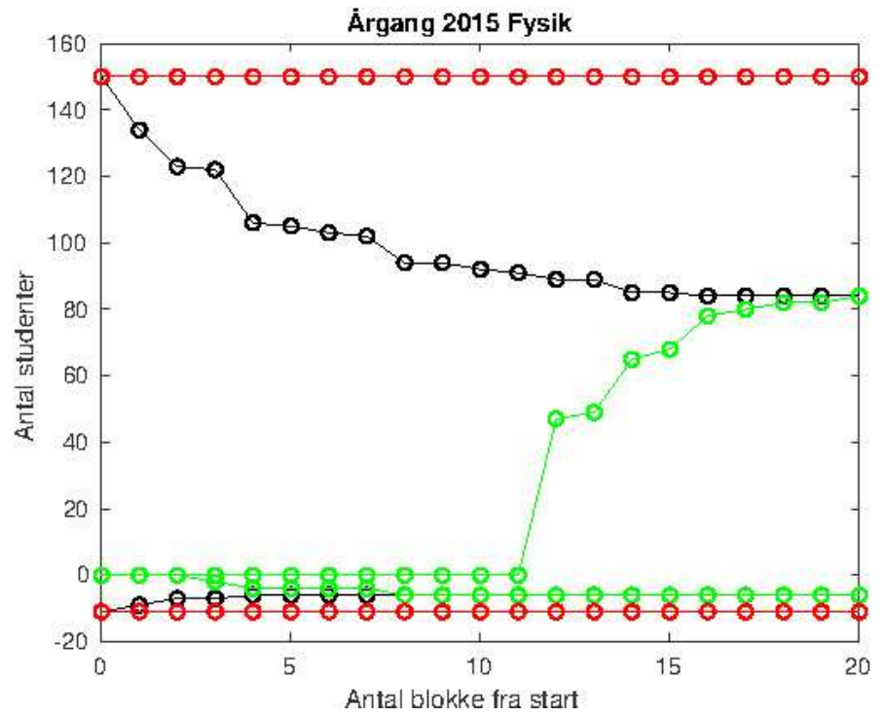
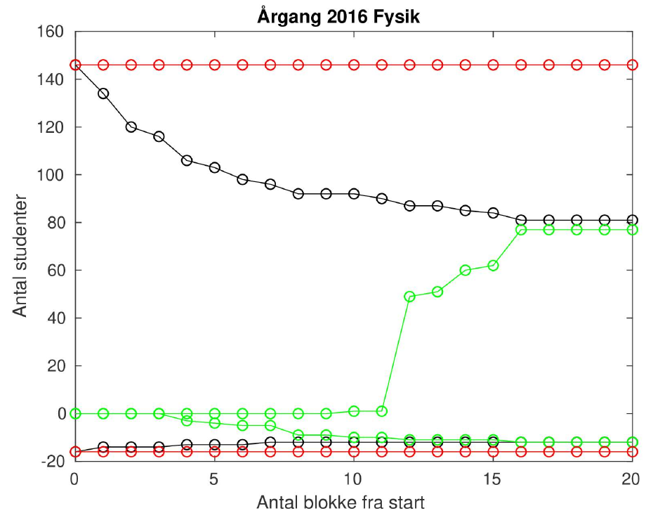
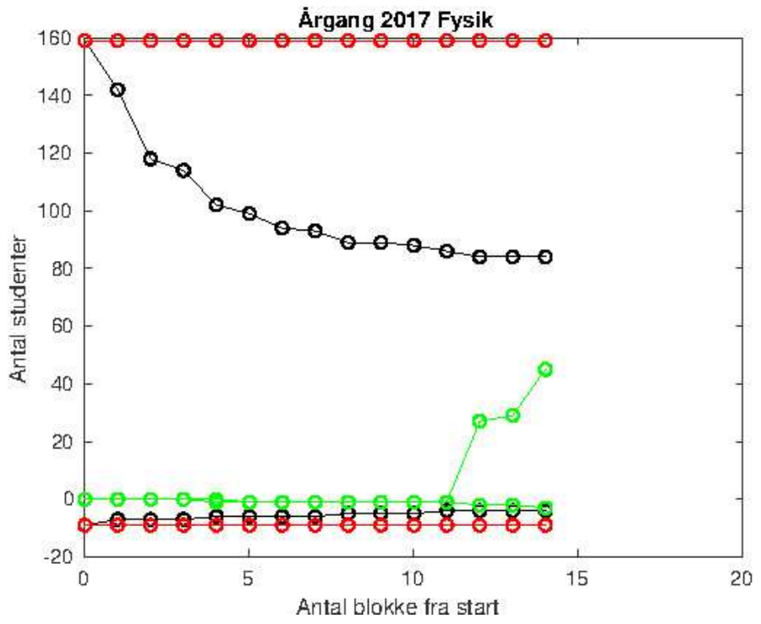
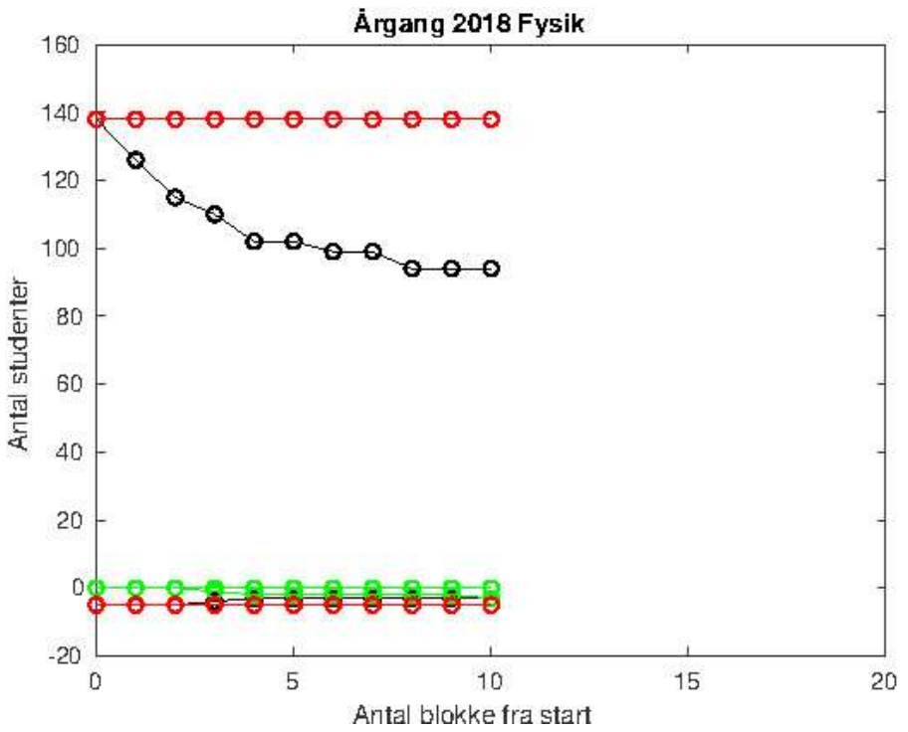
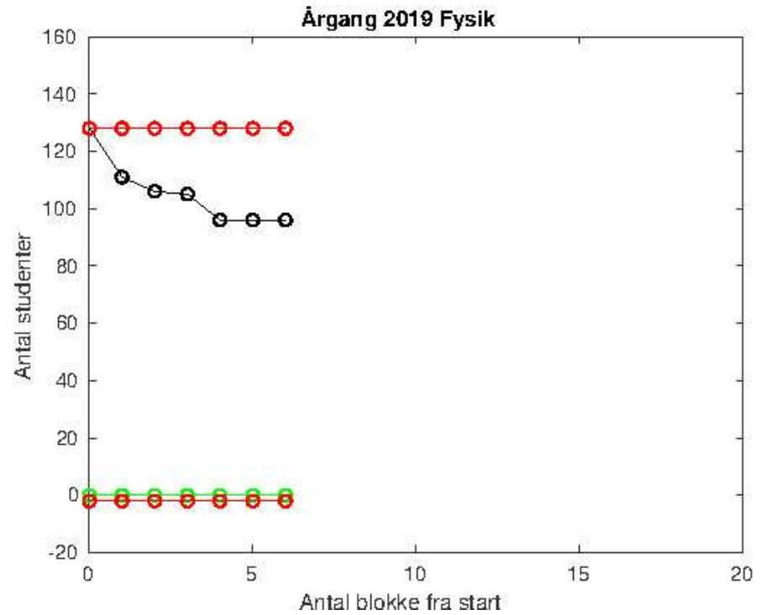
The years 2015-2019 at a glance
Year 2017 is a disaster.
82 already dropped out
8 more will surely do
Another 10 is blocked by 1-2 second year courses.
Estimate: 100 of 168(!)

Slide 7
The showstoppers
To pinpoint showstopper courses, we look at:
Information on non-passed exams
Exams that is passed only on 2nd - 5th attempt
Courses that visibly delay some students
Courses with low average grades and low pass numbers
Mekanik 2 (improved when changed to semester course MekRel)
Elektromagnetisme 1
Elektromagnetisme 2
Kvantemekanik 1 (only years 2015-2017)
Statistisk Fysik (strongly improved for year 2018)
Videnskabsteori (WARNING: mean grade fell by 3 from year 2017)

Slide 8
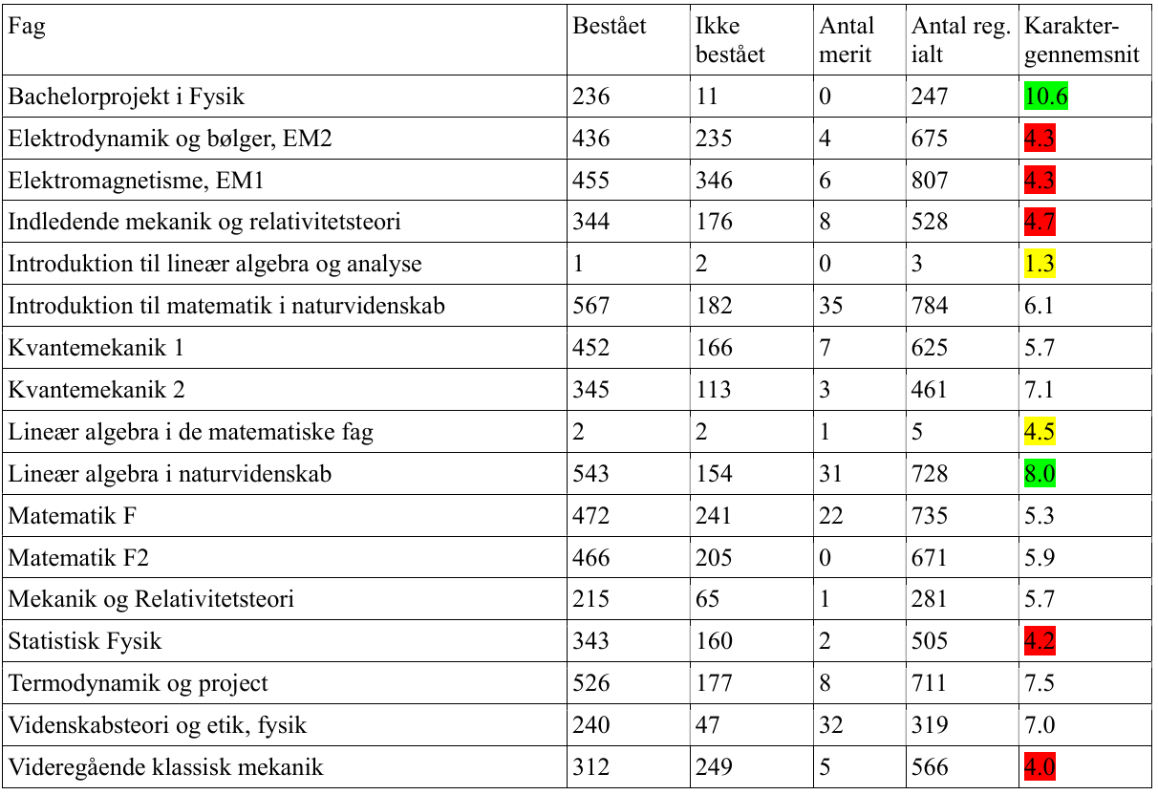
All courses, all exams

Slide 9
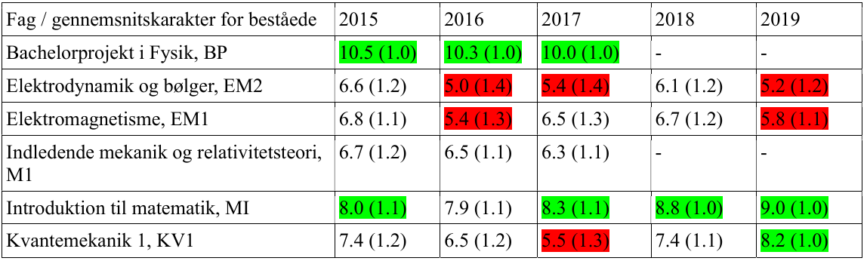
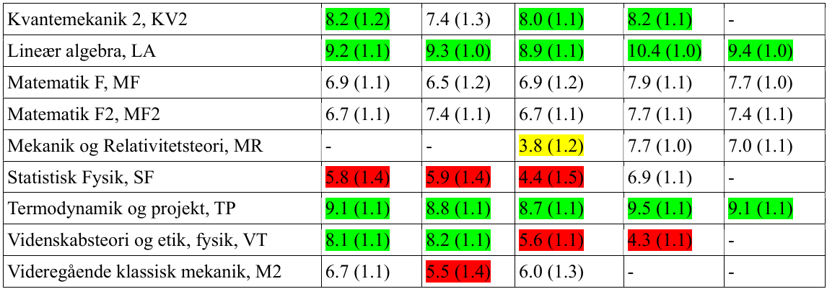
All courses, highest grade,
students passing their 1st year only
Numbers in parenthesis: average number of exam attempts (zero not counted)

Slide 10
The more detailed look, year 2017
Graduate within 2 y or earlier (merit) (1)
Graduate after 2.5 y or 3 y (27). Average 0.7 no-passes
Graduate after 3.5 y (19). Average 1.3 no-passes
Graduate after 4 y (0)
Graduate after 4.5 y or more (0)
Active, with merit (1)
Active, passed all 1st and 2nd year exams (20). Average no-passes: 2.7
Active, miss 1-2 courses before 1st+2nd years are done (10). No-passes: 10.0
Active, passed 1st y (2). No-passes: 10.0
Active, did not pass all of 1st year (6). No-passes: 16.7
Drop-out, no exam attempt (21)
Drop-out, only few exam attempts Blok 1-2 (32)
Drop-out after many exam attempts on 1st year (15) (average 7.7 no-passes)
Drop-out in August after 1 or 2 years straight study years (7)
Drop-out after passing all of 1st year and trying hard on 2nd year (7)

Slide 11
Conclusions
We have a lot of material.
Need to find out how to interpret it.
Need to find out what to do about it.
The discussion starts now.

