Slide 1
Tidal disruptions of stars by black holes
Clément Bonnerot
MSc Day @ NBIA
October 13th, 2021

Slide 2
Background
Star passing too close to a supermassive black hole gets tidally disrupted
Accretion of stellar gas causes a detectable flash of light
Unique probe of otherwise undetectable supermassive black holes
Events detected by the thousands by upcoming Rubin Observatory

Slide 3
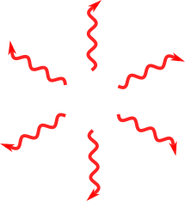
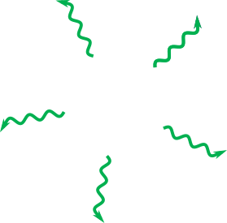
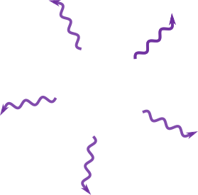
(2) Self-crossing
shock
(3) Circularizing
shocks
(4) Accretion
(0) Disruption
Tidal
radius
(1) Nozzle shock

Slide 4
Thank you for your attention !

