Slide 1
Can neutrinos really be plane waves?
Impact of wave packet separation in low-energy sterile searches
Toni Bertólez Martínez
antoni.bertolez@fqa.ub.edu
Here, There & Everywhere @NBIA
Based on Arguelles et al., 2201.05108
Notes:
Background color: #202729
Green: #00a168
Yellow: #ffff00

Slide 2
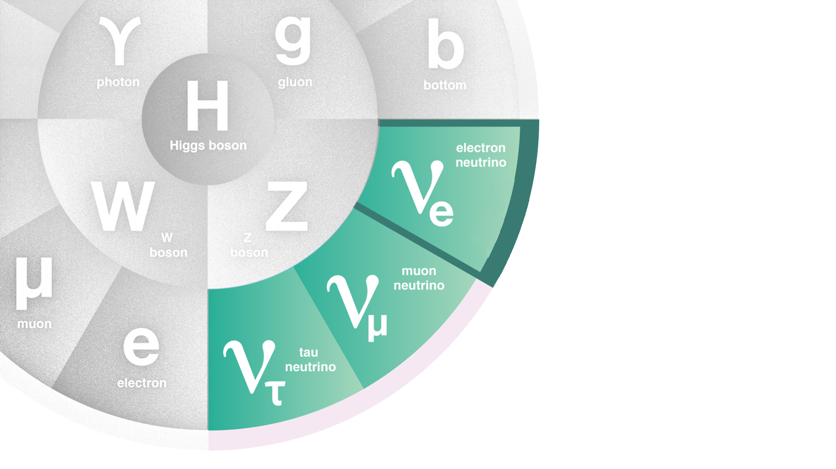
Flavour eigenstates
≠
Mass eigenstates

Slide 3
This is a simplification!

Slide 4
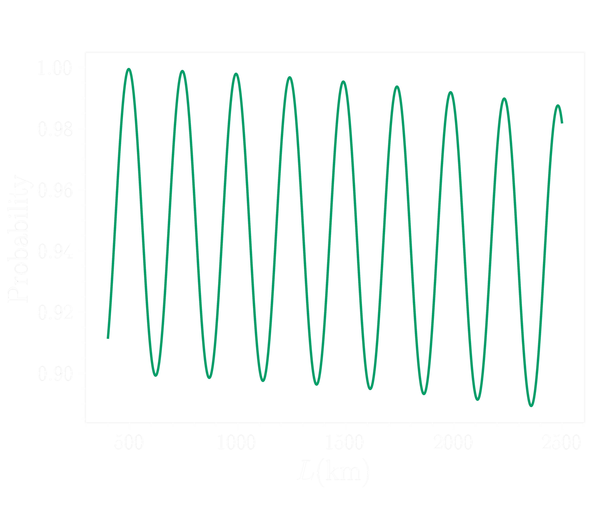
Plane wave approximation

Slide 5
Plane waves always overlap,

Slide 6
Plane waves always overlap,
wave packets can separate.

Slide 7
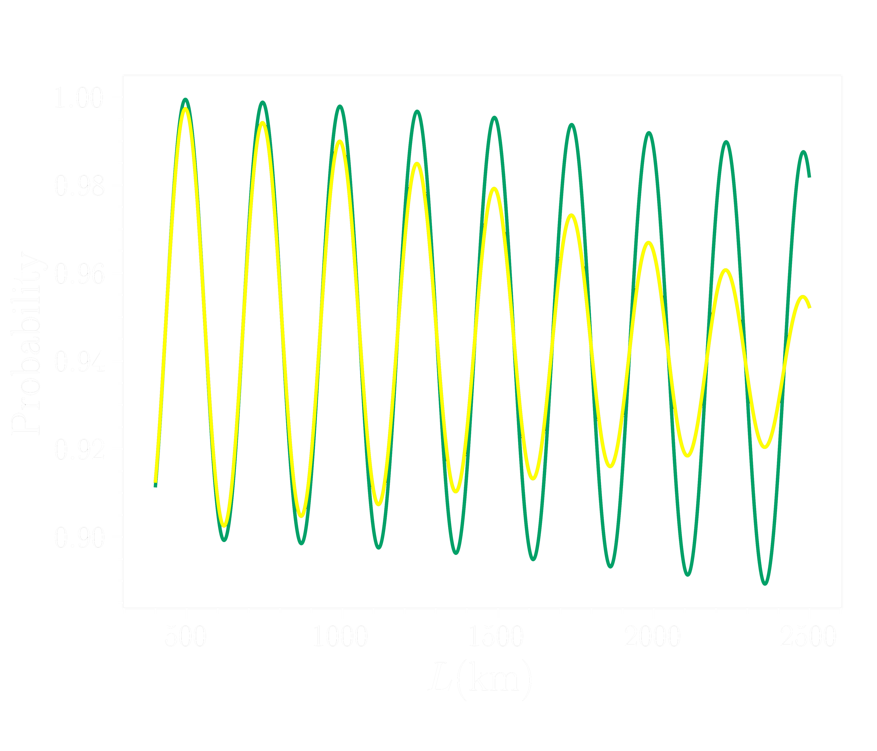
Wave packet formalism
Giunti, Kim, hep-ph/9711363
Giunti, Kim, hep-ph/9711363

Slide 8
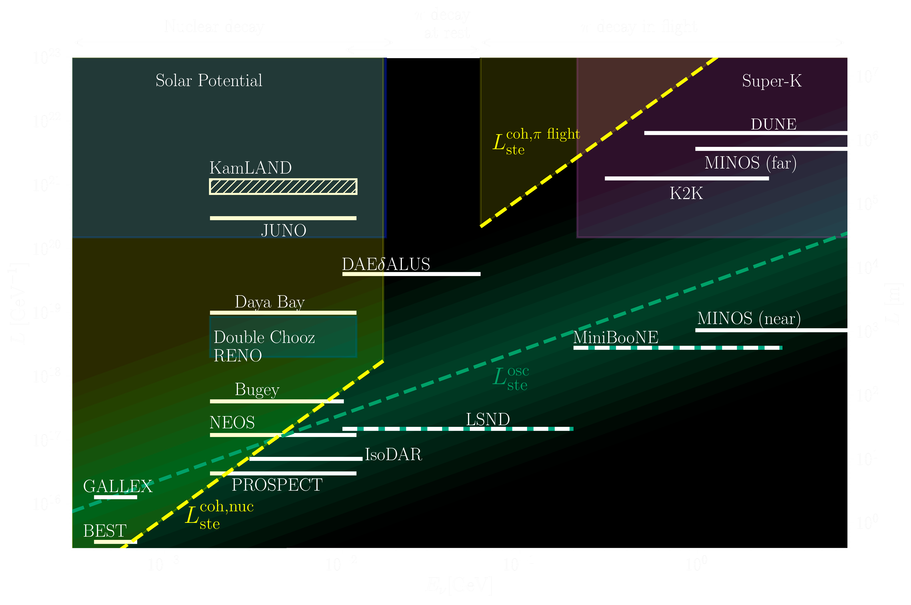

Slide 9
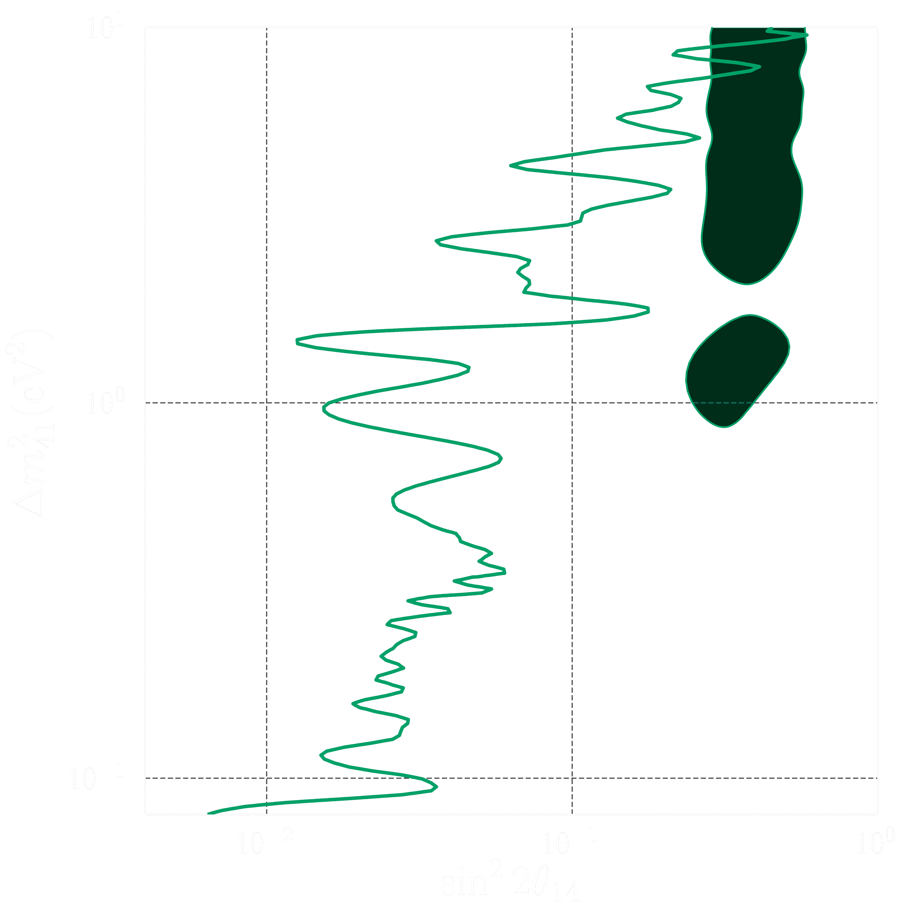
Nuclear reactor
Gallium
this is preferred!
this is excluded!
Notes:
The result of our paper

Slide 10
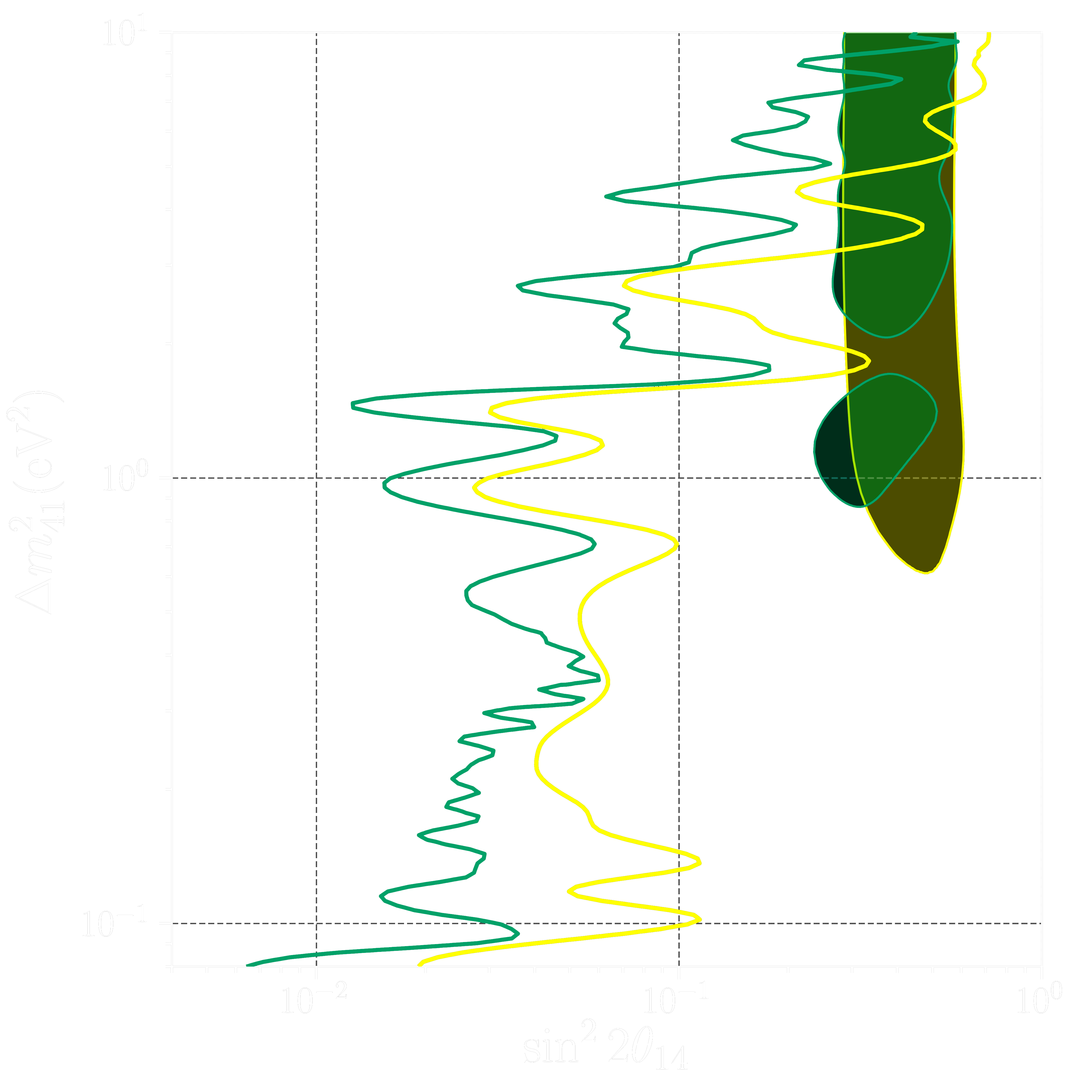
Nuclear reactor
Gallium
this is preferred!
this is excluded!
Notes:
The result of our paper

Slide 11
Oh wow we’re solving the sterile neutrino tension!
Yeah okay, but what is the wave packet width?

Slide 12
What is the size of the wave packet?

Slide 13
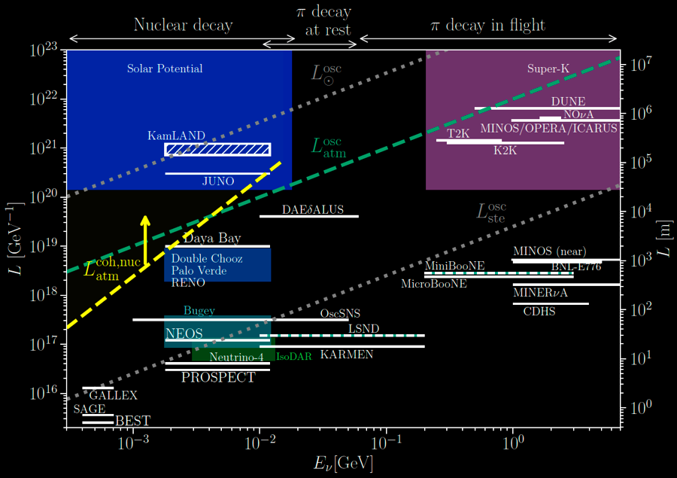
Will JUNO shed some light?

Slide 14
What will future experiments tell us?
Until then, let’s not forget about the wave packet width!
I’ll be glad to discuss more in my poster or you may check 2201.05108.
Thank you!
Notes:
Background color: #202729
Green: #00a168
Yellow: #ffff00

Slide 15
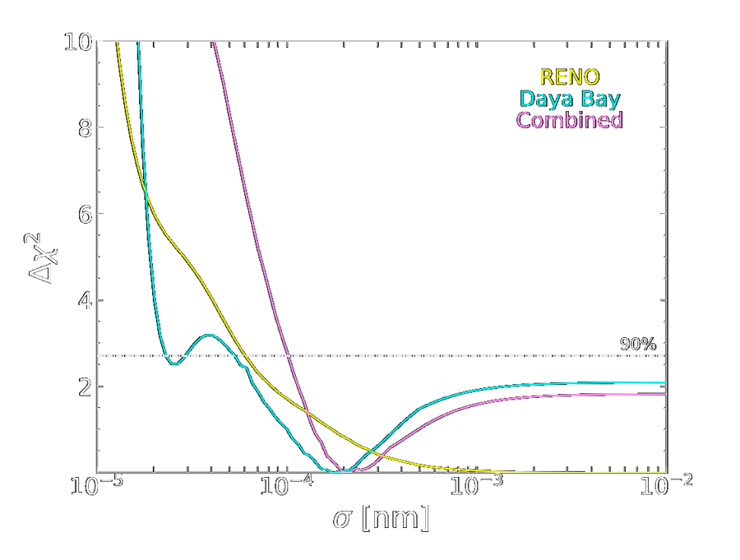
Only experimental bounds from oscillations exist:
Allowed values
$$σ_{x}≥{10}^{−4} nm$$
de Gouvea et al, 2005.03022

