Slide 1
Machine-learning aided experimental design for
P-ONE
J. Prottung, C. Haack & A. Llorente Anaya for P-ONE collaboration
TUM – Experimental Physics with Cosmic Particles

Slide 2
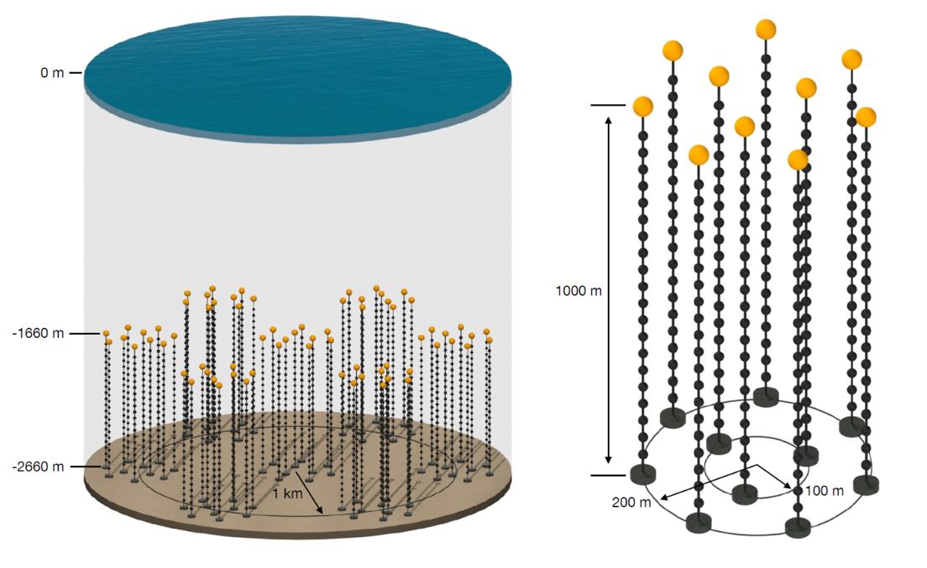
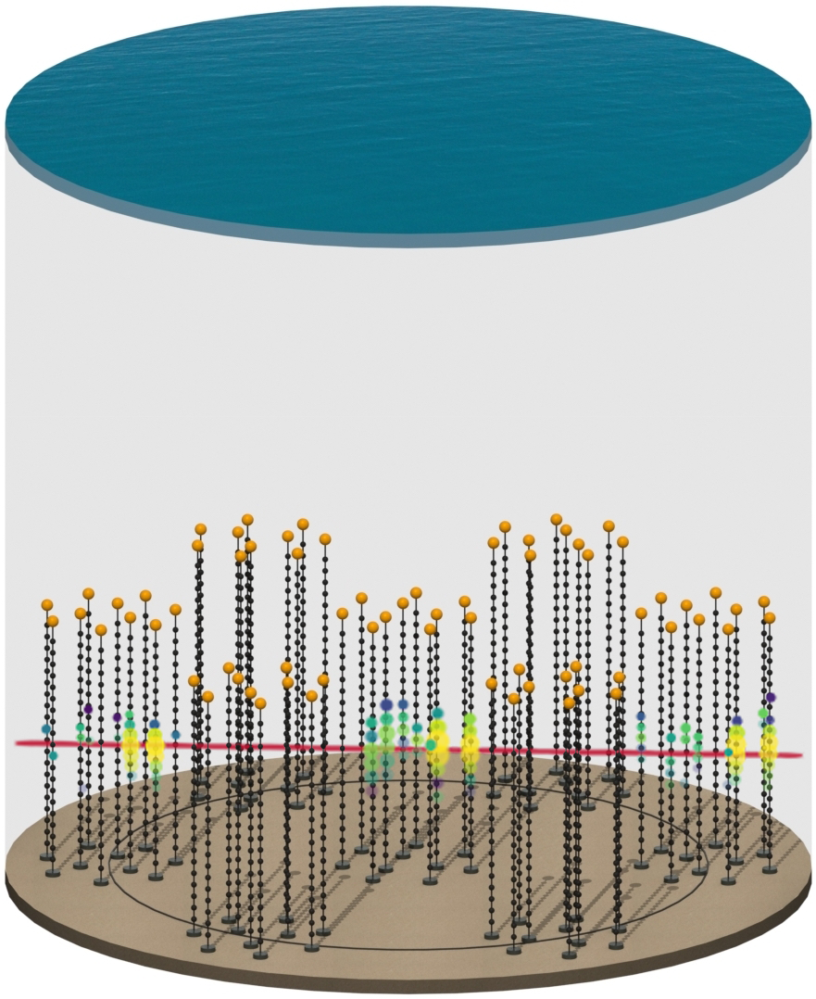
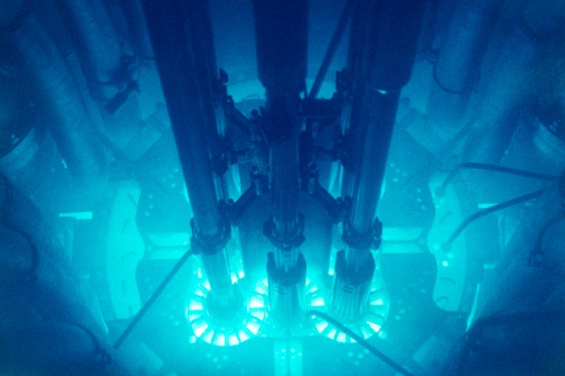
P-ONE – detector overview
P-ONE detector concept:
  7 clusters, 10 mooring lines each
  1000 m long mooring lines
Please note: Illustrations are preliminary studies!
PRELIMINARY
Image | nature.com
Notes:
Martin Dinkels Talk regarding the hardware and deployment
Pacific Ocean Neutrino Experiment
Sink Lines in Ocean -> each line has multiple modules able to detect Light via their embedded PMT (Photomultiplier Tubes)
Ability to detect Cherenkov light emitted by secondary particles
Reconstruct neutrinos
This talk about the optimization and machine learning. Why Machine Learning?

Slide 3
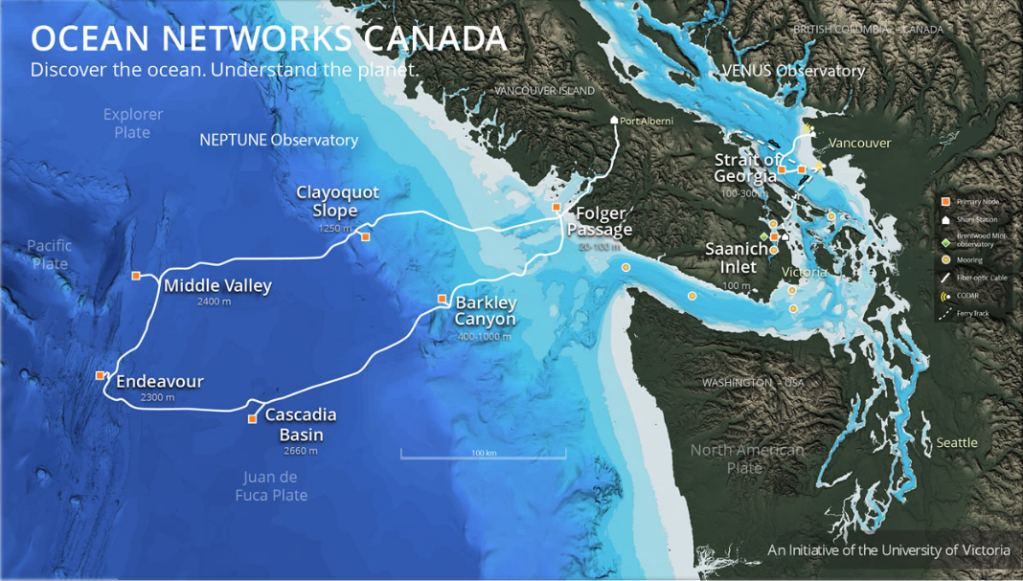
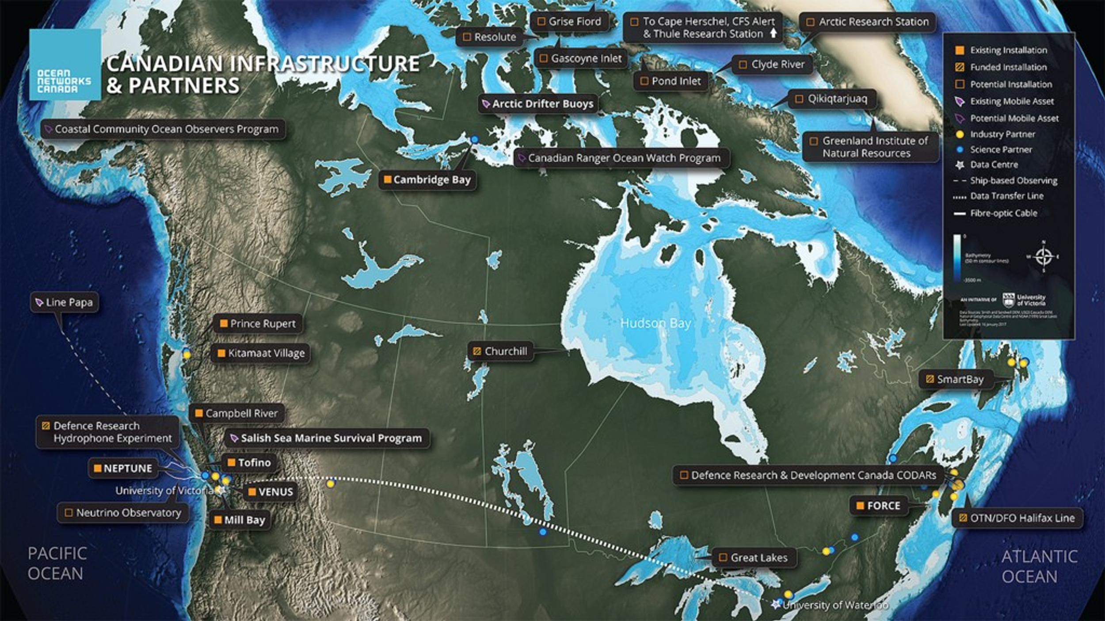

NEPTUNE observatory
Cabled ocean observatory (completed 2009)
Annual budget ~$27M (CDN)
800km loop of fiber optical cable (4GB/s, 8kW/node)

Slide 4
Motivation – Machine Learning
Raw Signal
Preprocessing
Trigger
Reconstruction
Analysis
Huge parameter space coverable with ML
Searching for possibilities to apply ML like triggering, reconstruction, simulation or analysis
Great success of NNs within IceCube Analysis
Notes:
ML has become more and more important and efficient for big data applications
Possibility to interpolate and cover a huge parameter space
Convinced that we can replace, improve our data processing pipeline
Looking for applications anywhere
Big successes at IceCube Analysis (Improved energy resolution by up to 50%)
For this talk mostly Trigger and Reconstruction
-> Let us have a look on our current data pipeline

Slide 5
Optimization Workflow
Simulate interaction (MC)
Calculate light yield
Photon Surrogate Model
One MC campaign to train model, exploration of parameter space is cheap.
The differentiable surrogate model gives access to continuous likelihood functions. Use FI to calc. resolutions.
No need to develop reconstruction algorithms.
Gradient-based optimisation algorithms
Propagate photons (MC)
Detector Response (MC)
Triggering
Trigger Model
Reconstruction
Fisher Information
Resolution Functions
Resolution Functions
Notes:
First generate the data
Start with the interaction
Calculate Light yield
Go on to bring photons to detector
Triggering for event selection
Reconstruction using fisher information
Now that we know where de data is coming from -> what is it that we can optimize?
Fisher Information -> reconstruct using maximum likelihood methods

Slide 6
Detector Optimization
Detector resolution & Effective Area
Hardware
Trigger Algorithms
Geometry
Cost
PMT properties
Calibration devices
Efficiency
Throughput
Hexagonal, Triangular, etc.
Module spacing on line
Number of Modules, Lines, etc.
Deployment complexity
Notes:
We want a good resolution (Energy, angle, etc.)
And a good effective area (get relevant information of as many events in the area as possible)
Hardware
PMT properties, dark rate, etc
Trigger algorithms
Accuracy of trigger
Geometry
Putting strings in triangular shape
Spacing of modules on line
Number of PMTs per Module
Cost
Number Modules
Deployment difficulty
How this can look like -> example spacing

Slide 7
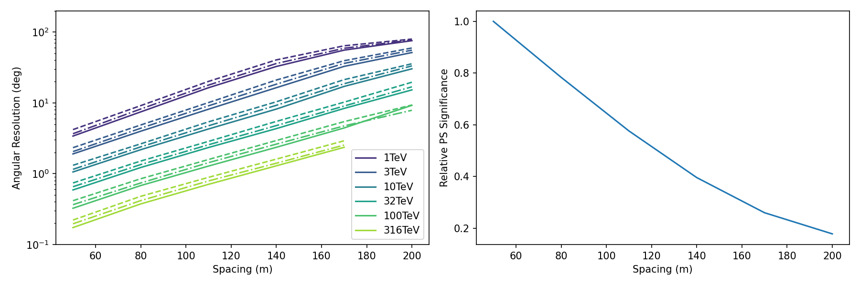
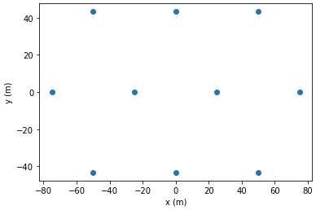
Detector Optimization - Resolution
The angular resolution of electromagnetic cascades based on energy and string spacing
Preliminary
Spacing
Note: Parameters are interdependent. Improvements in one often negatively impact others like cost and/or effective area
Used 10 string detector geometry
Notes:
Dependency of angular resolution of electromagnetic cascades based on string spacing and energy
Bottom left: top down view of the used 10 string triangular detector. X-y is the distance arrow indicates varied spacing
Based on this look to the right: we can see the angular resolution in degrees over the spacing in m. Different colors indicate different energies and the lines different nu of modules per module (16 solid, 20 dash-dot, 24 dashed)
The closer we the strings get the better the angular resolution
But: Dimensions get interdependent other decay more expensive or less effective area
After we have seen what we can optimize using machine learning -> Let’s have a more specific look on how exactly we are implementing these concepts based on triggering

Slide 8
Motivation – ML aided Triggering
Several sources of background: k40 decays, bioluminescence, atmospheric muons → several orders of magnitude
Limited Bandwidth of ~1 GB/s
Limited Power Availability: 5 kW/ node
Estimated event rate 2,5 kHz
→ Apply the power of Machine Learning
Notes:
First evaluate what makes the triggering difficult
A lot of background noise
K40 decays
Bioluminescence
Atmospheric muons
Probability for cosmic neutrino is several orders of magnitude smaller
Would create a lot of bandwidth -> availability only 1gb
Should be power efficient
Handle Rate of 2,5kHZ
All of this can be solved by Machine Learning
How do we deploy it to the ocean

Slide 9
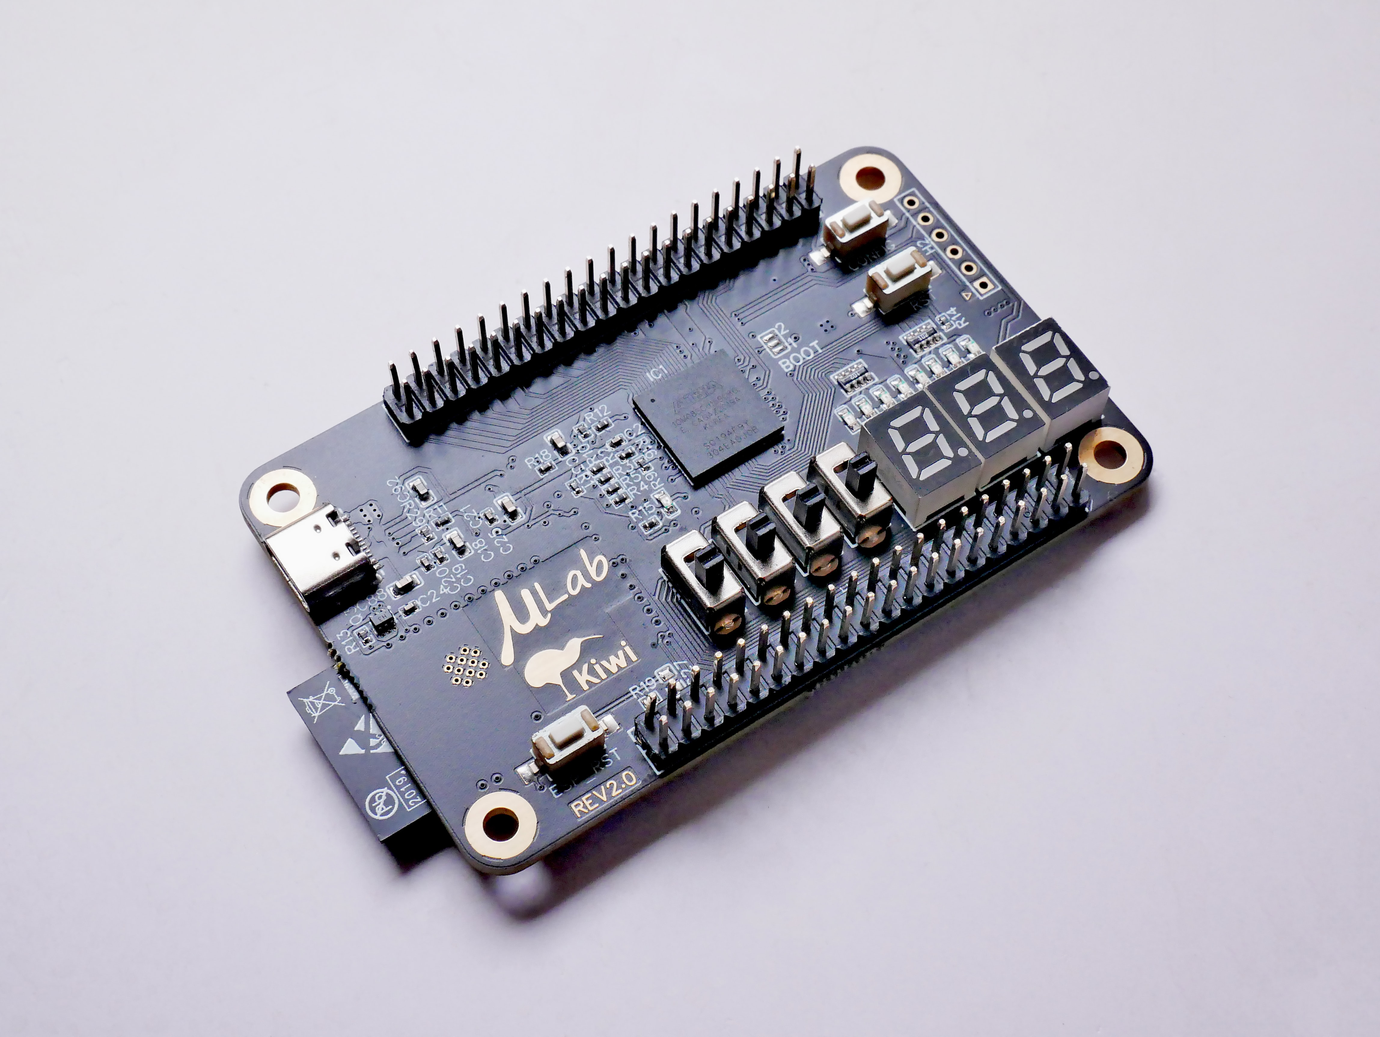
Motivation – ML based Triggers on FPGAs
Easy deployment in Module,
String or Junction Box
Improved performance due to
tailored application
Very power efficient
Promising applications at particle
detectors like Belle II
Photo by V. Mohanan: uLab FPGA
Notes:
Using FPGAs Field Programmable Gate Arrays
Can be easily deployed at string, junction or module
Good power efficient performance due to tailored application
Other experiments involving particles like at ATLAS or Belle already show promising results
As we now know why and what we want to use, let me show you how this looks like

Slide 10
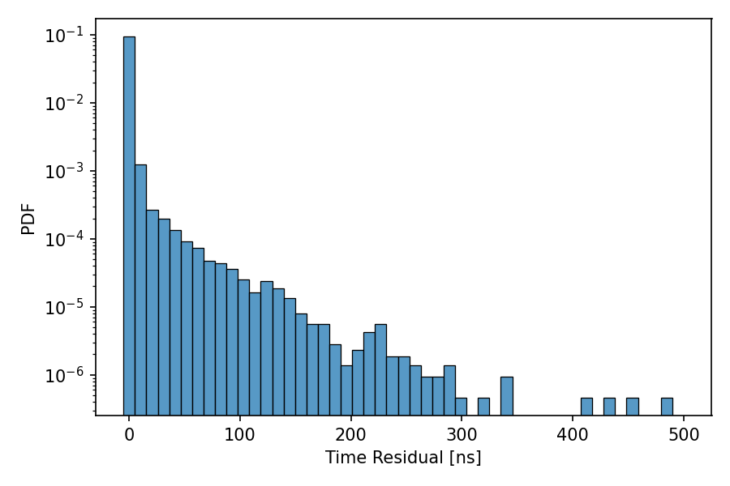
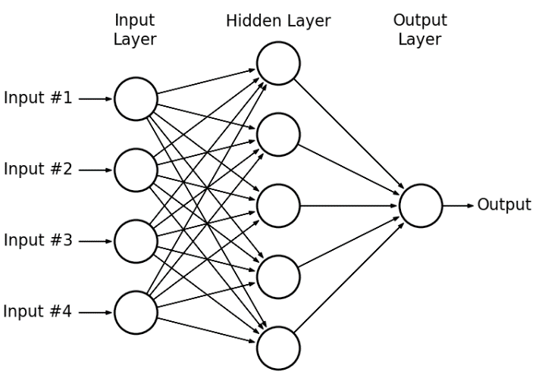
Triggering Principle
Cascade, track, background, noise, etc.
Preprocessing
Type
Keep (yes, no)
Event
Direction
Energy
…
Reconstructed properties
…
…
…
Figure: Mohamed Zahran
Notes:
An event generates photons
They generate responses at the detector
These have to be preprocessed and aggregated
As inputs for Neural network
Feature vector
Type -> Noise, Cascade, Track, etc.
Keep the data? -> Yes or no?
Optimally, already get some indication on reconstructed properties
Direction
Energy
Want to show How we combine the Simulation, with optimization and triggering

Slide 11
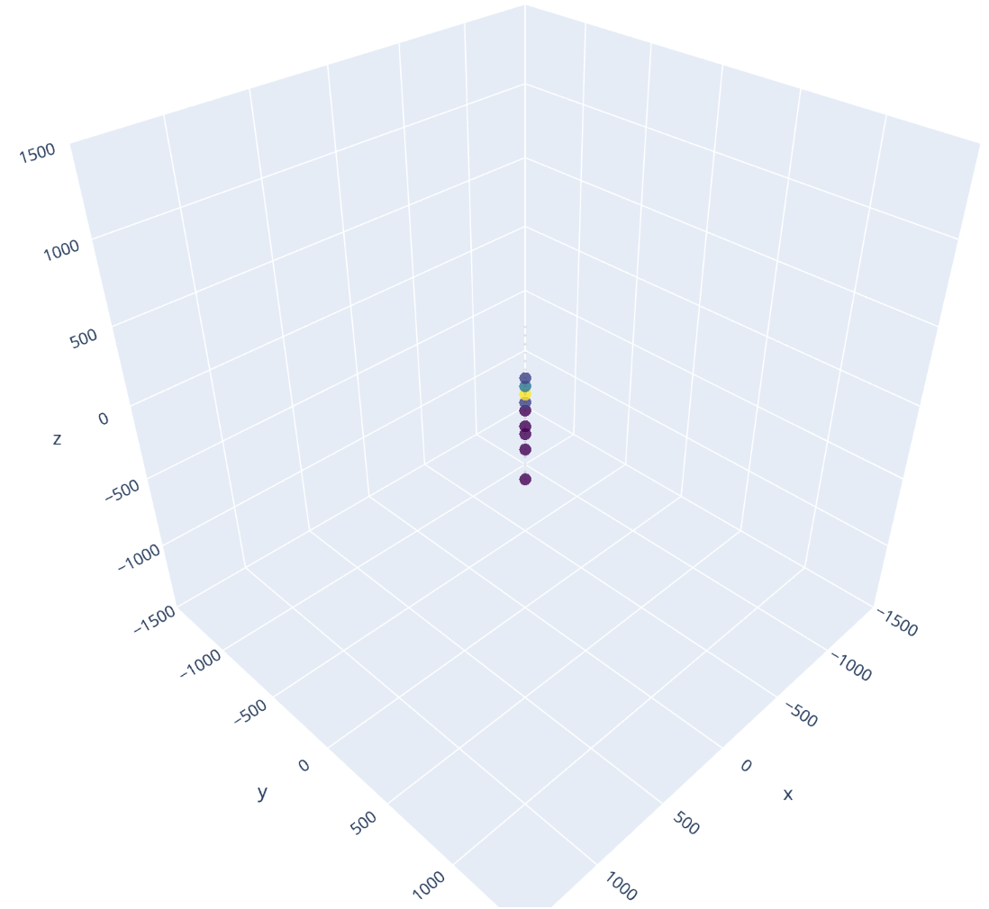
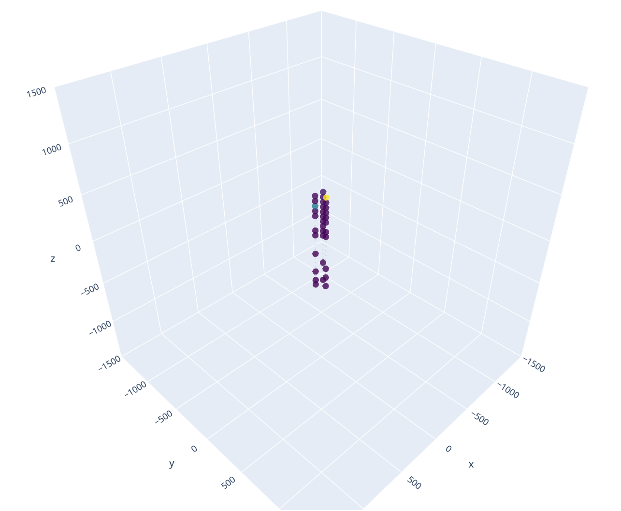
Digital Twin
  A realistic virtual model of detectors behavior in time
One String detector
Three String Detector
Notes:
For that we use a digital twin
We can generate nearly all kind of detector architecture
We can generate Cascades, Tracks, Noise, etc.
Overlap the signals
Display the module responses and use as inputs
Show One string detector with Photon Sources.
Let me conclude

Slide 12
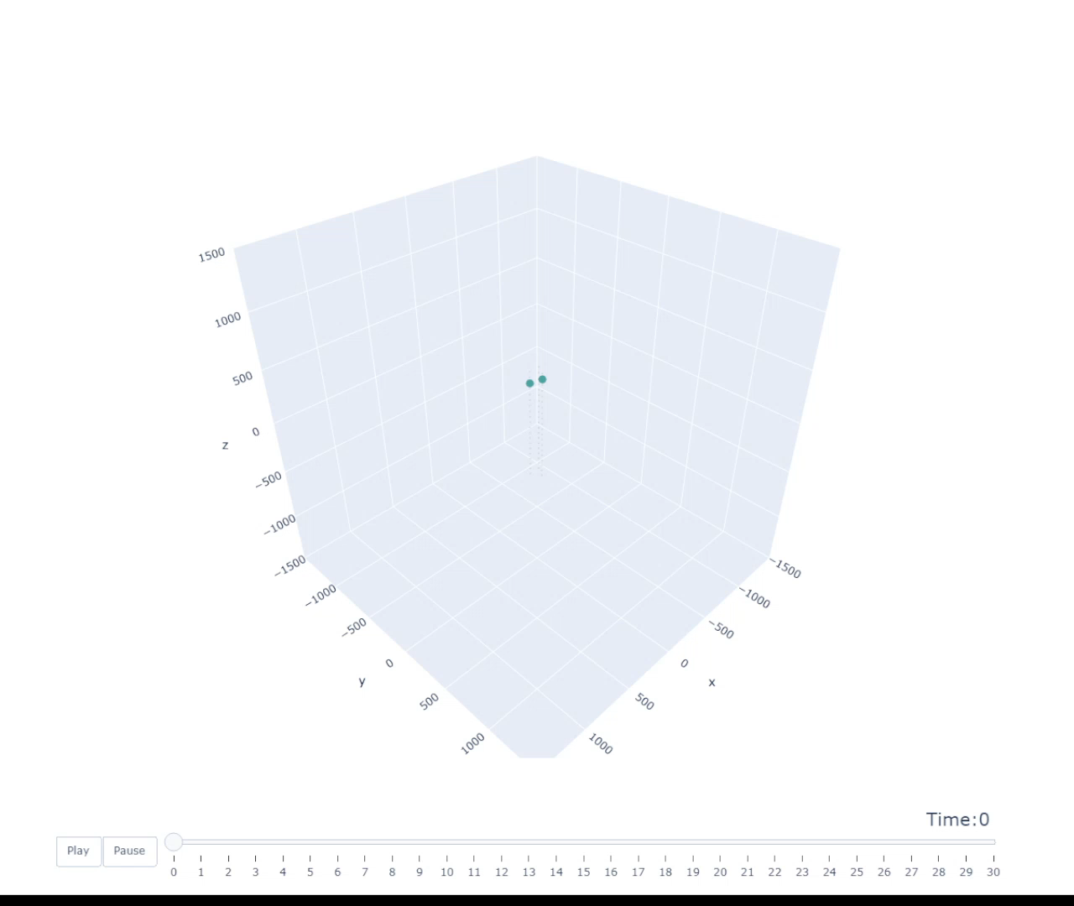
Digital Twin
Notes:
For that we use a digital twin
We can generate nearly all kind of detector architecture
We can generate Cascades, Tracks, Noise, etc.
Overlap the signals
Display the module responses and use as inputs
Show One string detector with Photon Sources.
Let me conclude

Slide 13
Conclusion & Next Steps
  Above’s machine learning model facilitates the detector design
  Geometry, Cost, Hardware and Trigger Algorithm affect performance
  Multiple architectures can be created using the digital twin
  Investigating machine learning-based trigger for P-One
  Could improve effective area
  Possibility to use FPGAs as efficient on-site computing units
  Up next: The creation of a real-time machine learning-based trigger algorithm
  Further optimize detector design
  Proof of concept: FPGA implementation of the algorithm
Notes:
In this talk we have seen
How and why we use machine learning to improve our data pipeline
What we can optimize with our optimization workflow
The use of a digital twin as testing ground for different architectures
As well, how ML will aid us for Trigger Algorithms specifically
Being part of the optimization dimensions
Possible application of ML on FPGAs as efficient deployment options
Extend the workflow to apply ml models on the recurring data stream produced by a time based detector
Implement model on an FPGA

Slide 14
Thank you for the attention!

Slide 15
Backup

Slide 16
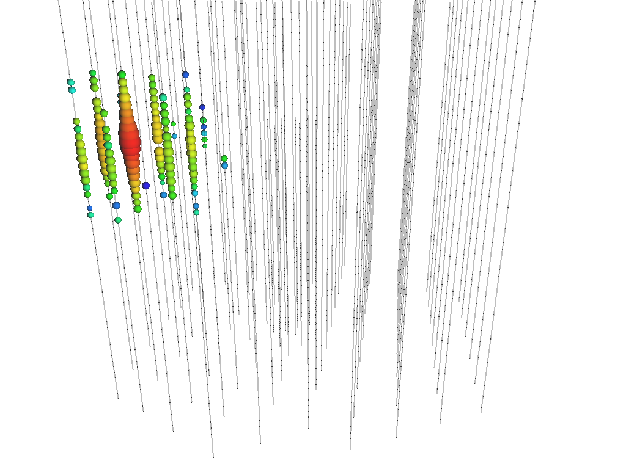
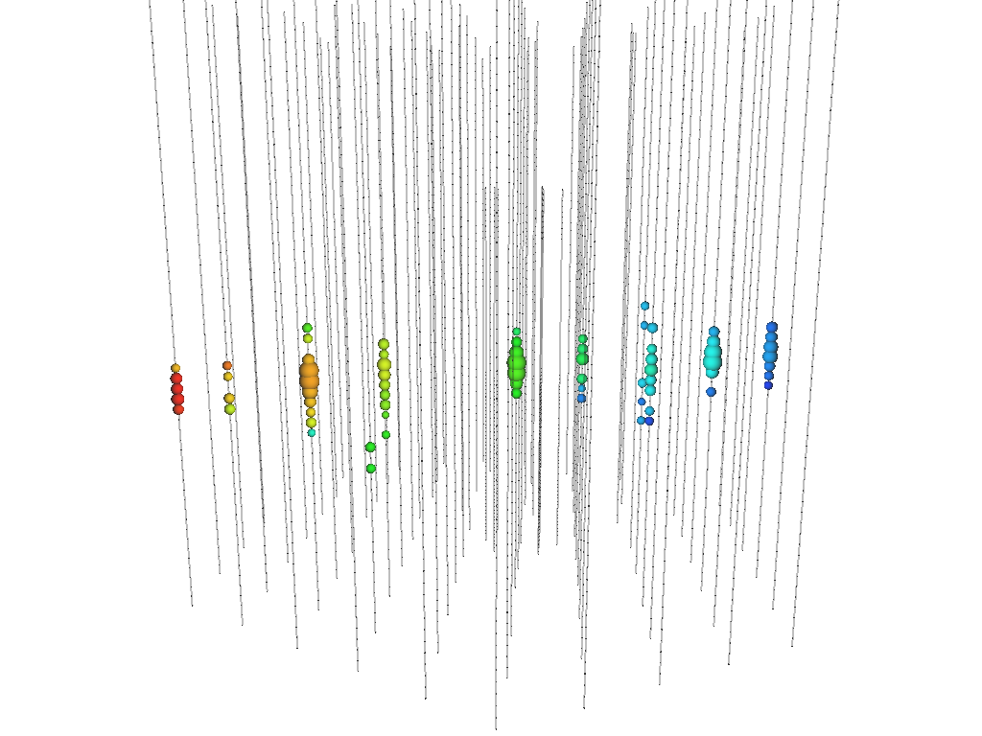
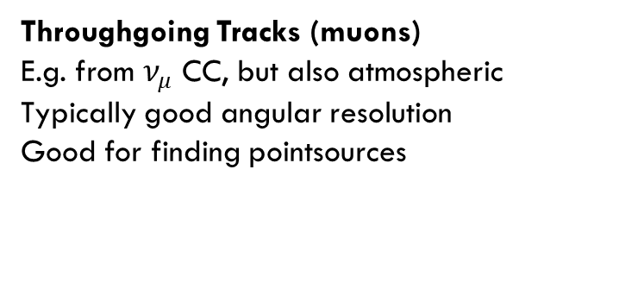
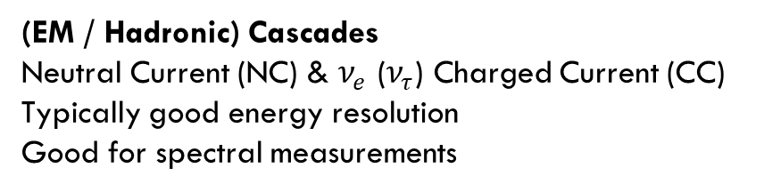
Why build a new Neutrino Detector?
IceCube
IceCube
Early Late
Time
(EM / Hadronic) Cascades
Neutral Current (NC) & $ν_{e}$ ($ν_{τ}$) Charged Current (CC)
Typically good energy resolution
Good for spectral measurements
Throughgoing Tracks (muons)
E.g. from $ν_{μ}$ CC, but also atmospheric
Typically good angular resolution
Good for finding pointsources
Notes:
Martin Dinkels Talk regarding the hardware and deployment
Pacific Ocean Neutrino Experiment
Sink Lines in Ocean -> each line has multiple modules able to detect Light via their embedded PMT (Photomultiplier Tubes)
Ability to detect Cherenkov light emitted by secondary particles
Reconstruct neutrinos
This talk about the optimization and machine learning. Why Machine Learning?

Slide 17
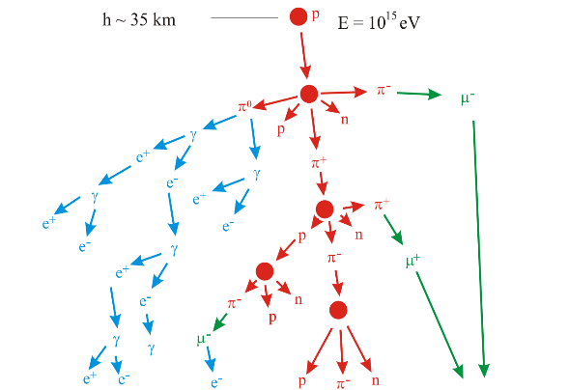
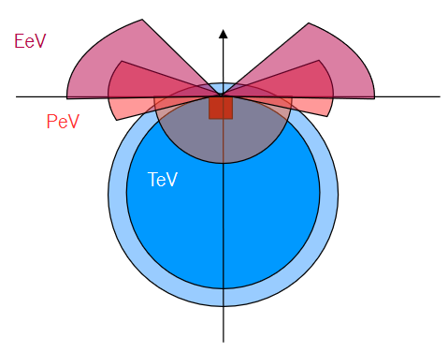
The Track Channel
Sketch by Antoine Kouchner
Downgoing region is dominated by atmo. muon background.
High-energy upgoing neutrinos are absorbed by Earth
Horizontal region is optimal for observing high-energy
tracks
Image | nature.com
Notes:
Martin Dinkels Talk regarding the hardware and deployment
Pacific Ocean Neutrino Experiment
Sink Lines in Ocean -> each line has multiple modules able to detect Light via their embedded PMT (Photomultiplier Tubes)
Ability to detect Cherenkov light emitted by secondary particles
Reconstruct neutrinos
This talk about the optimization and machine learning. Why Machine Learning?

Slide 18
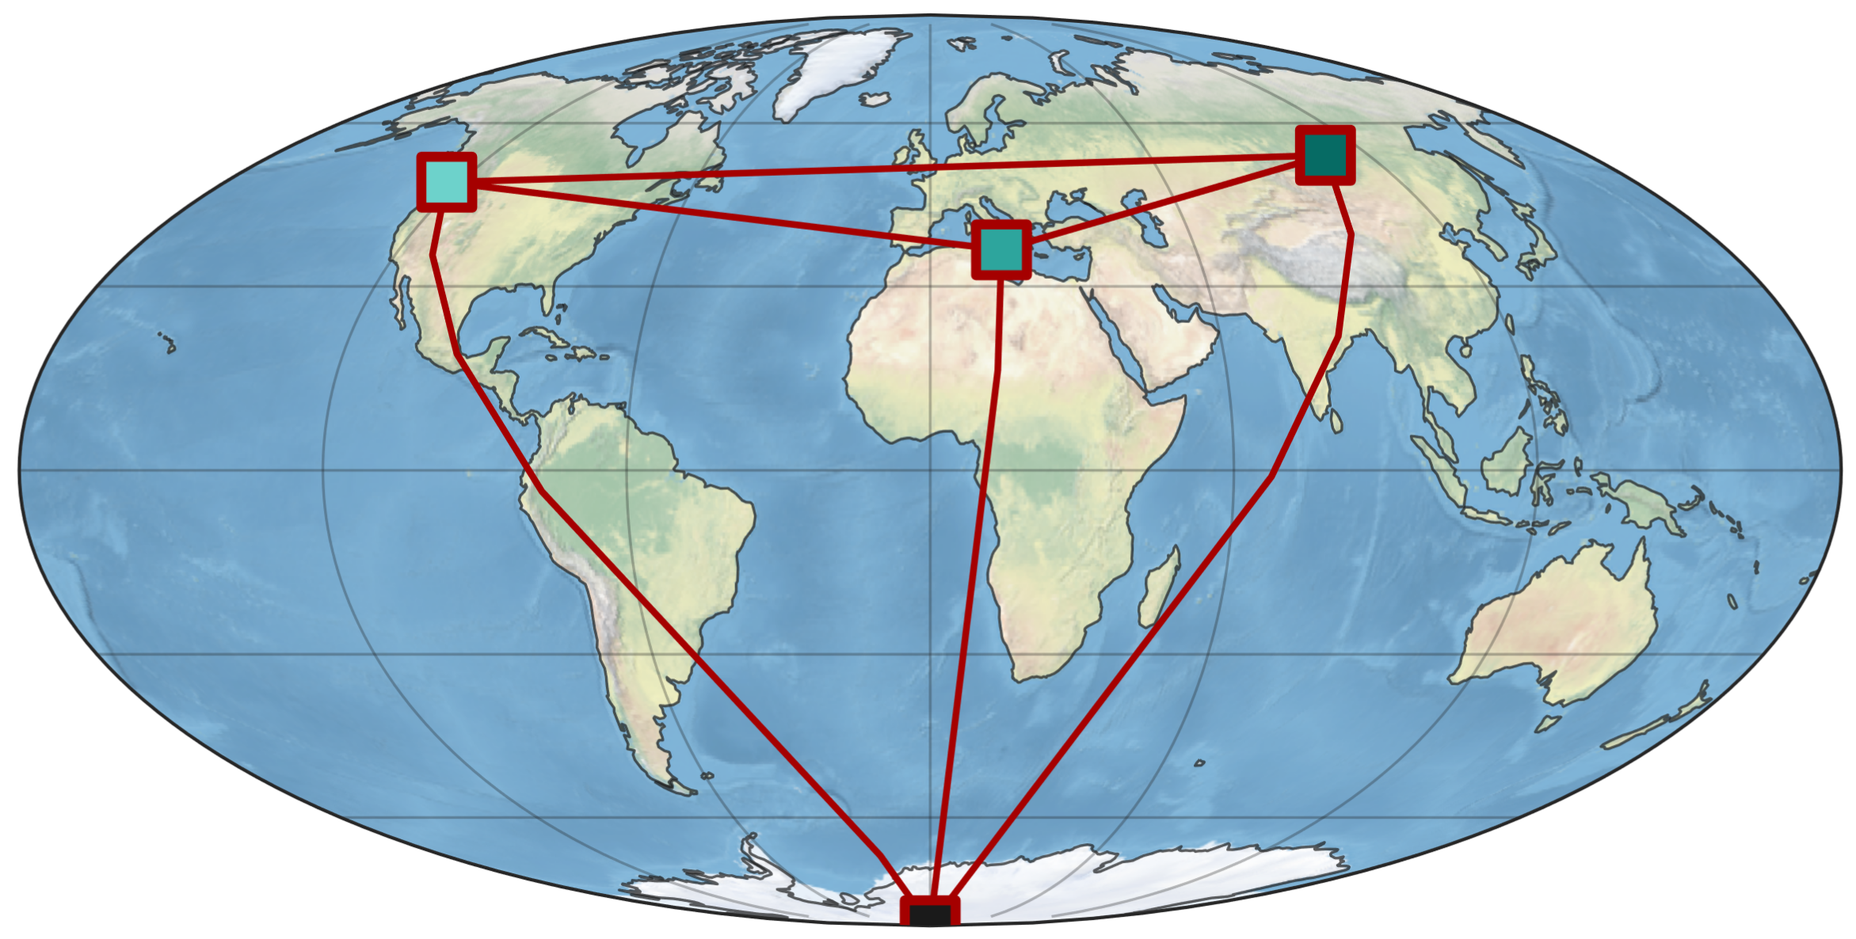




High Energy Neutrino Telescopes
Planned
In construction
Taking data for 10+ years
Image | nature.com
Notes:
Martin Dinkels Talk regarding the hardware and deployment
Pacific Ocean Neutrino Experiment
Sink Lines in Ocean -> each line has multiple modules able to detect Light via their embedded PMT (Photomultiplier Tubes)
Ability to detect Cherenkov light emitted by secondary particles
Reconstruct neutrinos
This talk about the optimization and machine learning. Why Machine Learning?

Slide 19
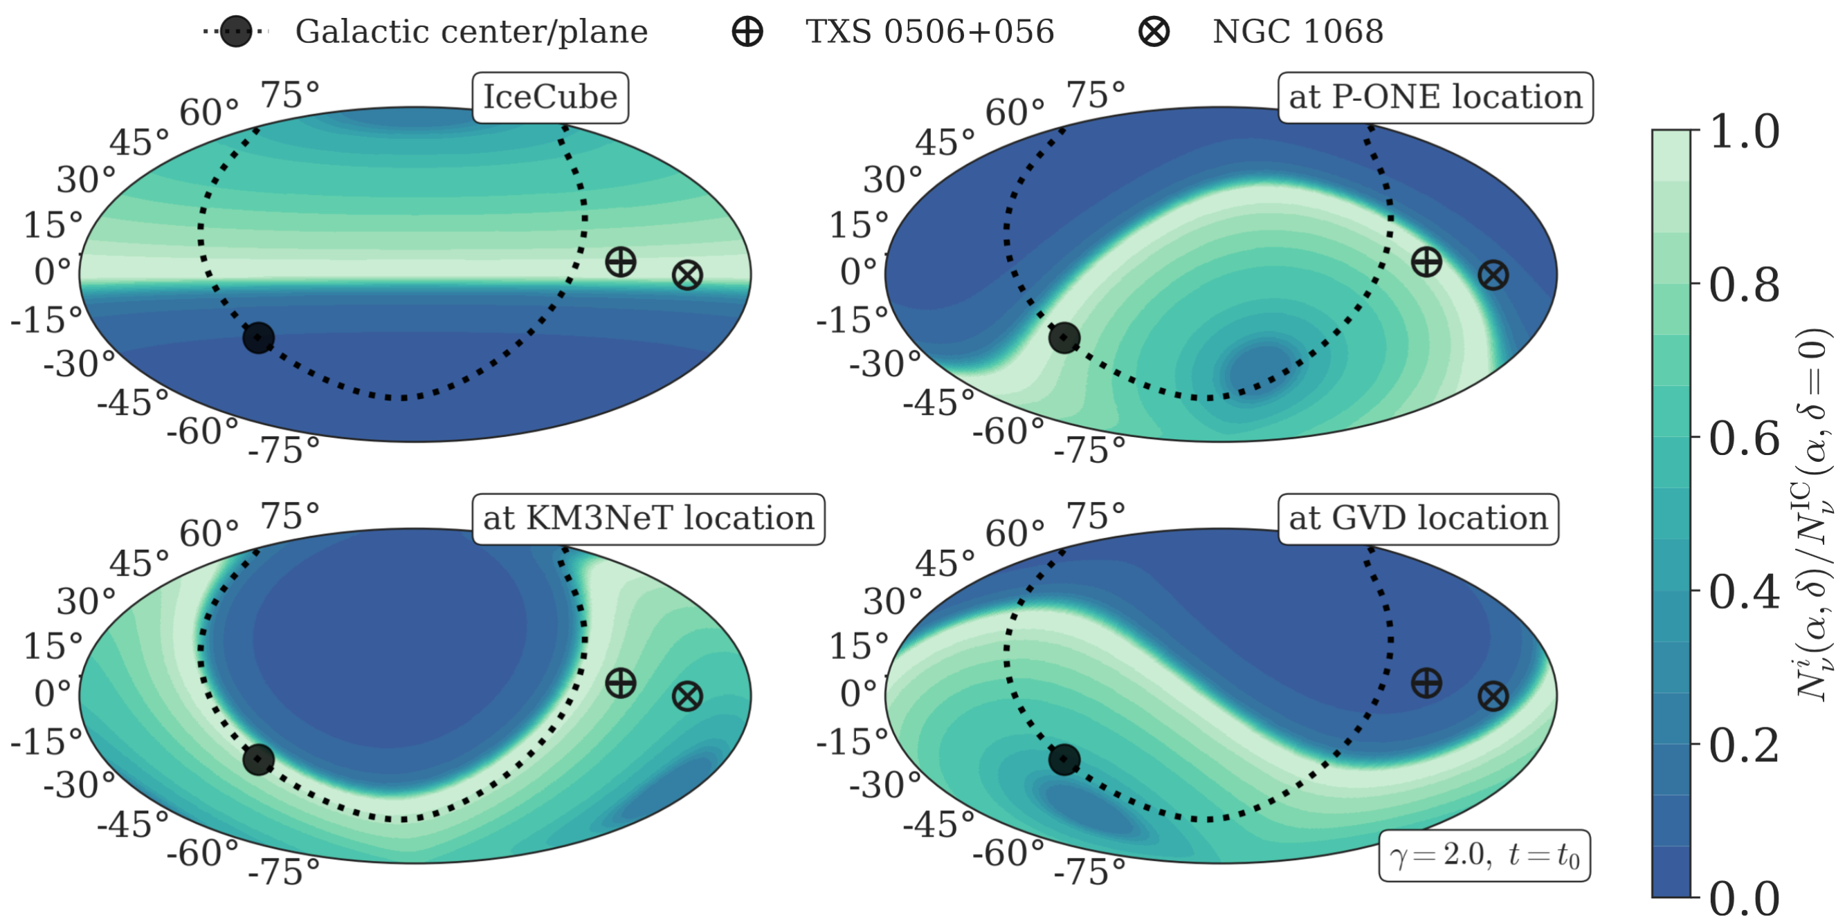
Relative Sensitivities
Local Coordinates
Relative Sensitivity
Lisa Schumacher, https://pos.sissa.it/395/1185/
Image | nature.com
Notes:
Martin Dinkels Talk regarding the hardware and deployment
Pacific Ocean Neutrino Experiment
Sink Lines in Ocean -> each line has multiple modules able to detect Light via their embedded PMT (Photomultiplier Tubes)
Ability to detect Cherenkov light emitted by secondary particles
Reconstruct neutrinos
This talk about the optimization and machine learning. Why Machine Learning?

Slide 20
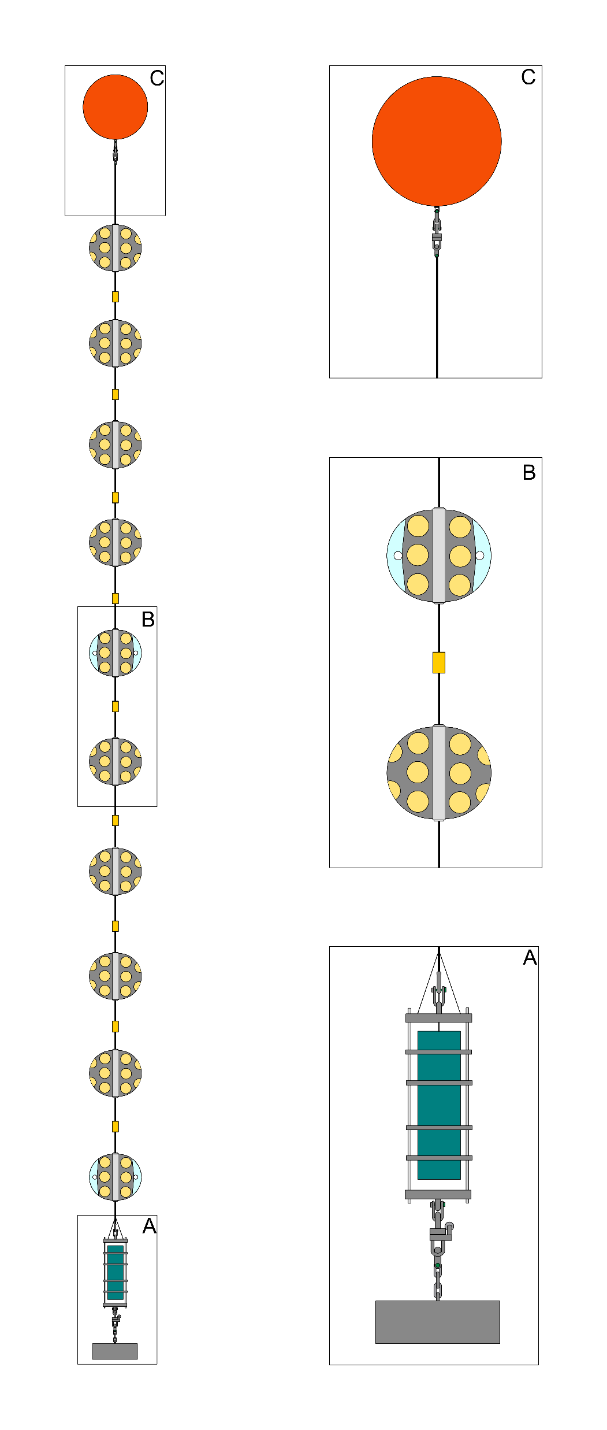
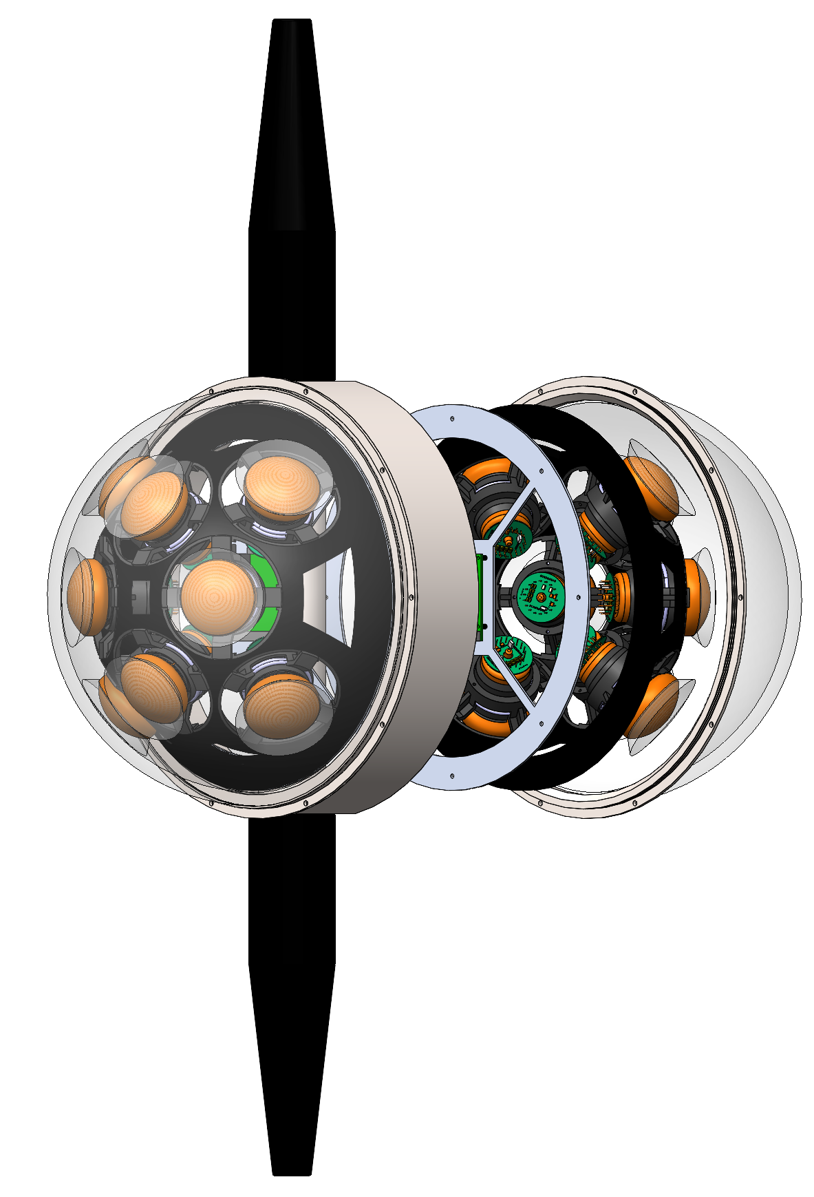
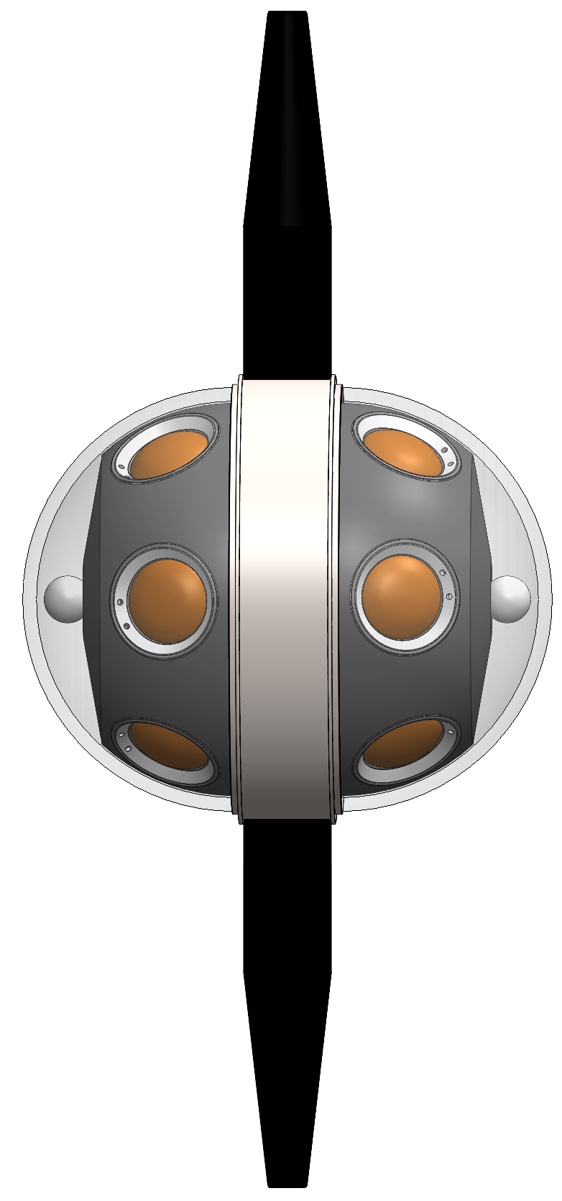
P-ONE-1 overview
Project target: Construction and deployment of a P-ONE mooring line as first installation of the final P-ONE detector. The prototype line shall verify the working principle, deployment technique, and be the blue print for the following mooring lines.
List of objectives:
  1st line of P-ONE
  Proof of deployment concept (scalability)
  Optical and calibration module development
  Time synchronisation for mooring line (and full P-ONE)
  Collect as much data as possible (understand data stream)

Slide 21
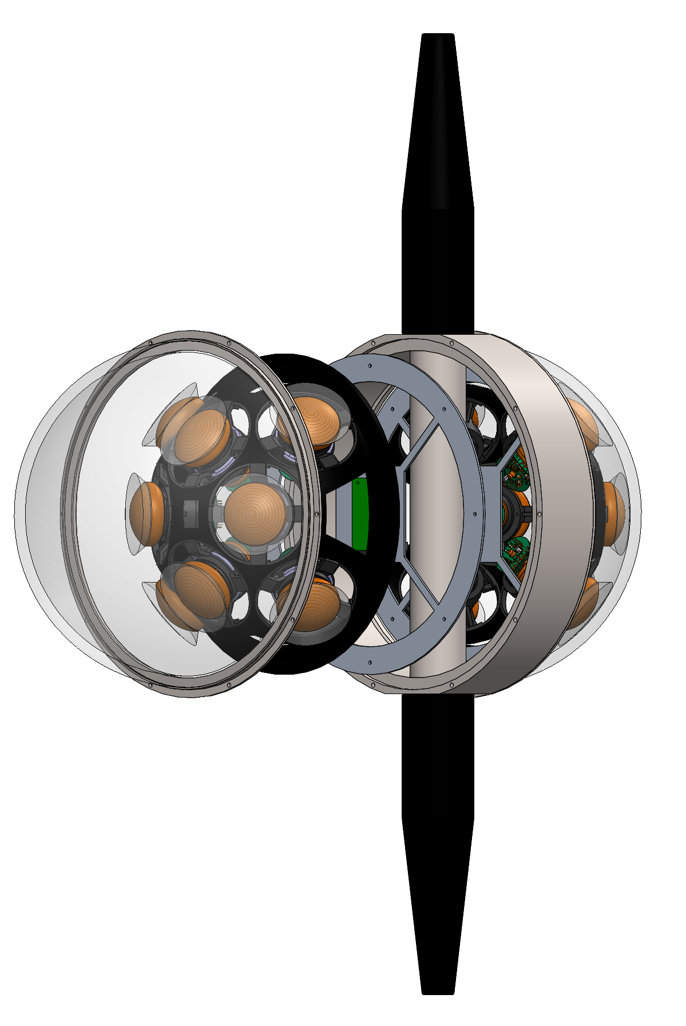
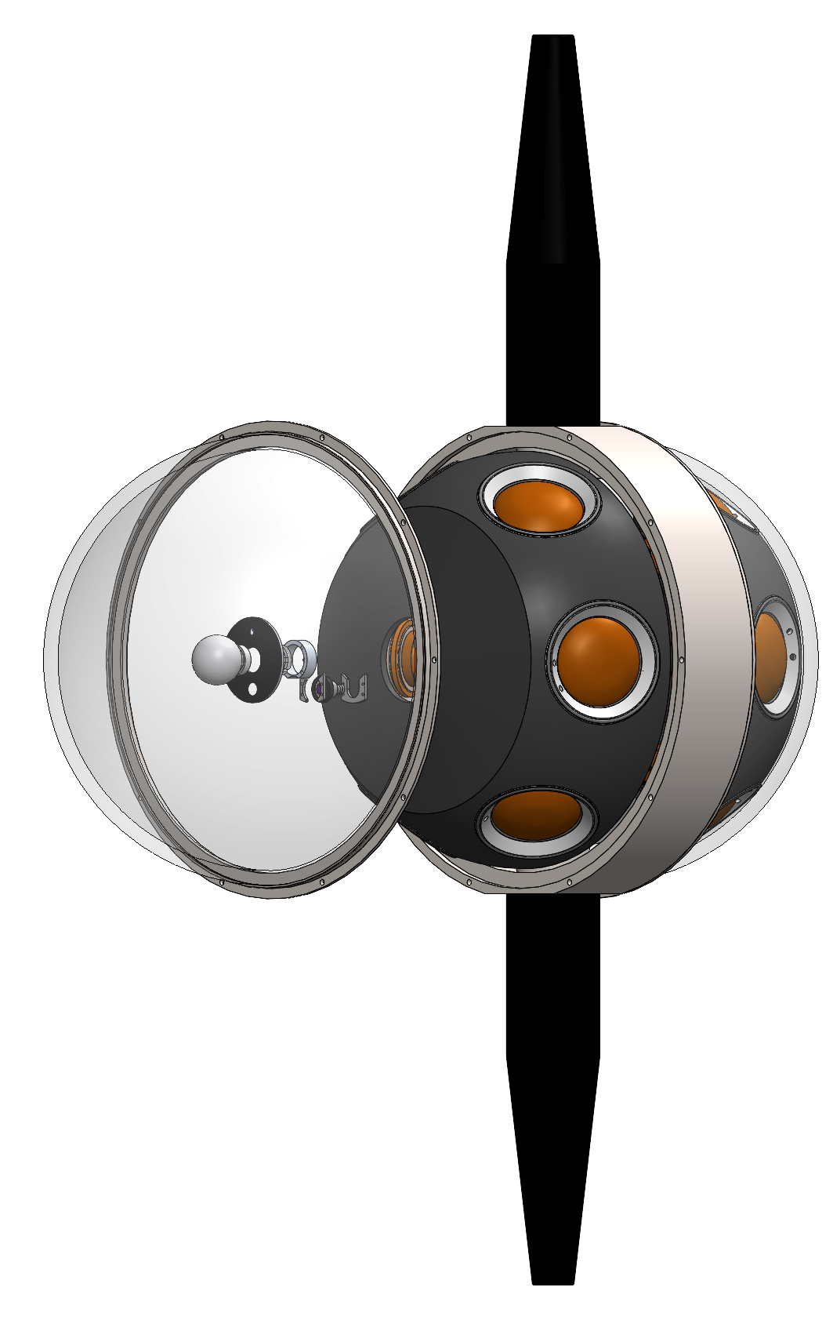
P-ONE-1 overview
Optical Module | around 16 PMTs | 16 pcs
Calibration Module| hybrid module | 4 pcs

Slide 22
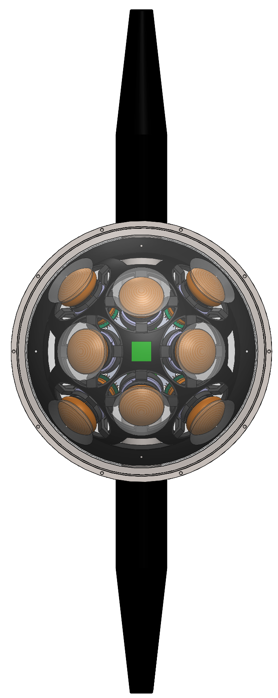
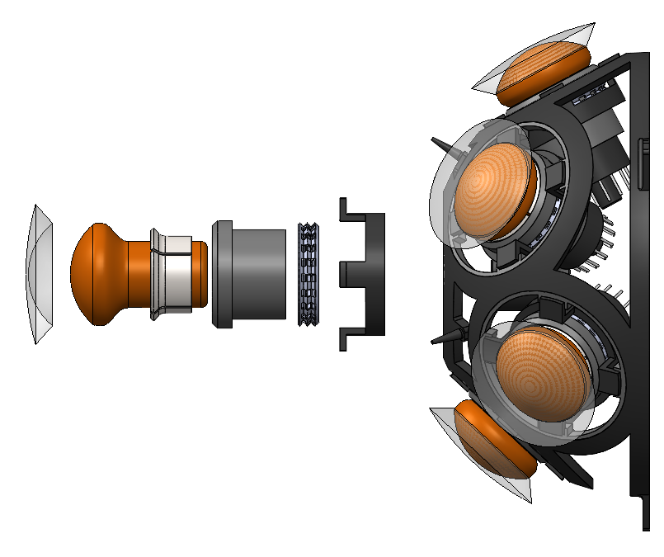
P-ONE – optical module
Photomultiplier tubes (PMT) used as photosensors
Multi-PMT approach
  Biological processes are slow(er)
  Suppression of background by requiring coincidence hits on PMTs (ns scale)
Modular mounting structure to ease construction effort
Electronics are currently developed

Slide 23



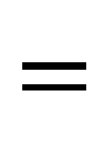
Photon Surrogate Model
Stochastic Muon Energy Losses
$$ν_{μ}$$
$$μ$$
N
Hadronic/EM Cascades (typical length in water: 10m)
Approximate EM/Hadronic showers and muons with linear combination of „pointlike“ emitters
$$=$$
$$≈$$
„pointlike“ Cherenkov emitters

Slide 24
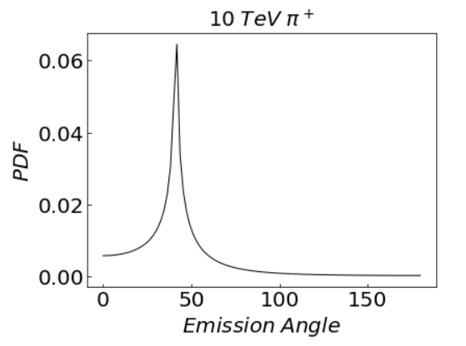
Photon Surrogate Model
"direct" photons
scattered photons
Photons
Detector
Cascade direction
Arrival time relative to direct propagation time
Hyperion photon propagation code. Implemented in jax
https://github.com/pone-software/hyperion

Slide 25
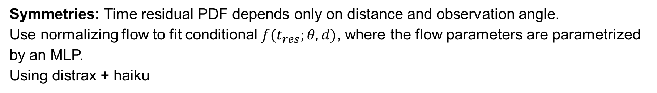
Photon Surrogate Model
Photons
Observation angle
Detector
Symmetries: Time residual PDF depends only on distance and observation angle.
Use normalizing flow to fit conditional $f(t_{res};θ, d)$, where the flow parameters are parametrized by an MLP.
Using distrax + haiku

Slide 26
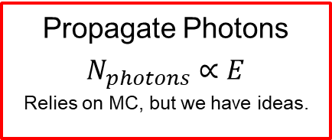
Simulating a Neutrino Telescope
How difficult is to achieve differentiability for each step?
Propagate neutrinos through Earth
Simulate neutrino interaction
Typically relies on MC
Propagate secondary particles
Typically relies on MC
We can start here
Simulate PMT, Electronics, DAQ
Some steps rely on MC.
Propagate Photons
$$N_{photons}∝E$$
Relies on MC, but we have ideas.
Calculate Cherenkov light yield of secondaries
Easy
Hard
Event Classification
(GNN)
Event Reconstruction
(GNN)
Analysis

Slide 27
Detector Optimization
Spacing → smaller distance: ↗ angular resolution, ↘ detector volume
Figure: Preliminary angular resolution and point source significance of cascades for three strings by C. Haack

