Slide 1
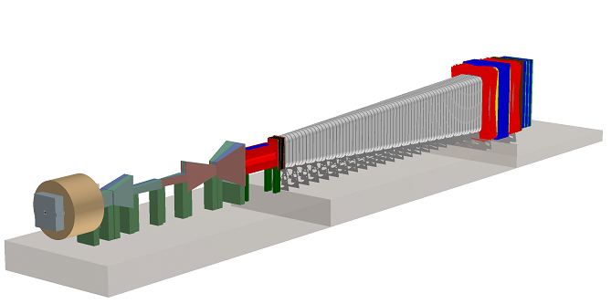

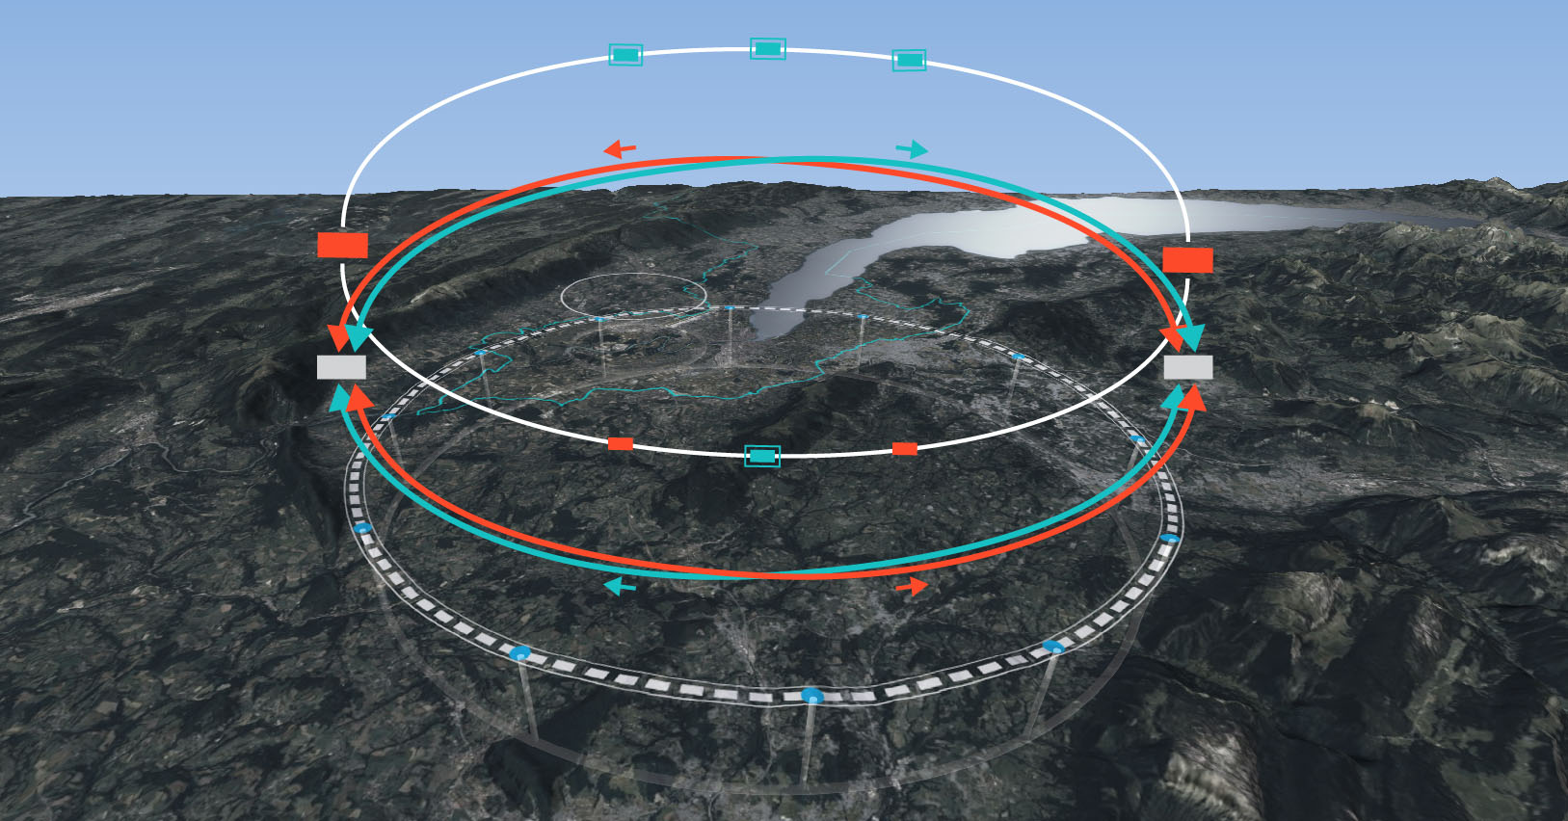
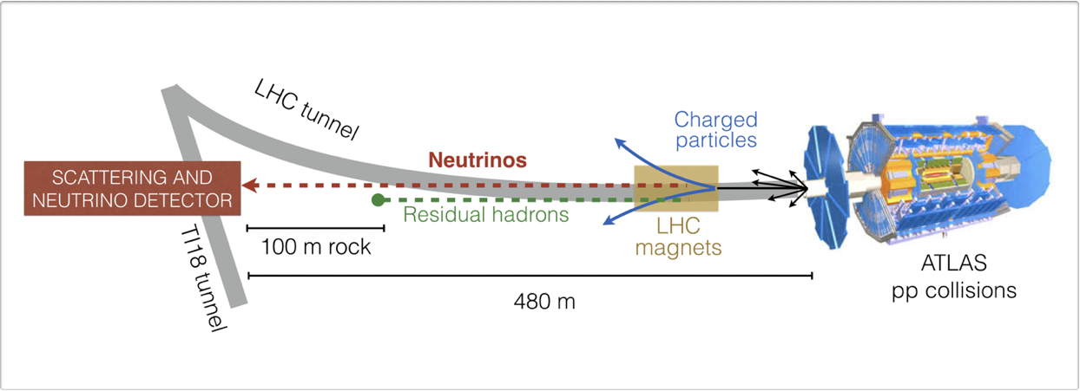
Future Facilities
Mogens Dam, NBI
Danish PANP Meeting
Odense, 21th April, 2022

Slide 2
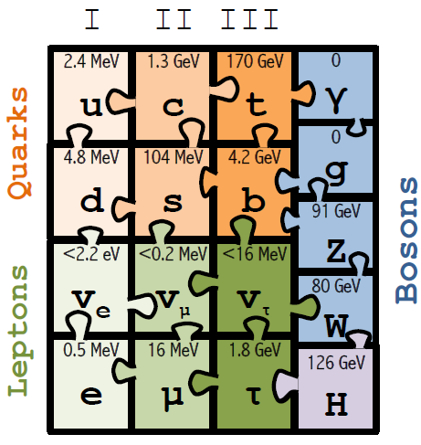
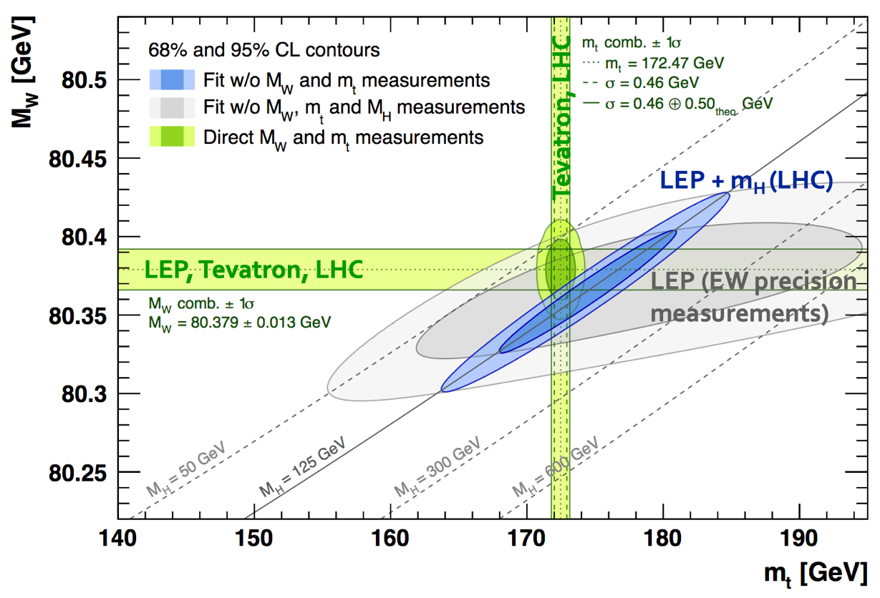
Status of the Standard Model (until April 7th)
With the Higgs boson, the Standard Model as a theory of particles and their interactions is now
✓ complete
✓ coherent (will return to this)
✓ predictive to all energies
…most likely not… !?
Many unanswered questions based on experimental observations?
Why 3 generations of fermions ?
What is the origin of neutrino masses and oscillations ?
What is the composition of dark matter ?
What is the origin of the matter-antimatter asymmetry in the Universe [BAU] ?
Why is gravity so weak ?
Why is the Higgs boson so light ?
so-called “naturalness” or “hierarchy” problem
What is the origin of the Universe’s accelerated expansion ?
Is this the end ?
complete
coherent

Slide 3
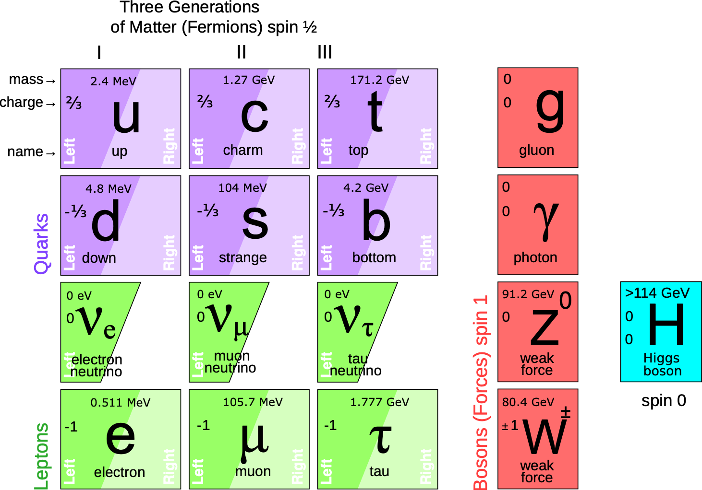

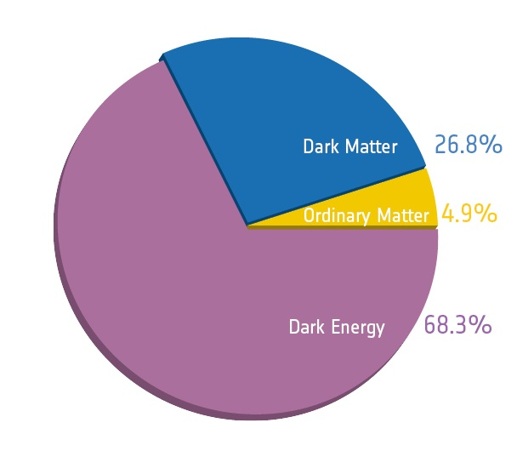
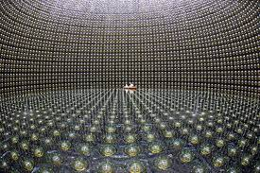

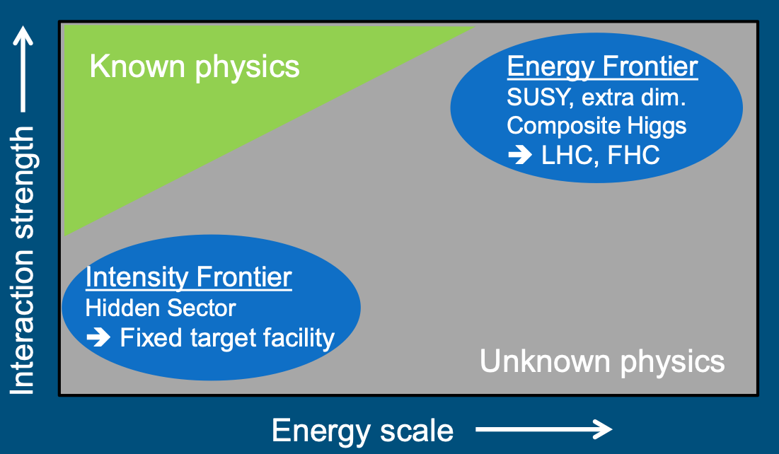
Beyond the Standard Model physics
and where NBI is going to find it
?
?
125
?
FCC-ee
Did not yet find new particles because they are:
Too heavy (energy frontier)
Interact too weakly (intensity frontier)

Slide 4



SHiP — Search for Hidden Particles
For particles below O(10) GeV SHiP provides unmatched sensitivity
SHiP
European Strategy Updage 2020:
… dedicated Physics Beyond Colliders study … Beam Dump Facility at the SPS … one of the frontrunners. However, such a project would be difficult to resource within the CERN budget, considering the other recommendations of this Strategy.

Slide 5
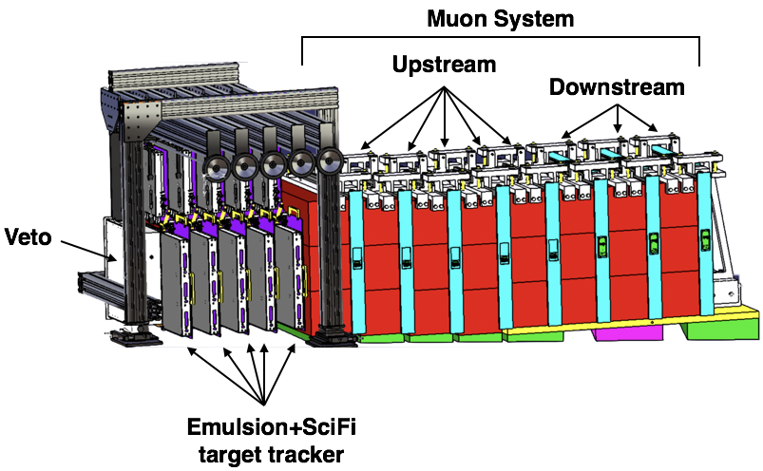

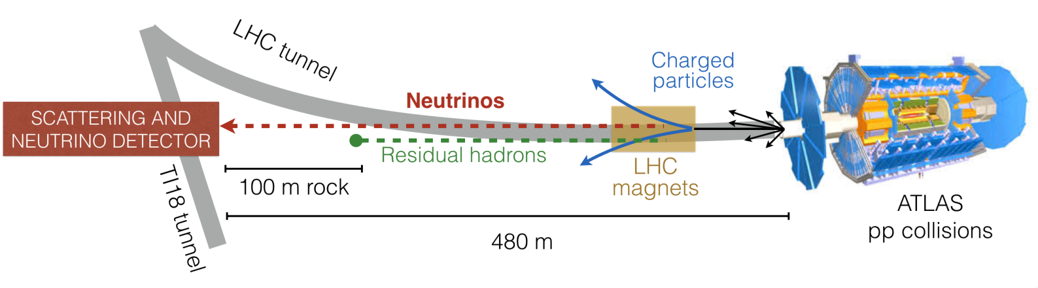

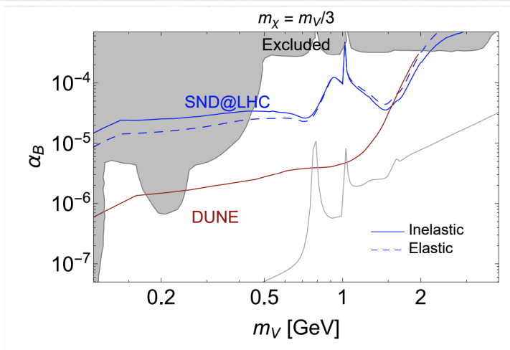
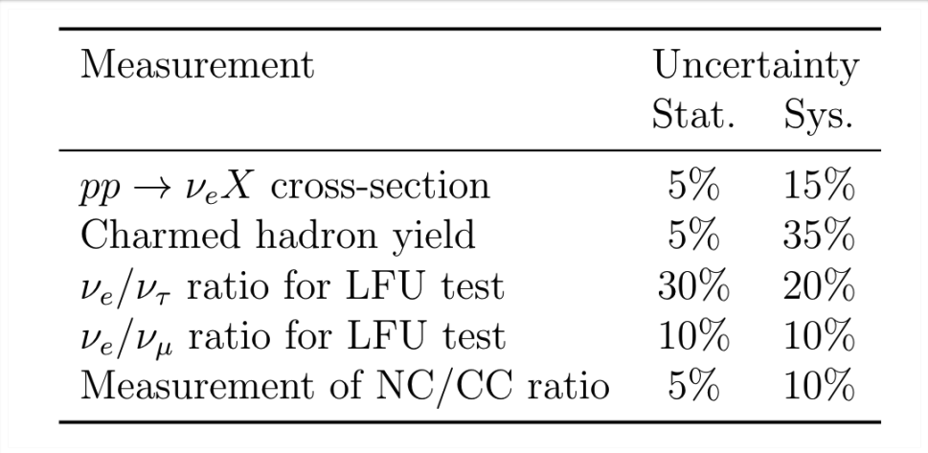
SND @ LHC
Stand-alone experiment to probe neutrino production at the LHC in the forward direction
Sensitivity also to FIPs (Feebly Interacting Particles) including Light Dark Matter
Approved by the CERN Research Board March, 2021
Under construction, data taking now in upcoming Run 3
Comprises 24 institutes from 13 countries
Light Dark Matter

Slide 6
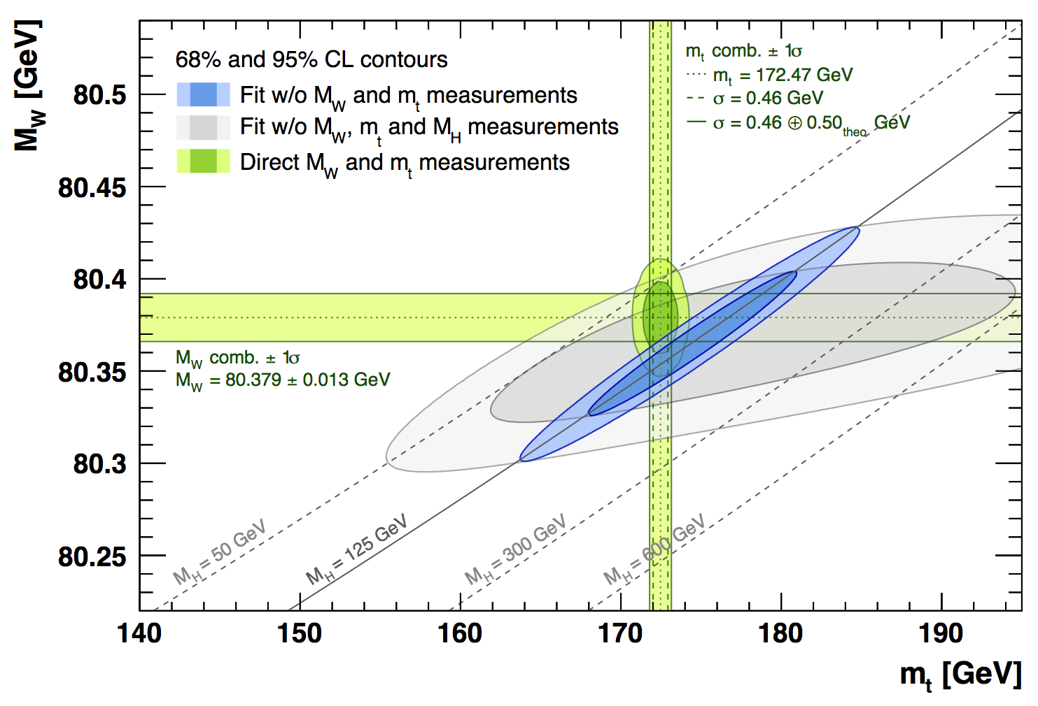
SM coherence before April 7th
Tevatron, LHC
LEP + m_{H} (LHC)
LEP, Tevatron, LHC
LEP (EW precision measurements)

Slide 7
SM coherence after April 7th
CDF:
”A comparison with the SM expectation of
𝑀_{𝑊} = 80,357±6 MeV, … yields a difference with a significance of 7.0σ and suggests the possibility of improvements to the SM calculation or of extensions to the SM.”
Tevatron, LHC
CDF: 80.4335 +/- 0.0094 MeV
LEP + m_{H} (LHC)
LEP, Tevatron, LHC
LEP (EW precision measurements)
Exciting….
… and what if we improve precision further?

Slide 8
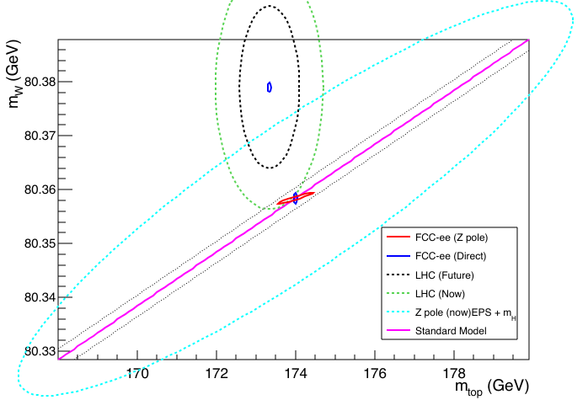
What if we improved all measurements by 1-2 orders ??
Direct measurements.
[Could be here, could be there]
Indirect constraints
”Today”
”2055”

Slide 9
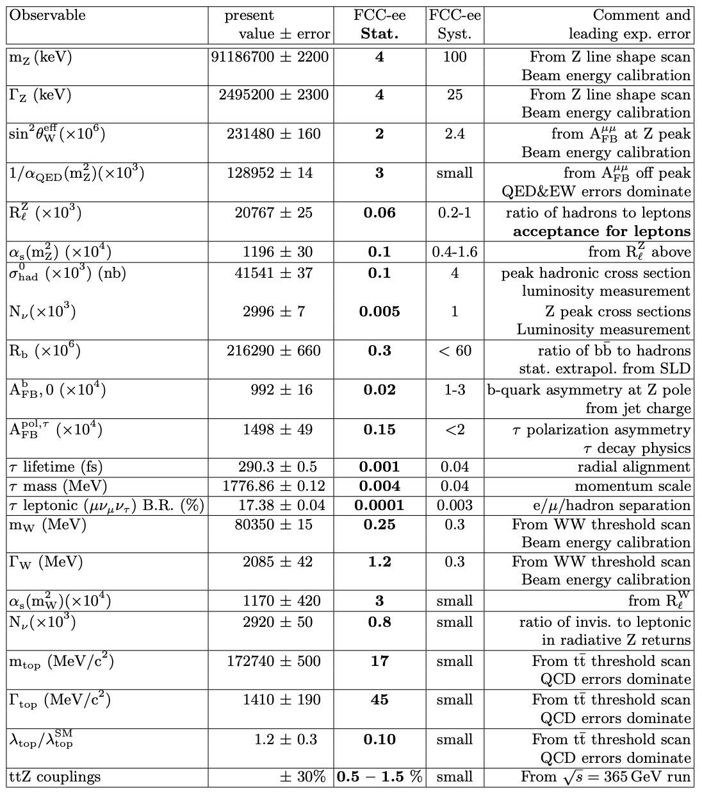
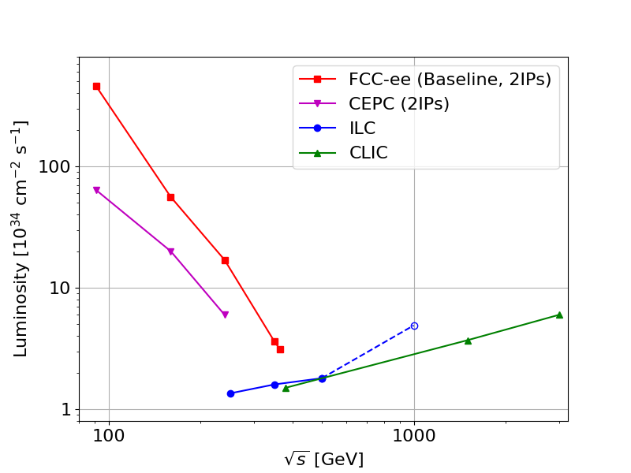
FCC-ee ; precision via luminosity m
Z WW ZH tt
10⁵ times LEP
5 x 10¹² Z decays
10⁸ WW pairs
Z
1.2 x 10⁶ Higgs decays
10⁶ tt pairs
Statistics is immense:
Ultimate factory for Z, W, Higgs, top, and heavy flavour, c, b, tau
Uncertainties will be systematics limited
WW
⇒ Detector Design is essential ⇐
tt

Slide 10
FCC and the 2020 European Particle Physcics Strategy Update
From the strategy document:
An electron-positron Higgs factory is the highest-priority next collider. For the longer term, the European particle physics community has the ambition to operate a proton-proton collider at the highest achievable energy.
Europe, together with its international partners, should investigate the technical and financial feasibility of a future hadron collider at CERN with a centre-of-mass energy of at least 100 TeV and with an electron-positron Higgs and electroweak factory as a possible first stage.
Such a feasibility study of the colliders and related infrastructure should be established as a global endeavour and be completed on the timescale of the next Strategy Update.
⇒ In June 2020, Future Circular Collider Feasibility Study was launched by CERN Council

Slide 11
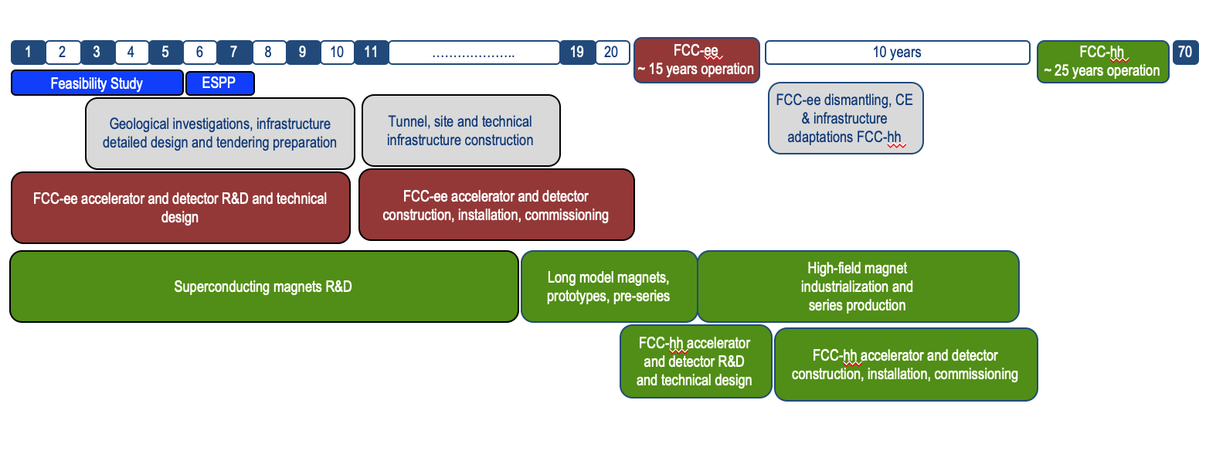
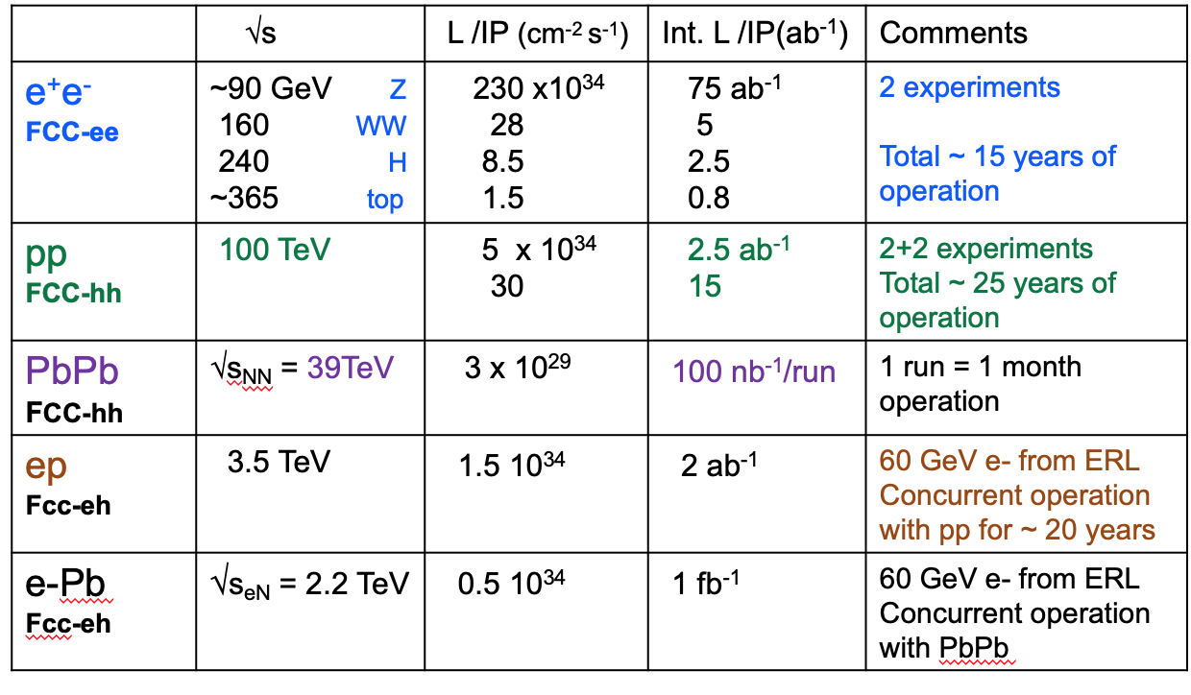
Timeline for FCC Integrated programme
Technical
schedule
2-4 experiments
20-30
Feasibility Study: 2021-2025
If project approved before end of
decade → construction can start
beginning 2030s
FCC-ee operation ~2045-2060
FCC-hh operation 2070-2090++

Slide 12
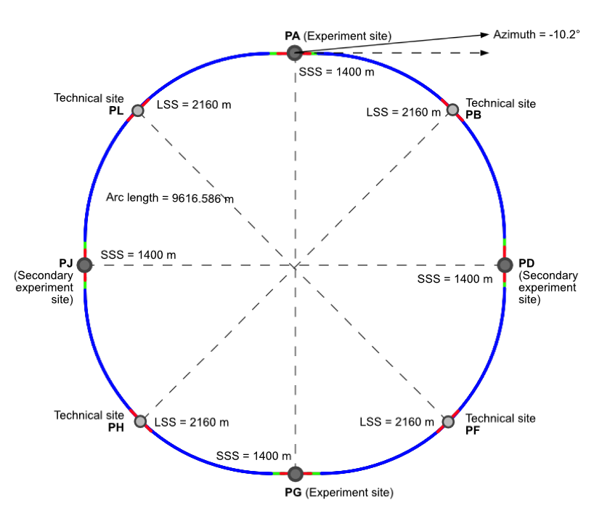
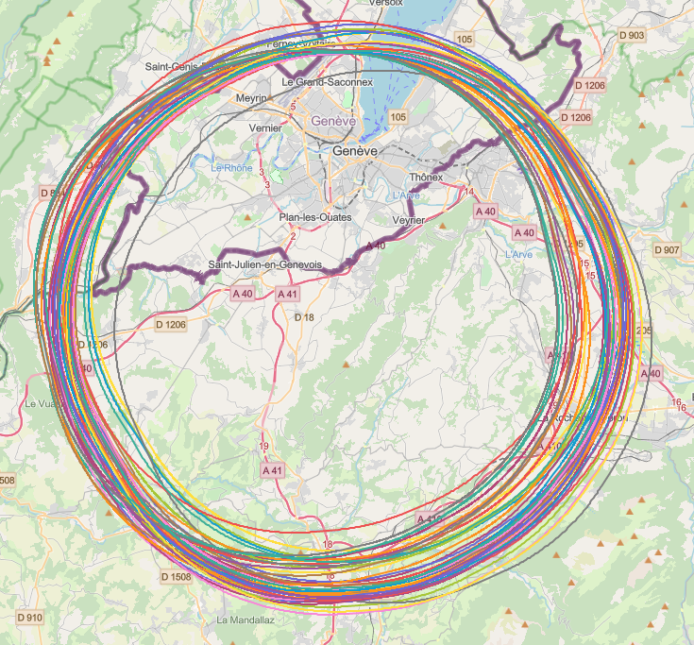
Geometry and Placement
8-fold symmetry: allows for 2 or 4 interaction points
Circumference 91.19 km [Z factory ;-)]
Placement studies

Slide 13

Status of Global FCC Collabortion
Increasing international collaboration as a prerequisite for success: links with science, research & development and high-tech industry will be essential to further advance and prepare the implementation of FCC
147
Institutes
30
Companies
34
Countries
EC
H2020

Slide 14
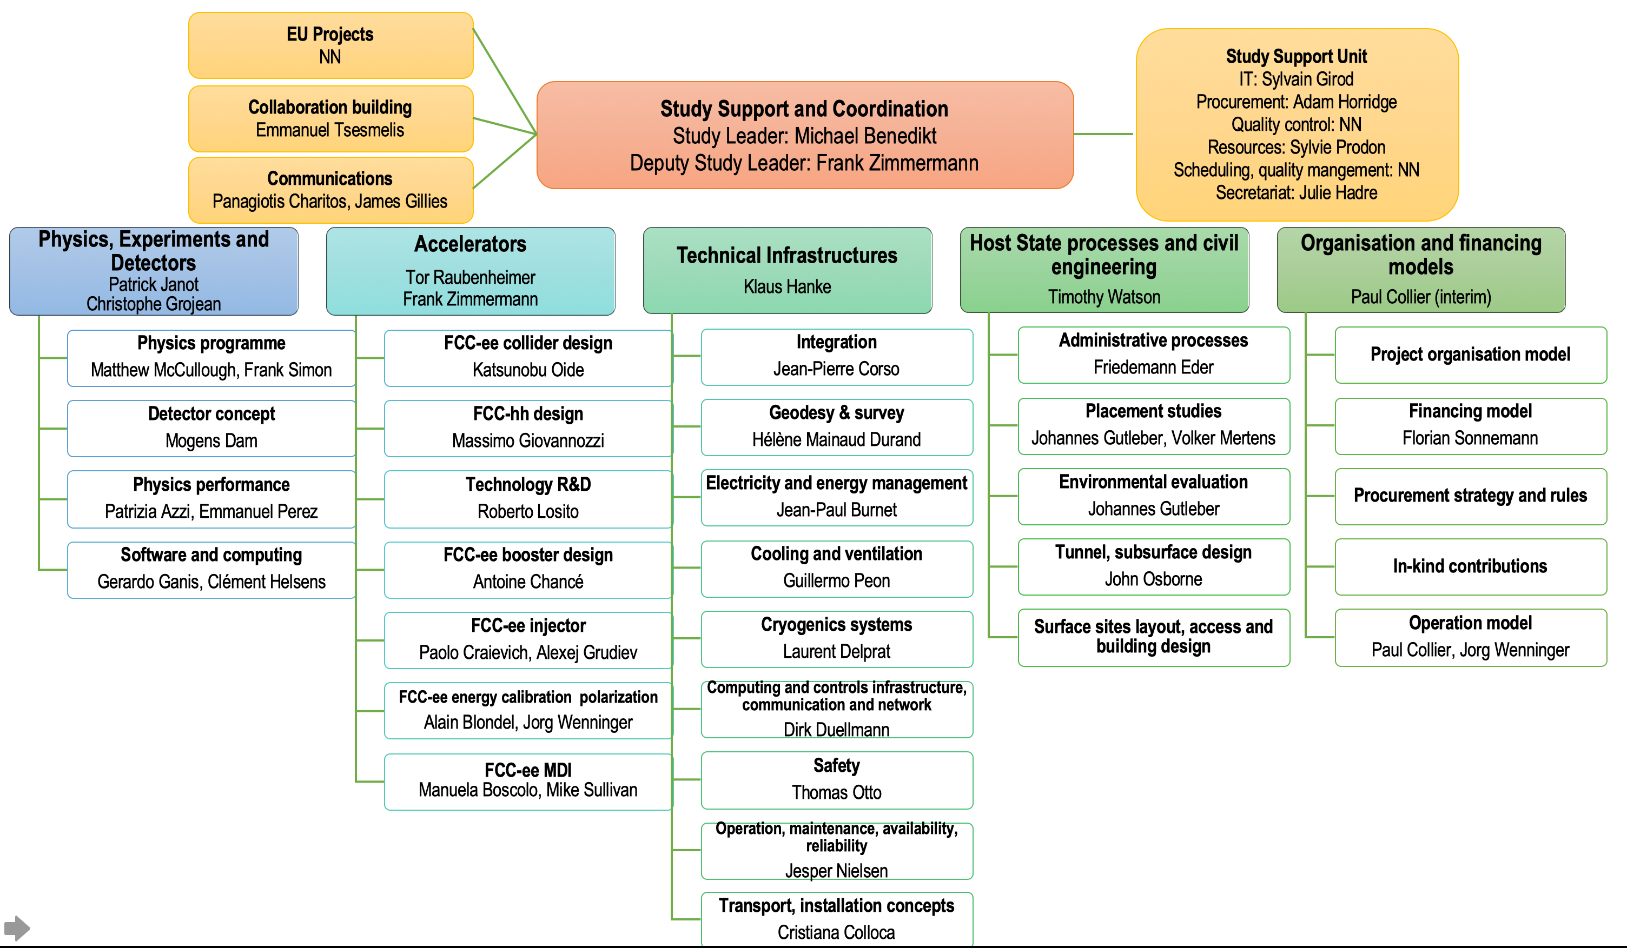
FCC Feasibility Study – Coordination Team
Luckily recently joined by
- Felix Sefkow, DESY
- Philipp Roloff, CERN
Status February 2022

Slide 15
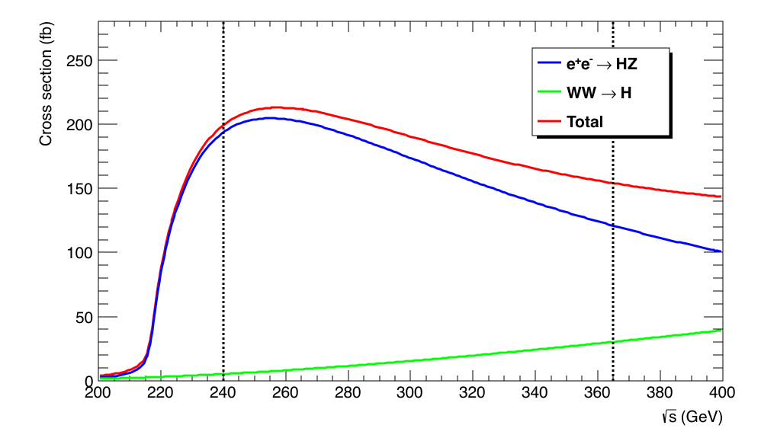
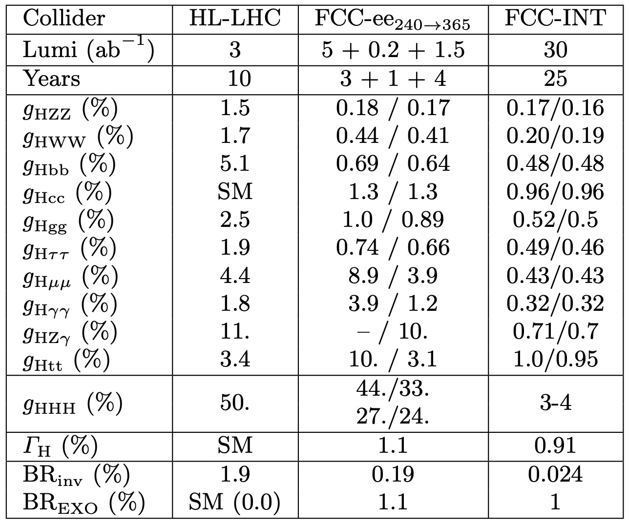
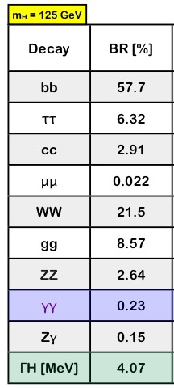
FCC-ee Higgs Factory
10⁶ Higgsstrahlung event at √s ~ 240 GeV
Complemented with 200k events at √s = 350 – 365 GeV
Of which 30% in the WW fusion channel (important for the Γ_{H} precision)
2IP
4IP
w/wo HL-LHC

Slide 16
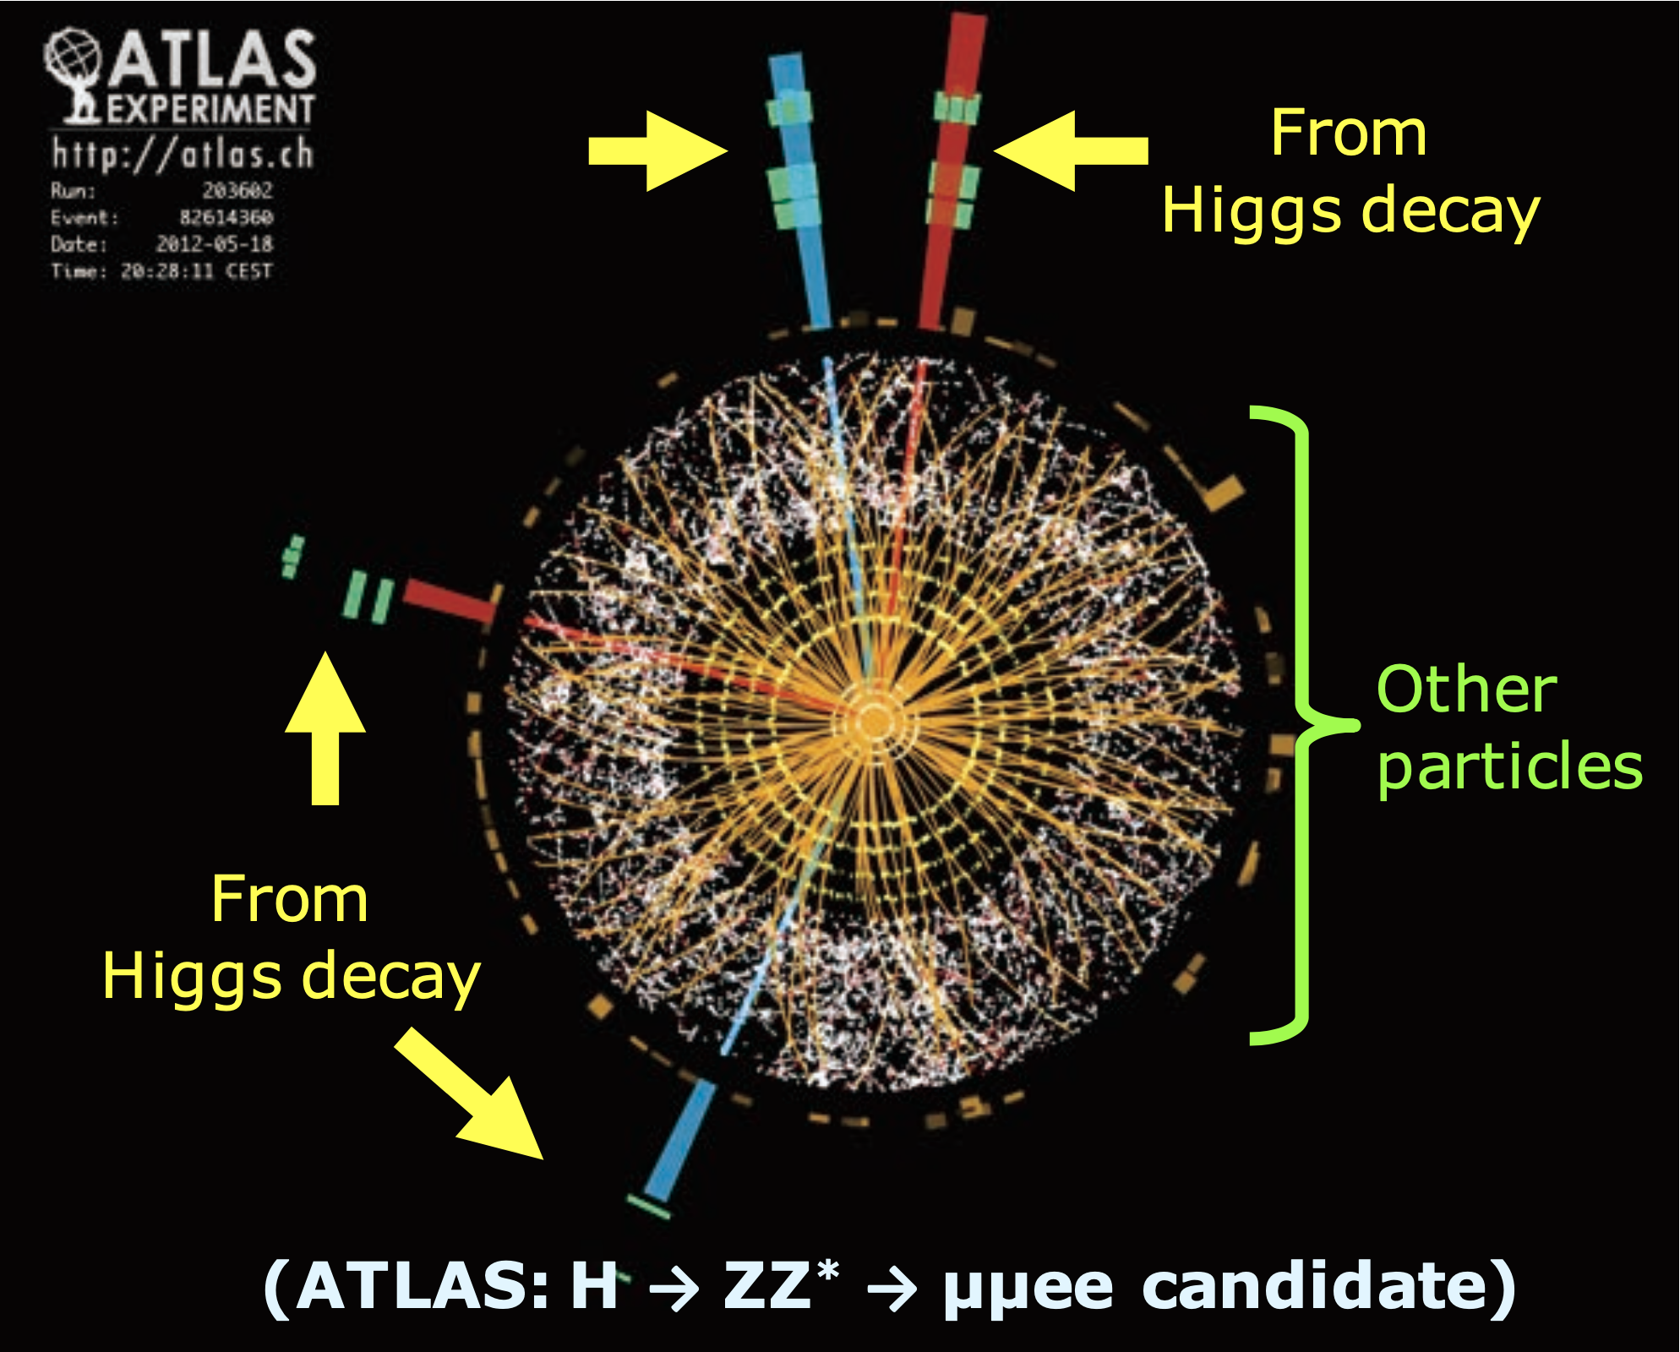
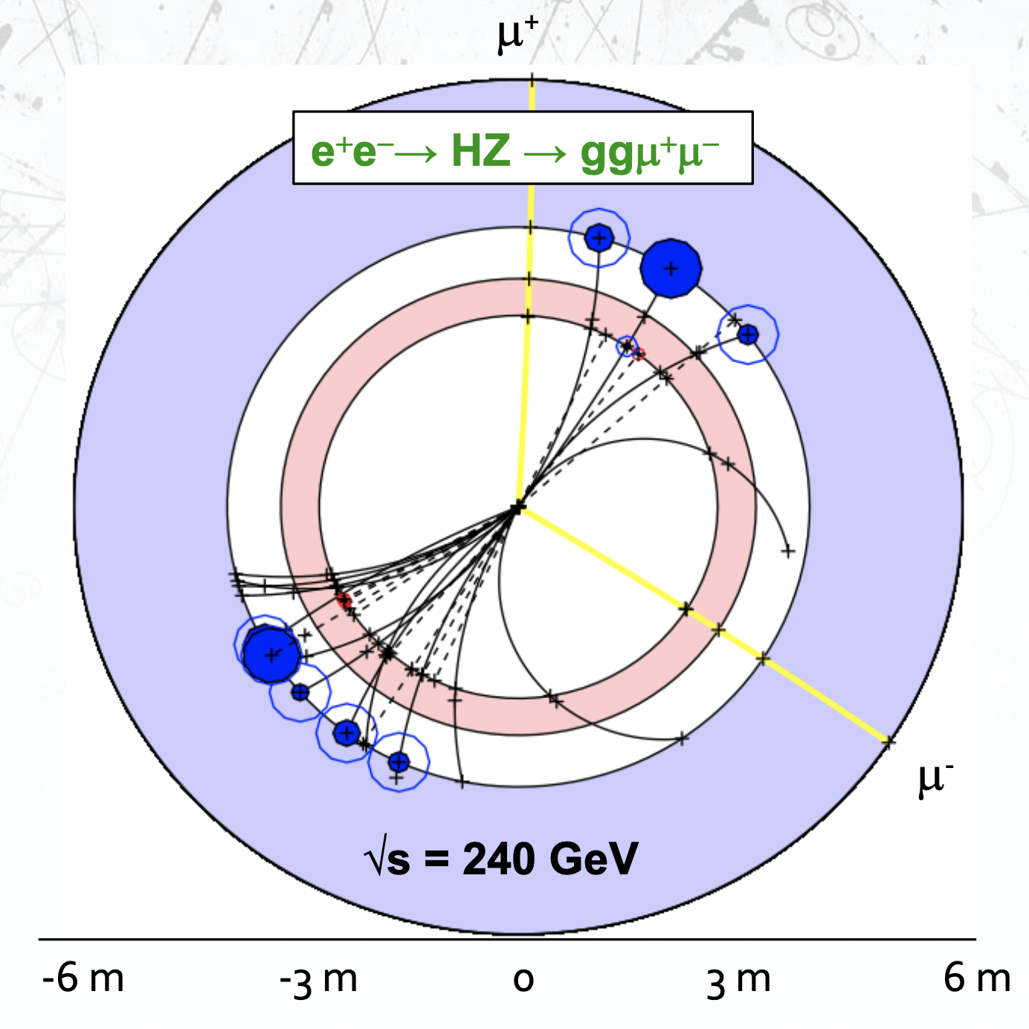
Reminder: Higgs event in pp and e⁺e⁻
Proton-proton: look for striking signal in large background
Already ~3 M Higgs bosons produced per LHC experiment
e+e⁻: detect everything; measure precisely
A ”beam” of Higgs’es tagged by the invariant mass and recoil mass of the Z decay products

Slide 17
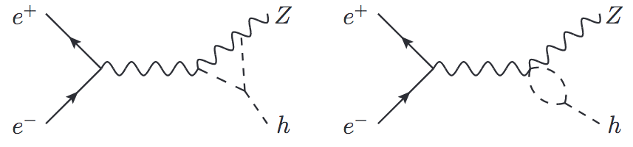
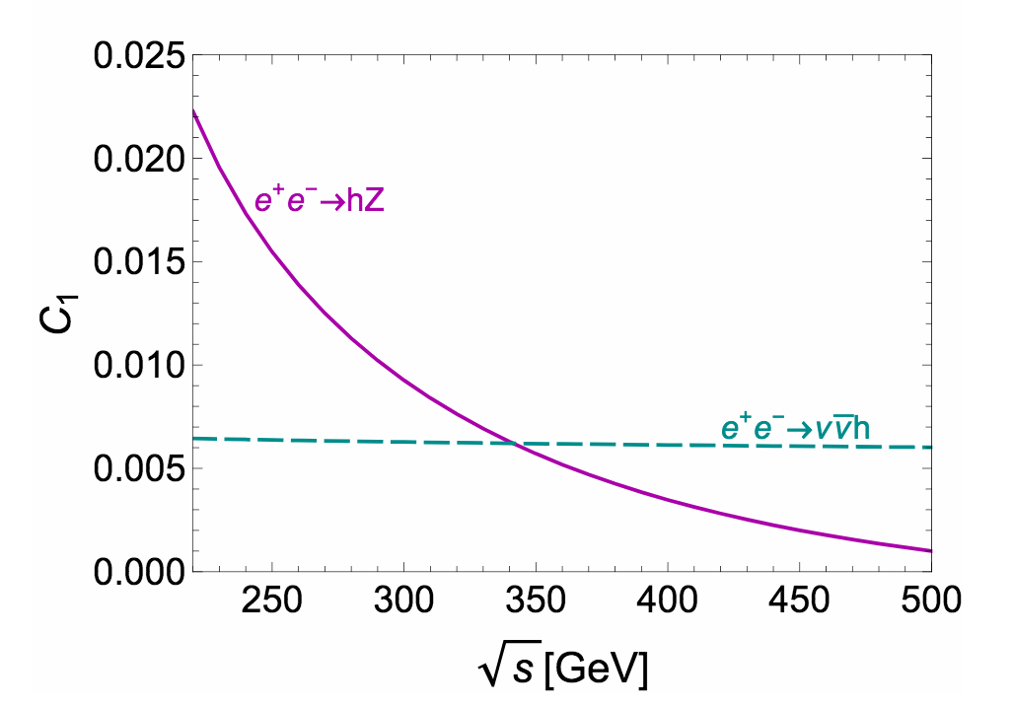
Higgs Self Coupling
FCC-ee does not produce Higgs pairs, from which self coupling can be extracted (insufficient energy)
But, loops including Higgs self coupling contribute to Higgs production
Effect of Higgs self coupling (κ_{λ}) on σ_{ZH} and σ_{ννH} depends on √s
Two energy points (240 and 365 GeV) lift the degeneracy between δκ_{Z} and δκ !
+
M. McCullough
arXiv:1312.3322
Up to 2% effect on σ_{HZ}
Δσ
3-4 σ evidence in baseline programme.
Run few more years, 5σ discovery
σ
δκ_{Z}
C. Grojean et al.
arXiv:1711.03978

Slide 18
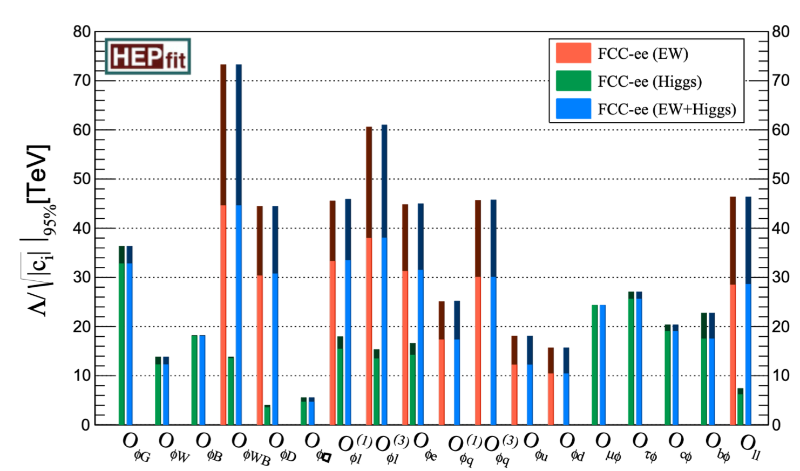
Precision Physics sensitivity to New Physics
Global EFT fit
Higgs and EW programmes are largely complementary
Generally highest reach via EW programme
Much higher statistics; Higgs programme statistics limited
Sensitivity to new physics up to 70 TeV

Slide 19
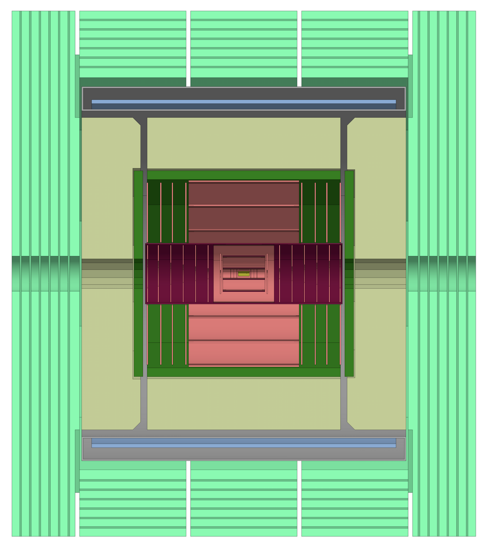
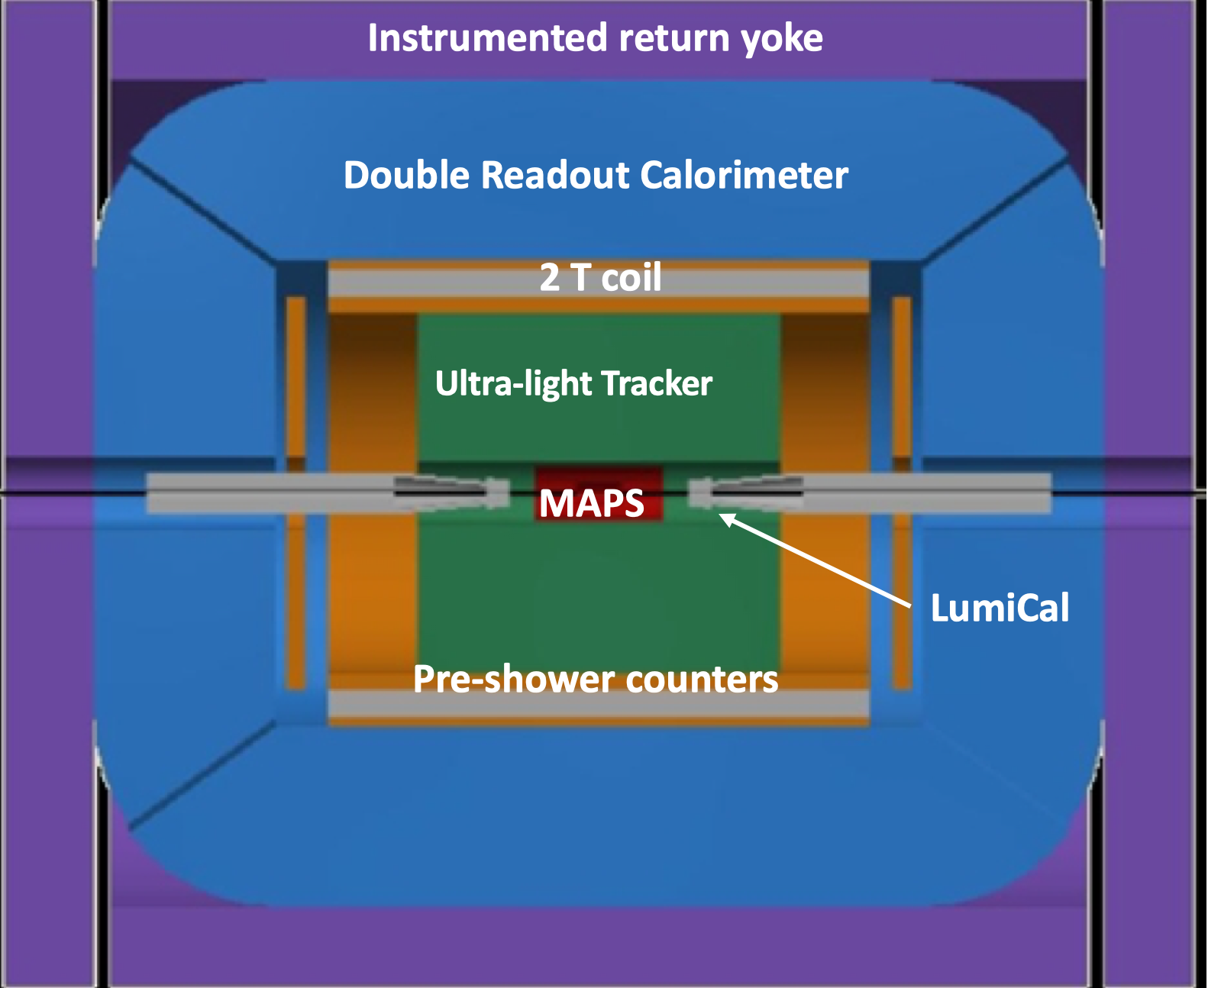
Detector Concepts: At least three Complementary Designs
2T coil
Scintillator-iron HCAL
Si Tracker
Here show only two
Si-W ECAL
CLD
Consolidated option based on the detector design developed for CLIC
All silicon vertex detector and tracker
3D-imaging highly-granular calorimeter system
Coil outside calorimeter system
Proven concept, understood performance
IDEA
New, innovative, possibly more cost-effective design
Silicon vertex detector
Short-drift, ultra-light wire chamber (fantastic PID)
Dual-readout calorimeter
Possibly (hopefully!) agumented with crystal ECAL
Thin and light solenoid coil inside calorimeter system

Slide 20
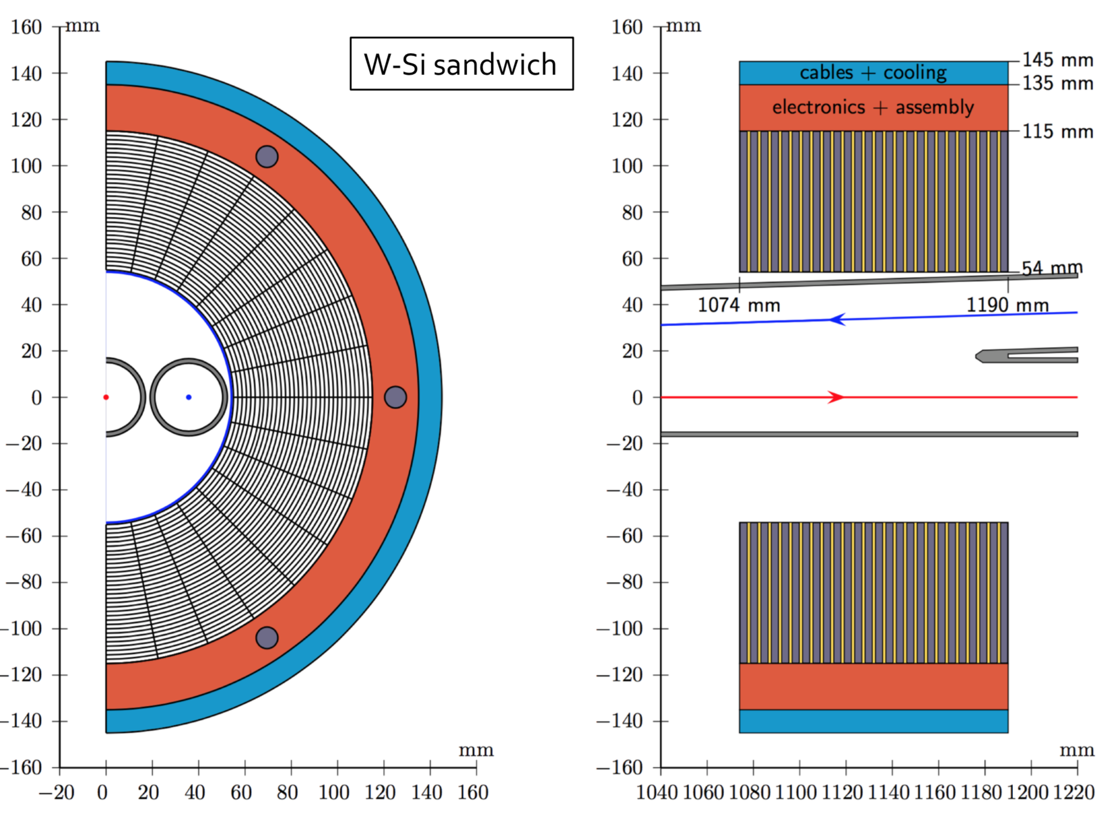
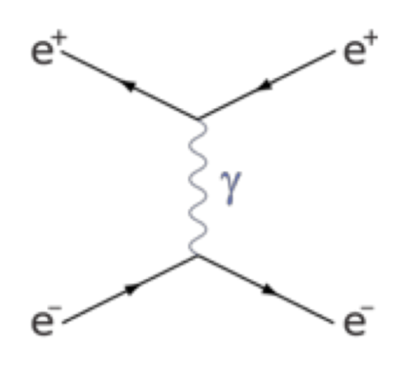
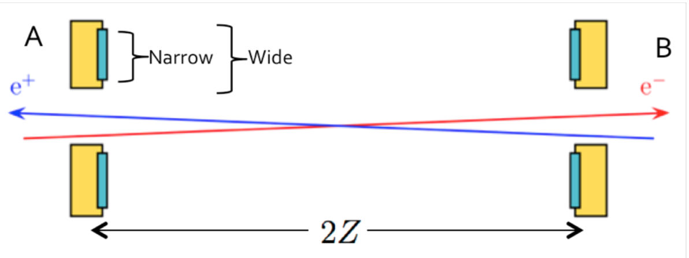
Precision Challenge: Luminosity Measurement
Ambitious goal:
Absolute to 10⁻⁴
Relative (energy-to-energy point) to 10⁻⁵
Small angle Bhabha scattering (QED).
Very strongly forward peaked
Monitors centered around outgoing beam lines
-- micron level precision needed on monitor dimensions (inner radius)
LumiCal design
Theory: Now at 3.8 × 10⁻⁴; theory friends foresee that 1 × 10⁻⁴ will happen
Backgrounds: have been studied and seem to be under control
Many (interesting!) R&D/engineering challenges
Precision on acceptance boundaries to 𝓞(1 μm) !
Mechanical assembly, metrology, alignment
Physics rate of 𝓞(100 kHz)
Readout at 50 MHz BX rate ?
Power management / cooling
Support / integration in crowded and complex MDI area

Slide 21

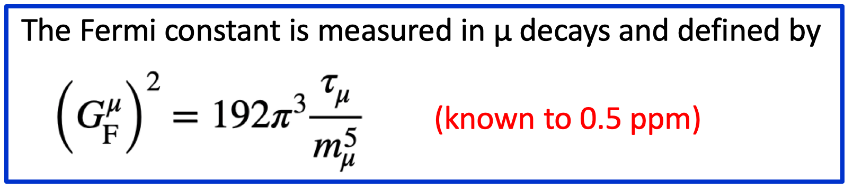
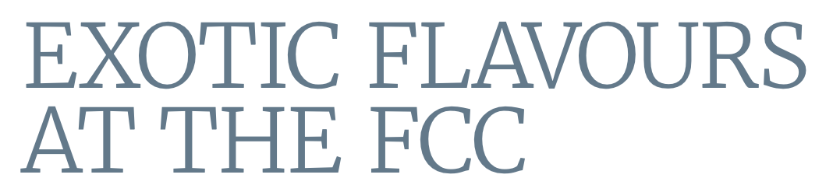

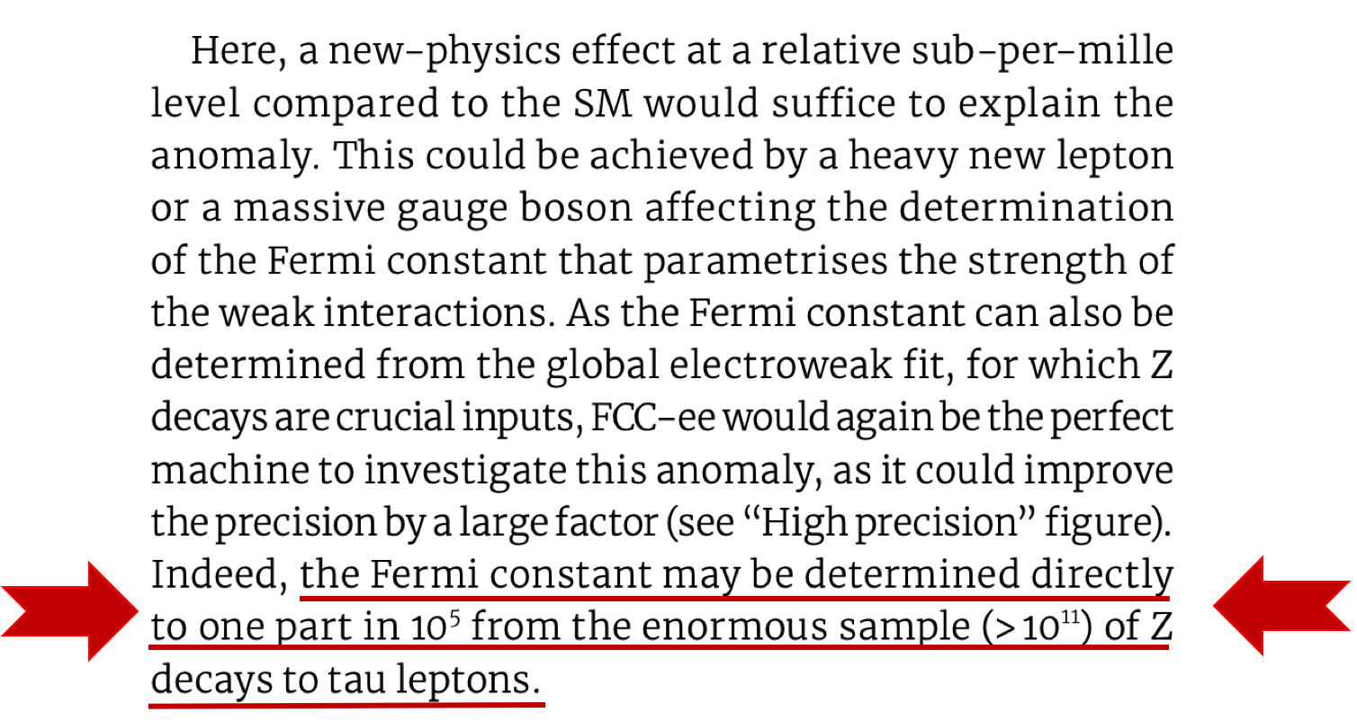
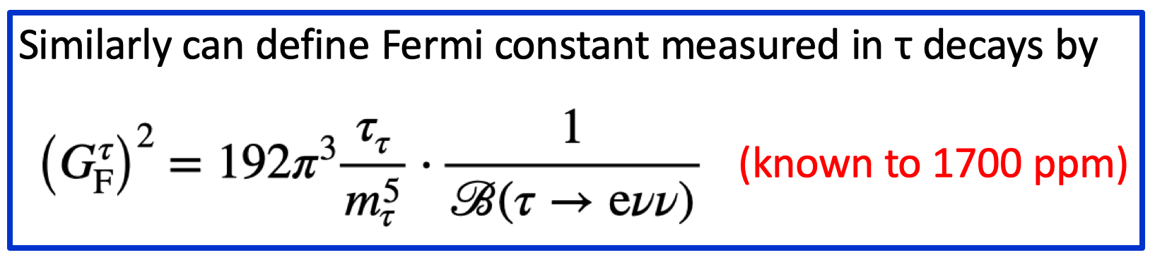
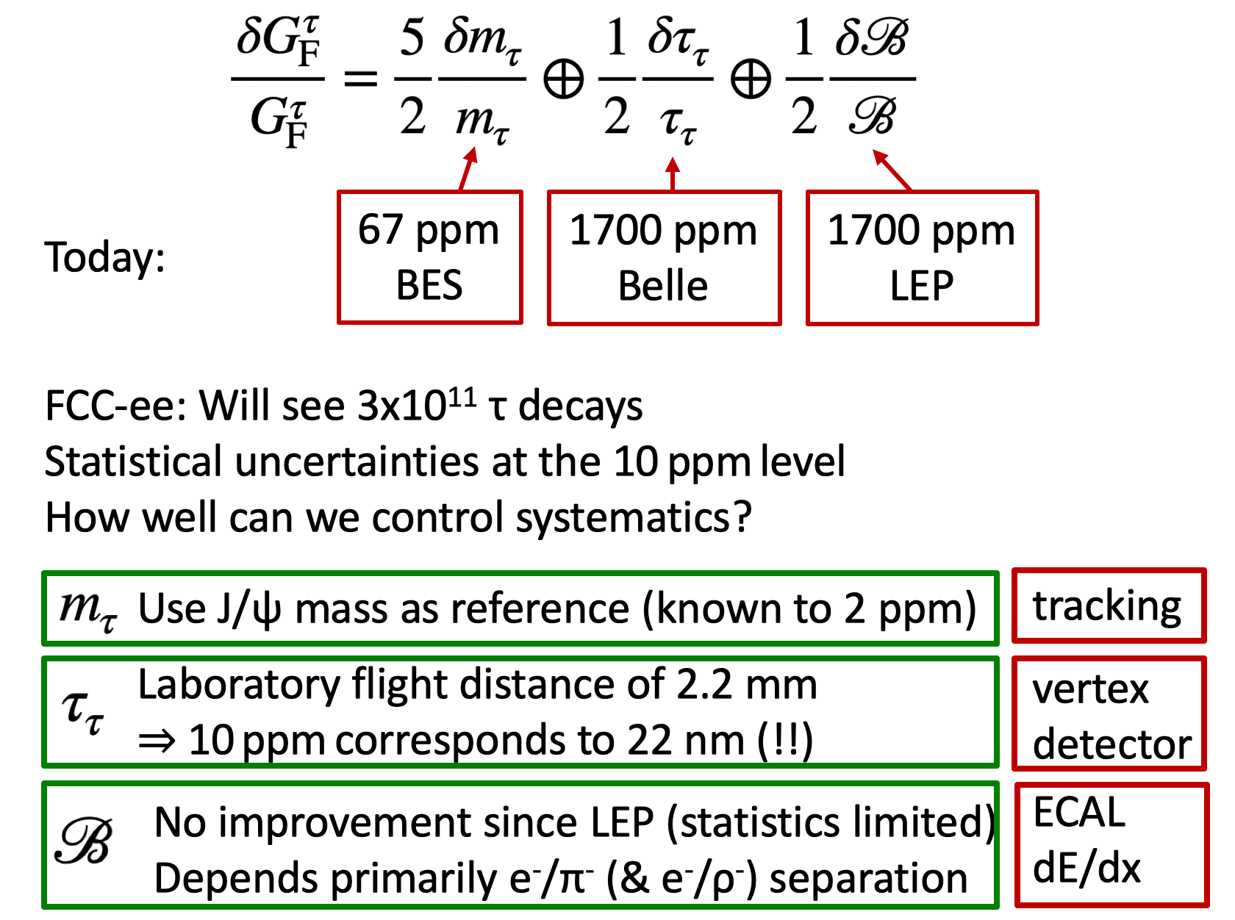
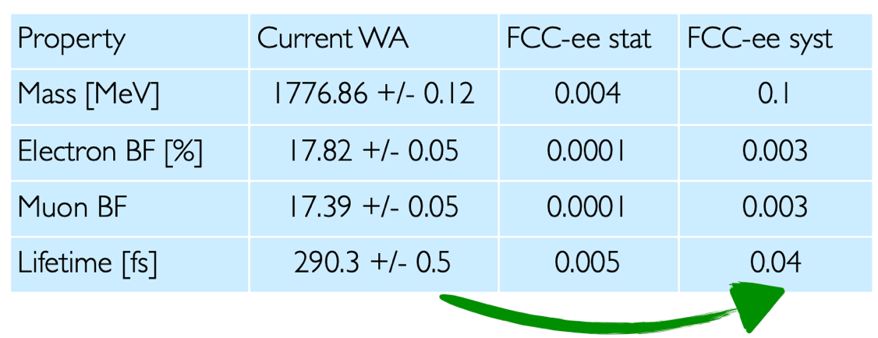
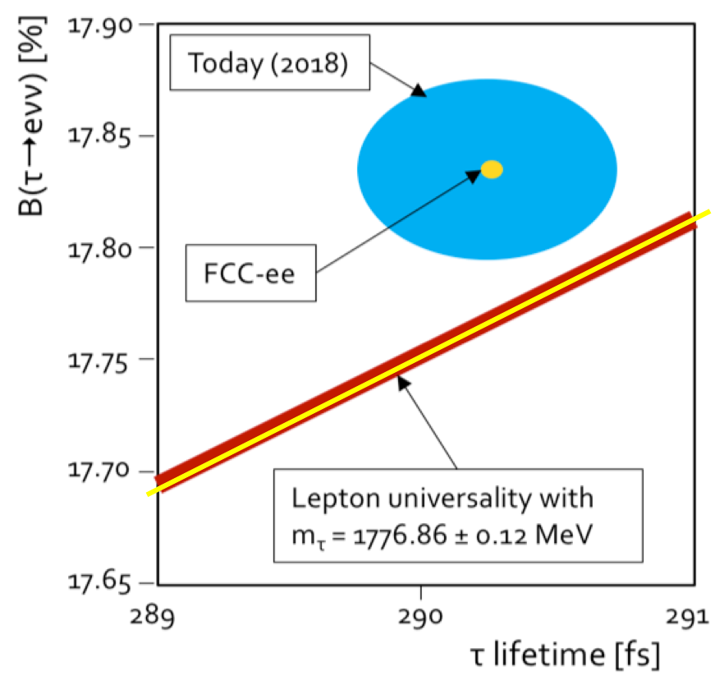
Example of precision challenge: Universality of Fermi constant
Shown in yellow: first guestimates on FCC-ee precisions

Slide 22
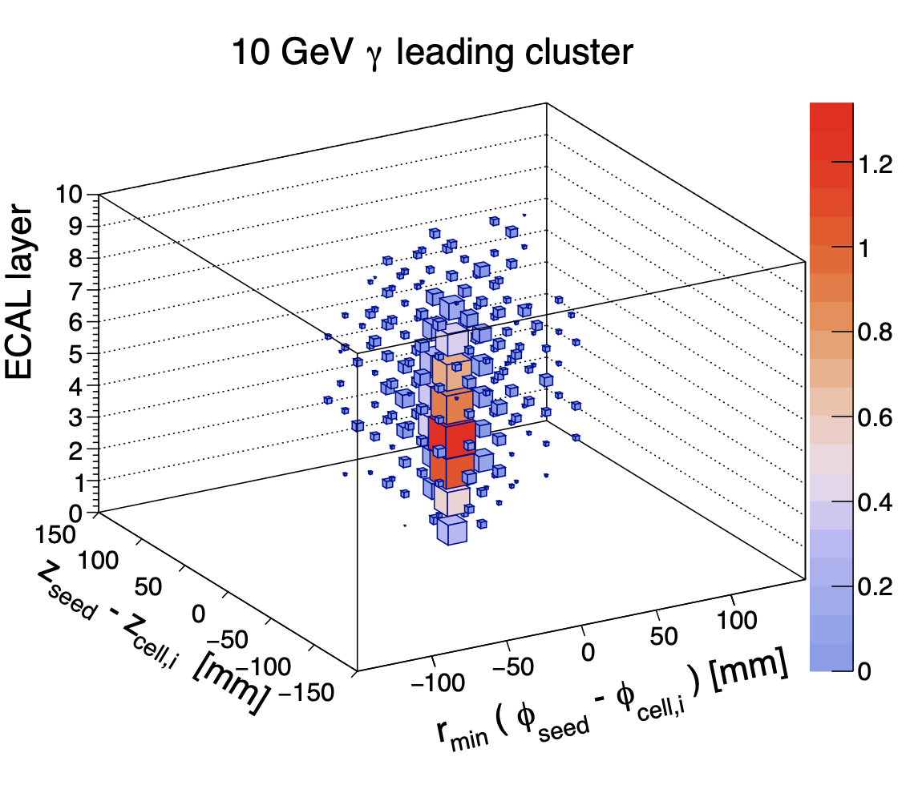
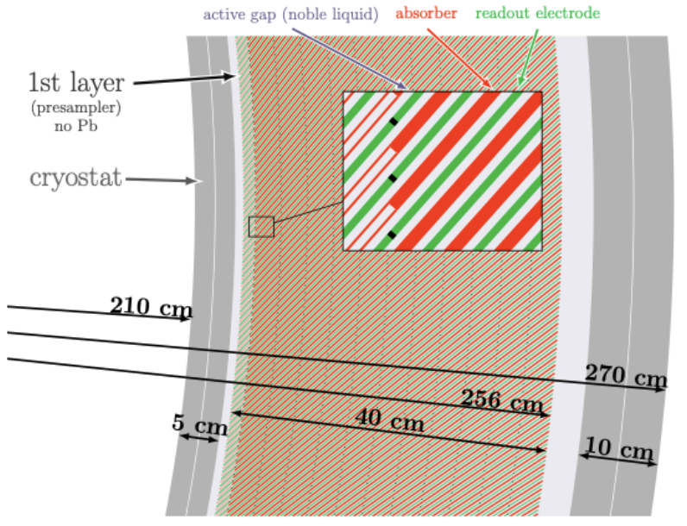
FCC at NBI
Together, Jørgen Beck Hansen and MD have adviced five FCC MSc projects
Sissel: Study of FCC-ee sensitivity to Heavy Neutral Leptons
PhD student at DTU
Molly: Study of tau decay performance of Dual Readout Calorimeter
job in ministry immediately
Kunal: B-tagging methods at FCC-ee
PhD student at CP3, Brussels
Julie: Study of SM-EFT anomalous contributions in 𝑡𝑡 production
PhD student at DESY, Hamburg
Katinka: Tau Decay Mode Identification in a Liquid Argon Electromagnetic Calorimeter at the FCC-ee
?

Slide 23
Outlook
Standard Model is extremely succesful in parametrizing Nature as we observe it in our laboratories
Leaves, however, unanswered the deepest questions about Nature
Exciting future ahead
LHC + HL-LHC:
Searches:
Be prepared for the unexpected
Both in general purpose experiments and in dedicated, small, ”parasitic” experiments
Precision measurements:
top quark and W boson masses (we really should try to beat CDF’s 9.4 MeV precision)
Higgs couplings to few %-level; Higgs triple selfcoupling (λ₃) to 50%
High intensity beam dump experiments (SHiP) ?
Priority in next ESPP?
Future Circular Collider
Ongoing Feasibility Study for decision on first step (FCC-ee) by next ESPP (~2026)
Possible long term future for CERN
FCC-IS: FCC-ee followed by FCC-hh
Unchallenged precision tests of Standard Model including Higgs sector (λ₃ to few %)
Unprecedented sensitivity to New Physics both indirectly (precision measurements) and directly at intensity as well as at energy frontier

