Slide 1
HEP Computing in Denmark
Present status and future perspectives
Danish contribution to LHC computing
Other HEP related computing activities
The Danish National Strategy for HPC and data management based on FAIR principles.
Future Danish contributions til LHC computing.
Danish PANP meeting
SDU 21st April 2022
(rECFA meeting in Copenhagen 2022)
(12th May 2022)
Professor John Renner Hansen
Niels Bohr Institute - UCPH

Slide 2
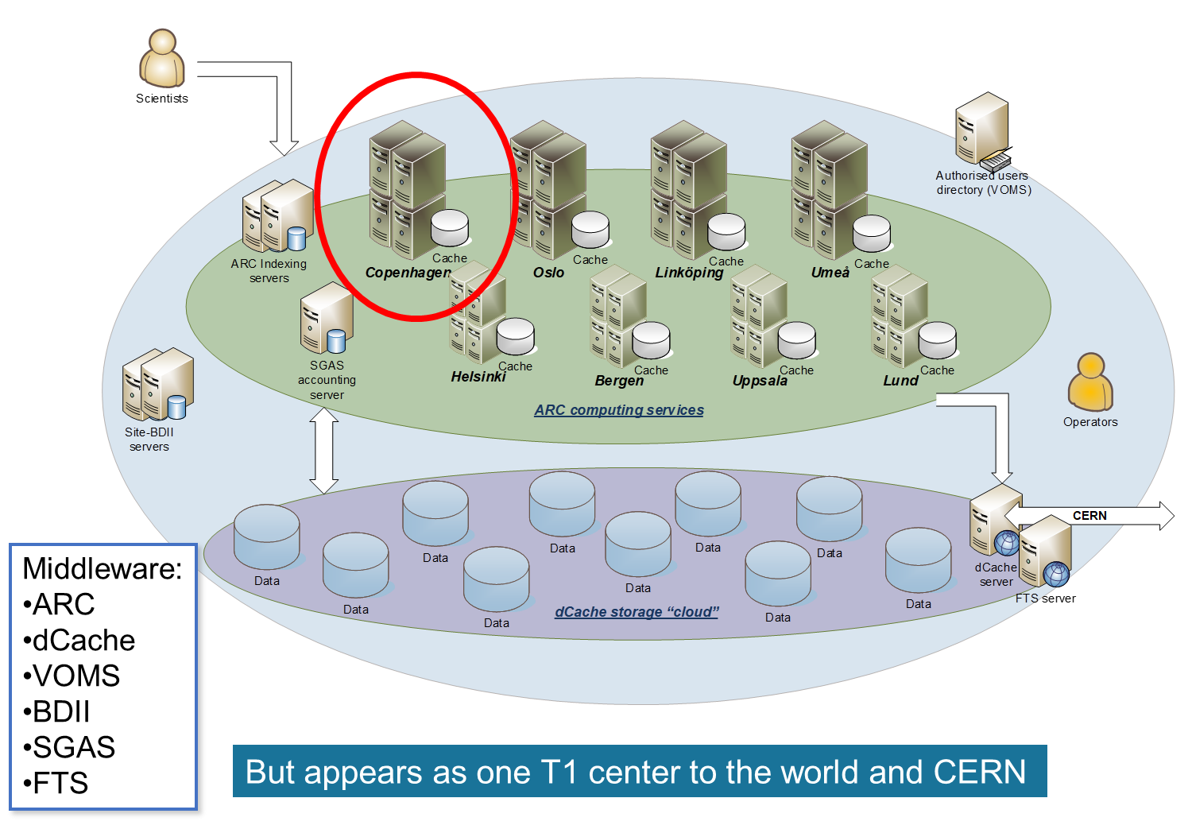

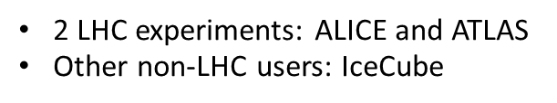
Nordic Tier 1 – Computing and Storage for the Large Hadron Collider at CERN
Original reasoning leading to NDGF I 2002
Advanced Resource Connector (ARC)
The setup in service since 2007
One big highly reliable storage system gives more value to the researchers
  Than 4-5 smaller national storage and computing systems
  Less effort to manage
Cooperation saves money
  While distributed operations have a bit of overhead...
  The replication of effort in running 4-5 independent national systems would be worse

Slide 3
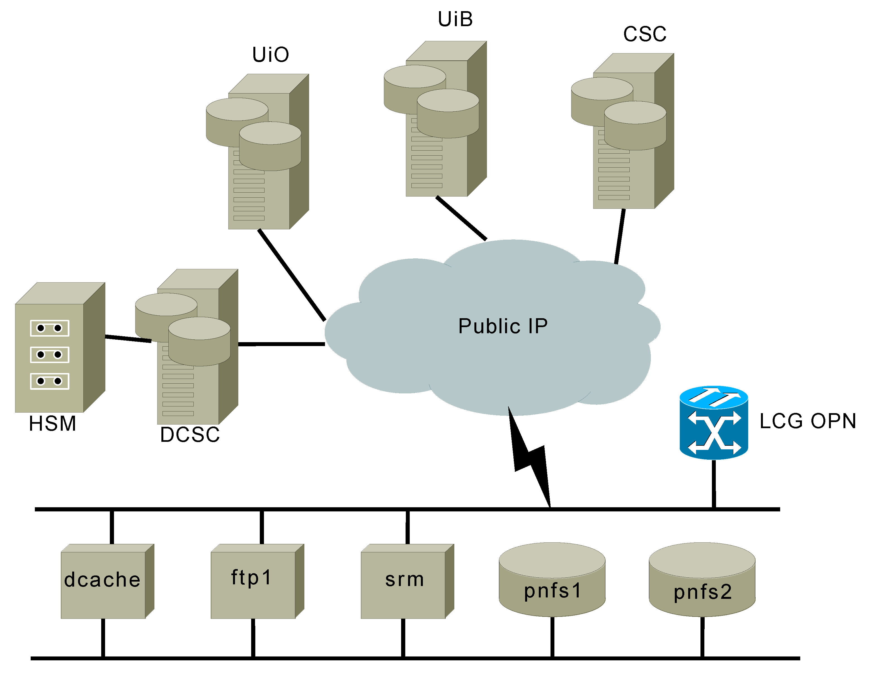
The Distributed storage system: dCache
Disk pools
Links to ARC Compute Elements
Tape storage
Link to CERN and other Tier1s
Central services
(common namespace etc)
But appears as one T1 storage to the world and CERN

Slide 4
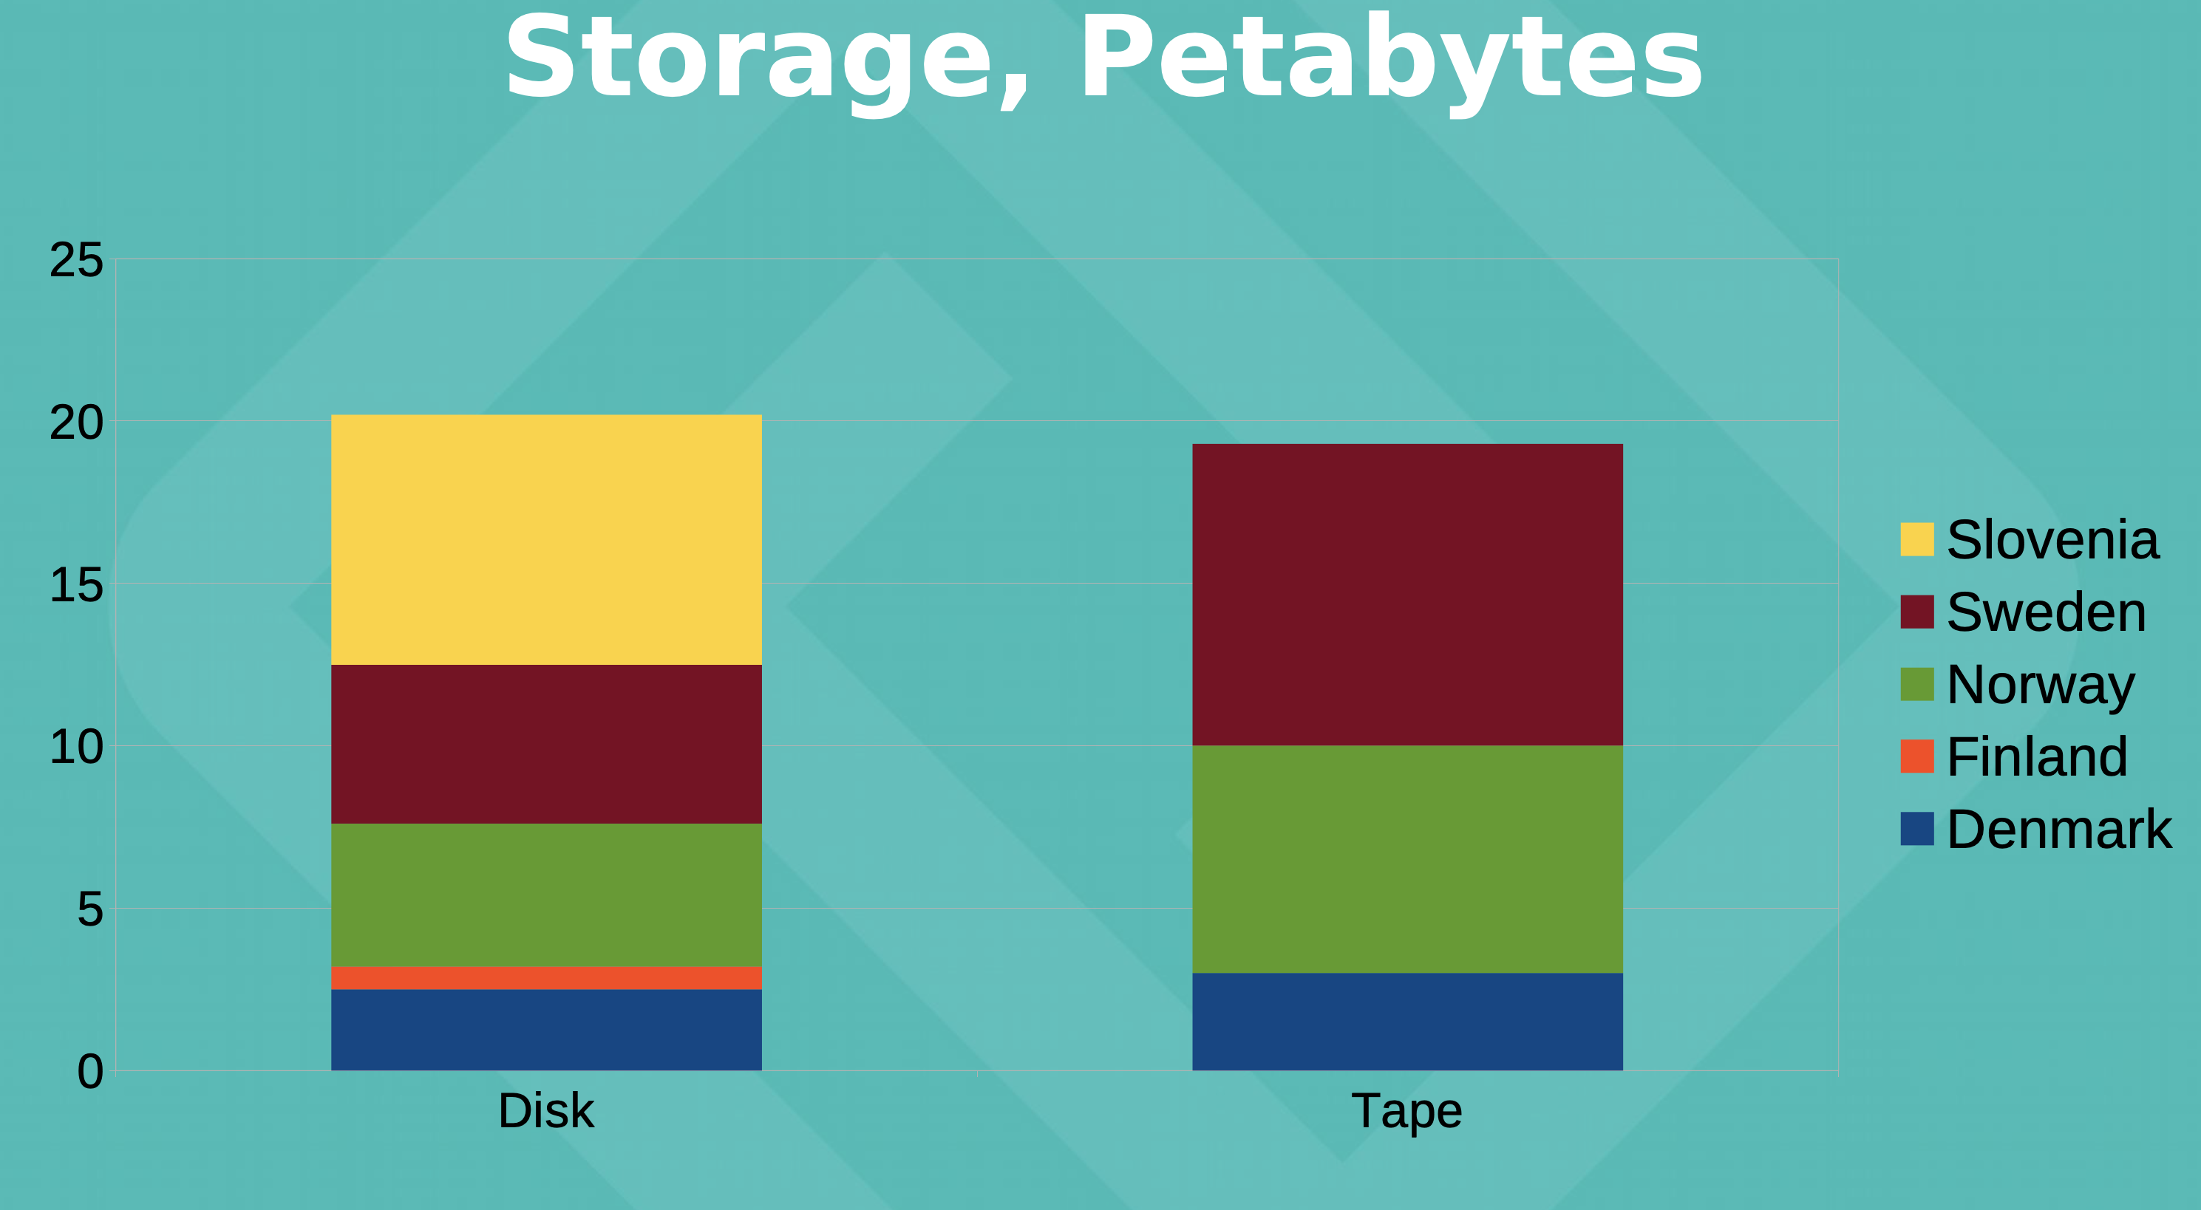
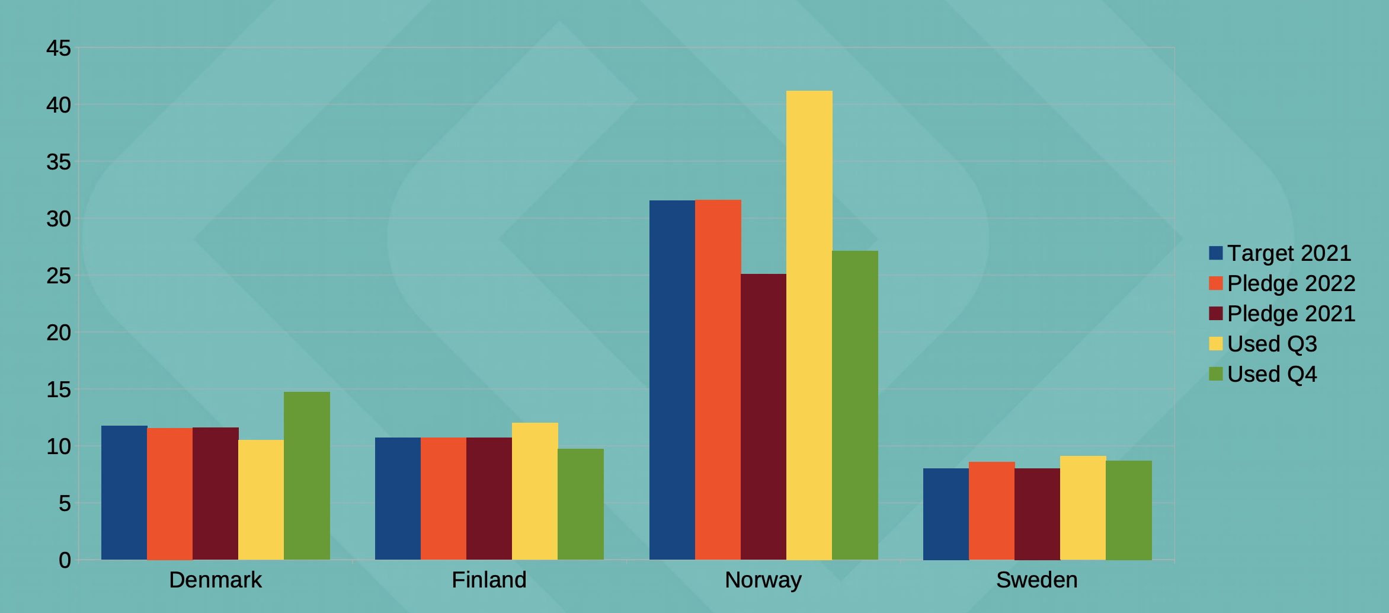
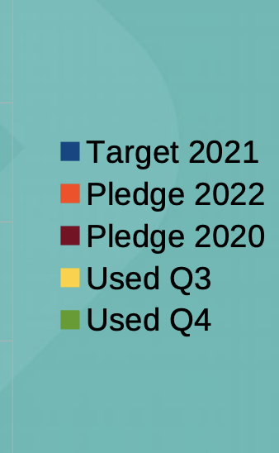
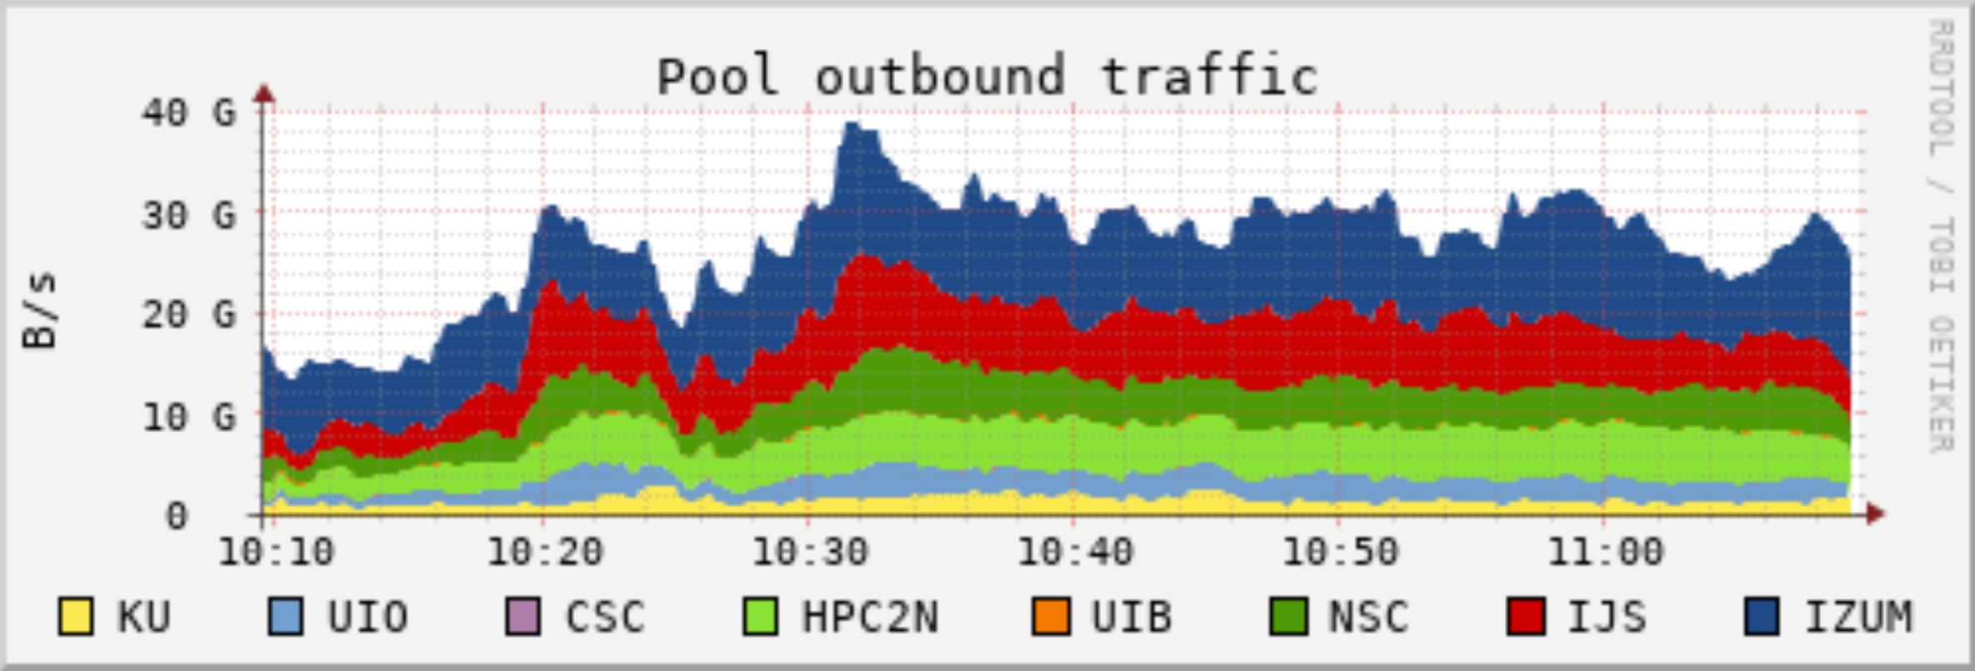
Danish resources to ALICE and ATLAS
DK-T1 is Located at the Niels Bohr Institute
  Network: 100G
  CPU: 23 kHEPSpec06
  Disk: 2 PB
  Tape: 3 PB
  1 FTE
Local resources
  150 cores on 6 servers
  0.1 PB disk
CPU, per experiment
kHEPSpec06

Slide 5
CERN-related computing at SDU – Current Status
A small pool of dedicated resources
  2 large GPU servers: x4 nVidia V100, x8 nVidia A100
  A few CPU servers for numerical simulations, symbolic calculations
Local resources at the faculty of Science
  Old HPC cluster ~200 CPU nodes with 24cores per node
  ~25%, ie. ~7M core*hours per year spent on CERN-related activities (theory)
  ~600TB of data from simulations
Use of national DeiC HPC systems and international HPC systems
  DeiC ~1M core*hours per year:
  Interactive HPC (data analysis and smaller simulations),
  Throughput HPC (larger simulations),
  Large Memory HPC (data analysis)
  LUMI, other EuroHPC systems, previously PRACE

Slide 6
Future needs at SDU for CERN-related computing
Similar amount of CPU core*hours: total ~10M core*hours per year
Expected more GPU*hours needed: total ~ 2-5M GPU*hours per year
A few workstation for symbolic calculation (e.g. with Mathematica) and software licenses
Similar amount of storage: total ~5-600TB storage for data

Slide 7
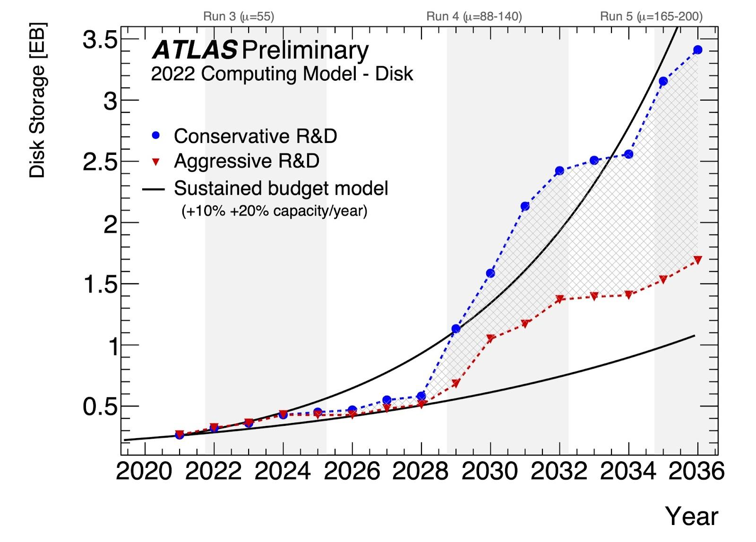
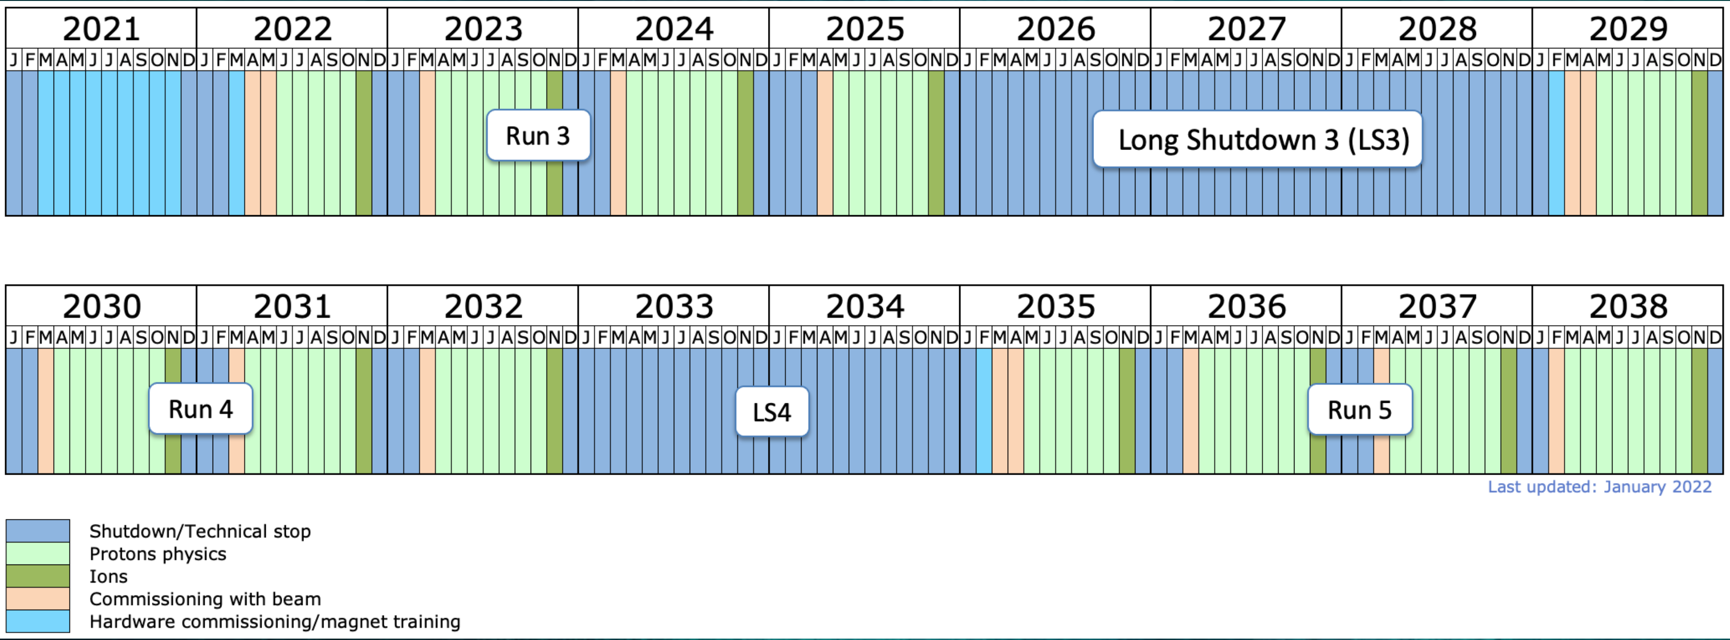
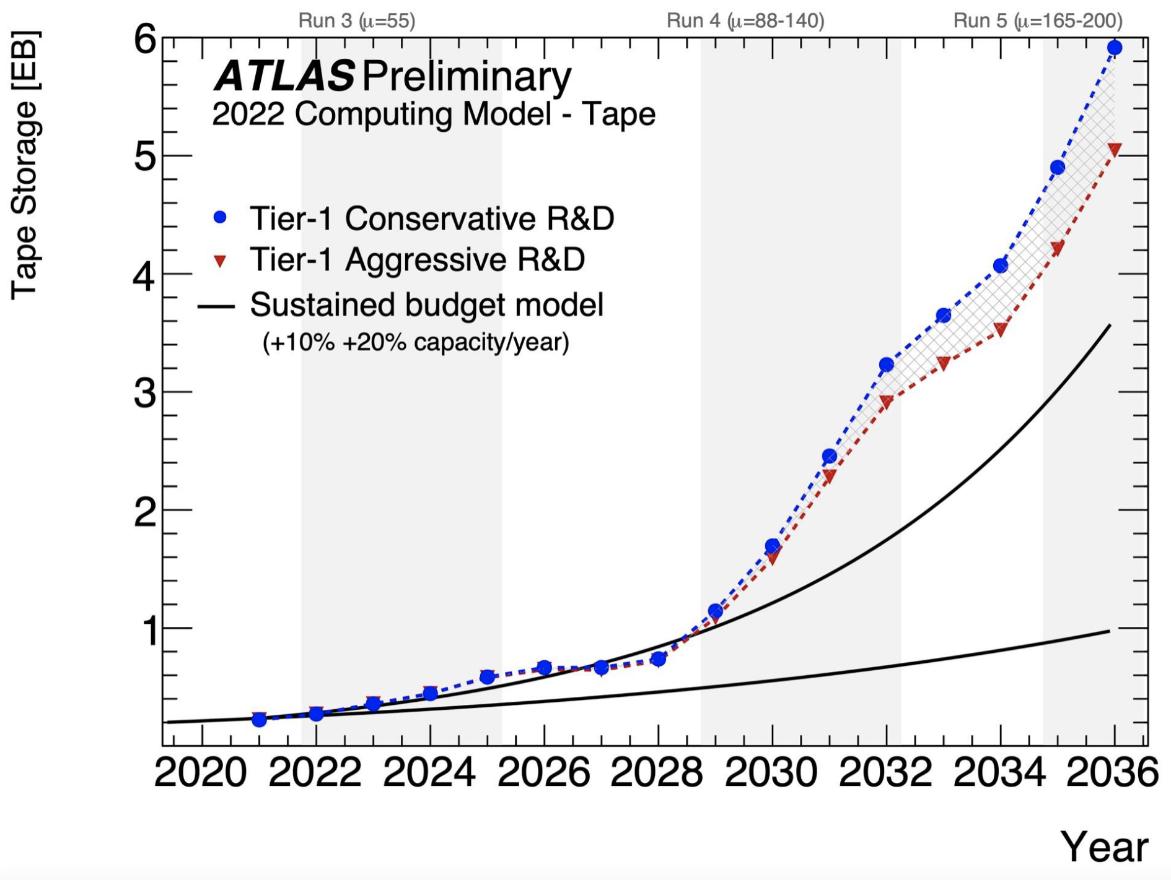
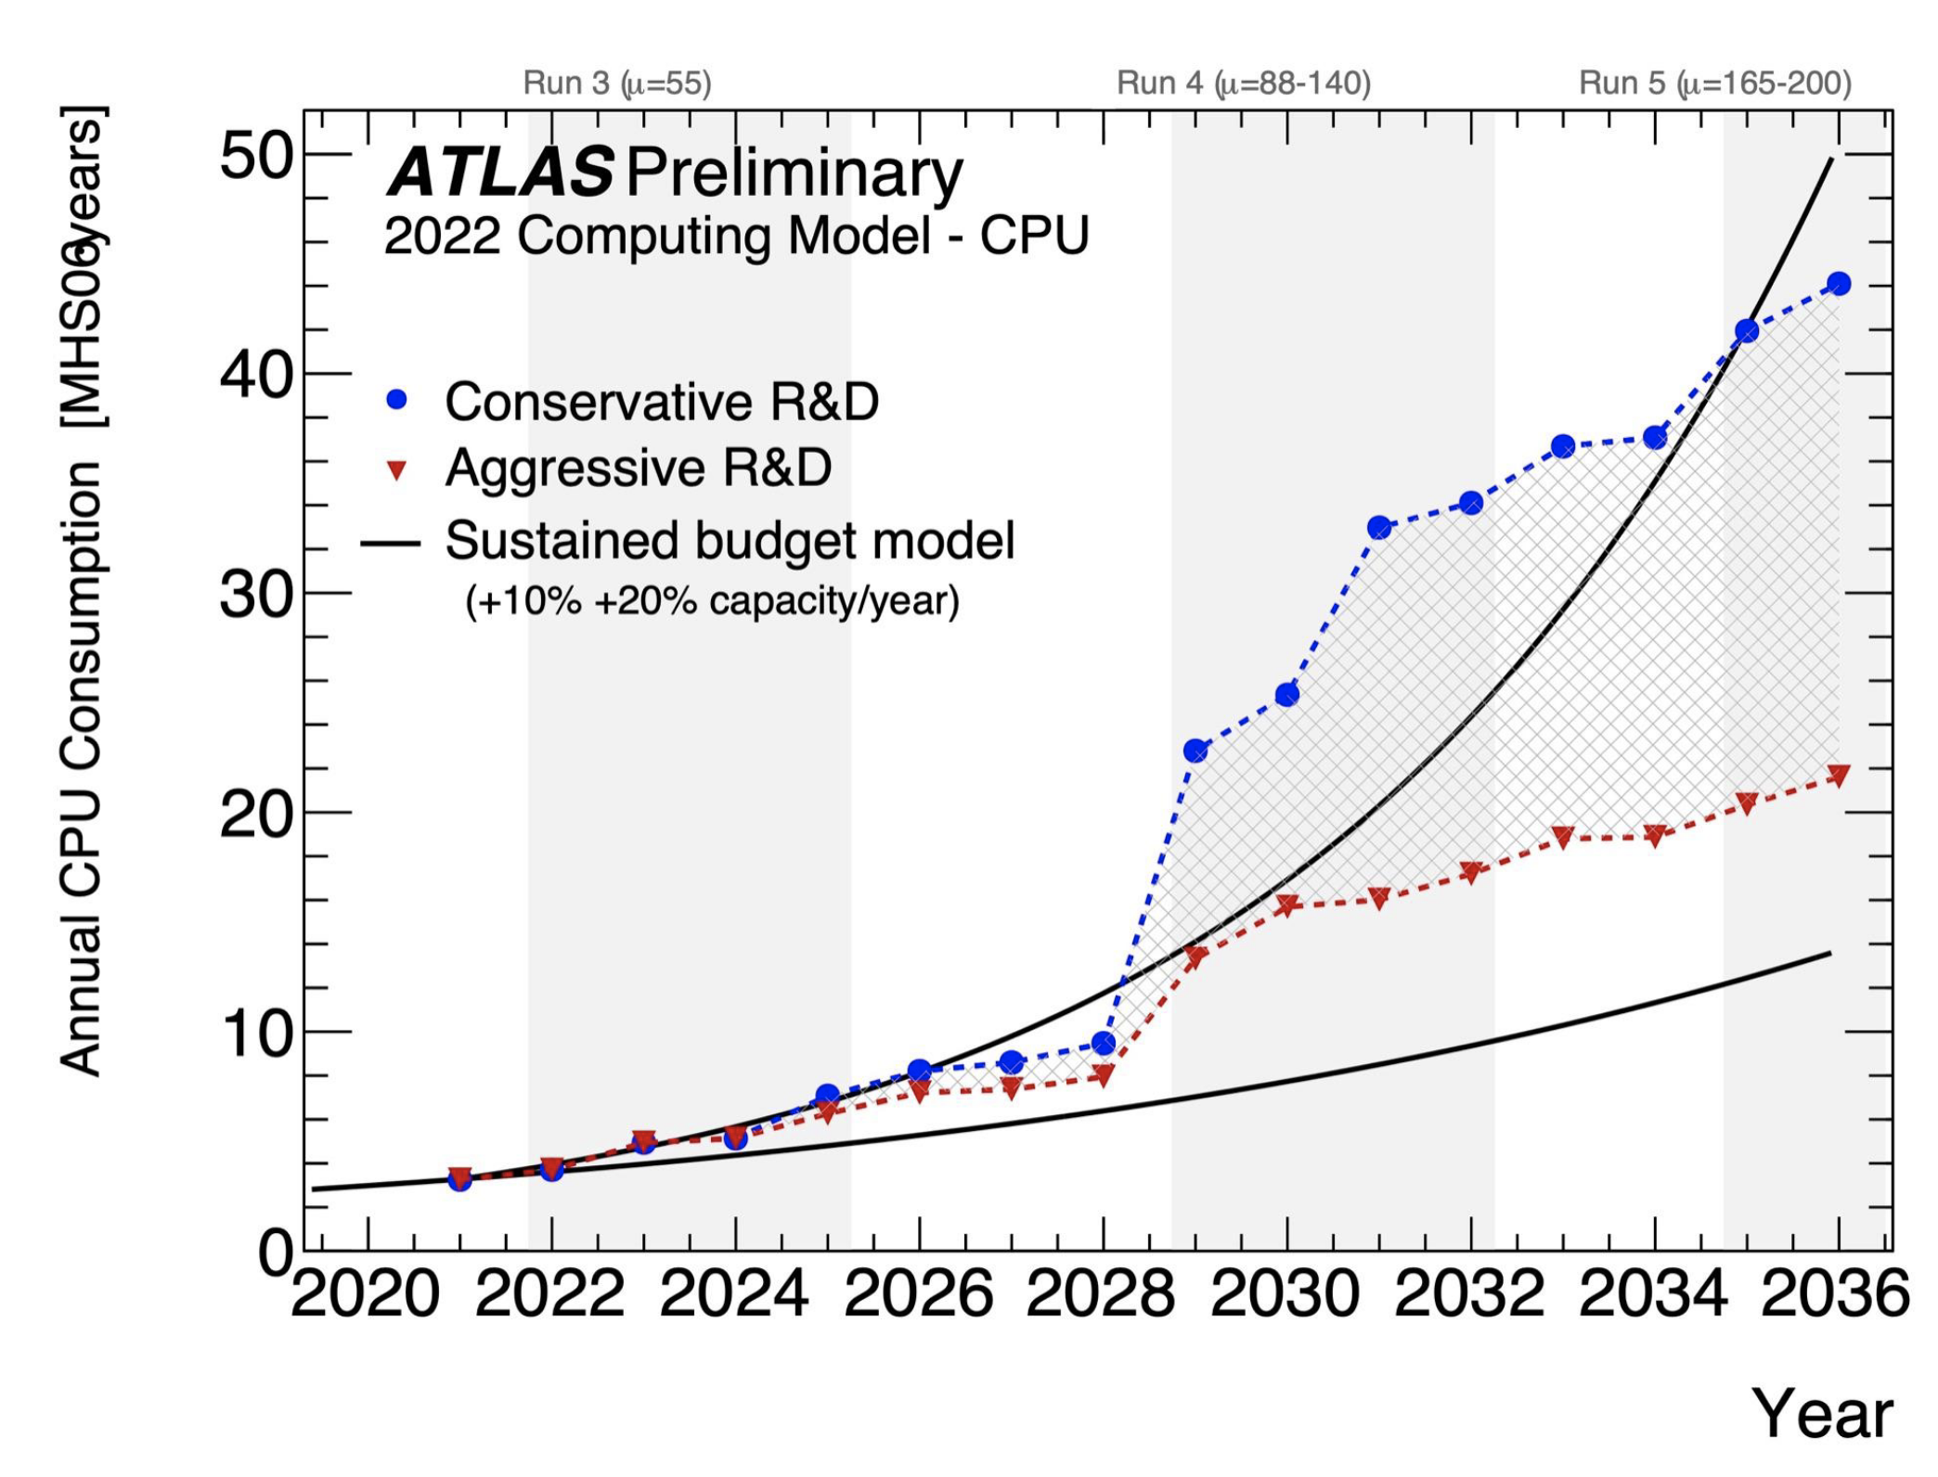
The future
LHC schedule dictates the needs
6% share for NT1
Over the next 10 years
  > x 3 CPU
  > x 5 Tape
  > x 5 Disk
  > 400Gb/s network (CERN+NT1 ”backbone”)
6% share for NT1
https://cds.cern.ch/record/2802918

Slide 8
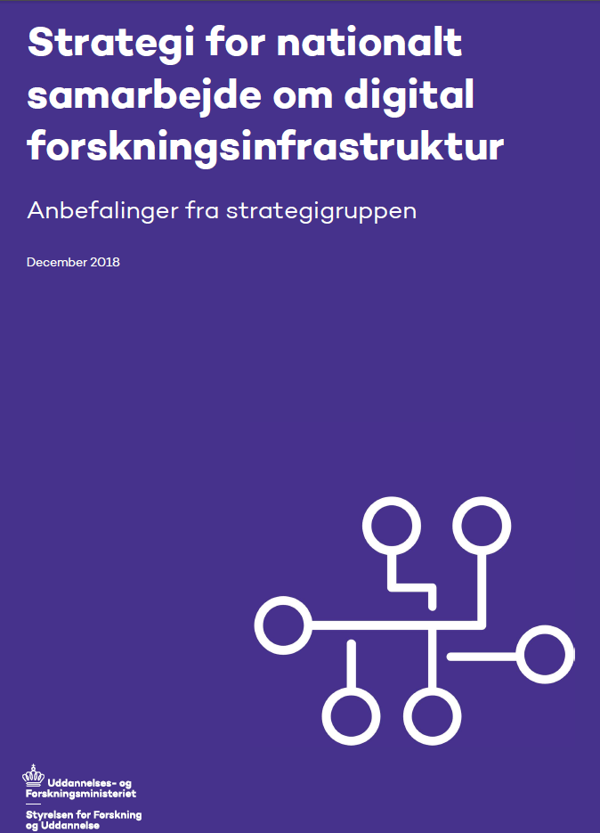
The national collaboration on digital infrastructure for research and education
December 2018

Slide 9
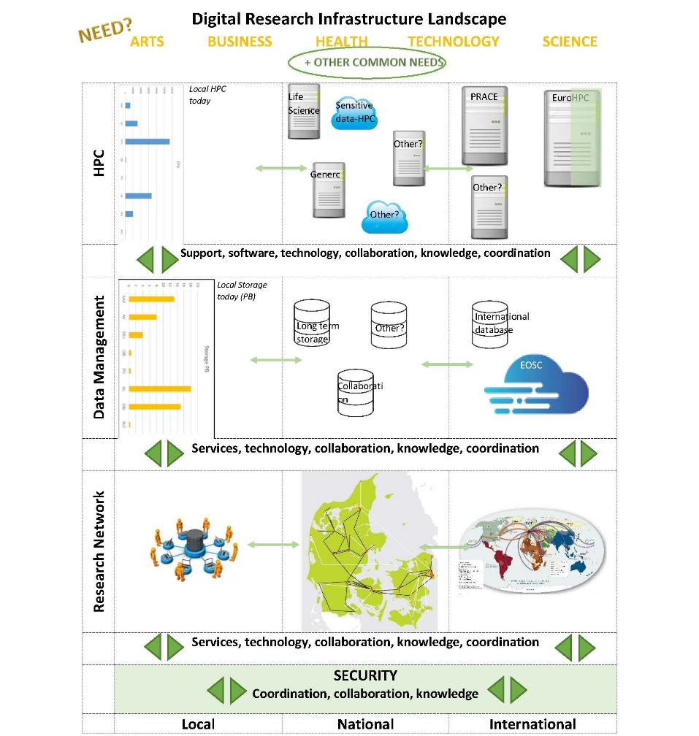
EuroHPC ~ 7 B€/5 years
Danish e-Infrastructure Collaboration (DeiC) is a result of the national e-Infrastructure strategy, created to handle the research data network, HPC and data storage for the 8 Danish universities. 50 MDKK extra for HPC and storage.
The 8 university rectors are directly represented at the DeiC Board. For the universities with CERN activities the board members are:
DTU – IT-chef Steen Pedersen
AU – Prodekan, prof. Brian Vinter
SDU – dekan, prof. Henrik Bindslev
KU – prof. John Renner Hansen (Chair)
EOSC ~ 1 B€/5 years

Slide 10

A new HPC landscape
The future national HPC landscape:
Researchers in Denmark have access to 4 types of HPC installations:
Universities asked to calculate their future needs for national HPC divided in 4 categories
How are we making the best possible use of the gigantic investment in EuroHPC?
Type 1: Interactive HPC | Type 2: Throughput HPC | Type 3: Large Memory HPC | Type 4: Accelerated HPC | Type 5: Capability HPC (LUMI)
On Hold

Slide 11
A national data management strategy based on FAIR
DeiC has lead the work, in collaboration with a wide range of stakeholders towards a national strategy for data management based on FAIR the principles.
Members of the working groups came from universities, ministries, private and public foundations, The Royal Library, The National Archive, Statistics Denmark, etc.
The strategy was accepted by the Ministry of Higher Education and Science August 2021.
It defines a set of principles on how the researchers, research institutions, preservation institutions, research funds etc. shall handle issues regarding data management,
based on the FAIR principles,
follow the policy prepared as a consequence of the directive on open data (PSI) article 10
The DeiC board will soon (May 2022) ask one or more universities to establish a national storage system for all sciences at Danish universities, to be ready ~ January 2023.

Slide 12
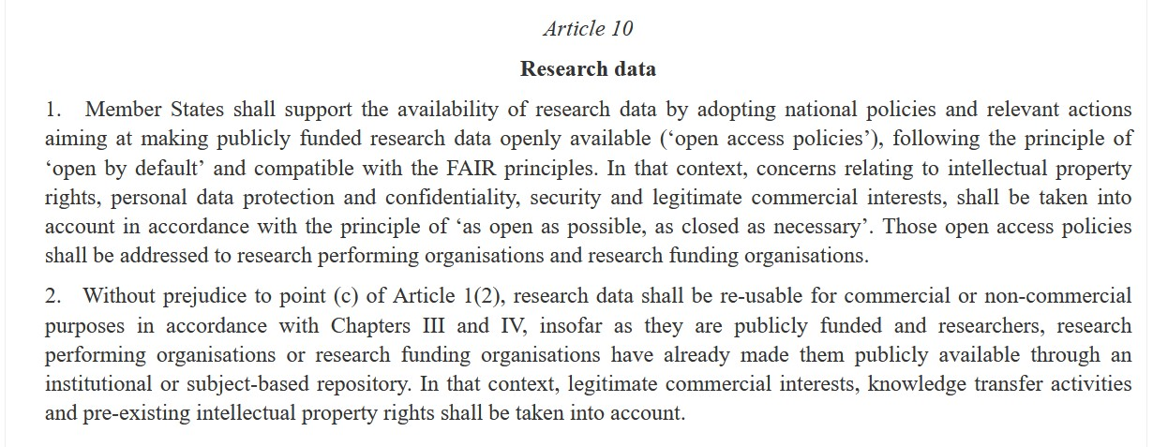
Public Service Directive article 10

Slide 13
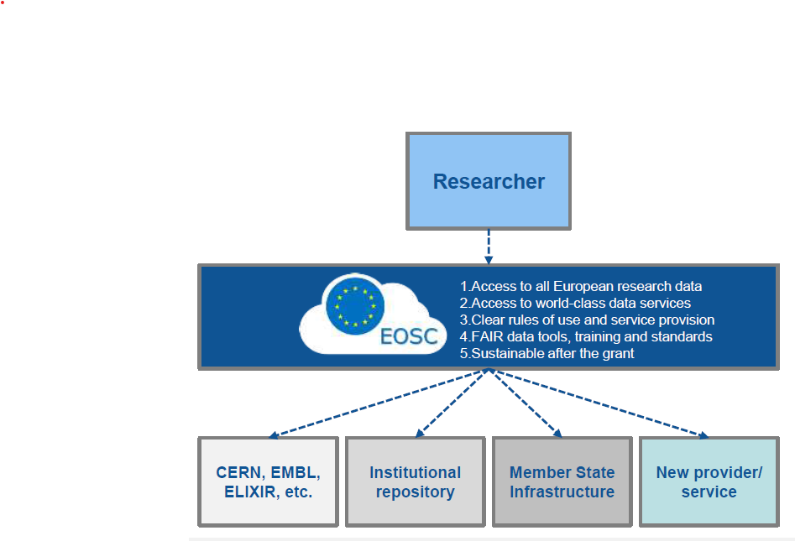
National strategy for data management based on the FAIR principles
August 2021.
European Open Science Cloud (EOSC)
EOSC is a federation of infrastructures, forming a Web of FAIR Digital Objects,
including publications, data, metadata software resources and other research artefacts, and
related Services for Science.
From “EOSC Strategic Implementation Roadmap 2018-2020”
Danmark is a member of EOSC
DeiC handles the Danish obligations in connection with EOSC membership
A prerequisite for DeiC's new national plan for data warehousing and data management is that it is compatible with EOSC

Slide 14
The future
LHC schedule dictates the needs
6% share for NT1
Over the next 10 years
  > x 3 CPU
  > x 5 Tape
  > x 5 Disk
  > 400Gb/s network (CERN+NT1 ”backbone”)
Looking towards EuroHPC (VEGA and LUMI)
- Discussions started with LUMI
Make use of the national storage system
6% share for NT1
https://cds.cern.ch/record/2802918

Slide 15
How do we transform NT1 from the present setup to a system within EuroHPC and EOSC agenda?

