Slide 1


How do black holes spin?
Daria Gangardt,
Nbia workshop
1/17

Slide 2
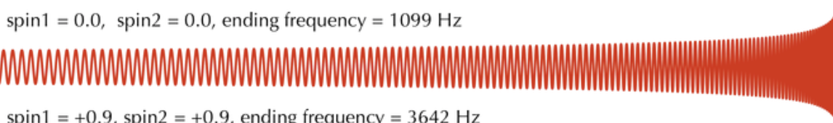


Intro: spin precession
t
[5]
Misaligned spins in a binary interact with each other and with the orbital angular momentum.
They tilt the orbital plane.
We detect modulations of the amplitude and frequency.
spin1 = 0.0, spin2 = 0.99
t
[6]
2/17

Slide 3
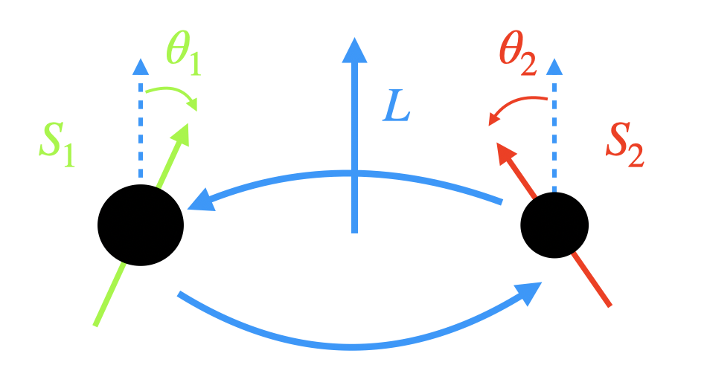
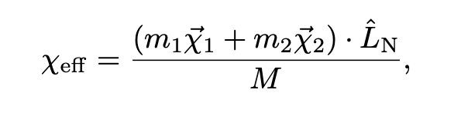
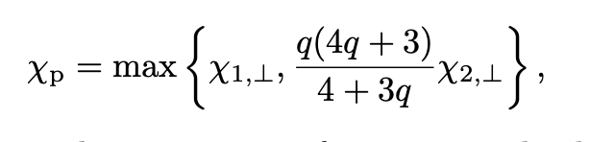
Describing binary black hole spin
Typically, we use effective spin parameters.
There is the effective inspiral spin parameter:
And the effective precession spin parameter:
[10]
3/17

Slide 4

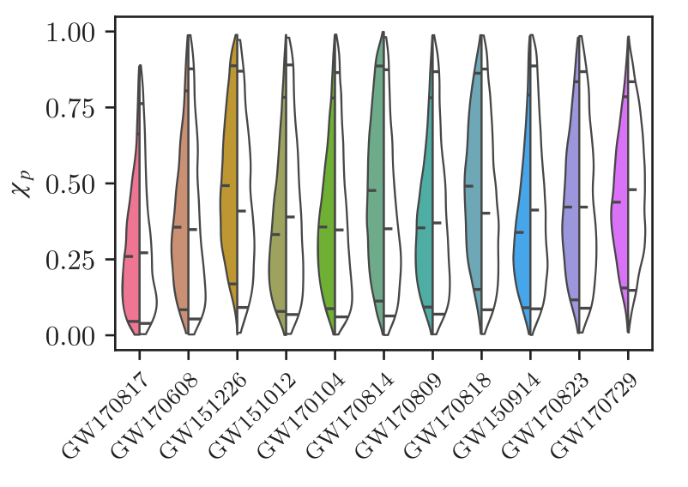
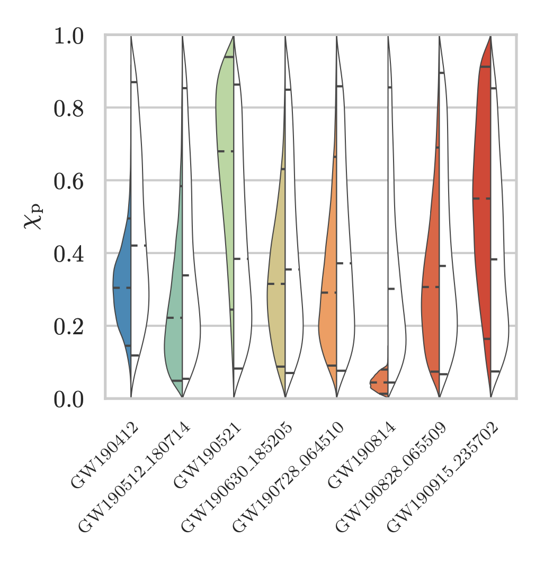
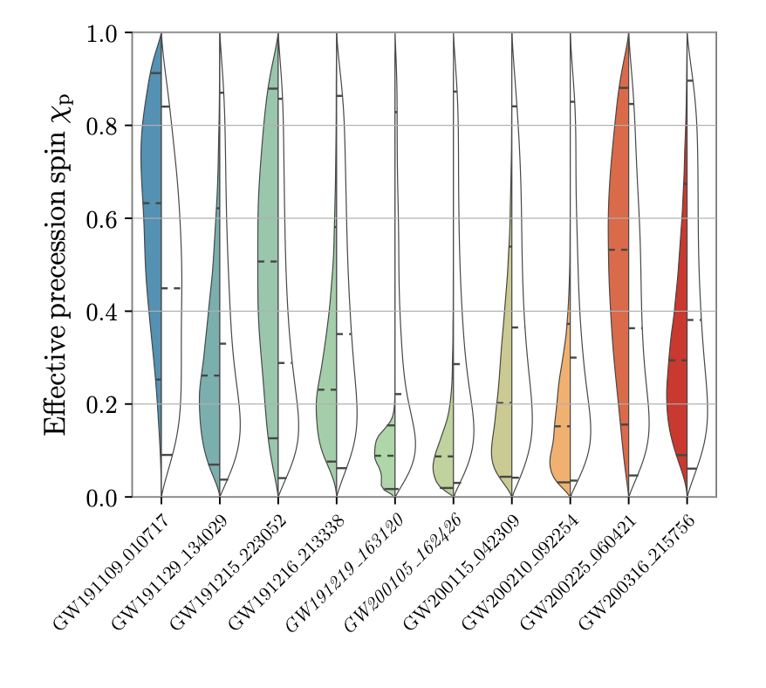
Detecting binary black hole spin
As detector sensitivities increase, we have detected more events with better constraints on spin precession.
Note the event GW190521 – it will make a reappearance.
[1]
4/17
[2]
[18]

Slide 5
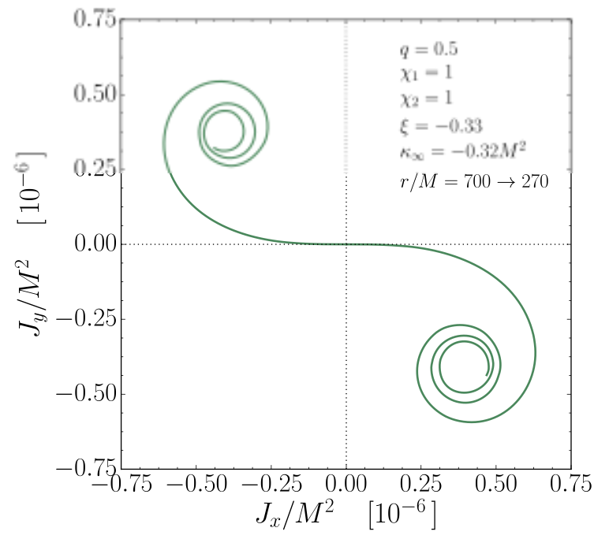
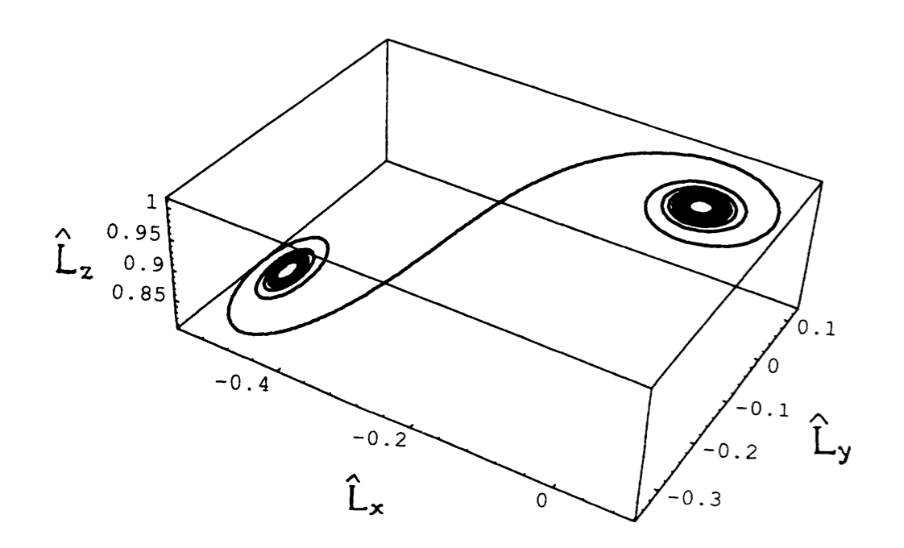
Describing binary black hole spin: revisit
The effective parameters are good for certain purposes, but they can obscure some of the interesting spin dynamics that can occur during the inspiral, including:
Transitional spin precession
Spin orbit resonances
Nutational resonances
[17]
[16]
5/17

Slide 6
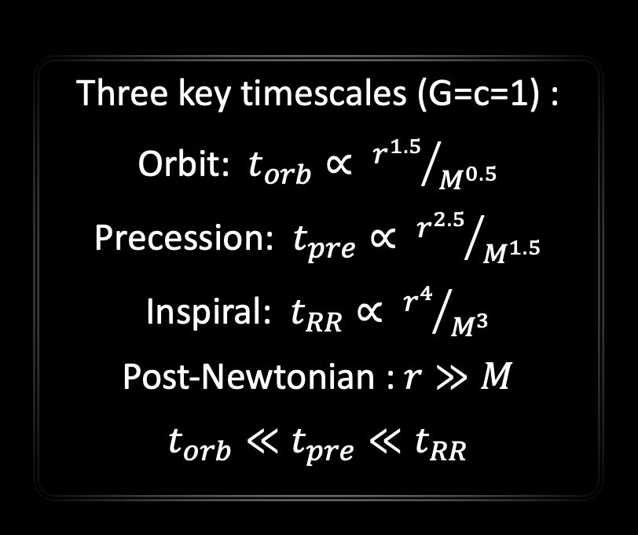
Multi-timescale analysis
inspiral
Obtaining analytical expressions
Three key timescales (G=c=1) :
Orbit: $t_{orb}∝ {r^{1.5}}/{M^{0.5}}$
Precession: $t_{pre}∝ {r^{2.5}}/{M^{1.5}}$
Inspiral: $t_{RR}∝ {r^{4}}/{M^{3}}$
Post-Newtonian : $r≫M$
$t_{orb}≪t_{pre}≪t_{RR}$
[14], [15]
6/17

Slide 7
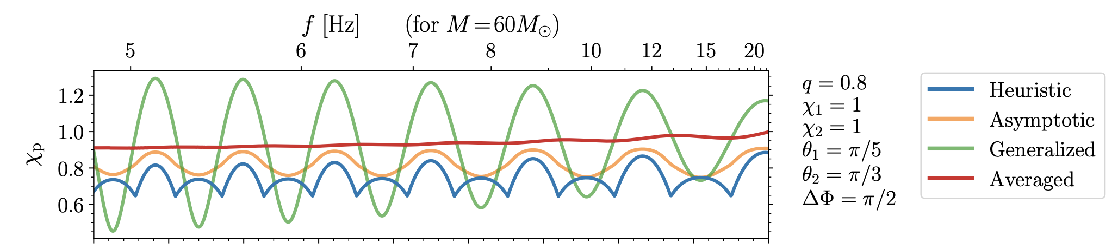



Sidenote: A better $χ$_{P}
The original $χ$_{P} has several inconsistencies
including the fact that it does not remain constant over the precession timescale.
[10]
We can use our precession averaging methodology to introduce a new, better, $χ$_{P} that is more consistent
(see D. Gerosa et al., 2021, “A generalized precession parameter χp to interpret gravitational-wave data” 2011.11948)
7/17

Slide 8
Taxonomy of spin precession
[3]
8/17

Slide 9
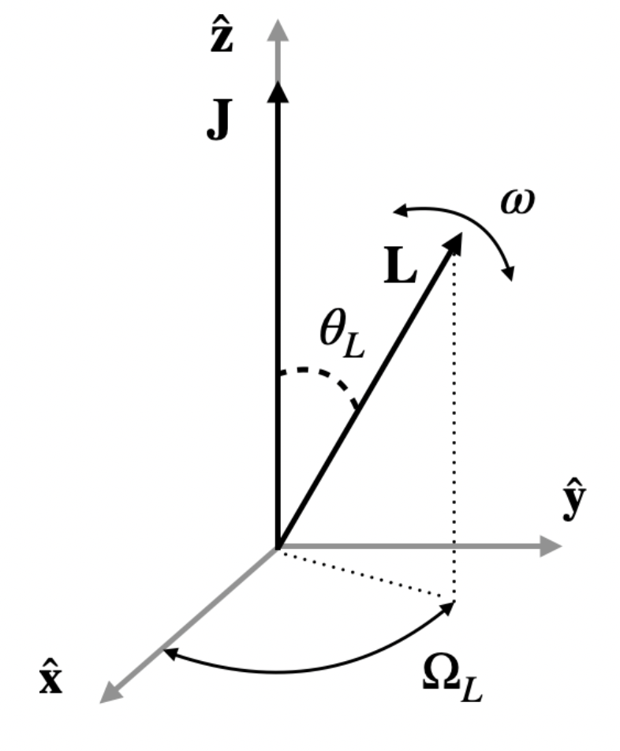

Five parameters
Amplitudes of motion:
Precession amplitude, $\left\langle θ_{L}\right\rangle$
Nutation amplitude, ${Δθ}_{L}$
Frequencies of motion:
Precession frequency, $\left\langle Ω_{L}\right\rangle$
Nutation frequency, $ω$
Precession frequency variation, ${ΔΩ}_{L}$
9/17

Slide 10


Taxonomy of spin precession
Evolve from $r→∞$ to $r=10M$
Using precession module
[3]
10/17

Slide 11
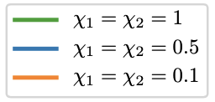
Taxonomy of spin precession
[3]
r = 10M
3 populations of isotropically distributed spin misalignments
11/17

Slide 12
Detecting binary black hole spin: revisit
Do we detect our BBH parameters in catalog?
Like in the GW catalogs, we condition our priors on the masses and on χ_{eff}
[18]
12/17

Slide 13
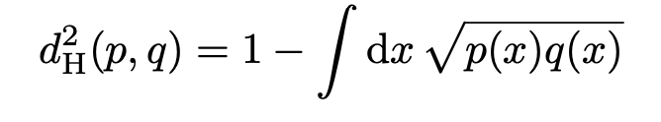
The Taxonomy in gw events
Events that stand out
Ten largest Hellinger distances between the prior conditioned on χ_{eff} and the masses and the posterior.
Hellinger distance goes between 0 and 1.
GW190521 stands out.
[4]
[19]
13/17

Slide 14
The Taxonomy in gw events
[2]
[4]
[18]
14/17

Slide 15
The Taxonomy in gw190412
GW190412 has an unequal mass ratio (q = 0.3) and a χ_{eff} constrained away from 0.
This makes it interesting, especially for the precession amplitude.
[4]
15/17
[18]

Slide 16
Conclusions from taxonomy in gw events
No evidence of nutation was found in the catalog.
Nutations can be detectable.
A black hole binary merger injection with maximised nutational amplitude can be constrained.
[4]
16/17

Slide 17
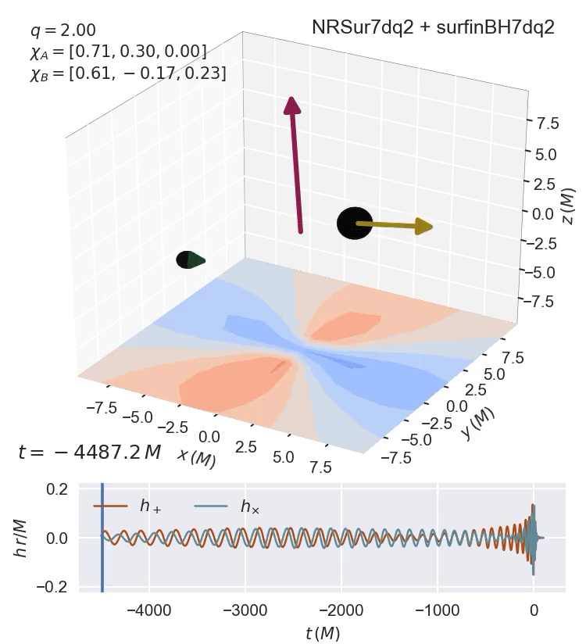
questions
Black hole spins are cool.
There is still a lot we can uncover about spin precession in GW events.
As instrument sensitivities improve more black hole spin dynamics can be uncovered.
Thank you for listening, any questions?
[20]
17/17

Slide 18
Extra slides

Slide 19
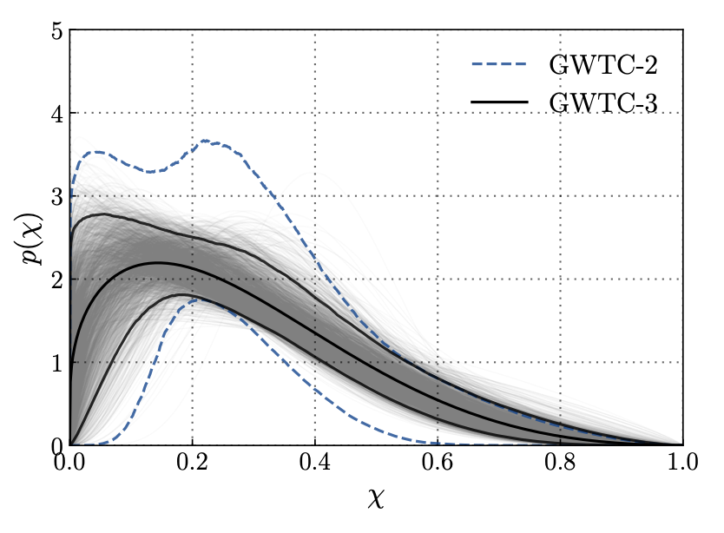
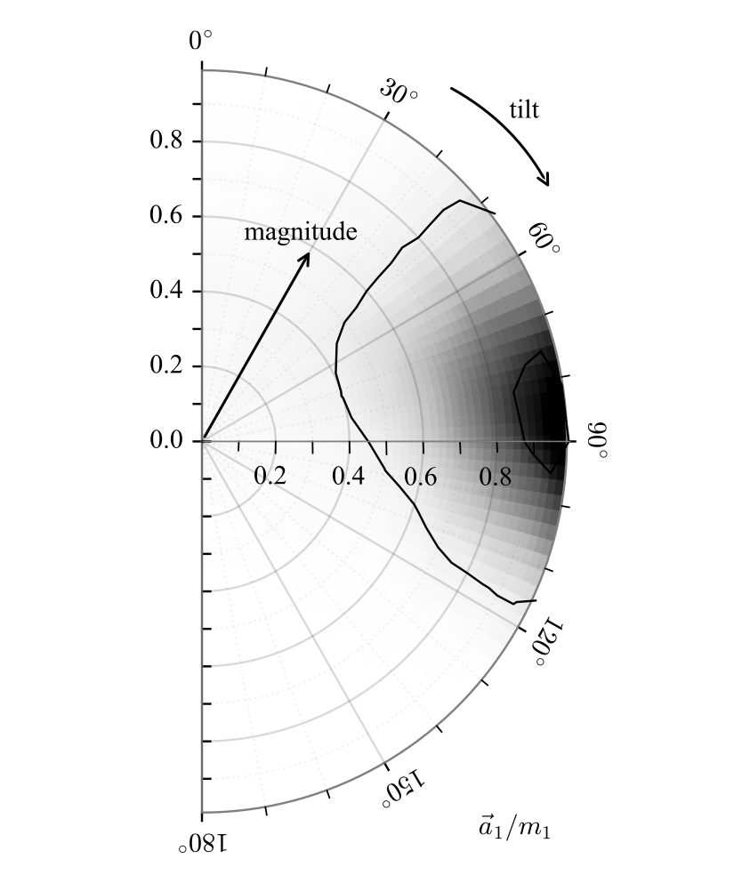
Introduction
Most likely. The population of gravitational wave events is precessing.
Hannam et al. claims confident detection for a single event, GW200129.
Have we detected spin precession?
[6]
[7]
5

Slide 20
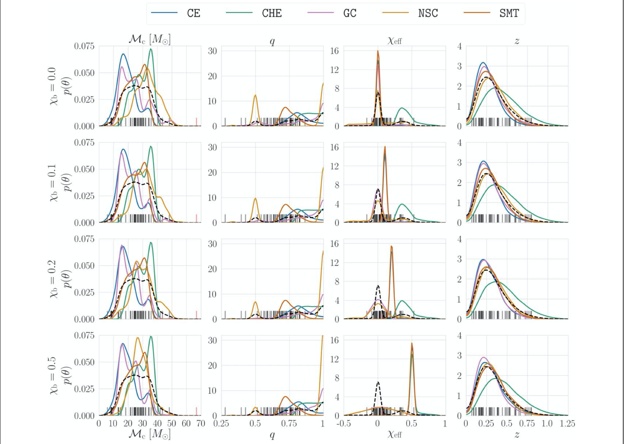
Introduction
Different formation channels predict different mass, spin and merger rate distributions.
Why is spin precession important?
[8]
7

Slide 21
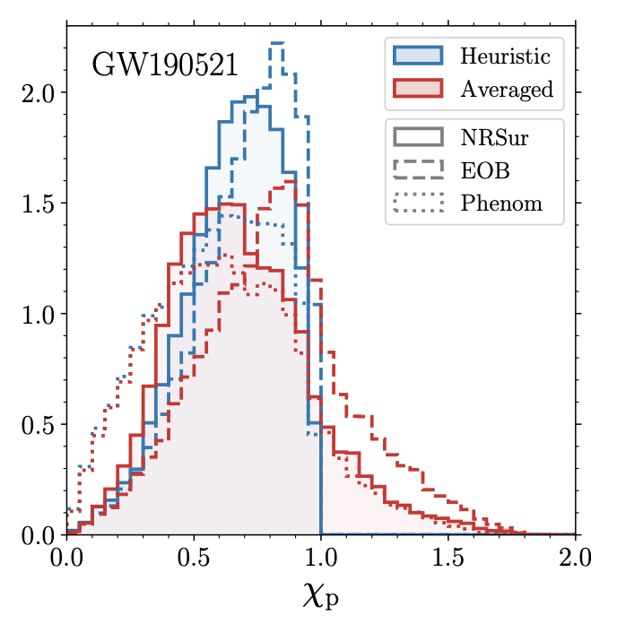
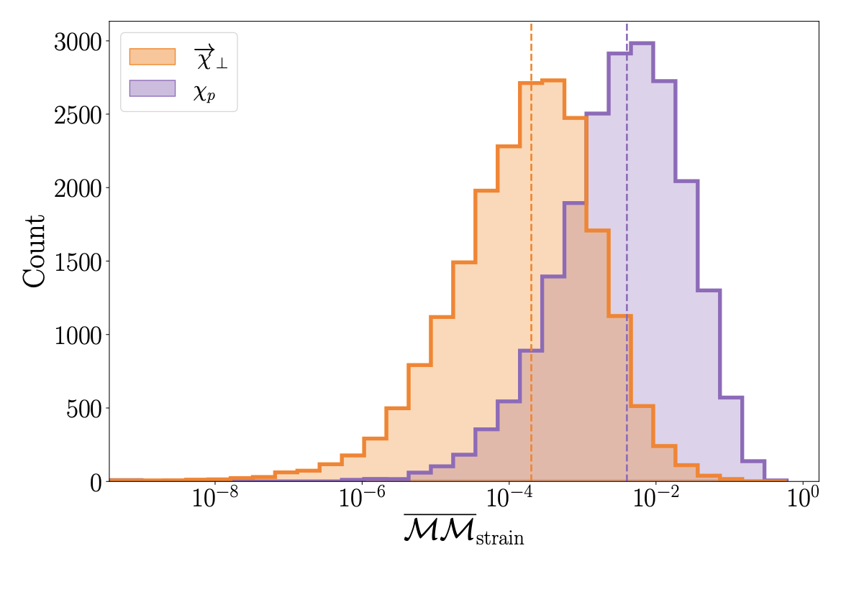
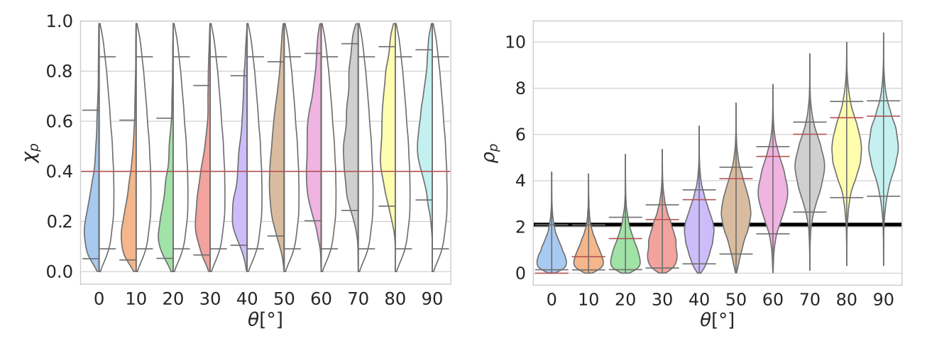
Introduction
Improvements:
The effective spin precession vector
The generalized effective precession spin
New:
The precession signal to noise ratio.
My work!
How do we characterize spins?
[11]
[12]
[13]
9

Slide 22
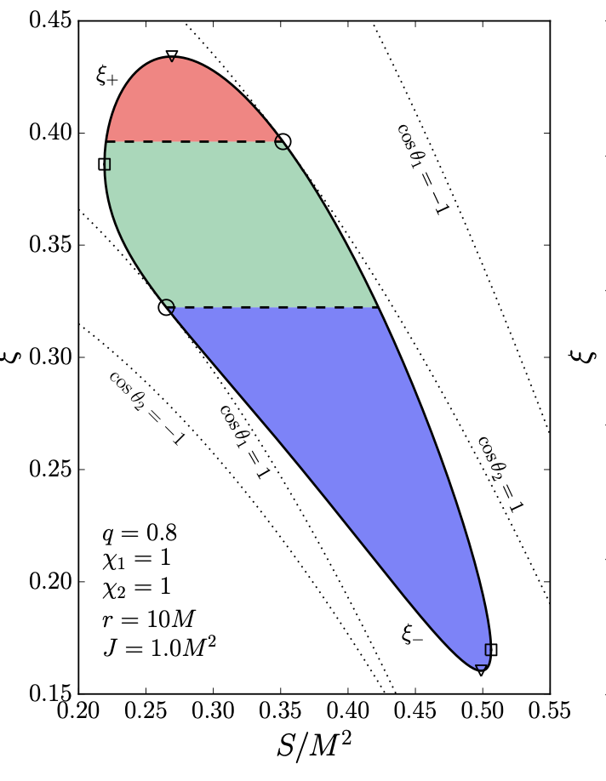
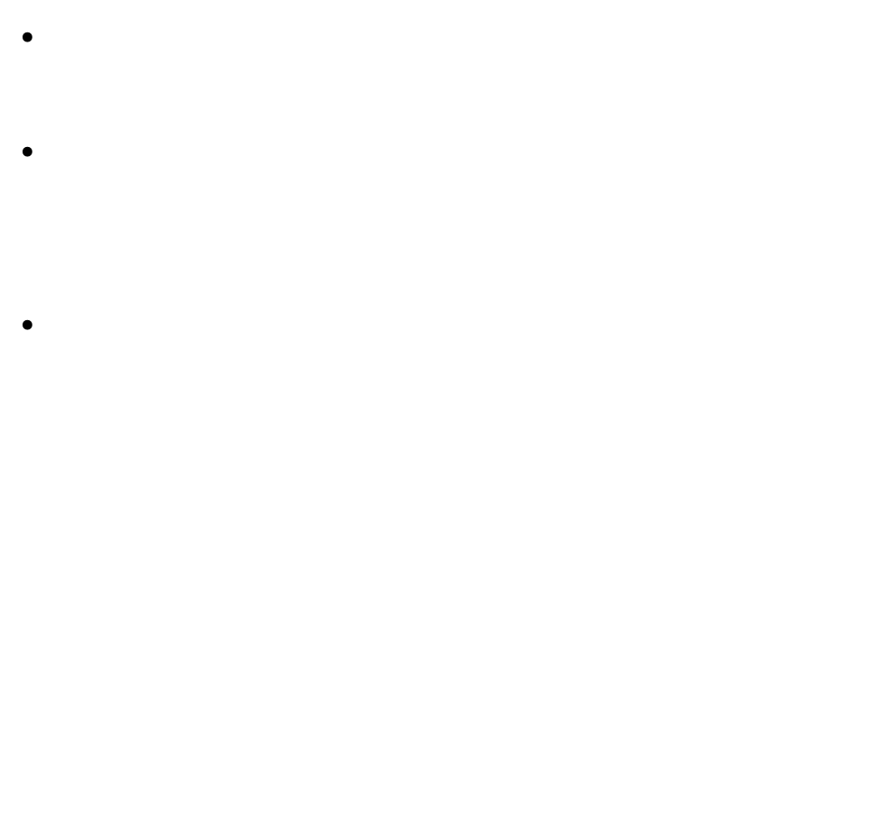

Taxonomy of spin precession
Obtaining analytical expressions
S changes:
$$S_{−}≤S ≤ S_{+}$$
Over a time period $τ$:
$$τ=2\int_{S_{−}}^{S_{+}}{{\left|\frac{dS}{dt}\right|}^{−1}}dS$$
We can find the precession average of a quantity X(S) by integrating:
$$\left\langle X\right\rangle =\frac{2}{τ}\int_{S_{−}}^{S_{+}}{\frac{X}{\left|{dS}/{dt}\right|}}dS$$
$$χ_{eff}$$
[15]
[14], [15]
12

Slide 23
Taxonomy of spin precession
[15]
15
[16]
[17]

Slide 24
The Taxonomy in gwtc3
Priors and Posteriors
A parameter is constrained if its posterior different from its prior.
We re-cast mass and spins into the five parameters.
We evaluate how our constraints depend on the measurement of certain black hole parameters.
[18]
21

Slide 25
The Taxonomy in gwtc3
Prior on S1, S2
Posterior m1, m2
Prior conditioned on m1, m2
Conditional Priors
We measure masses of gravitational wave events very well.
Mass priors are independent of spin measurements.
We combine mass posterior samples with spin prior samples.
22

Slide 26
The Taxonomy in gwtc3
χ_{eff} of posterior - χ_{eff} of sample < 10⁻³ ?
Sample from mass posterior
Keep sample
Reject sample
Sample from S1, S2 priors
Conditional Priors
Of the spin parameters, the best measured parameter is the effective spin χ_{eff} .
χ_{eff} is a combination of spin and mass parameters.
We condition our priors on χ_{eff} and the mass parameters numerically, sample by sample.
No
Yes
23

Slide 27
The Taxonomy in gwtc3
Over the whole catalog, we find that we cannot constrain nutations as well as we can constrain precession.
26

Slide 28
Conclusions from taxonomy in gwtc3
No evidence of nutation was found in the catalog.
Nutations can be detectable.
A black hole binary merger injection with maximised nutational amplitude can be constrained.
27

Slide 29
Other projects
Selection Effects and Machine Learning
In order to train a neural network, one needs good training data.
The data was challenging to work with.
28

Slide 30
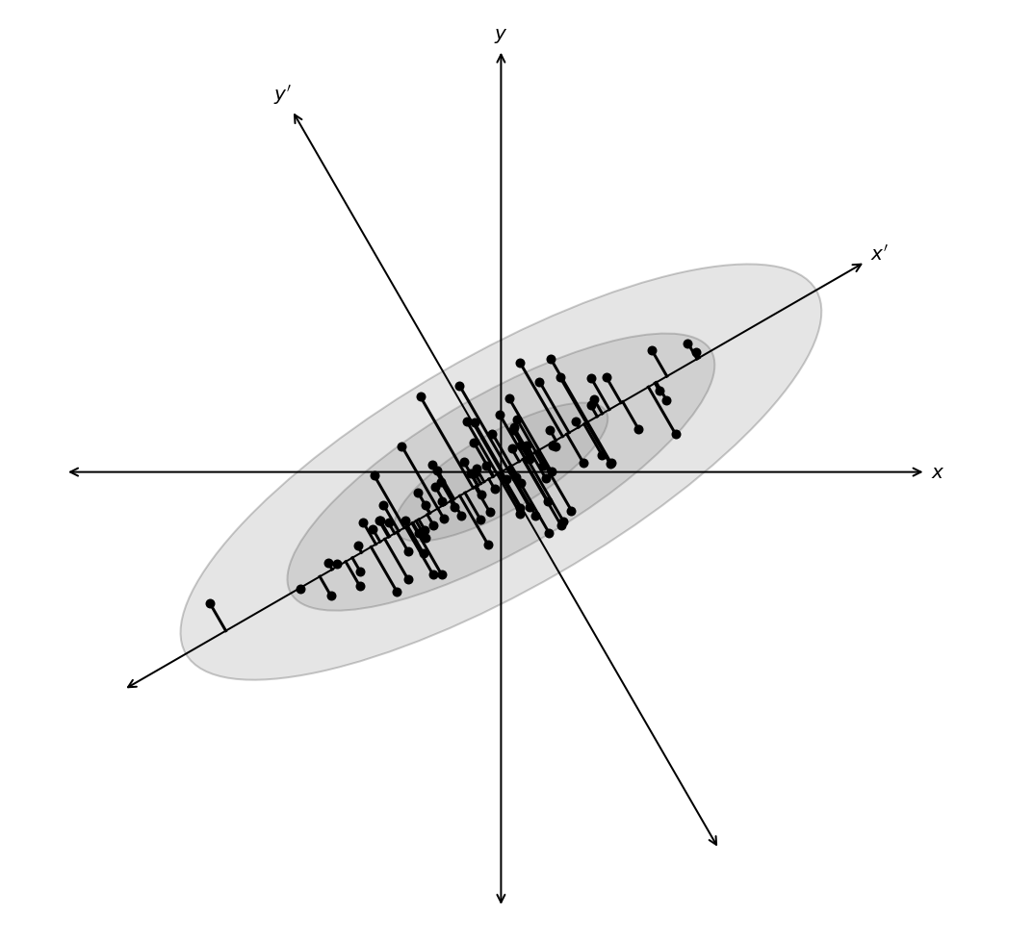
Future projects
Is χ_{eff} really the best combination of spin parameters we can measure?
Dimensionality Reduction
29

Slide 31
References
[1] LVKC, 2019, “GWTC-1: A Gravitational-Wave Transient Catalog of Compact Binary Mergers Observed by LIGO and Virgo during the First and Second Observing Runs”
[2] LVKC, 2021, “GWTC-2: Compact Binary Coalescences Observed by LIGO and Virgo During the First Half of the Third Observing Run”
[3] D. Gangardt & N. Steinle et al., 2021, “A taxonomy of black-hole binary spin precession and nutation”
[4] D. Gangardt et al., 2022, “Constraining black-hole binary spin precession and nutation with sequential prior conditioning”
[5] M. Favata et al., https://www.soundsofspacetime.org/spinning-binaries.html
[6] LVKC, 2022, “The population of merging compact binaries inferred using gravitational waves through GWTC-3 “
[7] M. Hannam et al., 2021, “Measurement of general-relativistic precession in a black-hole binary”
[8] M. Zevin et al., 2021, “One Channel to Rule Them All? Constraining the Origins of Binary Black Holes Using Multiple Formation Pathways”
[10] P. Schmidt et al., 2014, “Towards models of gravitational waveforms from generic binaries II: Modelling precession effects with a single effective precession parameter”
[11] D. Gerosa et al., 2021, “A generalized precession parameter χp to interpret gravitational-wave data”
[12] L. Thomas et al., 2021, “New effective precession spin for modeling multimodal gravitational waveforms in the strong-field regime”
[13] S. Fairhurst et al., 2020, ” When will we observe binary black holes precessing?”
[14] M. Kesden et al., 2015, “Effective potentials and morphological transitions for binary black-hole spin precession”
[15] D. Gerosa et al., 2015, “Multi-timescale analysis of phase transitions in precessing black-hole binaries”
[16] T. A. Apostolatos, 1994, “Spin-induced orbital precession and its modulation of the gravitational waveforms from merging binaries”
[17] X. Zhao et al., 2017, “Nutational resonances, transitional precession, and precession-averaged evolution in binary black-hole systems”
[18] LVKC, 2021, “GWTC-3: Compact Binary Coalescences Observed by LIGO and Virgo During the Second Part of the Third Observing Run”
[19] E. Hellinger, 1909, “Neue Begründung der Theorie quadratischer Formen von unendlichvielen Veränderlichen“
[20] V. Varma, https://vijayvarma392.github.io/binaryBHexp/#hangup
30

Slide 32
Appendix
31

Slide 33
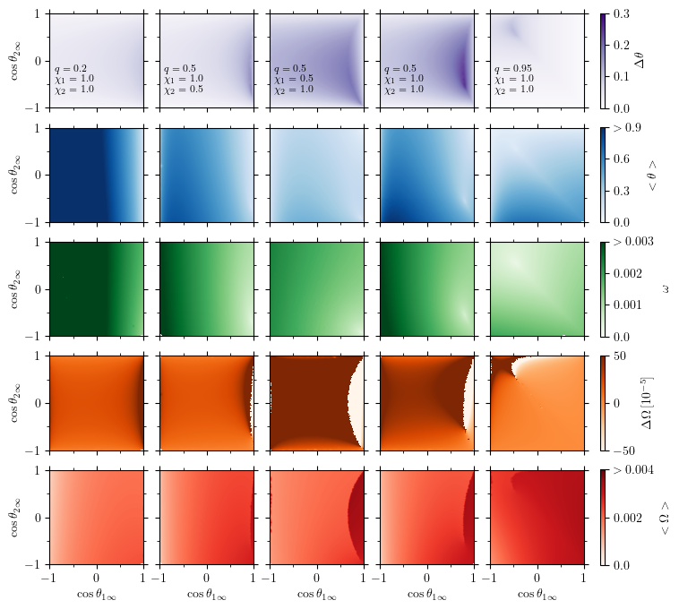
Taxonomy of spin precession
r = 10M
Consider five populations of isotropically distributed spin misalignments
18

Slide 34
Taxonomy of spin precession
Frequencies at r = 10M

Slide 35
Taxonomy of spin precession

