Slide 1


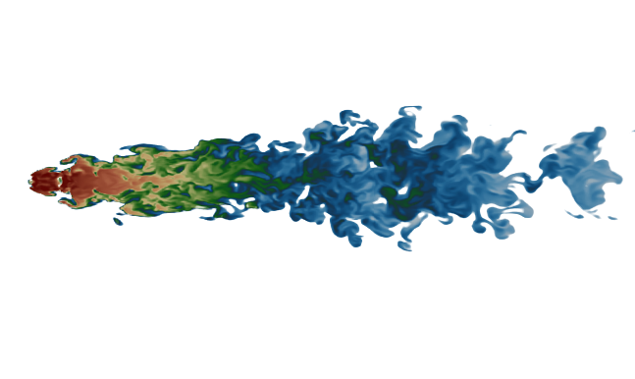
Cold clouds in outflows
6th ICM Theory and Computation Workshop,
Niels Bohr Institute, Copenhagen, Denmark
Is entrainment in trouble once again?
Alankar Dutta
Graduate student,
Indian Institute of Science, Bangalore, India

Slide 2



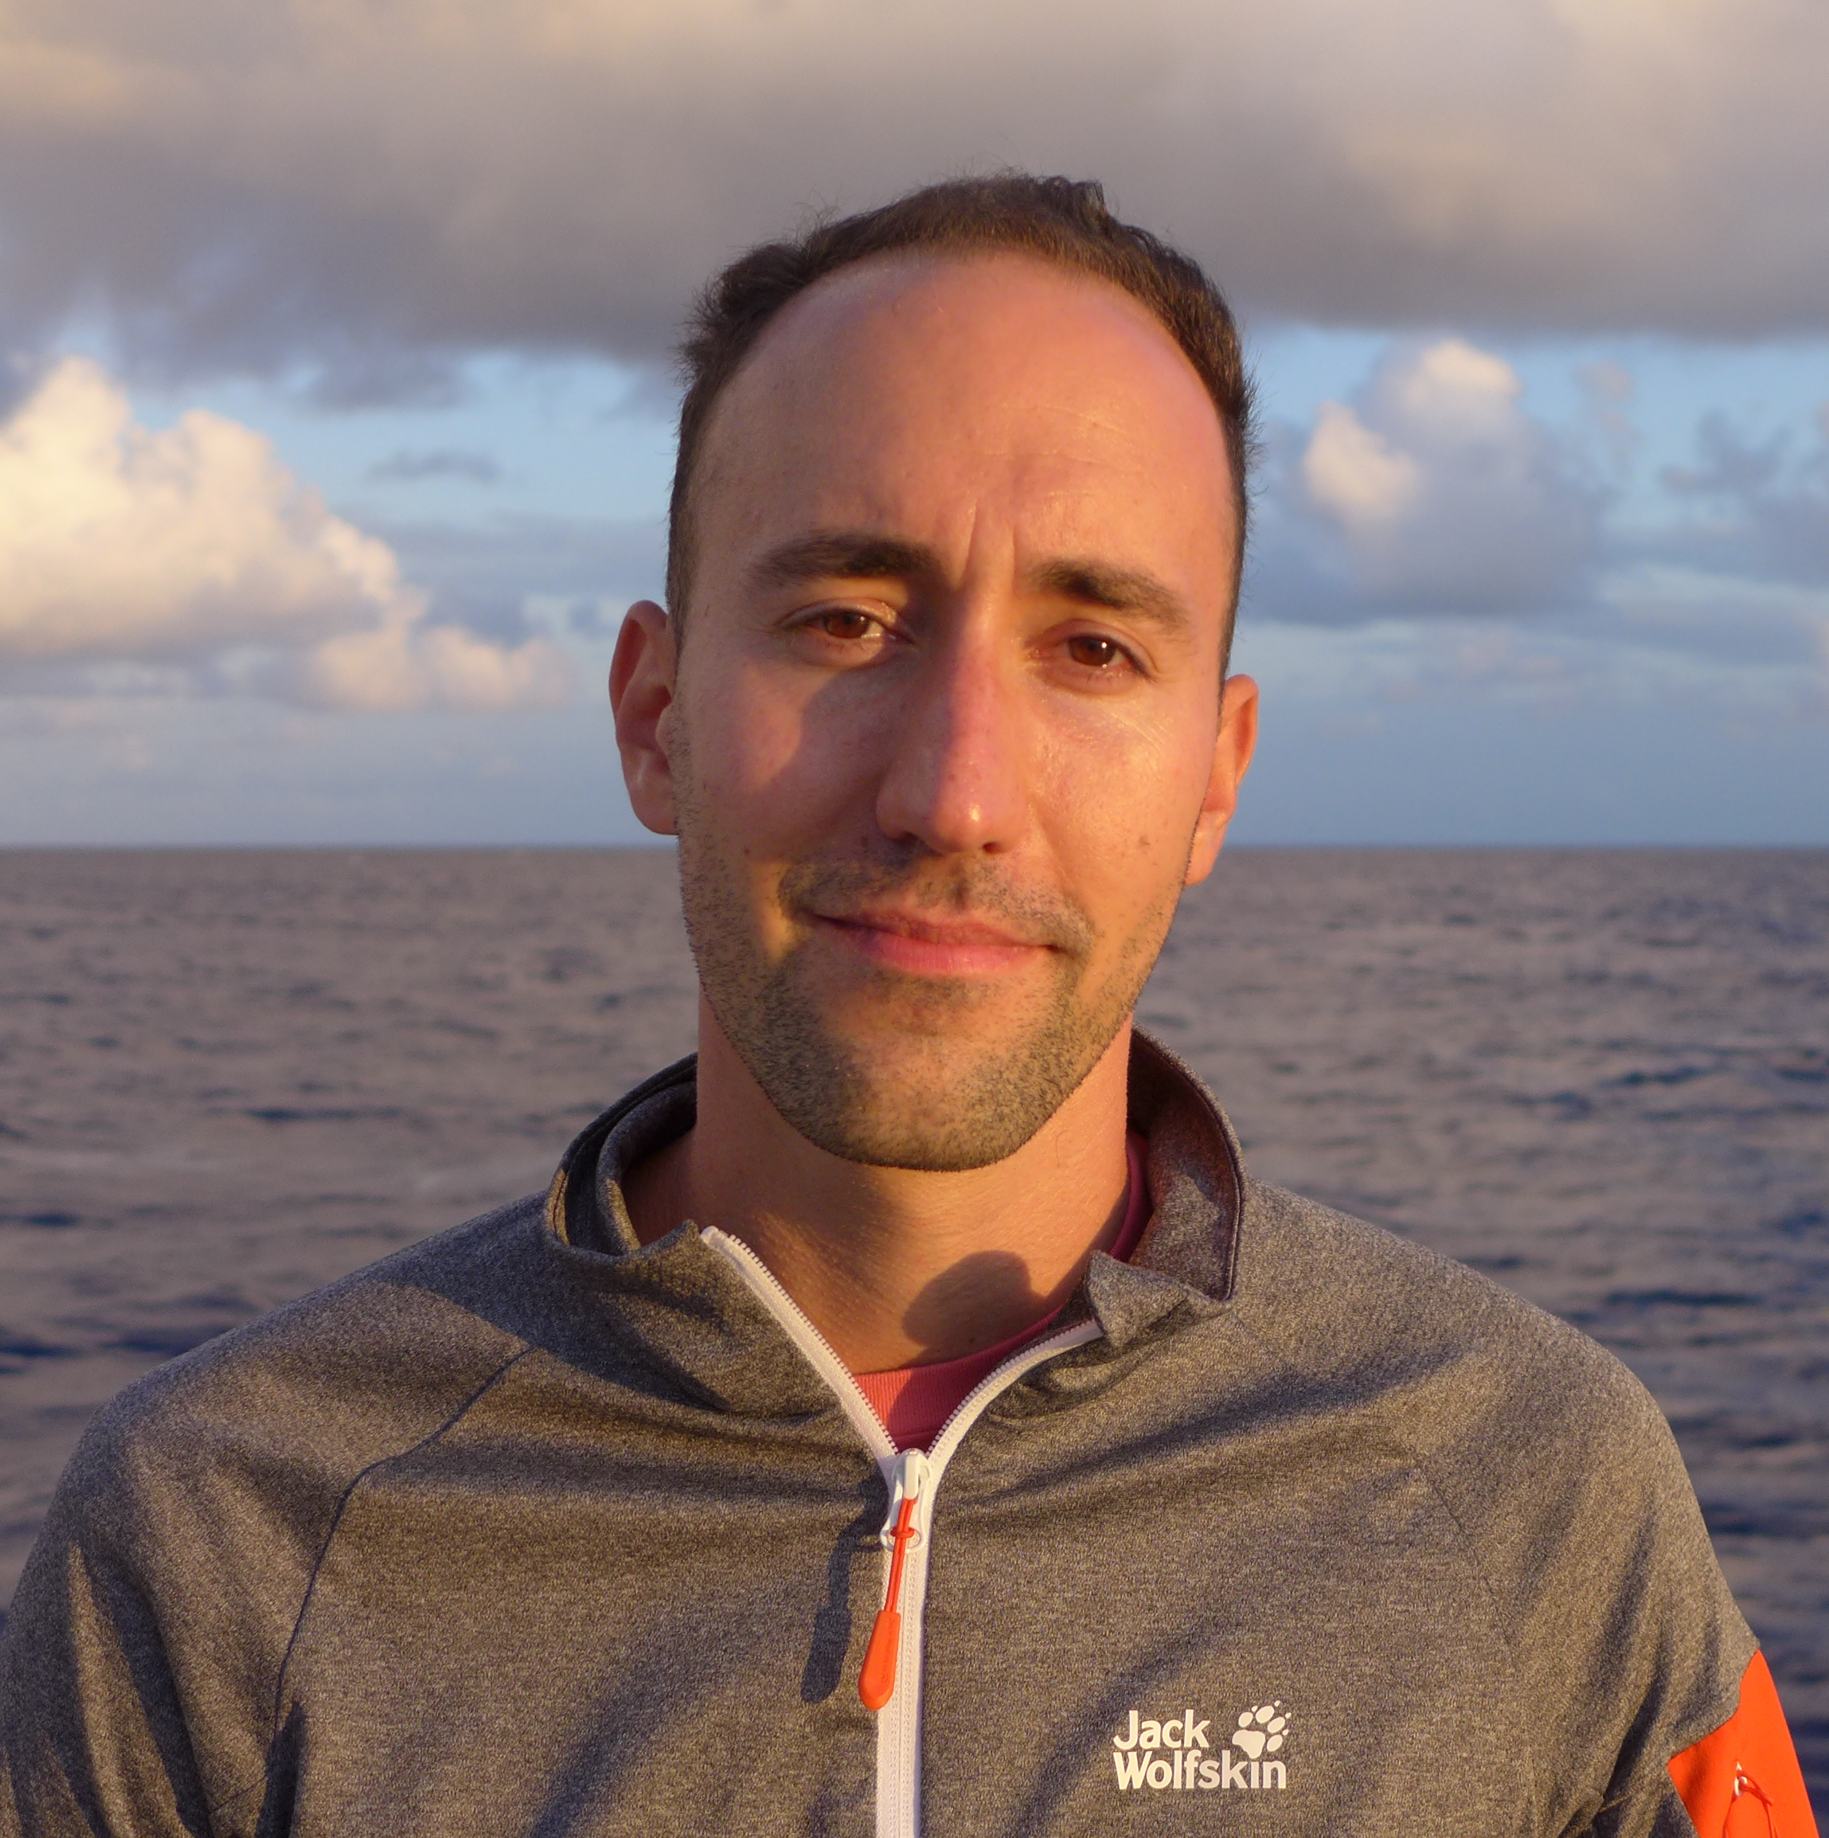
People involved
Alankar Dutta
Prateek Sharma
Tiago Costa

Slide 3


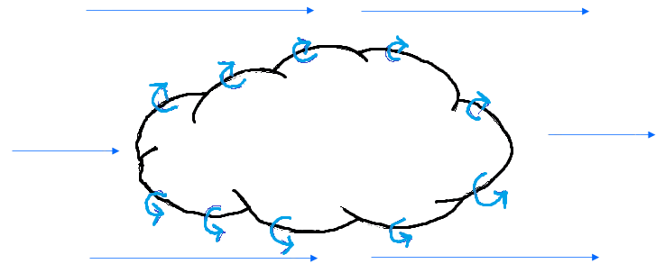






Cloud crushing simulations
$$t_{drag}>t_{cc}$$
$$ρ_{w}R_{c}^{2}v_{w}t_{drag}=ρ_{c}R_{c}^{3}$$
When mixed gas cools faster than cloud destruction, the clouds can grow as well as acquire momentum (Gronke et al, Li et al, Kanjilal et al, etc).
Radiative Cooling
$$c_{s,c}=\frac{c_{s,w}}{\sqrt{χ}}$$
Tries to explain the origin of fast moving cold gas.
Momentum transfer between the hot wind and cold cloud.
Survival of radiatively cooling clouds formed by mixing in a background hot wind.
$$t_{cc}=\sqrt{χ}\frac{R_{c}}{v_{w}}$$
Turbulent mixing
Background hot wind
$$χ=\frac{ρ_{C}}{ρ_{w}}$$
$$t_{drag}=χ\frac{R_{c}}{v_{w}}$$

Slide 4
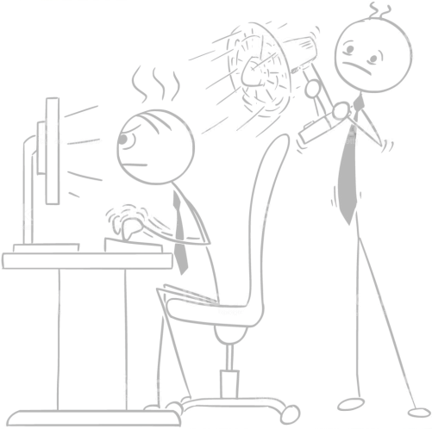
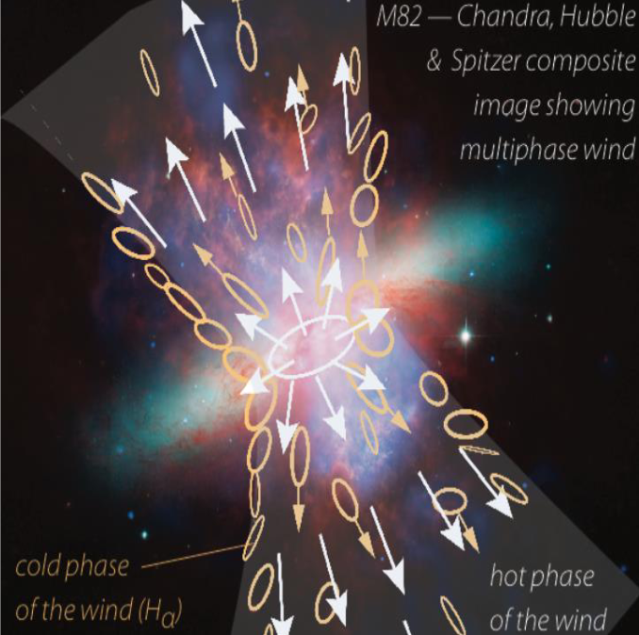
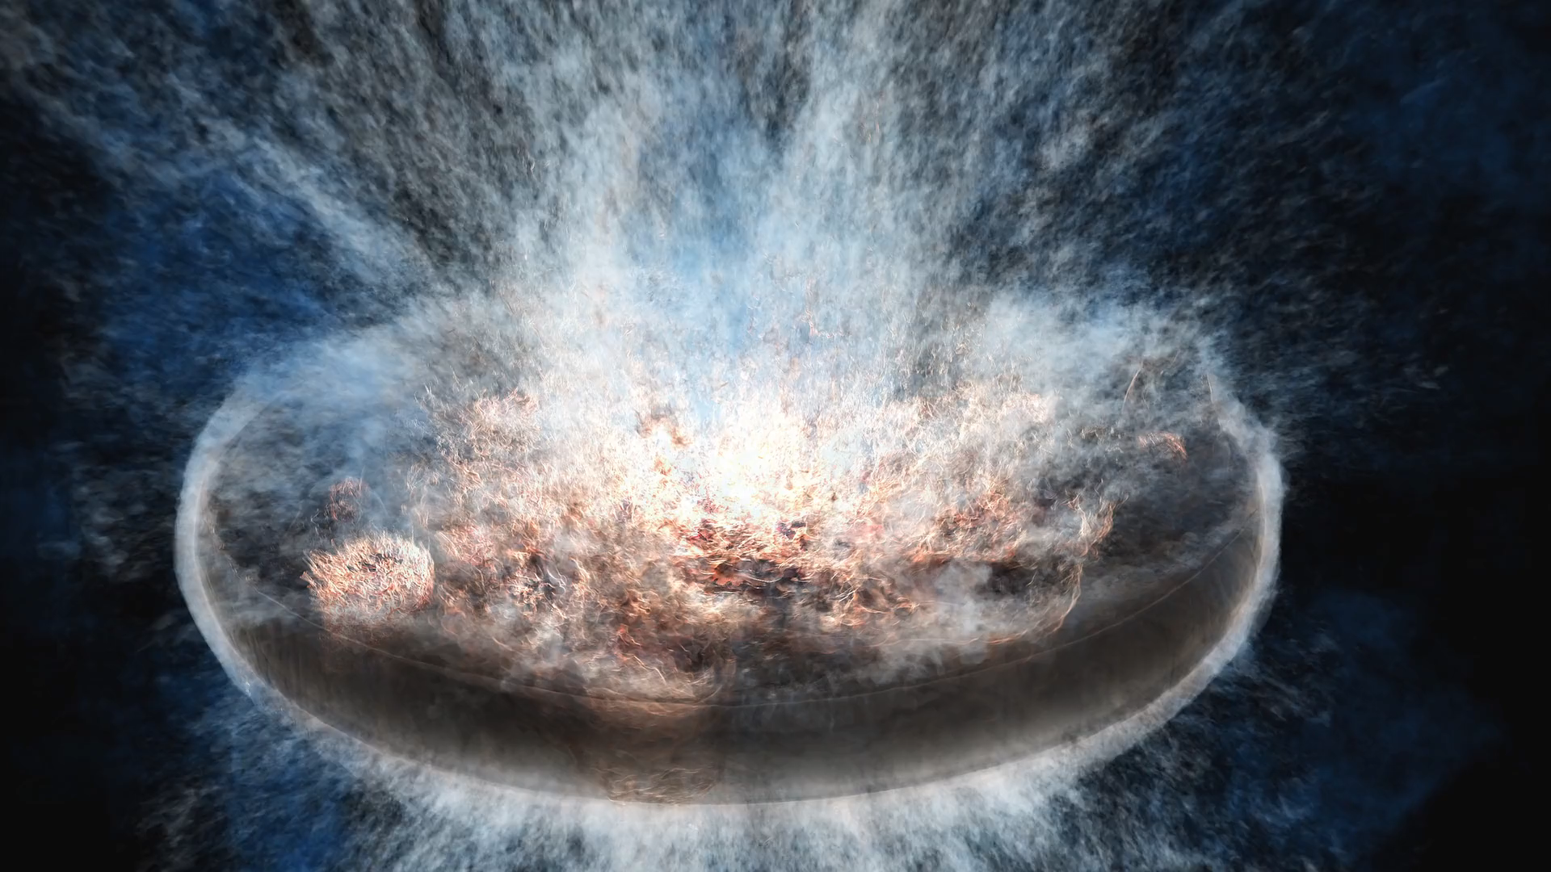
Putting the wind right!
A spatially fixed plane parallel wind is too idealized to capture the entire physics!
Galactic wind simulation by Evan Schneider

Slide 5

Time for some results!

Slide 6
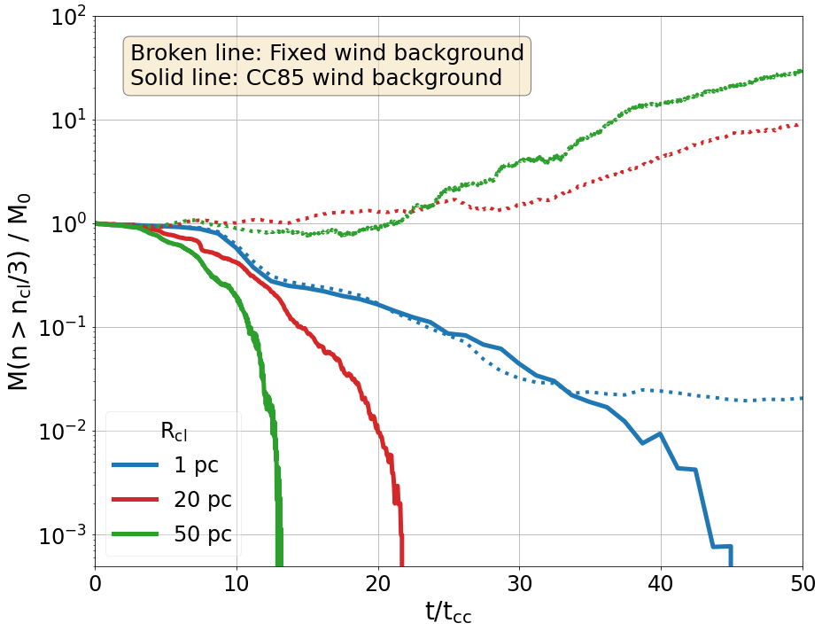
“Vanilla” CC!
Destroyed !!

Slide 7
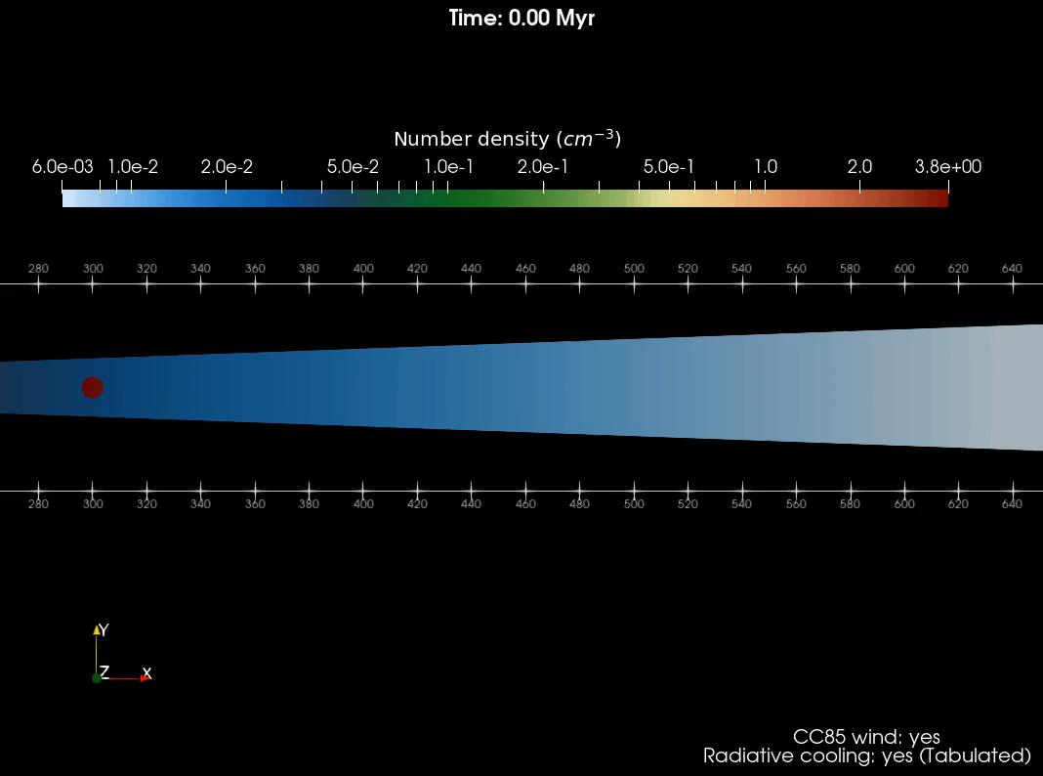

Movie time!
Denser background
Diffuse background

Slide 8

Clouds which can grow in a static wind
get destroyed in CC85 wind!

Slide 9
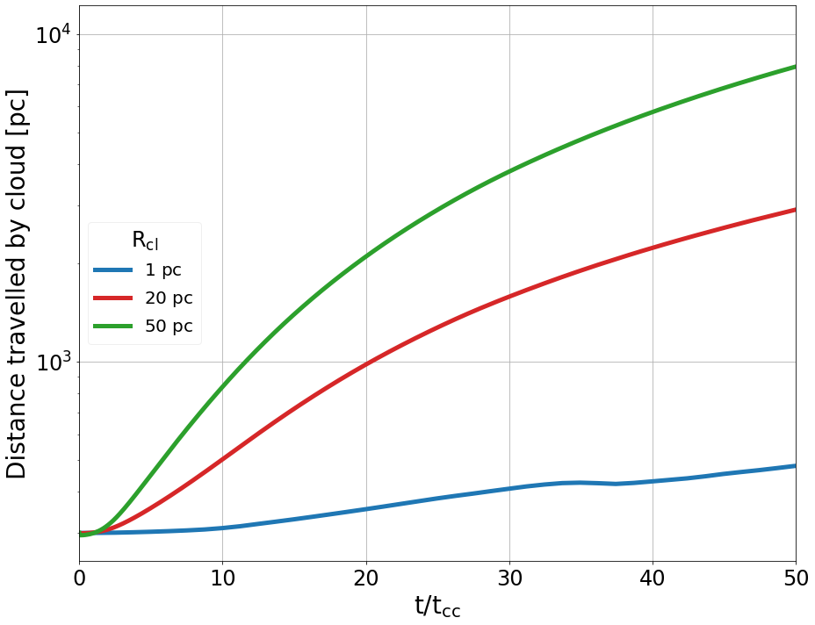
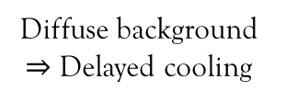
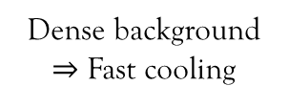
Diffuse background $⇒$ Delayed cooling
Dense background $⇒$ Fast cooling

Slide 10


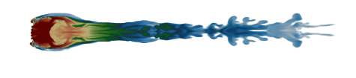
Thank You!!
Questions?

Slide 11
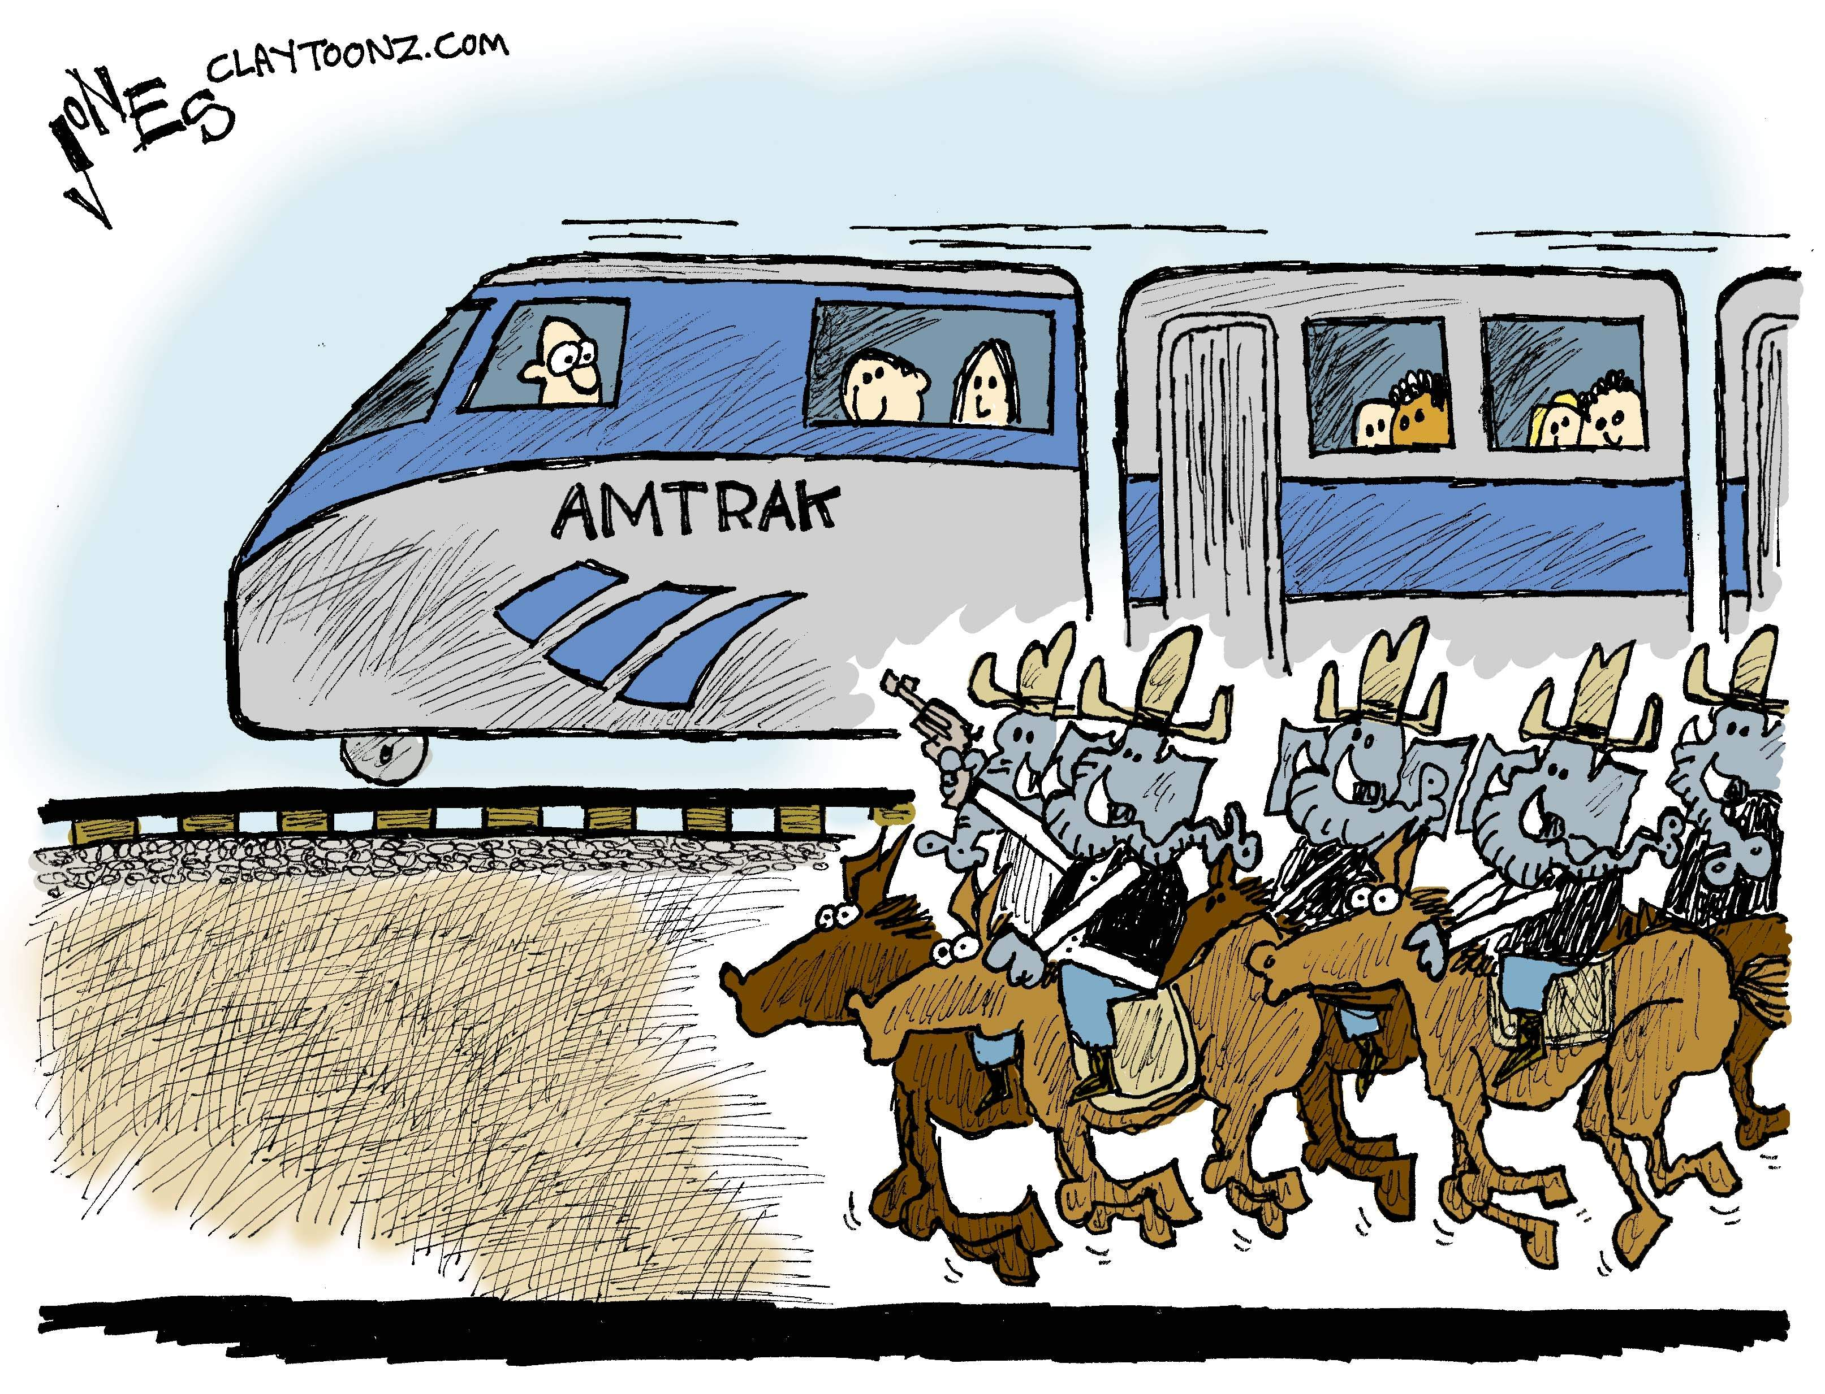
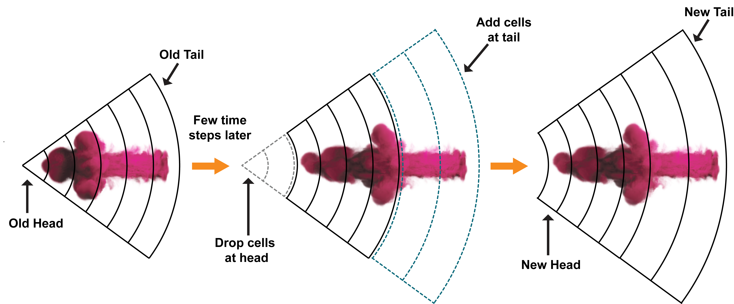
Track the cloud!

Slide 12

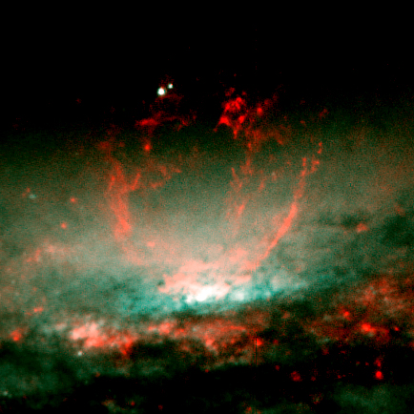
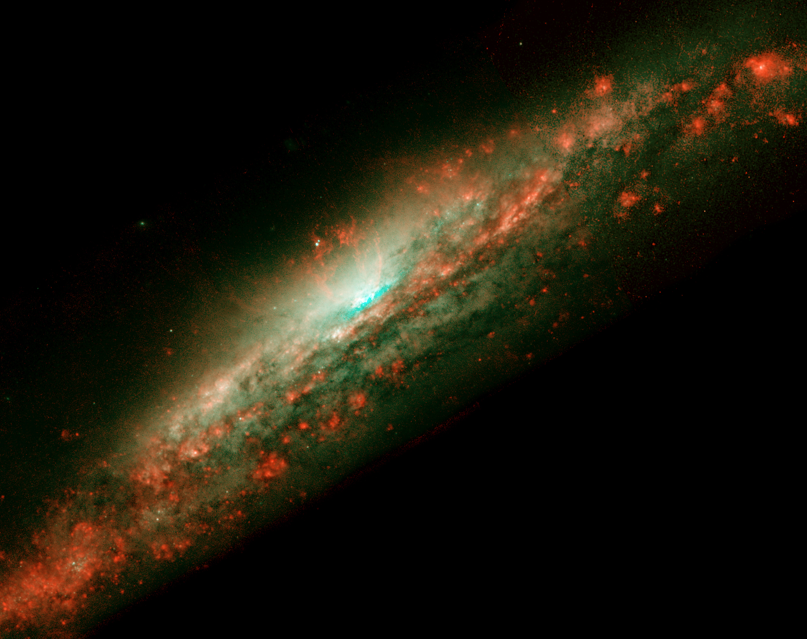
Putting the wind right!
Cold clouds are often observed to get accelerated in expanding outflows.
Static backgrounds are too ideal to capture all the essential physics.
We put in clouds in a local background undergoing a steady, adiabatic expansion (CC85).
Galactic wind simulation by Evan Schneider
HST image of NGC 3079

Slide 13
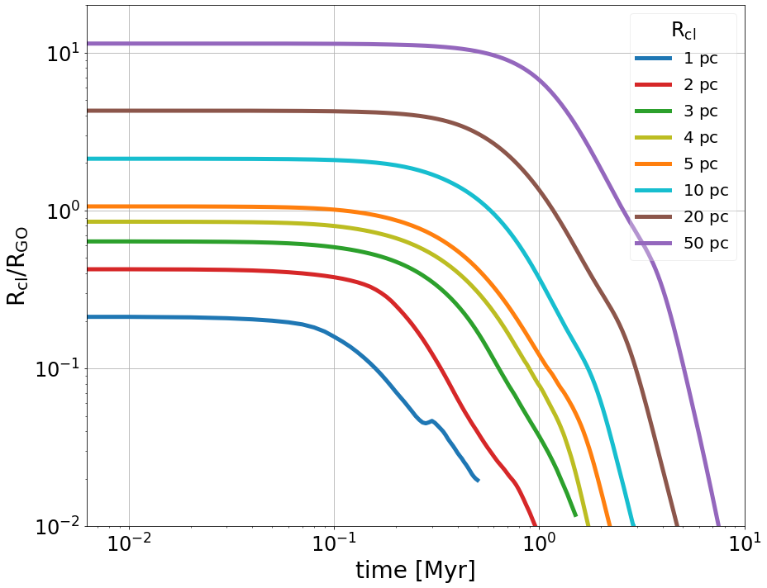
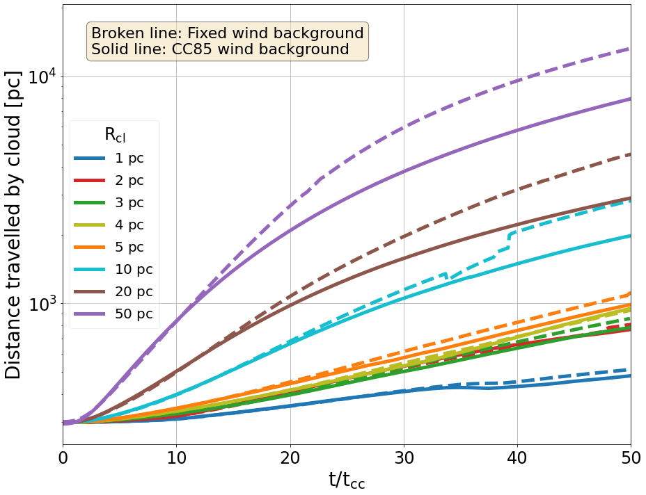
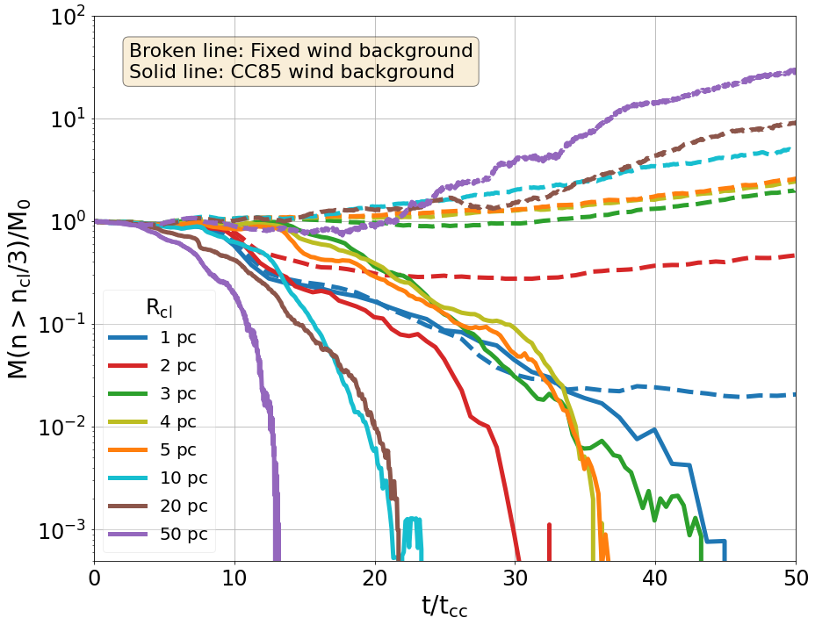
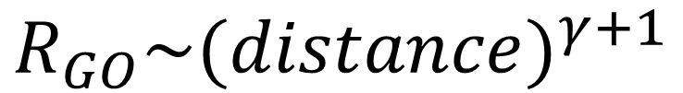
Time for some results!
$$R_{GO}\sim {(distance)}^{γ+1}$$
Clouds which can grow in a static wind gets destroyed in CC85 wind.

Slide 14
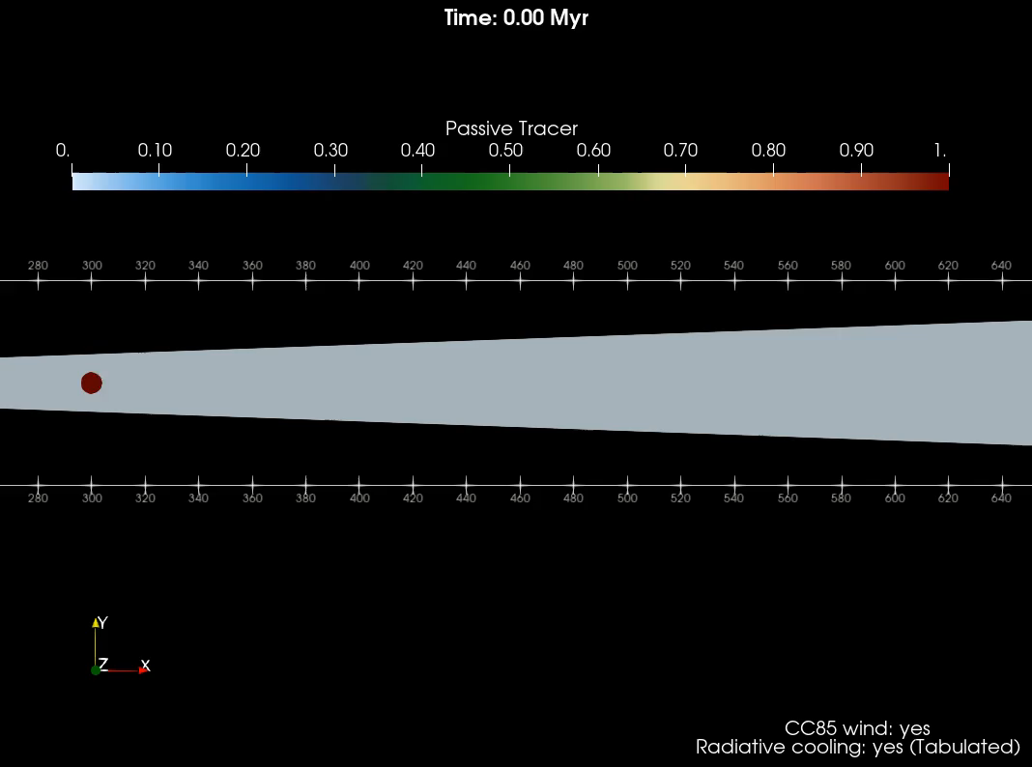
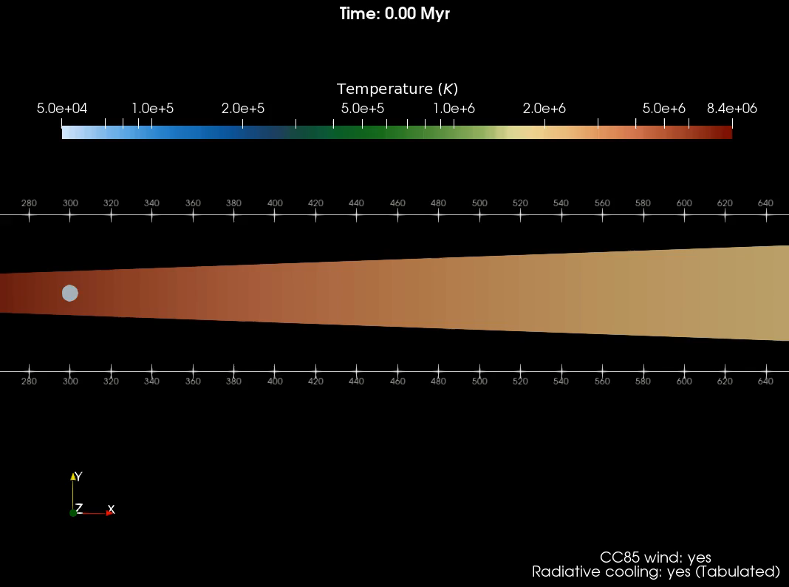
Epilogue = Movies!

