Slide 1
the little neutral ones
elusive fermions and how to spot them
IceCube Masterclass – 06/04/2022
Notes:
If you don’t know any of the vocabulary, please just put your hand up and stop me so I can clarify

Slide 2
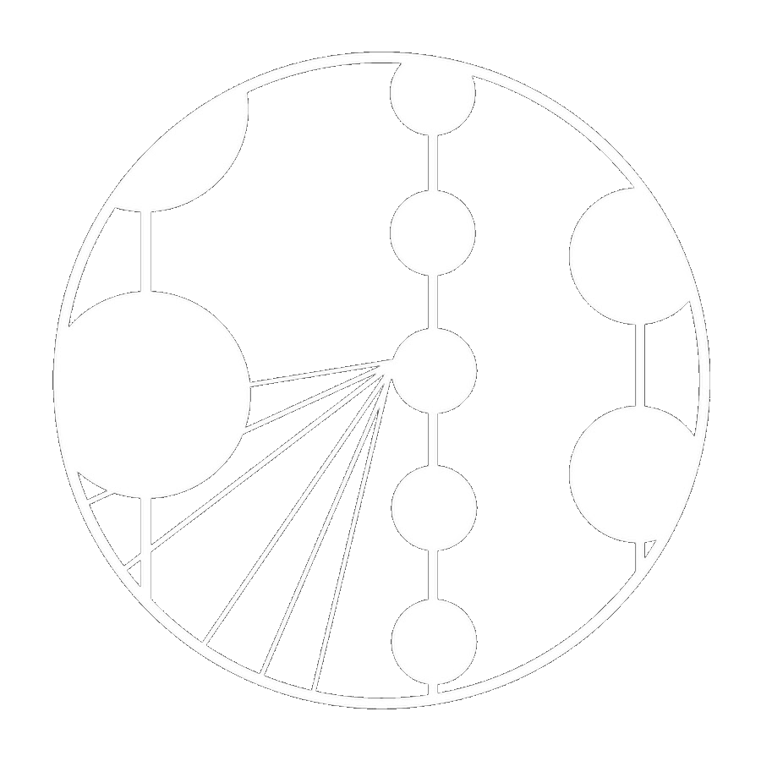
Concepts & Objectives
Recall
Conservation law
Ionising radiation
Energy spectra and quantisation
Describe the properties of the $β$-decay spectrum which implied the presence of new unexplained physics.
Use first principles to predict the properties of a 'missing' component of these nuclear processes.
Explain the mechanism by which such particles might be detected and the motives for doing so.
LOs
Introduction
2

Slide 3
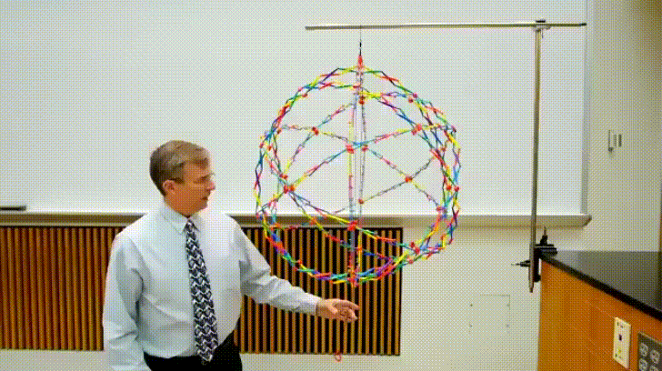
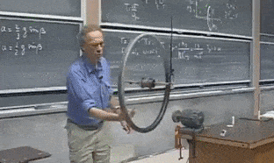
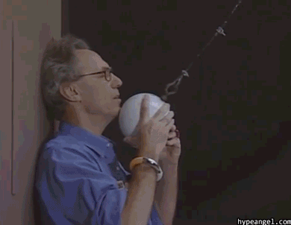
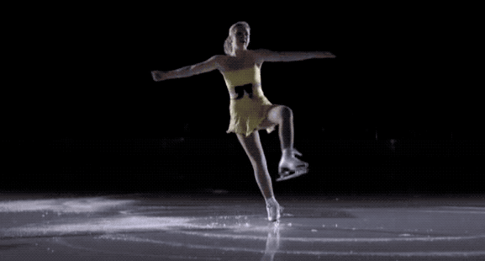
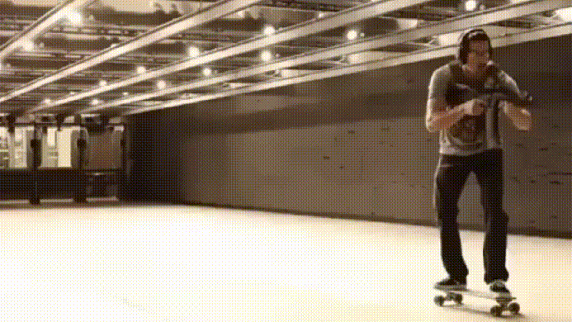
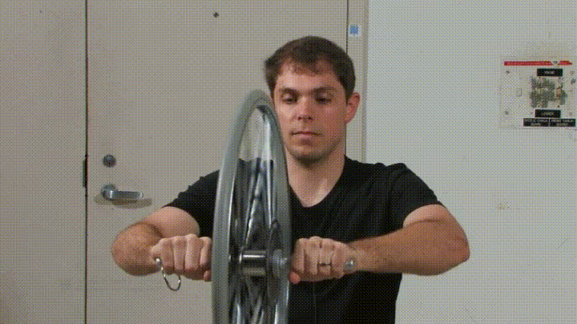
Conservation laws
Introduction
3

Slide 4
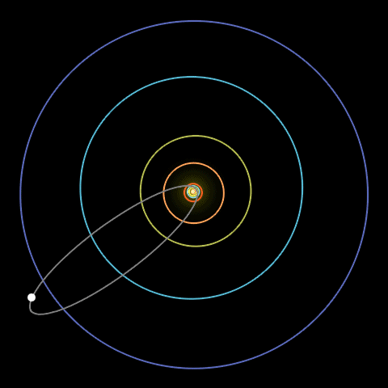
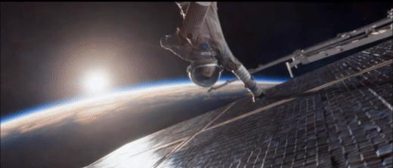
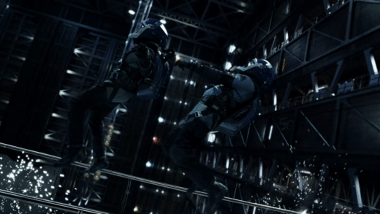
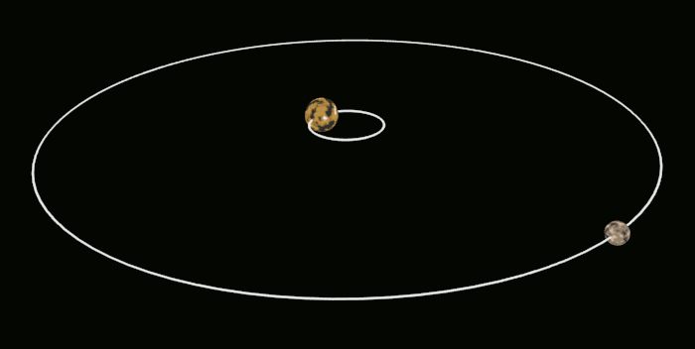
Conservation laws
Introduction
4

Slide 5
Noether’s theorem
continuous symmetry ⇔ a conserved quantity
Translation in space
Translation in time
Rotation in space
Momentum
Energy
Angular momentum
Introduction
5
Notes:
100 years ago emmy noether took an already 100 year old branch of mathematics and revolutionised theoretical physics Including but not limited to…

Slide 6
$β$-decay
A
Z
A
Z+1
β ⁻
Background
6
Notes:
The nucleus gains a positive charge
We observed it spit out a negatively charged beta ray
A nice simple 2-body decay model in which charge is conserved

Slide 7
$β$-decay
electric charge
Z
A
Z
A
Z+1
Z+1
β ⁻
-1
Background
7
Notes:
1910
Rutherford-Bohr model of the atom
Beta being a form of ionising radiation

Slide 8
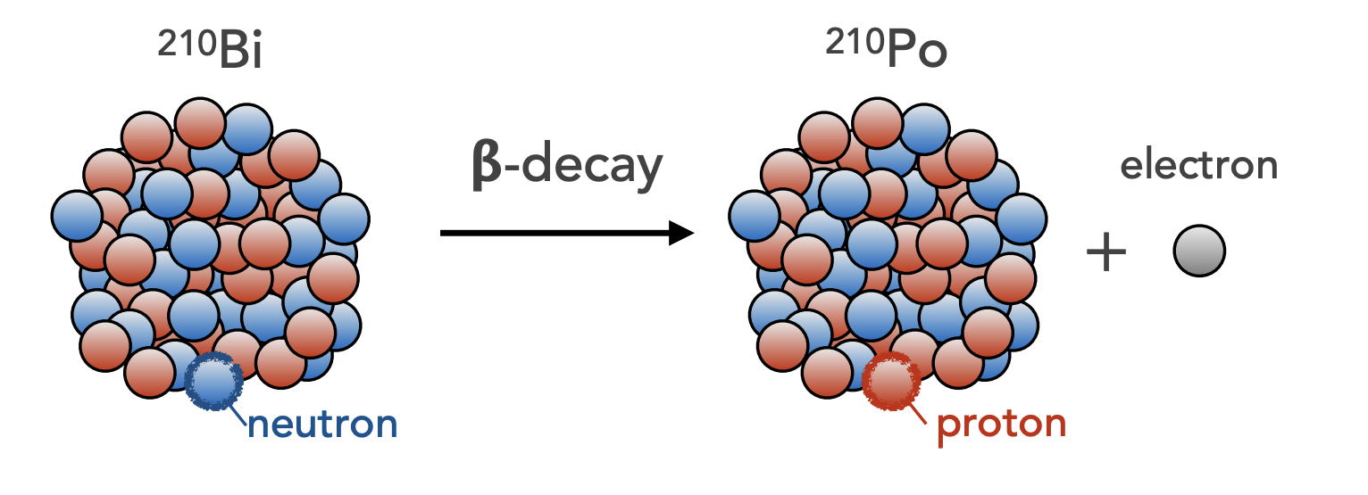
$β$-decay
Background
8
Notes:
Bismuth (z=83) -> Polonium (z=84)
*Q. What other kinds of ionising radiation do you know of?*
*A. Discovered alongside alpha and gamma radiation.*

Slide 9
$α$-decay
$$Eα$$
$X_{ Z}^{A}→Y_{ Z−2}^{A−4}+α_{2}^{4}$
Background
9
Notes:
Nuclear radiation energy spectrum, emission of a helium nucleus (2 protons 2 neutrons)
If there were simple mass differences at play we would only see one peak

Slide 10
$γ$-decay
$$Eγ$$
$$X_{ Z}^{A}→X_{ Z}^{A}+γ$$
Background
10
Notes:
For gamma emission, element X doesn’t change to Y or change isotope and yet has multiple peaks?
Q. Note the sharp discrete peaks of energy, what else do we know gives us discrete peaks of quantised energy?
A. Electron energy levels emitting and absorbing photons
Q. What does this tell us about the protons and neutrons of the nucleus?
A. Energy levels within an element (gamma) & between elements (alpha) have set differences.

Slide 11
$N_{ 7}^{ 14}$ $γ$-spectrum
Nitrogen
14
7
$γ$ emissions
Nuclear shells
$$Eγ$$
Background
11
Notes:
This tells us that the allowed potential energies of the nucleus are quantised
The protons and neutrons exist in shells within the nucleus
(just like the electrons in shells around the nucleus in Bohr’s model)
The energies of emissions should therefore be discrete and isotope specific
So for a decay that involves gaining a charge…

Slide 12
$C_{ 6}^{ 14} β$-spectrum
Carbon
14
6
β ⁻ emission
$$Qβ$$
Nitrogen
14
7
?
$$Eβ$$
Question
12
Notes:
… between elements, charged particles are emitted
*Q. What energy would you expect the Beta to have?*
*Q. How would you expect the energy spectrum to look?*

Slide 13
$C_{ 6}^{ 14} β$-spectrum
Carbon
14
6
14.003242 u
β ⁻ emission
$$Qβ$$
Nitrogen
14
7
14.003074 u
?
$$Eβ$$
Question
13
Notes:
Mass spectrometry is in its infancy, lets say we can measure beta energy better than atomic mass
So while we don’t know the value of Q_beta we can infer what shape E_beta spectrum should have
If you have discrete energy levels within nuclei, in a 2-body decay you expect…

Slide 14
$β$-spectrum
$$Eβ$$
$$Qβ$$
Question
14
Notes:
If a Beta particle is simply an electron then its mass…
…and therefore its kinetic energy should be constant
James Chadwick measured the Beta energy spectrum.

Slide 15
$β$-spectrum
$$Eβ$$
$$Qβ$$
Question
15
Notes:
Chadwick showed that the spectrum was continuous
This seemed to defy conservation of energy

Slide 16
$β$-spectrum
missing energy
$$Eβ$$
$$Qβ$$
Question
16
Notes:
Chadwick showed that the spectrum was continuous
This seemed to defy conservation of energy

Slide 17
$β$-decay
Spin
^{m}/₂
14
6
14
7
^{n}/₂
β ⁻
¹/₂
Question
17
Notes:
Even mass numbered nuclei have integer spin - Odd mass numbered nuclei have half integer spin
m and n can’t both be even if spin is conserved…
This model of carbon-14 decay doesn’t conserve angular momentum!

Slide 18
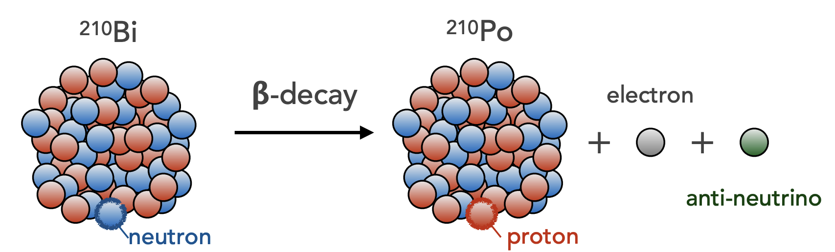
Deus ex Machina
?
Solution
18
Notes:
Who can tell me whats actually going on when a neutron becomes a proton?
Who can tell me what neutrons and protons are made up of?
What has to be released when a neutron/proton undergoes this process?

Slide 19
$β$-decay
Wolfgang Pauli, Zurich – 1930
Proposes ‘a desperate remedy’ to $β$-decay
Spin-half, electrically neutral particle
Light or massless, weakly-interacting
James Chadwick, Liverpool – 1932
Discovers the neutron – a neutral, spin-half particle
Too heavy to explain $β$-decay
Wolfgang Pauli, Zurich – 1930
“I have done something very bad
today by proposing a particle that
cannot be detected…”
James Chadwick, Liverpool – 1932
Pauli’s particle needed a mass
< 1% of the proton mass
…
Solution
19

Slide 20
Fundamentals
Quantum physics
Solar radiation
Quark model
Next generation
Forces incarnate
Forces unite
Standard model
H
c
n
t
u
p
Z
b
W
d
s
^{Cloud chamber}
^{Cathode ray deflection}
^{Photo-electric effect}
τ
µ
e⁻
¹⁸³⁸
¹⁸⁹⁷
¹⁹⁰⁰
¹⁹²¹
¹⁹²⁸
¹⁹³²
e⁺
ν_{e}
ν_{µ}
ν_{τ}
γ
Standard Model
20
Notes:
At this point the universe is made of protons neutrons electrons photons and the newly discovered positron
Who can tell me what is wrong with including protons and neutrons in this picture?
QUARKS

Slide 21
Neutrinos
Wolfgang Pauli & Enrico Fermi – 1934
Propose ‘neutrino’ or ‘little neutral one’
Spin-half, electrically neutral
Weakly-interacting particle
u
n → p + e⁻ + $\overline{ν}$
e⁻
d
W ⁻
$$α$$
Paper
$$\overline{ν}$$
250x thickness
9,000x density
$$ν$$
?
$$β$$
Aluminium
25x thickness
>4x density
$$γ$$
Lead
Solution
21
Notes:
Alpha particles are stopped by paper
Beta stopped by 2.5cm or so of aluminium
It takes about 60cm of lead to stop a gamma ray
One light year of lead!

Slide 22
Neutrinos
Wolfgang Pauli & Enrico Fermi – 1934
Propose ‘neutrino’ or ‘little neutral one’
Spin-half, electrically neutral
Weakly-interacting particle
u
n → p + e⁻ + $\overline{ν}$
e⁻
d
W ⁻
$$α$$
Paper
$$\overline{ν}$$
250x thickness
9,000x density
$$ν$$
9.6 $×$ 10¹² km of lead
would only stop 50%
$$β$$
Aluminium
25x thickness
>4x density
$$γ$$
Lead
Solution
22
Notes:
Alpha particles are stopped by paper
Beta stopped by 2.5cm or so of aluminium
It takes about 60cm of lead to stop a gamma ray
One light year of lead!

Slide 23
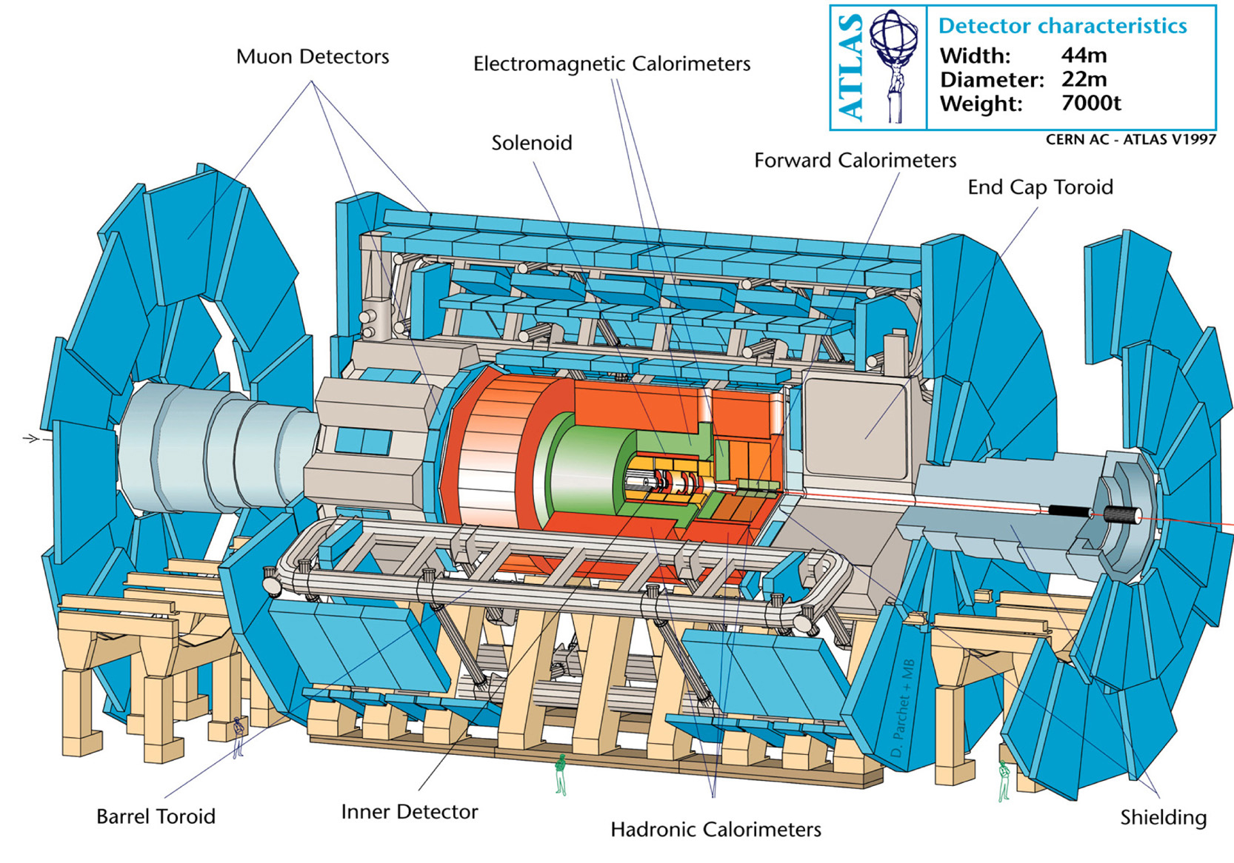
Hermetic detectors
Detection
23
Notes:
Surrounding the interaction point!
Presence is inferred from momentum imbalance among detected particles
All non-neutrinos produced must be detected, with no blind spots
They identify neutrinos (and potentially new dark matter particles) escaping the detector using missing energy

Slide 24
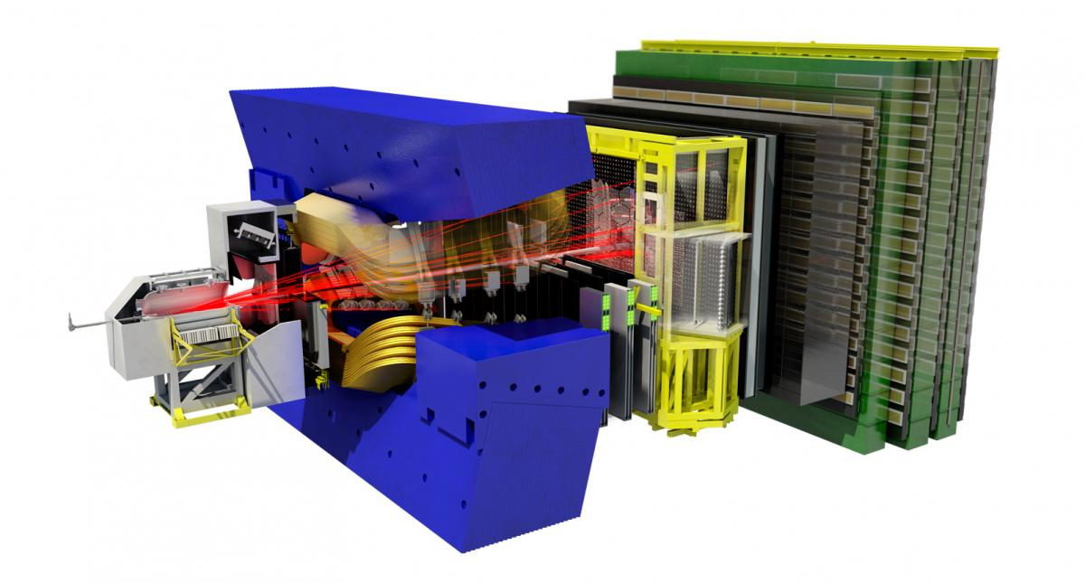
Non-hermetic detectors
Detection
24
Notes:
Other experiments exchange this unknown quantity for specialisation in other areas

Slide 25
Inverse $β$-decay
d
u
u
d
W
W
$$ν$$
e⁻
$$\overline{ν}$$
e⁺
n + $ν$ → p + e⁻
p + $\overline{ν}$ → n + e⁺
Detection
25
Notes:
*Q. Can anyone tell me what has changed in the Feynman diagram?*
Pull the leg of the diagram to require a neutrino instead of produce one…

Slide 26
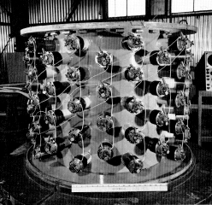
Reactor flux measurement
Reines & Cowen, South Carolina – 1956
Nearby nuclear reactor as $β$-decay $\overline{ν}$ source
Underground to shield from cosmic rays
Wolfgang Pauli & Enrico Fermi – 1934
Propose ‘neutrino’ or ‘little neutral one’
Spin half, electrically neutral
u
e⁻
d
W⁻
Two 100 litre tanks of water Cadmium chloride dissolved in solution Scintillator sandwich surrounded by photomultiplier tubes
…
$$\overline{ν}$$
Detection
26
Notes:
Cadmium absorbs neutrons of a specific energy range before decaying.
Scintillators give off flashes of light when exposed to ionizing radiation.

Slide 27
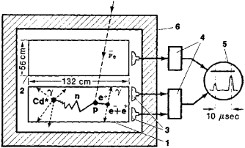
Reactor flux measurement
Reines & Cowen, South Carolina – 1956
5 $×$ 10¹⁵ anti-neutrinos cm⁻² s⁻¹
~ 3 events hour ⁻¹
Wolfgang Pauli & Enrico Fermi – 1934
Propose ‘neutrino’ or ‘little neutral one’
Spin half, electrically neutral
u
d
p + $\overline{ν}$ → n + e⁺ e⁺ + e⁻ → γγ
W
$$\overline{ν}$$
e⁺
Cd captures a neutron & undergoes γ-decay
γ-rays cause scintillator to emit a photon
Photons detected with distinct time interval
…
Detection
27
Notes:
Matter and anti-matter annihilate -> gamma
Cd-108 + n -> Cd-109 -> Cd-109 + gamma
NOBEL PRIZE 1995

Slide 28
Fundamentals
Quantum physics
Solar radiation
Quark model
Next generation
Forces incarnate
Forces unite
Standard model
H
c
n
t
u
p
Z
$π$ $K$
b
W
d
s
^{Cosmic rays}
τ
e
µ
¹⁹⁷⁰
¹⁹³⁶
ν
ν_{τ}
ν
¹⁹³⁰
¹⁹⁵⁶
^{Nuclear reactor}
ν_{µ}
γ
Standard Model
28

Slide 29
Time check
Recall
Conservation law
Ionising radiation
Energy spectra and quantisation
Describe the properties of the $β$-decay spectrum which implied the presence of new unexplained physics.
Use first principles to predict the properties of a 'missing' component of these nuclear processes.
Explain the mechanism by which such particles might be detected and the motives for doing so.
LOs
Introduction
29

Slide 30
Shielded spark chamber
u
$$ν$$
Brookhaven National Laboratory – 1962
Proton beam fired at a beryllium target
Pions (light $q\overline{q}$) produced decay to muons…
…heading towards 5,000 ton steel wall, 13.5 metres thick (recycled WWII battleship)
Neon filled spark chamber Muon production detected
…
$$\overline{d}$$
μ⁺
W⁺
d
u
W
$$ν$$
μ ⁻
Flavour
30
Notes:
The wall stops all particles except for most of the neutrinos
Some neutrinos interact with the shield from which…
…exclusive production of muons observed from beam’s neutrinos

Slide 31
Shielded spark chamber
u
$$ν$$
Brookhaven National Laboratory – 1962
Proton beam fired at a beryllium target
Pions (light $q\overline{q}$) produced decay to muons…
…heading towards 5,000 ton steel wall, 13.5 metres thick (recycled WWII battleship)
Neon filled spark chamber Muon production detected
…
$$\overline{d}$$
μ⁺
W⁺
d
u
d
u
W
W
$$ν_{μ}$$
μ ⁻
$$ν_{e}$$
e ⁻
Flavour
31
Notes:
This implied that neutrinos produced in muon / electron interactions…
…only interact with mus & es respectively (a whole new particle?)
NOBEL PRIZE 1988

Slide 32
Fundamentals
Quantum physics
Solar radiation
Quark model
Next generation
Forces incarnate
Forces unite
Standard model
H
^{Stanford Linear Accelerator}
c
t
u
Z
¹⁹⁶⁴
¹⁹⁶⁸
b
W
d
s
τ
e
µ
ν_{e}
ν_{τ}
ν_{µ}
¹⁹⁴⁰
¹⁹⁶²
Alternating Gradient Synchrotron
γ
Standard Model
32
Notes:
M_e = 0.5 MeV
M_u = 2.5 MeV
M_d = 5.0 MeV
M_p = 938 MeV

Slide 33
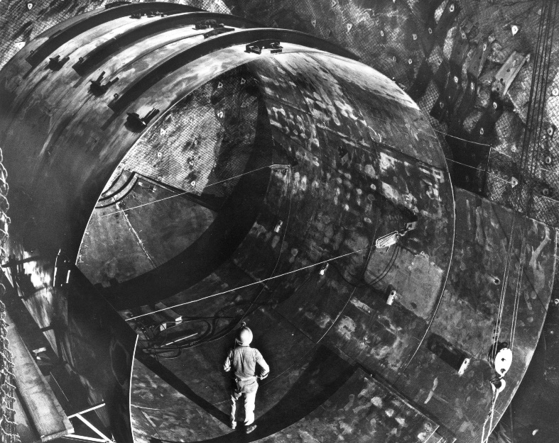
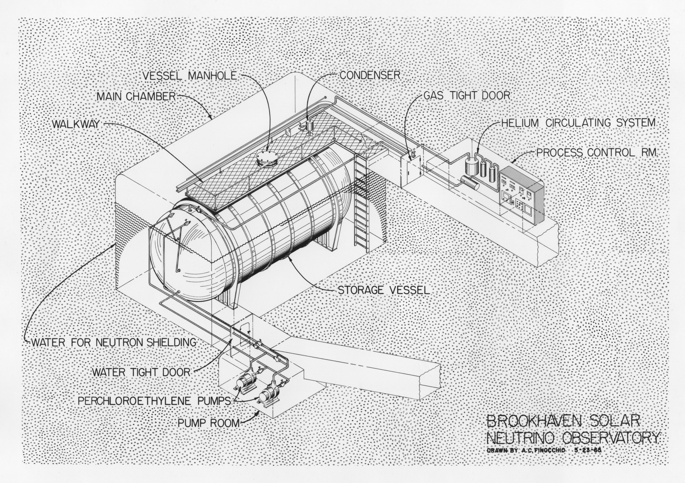
The solar neutrino problem
Homestake gold mine, South Dakota – 1970
Sun’s nuclear fusion provides ~10⁹ $ν_{e}$ cm⁻² s⁻¹
~ 450,000 litre tank 1,478 m underground
Filled with chlorine rich dry-cleaning fluid
..
Cl ³⁷ + $ν_{e}$ → Ar ³⁷ + e ⁻ Argon extracted & counted
Only ~ ¹/₃ of
expected $ν_{e}$
were detected
Flavour
33
Notes:
Radiochemical detector – argon filtered out and used as indication of flux
Sun’s fusion process well understood by this time, where are the neutrinos?
NOBEL PRIZE 2002

Slide 34
Fundamentals
Quantum physics
Solar radiation
Quark model
Next generation
Forces incarnate
Forces unite
Standard model
H
^{SPEAR & AGS}
c
¹⁹⁷⁰
¹⁹⁷⁴
t
u
Z
^{Brookhaven}
^{Nation Labs}
b
¹⁹⁷³
¹⁹⁷⁷
W
d
s
τ
¹⁹⁷¹
¹⁹⁷⁵
e
µ
Stanford positron electron asymmetric rings
ν_{e}
ν_{µ}
ν_{τ}
γ
Standard Model
34
Notes:
Third generation of quarks and charged leptons was discovered

Slide 35
Fundamentals
Quantum physics
Solar radiation
Quark model
Next generation
Forces incarnate
Forces unite
Standard model
H
Super proton anti-proton synchrotron
c
t
u
Z
¹⁹⁶⁸
¹⁹⁸³
b
W
d
s
τ
g
¹⁹⁶²
¹⁹⁷⁸
e
µ
ν_{e}
ν_{µ}
ν_{τ}
γ
^{Double storage}
^{ring at DESY}
Standard Model
35
Notes:
Strong and weak nuclear force carriers were found

Slide 36
Fundamentals
Quantum physics
Solar radiation
Quark model
Next generation
Forces incarnate
Forces unite
Standard model
^{LHC}
^{Tevatron}
¹⁹⁶⁴
²⁰¹²
H
c
t
¹⁹⁷³
¹⁹⁹⁵
u
Z
b
W
d
s
τ
g
e
µ
ν_{e}
ν_{µ}
ν_{τ}
¹⁹⁷⁵
²⁰⁰⁰
γ
^{Tevatron}
Standard Model
36
Notes:
NuMu discovery NOBEL PRIZE 1988
NOBEL PRIZE 1995
HOMESTAKE EXPERIMENT wins the NOBEL PRIZE 2002

Slide 37
Coupled pendulum
Time for a demonstration…..
Flavour
37
Notes:
If neutrinos aren’t massless then perhaps the different flavours have different masses?
If they have mass then maybe the masses don’t line up with the flavours neatly?
Maybe when a neutrino is created it has a superposition of the allowed masses?

Slide 38
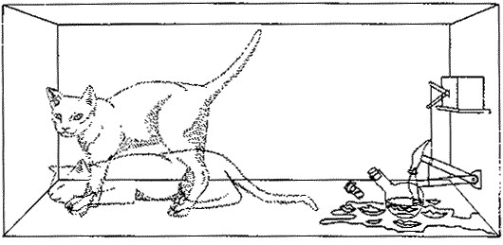
Neutrino masses
Flavour
Mass
Flavour
Mass
$$ν_{e}$$
m₁
e
m_{e}
am₁ + bm₂
μ
m_{μ}
$$ν_{μ}$$
cm₁ + dm₂
m₂
Flavour
38
Notes:
If neutrinos aren’t massless then perhaps the different flavours have different masses?
If they have mass then maybe the masses don’t line up with the flavours neatly?
Maybe when a neutrino is created it has a superposition of the allowed masses?

Slide 39
Neutrino masses
Mass
Flavour
Mass
Flavour
m₁
c${ ν}_{e}$ + d${ ν}_{μ}$
m_{e}
e
a${ ν}_{e}$ + b${ ν}_{μ}$
m_{μ}
μ
$$\text{m}\text{2}$$
Flavour
39
Notes:
If neutrinos aren’t massless then perhaps the different flavours have different masses?
If they have mass then maybe the masses don’t line up with the flavours neatly?
Maybe when a neutrino is created it has a superposition of the allowed masses?

Slide 40
Superposition
P_{L} = ↑ P_{s} + ↑ P_{o}
P_{R} = ↑ P_{s} + ↓ P_{o}
Oscillations
40
Notes:
Periodic exchange of overall amplitude
Due to the different rates of swinging
Aligning and anti-aligning

Slide 41
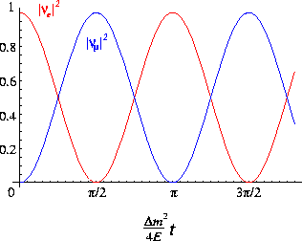
Neutrino oscillations
f_{e} = ↑ m₁ + ↑ m₂
f_{e} = ↑ m₁ + ↑ m₂
$$P_{e→e} ∝ 1−A sin^{2}\left(x\right)$$
$$P_{e→μ} ∝ A sin^{2}\left(x\right)$$
$$x$$
f_{μ} = ↑ m₁ + ↓ m₂
Oscillations
41
Notes:
Flavour dependant interactions are our overall observable
Background effect of different masses interfering with each other
m2 is heavier (has more energy like in analogy) thus higher freq.

Slide 42
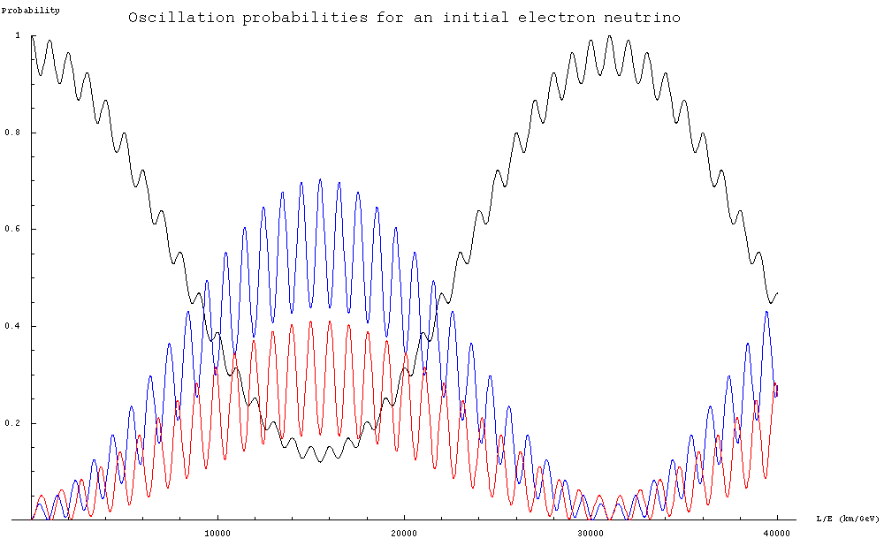
Neutrino oscillations
L = length travelled
E = neutrino energy
$Δm_{ij}^{2}≠0⇒$At least two non-
zero mass states
$θ_{ij}$ are described using a ‘flavour mixing’ matrix
The PMNS matrix contains an unknown CP-violating phase
$$P(a→b) ∝\sin^{2}θ_{ij} ∗\sin^{2} \left(Δm_{ij}^{2} ∗L/E\right)$$
1
1 GeV electron neutrino
$$P_{e→e}$$
$$P_{e→μ}$$
$$P_{e→τ}$$
0
0
Earth
diameter
L (km)
40,000
Oscillations
42
Notes:
Oscillations prove neutrinos masses !=0
Opens the door to other possibilities…

Slide 43
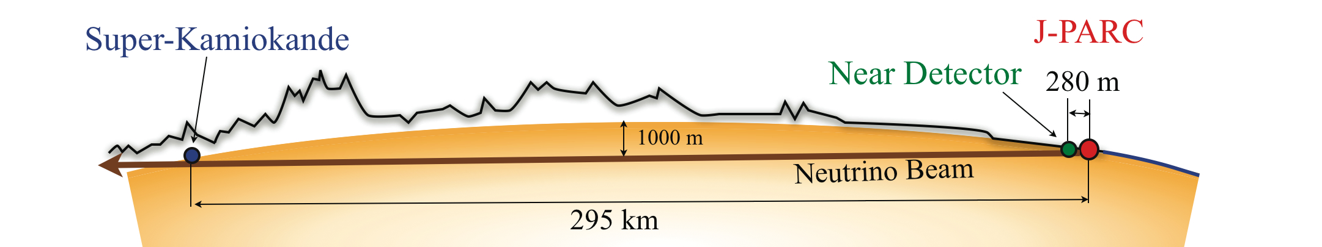
Long baseline experiments
Oscillations
43
Notes:
Tokai 2 Kamioka - Near detector with graphite target - beam's energy spectrum, flux, flavor content & cross-sections
Deep Underground Neutrino Experiment
68,000 tons of liquid argon ( < -186°C )
1,475 meters (4,850 feet) underground

Slide 44
Fundamentals
Quantum physics
Solar radiation
Quark model
Next generation
Forces incarnate
Forces unite
Standard model
H
c
t
u
Z
b
W
d
s
τ
g
e
µ
ν_{e}
ν_{µ}
ν_{τ}
γ
Beyond the Standard Model
44

Slide 45
Cherenkov radiation
u
d
d
u
W ⁻
W ⁺
$$\overline{ν}$$
e⁺
$$ν$$
e⁻
Detection
45
Notes:
Even mass numbered nuclei have integer spin - Odd mass numbered nuclei have half integer spin
m and n can’t both be even if spin is conserved…
This model of carbon-14 decay doesn’t conserve angular momentum!

Slide 46
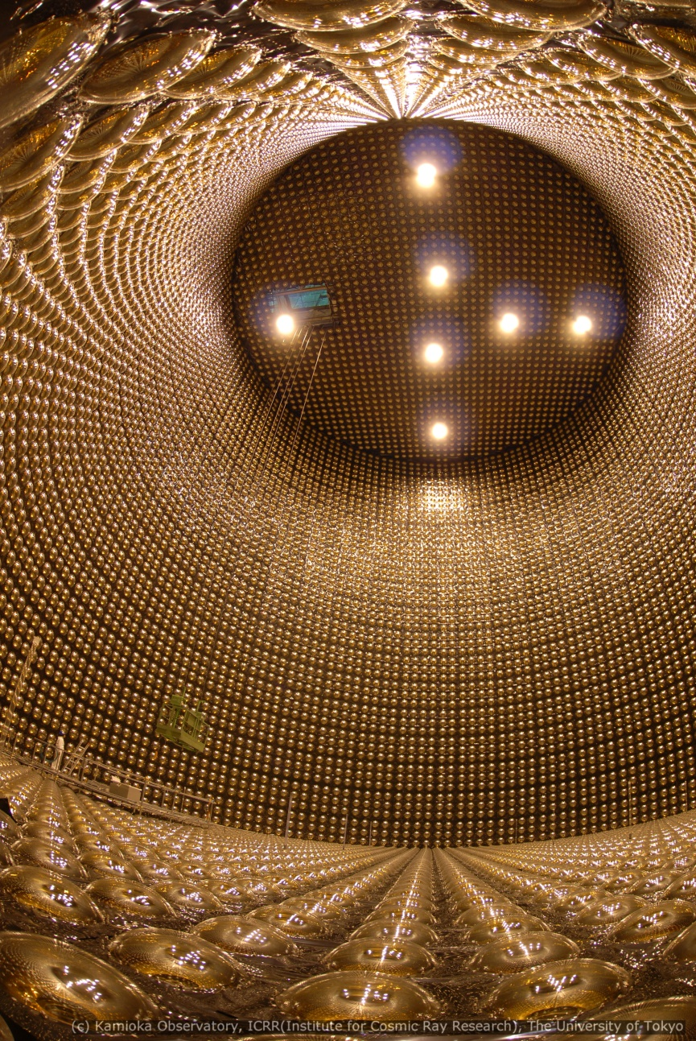
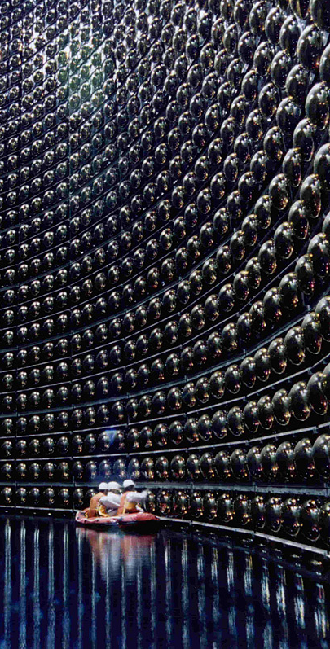
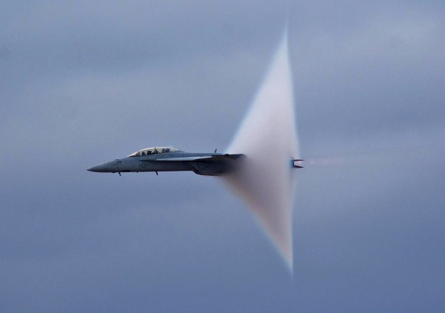
Cherenkov detectors
Super-Kamiokande, Japan – 2011
~ 1,000 m underground
~ 50,000 tons of ultra pure water
> 11,000 photomultiplier tubes
..
Produces superluminal particles
Cone of light
emitted
Introduction
46
Notes:
NOBEL PRIZE 2015 – Breakthrough prize
In 2011 the super-K detector in the T2K experiment announced their observation

Slide 47
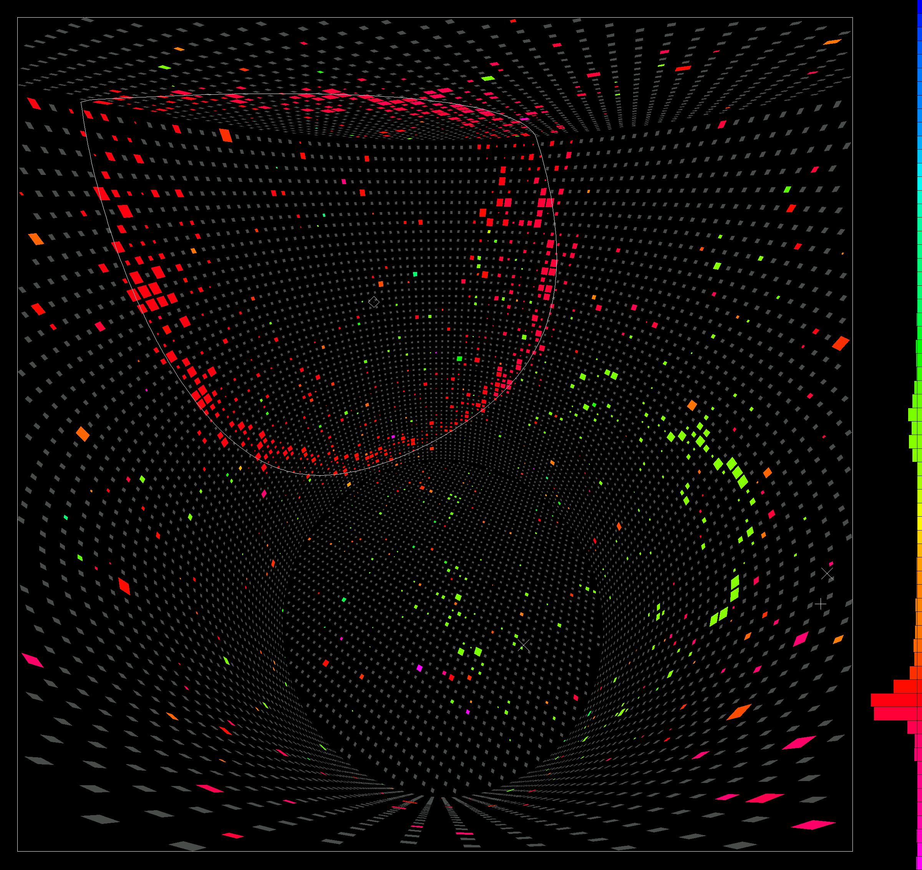
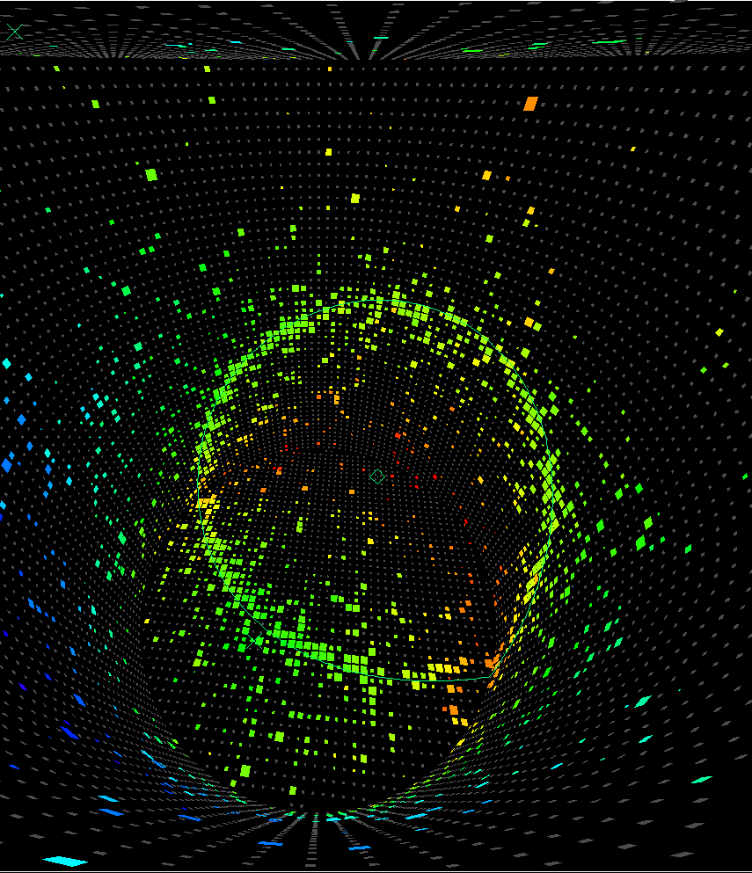
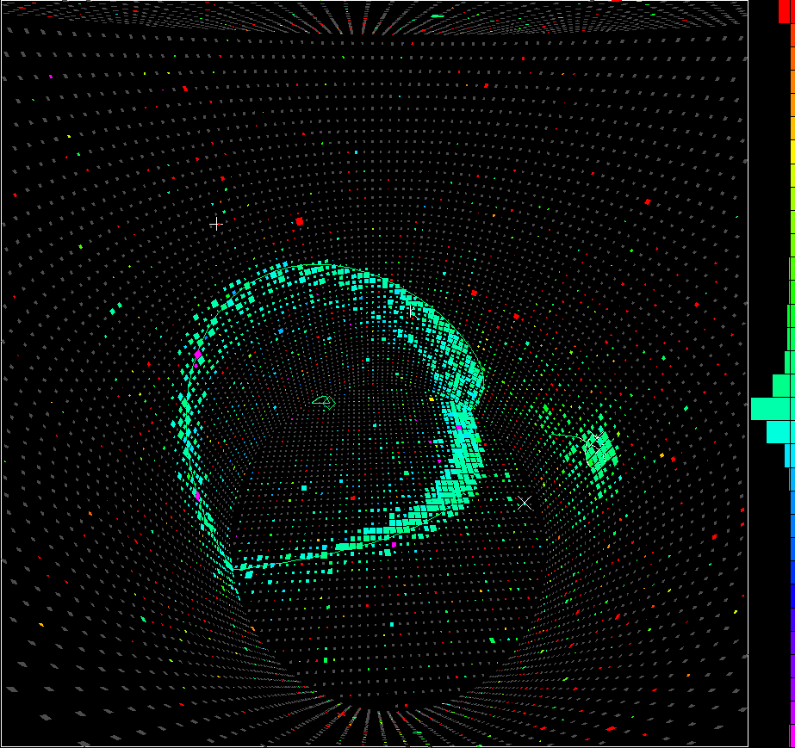
Cherenkov detectors
Introduction
47

Slide 48
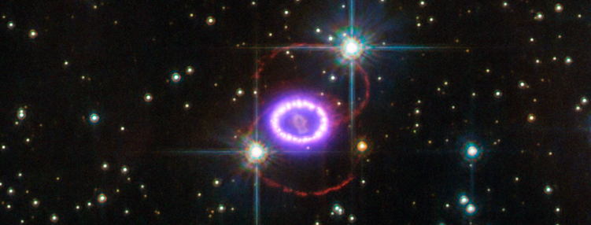
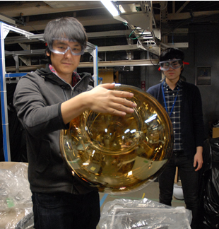
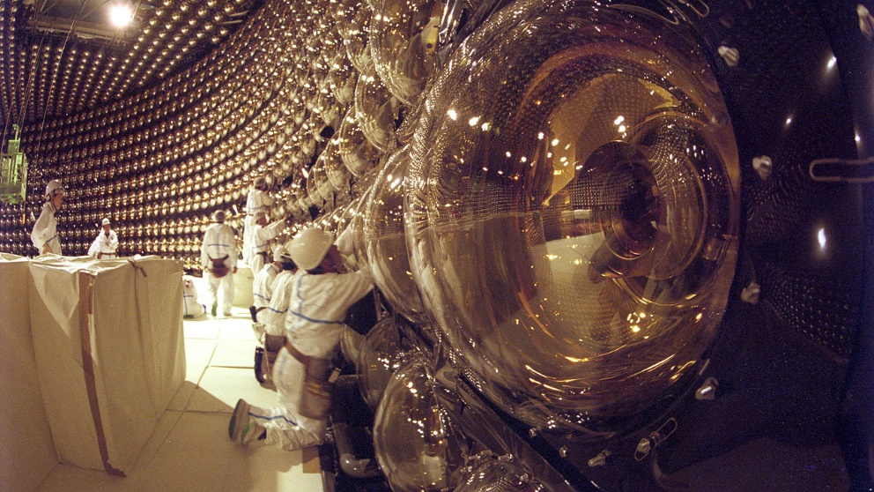
Cherenkov detectors
Kamiokande, Japan – 1987
~ 3,000 tons of ultra pure water
> 1,000 photomultiplier tubes
Supernova neutrino observation
Hyper-Kamiokande, Japan – 2025
Two parallel tanks
~ 1,000,000 tons of ultra pure water
> 40,000 photomultiplier tubes
Introduction
48
Notes:
1987 – 170,000 ly from earth [SN1987A]
10^58 neutrinos produced
Original Kamiokande observed an 11 event excess over 13 seconds

Slide 49
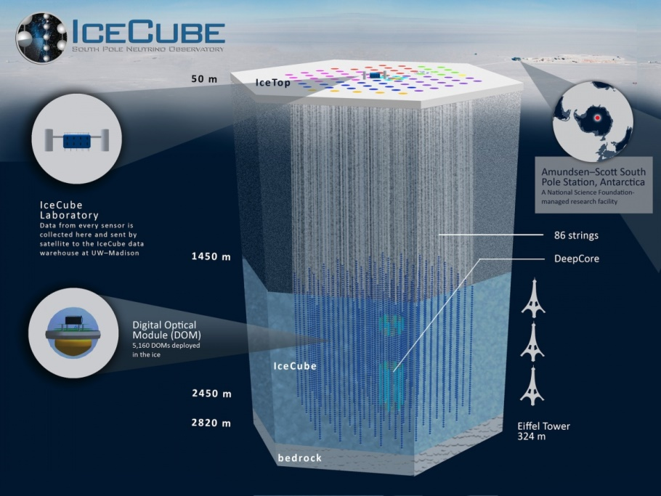
Cherenkov detectors
IceCube, Antarctica – 2010
~ 1,500 m underground
~ 1km³ of 100,000-year-old ice
> 5,000 optical sensors
..
Ultra high energy astrophysical neutrinos
DeepCore extends low energy sensitivity
Introduction
49

Slide 50
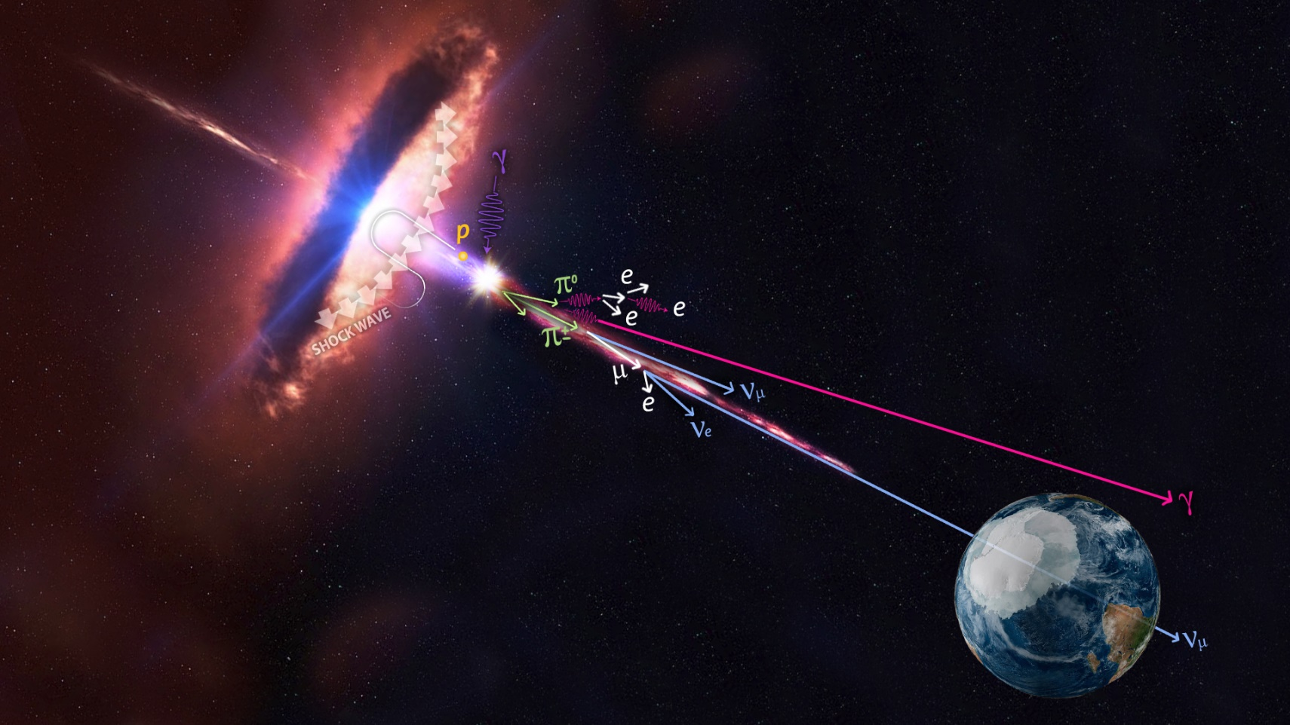
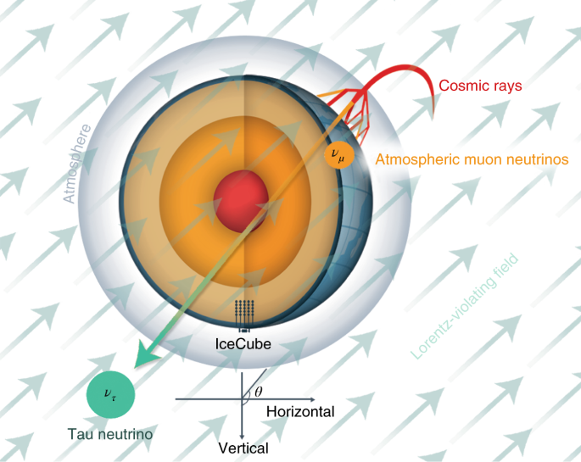
Cherenkov detectors
IceCube, Antarctica – 2010
~ 1,500 m underground
~ 1km³ of 100,000-year-old ice
> 5,000 optical sensors
..
Ultra high energy astrophysical neutrinos
DeepCore extends low energy sensitivity
Introduction
50
Notes:
LONGEST BASELINE ON EARTH

Slide 51
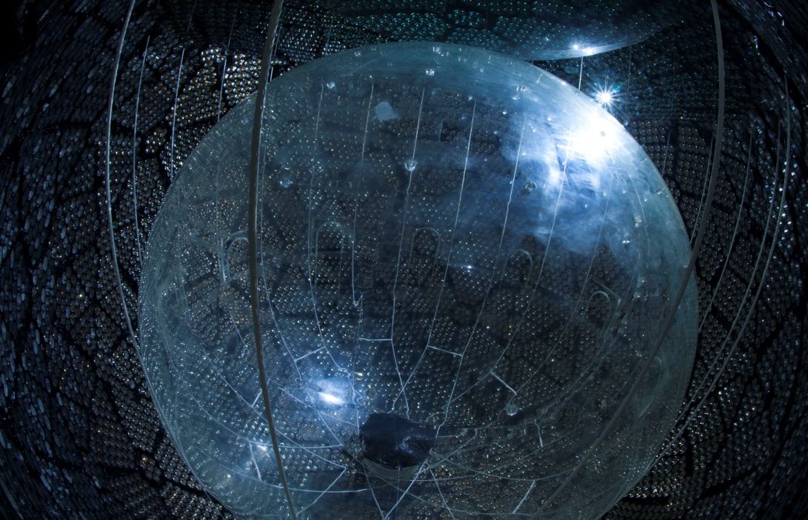
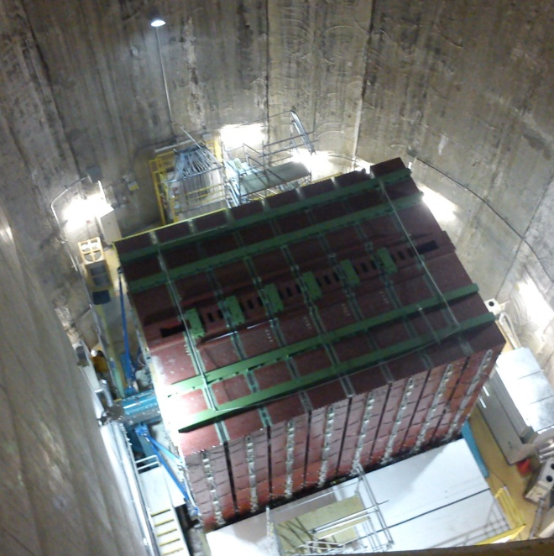
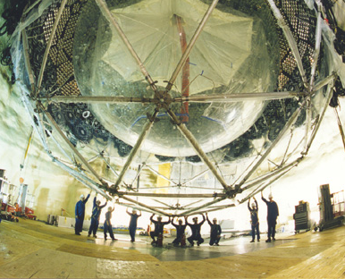
Scintillation detectors
SNO+, Canada
Upgrade from Cherenkov (SNO) to liquid scintillator
Searching for neutrinoless double β-decay
T2K-ND, Japan
Near detector (to neutrino source) for long baseline experiments
Being replaced by newer technologies
Introduction
51
Notes:
SNO water Cherenkov – SNO+ liquid scintillator (majorana neutrinos)
T2K’s near detector, interlocking layers of scintillator

Slide 52
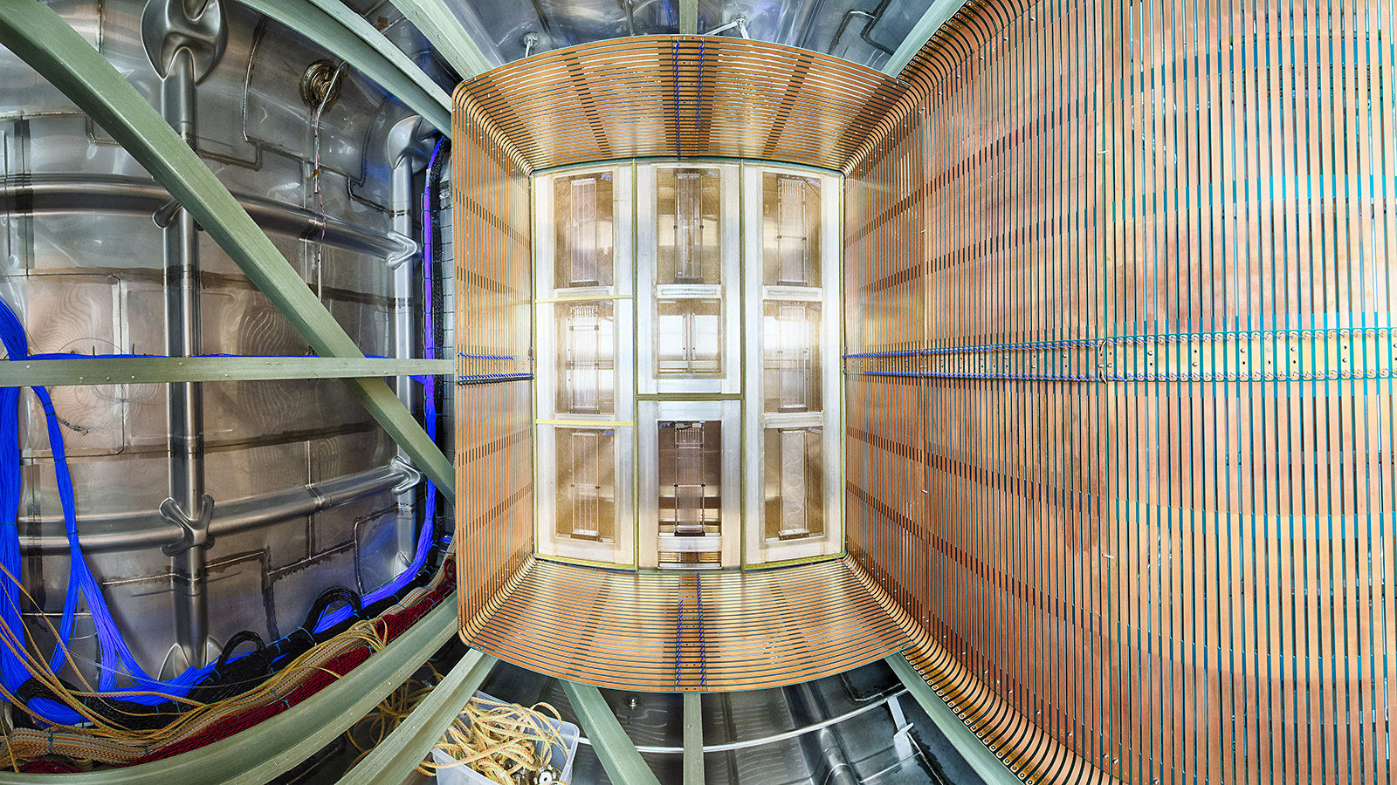
Time projection chambers
Introduction
52
Notes:
Time projection chamber
ARIADNE – Liverpool’s liquid argon tech development project
DUNE’s far detector…
SBND

Slide 53
Unanswered questions
What are their masses?
Why they are so light?
Which flavour is lightest or heaviest?
Could they be their own anti-particle?
Could other types be out there?
What would that even mean?
Introduction
53
Notes:
What we don’t know…. Hierarchy problem? Sterile neutrinos? Dark matter candidates? CP violation?

Slide 54
Summary
Ultra-light & neutral – weak & gravitational forces only
Come in 3 flavours – electron, muon & tau
Flavours ‘oscillate’ as they travel through space
Rely on high statistics from neutrino production
Rely on large bodies of interaction material
Collider experiments must account for ‘missing energy’
Introduction
54
Notes:
Recap of what we do know!

Slide 56
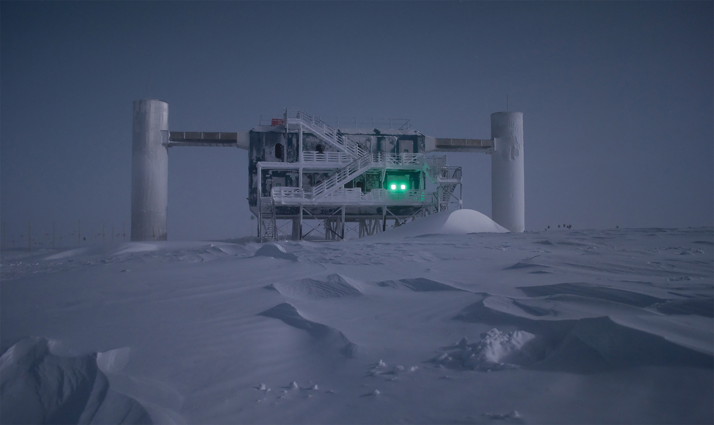
IceCube Neutrino Observatory
J V Mead
20/08/2021
56
Notes:
As we’ve just heard, the IceCube Neutrino Observatory is a giga-tonne particle detector embedded within the Antarctic ice sheet.
Where deepcore increased the instrumentation of icecube in the bottom centre of the detector volume, the upgrade infills further
7 new strings (red) will be installed with an array of sensors, optical modules and calibration devices at a higher density again throughout the centre of deepcore (green) Not only provides improvements to detector performance but our knowledge of the ice/detector for future extensions, able retroactively to existing deepcore datasets

Slide 57
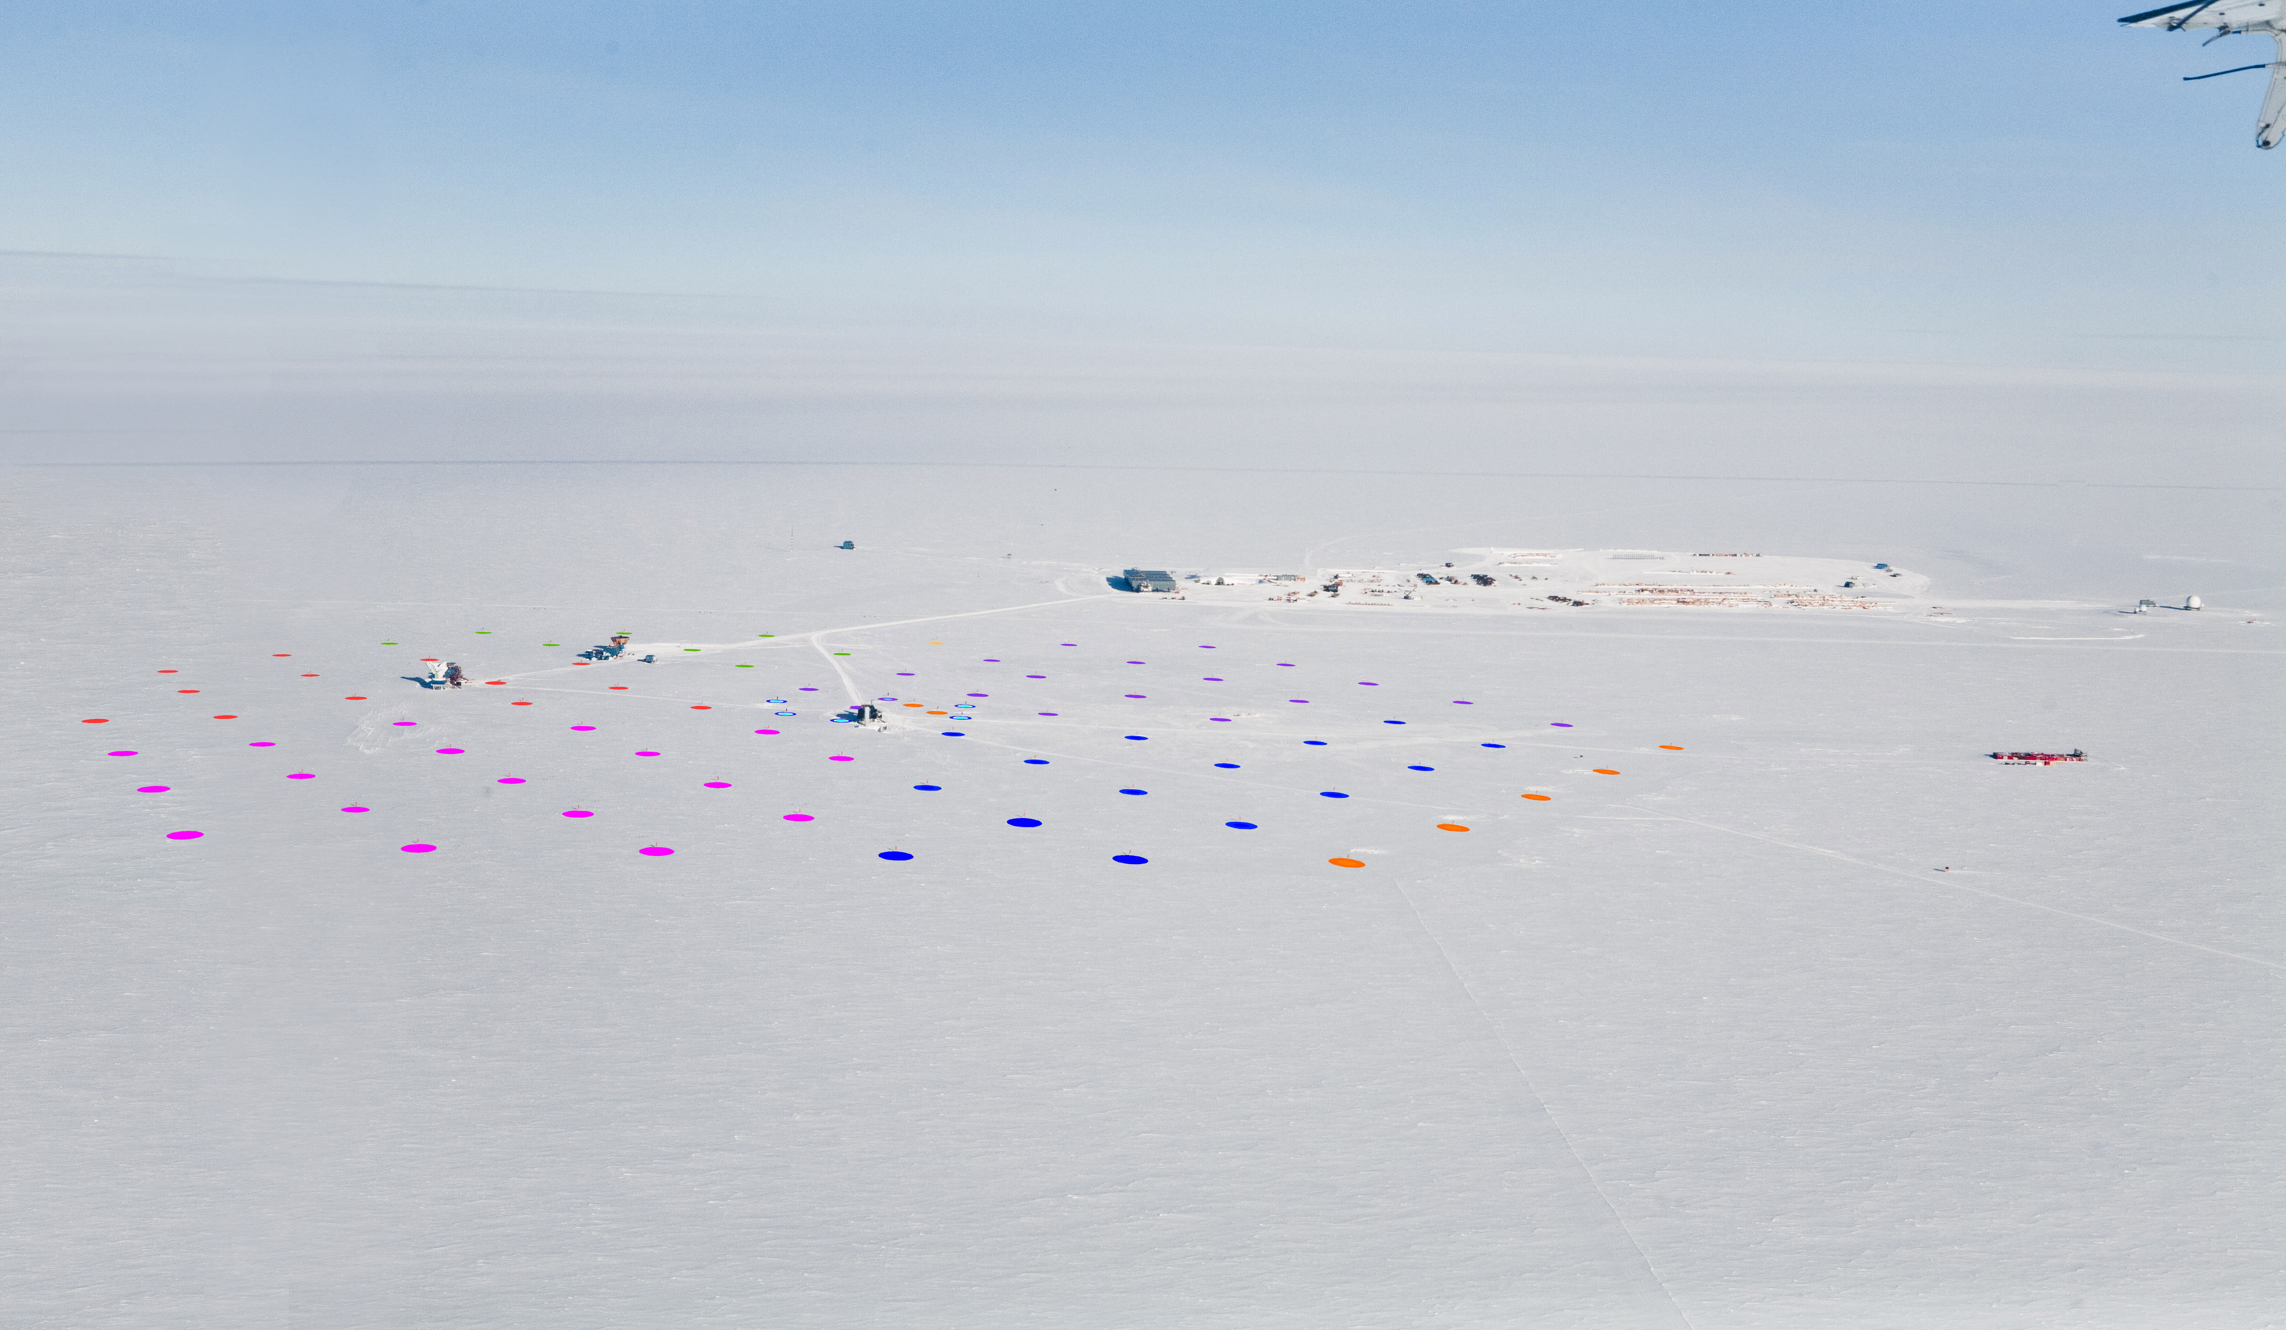
IceCube Neutrino Observatory
J V Mead
20/08/2021
57
Notes:
As we’ve just heard, the IceCube Neutrino Observatory is a giga-tonne particle detector embedded within the Antarctic ice sheet.
Where deepcore increased the instrumentation of icecube in the bottom centre of the detector volume, the upgrade infills further
7 new strings (red) will be installed with an array of sensors, optical modules and calibration devices at a higher density again throughout the centre of deepcore (green) Not only provides improvements to detector performance but our knowledge of the ice/detector for future extensions, able retroactively to existing deepcore datasets

Slide 58
IceCube Neutrino Observatory
J V Mead
20/08/2021
58
Notes:
As we’ve just heard, the IceCube Neutrino Observatory is a giga-tonne particle detector embedded within the Antarctic ice sheet.
Where deepcore increased the instrumentation of icecube in the bottom centre of the detector volume, the upgrade infills further
7 new strings (red) will be installed with an array of sensors, optical modules and calibration devices at a higher density again throughout the centre of deepcore (green) Not only provides improvements to detector performance but our knowledge of the ice/detector for future extensions, able retroactively to existing deepcore datasets

Slide 59
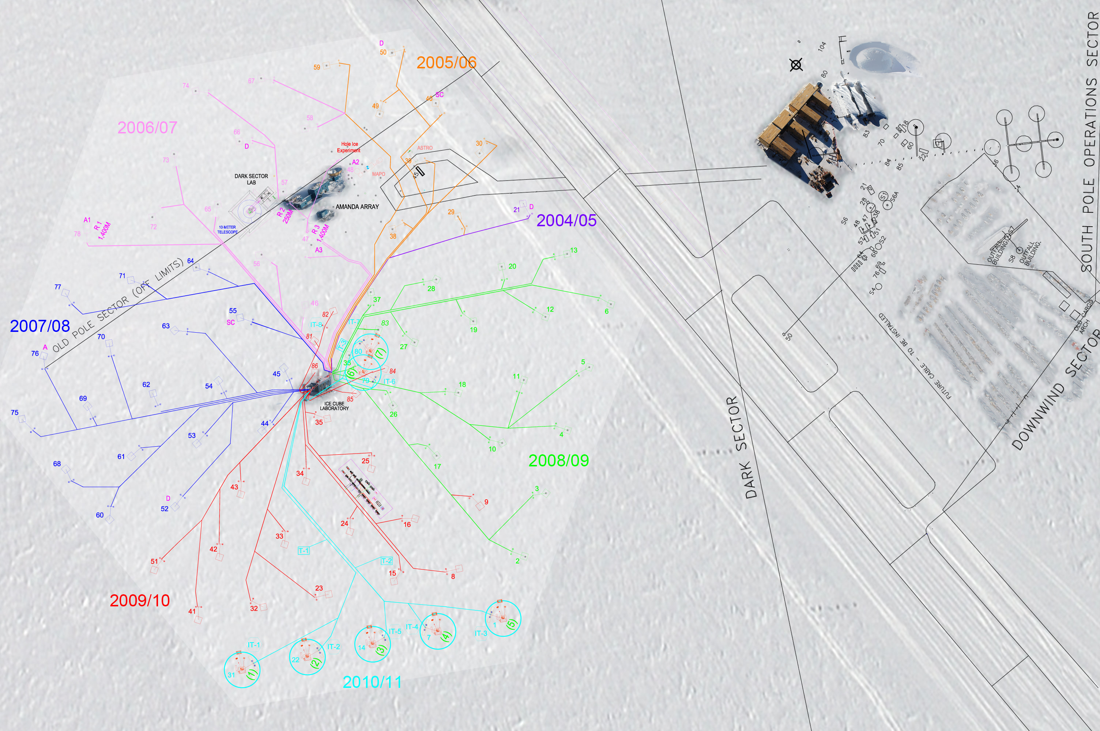
IceCube Neutrino Observatory
J V Mead
20/08/2021
59
Notes:
As we’ve just heard, the IceCube Neutrino Observatory is a giga-tonne particle detector embedded within the Antarctic ice sheet.
Where deepcore increased the instrumentation of icecube in the bottom centre of the detector volume, the upgrade infills further
7 new strings (red) will be installed with an array of sensors, optical modules and calibration devices at a higher density again throughout the centre of deepcore (green) Not only provides improvements to detector performance but our knowledge of the ice/detector for future extensions, able retroactively to existing deepcore datasets

Slide 60
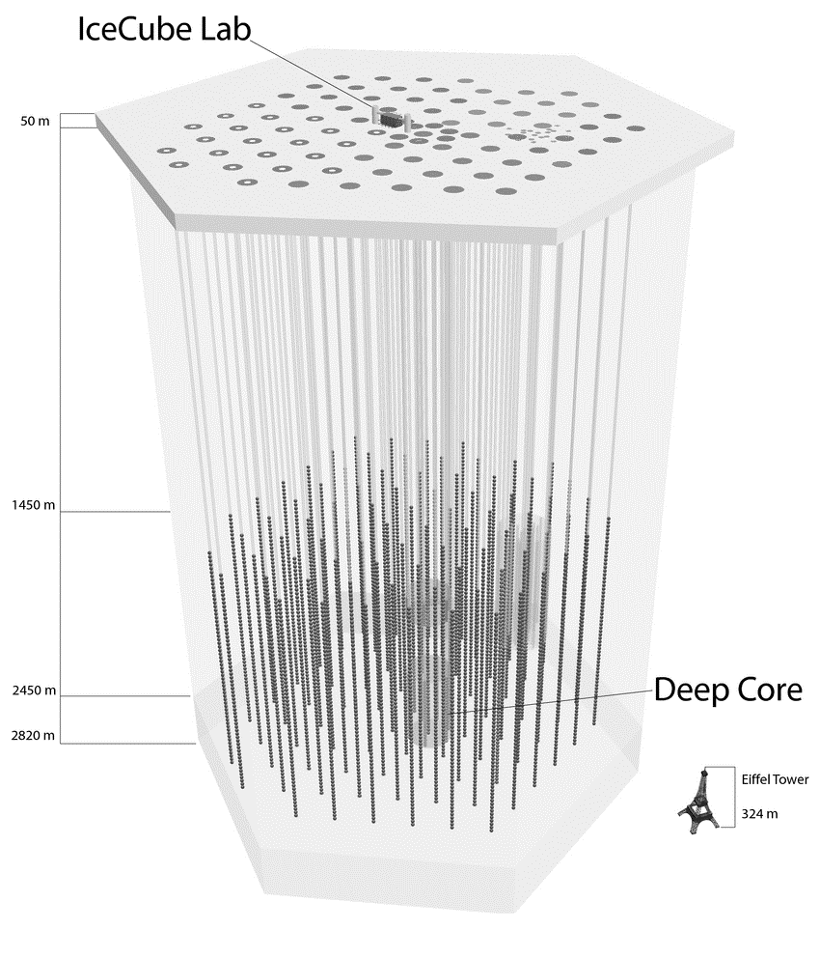
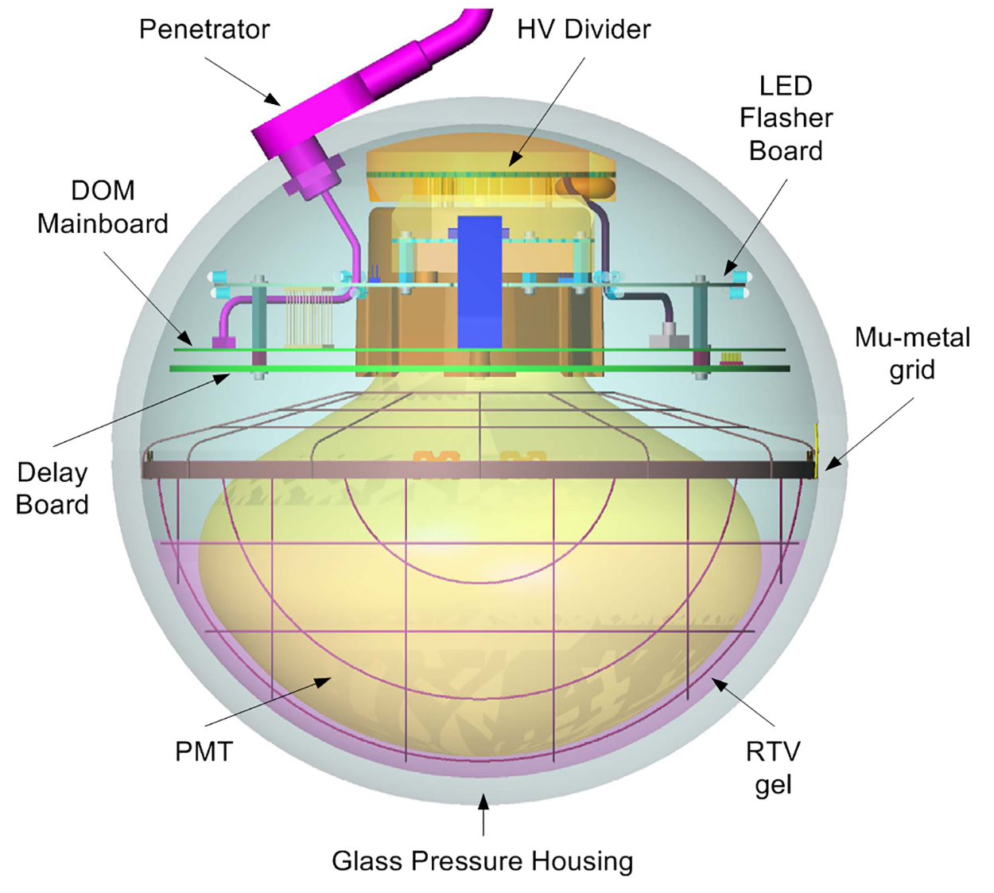
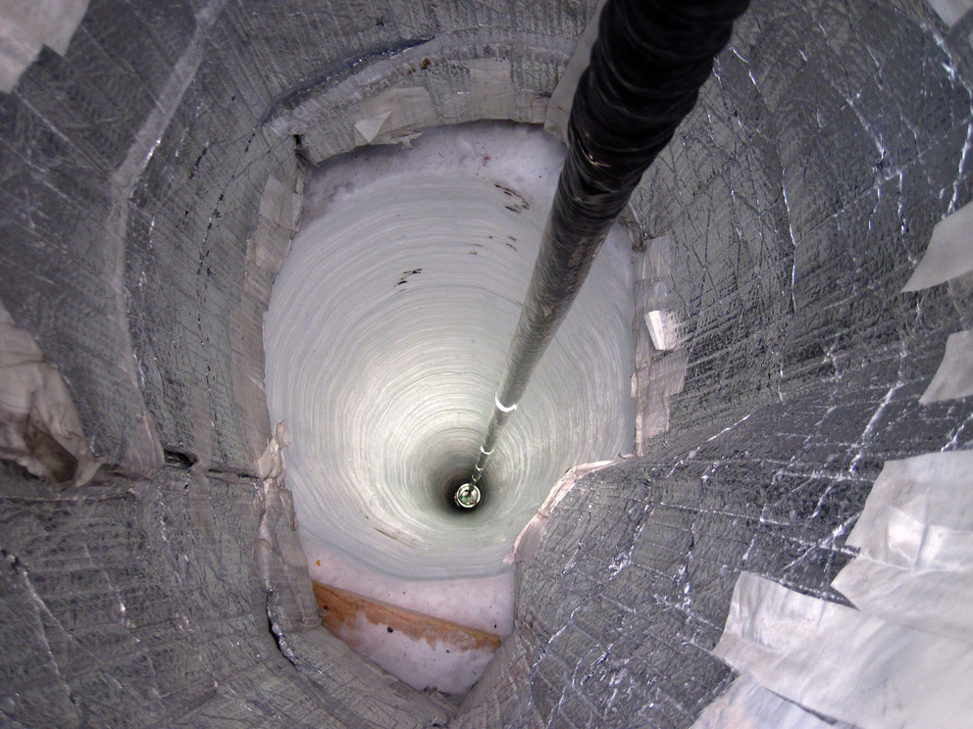
Digital optical module arrays
IceCube detector
$ν$-ice interactions $→$ relativistic charged particles
Superluminal products emit Cherenkov photons
Instrumentation
5160 sensors embedded within 1 km³ of glacial ice
Low-energy dark matter array at 5x density, DeepCore
[arXiv:1908.09441]
[arXiv:1204.4219]
J V Mead
20/08/2021
60
Notes:
As we’ve just heard, the IceCube Neutrino Observatory is a giga-tonne particle detector embedded within the Antarctic ice sheet.
Where deepcore increased the instrumentation of icecube in the bottom centre of the detector volume, the upgrade infills further
7 new strings (red) will be installed with an array of sensors, optical modules and calibration devices at a higher density again throughout the centre of deepcore (green) Not only provides improvements to detector performance but our knowledge of the ice/detector for future extensions, able retroactively to existing deepcore datasets
Upgrade installation (2022-2023)
7 columns of improved sensors at 10x density
Extending low energy range & building upon calibration tools

Slide 61
Low-energy extension
IceCube detector
$ν$-ice interactions $→$ relativistic charged particles
Superluminal products emit Cherenkov photons
Instrumentation
5160 sensors embedded within 1 km³ of glacial ice
Low-energy dark matter array at 5x density, DeepCore
Upgrade (installation 2023-2025)
7 columns of improved sensors at 10x density
Extending low energy range & building upon calibration tools
Gen-2 (operational 2033)
10km³ instrumented volume for huge boost in statistics
New surface radio array for Askaryan photons
[arXiv:1908.09441]
[arXiv:1204.4219]
J V Mead
20/08/2021
61
Notes:
As we’ve just heard, the IceCube Neutrino Observatory is a giga-tonne particle detector embedded within the Antarctic ice sheet.
Where deepcore increased the instrumentation of icecube in the bottom centre of the detector volume, the upgrade infills further
7 new strings (red) will be installed with an array of sensors, optical modules and calibration devices at a higher density again throughout the centre of deepcore (green) Not only provides improvements to detector performance but our knowledge of the ice/detector for future extensions, able retroactively to existing deepcore datasets

Slide 62
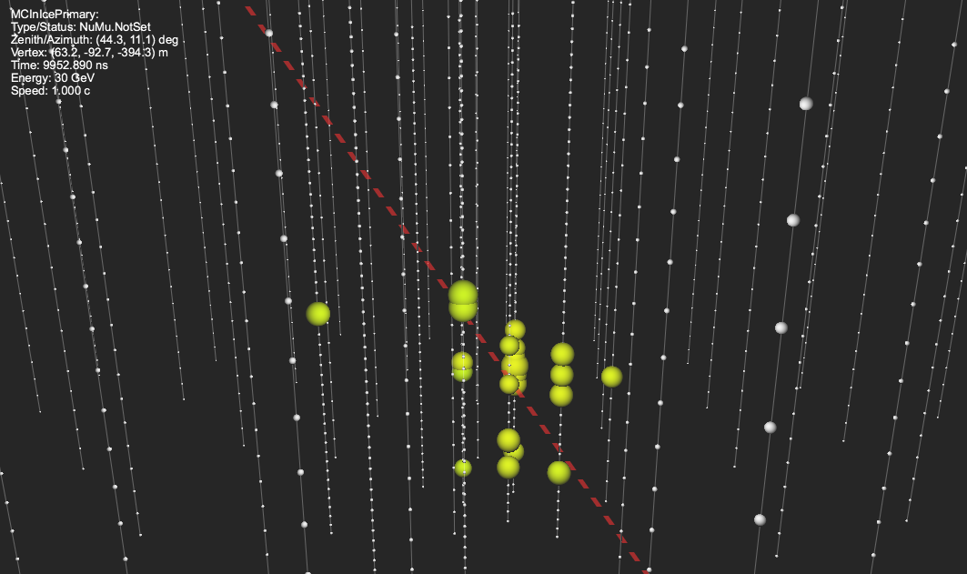
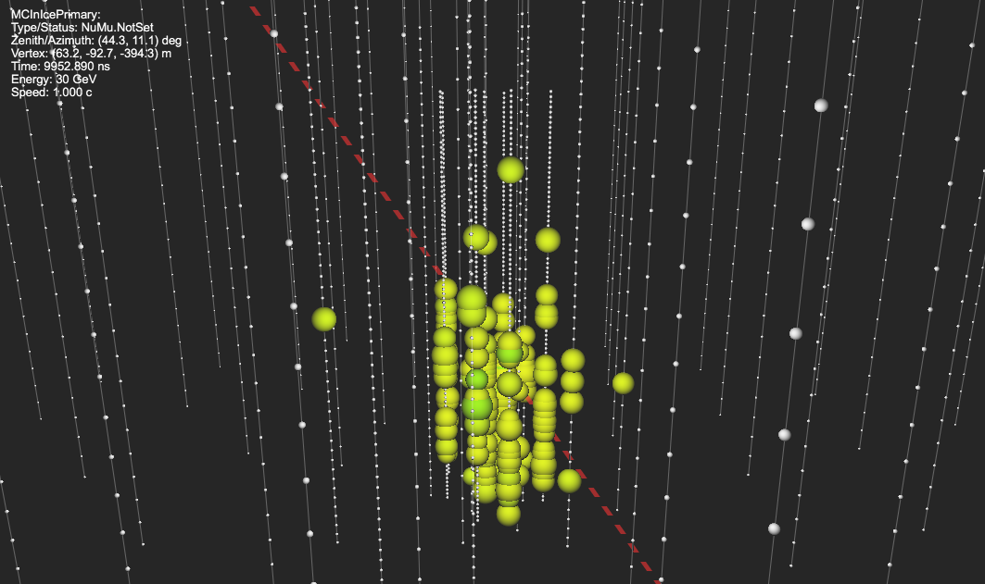
DeepCore event energy
DeepCore
Upgrade
The same simulated 30 GeV $ν_{μ}→μ$-track as viewed by each setup
J V Mead
20/08/2021
62
Notes:
Comparing detector response in the DeepCore region using simulation of identical muon tracks with and without the upgrade installed and within DeepCore’s optimal energy range

Slide 63
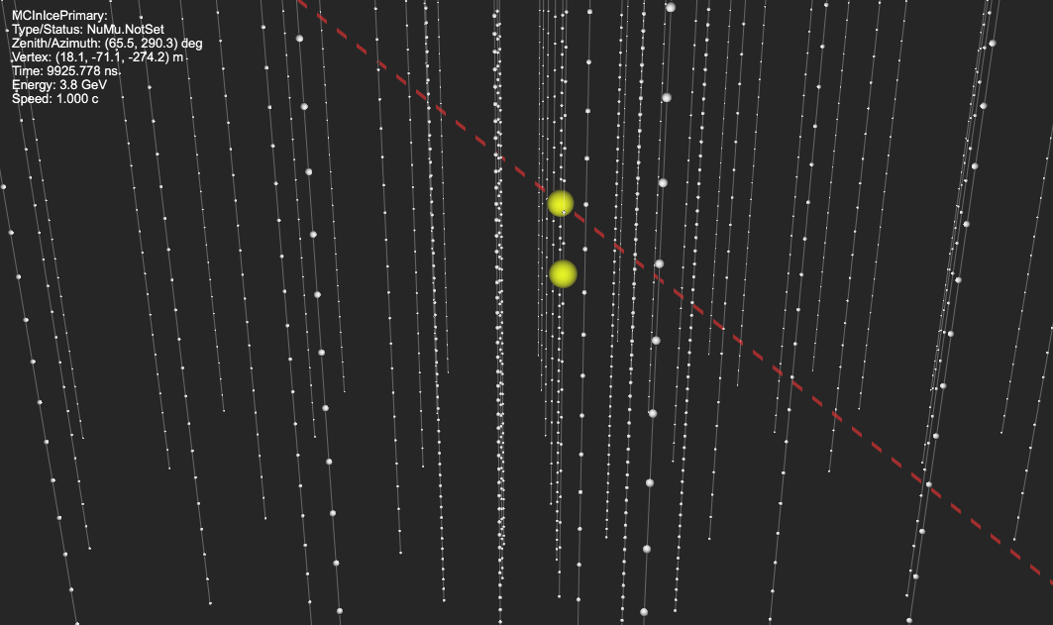
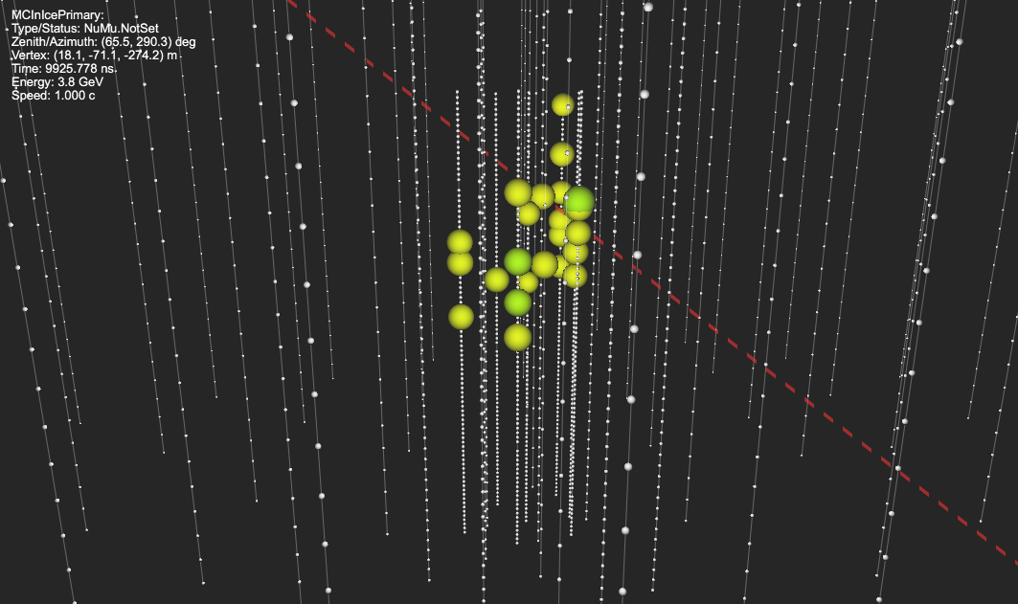
Upgrade event energy
DeepCore
Upgrade
The same simulated 3.8 GeV $ν_{μ}$ $→μ$-track as viewed by each setup
J V Mead
20/08/2021
63
Notes:
Comparing detector response in the DeepCore region using simulation of identical muon tracks with and without the upgrade installed and below DeepCore’s energy range
But why is low energy so important?

Slide 64
$ν$-oscillations at IceCube
Neutrino oscillations
Three flavours $ν_{e,μ,τ}$ $↔$ Three mass states $ν_{1,2,3}$
Propagate as flavour superpositions $⇒Δm_{ij}≠0$
Oscillations between flavours $⇒m{\left(ν\right)}_{1,2,3}≠0$
$P$(Transition) $∝f(L/E)$
Upgoing atmospheric muon neutrinos
Abundant & high-$E$ source:
Accesses oscillations with $Q^{2}$ for transition into $ν_{τ}$
Maximum ~13,000km baseline, $L$, as $f(θ_{Z})$:
Near maximal ($ν_{μ}→ν_{τ}$) oscillations for 𝛰(10 GeV)
DeepCore optimised for ~25 GeV, sensitive > 5 GeV:
Upgrade sensitivity designed for 𝛰(1 GeV)
electron neutrino
muon neutrino
tau neutrino
$$/$$
$cos\left(θ_{Z}\right)=$ -1
[icecube.wisc.edu]
J V Mead
20/08/2021
64
Notes:
So what do I mean by appearance and disappearance?
In the SM, we have 3 neutrinos corresponding to their namesake charged lepton counterparts, able to oscillate as a superpositon of flavours as they propagate
Their transition probablities depend on the differences between mass states, the neutrino energy, the distance travelled and the matter density of the medium
We only have upper limits on their tiny masses along with their squared mass differences coming from oscillations experiments
For oscillations, Icecube detects atmospheric neutrinos whereby Cosmic rays incident on the atmosphere result in high energy interactions producing showers containing muon neutrinos these are able to pass through the planet and up through the ice. over these distances, they exhibit flavour oscillations, where ‘missing’ muons and the observation of tau decays imply nu_mu disappearance (to nu_e,tau) and nu_tau appearance (from nu_mu)
The high energy of cosmics relative to beam experiments results in reduced suppression from the large tau mass produced in CC interactions from the tau state making icecube uniquely sensitive to nu_tau appareance

Slide 65
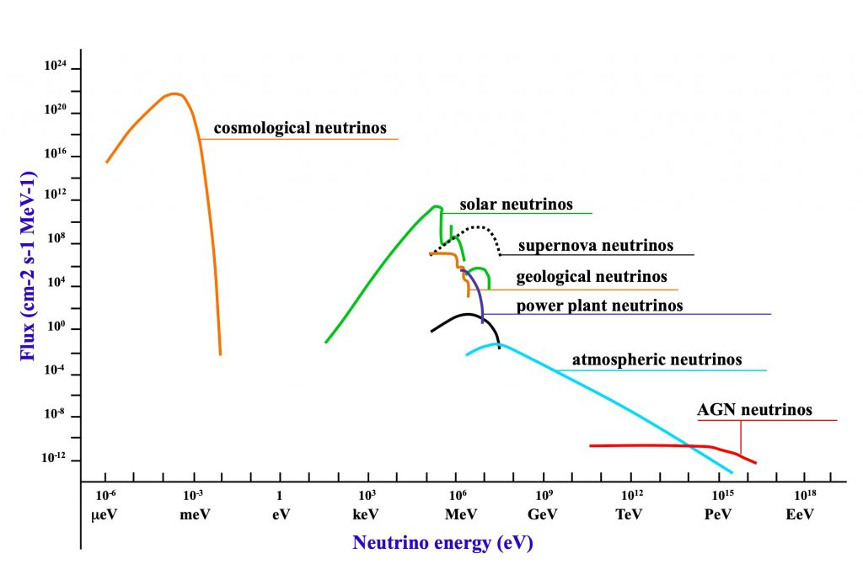
Long-baseline experiments
T2K
NOvA
MINOS
Gen-2 10GT
IceCube 1GT
DeepCore 10MT
Upgrade 10MT
Super-K 50kT
J V Mead
20/08/2021
65
Notes:
We’ll be focussing on the atmospheric oscillogram shown at truth level on the left (where zenith scans over different baselines and the bands are dependant on sine terms containing L/E Higher order region is accessed by super-K but it cannot resolve the individual bands, NOvA & T2K
Tests of unitarity and non-standard interactions become more tantalising following LHCb lepton flavour non-universality and muon g-2 anomalous magnetic moment results
IceCube’s tau sensitivity is key to constraining the nu_tau elements in the relevant matrices
If we extend our sensitivity range down to include the upgrade…

Slide 66
High-energy extension
IceCube detector
$ν$-ice interactions $→$ relativistic charged particles
Superluminal products emit Cherenkov photons
Instrumentation
5160 sensors embedded within 1 km³ of glacial ice
Low-energy dark matter array at 5x density, DeepCore
Upgrade (installation 2023-2025)
7 columns of improved sensors at 10x density
Extending low energy range & building upon calibration tools
Gen-2 (operational 2033)
10km³ instrumented volume for huge boost in statistics
New surface radio array for Askaryan photons
Detection
66
Notes:
As we’ve just heard, the IceCube Neutrino Observatory is a giga-tonne particle detector embedded within the Antarctic ice sheet.
Where deepcore increased the instrumentation of icecube in the bottom centre of the detector volume, the upgrade infills further
7 new strings (red) will be installed with an array of sensors, optical modules and calibration devices at a higher density again throughout the centre of deepcore (green) Not only provides improvements to detector performance but our knowledge of the ice/detector for future extensions, able retroactively to existing deepcore datasets

Slide 67
UH-energy extension
IceCube detector
$ν$-ice interactions $→$ relativistic charged particles
Superluminal products emit Cherenkov photons
Instrumentation
5160 sensors embedded within 1 km³ of glacial ice
Low-energy dark matter array at 5x density, DeepCore
Upgrade (installation 2023-2025)
7 columns of improved sensors at 10x density
Extending low energy range & building upon calibration tools
Gen-2 (operational 2033)
10km³ instrumented volume for huge boost in statistics
New surface radio array for Askaryan photons
IceCube
IceTop
Gen-2 radio
DeepCore
Gen-2 optical
Detection
67
Notes:
As we’ve just heard, the IceCube Neutrino Observatory is a giga-tonne particle detector embedded within the Antarctic ice sheet.
Where deepcore increased the instrumentation of icecube in the bottom centre of the detector volume, the upgrade infills further
7 new strings (red) will be installed with an array of sensors, optical modules and calibration devices at a higher density again throughout the centre of deepcore (green) Not only provides improvements to detector performance but our knowledge of the ice/detector for future extensions, able retroactively to existing deepcore datasets

