Slide 1
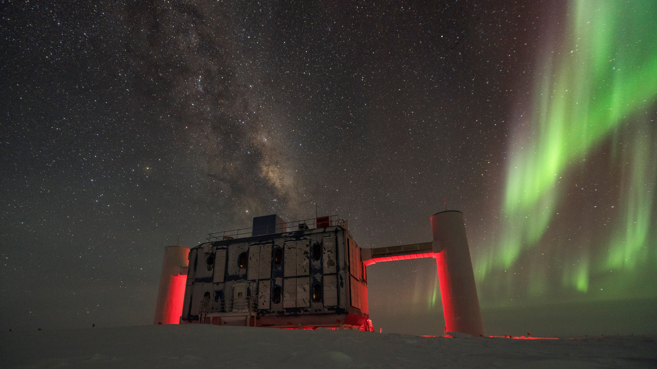
IceCube: Inside a neutrino Detector
The IceCube Laboratory (ICL)
Image credit: Martin Wolf / NSF

Slide 2
Detecting Neutrinos
Neutrinos are famously hard to catch

Slide 3
Detecting Neutrinos
There are two types of interactions with IceCube neutrinos:
“Track” interactions
Muon-neutrino

Slide 4
Detecting Neutrinos
There are two types of interactions with IceCube neutrinos:
“Track” interactions

Slide 5
Detecting Neutrinos
There are two types of interactions with IceCube neutrinos:
“Track” interactions
Muon + light

Slide 6
Detecting Neutrinos
There are two types of interactions with IceCube neutrinos:
“Track” interactions
“Cascade” interactions
Nucleon
(made up of quarks)

Slide 7
Detecting Neutrinos
There are two types of interactions with IceCube neutrinos:
“Track” interactions
“Cascade” interactions
Nucleon
(made up of quarks)

Slide 8
Detecting Neutrinos
There are two types of interactions with IceCube neutrinos:
“Track” interactions
“Cascade” interactions
$$π^{−}$$
$$π^{+}$$
Quarks fragmenting into Unstable particles (through the magic of the strong interaction)
$$π^{0}$$

Slide 9
Detecting Neutrinos
There are two types of interactions with IceCube neutrinos:
“Charged current” interactions
“Neutral current” interactions
Unstable particles decay and produce secondary particles and a lot of light

Slide 10
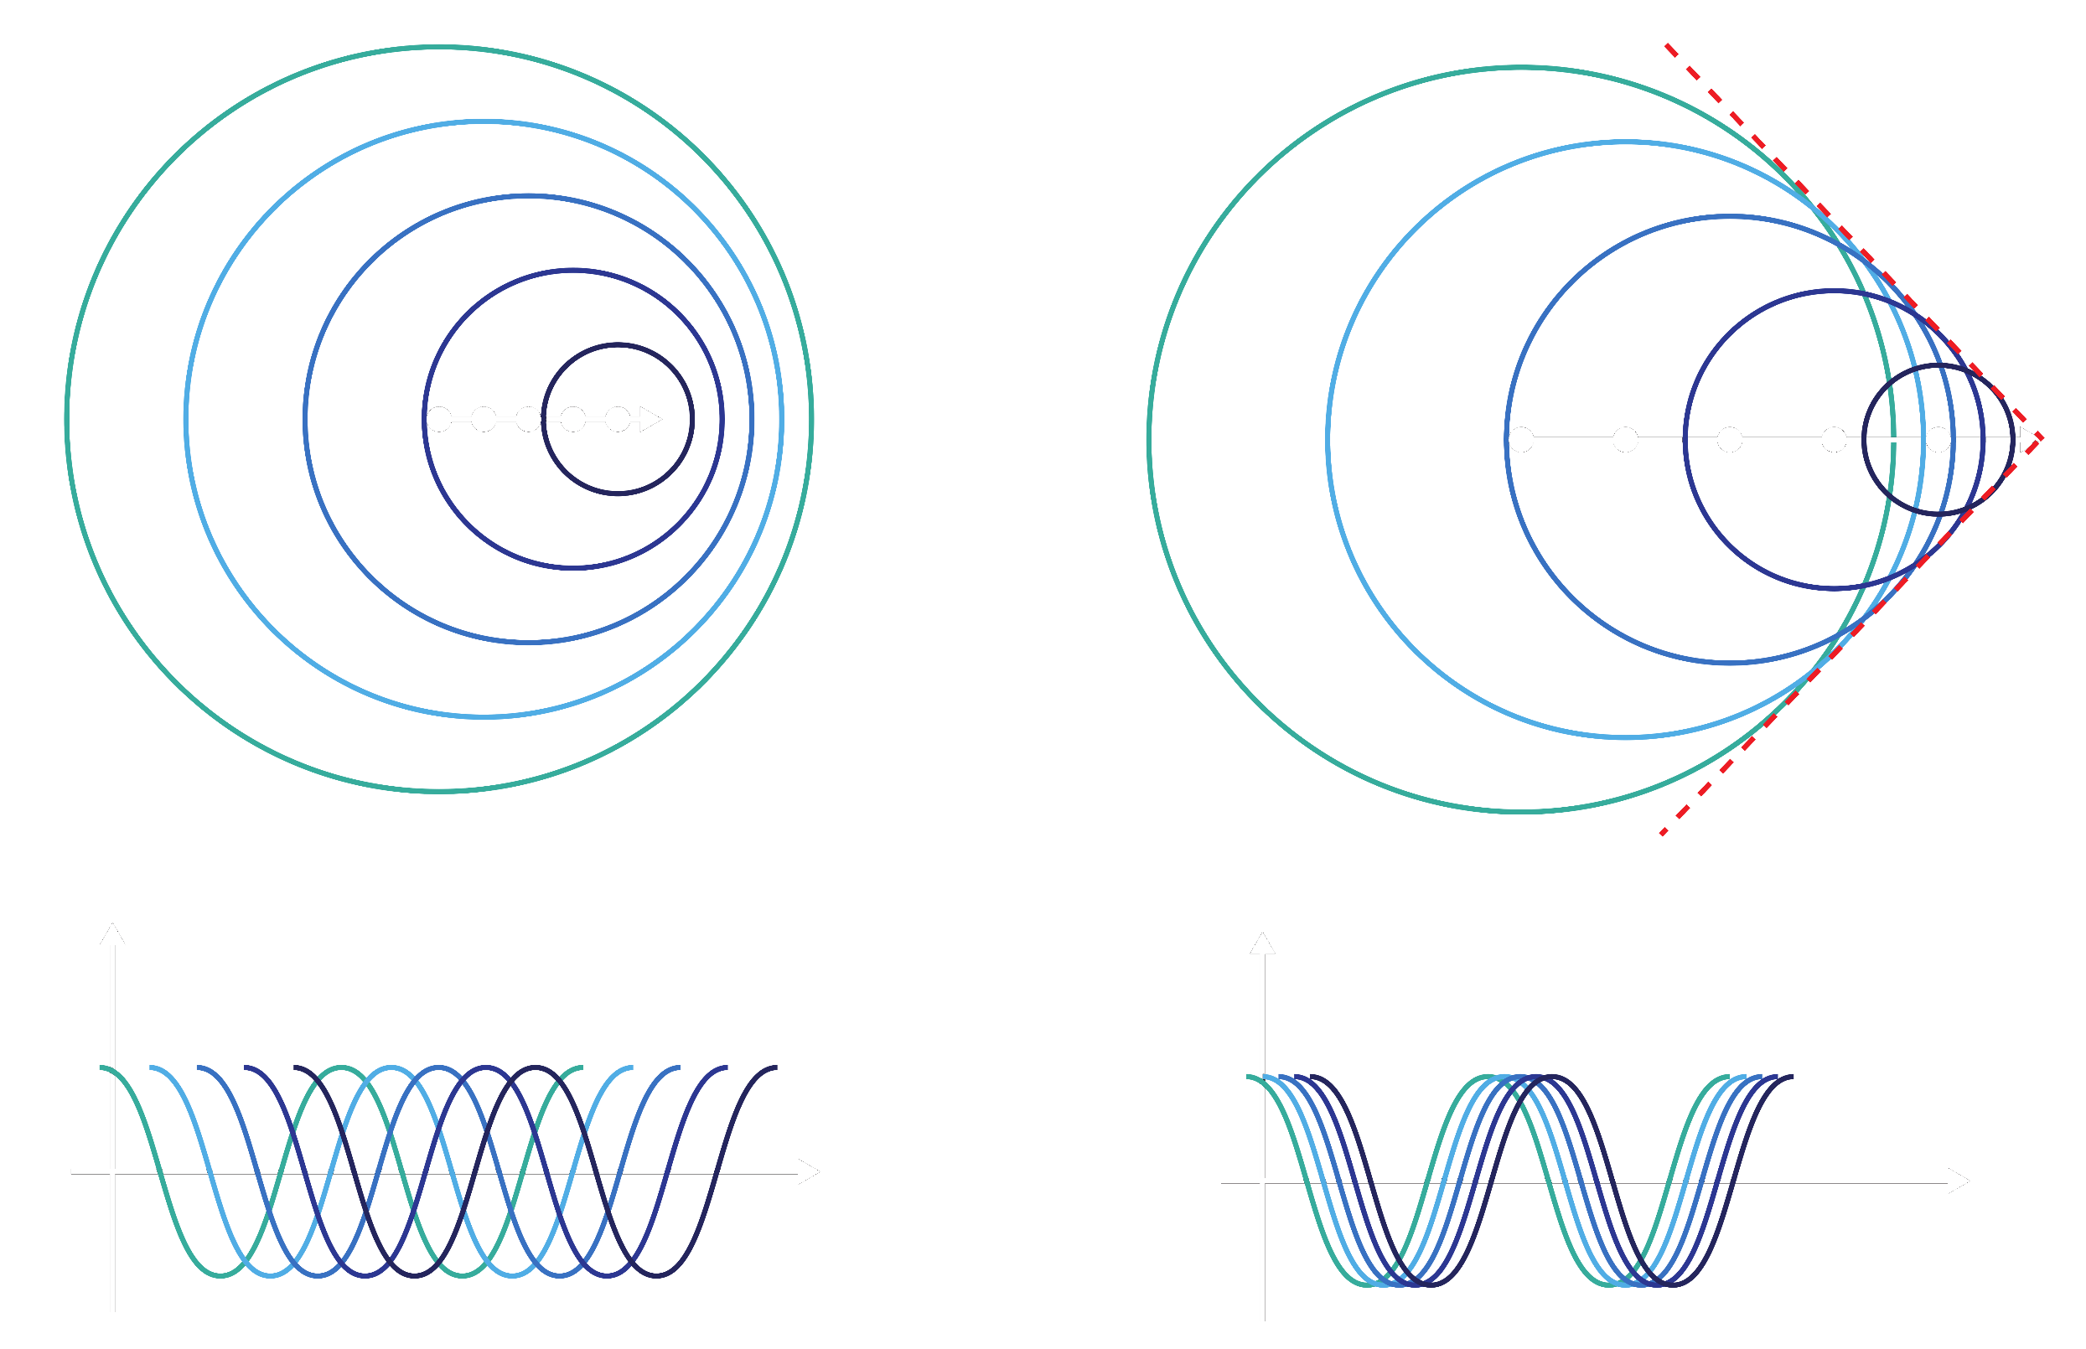
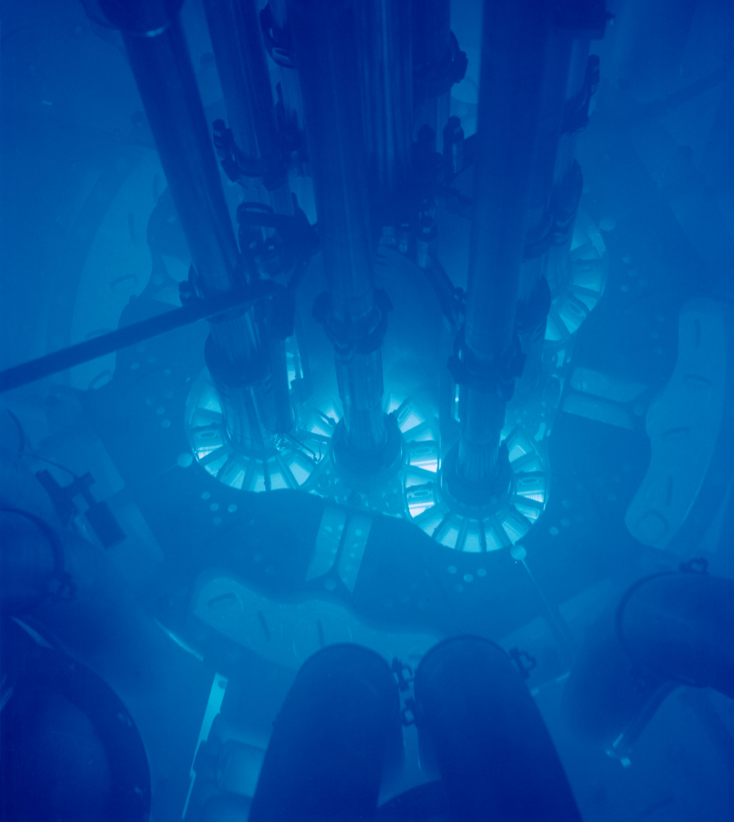
The key to detecting neutrinos: Light
IceCube is able to detect neutrino because these interactions produce light
The light produced comes from Cherenkov radiation

Slide 11
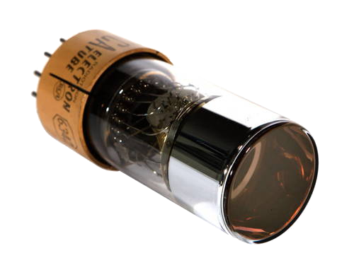
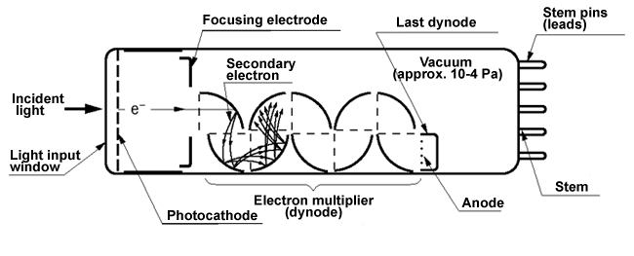
The key to detecting neutrinos: Light
Very brief and dim Cherenkov light is detected using photomultiplier tube
Convert 1 photon into [100-1 million] electrons

Slide 12
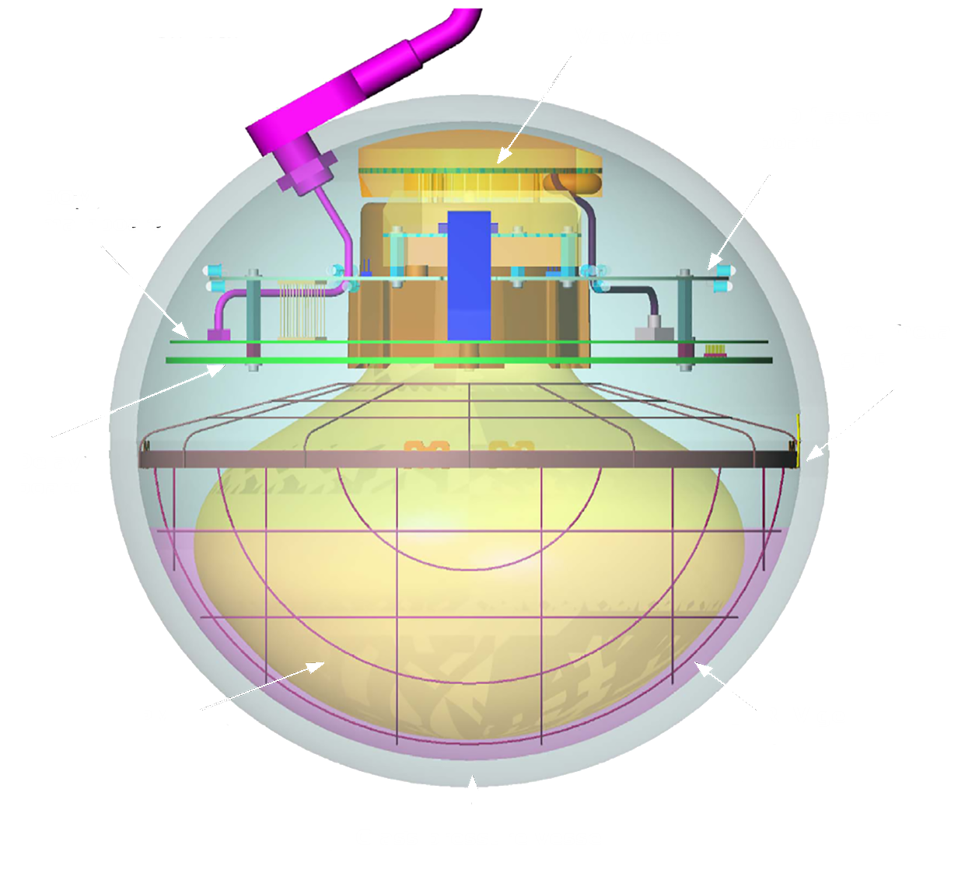
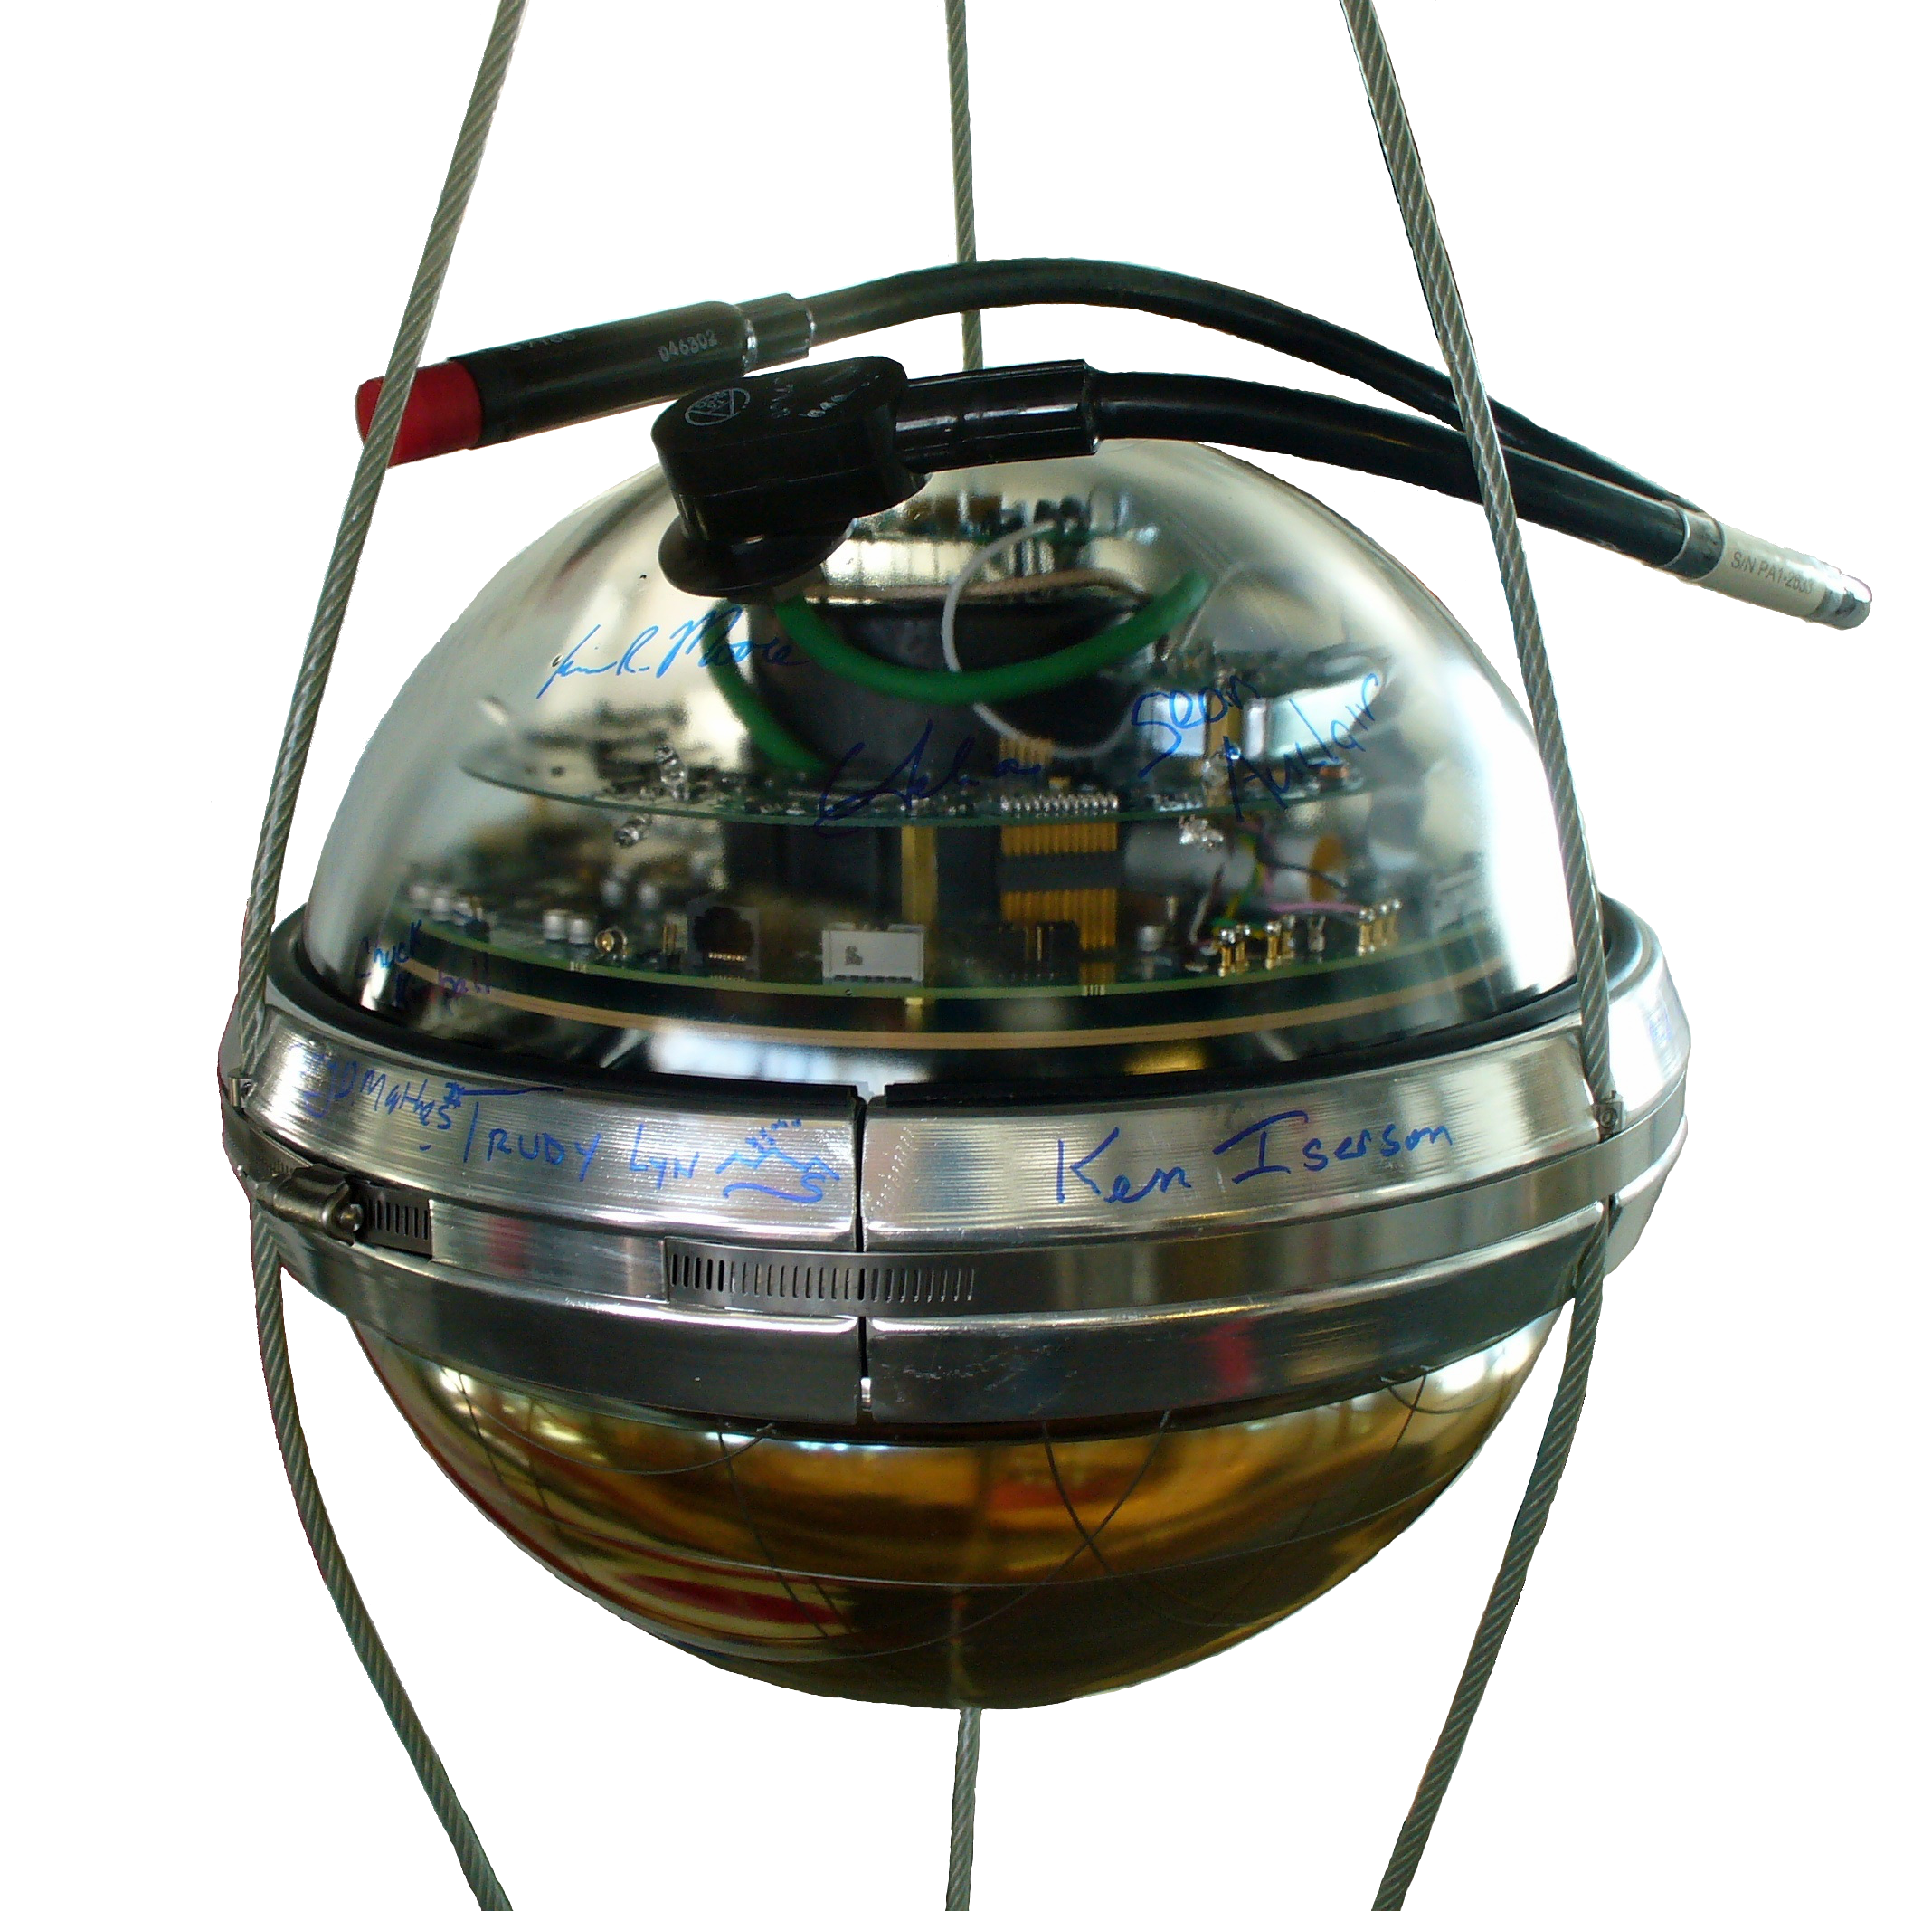
The IceCube Digital Optical Module (DOM)

Slide 13
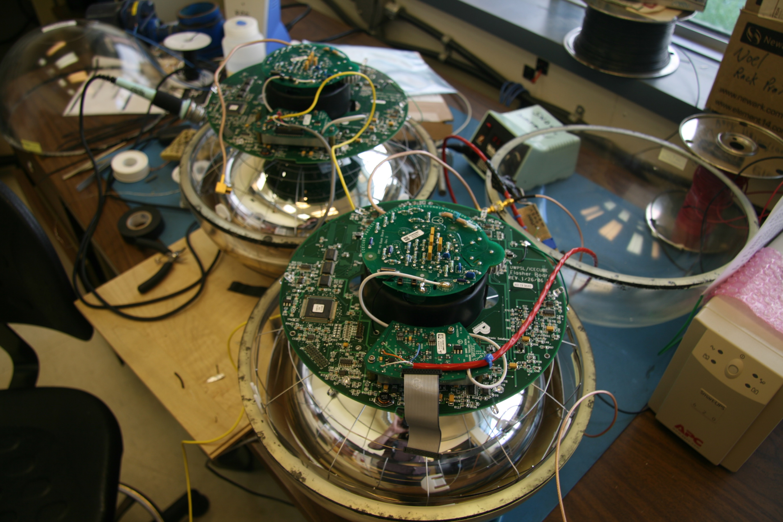
InSide the IceCube DOM

Slide 14
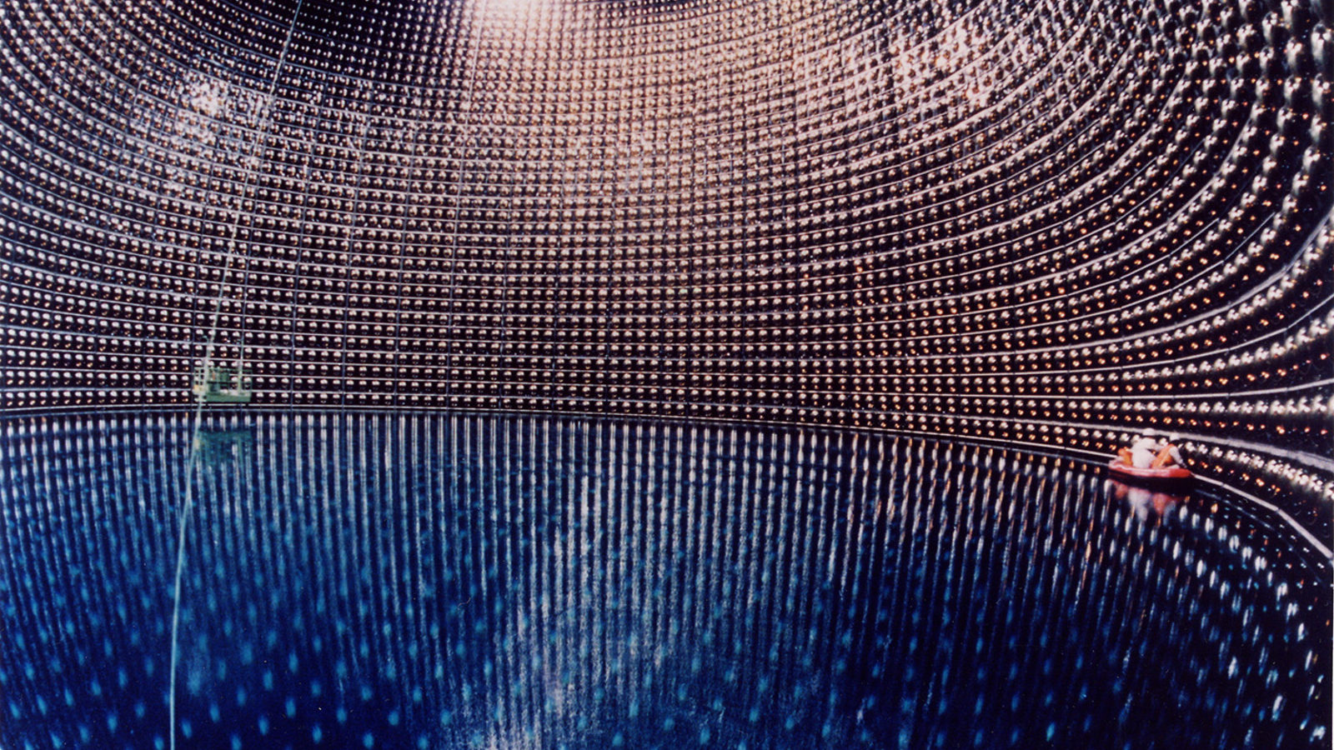
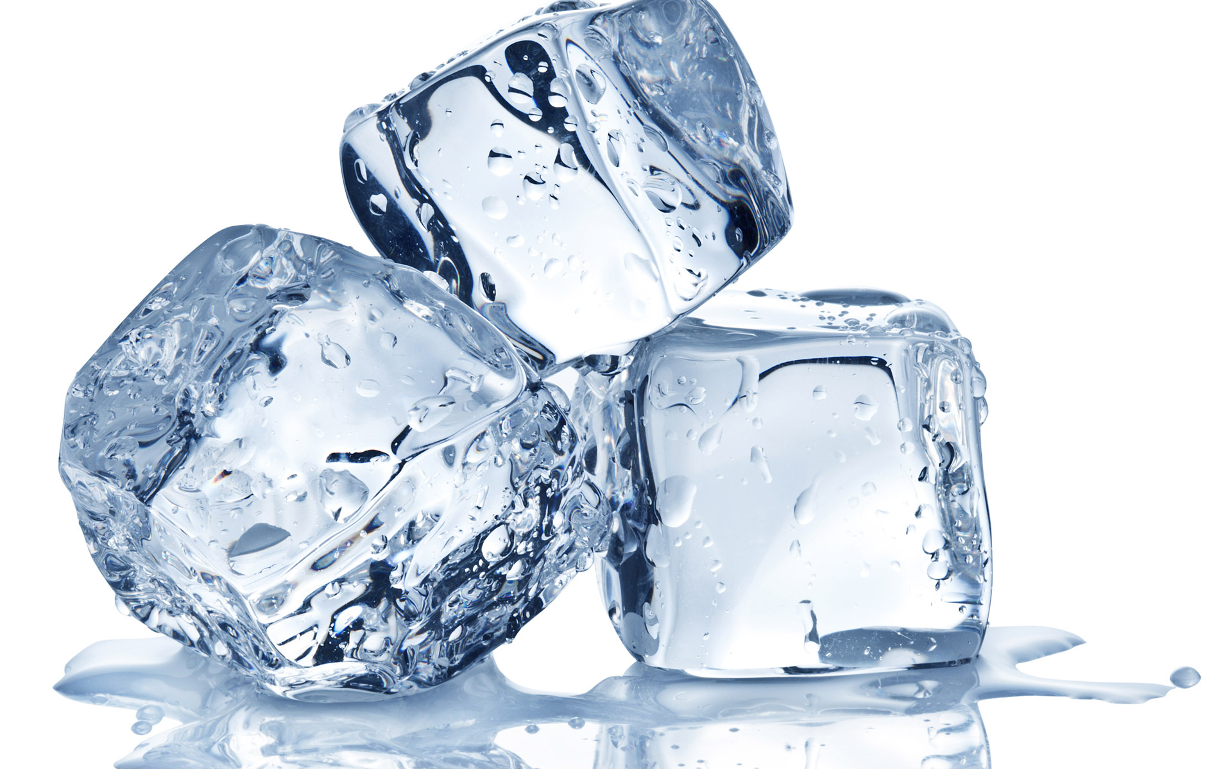
Cherenkov-light Neutrino detectors
You need a transparent medium to detect Cherenkov light
You need a big volume to detect high-energy neutrinos
OR
Ice!
Water
(Super-kamiokande in Japan)

Slide 15
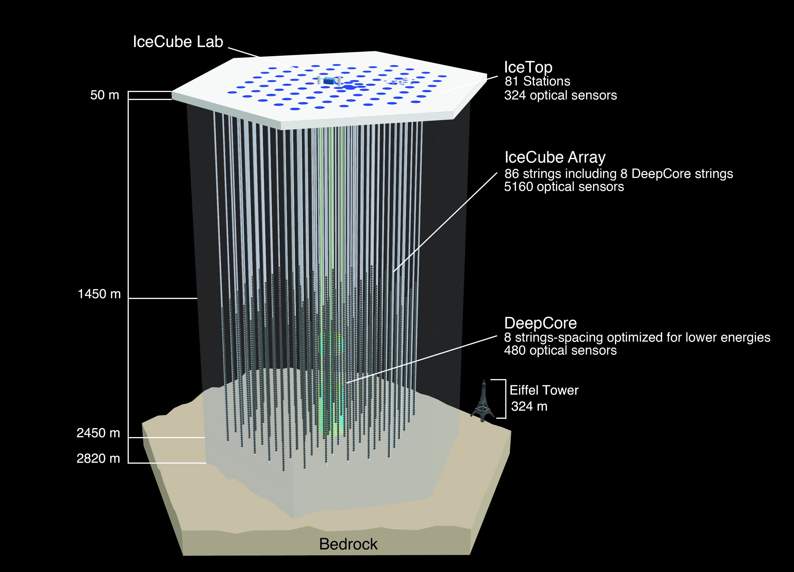
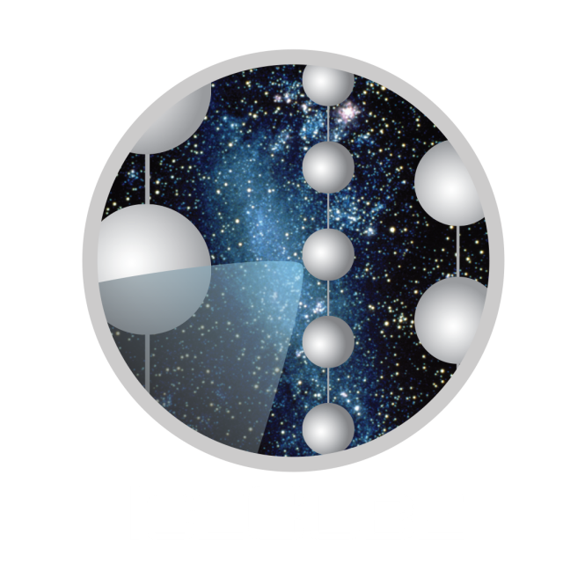
The IceCube Neutrino Telescope
Goal: Detect high-energy neutrinos from outer space

Slide 16
Finding neutrino signals in ice

Slide 17
Finding neutrino signals in ice

Slide 18
Finding neutrino signals in ice

Slide 19
Finding neutrino signals in ice

Slide 20
Finding neutrino signals in ice

Slide 21
Finding neutrino signals in ice

Slide 22
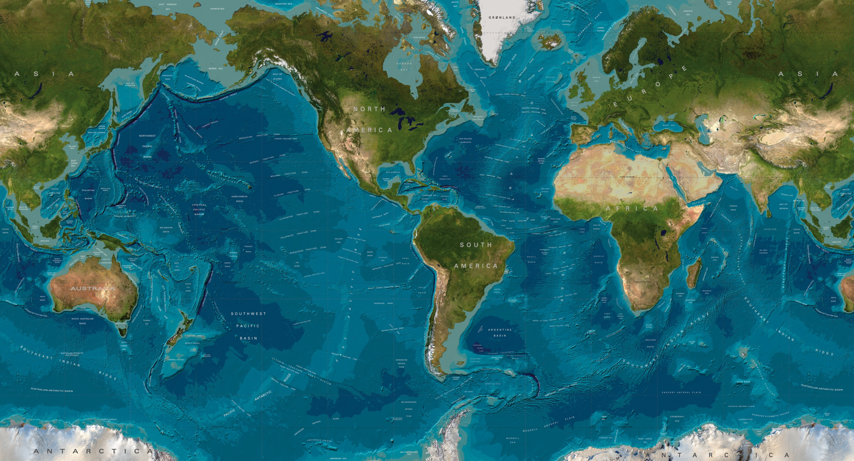
How to get to the South Pole?

Slide 23
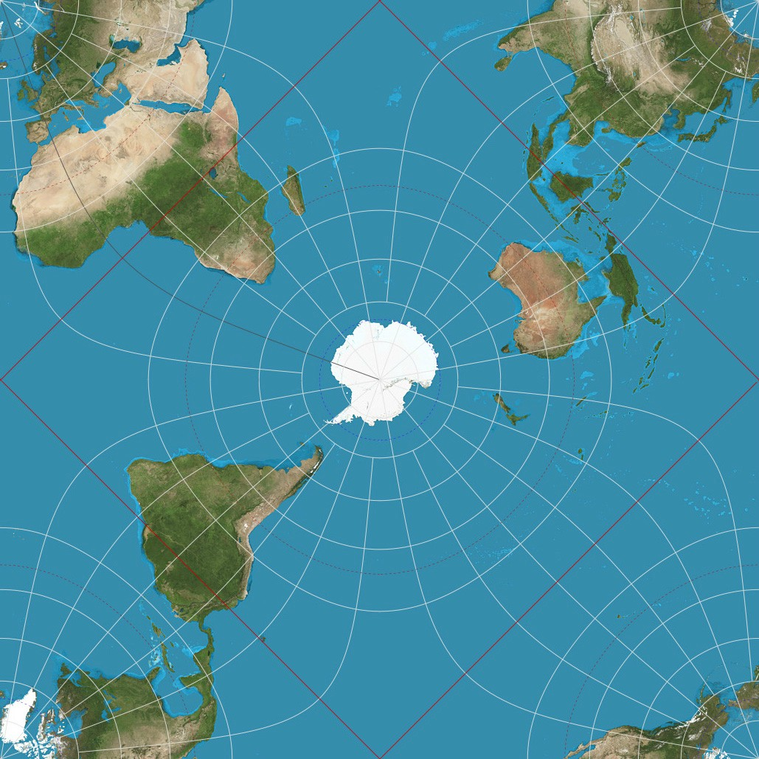
How to get to the South Pole?
Start by changing your map projection
(and your world view)

Slide 24
How to get to the South Pole?
Step 1: Fly to New Zealand
(and get your gear)

Slide 25
How to get to the South Pole?
Step 2: Fly to McMurdo research station

Slide 26
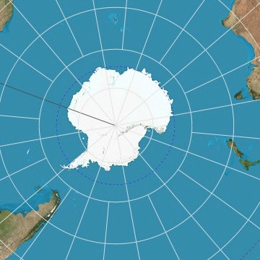
How to get to the South Pole?
Step 2: Fly to the Amundsen-Scott South Pole Station

Slide 27
Building IceCube

Slide 28
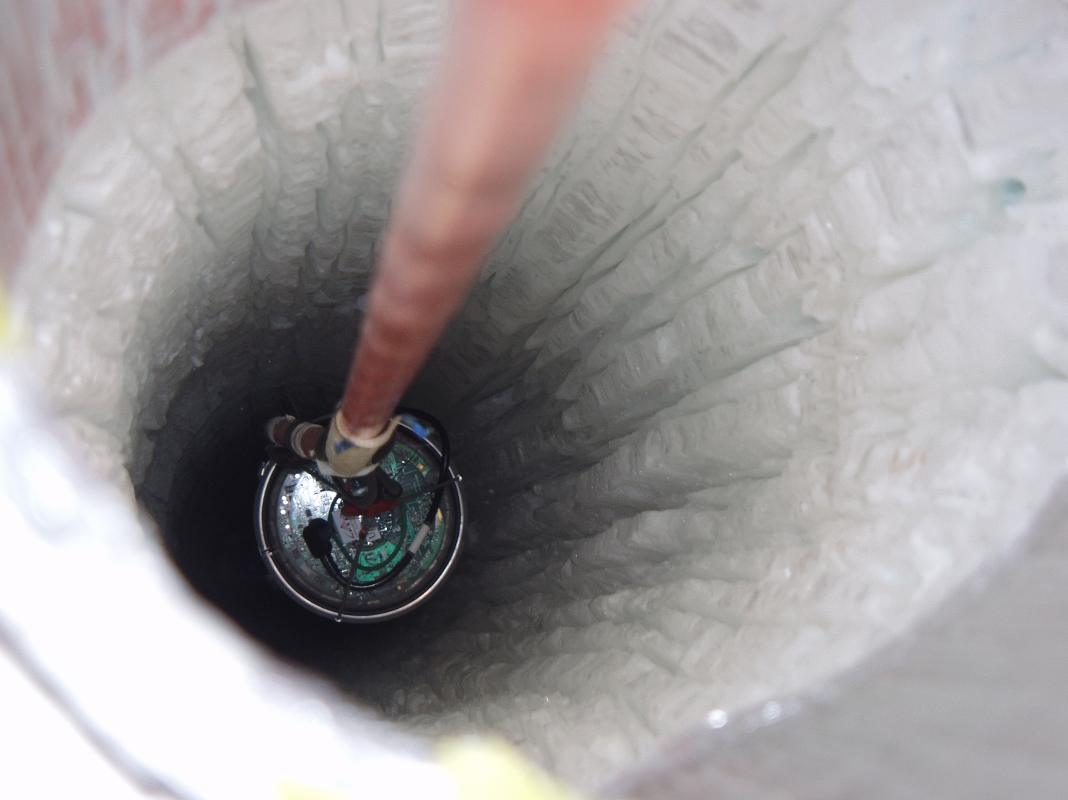
Building IceCube

Slide 30
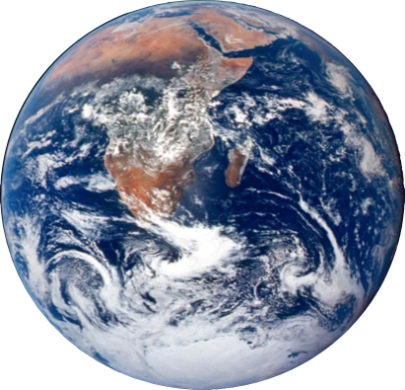
Distinguishing signal from background
νe
ν$μ$
ν$μ$
Cosmic ray
$$μ$$
ν$μ$
A lot of particles can end up inside IceCube
ν$astrophysical$

Slide 31
Distinguishing signal from background
νμ Astrophysical
Penetrating
Muons
(μ)
μ
Trigger Level
10⁶:1
μ
νμ
Atmospheric
Notes:
-Reason why detectors are deep
-Identify and remove penetrating muons

Slide 32
How can we distinguish neutrino from background????
Our first exercice…

