Slide 1
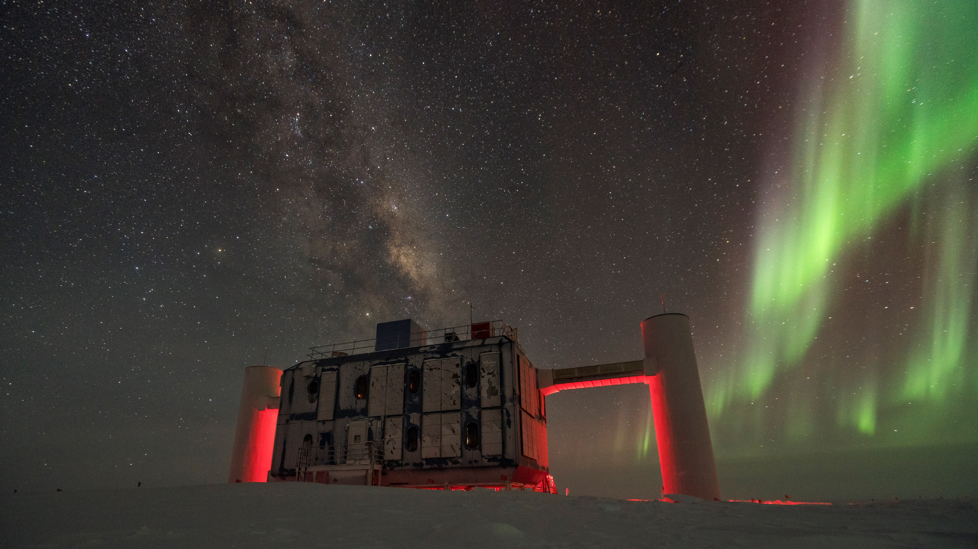

Velkommen

Slide 2





IceCube Masterclass 2022
Niels Bohr Institute
06/04/2022

Slide 3

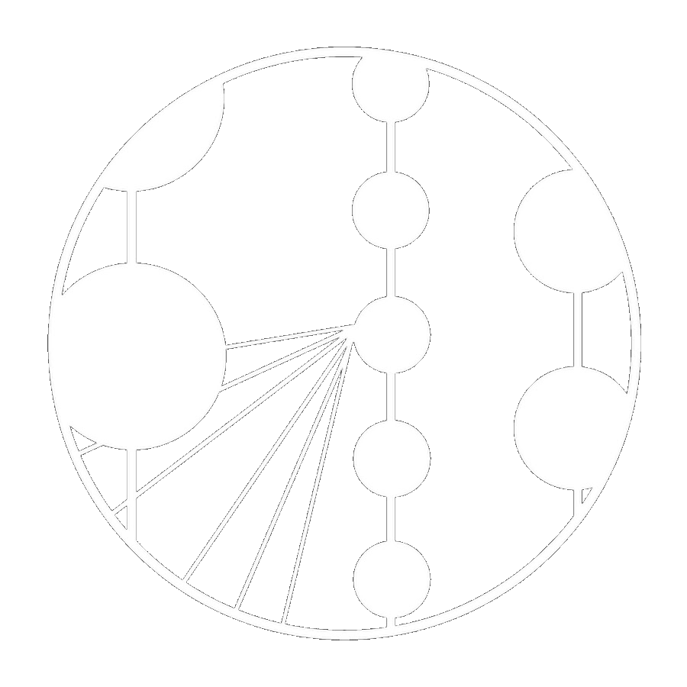
Formalities
9:00 - 9:15 Aud A | Welcome
9:15 - 9:45 Aud A | Introduction to neutrino physics James Mead
9:45 - 10:15 Aud A | The IceCube Experiment James Mead
10:15 - 11:15 Aud A | Workshop 1: Finding neutrinos in IceCube data James Mead
11:15 - 11:30 BK2 | Break
11:30 - 12:30 Aud A | Workshop 1: Finding neutrinos in IceCube data (continued)
12:30 - 13:30 BK2 | Lunch
13:30 - 14:00 Aud A | Introduction to neutrino astronomy Victor Valera and Ersilia Guarini
14:00 - 16:00 Aud A | Workshop 2: Finding neutrino sources with IceCube Tania Kozynets
16:00 - 16:15 BK2 | Break
16:15 - 16:45 Aud A | Life at the pole Morten Medici
16:45 - 17:00 Aud A | Q&A / Farewell
WIFI: ‘KU Guest’
Water fountain directly outside
Toilets downstairs one floor
Breaks & lunch provided in BK2
GDPR form
Feedback forms
Certificates of attendance
Group photo
06/04/2022
NBI
3

Slide 4
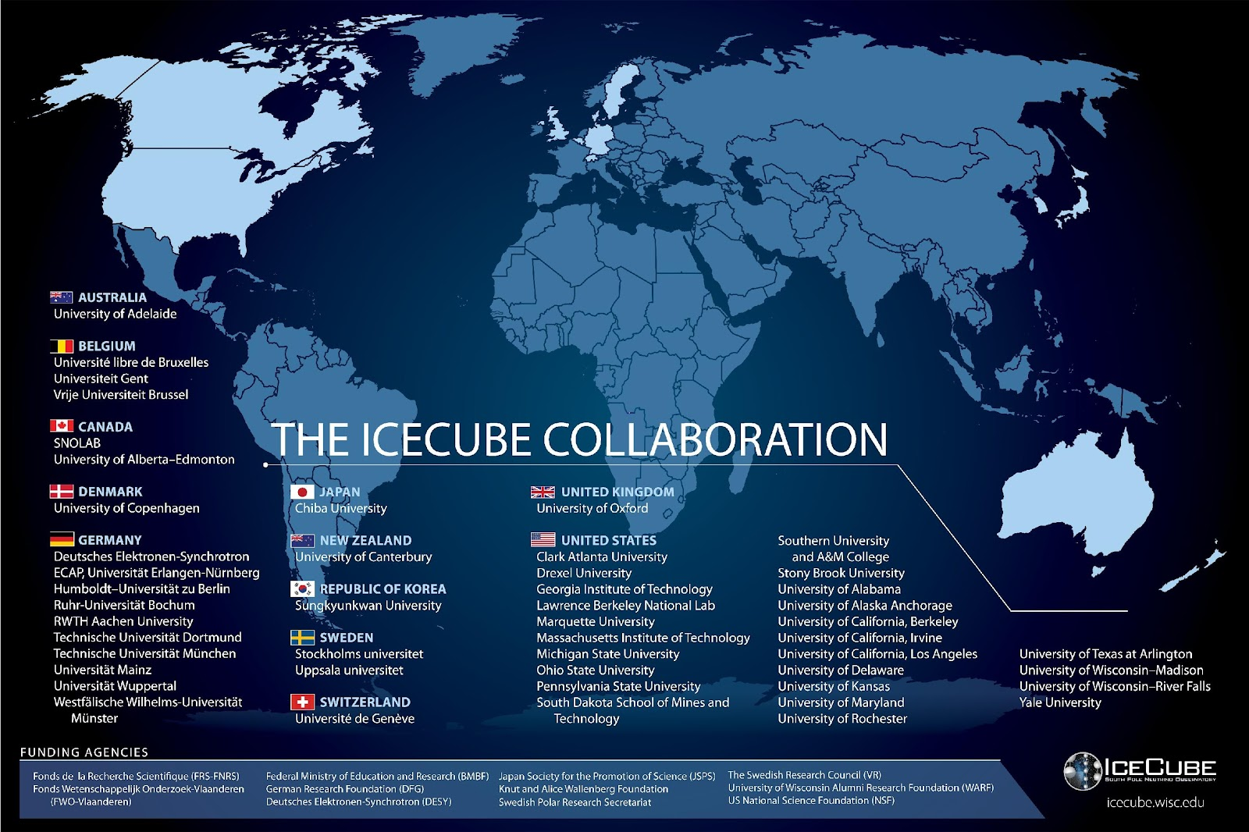
The IceCube Collaboration
>300 researchers
based in 12 countries
50% of collaboration
at US institutes
Base of operations:
Madison, WI
06/04/2022
NBI
4

Slide 5
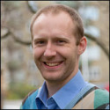
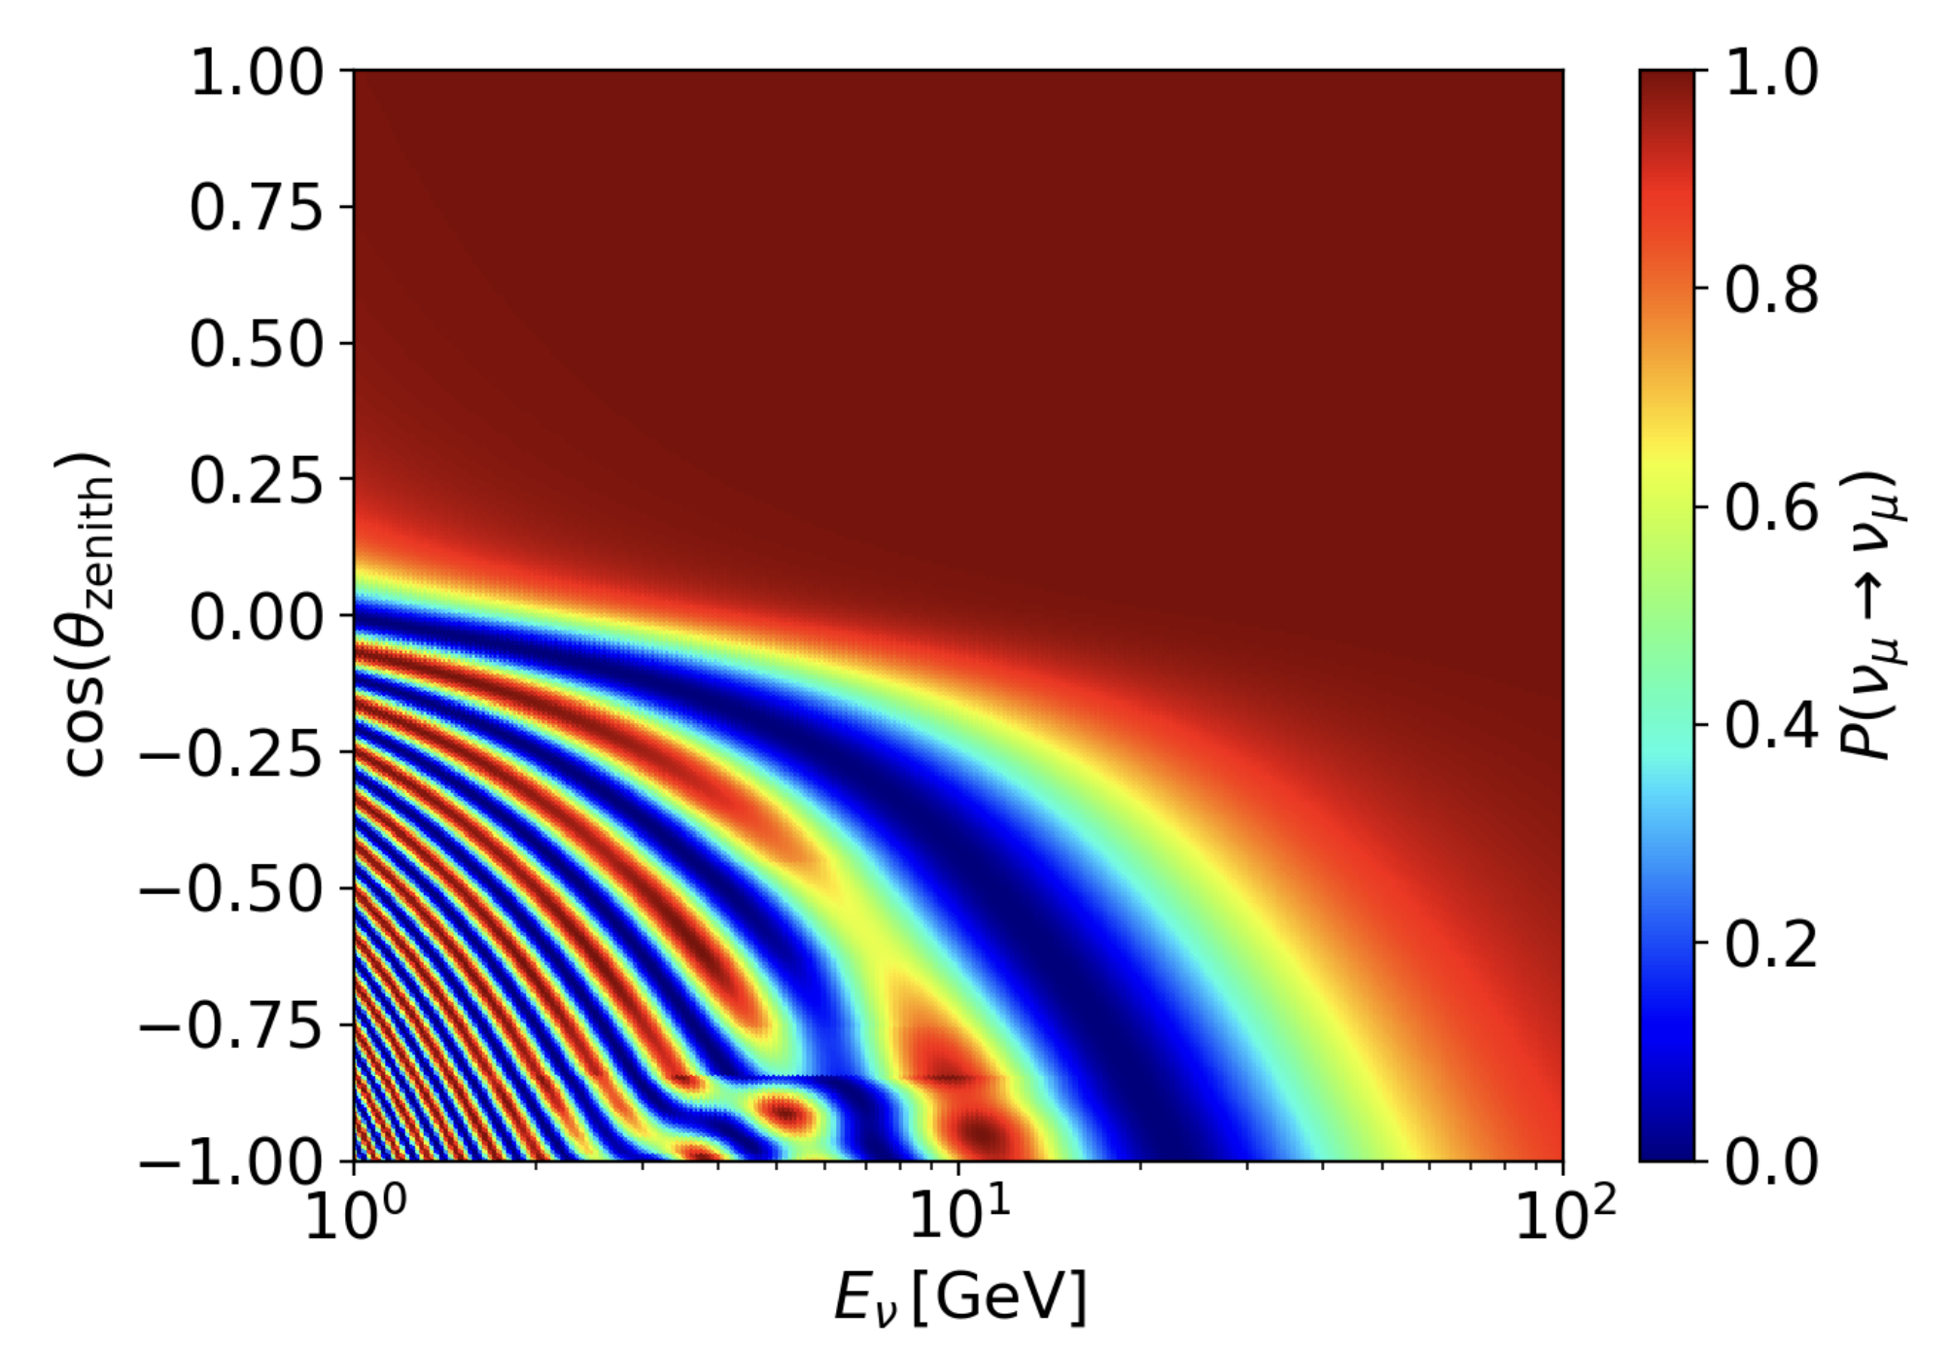

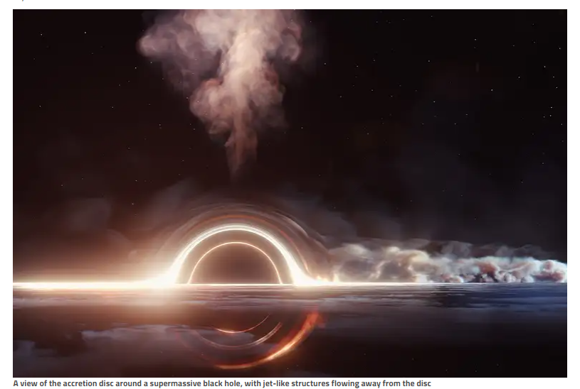
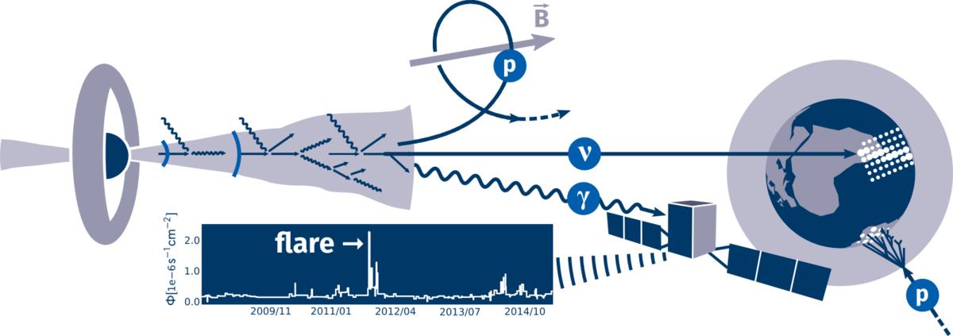
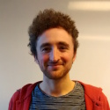
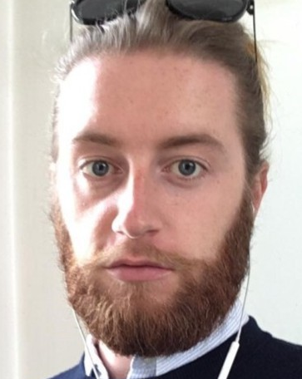
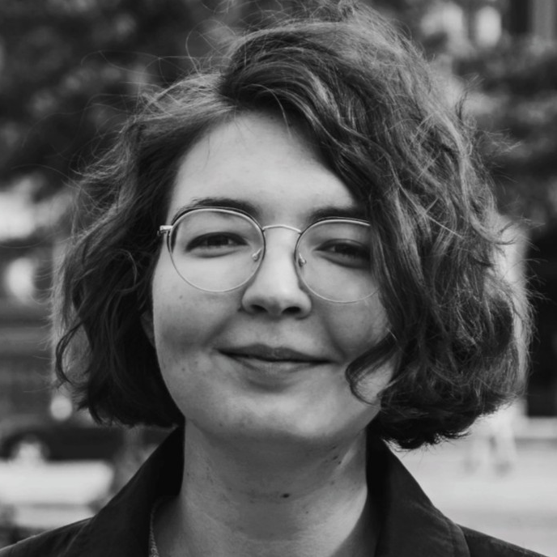
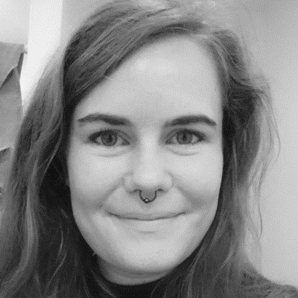
NBI IceCube group
Prof Jason Koskinen
  NBI subatomic physics
    Neutrino oscillations at IceCube
Prof Markus Ahlers
  NBIA astroparticle physics
    Neutrino oscillations at IceCube
  Two postdocs
    Two PhD students
      Six Masters students
06/04/2022
NBI
5

Slide 6
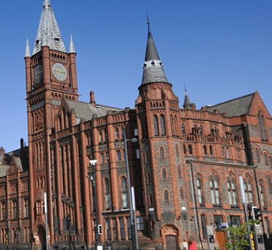




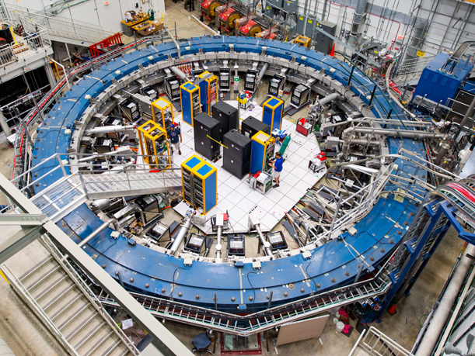
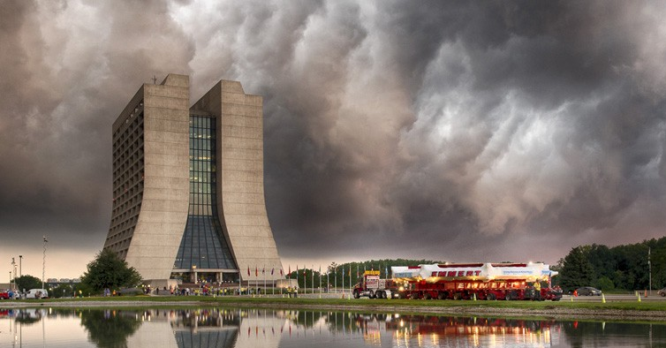

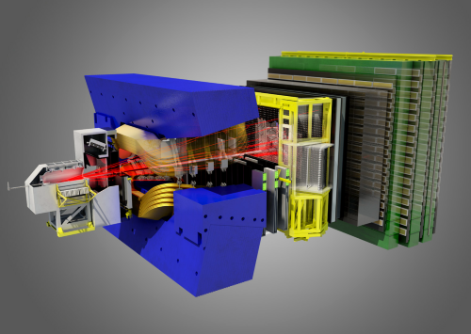


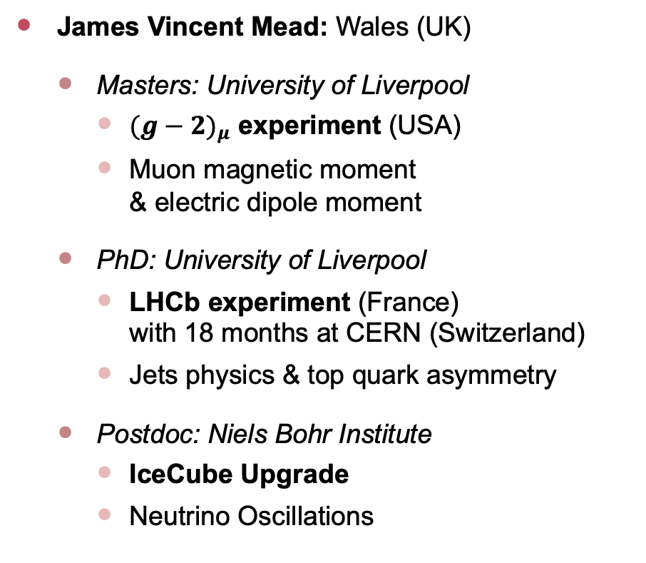
NBI IceCube group
James Vincent Mead: Wales (UK)
  Masters: University of Liverpool
    ${(g−2)}_{μ}$ experiment (USA)
    Muon magnetic moment
    & electric dipole moment
  PhD: University of Liverpool
    LHCb experiment (France)
    with 18 months at CERN (Switzerland)
    Jets physics & top quark asymmetry
  Postdoc: Niels Bohr Institute
    IceCube Upgrade
    Neutrino Oscillations
06/04/2022
NBI
6

Slide 7
NBI IceCube group
Tania Kozynets
  Masters
  PhD
06/04/2022
NBI
7

Slide 8
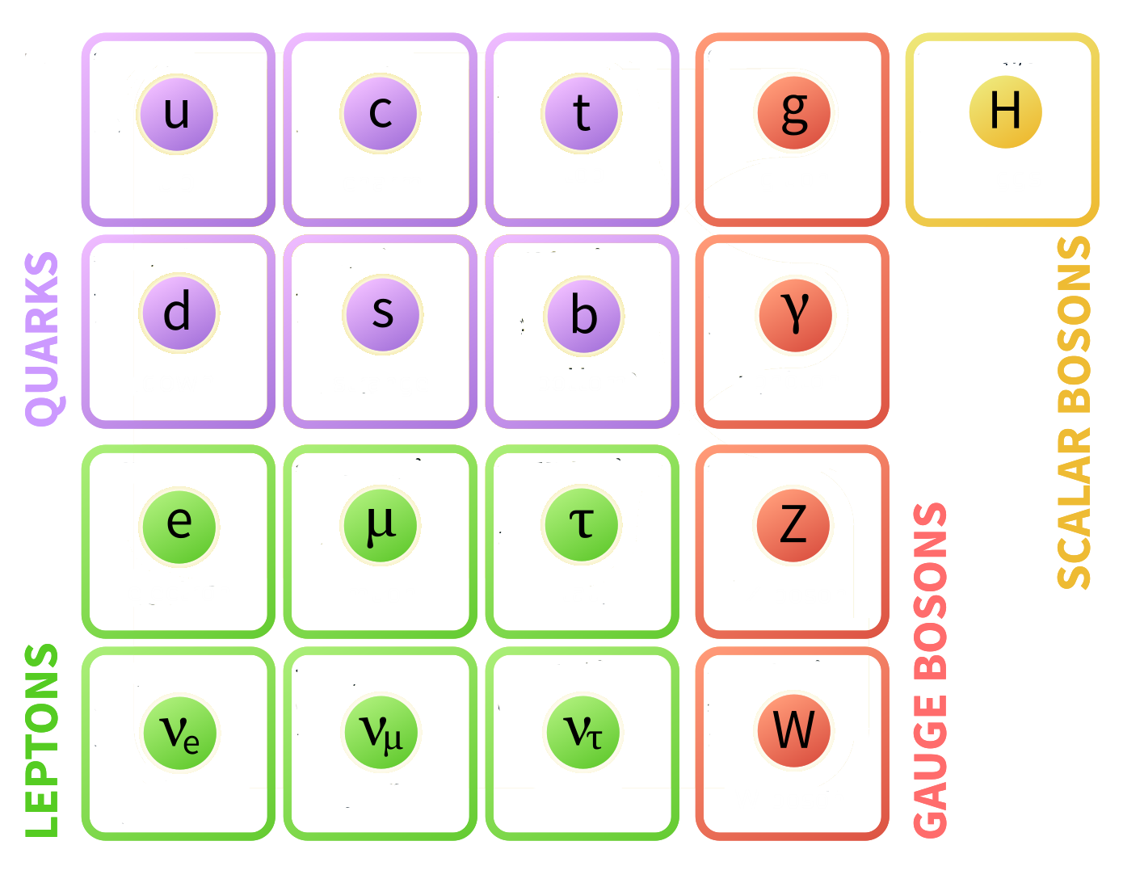
The fundamentals
everyday matter
Protons, neutrons and all their friends
The electron and its extended family
Force carrying jedi
increasing mass
06/04/2022
NBI
8

Slide 9
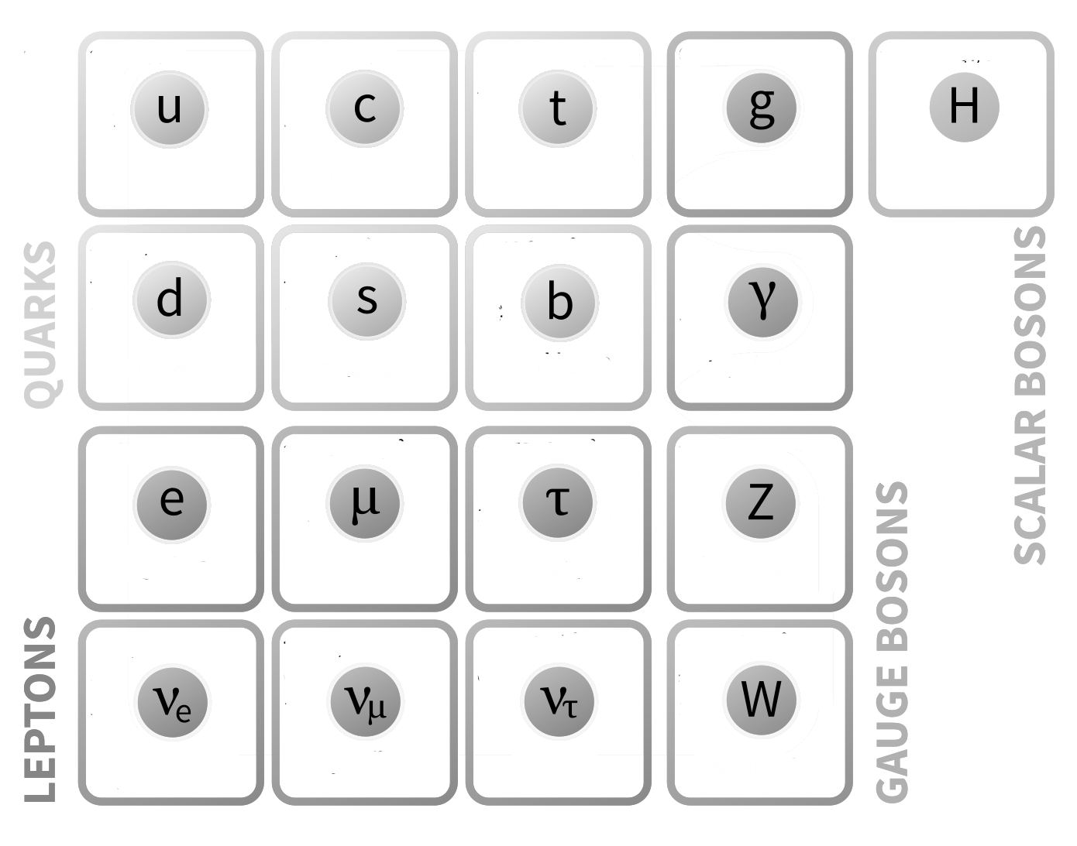
The fundamentals
+
+
+
-
-
-
-
-
-
-
-
-
-
+
-
+
-
+
-
-
-
-
-
The evil twins
+
+
-
+
-
-
-
06/04/2022
NBI
9

Slide 10
The fundamentals
Protons, neutrons and all their friends
The electron and its extended family
Force carrying jedi
Last to the party
06/04/2022
NBI
10

Slide 11
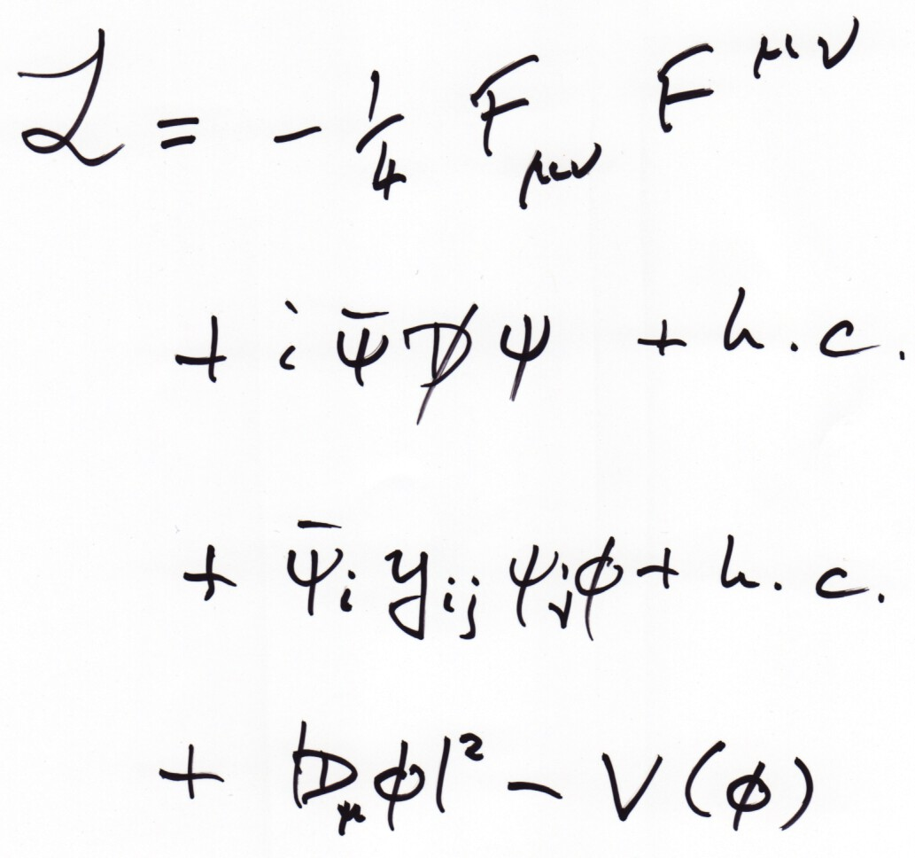
The fundamentals
06/04/2022
NBI
11

Slide 12
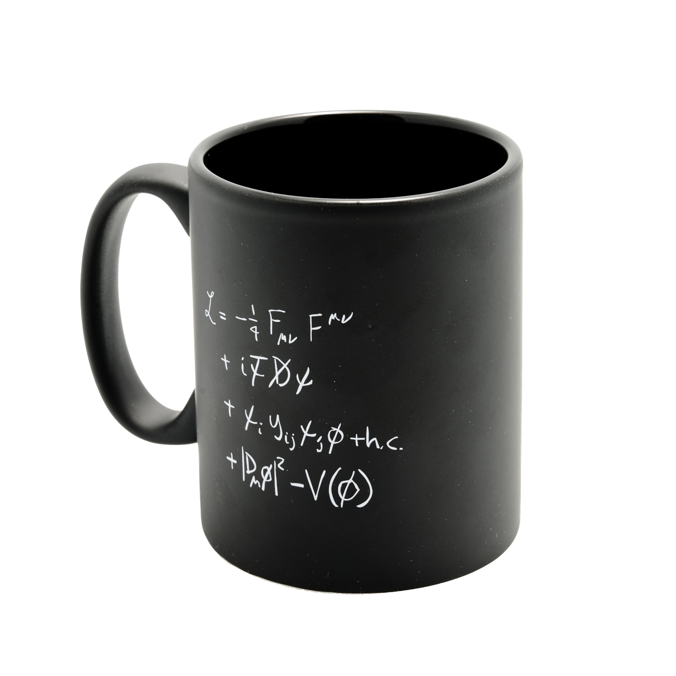
The fundamentals
06/04/2022
NBI
12

Slide 13


