Slide 1
Heat exchange systems with minimal irreversibility
Bjarne Andresen Niels Bohr Institute University of Copenhagen Blegdamsvej 17 DK-2100 Copenhagen Ø, Denmark
Margarita A. Zaeva, Anatoly M. Tsirlin Program Systems Institute of RAS Petra Pervogo Str. 4A RU-152020 Pereslavl-Zalessky, Russia

Slide 2
Tsirlin’s approach to optimization
Min dissipation vs. max speed: Finite-time thermodynamics (FTT).
Min exergy loss = min entropy production.
Q: Without specifying engineering details, find the least lossy design:
Which conditions must be met by the heat exchange system such that the production of entropy in it (and hence the loss of exergy) is minimal under the given restrictions?
Many previous attempts under different assumptions, e.g.
Tondeur, Kvaalen (1987): const rate of entropy production
Tsirlin, Mironova, Amelkin, Kazakov (1998): arbitrary kinetics
Tsirlin, Kazakov, Kolinko (2003): micro-economics
Pinch analysis [Linnhoff, Hindmarsh (1983)] via (T,Q) plots assuming fixed size heat exchangers. – I.e. components off the shelf.
By contrast we assume fixed total amount of heat exchange capability. – I.e. new component designs.

Slide 3
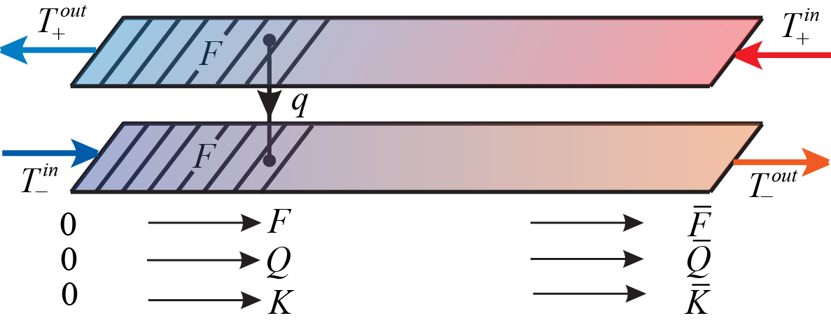
Simple heat exchanger
x
x distance along path
F(x) heat exchange area
T(x) temperatures
… all monotonic functions of x
q(x) heat transfer rate

Slide 4
Problem
Objective:
min entropy production rate σ*
Given:
total heat conductance K_{tot}
total heat load Q_{tot}
some inlet and outlet temperatures T^{in/out}
Varying:
local heat conductances K
local heat capacity rates W=g·C
Allowing:
multiple streams
phase change

Slide 5
Thermal conductance
Heat flow q(T₊, T_) = k∙z(T₊, T_)
(monotonic in T₊ and T_)
e.g.
Newtonian z(T₊, T_) = T₊ - T_
Fourier z(T₊, T_) = 1/T_ - 1/T₊
radiative z(T₊, T_) = T₊⁴ - T_⁴
Notes:
Sign of k depends on the function z.

Slide 6
The “trick”
Change of variables – all monotonically dependent:
distance along HX x
area covered F
heat transfered Q
heat conductance passed K
cold flow temperature T_

Slide 7
Reformulation of the problem
Then dQ/dT_ = W_ dQ/dT₊ = -W₊
and the problem reduces from
$$\text{minimize} σ=\int_{0}^{F_{tot}}{k z(T_{+},T_{−})\left(\frac{1}{T_{−}}−\frac{1}{T_{+}}\right)}dF$$
$$\text{given} \int_{0}^{F_{tot}}{K(F)}dF= K_{tot} \text{and} \int_{0}^{F_{tot}}{k z\left(T_{+},T_{−}\right) dF=Q_{tot}}$$
to
$$\text{minimize} σ=\int_{0}^{Q_{tot}}{\left(\frac{1}{T_{−}}−\frac{1}{T_{+}}\right)}dQ$$
$$\text{given} \int_{0}^{Q_{tot}}{\frac{dQ}{z\left(T_{+},T_{−}\right)}}= K_{tot} \text{and} \frac{dT_{+}}{dQ}=\frac{1}{W_{+}(Q)} \text{and} \frac{dT_{−}}{dQ}=\frac{1}{W_{−}(Q)}$$
Notes:
Solve by Lagrange multipliers.
Temperature profiles of contacting streams through conditions in top line ⇐ corresponding changes in heat capacity rates.
Heat rates, not the temperatures, are being controlled for the optimization.

Slide 8
Phase change
liquid condense / evaporate gas
In each stage the heat capacity rate is constant – but they usually will differ.

Slide 9
Multi-stream heat exchange systems
An equivalent stream (cold or hot) is a stream whose heat capacity rate at each temperature is equal to the sum of the heat capacity rates of all cold or hot streams having the same temperature.
Definition. Two heat exchange systems are thermodynamically equivalent if they have the same inlet and outlet stream temperatures, total heat loads Q, total thermal conductivity coefficients K, and entropy production σ.
Theorem. For any law of change in the temperature of the hot stream T₊(Q) > T₋(Q), the calculated two-stream system is thermodynamically equivalent to a multi-stream system consisting of n heat exchangers, in each of which the ith cold stream contacts the ith hot stream (under obvious conditions of energy conservation).
The number of heat exchangers is at most equal to the number of streams with fixed parameters.
The composite HX curves [T(Q)] are similar to those of pinch analysis — but we optimize the whole setup rather than record ad hos choices.

Slide 10
Multi-stream systems – procedure
Consider for calculational purposes a dual-stream heat transfer system in which the cold stream has a variable heat capacity rate and is equivalent to the cold streams of the multi-stream system being synthesized.
Write down the conditions under which the designed system is thermodynamically equivalent to a system consisting of dual-stream heat exchangers, each of which receives one cold stream.
Solve the problem of minimal dissipation for the calculational dual-stream system.
Select the parameters of a multi-stream system (heat loads, heat transfer coefficients, heat capacity rates of controlled streams) so that it is thermodynamically equivalent to the calculated dual-stream system with minimal dissipation.

Slide 11
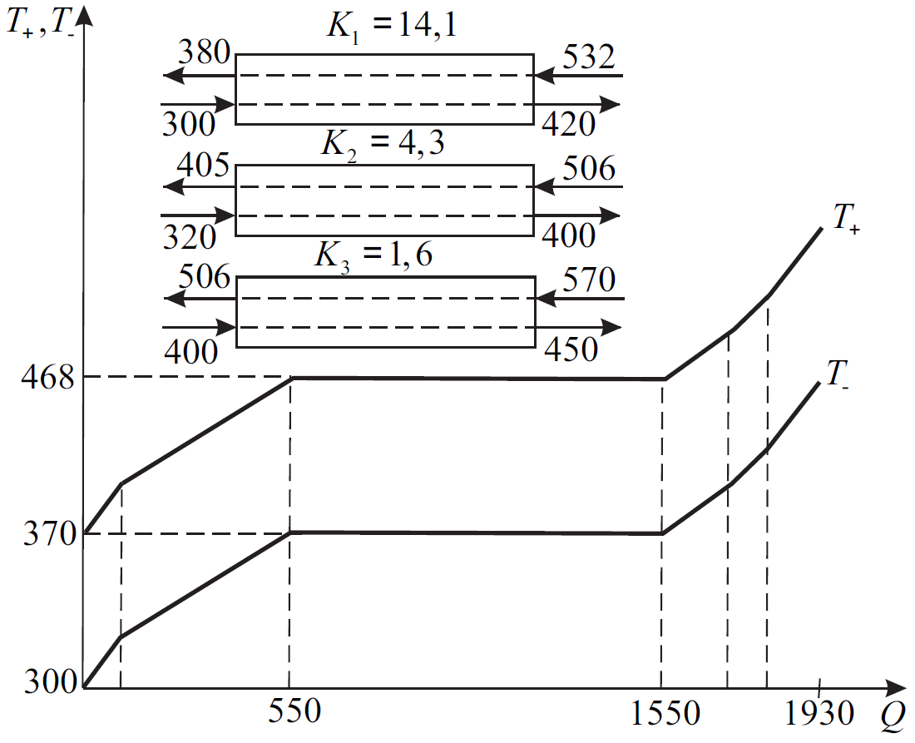
Example – 3 multi-stream heat exchangers

Slide 12
Conclusions
General optimality conditions are derived for a wide range of types of heat exchange dependencies on T (e.g. Newtonian, Fourier, radiative). A total heat transfer coefficient (“HX area”) is available as well as a total heat load (from the utility supplier).
Phase change is allowed in the heat exchange streams.
The concept of thermodynamic equivalence of multi-stream systems allows a combined optimization of multi-stream counter current heat exchange systems.
M. A. Zaeva, B. Andresen, A. M. Tsirlin: Heat exchange systems with minimal irreversibility; Chem. Eng. Res. Design 171, 317–326 (2021).

