Slide 1
Dynamics in Slow Time
Bjarne Andresen
Niels Bohr Institute, University of Copenhagen
Universitetsparken 5, DK-2100 Copenhagen Ø, Denmark
Christopher Essex
Department of Applied Mathematics
University of Western Ontario, London ON, Canada

Slide 2

Timescales
Fast time
Slow time
too fast to see
just right
too slow to see
Dt
Dt
Inner
Timescale
Outer
Timescale
Inner
Timescale
Outer
Timescale
Too Fast: Dt too small to distinguish order of events,
or too short an appearance to register at all.
Too Slow: Dt too large to see, notice, or care about both events
Notes:
cf. Brownian motion
Chaos / kinetics < LTE = Equilibration of ceratain degrees of fredom (T, P,…) < Total equil.
Currently photons <> equil. with matter
cf. our ‘Principal equations of state’ paper

Slide 3
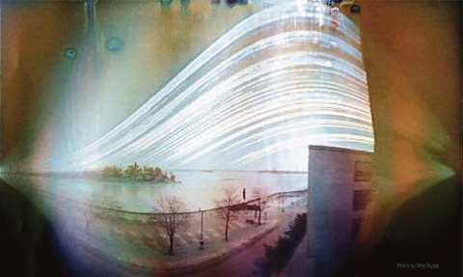
Thermodynamics on very long timescales Sun over parking lot
Notes:
solargraph

Slide 4
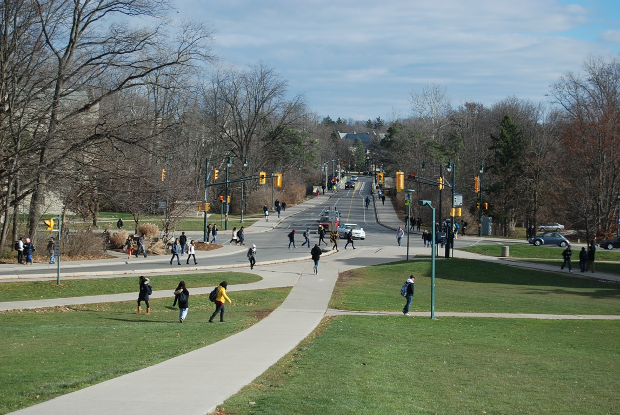
Busy campus intersection
1/125 sec
Notes:
The pictures illustrate how some effects disappear while others become obvious, previously obscured by transients.

Slide 5
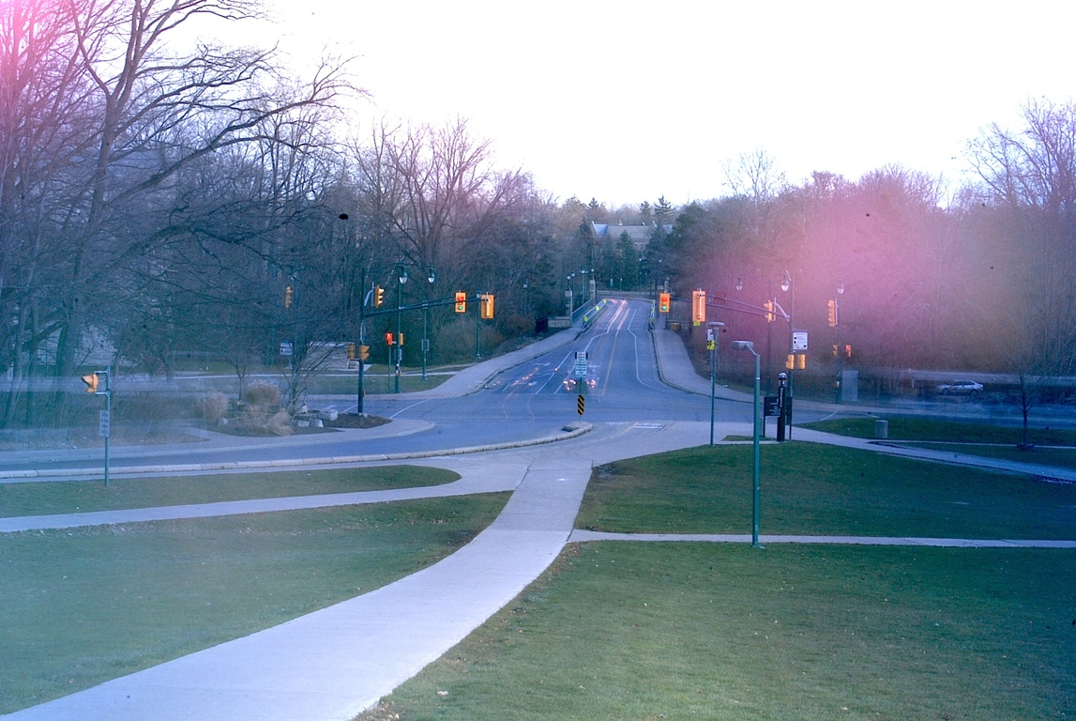
Busy campus intersection
10 min

Slide 6
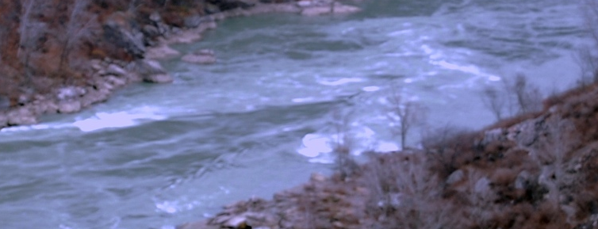
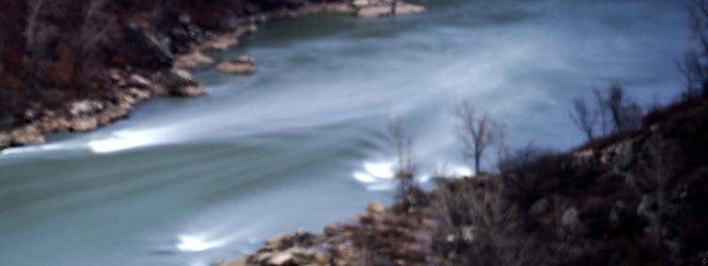
Niagara river
0.4 sec
50 sec

Slide 7
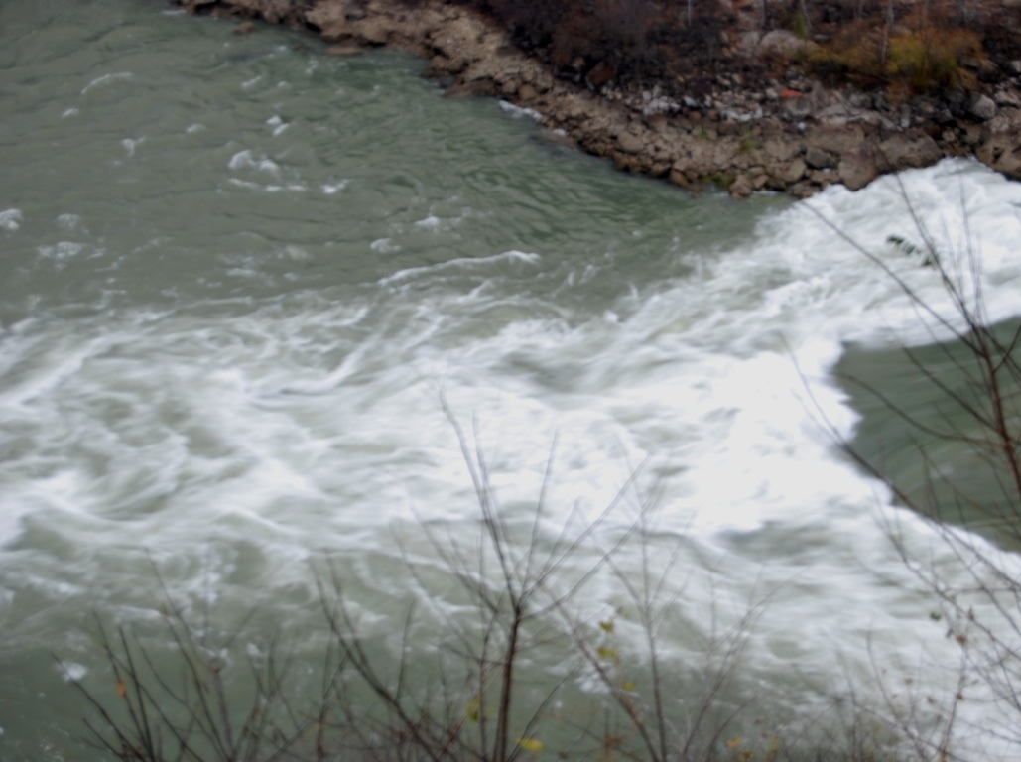

1/5 s
0.2 sec
77 s
77 sec

Slide 8
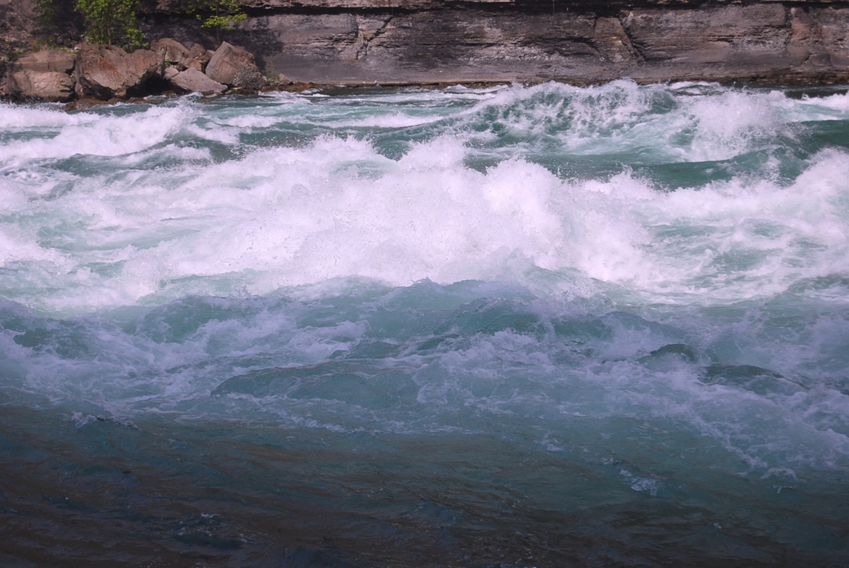
Class VI rapids
1/250 sec

Slide 9

Class VI rapids
3 min

Slide 10
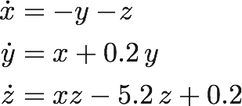
Rösler equations

Slide 11
C=5.981 C=5.982

Slide 12

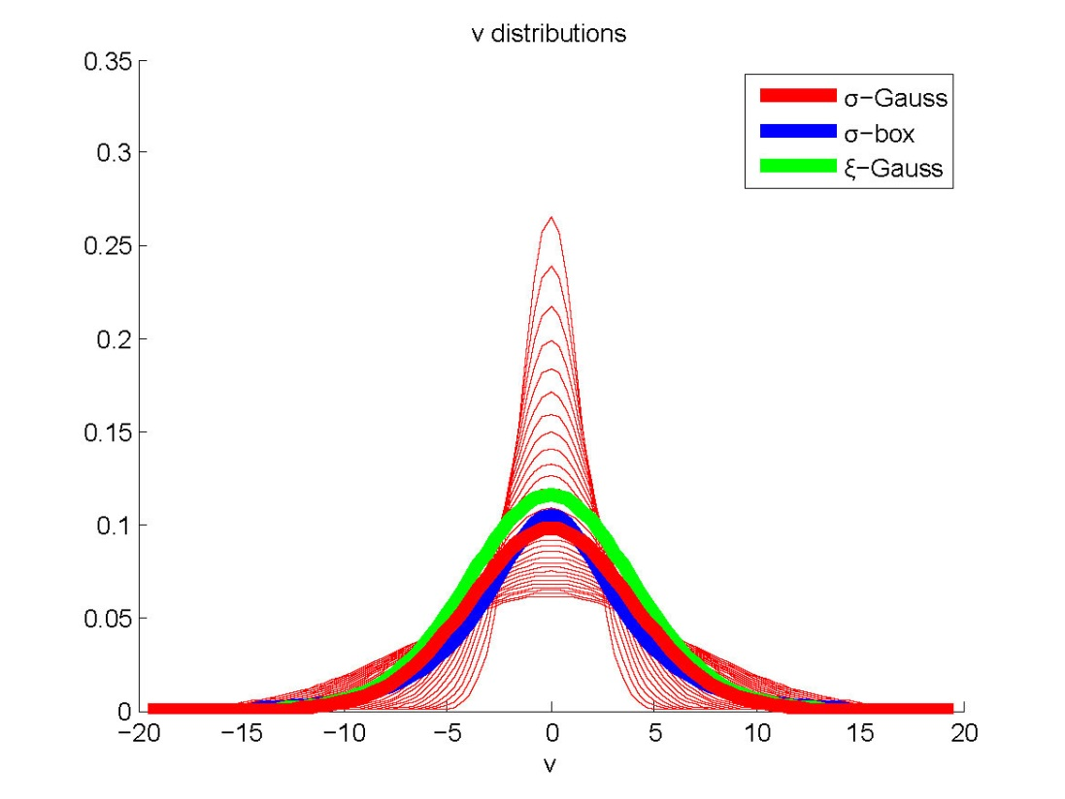


Distributions of distributions − wind
Mean air velocity (wind) fluctuates and turns into a slightly increased temperature, “thermalizing” wind:
Wind fluctuates too fast to see, thus no wind.
Notes:
Fluctuation distrib. not known, so let’s assume gaussian.
precision (xi = 1/sigma) rather than variation (sigma)

Slide 13
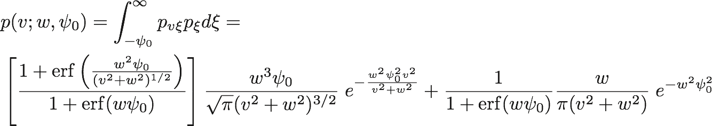
Distributions of distributions − temperature
By contrast, temperature fluctuations do not result in a new temperature, a new Maxwellian distribution:
The result is polynomial tails of degree either -3 (infinite fluctuation domain) or -2 (semi-infinite domain).
[w is the precision of the velocity precision]
Notes:
Inf. precision (w = inf.) p ->single gaussian
v<<w: simple gaussian i.e. gaussian core + polynomial wings

Slide 14




Infinite Domain
Semi-Infinite Domain

Slide 15

The Gaussian Core and Limit
Core:
Limit:

Slide 16



Comparing the Semi-Infinite to the Infinite Scenarios: L
Properties of L

Slide 17
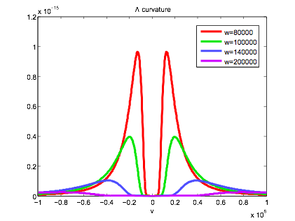
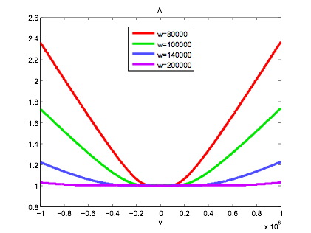
Wings
and
Core of L:

Slide 18
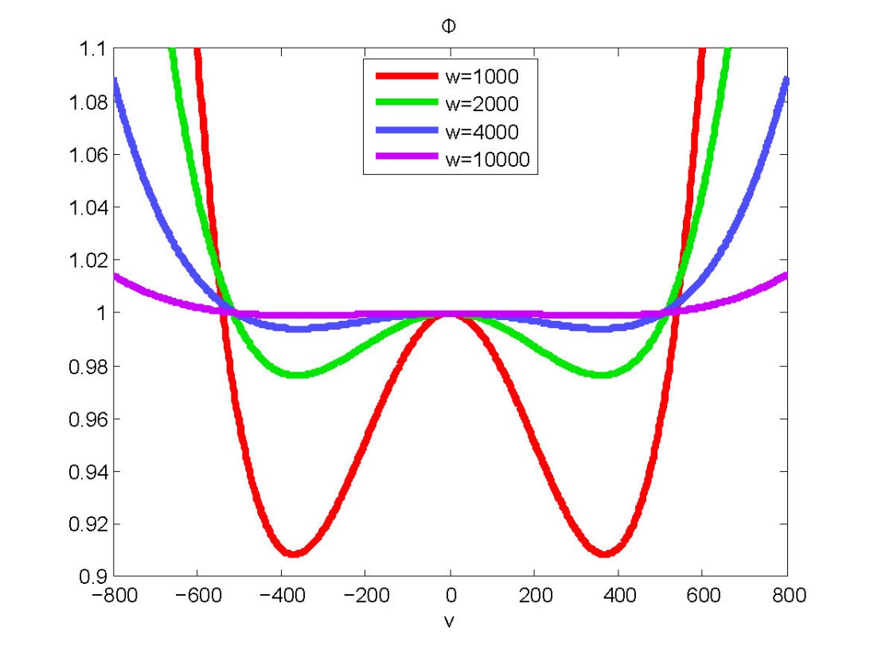
Convoluted distribution compared to standard Maxwellian
Notes:
Phi == p(convoluted)/p(simple gaussian)

Slide 19
Conclusions
The observational timescale has a profound influence on what is observed and which information it is possible (or of interest) to extract. The world looks very different depending on who is looking and what you are looking for.
All thermodynamic functions may not exist at longer and shorter timescales.

