Slide 1
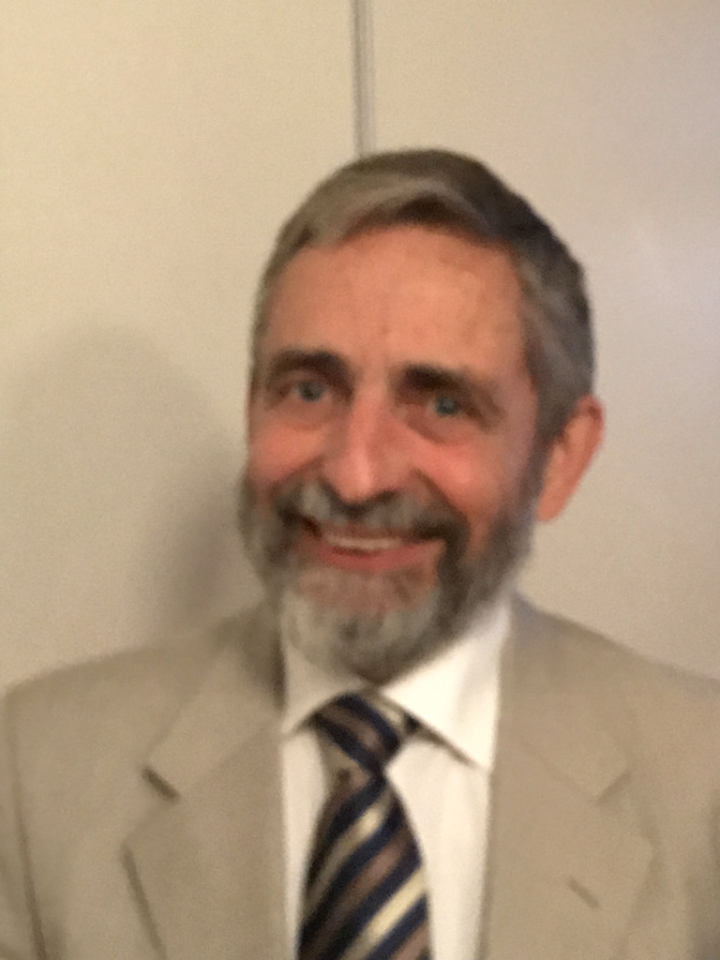

Of thermodynamics and energy landscapes: A voyage through science with Bjarne
J. C. Schön
Max-Planck-Institut für Festkörperforschung
D-70569 Stuttgart

Slide 2
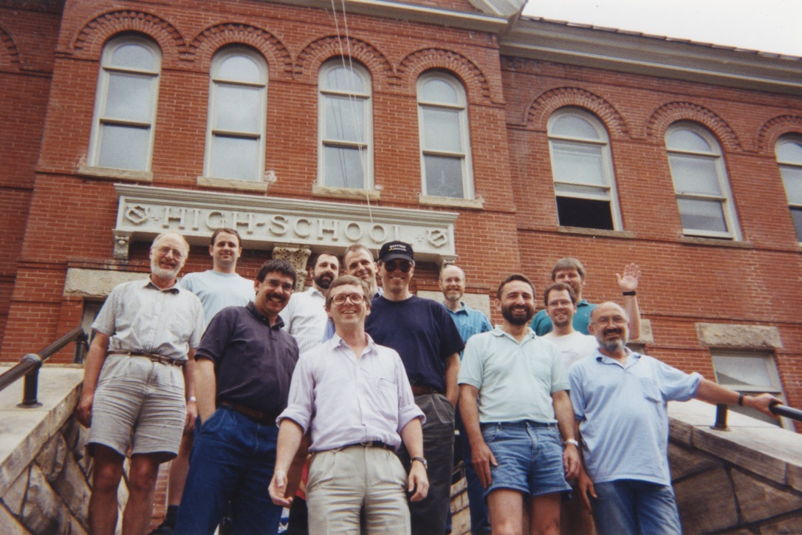
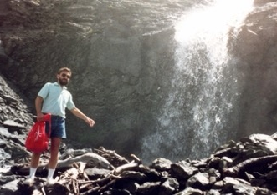
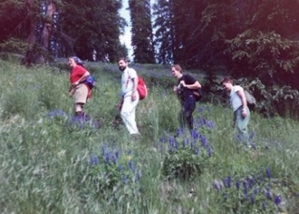
1991

Slide 3
Optimization of distillation columns
1992
Optimization parameter: heat flow Q
Find minimal Q for set purity of the
distillate and for a given number of plates N_{C}
Due to plate inefficiency, N(Q) exhibits
several heat flows Q for which N(Q) = N_{C}

Slide 4
Optimization of distillation columns
N_{C}
(Schön, Andresen, Ind. Eng. Chem. Res. 1996)

Slide 5
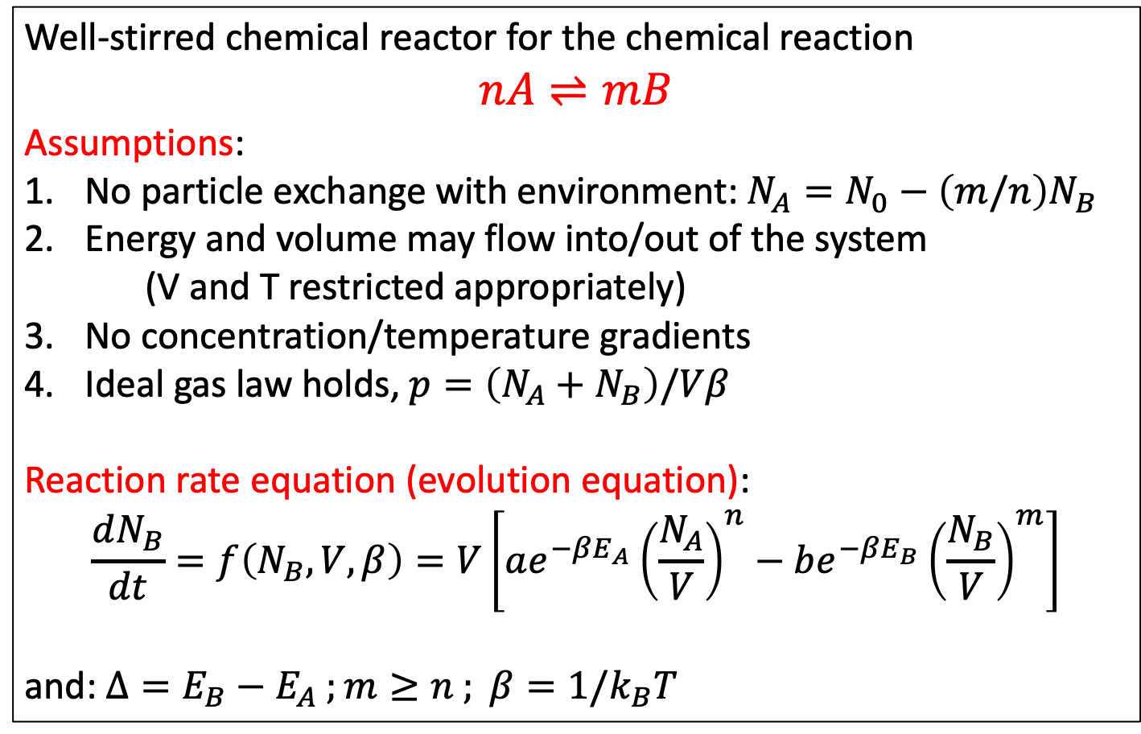
Optimization of chemical reactions
1992
Well-stirred chemical reactor for the chemical reaction
$$nA⇌mB$$
Assumptions:
No particle exchange with environment: $N_{A}=N_{0}−\left(m/n\right)N_{B}$
Energy and volume may flow into/out of the system
(V and T restricted appropriately)
No concentration/temperature gradients
Ideal gas law holds, $p=\left(N_{A}+N_{B}\right)/Vβ$
Reaction rate equation (evolution equation):
$$\frac{dN_{B}}{dt}=f\left(N_{B},V,β\right)=V\left[ae^{−βE_{A}}{\left(\frac{N_{A}}{V}\right)}^{n}−be^{−βE_{B}}{\left(\frac{N_{B}}{V}\right)}^{m}\right]$$
and: $Δ=E_{B}−E_{A} ;m≥n ; β=1/k_{B}T$
(Schön, Andresen, J. Phys. Chem. 1996)

Slide 6
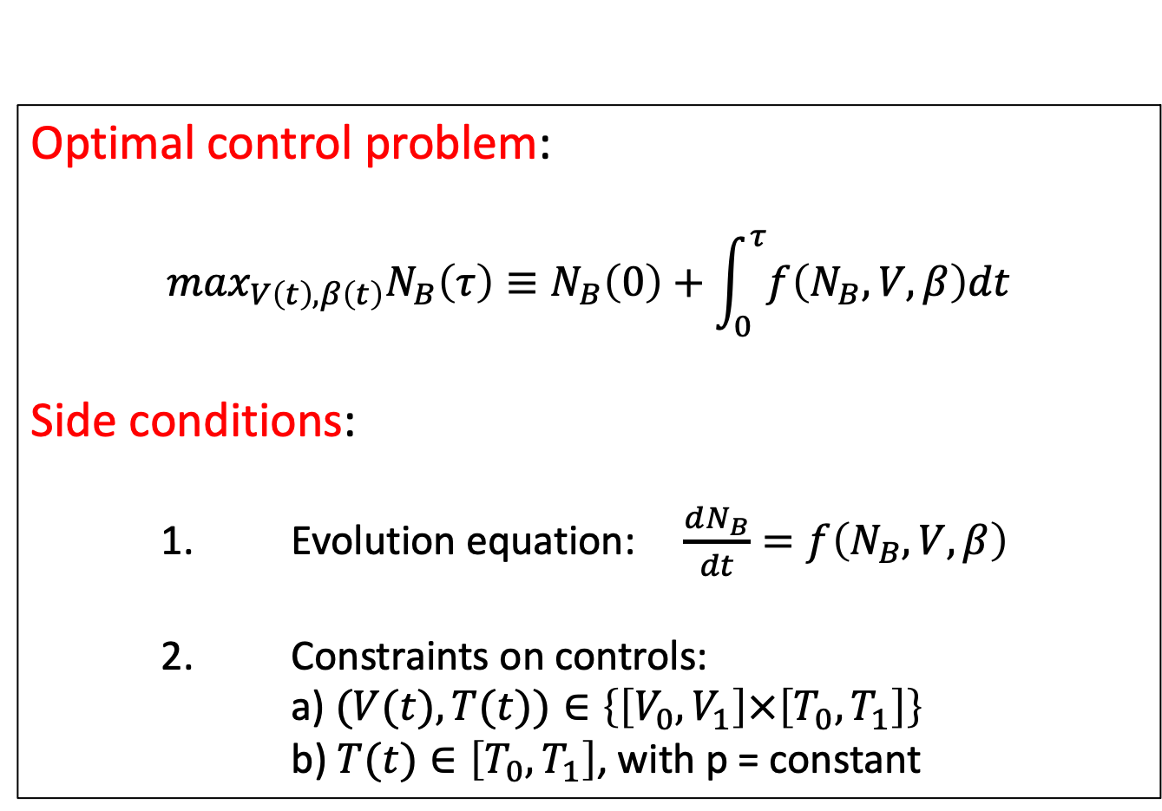
Optimization of chemical reactions
Optimal control problem:
$$\max_{V\left(t\right),β\left(t\right)}N_{B}\left(τ\right)≡N_{B}\left(0\right)+\int_{0}^{τ}{f\left(N_{B},V,β\right)dt}$$
Side conditions:
1. Evolution equation: $\frac{dN_{B}}{dt}=f\left(N_{B},V,β\right)$
2. Constraints on controls:
a) $(V(t),T(t))∈\left\{\left[V_{0},V_{1}\right]×\left[T_{0},T_{1}\right]\right\}$
b) $T(t)∈\left[T_{0},T_{1}\right]$, with p = constant

Slide 7
Optimization of chemical reactions

Slide 8
Optimization of chemical reactions

Slide 9
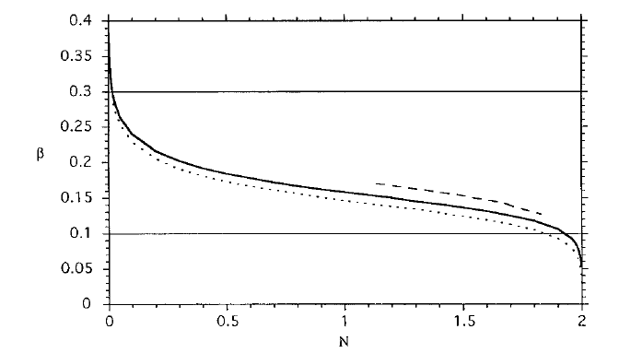
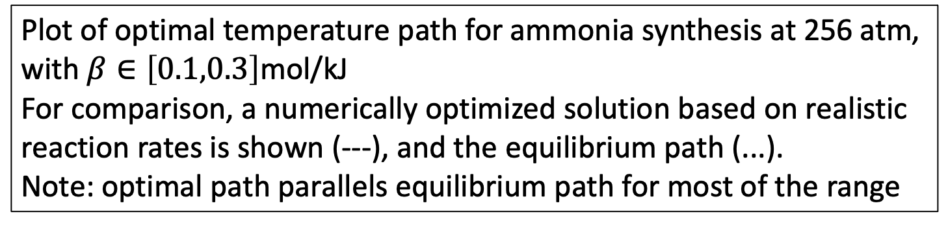
Optimization of chemical reactions
1992
Plot of optimal temperature path for ammonia synthesis at 256 atm,
with $β∈\left[0.1,0.3\right]$mol/kJ
For comparison, a numerically optimized solution based on realistic reaction rates is shown (---), and the equilibrium path (...).
Note: optimal path parallels equilibrium path for most of the range
(Schön, Andresen, J. Phys. Chem. 1996)

Slide 10
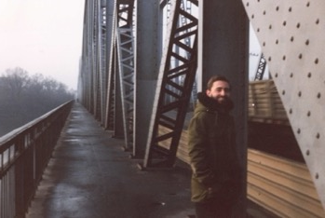
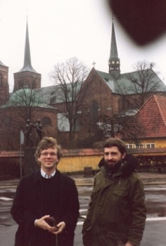
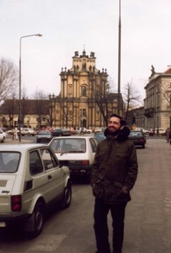
Sightseeing with Bjarne
1992

Slide 11
Design in Materials Chemistry –
Energy Landscapes, Optimization, Thermodynamics
Finding new chemical compounds is an explorative enterprise
Synthesis of new chemical compounds is an explorative enterprise
Optimizing a synthesis route is a massive (statistics driven) effort
Goal: Find a way to support these efforts by theoretical approaches
1) Predict new compounds – study their energy landscape !
2) Model the synthesis (routes) – follow their paths on the landscape and the flow of probability
3) Optimize the routes – optimal control problem
Tool development: New landscape exploration methods and application of concepts from finite-time thermodynamics
1993 - today
(J. C. Schön, Adv. Chem. Phys., 2015)

Slide 12

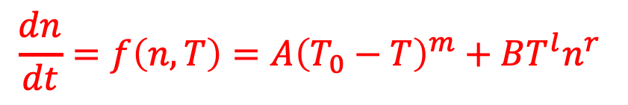

Optimizing nucleation and growth of (competing) crystalline phases from the melt
2009
Goal: Maximizing output in finite time by controlling T(t)
i) The growth rate is supposed to depend on the amount of material n already present in the solid (crystalline) phase, in form of a power law, n^{r} (0< r ≤ 1), while the nucleation rate is independent of n, since we assume
ii) The temperature dependences of nucleation and growth follow power laws in range between two reference temperatures T₁ (=0) < T < T₀, (T₀ – T)^{m} and (T-T₁)^{l}, respectively. Permitted temperature interval for control is [0, T₀]
iii) Evolution equations:
iv) Instantaneous reaction to changes in external temperature:
$$n≪n_{melt}=n_{total}−n≈n_{total}$$
$$\frac{dn}{dt}=f\left(n,T\right)=A{\left(T_{0}−T\right)}^{m}+BT^{l}n^{r}$$
with m,l ≥ 1 and 0 < r ≤ 1
$$T\left(t\right)=T_{ext}(t)$$
(J. C. Schön, Z. Anorg. Allg. Chem., 2009)

Slide 13
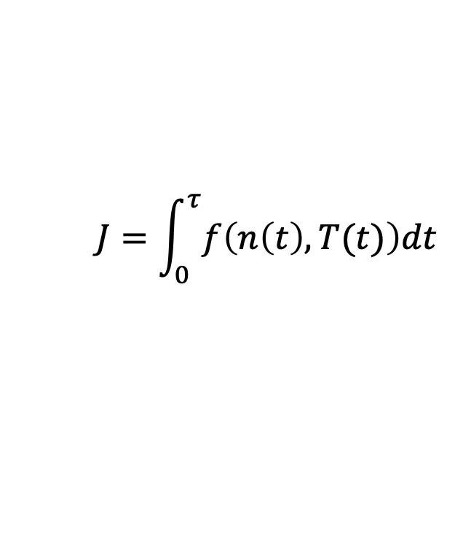
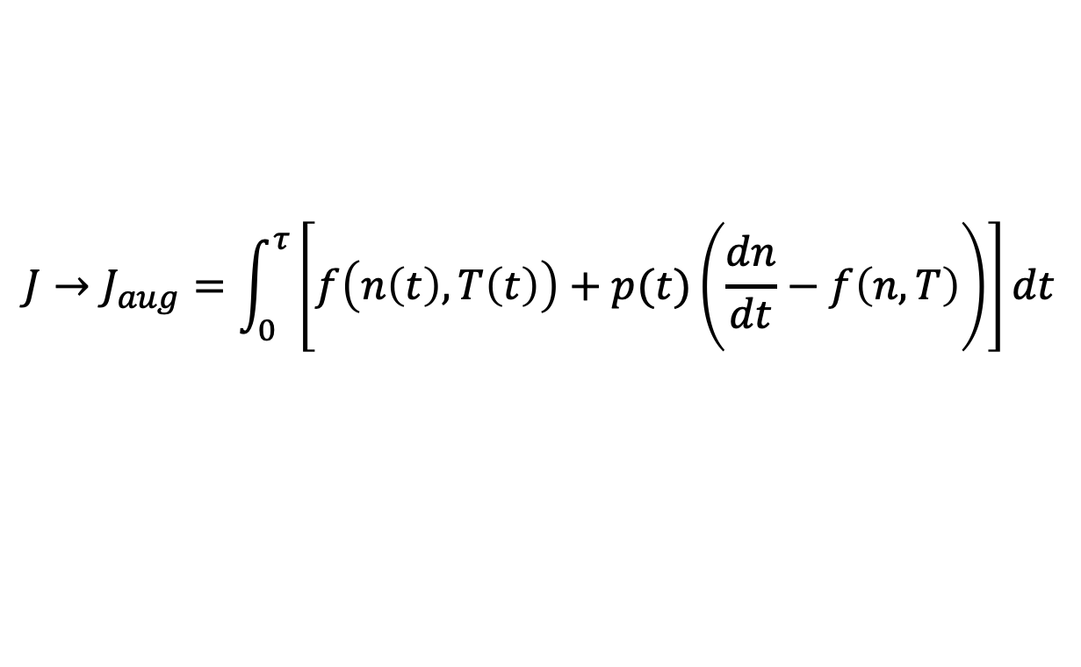
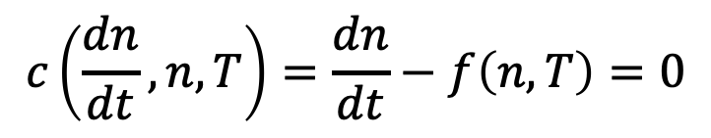
Optimizing nucleation and growth of (competing) crystalline phases from the melt
Cost function
$J=n\left(τ\right)$is the material generated in the interval [0, τ], i.e.
$$J=\int_{0}^{τ}{f\left(n\left(t\right),T(t)\right)dt}$$
$$c\left(\frac{dn}{dt}, n,T\right)=\frac{dn}{dt}−f\left(n,T\right)=0$$
with
Optimal control task
$$J→J_{aug}=\int_{0}^{τ}{\left[f\left(n\left(t\right),T\left(t\right)\right)+p(t)\left(\frac{dn}{dt}−f\left(n,T\right)\right)\right]dt}$$
Maximize the amount of product at the end of the duration of
the synthesis, J(τ), by adjusting the temperature along the path,
where the initial amount of product is zero

Slide 14
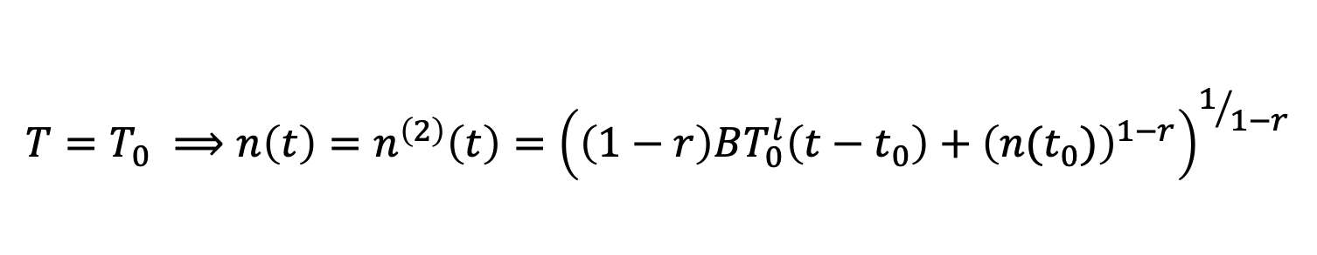
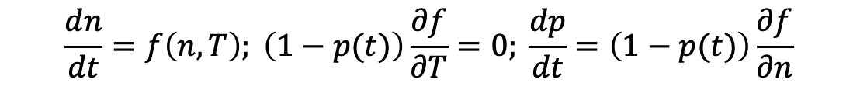
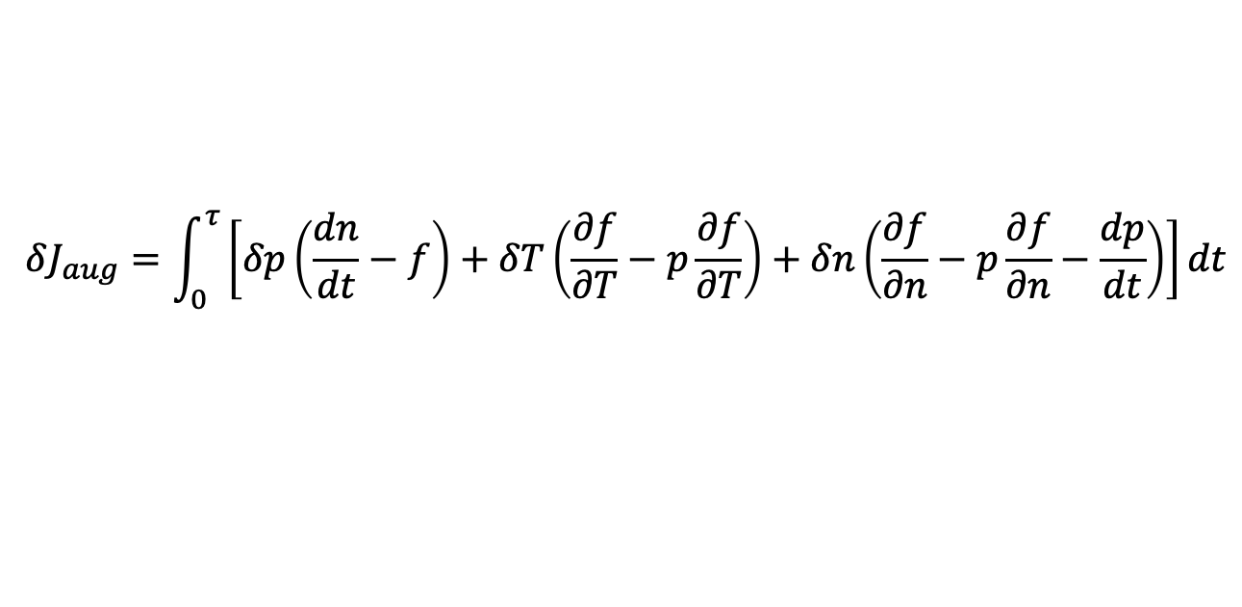

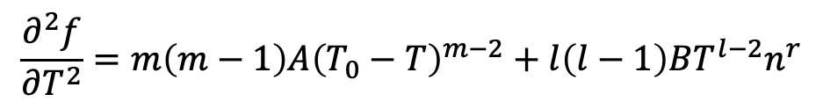
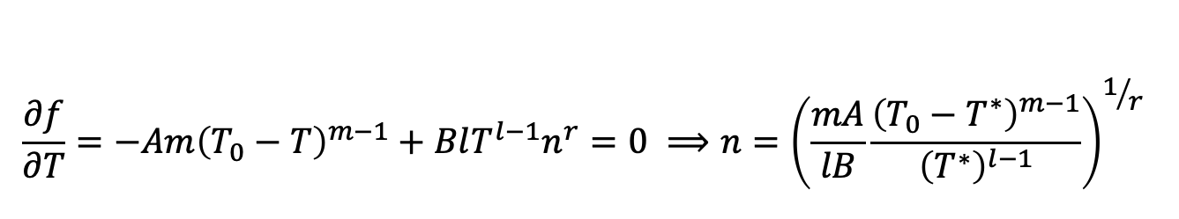
Optimizing nucleation and growth of (competing) crystalline phases from the melt
$$δJ_{aug}=\int_{0}^{τ}{\left[δp\left(\frac{dn}{dt}−f\right)+δT\left(\frac{∂f}{∂T}−p\frac{∂f}{∂T}\right)+δn\left(\frac{∂f}{∂n}−p\frac{∂f}{∂n}−\frac{dp}{dt}\right)\right]dt}$$
$$\frac{dn}{dt}=f\left(n,T\right); \left(1−p(t)\right)\frac{∂f}{∂T}=0; \frac{dp}{dt}=\left(1−p(t)\right)\frac{∂f}{∂n}$$
Non-trivial solution must have p(t) ≠ 1. Thus we require:
$$\frac{∂f}{∂T}=−Am{\left(T_{0}−T\right)}^{m−1}+BlT^{l−1}n^{r}=0 ⟹n={\left(\frac{mA}{lB}\frac{{\left(T_{0}−T^{∗}\right)}^{m−1}}{{\left(T^{∗}\right)}^{l−1}}\right)}^{1/r}$$
$$\frac{∂^{2}f}{∂T^{2}}=m\left(m−1\right)A{\left(T_{0}−T\right)}^{m−2}+l\left(l−1\right)BT^{l−2}n^{r}$$
Optimal solution must be a bang-bang-type of solution:
$$f\left(T=0,n\right)=AT_{0}^{m} ;f\left(T=T_{0},n\right)=BT_{0}^{l}n^{r}$$
$$T=0 ⟹n\left(t\right)=n^{\left(1\right)}\left(t\right)=n\left(t_{0}\right)+AT_{0}^{m}\left(t−t_{0}\right)$$
$$T=T_{0} ⟹n\left(t\right)=n^{\left(2\right)}\left(t\right)={\left(\left(1−r\right)BT_{0}^{l}\left(t−t_{0}\right)+{\left(n(t_{0})\right)}^{1−r}\right)}^{1/{1−r}}$$

Slide 15
Optimizing nucleation and growth of (competing) crystalline phases from the melt - Example: Synthesis of glycerol crystals
i) Nucleation rate:
Increases very rapidly upon cooling to a maximum at T₁ ≈ -65 °C, and then abruptly drops to zero before glass transition at T_{glass} ≈ -85 °C is reached
ii) Growth rate:
Increases quickly with temperature to a maximum at T₀ ≈ 0 °C, and then rapidly decreases to zero at the melting temperature Tmelt ≈ +18 °C
iii) From fit to power laws:
A ≈ 2.4 × 10⁻¹³/sec cm³ K⁹, B ≈ 0.3/sec cm K³, m = 9, l = 3, r = 2/3
iv) Switching time: t_{s}* ≈ 2 sec, i.e. keep the supercooled melt
at T = -65 °C for 2 seconds, and then let the solution grow at 0 °C
for the rest of the available time.

Slide 16
Optimization of probability flows
for the chemical system solid MgF₂
1998 -
2020
Goal:
Use optimal control of temperature to steer the
probability flows on the energy landscape of MgF₂
such that desired minima can be reached with
maximal probability
(K. H. Hoffmann, J. C. Schön, Eur. J. Phys., 2013 & 2017)

Slide 17
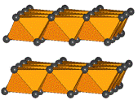
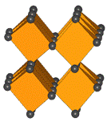
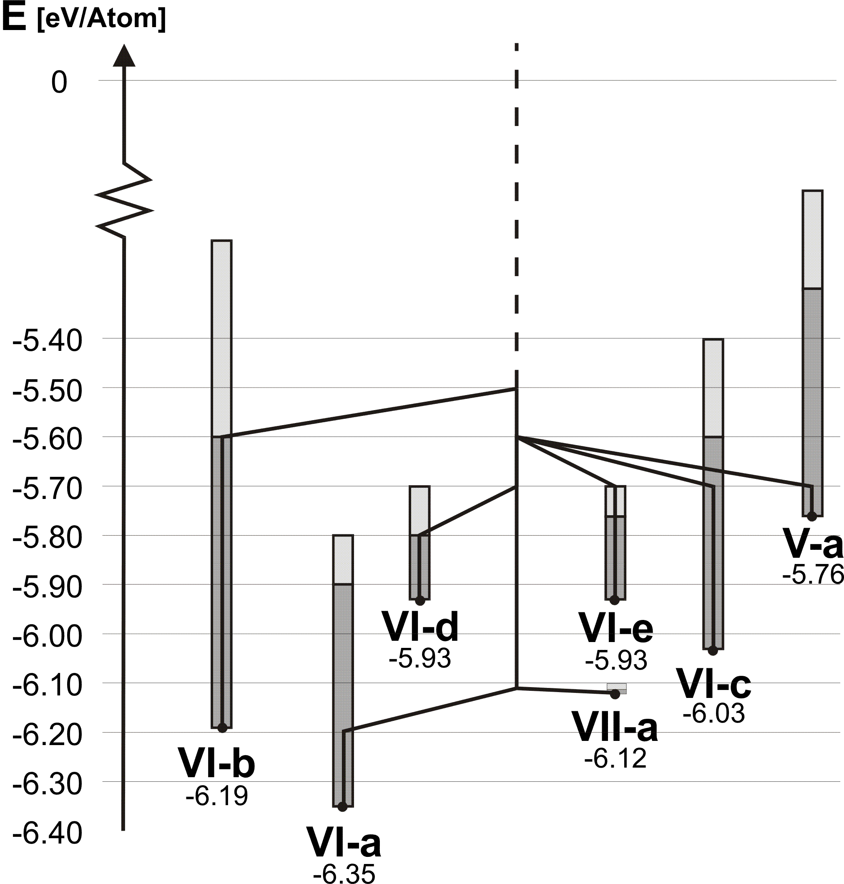
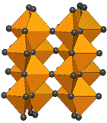
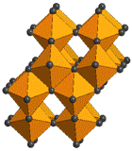
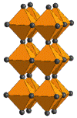
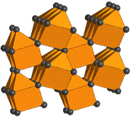
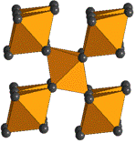
Energy landscape and structures of MgF₂
(Wevers, Schön, Jansen, J. Sol. State Chem., 1998)
(Wevers, Schön, Jansen, J. Phys. Cond. Mat., 1999)

Slide 18
Optimization of probability flows:
Example MgF₂
Procedure:
We focus only on the most important subset of the minima : rutile (VI-a), anatase (VI-b), Mp1 (VII-a), 1/2Occp (VI-c); CdI2 (VI-d), 1/2BN (V-a)
We collect data about the local DOS and the transitions as function of energy lid using the threshold algorithm; this yields horizontal and vertical transition matrices H and L
We construct a lumped Markov matrix description of the dynamics, including the temperature and pressure dependence : P(t_{m+1}) = G(T(t_{m+1})) P(t_{m}); G = H L(T)
We maximize the objective funtion <O>_{M} = Σ_{j} O_{j} P_{j}(t_{M}) where P_{j}(t_{M}) is the final probability to be in basin j after M time steps, P_{j}(t₀) is the given initial probability distribution, and O_{j} = δ_{jk} if goal is to be in basin k at the time t_{M}
Obeying the master equation at every time step corresponds to M constraint equations with Lagrange multipliers Λ^{tr}(t_{m+1}) : F = <O>_{M} + Σ_{m=0,M-1} Λ^{tr}(t_{m+1})[G(T(t_{m+1})P(t_{m}) – P(t_{m+1})]

Slide 19
Optimal control of probability
flows – varying both
temperature and pressure
Starting distribution is an equal probability distribution with ¼ assigned to each of the four phases
(K. H. Hoffmann, J. C. Schön, Eur. J. Phys. 2017)

Slide 20
Optimal control of a hydrogen-like atom ?
Background motivation
2017
People have analyzed the optimal control of systems of quantum harmonic oscillators, performing engine-like cycles of adding energy, modifying the harmonic oscillator adiabatically, extracting energy etc.
Note: The analysis has profited from the high degree of symmetry in this problem
Another quantum mechanical problem that might be amenable to such an analysis is the hydrogen atom:
On the technical level, it also possesses a very high degree of symmetry (Runge-Lenz-vector, in addition to radial symmetry)
On the applications type level, we have hydrogen-like atoms, e.g. excitons inside a solid, that can be controlled by modifying the environment while the hydrogen-like atom remains in its state
Controlling such a system might allow us to construct nano-sized engines inside solids

Slide 21
Optimal control of a hydrogen-like atom (“classical”)
2020
”Stirling”-cycle
”Otto”-cycle
”Carnot”-cycle
(J. C. Schön, Entropy 2020; c.f.: J. C. Schön, JCP 1996 on optimal free energy calculations)

Slide 22
Optimal control (general results)
Thermodynamic lengths, in heat (Q) and entropy (S) metrics
Thermodynamic Lengths
Heat metric
FTT time allocation
Entropy metric

Slide 23
Optimal control of a hydrogen-like atom (“classical”):
Finite time thermodynamics-like results in Q-metric
”Stirling”-cycle
”Otto”-cycle
”Carnot”-cycle

Slide 24
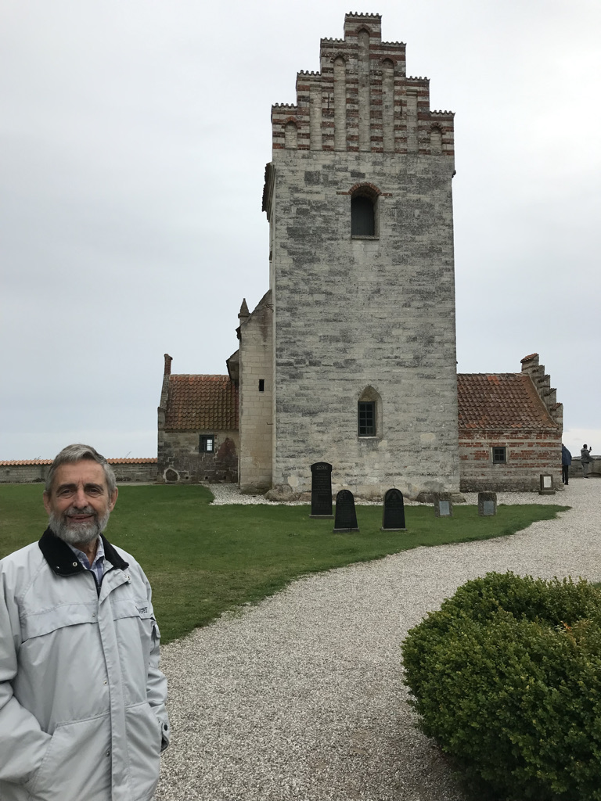
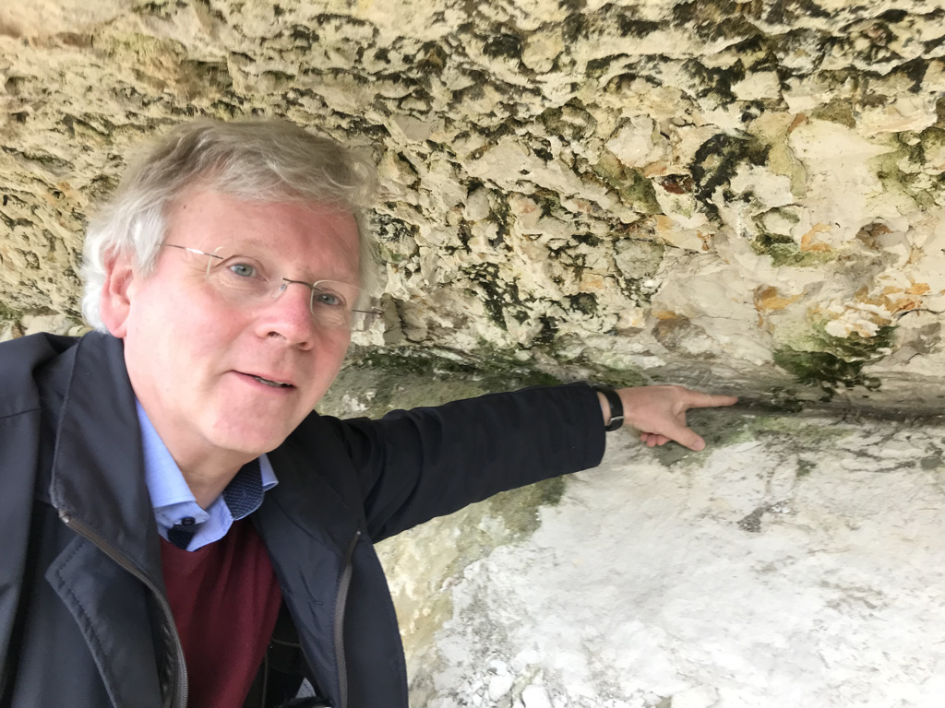
Visiting the cretaceous-tertiary geological boundary
2021

Slide 25
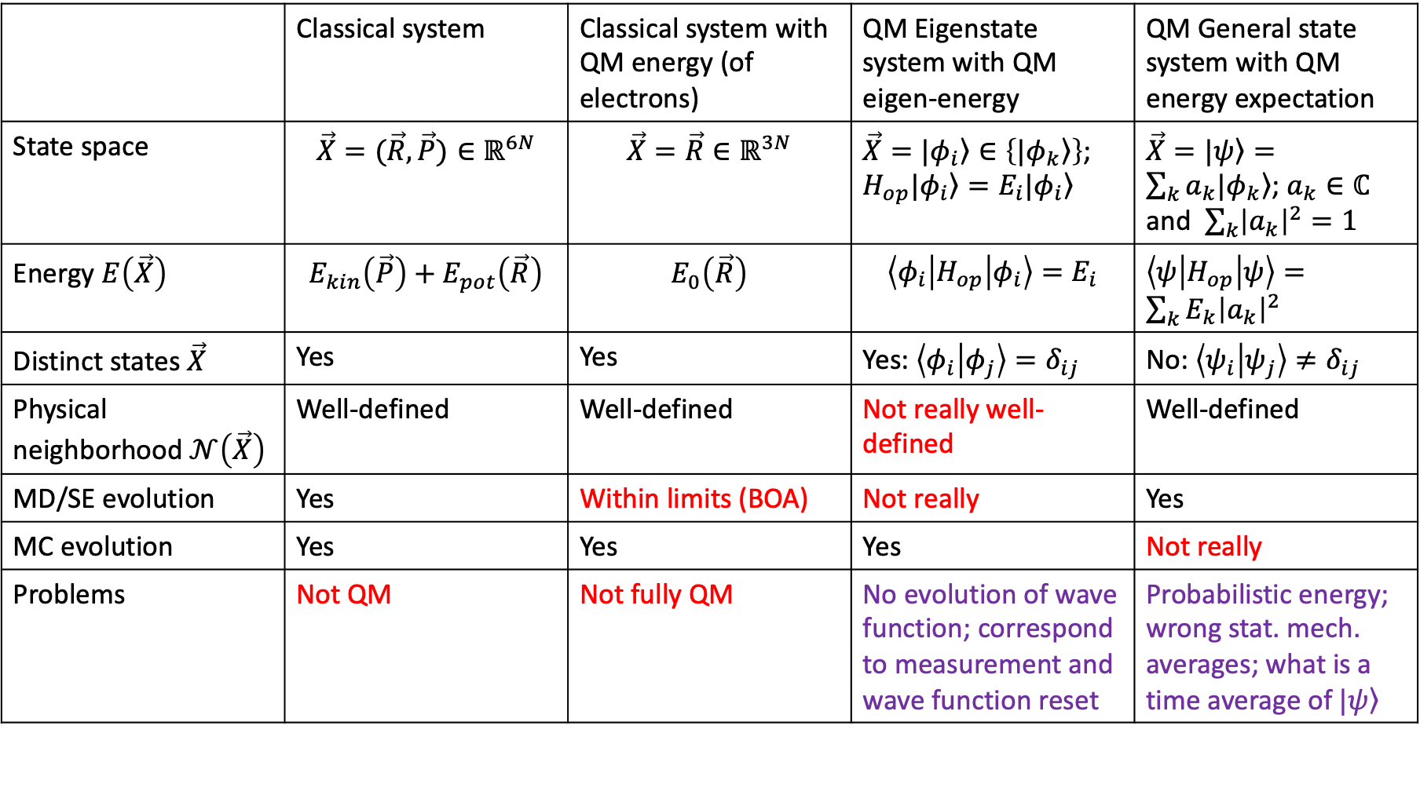
What is the Energy Landscape in Quantum Mechanics ?
2022
 | Classical system | Classical system with QM energy (of electrons) | QM Eigenstate system with QM eigen-energy | QM General state system with QM energy expectation
State space | $$\vec{X}=(\vec{R},\vec{P})∈ℝ^{6N}$$ | $$\vec{X}=\vec{R}∈ℝ^{3N}$$ | $\vec{X}=\left.|φ_{i}\right\rangle ∈\left\{\left.|φ_{k}\right\rangle \right\}$; $H_{op}\left.|φ_{i}\right\rangle =E_{i}\left.|φ_{i}\right\rangle$ | $\vec{X}=\left.|ψ\right\rangle =\sum_{k}{a_{k}\left.|φ_{k}\right\rangle }$; $a_{k}∈ℂ$ and $\sum_{k}{{\left|a_{k}\right|}^{2}}=1$
Energy $E\left(\vec{X}\right)$ | $$E_{kin}\left(\vec{P}\right)+E_{pot}\left(\vec{R}\right)$$ | $$E_{0}\left(\vec{R}\right)$$ | $${\left\langle φ_{i} | H_{op} | φ_{i}\right\rangle =E}_{i}$$ | $\left\langle ψ | H_{op} | ψ\right\rangle =\sum_{k}{E_{k}{\left|a_{k}\right|}^{2}}$
Distinct states $\vec{X}$ | Yes | Yes | Yes: $\left\langle φ_{i} | φ_{j}\right\rangle =δ_{ij}$ | No: $\left\langle ψ_{i} | ψ_{j}\right\rangle ≠δ_{ij}$
Physical neighborhood $𝒩\left(\vec{X}\right)$ | Well-defined | Well-defined | Not really well-defined | Well-defined
MD/SE evolution | Yes | Within limits (BOA) | Not really | Yes
MC evolution | Yes | Yes | Yes | Not really
Problems | Not QM | Not fully QM | No evolution of wave function; correspond to measurement and wave function reset | Probabilistic energy; wrong stat. mech. averages; what is a time average of$\left.|ψ\right\rangle$

Slide 26
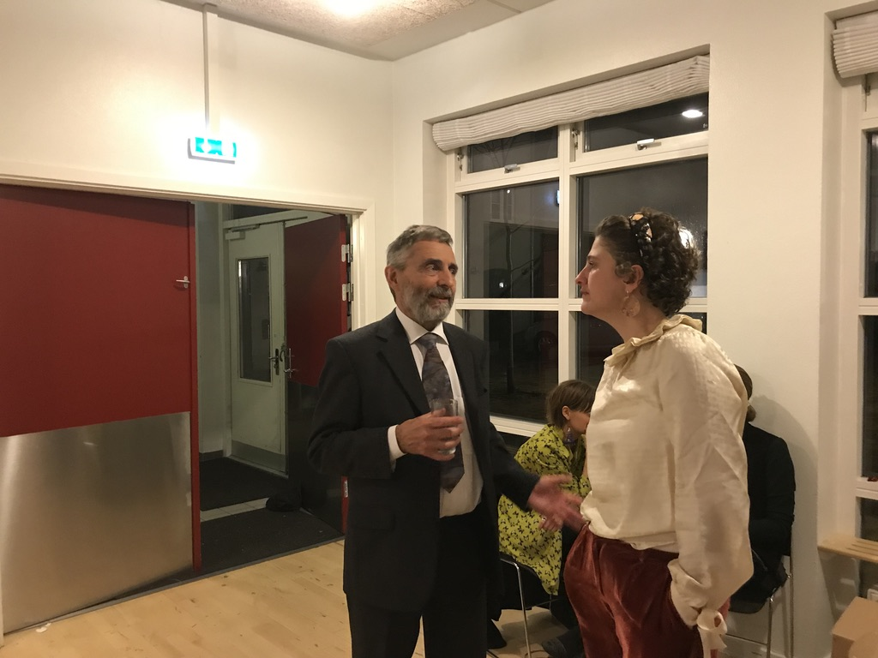
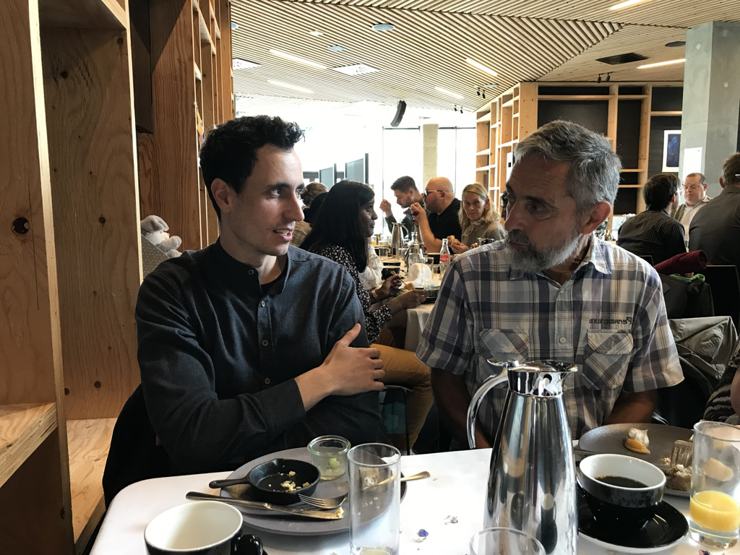
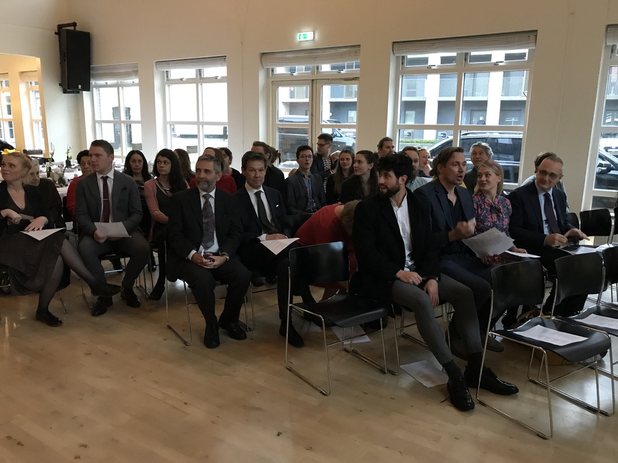
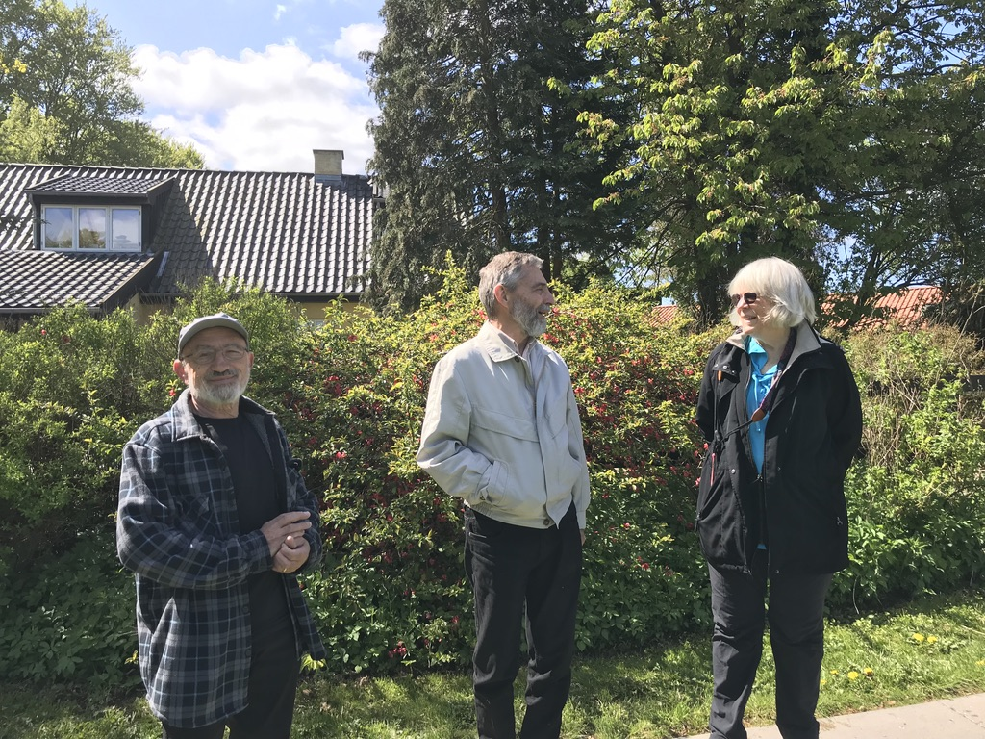
Time with friends

Slide 27
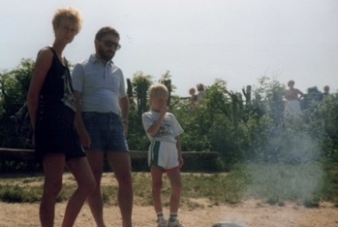
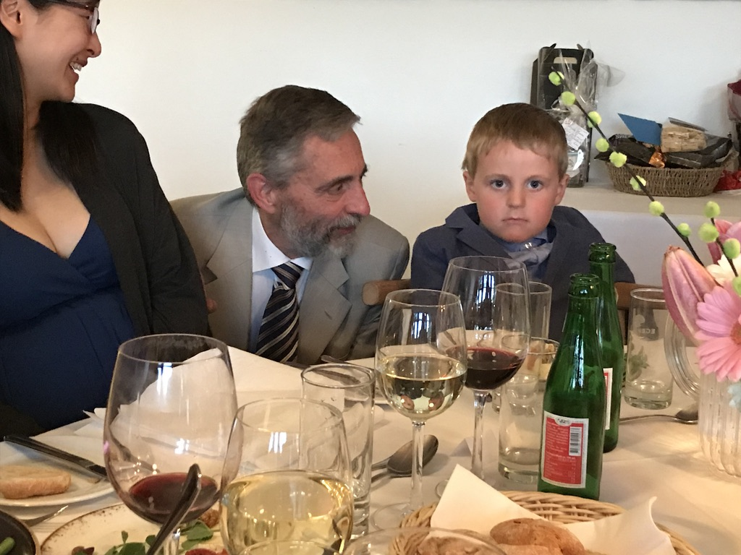
Time with family
It has been great, exploring the landscape of science with you, Bjarne !
Looking forward to many more years !

